Slide 1
Getting the Right Radiology Study the First Time
Evidence-Based Imaging for Pediatric Hospitalists
Erich C. Maul, DO, MPH, FAAP
Associate Professor of Pediatrics
University of Kentucky

Slide 2
Disclosures
I have no relevant financial relationships with the manufacturers of any commercial products and/or providers of commercial services discussed in this CME activity
I do not intend to discuss an unapproved or investigative use of a commercial product or device in my presentation.

Slide 3
Objectives
Recognize some of the controversies surrounding imaging in hospitalized patients
Learn to use the ACR (American College of Radiology Appropriateness Criteria) to your patient’s advantage

Slide 4
Objectives
Determine appropriate imaging strategies for
  Head trauma
  Ventriculoperitoneal (VP) shunt malfunction
  Vomiting infants
  Fever without a source
  Abdominal pain

Slide 5
Audience Response
Most of you have a Turning Point™ ARS remote
Makes for interactive presentation
  (so you don’t fall asleep!)
Let’s try it…

Slide 6
I have 24/7 access to pediatric radiologists (board-certified, fellowship-trained) at my hospital
Yes
No
Only in my dreams

Slide 7
I work in a…
University-based free-standing CH
University-based CH-within-a- hospital
Community hospital with trainees
Community hospital without trainees
Other

Slide 8
How many years ago did you graduate from medical school?
<3
4-6
7-9
10-12
13+

Slide 9
Radiation Safety

Slide 10
Not a Physics Lecture!!!
Concerned about ionizing radiation
  Absorbed dose (mGy) vs. effective dose (mSv)
Imaging modalities that use ionizing radiation
  CT
  Fluoroscopy (“fluoro”)
  X-rays (aka radiographs)
  Nuclear medicine studies
Notes:
Absorbed dose=total radiation delivered to area in question
Effective dose=abs dose * tissue factor; tissue factor is a weighting factor that accounts for sensitivity of tissue to ionizing radiation.

Slide 11
Radiation Dosing¹
Background radiation
  3 mSv/yr. (millisieverts per year)
    67% from Radon exposure
Occupational exposure
  20-50 mSv/yr.
  Above background exposure
Notes:
the Health Physics Society’s position statement, Radiation Risk in Perspective states that at effective doses below 50–100 mSv, the risks of health effects are either too small to be observed or are nonexistent.

Slide 12
So what’s the big deal?
  Theoretical cancer risk based on cumulative dose

Slide 13
Epidemiologic Risks and the Risks of Epidemiology
Take it from the new MPH
  Take ALL epidemiologic studies with a healthy dose of skepticism
  One model is just one model
    It does not fit all; no one model is right or wrong
    Meant to try to predict what we can’t experimentally determine

Slide 14
CT-specific data²
 | Head | Chest | Abd/Pelvis | Total
Dose (mSv) | 1.1-3.5 | 5.3-7.5 | 5.8-8.8
Projected Cancers | 1210 | 2930 | 350 | 4490
Decrease # scans by 33% | 810 | 1950 | 260 | 3020
Decrease dose from 75%ile to median | 630 | 1730 | 210 | 2570
Notes:
1. Miglioretti DL, Johnson E, Williams A, et al. The use of computed tomography in pediatrics and the associated radiation exposure and estimated cancer risk. JAMA pediatrics 2013;167:700-7.

Slide 15
Ionizing Radiation and Cancer
Ionizing radiation exposure and cancer
Several studies show association between risk of cancer and increased use of CT scans
  Association ≠ Causality

Slide 16
Consider this, for example³
Subsequent cancer risk of children receiving post voiding cystourethrography: A nationwide population-based retrospective cohort study
  Pediatr Nephrol (2014) 29:885–891

Slide 17
Pediatr Nephrol (2014) 29:885–891
31,908 participants <18 years old
Underwent VCUG between 1997 and 2008
Comparison cohort randomly selected among children who did not undergo VCUG during that same period

Slide 18
Results³
Overall cancer risk of VCUG cohort is 1.92-fold higher than non-VCUG cohort
  95%CI 1.34, 2.74

Slide 19
Results³
Genital cancer risk in VCUG cohort is 6.19-fold higher than those of the non-VCUG cohort
  95% CI 1.37, 28.0

Slide 20
Results³
Urinary system cancer risk in VCUG cohort is 5.8-fold higher than those of the non-VCUG cohort
  95% CI 1.54, 21.9

Slide 21
Conclusion³
Pediatric VCUG is associated with increased subsequent cancer risk, especially in the genitourinary system
But…

Slide 22
Limitations³
China
  Exposures might be different, background risks
Adjusted hazard ratios only adjusted for age
Used administrative data which can lead to both selection and information bias
No data on radiation dose delivered

Slide 23
Bottom Line…
Costs of Imaging

Slide 24
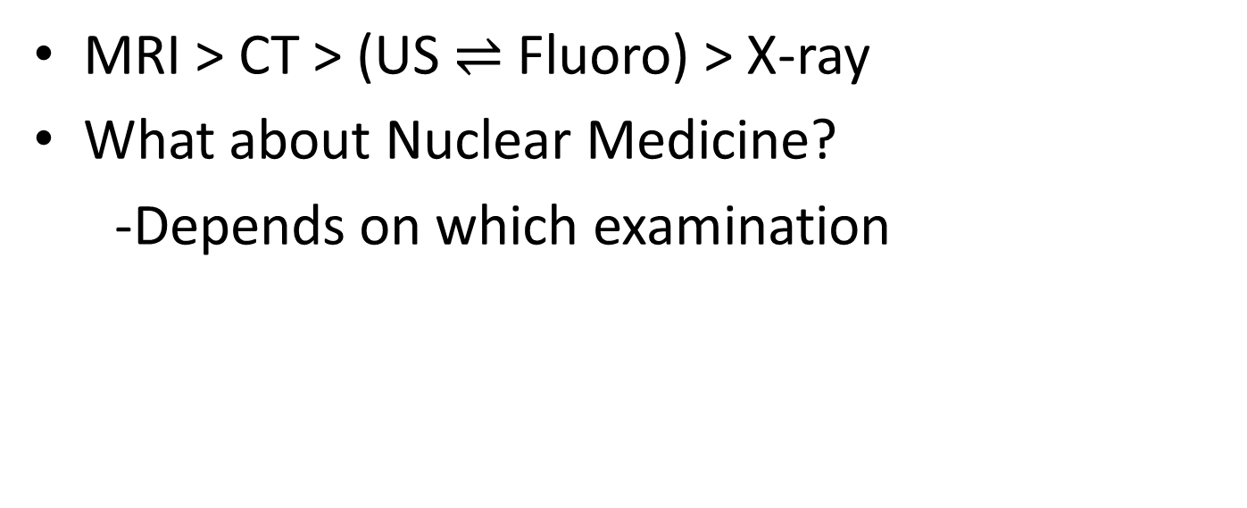
Relative Co$t$ of Imaging Studies
MRI > CT > (US $⇌$ Fluoro) > X-ray
What about Nuclear Medicine?
-Depends on which examination

Slide 25
Cost of Imaging Studies^{1,4}
 | Mean Radiation (mSv) | CXR Equivalents | Charges (US$)
CXR | 0.05 | 1 | 50-300
KUB/Abdomen | 0.7 | 14 | 50-350
Head CT without contrast | 1-3 | 20-60 | 200-1200
Chest CT without contrast | 5-8 | 100-160 | 200-1500
Abd/Pelvis with contrast | 10-15 | 200-300 | 500-4500
DMSA or MAG3 | 3 | 60 | 150-1850
MRI brain without contrast | 0 | 0 | 550-2250
Ultrasound of (insert organ here) | 0 | 0 | 100-1000
Adapted from KMSF data, Lexington, KY, and Reference 1

Slide 26
The Dreaded issue of contrast

Slide 27
Why use contrast?
The mass is in the lumen
The mass is in the wall
The mass is behind the wall
The mass is compressing the lumen
Cannot determine

Slide 28
Why use contrast?

Slide 29
Oral Contrast
When NOT to use Barium
Esophageal perforation
Bowel perforation
If there is a possibility of perforation, use
low-osmolality water-soluble contrast,
NOT high-osmolality water-soluble contrast, e.g., Gastrograffin®

Slide 30
Contrast or not to contrast… that is the question…
If you need help, the radiologist is your best resource and will be able to answer your question

Slide 31
Best Practices

Slide 32
ALARA Principle
Ionizing radiation dose should be As Low As Reasonably Achievable
Sometimes no ionizing radiation may be what is “reasonably achievable”
  For example, if your clinical question can be answered with an ultrasound instead of a CT, then ultrasound is the better choice

Slide 33
BEST PRACTICES
Stay safety-prioritized
Patient-centered
Quality-focused
Don’t order unnecessary studies, particularly studies that use ionizing radiation
  Exam not indicated
  Exam irradiates anatomy that does not need evaluation

Slide 34
BABYGRAM
Babygram ordered when you only need a chest x-ray
Babygram ordered when you only need an abdominal x-ray

Slide 35
GONADAL SHIELDS
Ask your radiologists if they using gonadal shields in every examination for which they are appropriate

Slide 36
“CONING OUT” (Collimation)
If region of gonads, e.g., female pelvis, does not need to be included in study, make sure your radiologists/technologists are using gonadal shields and “coning out” the gonads

Slide 37
Image Gently⁵
http://www.imagegently.org/
Campaign to promote radiation safety and awareness in pediatric imaging

Slide 38
IMAGE GENTLY Campaign
Society for Pediatric Radiology (SPR)
Launched on 1/22/2008
The pledge: Taken by >20,000 medical professionals
CT protocols have been downloaded >30,000 times

Slide 39
My facility uses pediatric-specific CT protocols
Yes
B. No
C. Unsure

Slide 40
I have heard of the American College of Radiology (ACR) Appropriateness Criteria
Yes
No

Slide 41
I regularly use the ACR Appropriateness Criteria
Yes
No

Slide 42
Evidence-Based Imaging in Children
The American College of Radiology (ACR) Appropriateness Criteria
Quality initiative
Decision support tool to help you order the right imaging study, the first time

Slide 43
ACR Appropriateness Criteria⁶
For a given clinical scenario, e.g., limping child
  Rate the appropriateness of various imaging studies
  Stratify studies with regard to radiation dose
Unfortunately
  No cost data
  No phone app

Slide 44
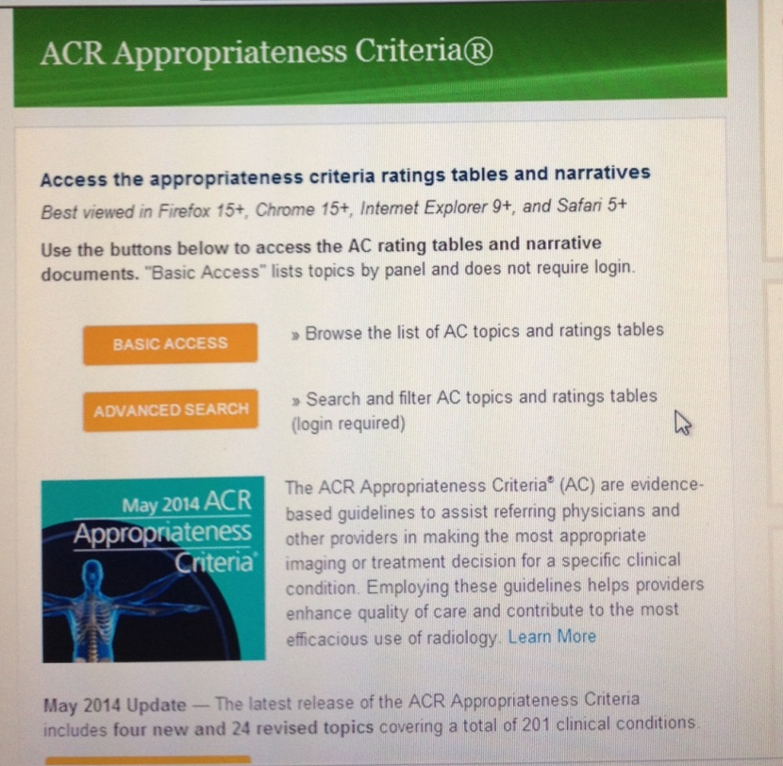
ACR Appropriateness Criteria⁶
Easy online access
ACR appro…

Slide 45
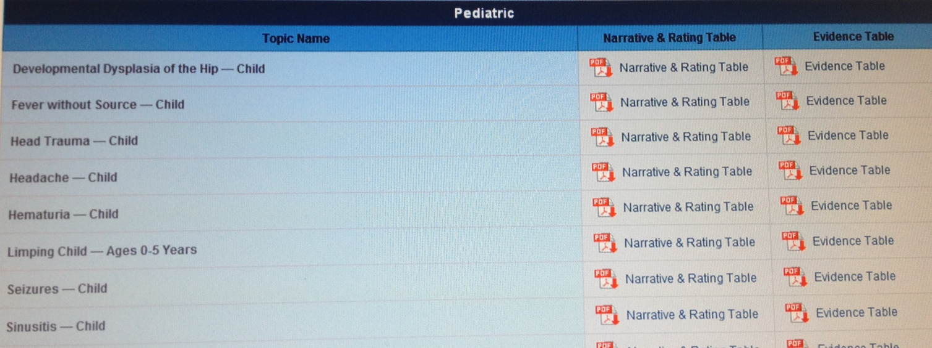
ACR Appropriateness Criteria⁶

Slide 46
Clinical Cases

Slide 47
The vomickin’

Slide 48
The Case…
4 day old male with bilious emesis
NPO
IV started in ED and the PA on duty asks you to admit the child and help with imaging

Slide 49
What study would you order fist
KUB
UGI series
Contrast enema
US abdomen
Abdominal CT

Slide 50
ACR Appropriateness Criteria⁷
ACR Appropriateness Criteria® Last review date: 2011
Clinical Condition: Vomiting in Infants Up to 3 Months of Age
Variant 1: Bilious vomiting in neonate up to 1 week old
Radiologic Procedure | Rating | Comments | RRL*
X-ray abdomen | 9 | Initial x-ray will help determine further workup strategy. | ☢☢
X-ray upper GI series | 8 |  | ☢☢☢
X-ray contrast enema | 7 |  | ☢☢☢☢
Rating Scale: 1,2,3 Usually not appropriate; 4,5,6 May be appropriate; 7,8,9 Usually appropriate |  |  | *Relative Radiation Level

Slide 51
Case Variant #2
4 week old girl with bilious vomiting
NPO
IV started in ED and the PA on duty asks you to admit the child and help with imaging

Slide 52
What study would you order fist
KUB
UGI series
Contrast enema
US abdomen
Abdominal CT

Slide 53
ACR Appropriateness Criteria⁷
Clinical Condition: Vomiting in Infants Up to 3 Months of Age
Variant 2: Bilious vomiting in infant 1 week old to 3 months old
Radiologic Procedure | Rating | Comments | RRL*
X-ray upper GI series | 9 |  | ☢☢☢
X-ray abdomen | 5 |  | ☢☢
US abdomen (UGI tract) | 3 |  | O
Tc-99m sulfur colloid reflux scintigraphy | 1 |  | ☢☢☢
Rating Scale: 1,2,3 Usually not appropriate; 4,5,6 May be appropriate; 7,8,9 Usually appropriate |  |  | *Relative Radiation Level

Slide 54
Just Another Fever

Slide 55
The kid
13 month old boy
Fever to 40.6ºC; no respiratory s/s, but dehydrated
ED doc got CBC, BCx; no urine
  WBC=39,342
  He wants to know if you want a CXR before you admit him…

Slide 56
You reply…
Yes please!
No thanks.
Why are you asking?

Slide 57
ACR AC-Fever without Source⁸
CXR appropriate in kids
  with respiratory s/s OR
  Fever>39ºC and WBC>20,000
Might be appropriate in kids <1 month old, FUO, neutropenic fever

Slide 58
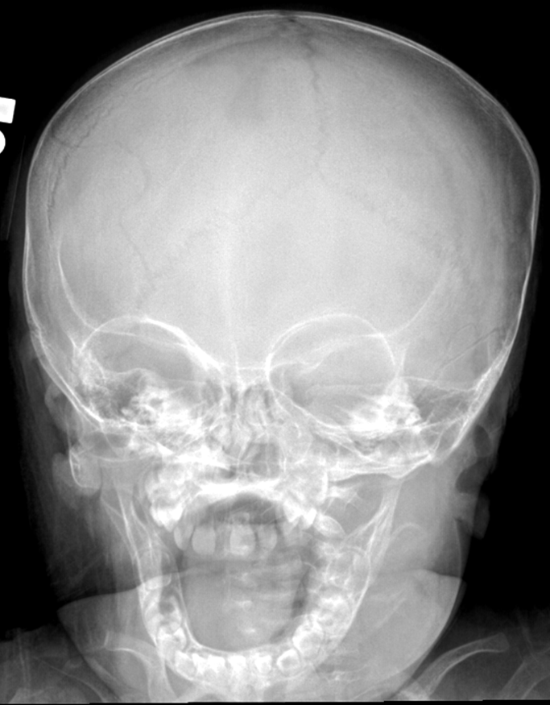
Your head has to hurt

Slide 59
In the Fantasyland ED…⁹
Called to help evaluate a 5 year old boy who fell off a 2 foot step ladder and smacked his head
Large hematoma on left superior parietal area
No LOC, normal neuro exam
ED asks you if you want a CT before admitting him

Slide 60
You reply
Yes please!
No thanks.
You mean you didn’t already get the CT?
Why are you asking me?

Slide 61
A second head kid¹⁰
2 y/o girl with CP and a VP shunt
You are concerned for shunt malfunction
Shunt series radiographs negative
What next?

Slide 62
You desire?
Ultrasound
Rapid brain MRI
Contrast CT
CT head

Slide 63
In reality, I get
Ultrasound
Rapid brain MRI
Contrast CT
CT head

Slide 64
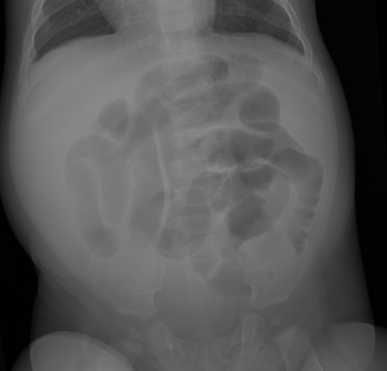
Another kid with belly pain

Slide 65
C’mon Man
We just ask our expert to go to ACR AC webpage and look it up…

Slide 66
Sorry, I got nothin’
Abdominal pain evaluation is highly clinical
No CPG or criteria based yet
Biondi, et al., 2013¹¹
  18% of CT’s necessary; 26% unnecessary but helpful; 57% unnecessary and unhelpful
  Leukocytosis, male gender and peritoneal signs increase yield of CT

Slide 67
Abdominal Pain Radiography¹¹⁻¹³
Use ultrasound when you can
If CT necessary,
  make sure to use IV contrast
    +/- on oral or rectal
  ALARA principle
  Avoid multi-phased scans

Slide 68
References
1. Mettler FA. Essentials of radiology. 3rd ed. Philadelphia: Elsevier/Saunders; 2014.
2. Miglioretti DL, Johnson E, Williams A, et al. The use of computed tomography in pediatrics and the associated radiation exposure and estimated cancer risk. JAMA pediatrics. 2013;167(8):700-707.
3. Liao YH, Lin CL, Wei CC, et al. Subsequent cancer risk of children receiving post voiding cystourethrography: a nationwide population-based retrospective cohort study. Pediatr Nephrol. 2014;29(5):885-891.
4. Maul E. Kentucky Medical Services Foundation Financial Database. KMSF; 2014.
5. SPR. Image Gently. 2014; http://www.imagegently.org/, 2014.
6. ACR. American College of Radiology Appropriateness Criteria. 2015; https://acsearch.acr.org/list. Accessed 1/3/2015.
7. ACR. Vomiting in Infants up to 3 Months of Age. ACR Appropriateness Criteria 2011; https://acsearch.acr.org/docs/69445/Narrative/. Accessed 1/3/2015.
8. ACR. Fever without Source-Child. ACR Appropriateness Criteria 2011; https://acsearch.acr.org/docs/69438/Narrative/. Accessed 1/3/2015.
9. ACR. Head Trauma-Child. ACR Appropriateness Criteria 2014; https://acsearch.acr.org/docs/3083021/Narrative/. Accessed 1/3/2015.
10. Boyle TP, Paldino MJ, Kimia AA, et al. Comparison of rapid cranial MRI to CT for ventricular shunt malfunction. Pediatrics. 2014;134(1):e47-54.
11. Biondi E, Macduff S, Capucilli P, et al. Using patient characteristics to predict usefulness of abdominal computed tomography in children. Hosp Pediatr. 2013;3(3):226-232.
12. Nosek AE, Hartin CW, Jr., Bass KD, et al. Are facilities following best practices of pediatric abdominal CT scans? J Surg Res. 2013;181(1):11-15.
13. Muratore CS. Pediatric abdominal CT scans: do it correctly. Better yet, don't do it at all. J Surg Res. 2013;185(2):533-534.
Notes:
11.

Slide 69
Changes to Practice
www.wordle.com

