Slide 1
PEDIATRIC EKGs
DEMYSTIFIED
Erich C. Maul, DO, FAAP, FHM
Associate Professor of Pediatrics
University of Kentucky

Slide 2
Disclosures
I have no relevant financial relationships with the manufacturers of any commercial products and/or providers of commercial services discussed in this CME activity
I do not intend to discuss an unapproved/investigative use of a commercial product/device in my presentation.

Slide 3
Objectives
Describe basic EKG physiology
Specify age related changes to EKGs
Employ a basic, reliable system for EKG review and interpretation
Not make you a cardiologist, but an astute clinician who recognizes abnormal from normal

Slide 4
What is an EKG?
Graphic representation of the progression of electrical activity of the heart
Many times a poor screening test, but it’s quick, non-invasive and cheap
  And if you interpret it, you can bill for it and make $
  May help with diagnosis ~20% of the time

Slide 5
Laws of EKG’s I learned in Physics…but just never knew it
− +
− +
− +

Slide 6
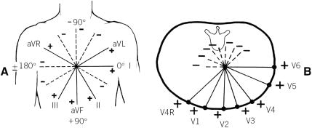
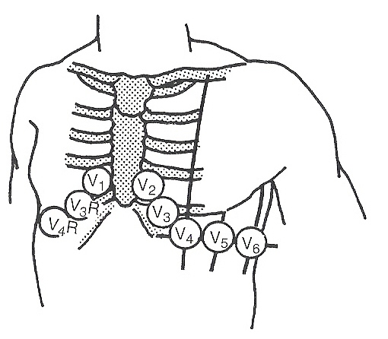
Do I really need to know this?
Lead V₁ fourth intercostal space just right of the sternum.
Lead V₂ fourth intercostal space just left of the sternum.
Lead V₃ midway between leads V₂ and V₄.
Lead V₄ midclavicular line in the fifth interspace.
Lead V₅ anterior axillary line at same level as lead V₄.
Lead V₆ midaxillary line at same level as lead V₄
From Reference 3
Copyright permission obtained

Slide 7
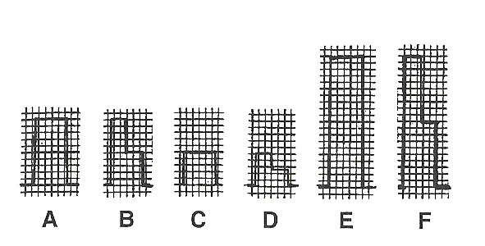
Standardization
Can change the gain
  Change amplitude of complexes
  Normal is 10mm/mV
  Common variant is 10-5mm/mV
Can change the speed
  Normal is 25mm/sec
From Reference 3
Copyright permission obtained

Slide 8
Why 12 leads?
History essentially, but can modify if needed
  Right sided leads
Allows for using 2-D technology and our innate smarts to get a 3-D image of the heart
  Think of each lead as a camera looking at the heart from that specific angle

Slide 9
When do you get them?
Bedside monitoring
Suspicion of…
  Arrhythmia/conduction anomaly
  Congenital heart disease
  Acquired heart disease
Prior to drug therapy initiation

Slide 10
Interpretation of EKG’s
Need a system
Need a method
Need a drink…
How you interpret depends on the situation you are in

Slide 11
Methods of interpretation
Pattern recognition
  What you learn in PALS/ACLS
  Read and react
More stable kid
  Scalar
    EKG lead with magnitude only
    Can make a vector using 2 different scalar leads
  Vector
    EKG with magnitude and direction
    Easier than it sounds

Slide 12
Pattern recognition
Know them for life-threatening situations so you an intervene appropriately
Method
  Sinus or not
  Fast or slow
  QRS wide or narrow
  Stable or unstable

Slide 13
The more stable kid
Age
Rate
Rhythm
Axis
  P, QRS, T
Intervals and waves
  P, QRS, T
  PR, ST, QT/QTc
  R wave progression
Hypertrophy or enlargement
  Atrial
  Ventricular
Conduction disturbance

Slide 14
How are you to remember all these age appropriate norms?
LOOK THEM UP IN a peripheral brain
  Harriet Lane Handbook
  Caring for the Hospitalized Child
When evaluating an EKG, go to the Cardiology chapter and look at the EKG section…it is scarily similar to my talk
  Guess how my mentors taught me EKG’s

Slide 15
Age
EKG’s vary greatly with age
Newborns
  Right sided dominance of forces
Adult EKG form by age 3 y/o, with most changes occurring by 3-6 months

Slide 16
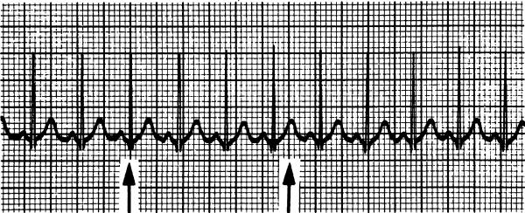
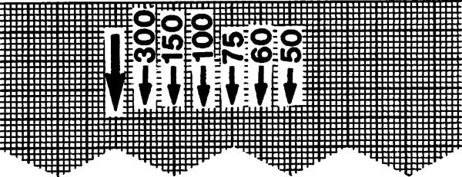
Rate
Read the machine!
  60/RR interval=rate
  Count # of RR’s in 6 large divisions and multiply by 50
From Reference 3
Copyright permission obtained

Slide 17
Rhythm
Sinus
  P wave before every QRS
  Normal PR interval for age
  Normal P wave axis
    Upright I and aVF
Non-sinus

Slide 18
Axis
What is it?
  Helps determine where the majority of electrical forces are “headed”
  Gives a direction to the electrical forces in the myocardium
  Can generate a P, QRS, T axis and a QRS-T angle

Slide 19
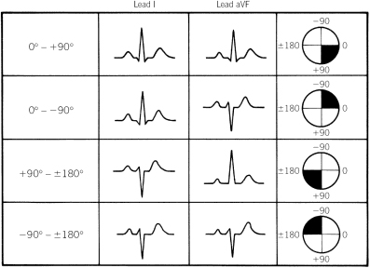
Axis
Determine quadrant at a minimum
Successive approximation to fine tune axis
Use leads I and aVF
From Reference 3
Copyright permission obtained

Slide 20
Successive Approximation
Find the axis quadrant
Look for limb lead that is biphasic
  Or close to biphasic
Axis is perpendicular to the biphasic lead

Slide 21
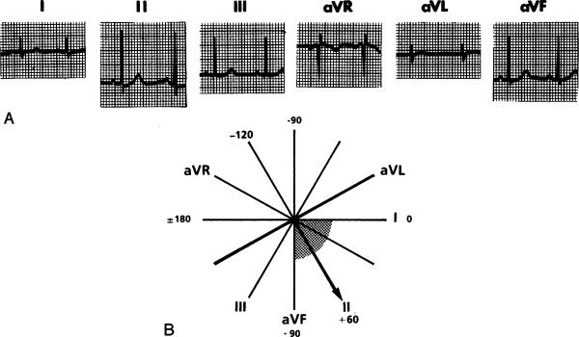
Successive Approximation
Find quadrant
Find biphasic limb lead; axis is perpendicular to that lead
From Reference 3
Copyright permission obtained

Slide 22
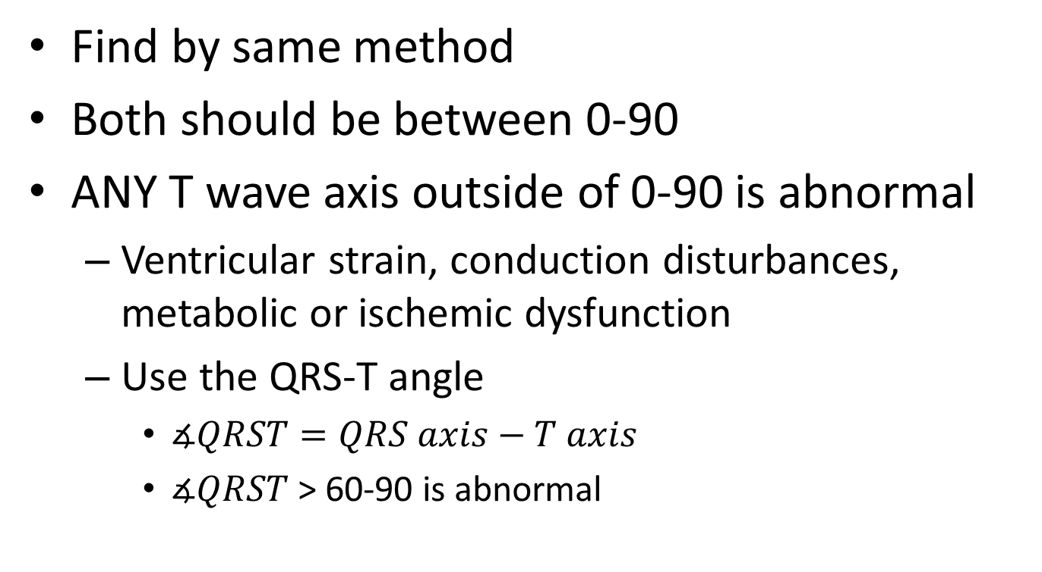
P wave and T wave axis
Find by same method
Both should be between 0-90
ANY T wave axis outside of 0-90 is abnormal
  Ventricular strain, conduction disturbances, metabolic or ischemic dysfunction
  Use the QRS-T angle
    $∡QRST=QRS axis−T axis$
    $∡QRST$> 60-90 is abnormal

Slide 23
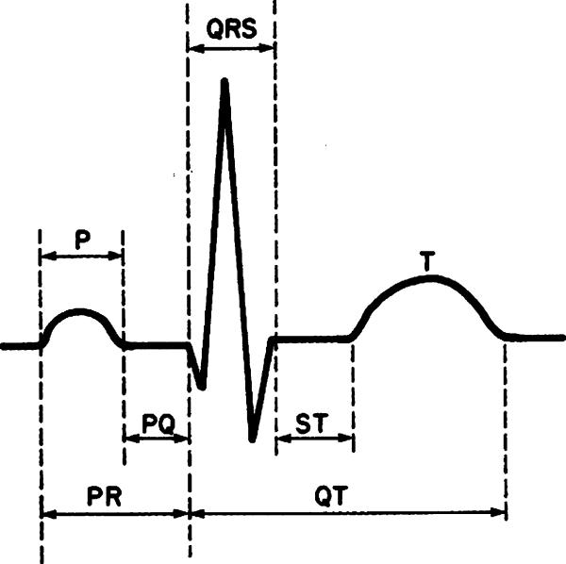
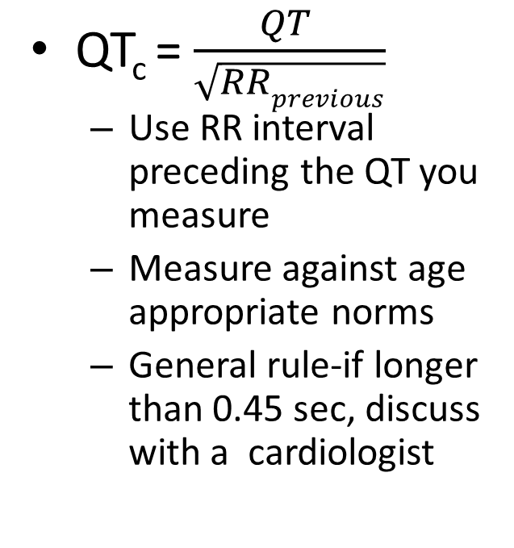
Intervals and waves
QT_{c} = $\frac{QT }{\sqrt{RRprevious}}$
  Use RR interval preceding the QT you measure
  Measure against age appropriate norms
  General rule-if longer than 0.45 sec, discuss with a cardiologist
From Reference 3
Copyright permission obtained

Slide 24
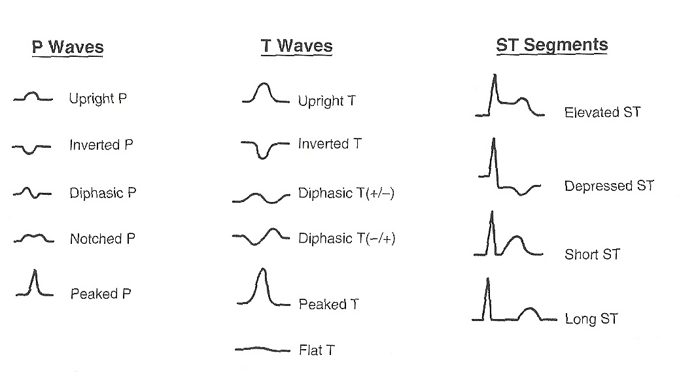
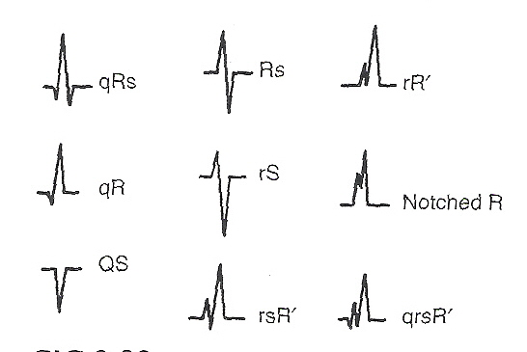
P waves, T waves, ST, QRS, LMNOP, oh my!
From Reference 3
Copyright permission obtained

Slide 25
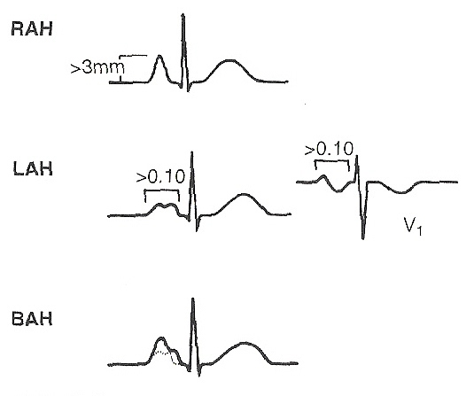
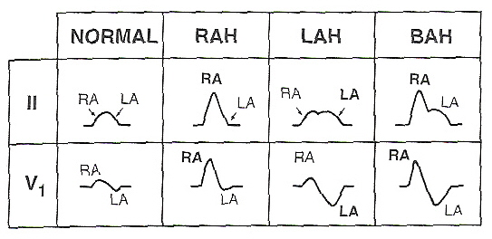
Atrial Hypertrophy
RAH
  p-pulmonale
  P>3mm
  II, V1, V2
LAH
  p-mitrale
  P duration >0.1s
  Any lead
BAH
  Combination of both
From Reference 3
Copyright permission obtained

Slide 26
Ventricular Hypertrophy
Guiding Principles
QRS axis usually directed toward hypertrophied ventricle
QRS voltages increase toward direction of involved ventricle
R/S ratio changes according to the ventricle that is hypertrophied
Severe hypertrophy may yield T wave axis changes (strain)
May slightly increase QRS duration
EKG criteria SUGGEST hypertrophy-need echo to confirm or refute

Slide 27
RVH (newborn)
S in lead I >12mm
pure R in V1<10mm
R in V1>25mm or R in aVR>8mm
qR in V1
upright T in V1 after 3 dol
QRS with right axis>180

Slide 28
RVH (outside newborn)
Right axis deviation
R in V1 or S in V6 >98th %ile
Upright T in V1 after dol 3
Abnml R/S ratio that favors RV
RV strain
Q in V1 (qR or qRs pattern) suggests RVH
If voltage criteria for RVH, wide QRS-T angle with abnml T wave axis indicates strain pattern

Slide 29
LVH
Left axis deviation
R in V6 or S in V1 >98th %ile
Abnml R/S ratio that favors LV
Q in V5 or V6 >5mm with tall T waves in those leads
If voltage criteria for LVH, a wide QRS-T angle with T axis outside of normal indicates strain

Slide 30
Biventricular Hypertrophy
Characteristics of RVH and LVH

Slide 31
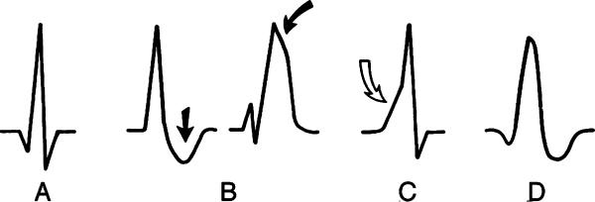
Ventricular Conduction Disturbances (VCD)
From Reference 3
Copyright permission obtained
Abnormally prolonged QRS duration
  RBBB
  LBBB
  Pre-excitiation
  Pacemakers-look for pacing spike
CANNOT diagnose hypertrophy if a BBB is present
Slurred R wave is key

Slide 32
RBBB
Most common VCD in peds
  After open heart surgery
  Lesions with RV volume overload (ASD)
  CHD such as Ebstein’s anomaly and CoA
  Cardiomyopathy, myocarditis, CHF, muscle diseases (DMD), Kearns-Sayre syndrome, Brugada syndrome, Arrhythmogenic RV dysplasia, congenital hereditary RBBB (Chrom19)

Slide 33
RBBB Criteria
Right axis deviation
Prolonged QRS for age
Terminal slurring of QRS
  Wide slurred S in I, V5, V6
  Terminal slurred R’ in aVR, V4R, V1, V2
ST depression and T wave inversion
  (adults)

Slide 34
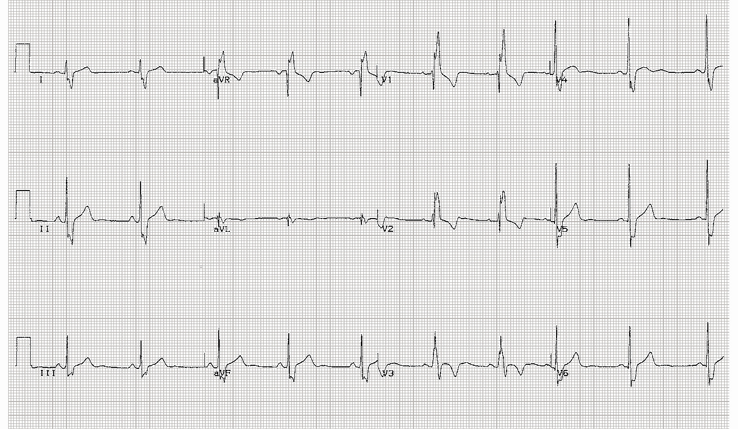

Slide 35
LBBB
Common in adults due to HTN and ischemia, but rare in kids
Usually result of
  Surgery-Ao valve replacement, ventriculotomy, septal myomectomy, LVOT procedures
  Hypertrophic cardiomyopathy
  Myocarditis

Slide 36
LBBB Criteria
Left axis deviation
Prolonged QRS for age
Loss of Q in V5 and V6
QS pattern in V1
Slurred QRS
  Slurred, wide R in I aVL, V5, V6
  Wide s in V1, V2
ST depression and T wave inversion in V4-V6

Slide 37
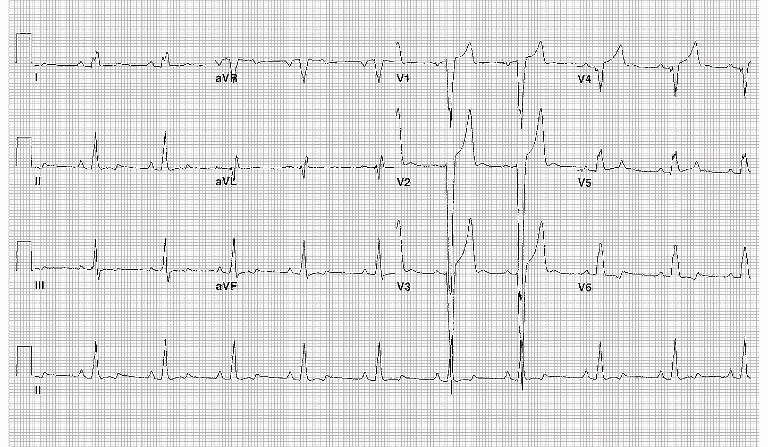

Slide 38
Moron Moment… is it a VCD or Hypertrophy?
QRS Duration | QRS Voltage | Interpretation
Normal | Normal | Normal
 | Increased | Hypertrophy
Borderline increased | Normal | Normal or mild conduction delay
 | Increased | Probably hypertrophy
Increased | Normal or Increased | Conduction defect

Slide 39
Pre-excitation
Accelerated AV conduction to one ventricle via an accessory pathway
Classic examples
  Wolff Parkinson White
  Lown Ganong Levine syndrome
    Short PR, normal QRS
  Anomalous nodoventricular connections
    Mahaim fibers
    Normal PR, long QRS with delta wave

Slide 40
WPW
Kent bundle conducts faster than the AV node (normal conduction delay)
Ventricle depolarizes, but at a slower rate than His-Purkinje system
  Delta wave
If AV node impulse conducts, the QRS becomes characteristic of WPW

Slide 41
WPW Criteria
Short PR interval for age
Delta wave
Wide QRS for age

Slide 42
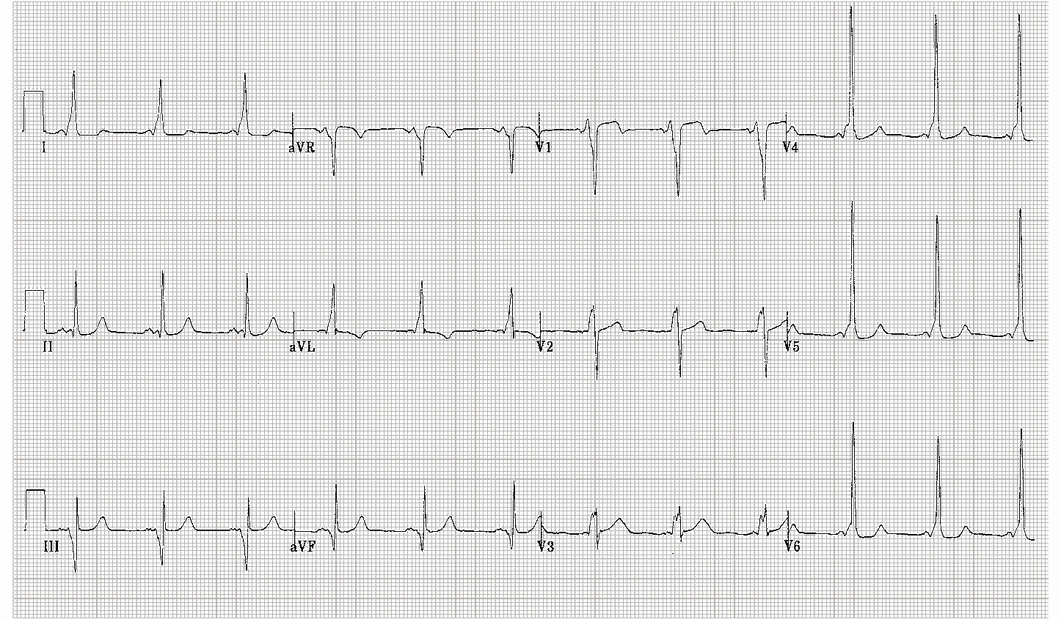

Slide 43
What’s the big deal about WPW?
Prone to attacks of SVT
  Tachycardia masks the delta wave because of a re-entrant pathway
Pre-excitation can mimic ventricular hypertrophies and BBB; you then make the wrong diagnosis
Can be associated with congenital heart disease
  Ebstein’s anomaly, glycogen storage dz

Slide 44
References
Maul EC. 2013. Electrocardiogram Interpretation. IN: Caring for the Hospitalized Child, AAP, Elk Grove.
Park MK. 2010. Pediatric Cardiology Handbook, 4rd edition, Mosby, Philadelphia.
Park MK. 2008. Pediatric Cardiology for Practitioners, 5th edition, Mosby Elsevier, Philadelphia.
Park MK. and Guntheroth WG. 2006. How to Read Pediatric ECGs, 4th edition, Mosby Elsevier, Philadelphia.

Slide 45
Changes to Practice
Assure proper references are available for reading EKG’s
Establish communication with local Cardiology Group for EKG assistance
Commit to applying EKG reading skills to my population
  We will do that right now.

Slide 46
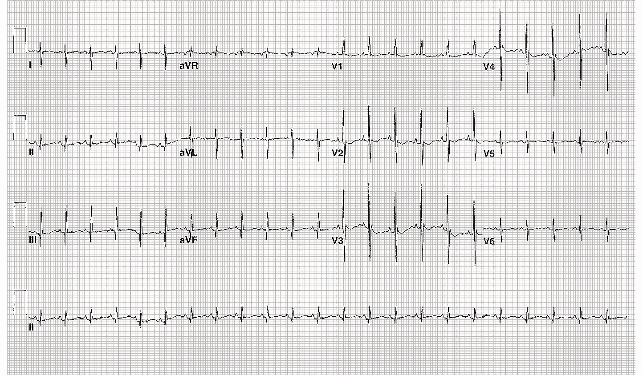
Figure 1: 1-day-old infant in NBN, the resident on call last night heard a murmur and got an EKG
Notes:
Normal for age
NSR, 140
QRS +120
Pure R wave in V1
S in V6=5mm
RV predominance of forces; upright T wave in V1 is normal up to dol 7

Slide 47
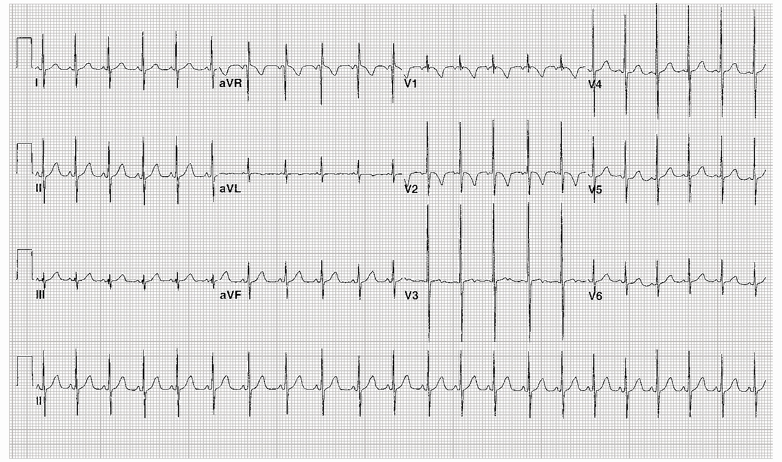
Figure 2: 5-month-old female screening for long QT syndrome since
15 y/o sibling has it
Notes:
Normal for age
NSR; QRS +30, Rsr’ pattern in V1(nl variant); S in V6 =3mm

Slide 48
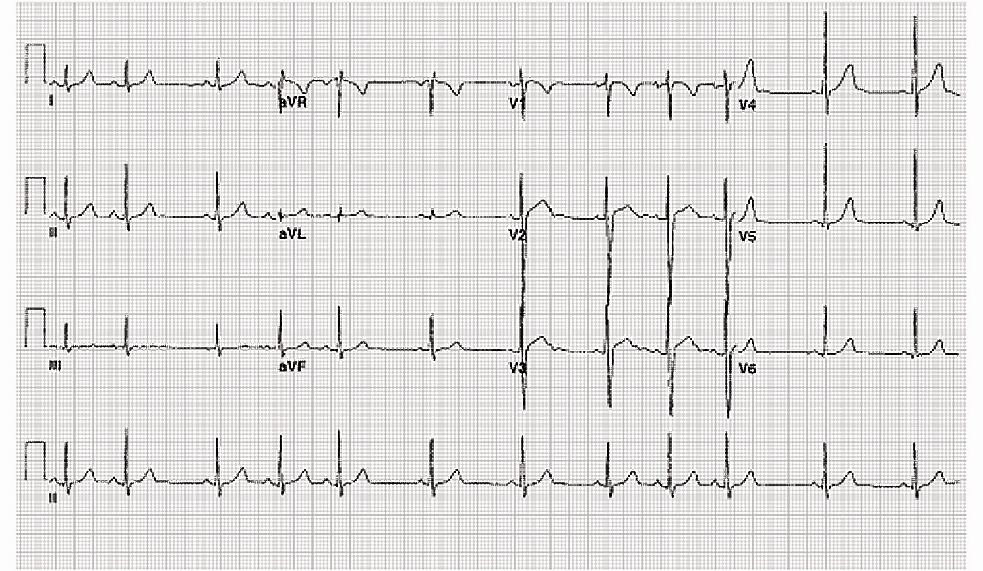
Figure 3: 8-year-old boy referred ED for irregular heart rhythm; ED is now calling you for admission to telemetry for arrhythmia
Notes:
Sinus arrhythmia
HR speeds up with inspiration and decreases with expiration (Can you describe the physiology?)
P before every QRS, nml PR interval, normal P wave axis

Slide 49
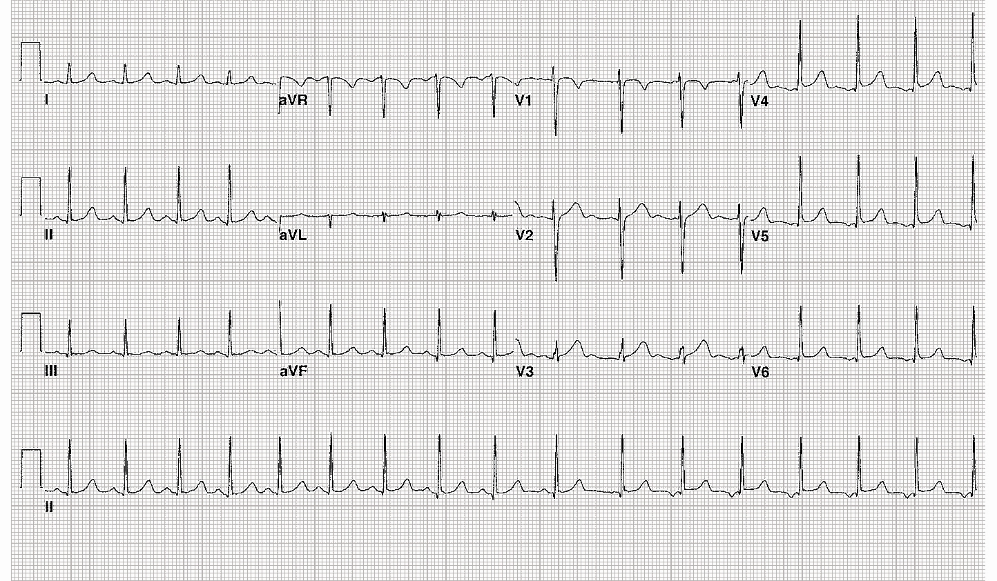
Figure 4: Asymptomatic 14-year-old female; was placed on bedside EKG prior to sedation for fracture. Noted “funny rhythm” and got a 12-lead EKG
Notes:
Wandering atrial pacemaker
The location of the artial pacer is different throughout the strip
First 10 complexes are sinus, complex 11 is junctional or left atrial (LA), 12-17 have inverted P waves, suggesting LA origin of impulse
Incidentally, her QTc is ULN at 0.45

Slide 50
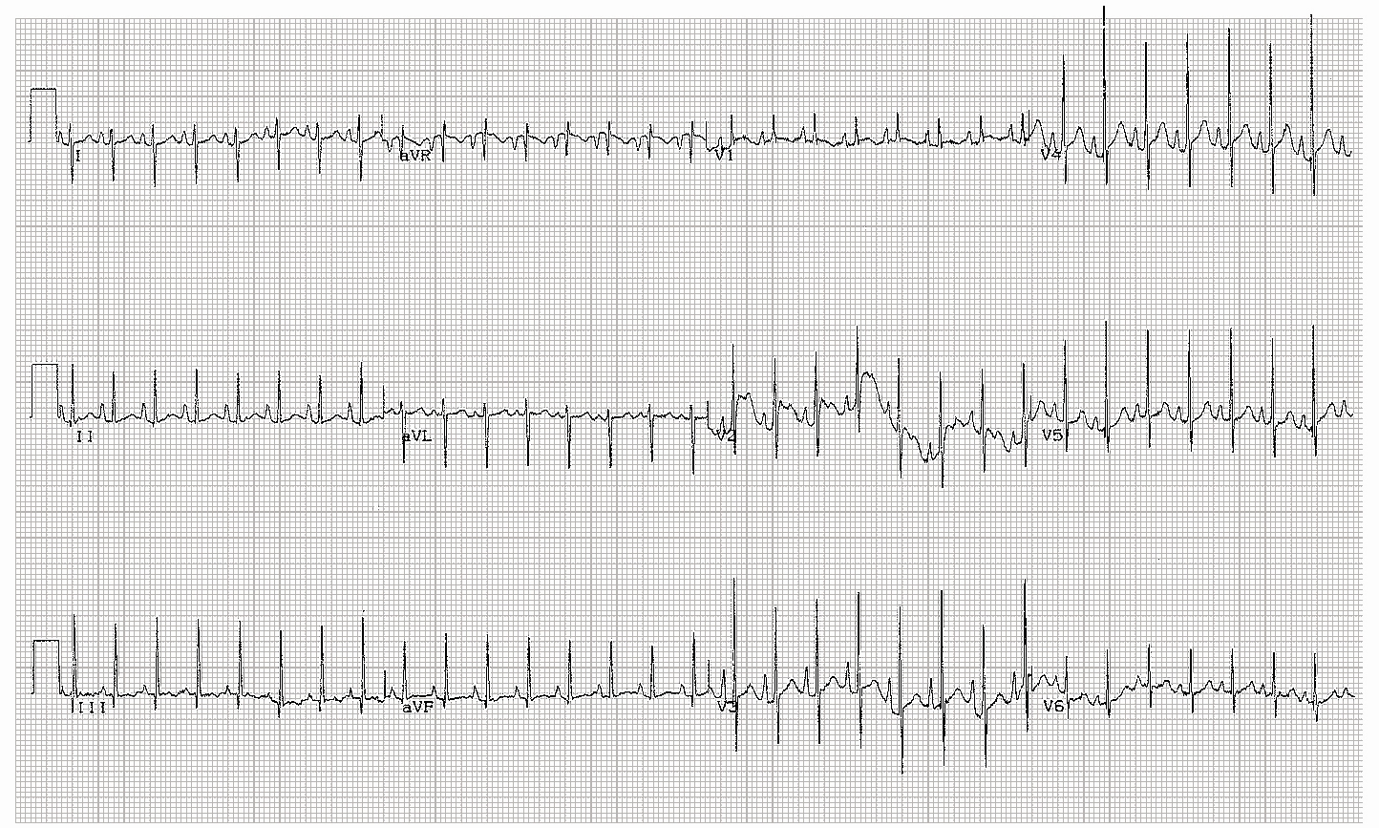
Figure 5: 6-month-old infant with chronic lung disease and pulmonary hypertension
Notes:
Right Atrial Enlargement, ?RVH
Sinus tachycardia, QRS axis 110, tall P waves in II, V1-V5 (>3mm)

Slide 51
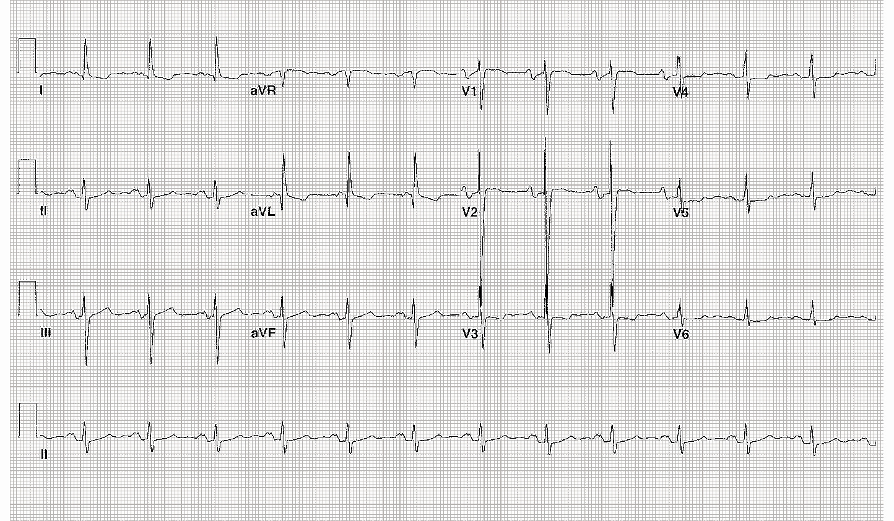
Figure 6: 16-year-old girl with tricuspid atresia status post Fontan procedure 2 years ago
Notes:
Left atrial Enlargement
Sinus rhythm, , QRS axis -20; left axis deviation
First degree AV block
Broad notched P waves in I, II, aVF (>0.1 sec)
Deep S in V2 suggests LVH

Slide 52
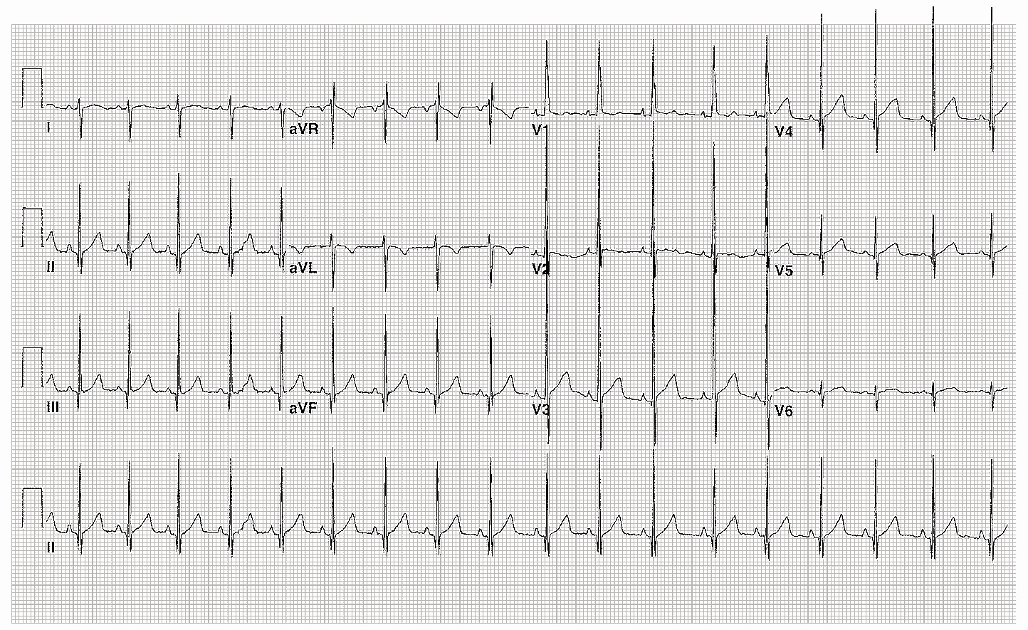
Figure 7: 1-year-old male with loud systolic murmur at left upper sternal border
Notes:
RVH
NSR
QRS +110, Right axis deviation
qR pattern in V1
Tall R in V1 (21mm) reciprocal changes in S wave in V6 (8mm)
Upright T in V1 (abnml after first week of life)

Slide 53
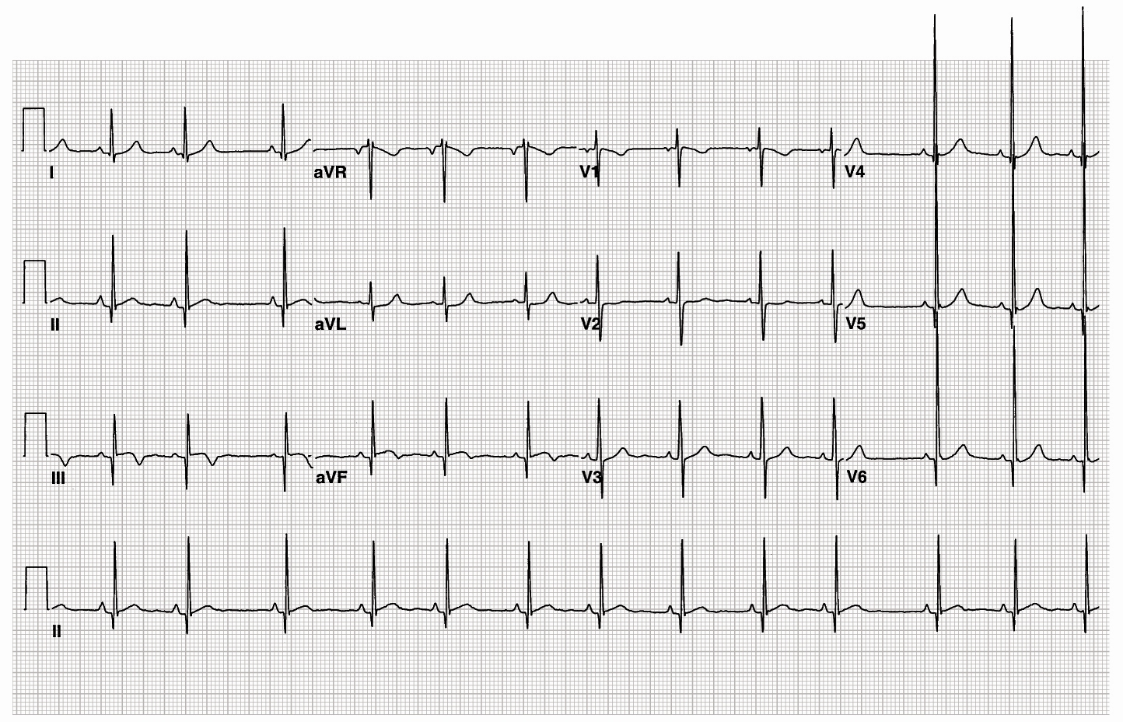
Figure 8: 5-year-old girl with systolic murmur at right upper sternal border
Notes:
LVH
NSR with sinus arrhythmia
QRS 45
R in V6 >30mm
Q in lead III of 8mm, V6=6mm
Early repolarization

Slide 54
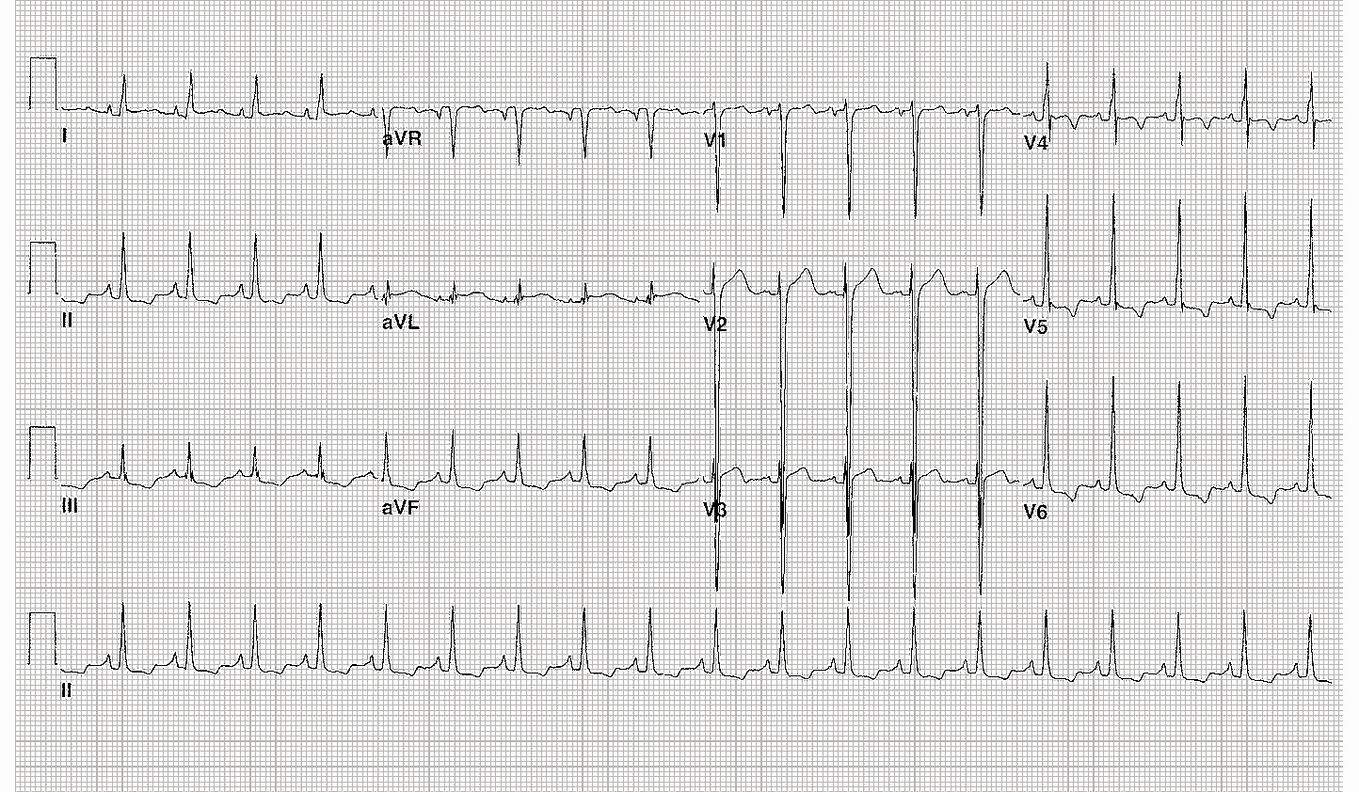
Figure 9: 13-year-old boy with chest pain while playing soccer
Notes:
LVH with strain
NSR, QRS axis about +60, T wave axis in RUQ, ? About –90, therefore QRS-T angle >90 degrees which indicates a strain pattern
S in V2 =45mm
R in V6 =22mm
Inverted T waves in II, III, aVF, V4-6

Slide 55
Figure 10: 13-year-old boy upon admission to the PICU status post repair of ventricular septal defect
Notes:
RBBB
Sinus bradycardia
QRS=0.15sec
rsR’ in V1, V2
Slurred, wide S in I, V6

Slide 56
Figure 11: 13-year-old boy with hypertrophic cardiomyopathy
Notes:
LBBB-RARE IN CHILDREN
Sinus rhythm=60
LAE-duration of P is >0.1 sec
QRS=0.135 sec
Wide, slurred S in V1-V3
Slurred upstroke of R in V5-V6
QS in V2

Slide 57
Figure 12: 12-year-old boy with syncope during a lacrosse game. ED calls for telemetry admission for
“incomplete bundle branch block and long QT”
Notes:
WPW syndrome
Sinus rhythm
Short PR=0.06 sec
Delta wave with QRS prolongation =0.16 sec
Don’t forget about possible associated congenital anomalies (Ebstein’s, glycogen storage dz)

Slide 58
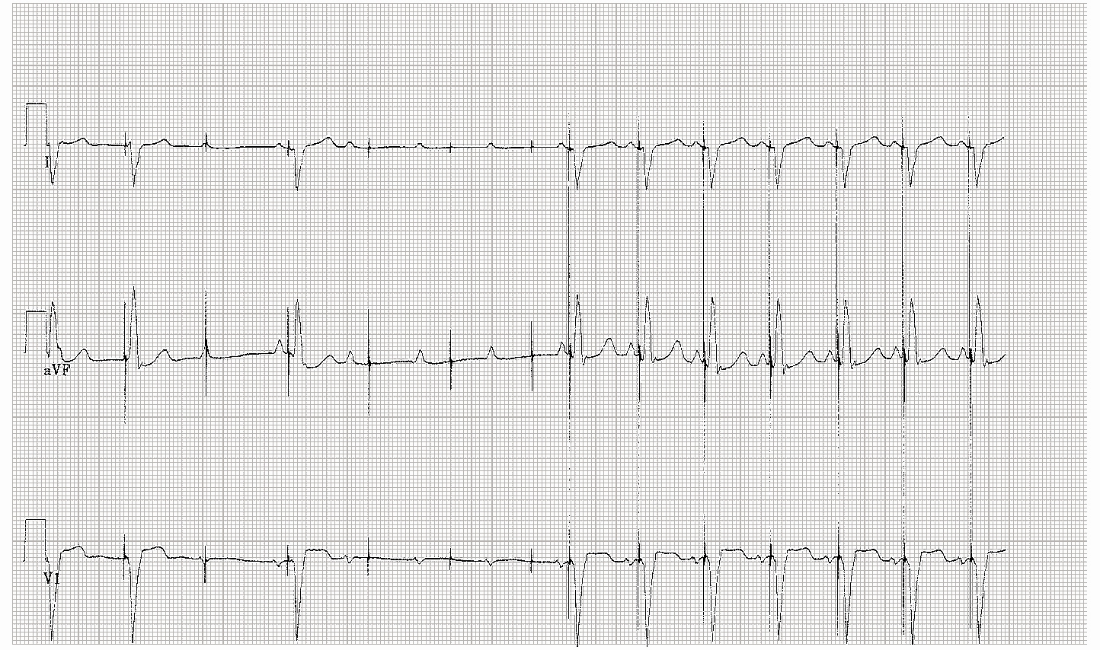
Figure 13: 11-year-old boy with surgical complete heart block requiring dual-chamber pacemaker placement. ED calls for admission because child has been fatigued for a week, is dehydrated and they think he has mono
Notes:
Pacemaker malfunction: failure to capture
First 2 beats capture, loss of capture, single captured beat, 3 missed capture, resumption of pacing
Call the patient’s friendly neighborhood cardiologist for help

