Slide 1

Erich C. Maul, DO, FAAP
Pediatric Hospitalist
Chief Moron in Residence
Kentucky Children’s Hospital

Slide 2
Disclosures
Nothing to disclose, no conflicts of interest, and no off label therapies
However…

Slide 3


Slide 4


Slide 5


Slide 6

Charlie and Snoopy

Slide 7
Objectives
Review basic EKG physiology
Discuss age related changes to EKGs
Present a basic, reliable system for EKG review and interpretation
Not make you a cardiologist, but an astute clinician who recognizes abnormal from normal

Slide 8
What is an EKG?
Graphic representation of the progression of electrical activity of the heart
Many times a poor screening test, but it’s quick, non-invasive and cheap
  And if you interpret it, you can bill for it and make $
    93000-perform and interpret
    93010-interpret only
  May help with diagnosis ~20% of the time

Slide 9
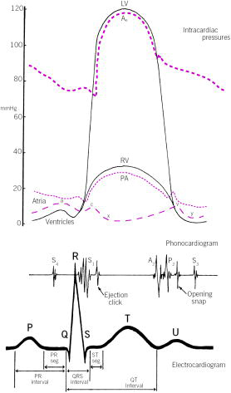

Slide 10
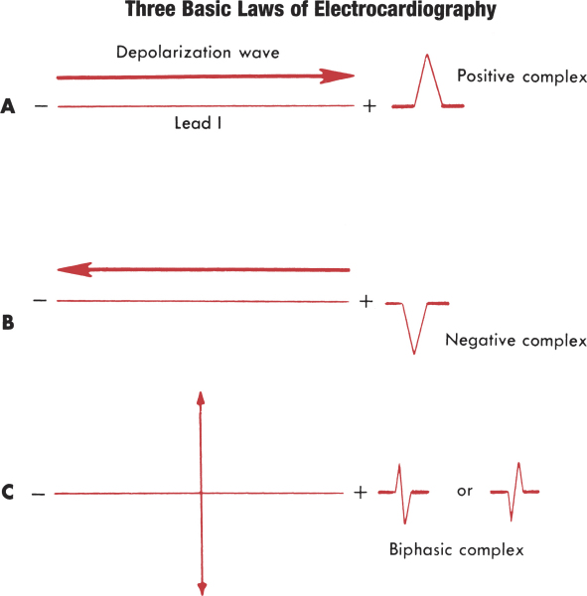
Laws of EKG’s I learned in Physics…but just never knew it

Slide 11
Why 12 leads?
History essentially, but can modify if needed
  Right sided leads
Allows for using 2-D technology and our innate smarts to get a 3-D image of the heart
  Think of each lead as a camera looking at the heart from that specific angle

Slide 12
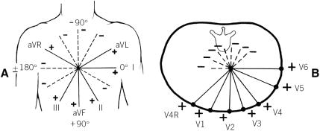
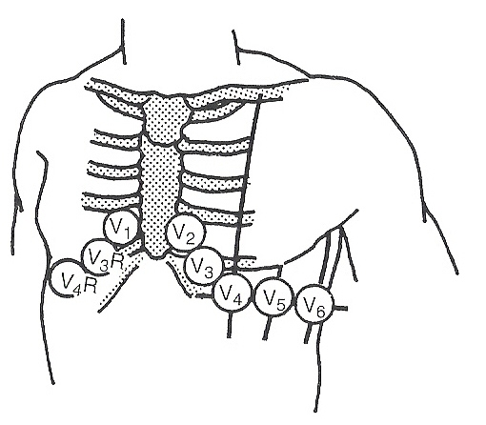
Do I really need to know this?
Lead V₁ fourth intercostal space just right of the sternum.
Lead V₂ fourth intercostal space just left of the sternum.
Lead V₃ midway between leads V₂ and V₄.
Lead V₄ midclavicular line in the fifth interspace.
Lead V₅ anterior axillary line at same level as lead V₄.
Lead V₆ midaxillary line at same level as lead V₄

Slide 13
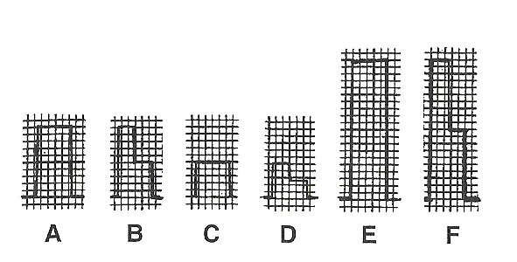
Standardization
Can change the gain
  Change amplitude of complexes
  Normal is 10mm/mV
  Common variant is 10-5mm/mV
Can change the speed
  Normal is 25mm/sec

Slide 14
When do you get them?
Bedside monitoring
Suspicion of…
  Arrhythmia/conduction anomaly
  Congenital heart disease
  Acquired heart disease
Prior to drug therapy initiation

Slide 15
Interpretation of EKG’s
Need a system
Need a method
Some need a drink…
How you interpret depends on the situation you are in
  Acutely ill in PICU/ED/Floor-pattern recognition
  Stable in clinic/ED/ward-scalar or vector approach

Slide 16
Methods of interpretation
Pattern recognition
  What you learn in PALS/ACLS
  Read and react
Vector
  EKG with magnitude and direction
  Easier than it sounds
Scalar
  EKG lead with magnitude only
  Can make a vector using 2 different scalar leads

Slide 17
Pattern recognition
Know them for life-threatening situations so you an intervene appropriately
Method
  Sinus or not
  Fast or slow
  QRS wide or narrow
  Stable or unstable

Slide 18
The more stable kid
Age
Rate
Rhythm
Axis
  P, QRS, T
Intervals and waves
  P, QRS, T
  PR, ST, QT/QTc
  R wave progression
Hypertrophy or enlargement
  Atrial
  Ventricular
Conduction disturbance

Slide 19
Brain Overload…
How are you to remember all these age appropriate norms?
  LOOK THEM UP IN HARRIET LANE!
    Guess how my mentors taught me EKG’s
  Make your own peripheral brain
  Get help from friendly neighborhood cardiologist

Slide 20
Biggest Take-home Point
Never read an EKG in isolation
  Always do it as related to a clinical case or in relation to the reason you got it.
  The clinical background is very important
    Age, weight, previous EKG, medications, etc
Don’t believe everything the machine tells you

Slide 21
Age
EKG’s vary greatly with age
Newborns
  Right sided dominance of forces
Adult EKG form by age 3 y/o, with most changes occurring by 3-6 months

Slide 22
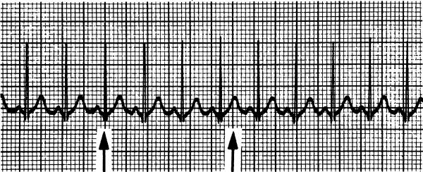
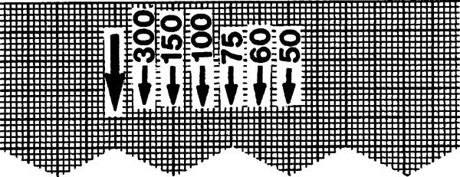
Rate
60/RR interval=rate
Count # of RR’s in 6 large divisions and multiply by 50
Read the machine!

Slide 23
Rhythm
Sinus
  P wave before every QRS
  Normal PR interval for age
  Normal P wave axis
    Upright I and aVF
Non-sinus

Slide 24
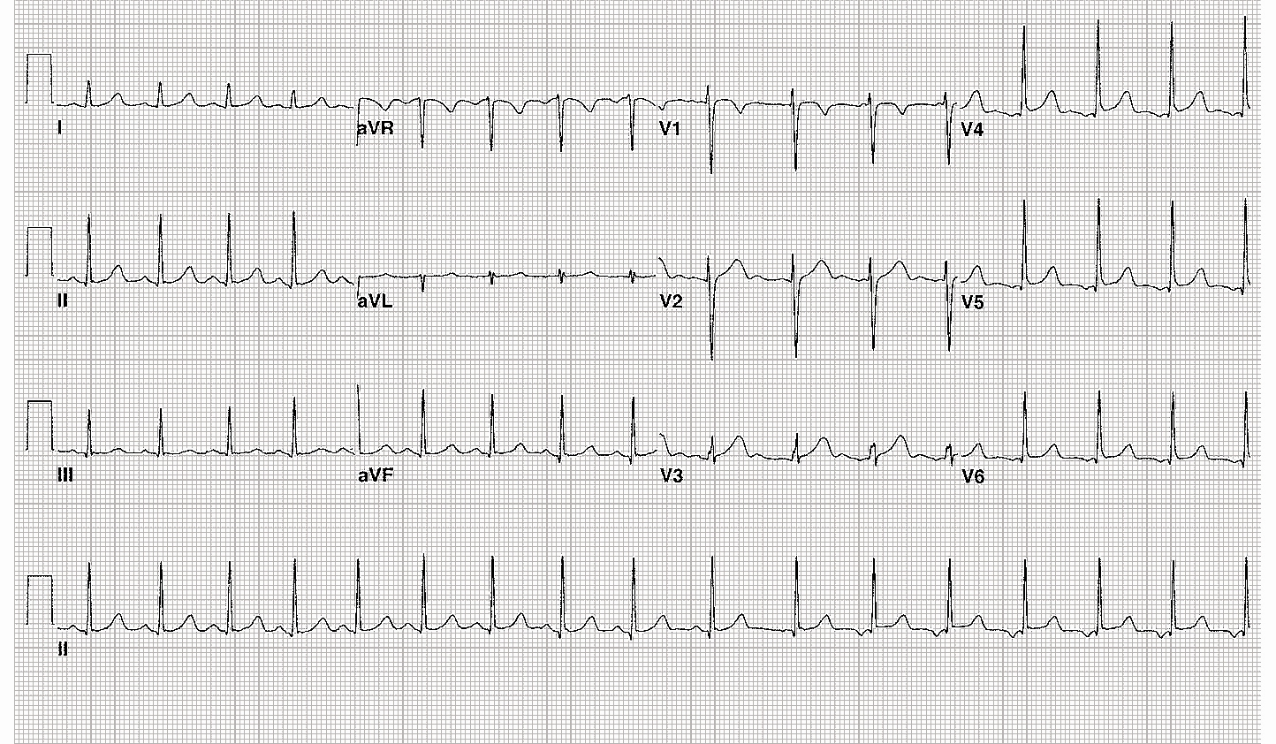
Figure 1: Asymptomatic 14-year-old female, local psychiatrist wants to start TCA for depression
Notes:
Wandering atrial pacemaker
The location of the artial pacer is different throughout the strip
First 10 complexes are sinus, complex 11 is junctional or left atrial (LA), 12-17 have inverted P waves, suggesting LA origin of impulse
Incidentally, her QTc is ULN at 0.45; would not start TCAs if ANY EKG abnormality, there are better antidepressants out there
From: Park: Pediatric Cardiology for Practitioners, 5th ed.
WANDERING ATRIAL PACEMAKER
Description.
Wandering atrial pacemaker is characterized by gradual changes in the shape of P waves and PR intervals. The QRS complex is normal.
Causes.
Wandering atrial pacemaker is seen in otherwise healthy children. It is the result of a gradual shift of the site of impulse formation in the atria through several cardiac cycles.
Significance.
Wandering atrial pacemaker is a benign arrhythmia and has no clinical significance.
Management.
No treatment is indicated.

Slide 25
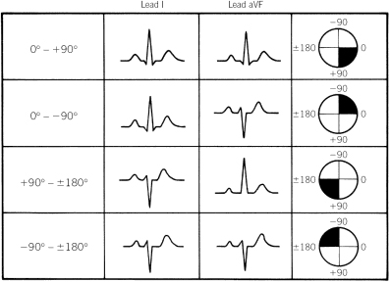
Axis
Determine quadrant at a minimum
Successive approximation to fine tune axis
Use leads I and aVF

Slide 26
Successive Approximation
Find the axis quadrant
Look for limb lead that is biphasic
  Or close to biphasic
Axis is perpendicular to the biphasic lead

Slide 27
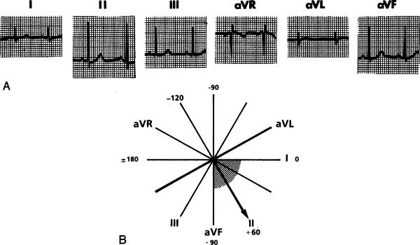
Successive Approximation
Find quadrant
Find biphasic limb lead; axis is perpendicular to that lead

Slide 28
P wave and T wave axis
Find by same method
Both should be between 0-90
ANY T wave axis outside of 0-90 is abnormal
  Ventricular strain, conduction disturbances, metabolic or ischemic dysfunction

Slide 29
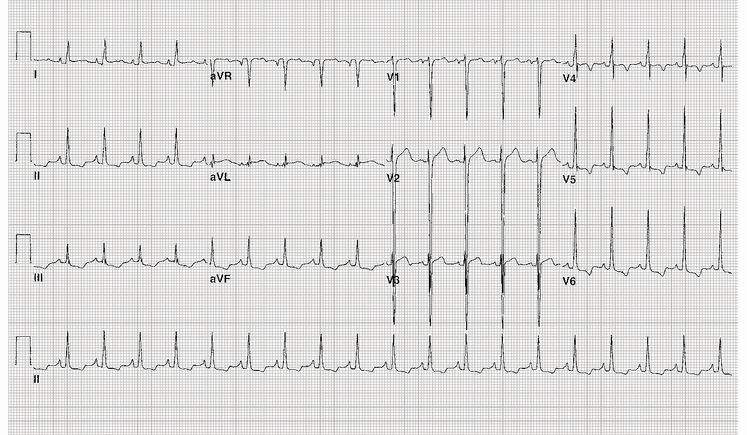
Figure 2: 13-year-old boy with exertional chest pain
Notes:
LVH with strain
NSR, QRS axis about +60, T wave axis in RUQ, ? About –90, therefore QRS-T angle >90 degrees which indicates a strain pattern
S in V2 =45mm
R in V6 =22mm
Inverted T waves in II, III, aVF, V4-6
Strain pattern indicates abnormal ventricular repolarization and probably severe ventricular hypertrophy

Slide 30
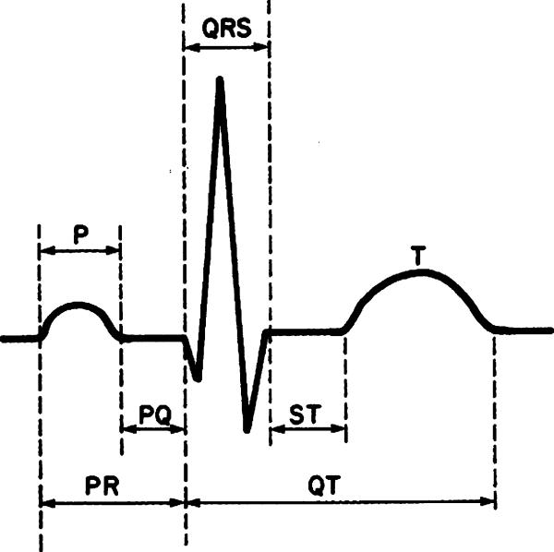

Intervals and waves
Measure against age appropriate norms
Use RR interval preceding the QT you measure

Slide 31
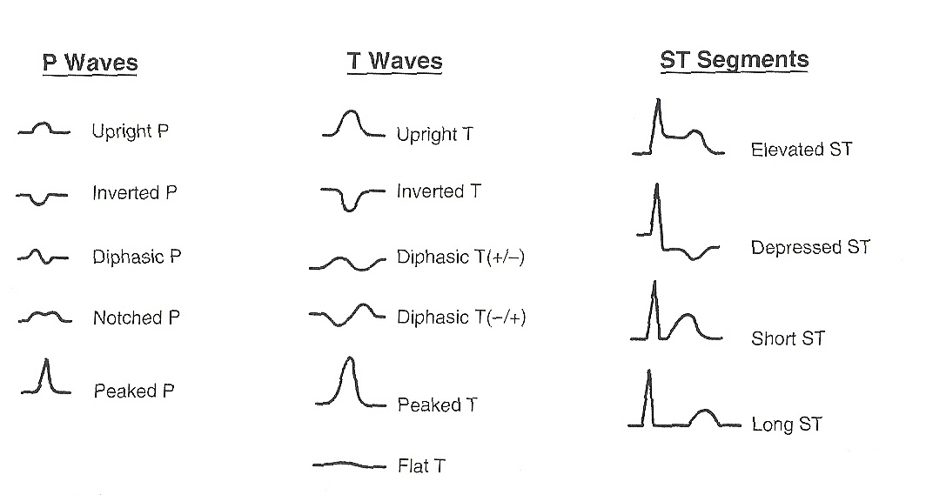
P waves, T waves, ST, oh my!

Slide 32
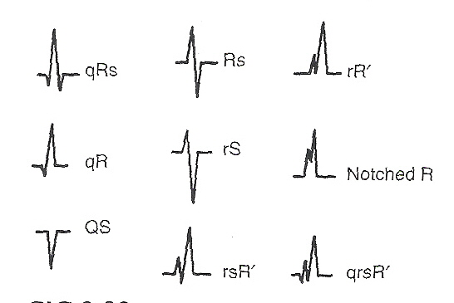
QRS waves

Slide 33
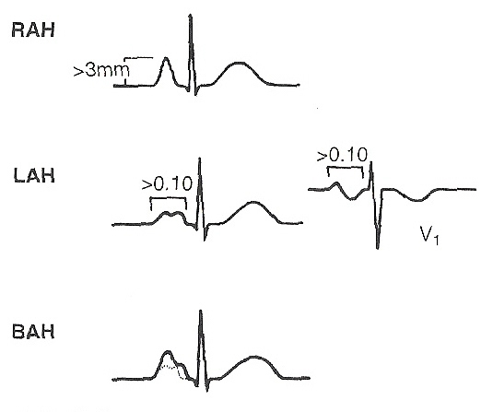
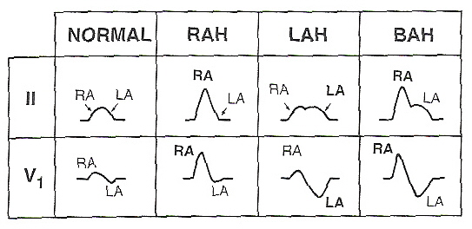
Atrial Hypertrophy
RAH
  p-pulmonale
  P>3mm
  II, V1, V2
LAH
  p-mitrale
  P duration >0.1s
  Any lead
BAH
  Combination of both

Slide 34
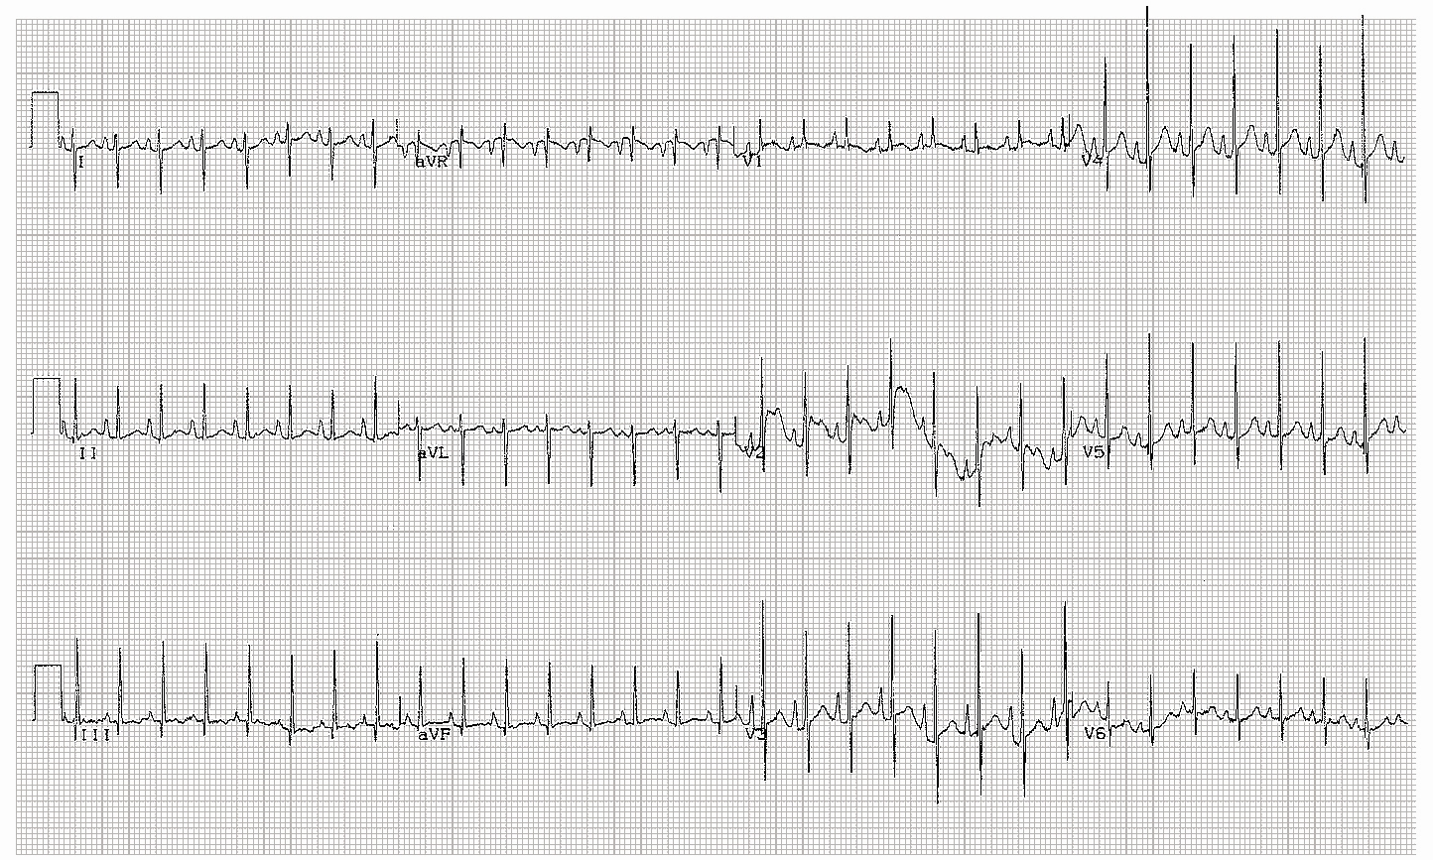
Figure 3: 3-month-old infant with chronic lung disease and a murmur at LUSB
Notes:
Right Atrial Enlargement
Sinus tachycardia, QRS axis 110, tall P waves in II, V1-V5 (>3mm)
In this setting, the DDx includes murmurs of LUSB origin
Most common
pulmonary valve stenosis, atrial septal defect, innocent pulmonary ejection murmur, pulmonary flow murmur of the newborn (PPS)
Less common
PA stenosis, Aortic stenosis, coarctation, PDA, PAPVR, TAPVR, pulmonary regurgitation(diastolic murmur)

Slide 35
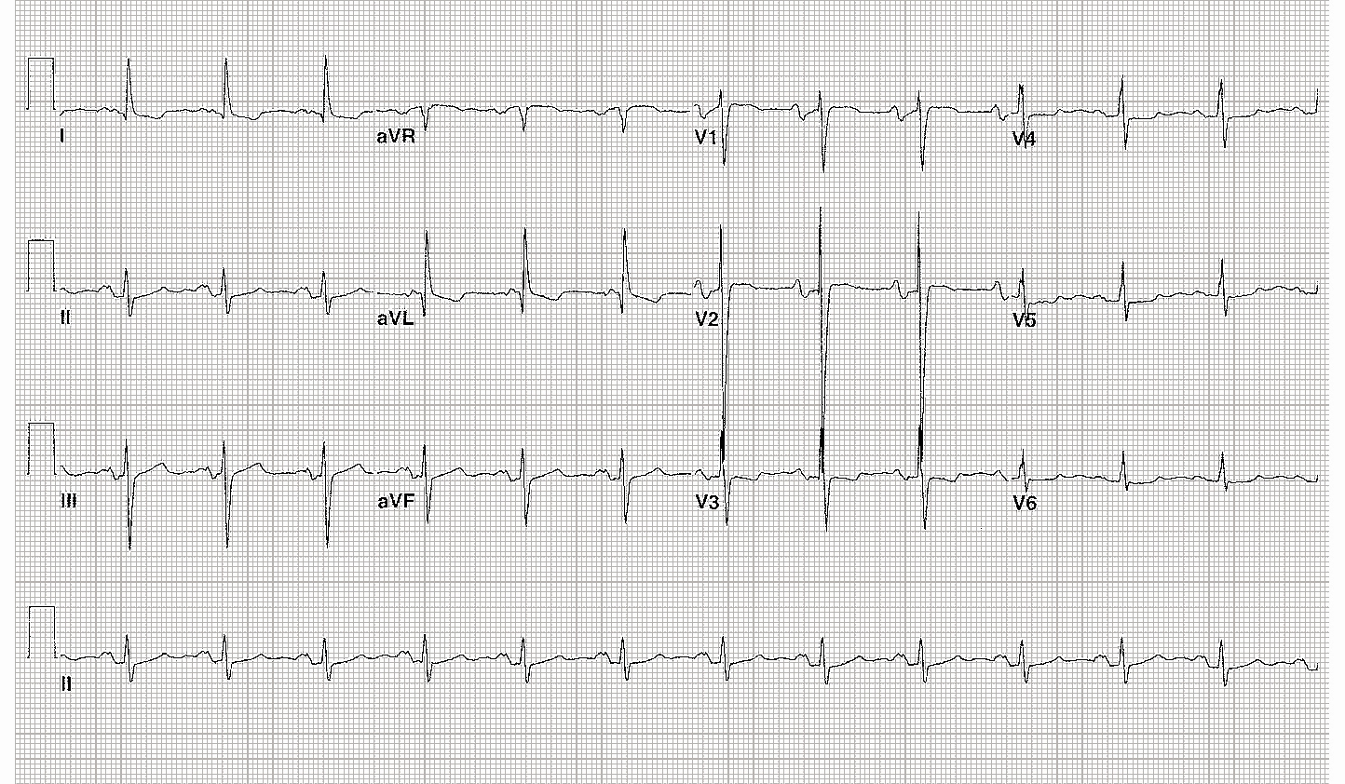
Figure 4: 16-year-old girl with tricuspid atresia status post Fontan procedure, acute onset of chest pain without dyspnea
Notes:
Left atrial Enlargement
Sinus rhythm, , QRS axis -20; left axis deviation
First degree AV block
Broad notched P waves in I, II, aVF (>0.1 sec)
Deep S in V2 suggests LVH
This all makes sense since no blood flow is going to the RA after a Fontan, venous circulation is passive to lungs and all returns to LA.

Slide 36
Ventricular Hypertrophy
Guiding Principles
QRS axis usually directed toward hypertrophied ventricle
QRS voltages increase toward direction of involved ventricle
R/S ratio changes according to the ventricle that is hypertrophied
Severe hypertrophy may yield T wave axis changes (strain)
May slightly increase QRS duration

Slide 37
RVH (outside newborn)
Right axis deviation
R in V1 or S in V6 >98th %ile
Upright T in V1 after dol 3
Abnml R/S ratio that favors RV
RV strain
Q in V1 (qR or qRs pattern) suggests RVH
If voltage criteria for RVH, wide QRS-T angle with abnml T wave axis indicates strain pattern

Slide 38
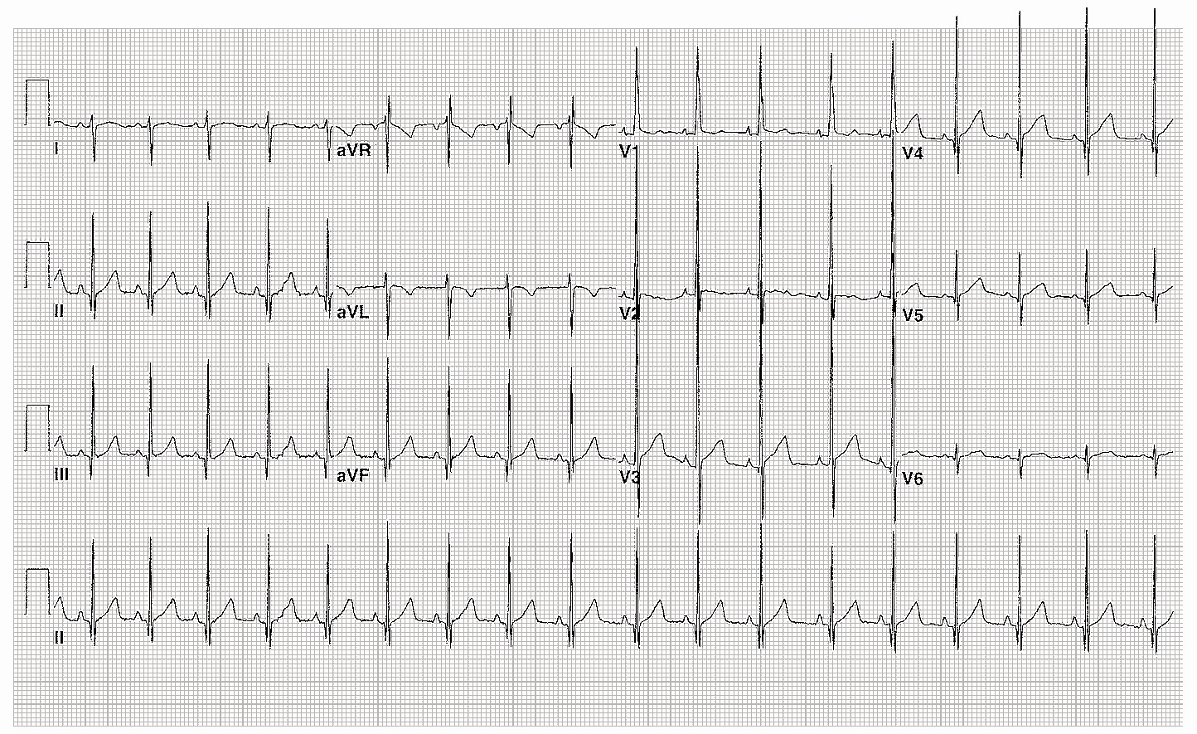
Figure 5: 7-month-old infant with loud systolic murmur at left upper sternal border
Notes:
RVH
NSR
QRS +110, Right axis deviation
qR pattern in V1
Tall R in V1 (21mm) reciprocal changes in S wave in V6 (8mm)
Upright T in V1 (abnml after first week of life)
Most common
pulmonary valve stenosis, atrial septal defect, innocent pulmonary ejection murmur, pulmonary flow murmur of the newborn (PPS)
Less common
PA stenosis, Aortic stenosis, coarctation, PDA, PAPVR, TAPVR, pulmonary regurgitation(diastolic murmur)

Slide 39
LVH
Left axis deviation
R in V6 or S in V1 >98th %ile
Abnml R/S ratio that favors LV
Q in V5 or V6 >5mm with tall T waves in those leads
If voltage criteria for LVH, a wide QRS-T angle with T axis outside of normal indicates strain

Slide 40
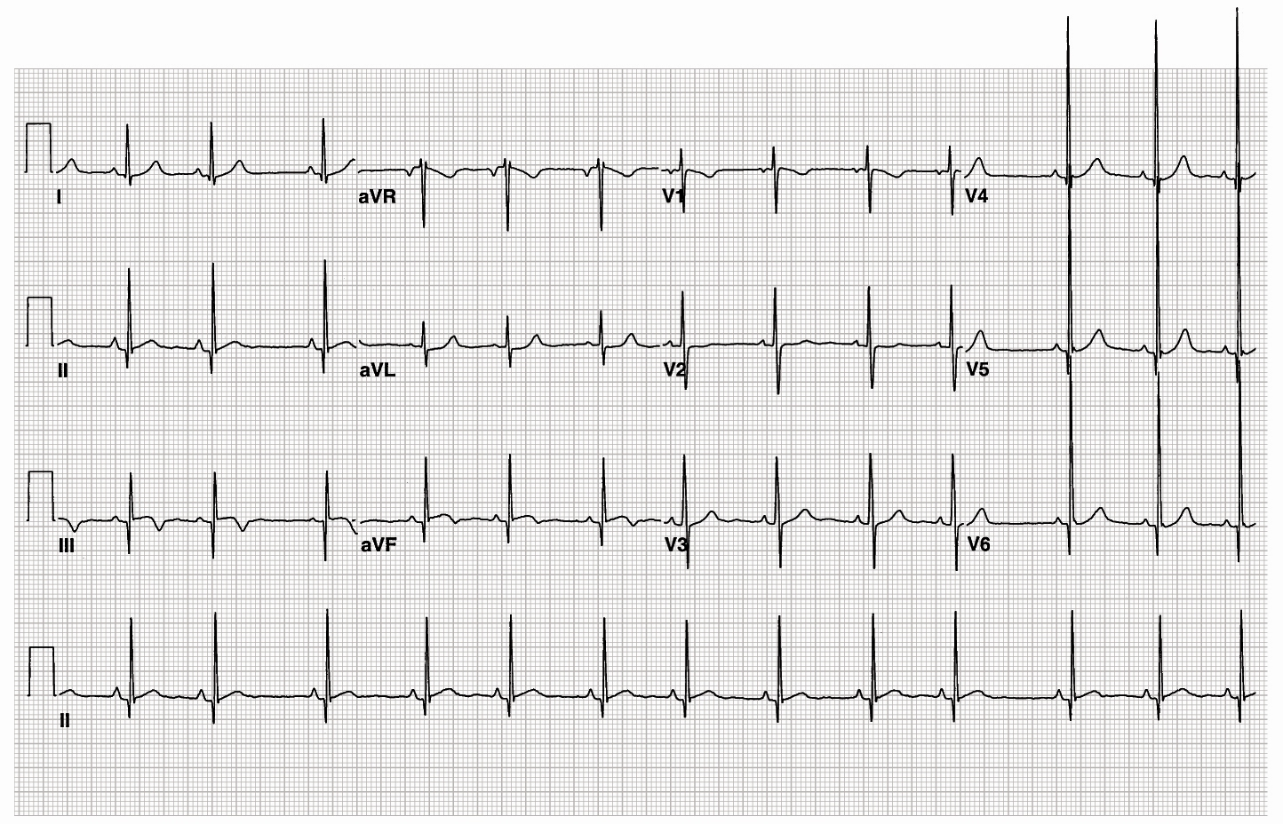
Figure 6: 5-year-old girl with systolic murmur at right upper sternal border
Notes:
LVH
NSR with sinus arrhythmia
QRS 45
R in V6 >30mm
Q in lead III of 8mm, V6=6mm
Early repolarization
Most common
Aortic stenosis
Less common
supravalvular AS
subvalvular AS
aortic regurgitation(diastolic murmur)

Slide 41
Figure 7: 13-year-old boy with exertional chest pain
(Same kid as Figure 2 )
Notes:
LVH with strain
NSR, QRS axis about +60, T wave axis in RUQ, ? About –90, therefore QRS-T angle >90 degrees which indicates a strain pattern
S in V2 =45mm
R in V6 =22mm
Inverted T waves in II, III, aVF, V4-6
Strain pattern indicates abnormal ventricular repolarization and probably severe ventricular hypertrophy

Slide 42
Biventricular Hypertrophy
Characteristics of RVH and LVH

Slide 43
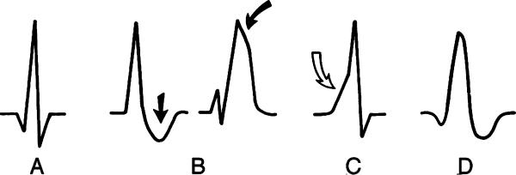
Ventricular Conduction Disturbances
Abnormally prolonged QRS duration
  RBBB
  LBBB
  Pre-excitiation
  Pacemakers-look for pacing spike
CANNOT diagnose hypertrophy if a BBB is present

Slide 44
RBBB
Most common VCD in peds
  After open heart surgery
  Lesions with RV volume overload (ASD)
  CHD such as Ebstein’s anomaly and CoA
  Cardiomyopathy, myocarditis, CHF, muscle diseases (DMD), Kearns-Sayre syndrome, Brugada syndrome, Arrhythmogenic RV dysplasia, congenital hereditary RBBB (Chro19)

Slide 45
RBBB Criteria
Right axis deviation
Prolonged QRS for age
Terminal slurring of QRS
  Wide slurred S in I, V5, V6
  Terminal slurred R’ in aVR, V4R, V1, V2
ST depression and T wave inversion
  (adults)

Slide 46
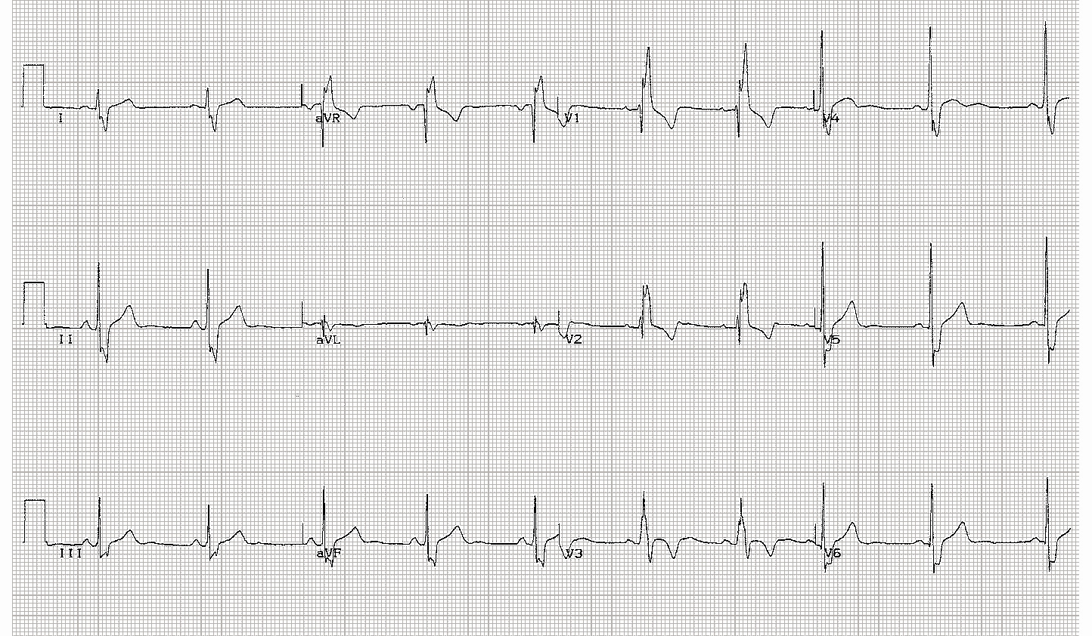
Figure 8: 13-year-old boy status post repair of ventricular septal defect
Notes:
RBBB
Sinus bradycardia
QRS=0.15sec
rsR’ in V1, V2
Slurred, wide S in I, V6
Commonly seen after open heart procedures, lesions with RV volume overload (ASD), certain CHD lesions like Ebstein’s anomaly and coarctation.
Less common causes include cardiomyopathy, myocarditis, CHF, DMD, myotonic dystrophy, Kears-Sayre syndrome, Brugada syndrome, ARVD, congenital hereditary RBBB (Chr 19), idiopathic
Kerns-Sayre: ptosis, external ophthalmoplegia, abnml retinal pigmentation, heart block, sudden cardiac death
Brugada syndrome: RBB, ST elevations >2mm in V1-V3, sudden death
ARVD: arrhythmogenic RV dysplasia-similar to Brugada syndrome

Slide 47
LBBB
Common in adults due to HTN and ischemia, but rare in kids
Usually result of
  Surgery-Ao valve replacement, ventriculotomy, septal myomectomy, LVOT procedures
  Hypertrophic cardiomyopathy
  Myocarditis

Slide 48
LBBB Criteria
Left axis deviation
Prolonged QRS for age
Loss of Q in V5 and V6
QS pattern in V1
Slurred QRS
  Slurred, wide R in I aVL, V5, V6
  Wide s in V1, V2
ST depression and T wave inversion in V4-V6

Slide 49
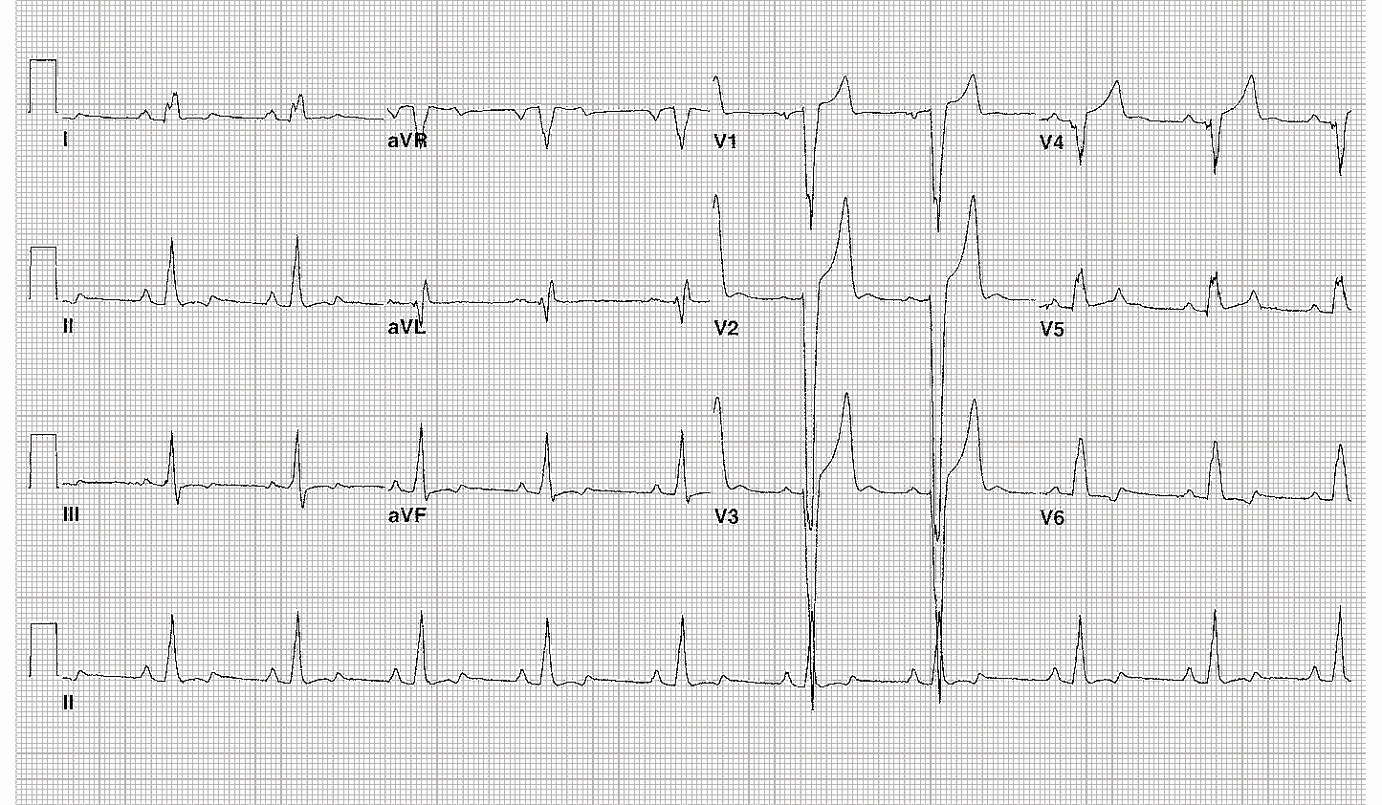
Figure 9: 13-year-old boy with family history hypertrophic cardiomyopathy
Notes:
LBBB-RARE IN CHILDREN
Sinus rhythm=60
LAE-duration of P is >0.1 sec
QRS=0.135 sec
Wide, slurred S in V1-V3
Slurred upstroke of R in V5-V6
QS in V2
Usually the result of surgery on LV outflow tract, myocarditis or hypertrophic cardiomyopathy

Slide 50
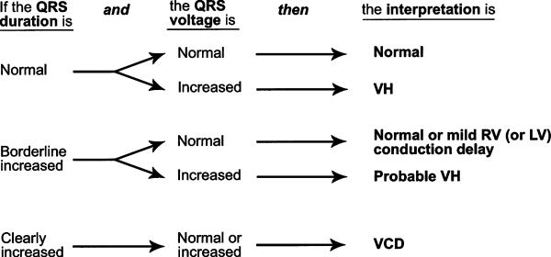
Is it a VCD or Hypertrophy?

Slide 51
Pre-excitation
Accelerated AV conduction to one ventricle via an accessory pathway
Classic examples
  Wolff Parkinson White
  Lown Ganong Levine syndrome
    Short PR, normal QRS
  Anomalous nodoventricular connections
    Mahaim fibers
    Normal PR, long QRS with delta wave

Slide 52
WPW
Kent bundle conducts faster than the AV node (normal conduction delay)
Ventricle depolarizes, but at a slower rate than His-Purkinje system
  Delta wave
If AV node impulse conducts, the QRS becomes characteristic of WPW

Slide 53
WPW Criteria
Short PR interval for age
Delta wave
Wide QRS for age
Don’t worry about delta wave polarity or type A or B, let Electrophysiologist figure it out

Slide 54
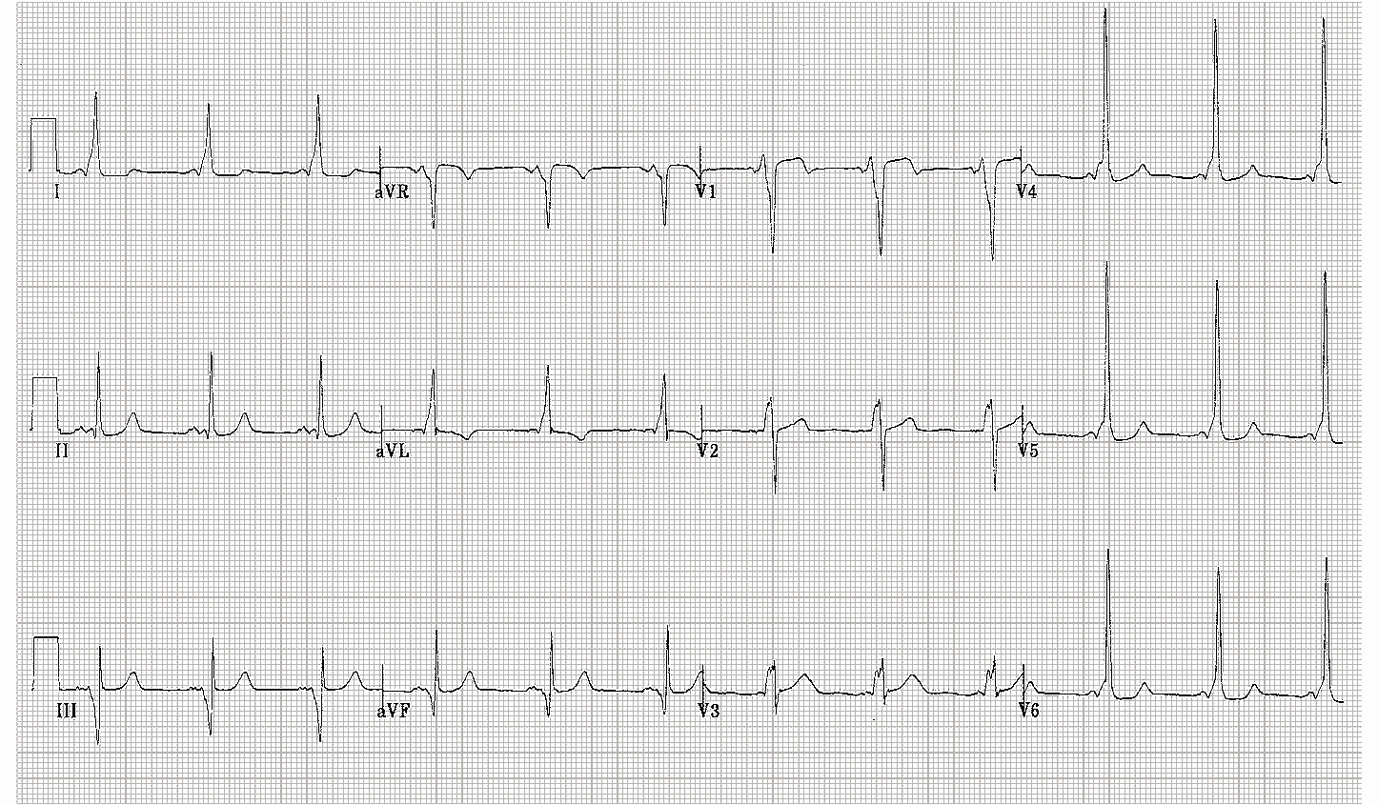
Figure 10: 12-year-old boy with syncope during a baseball game, you see him in the office 2 days after ER discharge; EKG is “normal” per ER read. You don’t have a copy, so you get one in your office…
Notes:
WPW syndrome
Sinus rhythm
Short PR=0.06 sec
Delta wave with QRS prolongation =0.16 sec
Don’t forget about possible associated congenital anomalies (Ebstein’s, glycogen storage dz)

Slide 55
What’s the big deal about WPW?
Prone to attacks of SVT
  Tachycardia masks the delta wave because of a re-entrant pathway
Pre-excitation can mimic ventricular hypertrophies and BBB; you then make the wrong diagnosis
Can be associated with congenital heart disease
  Ebstein’s anomaly, glycogen storage dz

Slide 56
Summary
Have a system and a reliable peripheral brain
Understand age appropriate normal from abnormal
Never interpret the EKG in isolation

Slide 57
References
Park MK. 2003. Pediatric Cardiology Handbook, 3rd edition, Mosby, Philadelphia.
Park MK. 2008. Pediatric Cardiology for Practitioners, 5th edition, Mosby Elsevier, Philadelphia.
Park MK. and Guntherroth WG. 2006. How to Read Pediatric ECGs, 4th edition, Mosby Elsevier, Philadelphia.
Deal BJ, Johnsrude CL, Buck SH. 2004. Pediatric ECG Interpretation An Illustrative Guide, Futura Blackwell
Goldberger AL. 2006. Clinical Electrocardiography, a Simplified Approach, 7th edition, Mosby Elsevier, Philadelphia.

Slide 58
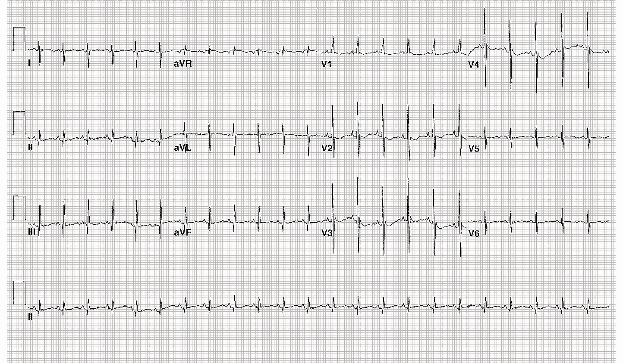
Figure 11: 1-day-old infant, PCP got EKG because he heard a murmur at 2 hol; feeding well, no cyanosis, no tachypnea
Notes:
Normal for age
NSR, 140; QRS +120; Pure R wave in V1; S in V6=5mm
RV predominance of forces; upright T wave in V1 is normal up to dol 7
Park: Pediatric Cardiology for Practitioners, 5th ed.
Comparison of Pediatric and Adult Electrocardiograms
ECGs of normal infants and children are quite different from those of normal adults. The most remarkable difference is RV dominance in infants. RV dominance is most noticeable in newborns, and it gradually changes to left ventricular (LV) dominance of adults. By 3 years of age, the child's ECG resembles that of young adults. The age-related difference in the ECG reflects age-related anatomic differences; the right ventricle (RV) is thicker than the left ventricle (LV) in newborns and infants, and the LV is much thicker than the RV in adults.
RV dominance of infants is expressed in the ECG by right axis deviation (RAD) and large rightward and/or anterior QRS forces (i.e., tall R waves in lead aVR and the right precordial leads [V4R, V1, and V2] and deep S waves in lead I and the left precordial leads [V5 and V6]), compared with the adult ECG.
An ECG from a 1-week old neonate is compared with that of a young adult . The infant's ECG demonstrates RAD (+140 degrees) and dominant R waves in the right precordial leads. The T wave in V1 is usually negative. Upright T waves in V1 in this age group suggest right ventricular hypertrophy (RVH). Adult-type R/S progression in the precordial leads (deep S waves in V1 and V2 and tall R waves in V5 and V6) is rarely seen in the first month of life; instead, there may be complete reversal of the adult-type R/S progression, with tall R waves in V1 and V2 and deep S waves in V5 and V6. Partial reversal is usually present, with dominant R waves in V1 and V2 as well as in V5 and V6, in children between the ages of 1 month and 3 years.

Slide 59
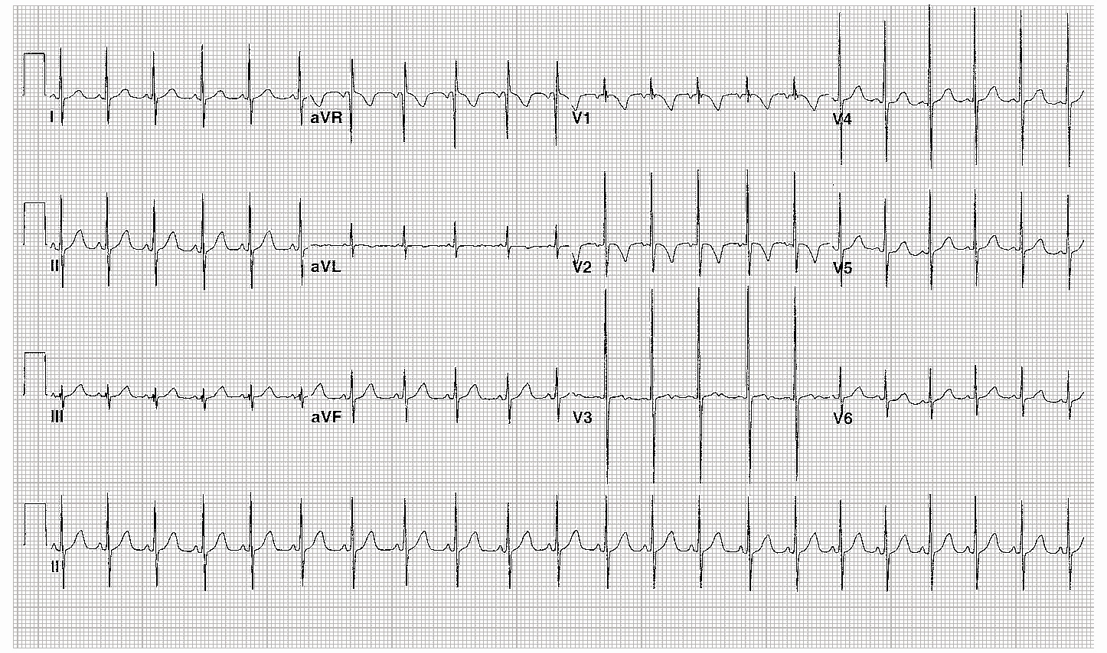
Figure 12: 5-month-old female, family history of LQTc syndrome
Notes:
Normal for age
NSR; QRS +30, Rsr’ pattern in V1(nl variant); S in V6 =3mm
For the most current review, see:
Roden DM. Clinical practice. Long-QT syndrome. N Engl J Med. 2008 Jan 10;358(2):169-76. Review. No abstract available. PMID: 18184962 [PubMed - indexed for MEDLINE]

Slide 60
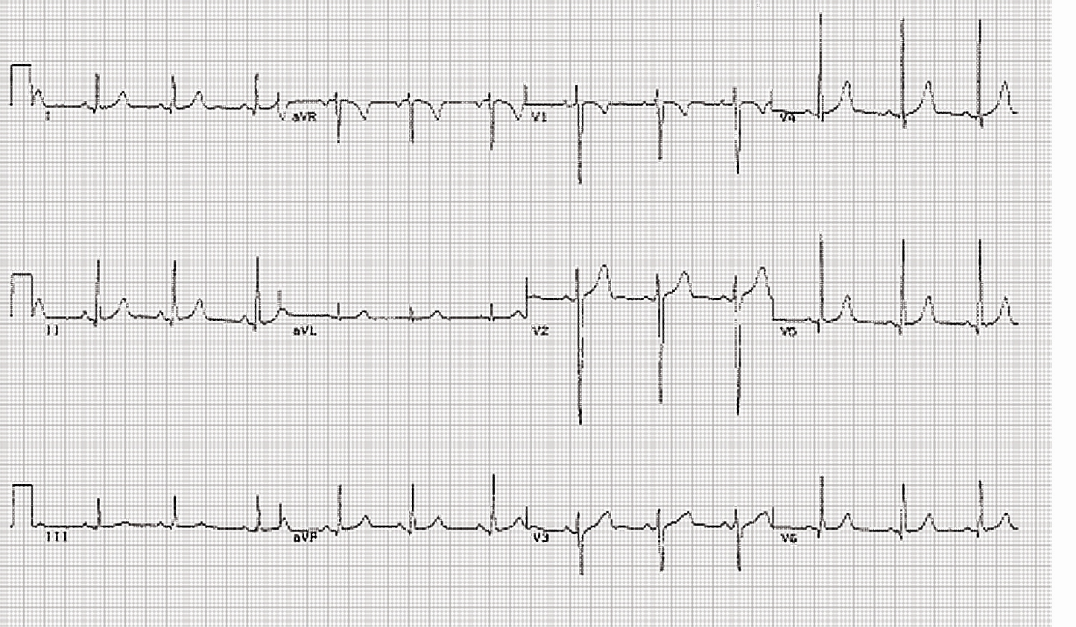
Figure 13: Asymptomatic 8-year-old female, “the voices” told her mom that her child was going to die of Sudden Cardiac Death
Notes:
Normal for age
NSR; QRS axis +60, rS in V1, qR in V6, normal R wave progression

Slide 61
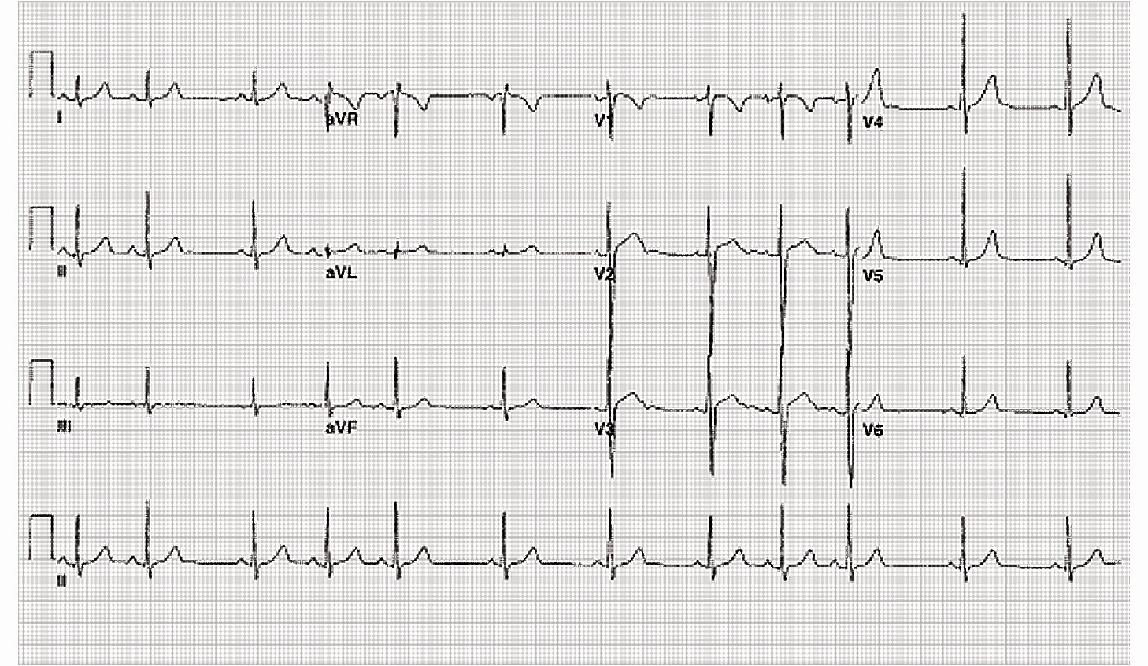
Figure 14: 8-year-old boy referred to ED for irregular heart rhythm in PCP’s office, you are consulted for admission with telemetry
Notes:
Sinus arrhythmia
On exam, you notice that the HR speeds up with inspiration and decreases with expiration
P before every QRS, nml PR interval, normal P wave axis
(Can you describe the physiology?)
From: Park: Pediatric Cardiology for Practitioners, 5th ed.
SINUS ARRHYTHMIA
Description.
There is a phasic variation in the heart rate, increasing during inspiration and decreasing during expiration. The arrhythmia occurs with maintenance of characteristics of sinus rhythm.
Causes.
This is a normal phenomenon and is due to phasic variation in the firing rate of cardiac autonomic nerves with the phases of respiration.
Significance.
Sinus arrhythmia has no significance because it is a normal finding in children and a sign of good cardiac reserve.
Management.
No treatment is indicated.

Slide 62
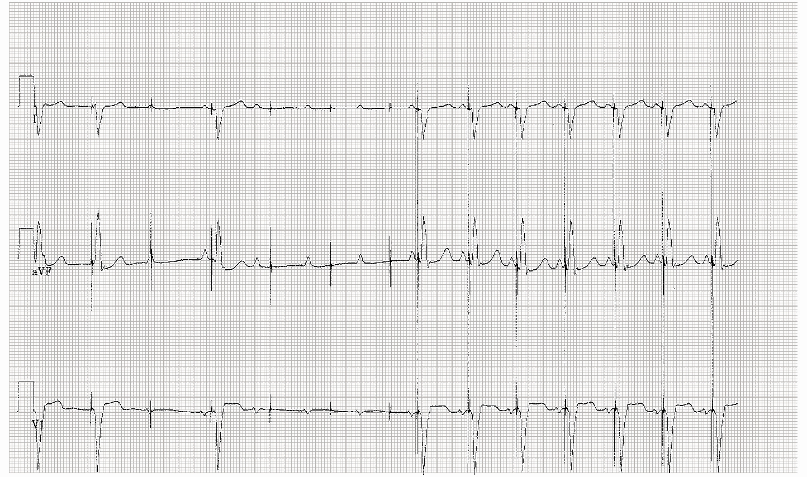
Figure 15: 11-year-old with surgical complete heart block, dual-chamber pacemaker who comes to your office feeling weak and fatigued
Notes:
Pacemaker malfunction: failure to capture
First 2 beats capture, loss of capture, single captured beat, 3 missed capture, resumption of pacing
Call the patient’s friendly neighborhood cardiologist for help

