Slide 1
Saving Time Under Pressure
Effectiveness of Standardizing Pediatric Resuscitation Carts
Erich Maul, DO
Philip Westgate, PhD
Barbara Latham, RN, MSN

Slide 2
Disclosures
I have no financial relationships to disclose or conflicts of interest to resolve
I will not be discussing any unapproved or off-label, experimental or investigational use

Slide 3
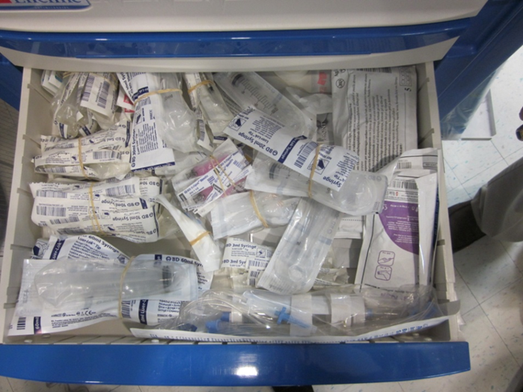
Find something quickly in this mess
Notes:
You can’t very efficiently.
Sad to say, this is what some of the resuscitation carts at KCH looked like 5 years ago!
When you are under stress in a resuscitation situation, it becomes more difficult to remember your name, much less where the 10 mL syringes are.

Slide 4
Time is Critical
This is obvious during a resuscitation situation
Standardization of resuscitation carts is logical
Little data to evaluate the scope of the problem
  Agarwal, et al., Pediatrics, 2005; 116:e326-33
    Broselow® cart easier to use and preferred by participants
    Cost prohibitive?
    Standard, highly visual prepackaged layout
  Rousek & Hallbeck. Human Factors 2011; 53:626-36
    Standardized medication compartment only
    Successful, low-cost, generalizable
Notes:
Cost prohibitive to redesign entire hospital system with Broselow carts
~$4000/cart=~$68,000 outlay for just the carts

Slide 5
Objective
To document increased efficiency in finding resuscitation equipment in a standardized resuscitation cart
  Find item in <15 seconds
  Monitor times for degrading skill
Notes:
Efficiency meant find item in <15 seconds and follow as a time series looking for degradation of skills

Slide 6
Methods
Setting
  Hospital within a Hospital in Lexington, KY
  Carts located across entire healthcare system
    Within Children’s Hospital
    Ancillary areas
Notes:
Ancillary areas were places like MRI, dialysis, Center for Advanced Surgery, etc.

Slide 7
Methods
Cart Design
  Used Lean methodology to find the waste in the carts and design prototype
  5 S
    Sort-what was necessary equipment?
    Set-design drawers and time standards
    Shine-inspect final design
    Standardize-create plan for Materials and Users
    Sustain-continued education and cart checks
Notes:
Very visual
Better outside labeling
Standard design of each drawer and maintained between carts

Slide 8

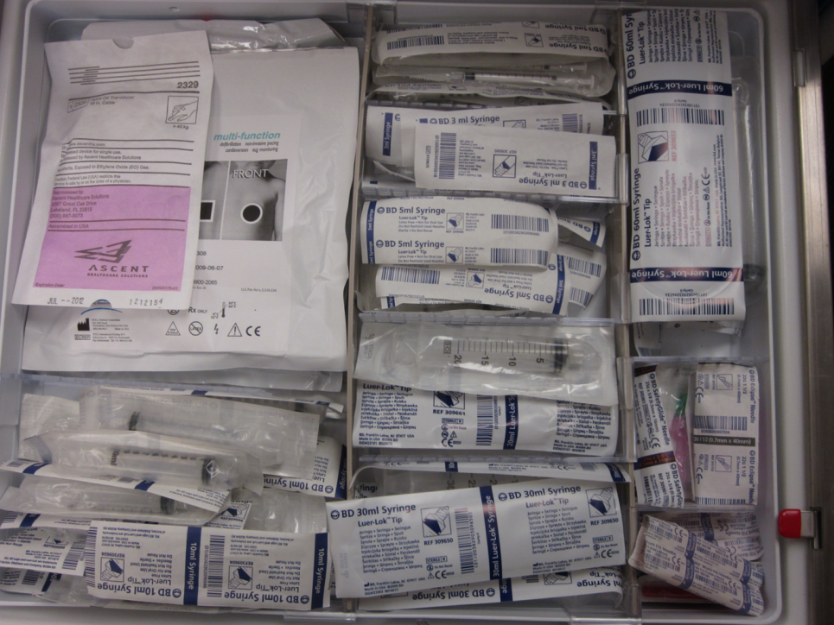
Remember the Drawer of Disaster?
Before
After

Slide 9
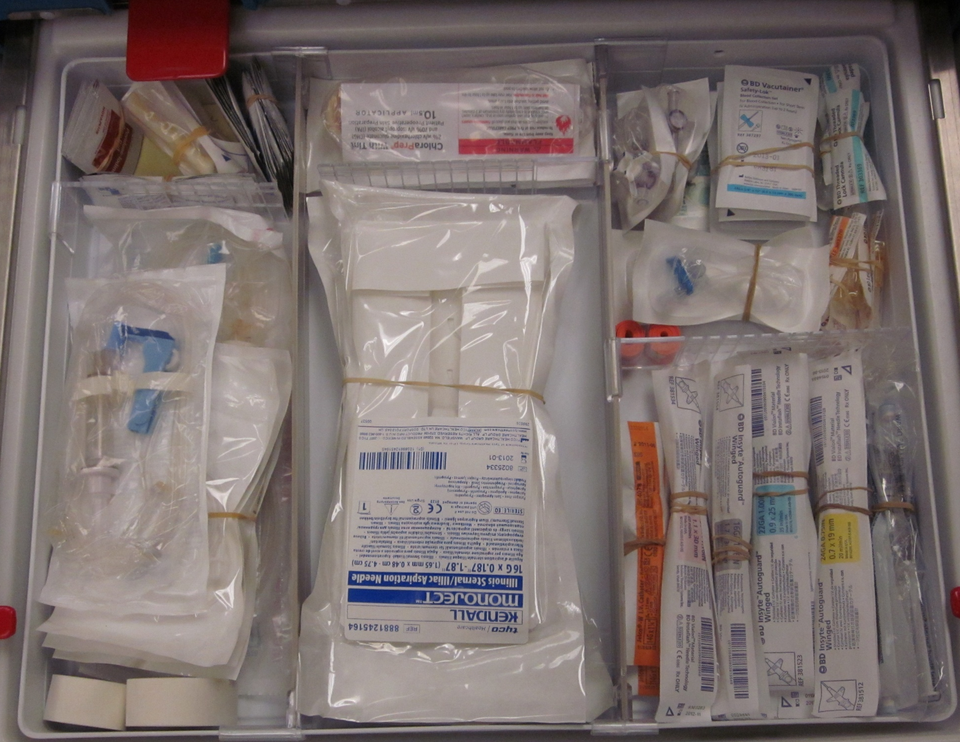
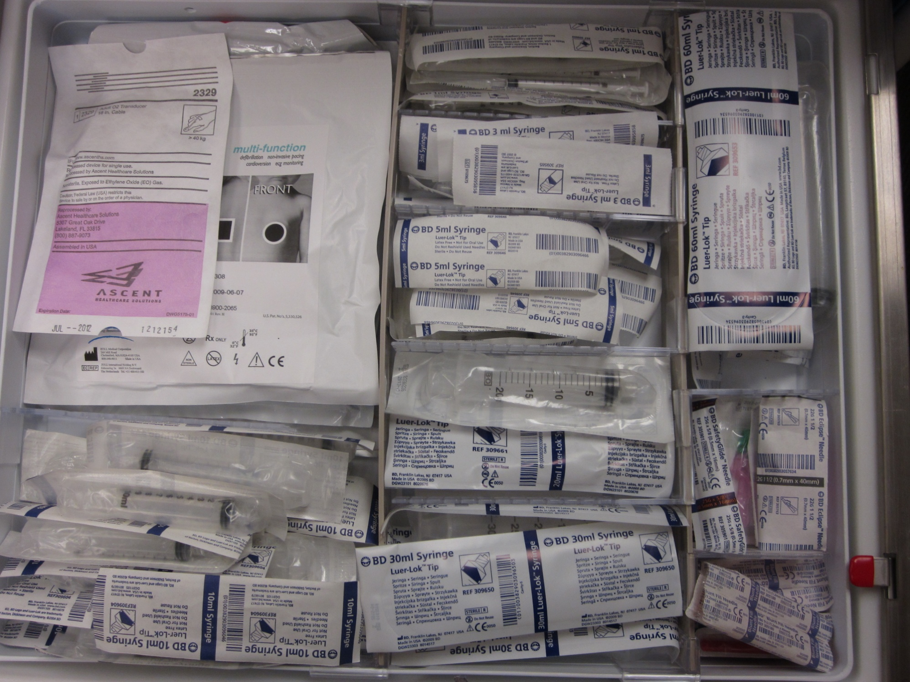
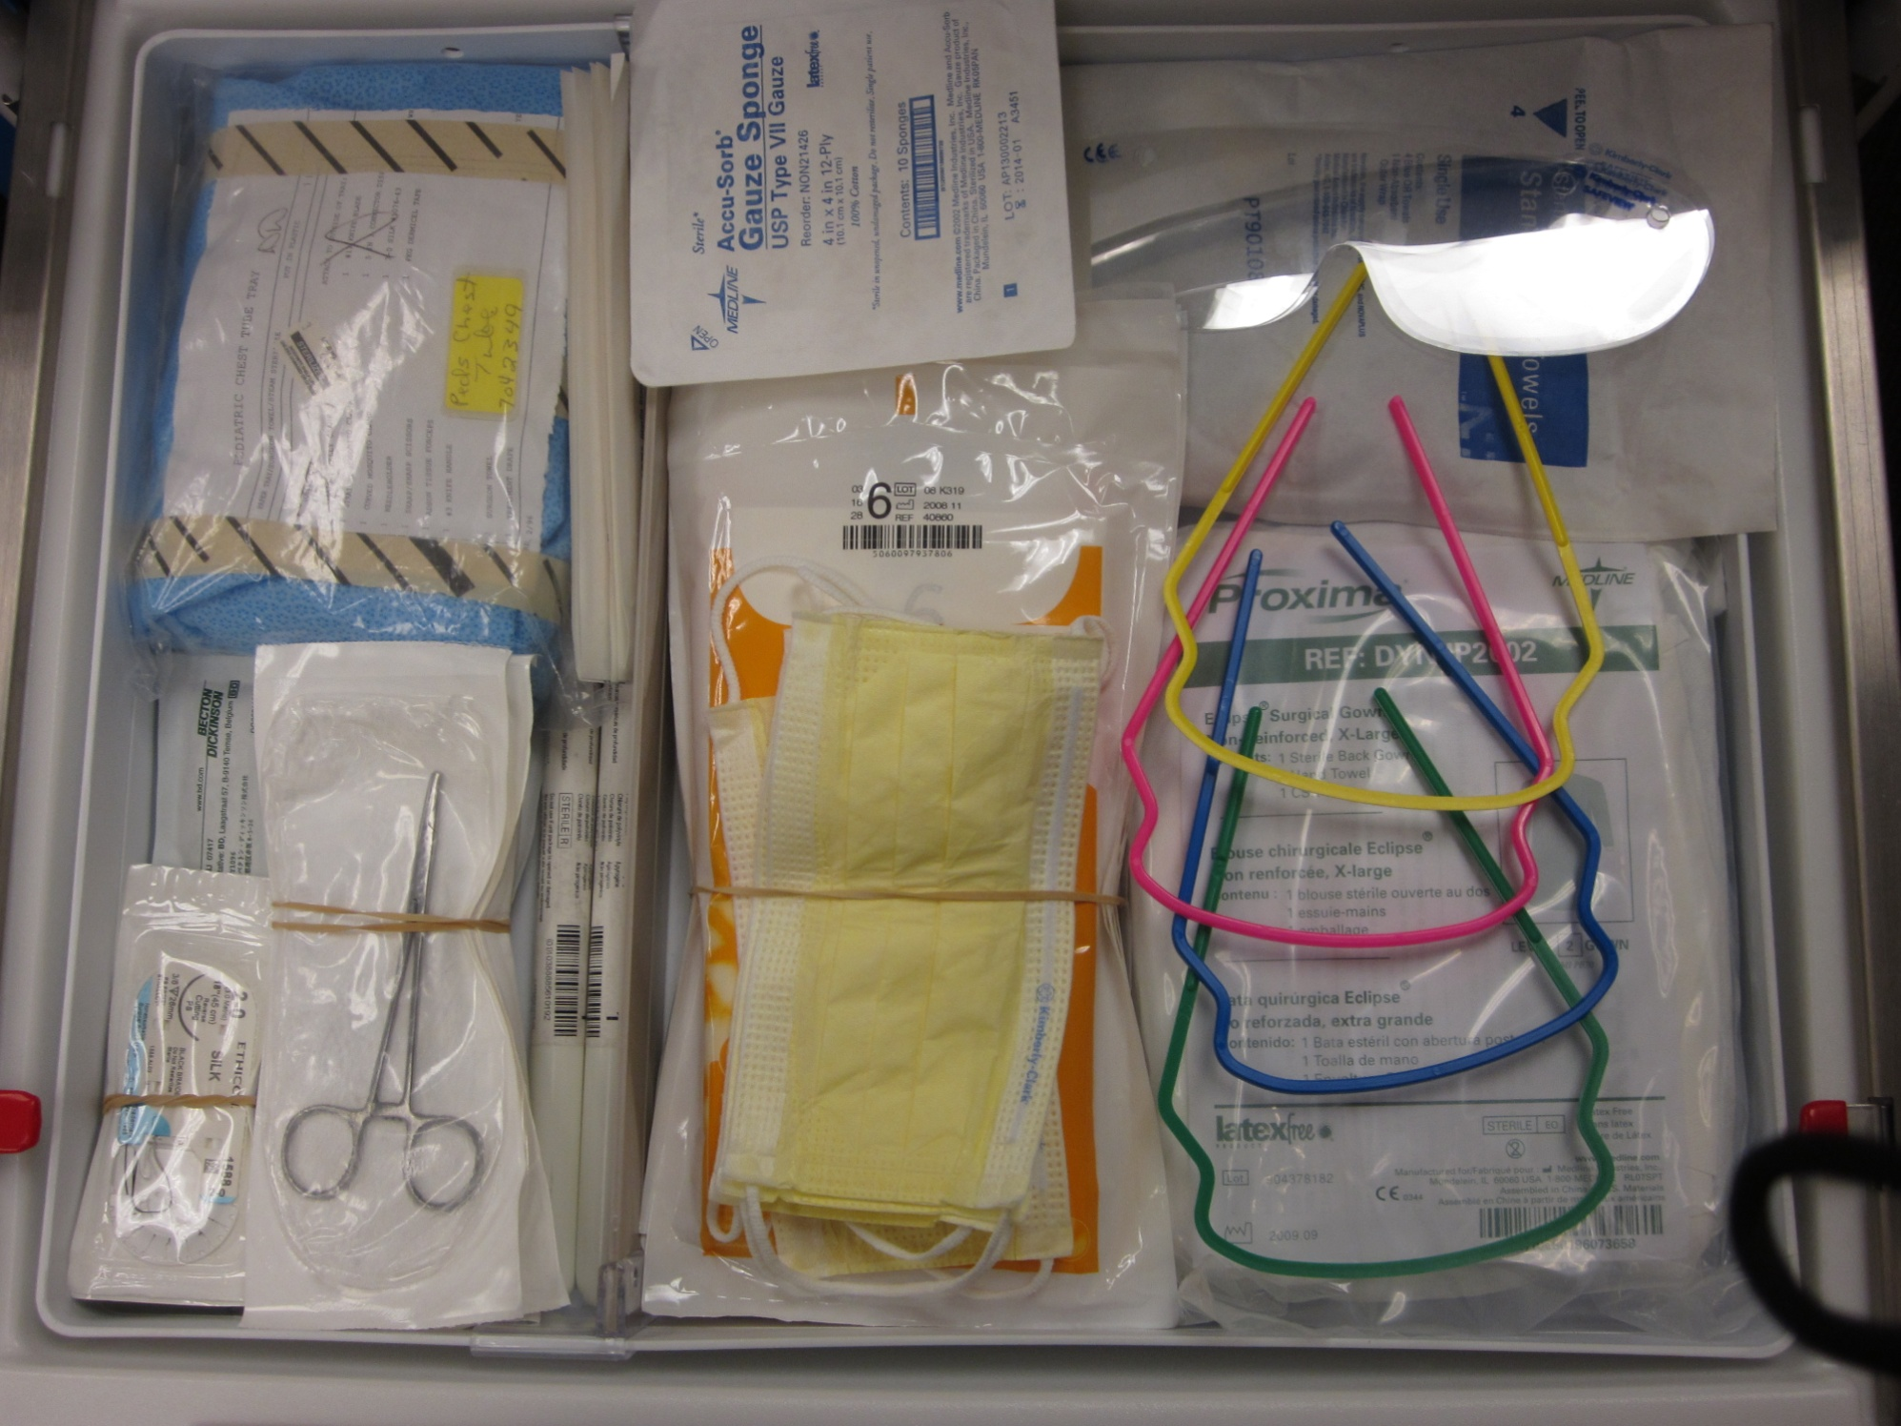
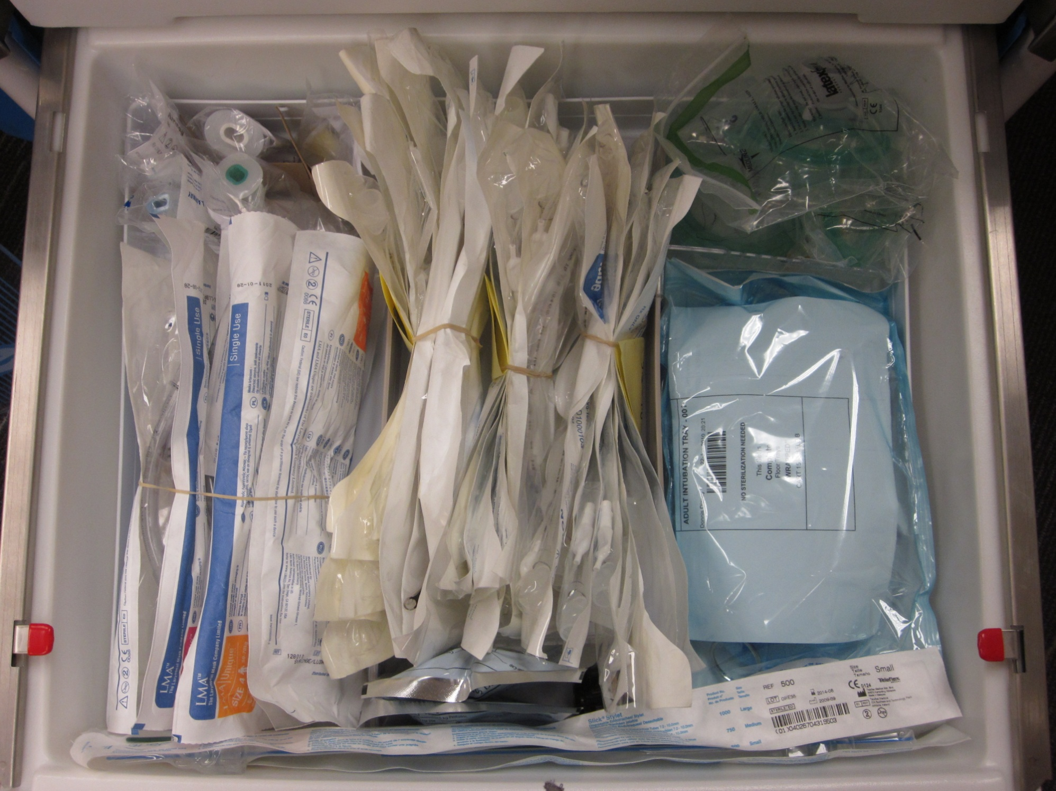
Notes:
Insert front view of cart here and some drawer pictures

Slide 10
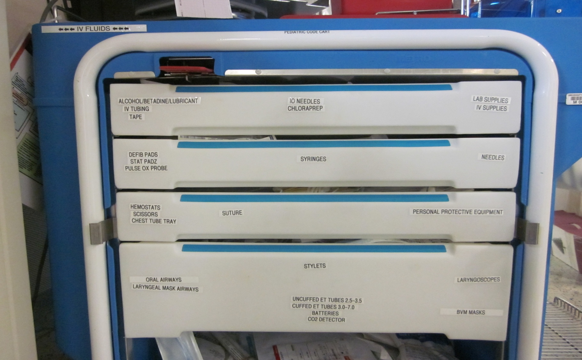
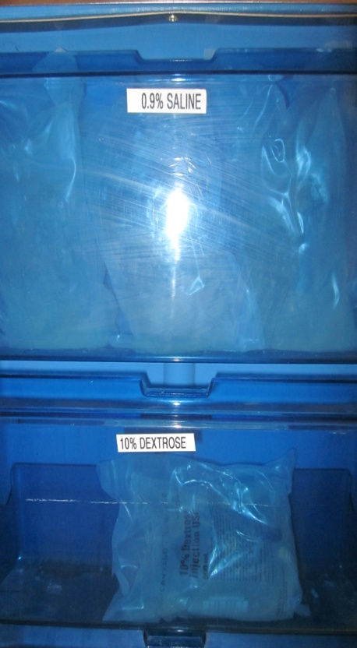
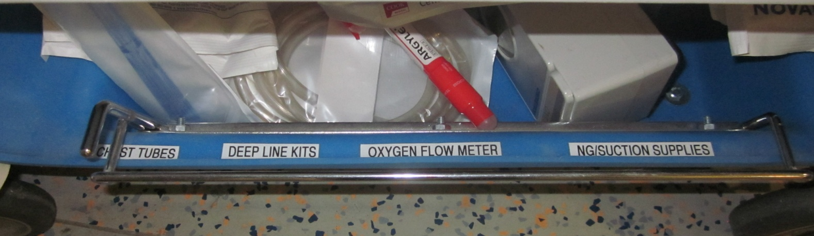
Left side

Slide 11
Methods
System-wide Education
  Live at Staff Meetings, Web-based Training
  Prototype available for staff to explore
  Picture atlas sent to each staff member and Materials
  Informed of time trials and standards
    Find item in less than 15 seconds

Slide 12
Methods
Studied multiple cohorts from Jan 2011-Jan 2012
  IRB approval was obtained
  5 cohorts of 10 Registered Nurses
    First cohort paired
  Each RN asked to find 3 random items selected from a card array
Statistics
  Descriptive stats for each cohort
  Paired t-test for paired cohort; two-sample t-test with Satterthwaite approximations for remaining groups
  Spline model to look for skill degradation
Notes:
Testing done in situ on the KCH wards
-first cohort wound up being paired due to how the RN’s on the floor were scheduled
-randomly selected a card from an array and was timed to find the item
Satterthwaite approximation takes into account the unequal variances across the days
Originally submitted with ANOVA analysis and regression-Dr Westgate applied more appropriate methods; this did nothing to change the clinical or statistical significance of the results

Slide 13
Results
Days from Launch of New Code Cart
 | -1 | 1 | 12 | 49 | 152 | 351 | 351*
Mean (sec) | 30.34 | 16.41 | 13.40 | 9.92 | 12.13 | 19.78 | 16.32
Median (sec) | 27.37 | 15.98 | 11.28 | 9.35 | 13.93 | 13.85 | 12.90
SD (sec) | 17.26 | 10.37 | 9.34 | 4.98 | 5.03 | 13.33 | 8.06
95% CI L | 17.99 | 8.98 | 6.71 | 6.36 | 8.53 | 10.25 | 10.12
U | 42.68 | 23.83 | 20.08 | 13.48 | 15.73 | 29.31 | 22.51
p value | ref | 0.028 | 0.016 | 0.005 | 0.009 | 0.14 | 0.038
*outlier removed
Notes:
On D-1, trialed RN’s on old carts to set baseline
D-day=changed out all 17 code carts
On D+1, only 40% stated they had any “training” on new code cart; would have been interesting to track this for the entire duration to find the “tipping point”
D+351 Outlier=140 sec to find item
46% reduction in time from D-1 to D+1
67% reduction by D+49

Slide 14
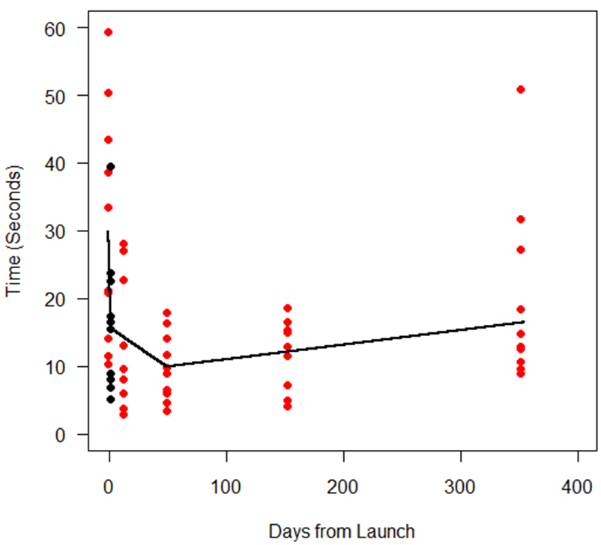
Spline Model
<15 seconds
  ~6 days
>15 seconds
  ~287 days
Notes:
Created a stable platform, but was education intensive

Slide 15
Limitations
Is this really true performance in a resuscitation situation?
Did not track proportion of staff who admitted to receiving “training”
Did not test clinical areas with carts outside of the Children’s Hospital
Notes:
Impact of PRRT: at KCH, the incidence of a Code Blue OUTSIDE the PICU or ED is 3/100,000 bed-days. How this cart performs in a real situation is rare-PICU would be ideal place to trial this since they use the carts much more frequently than anyone else.
Tipping point: would have been interesting to have tracked this

Slide 16
Conclusions
Standardization will reduce time to find items
Can be effective and, at the same time, save costs
Created a stable platform, but requires maintenance
  Skill degrades over time, before annual refresher training cycles
  Refresher training every 6 months
Notes:
Doubtful this is superior to length-based color coded systems

