Slide 1
Tales from the Blips
Telemetry and Arrhythmias for Hospitalists
Erich Maul, DO
Anna Kamp, MD, MPH

Slide 2
Disclosures
Dr. Maul
Dr. Kamp
I have no relevant financial relationships with the manufacturer(s) of any commercial product(s) and/or provider(s) of commercial services discussed in this CME activity
I do not intend to discuss an unapproved/investigative use of a commercial product/device in my presentations
I have no relevant financial relationships with the manufacturer(s) of any commercial product(s) and/or provider(s) of commercial services discussed in this CME activity
I do not intend to discuss an unapproved/investigative use of a commercial product/device in my presentations

Slide 3
Objectives
Review guideline to rhythm interpretation.
Review common arrhythmias and possible treatments
Describe monitor tracings that may suggest a more sinister underlying condition
Compose a "price of admission" for cardiology consultation
Notes:
**I CHANGED OBJECTIVE #1. AND #2.

Slide 4
PHM Competencies
Stucky ER, Maniscalco J, Ottolini MC, et al. The Pediatric Hospital Medicine Core Competencies Supplement: a Framework for Curriculum Development by the Society of Hospital Medicine with acknowledgement to pediatric hospitalists from the American Academy of Pediatrics and the Academic Pediatric Association. J Hosp Med 2010;5 Suppl 2:i-xv, 1-114.
ECG Interpretation
Non-invasive Monitoring
Identify arrhythmias
Treatment of arrhythmias
List ECG findings that prompt consultation with a cardiologist
List types of monitoring devices
Describe proper procedures for cardiopulmonary monitoring (telemetry)
Correctly interpret monitor data and respond appropriately

Slide 5
Roadmap
Introductions and Housekeeping
Know your System
How to interpret ECG tracings at the bedside
Clinical Cases
Data for Cardiology Consultation

Slide 6
This is an
Interactive Session
Will use TurningPoint ARS® to collect answers to various questions and demographic information
Responses are 100% de-identified, so please answer honestly

Slide 7
Grab a clicker…
Segue…

Slide 8
What best describes your practice setting?
A Community Hospital
Children’s Hospital within a hospital
Stand alone Children’s Hospital

Slide 9
How many years has it been since you graduated medical school?
<3
3-5
6-8
9-11
12 or more

Slide 10
Do you have 24/7 access to a pediatric cardiologist?
Yes
No

Slide 11
Do you know what kind of telemetry system you have?
Yes
No

Slide 12
Do you have in-house, centrally monitored telemetry?
Yes, via a central monitoring station for the whole hospital
Yes, at the nursing station for the unit
Yes, but not all units monitored centrally
No
Notes:
I changed the wording slightly

Slide 13
What area of the country are you from?
Northeast: CT, MA, ME, NH, NJ, NY, PA, RI, VT
Midwest: IA, IL, IN, KS, MN, MO, NE, ND, OH, MI, SD, WI
South: AL, AR, DC, DE, FL, GA, KY, LA, MD, MS, NC, OK, SC, TN, TX, VA, WV
West: AK, AZ, CA, CO, HI, ID, MT, NM, NV, OR, UT, WA, WY
Other

Slide 14
I feel confident in my ability to diagnose arrhythmias
Strongly agree
Agree
Neutral
Disagree
Strongly disagree

Slide 15
I feel confident in my ability to treat arrhythmias
Strongly agree
Agree
Neutral
Disagree
Strongly disagree

Slide 16
Physician… know thy Equipment

Slide 17
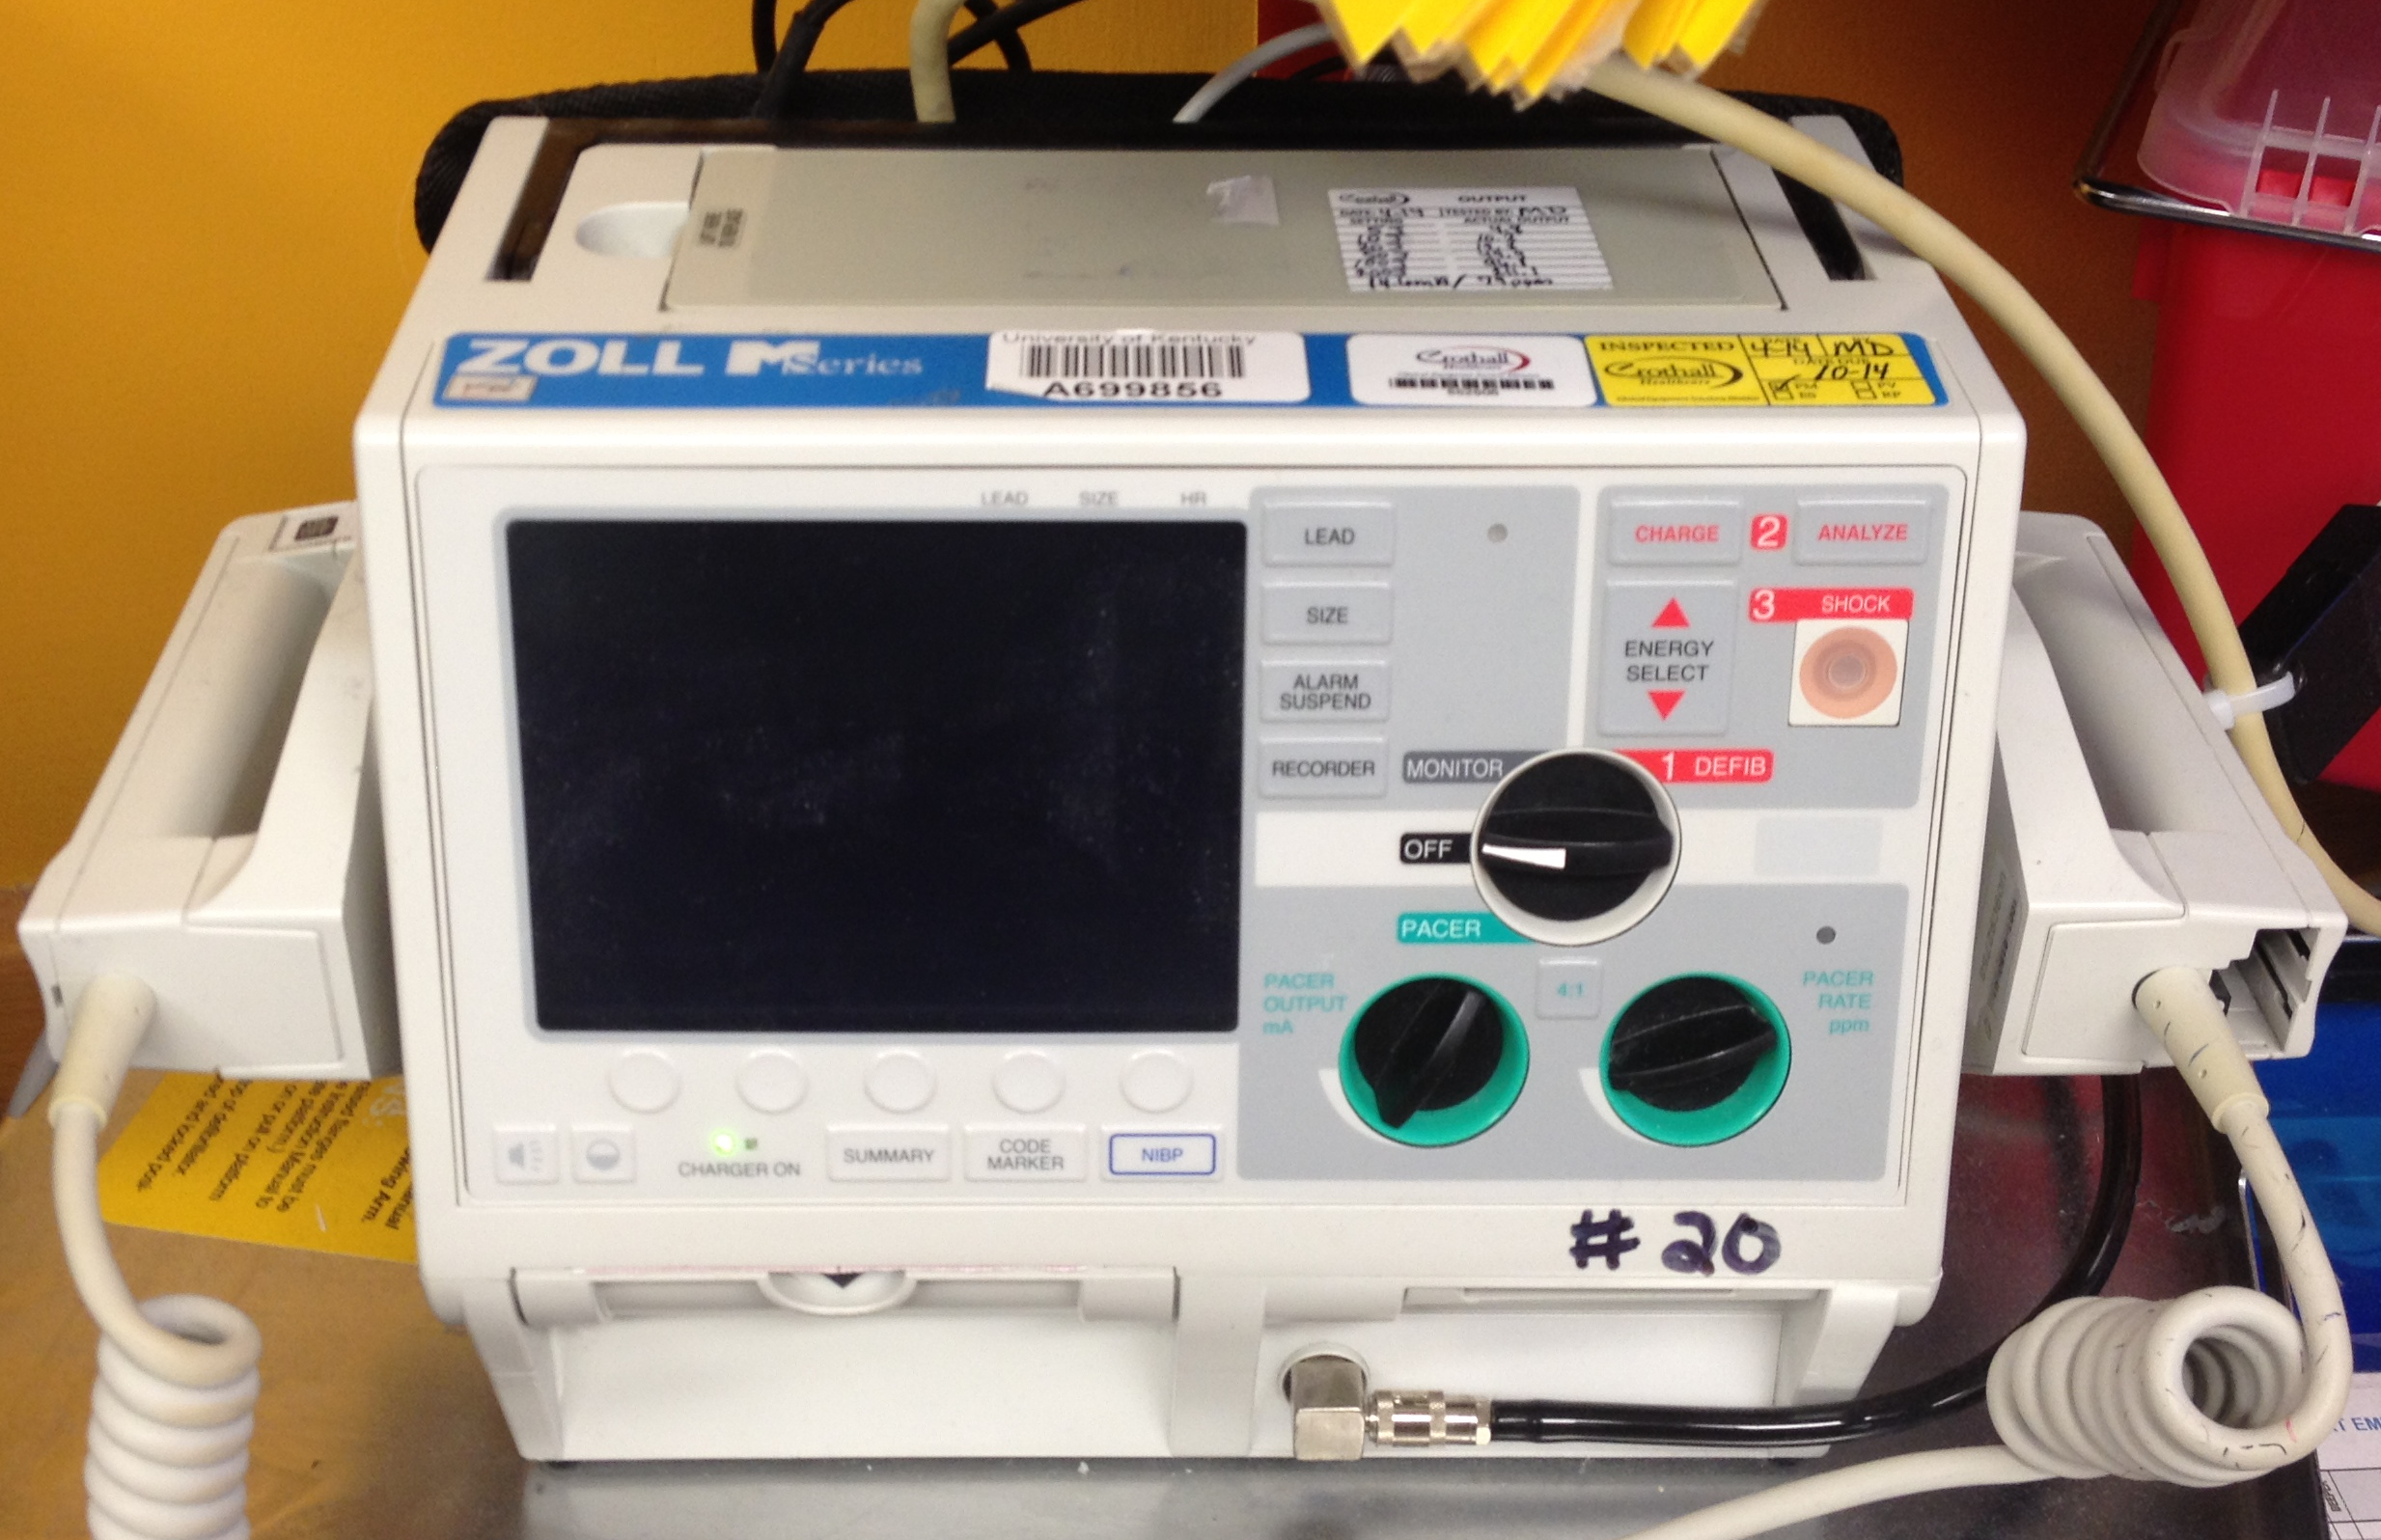
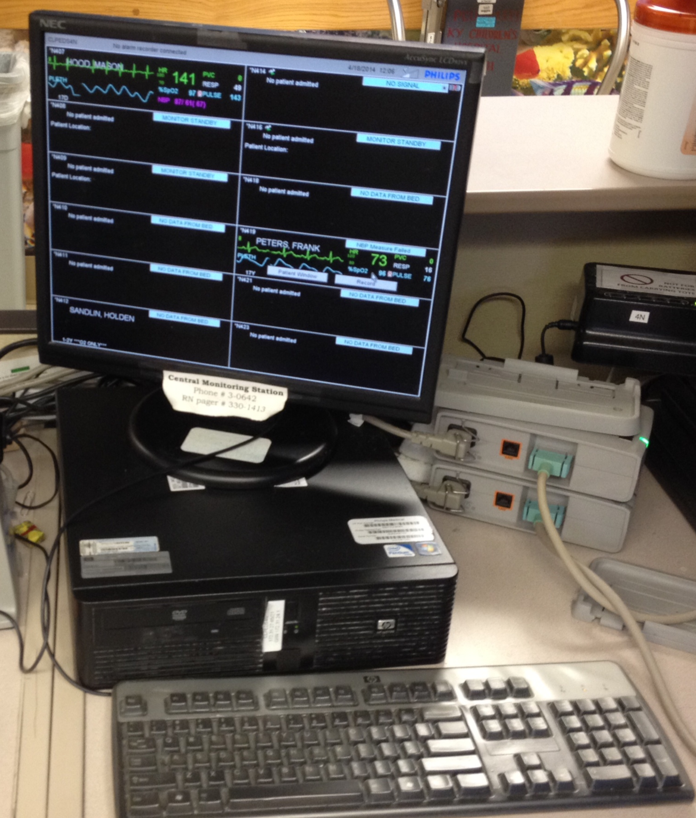
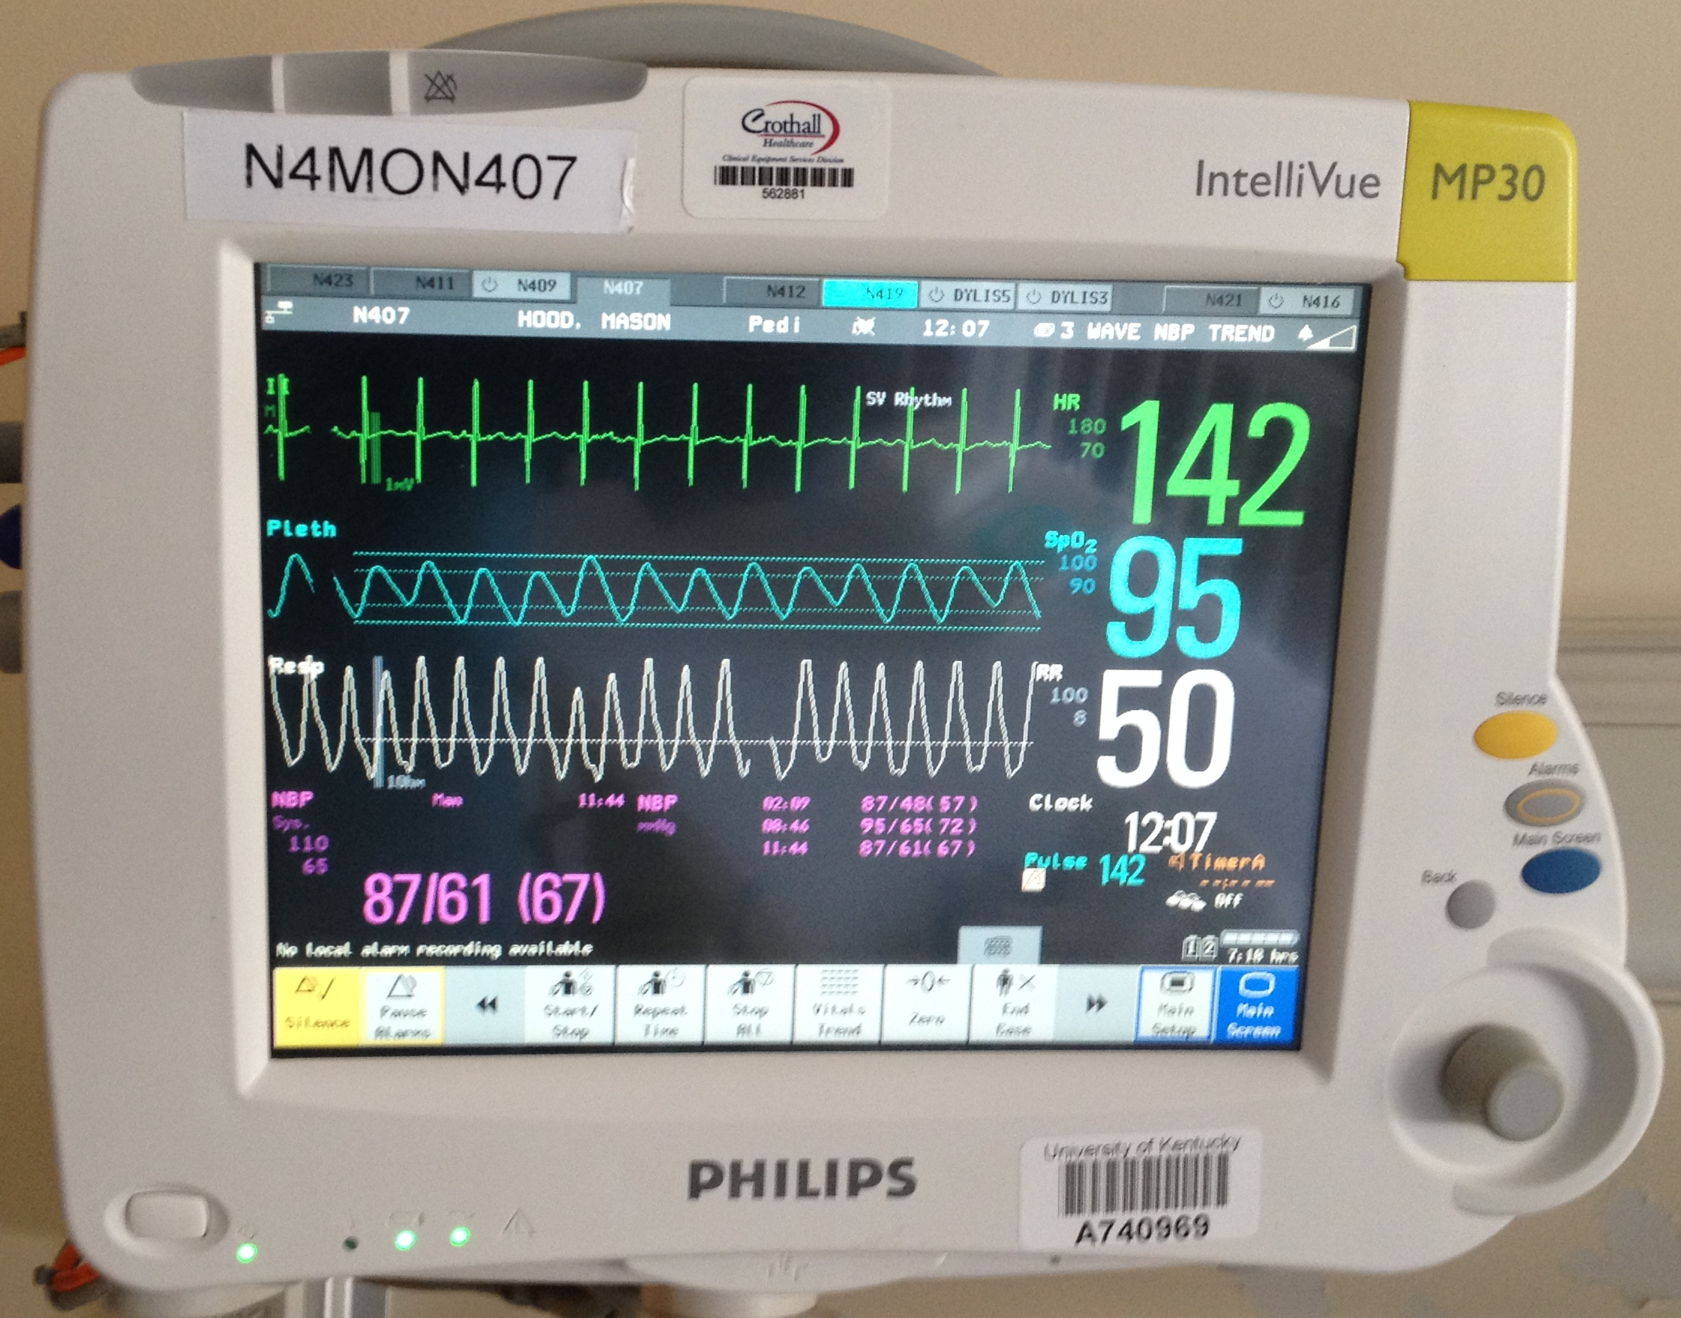
The Hardware
Notes:
Yes, you need to know how to operate it
Need to know how to set alarms and check alarms…and you need to LOOK at the alarms

Slide 18
The Software
How to print strips
How to archive strips
How to use the software tools
How to set alarms and how to assure no one turns off what you set

Slide 19
A system of interpretation

Slide 20
Basic Approach to Dysrhythmias
Is your patient unstable? → PALS
  Hypotension, AMS, shock
  VF, pulseless VT, asystole
Is the rate fast or slow for age
Is the QRS wide or narrow?
  QRS > 0.09 sec
Is the rhythm regular or irregular?
Document your arrhythmia for your consultant
Don’t forget your system to interpret 12 lead ECG’s as well

Slide 21
On-call freak-out
Case 1
Notes:
Artifact case
Back-pat VT

Slide 22
Case 1
You are quietly charting near RN station. RN grabs you to assess telemetry alarm for a child…

Slide 23
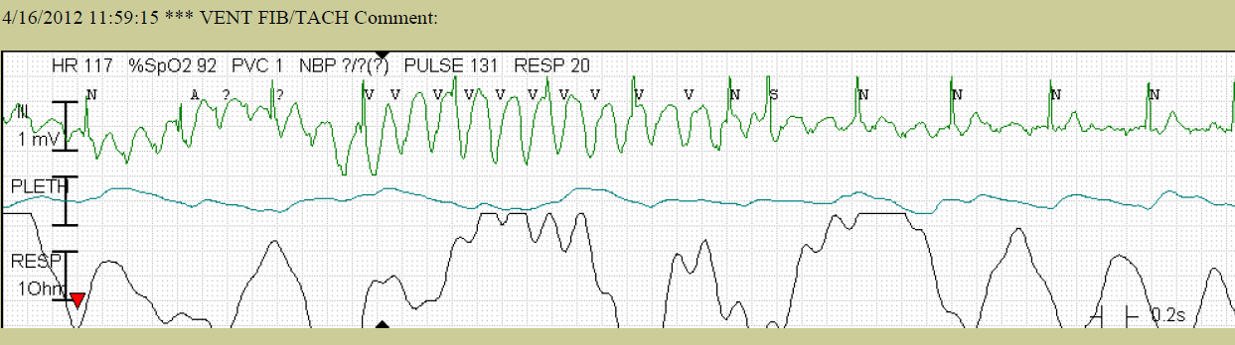
Notes:
Hamblin VT artifact

Slide 24
What do you do?
Keep drinking your coffee
Get more history from the RN
Drop what you are doing and check the kid
Transfer to PICU for further monitoring
Order amiodarone
I don’t know

Slide 25
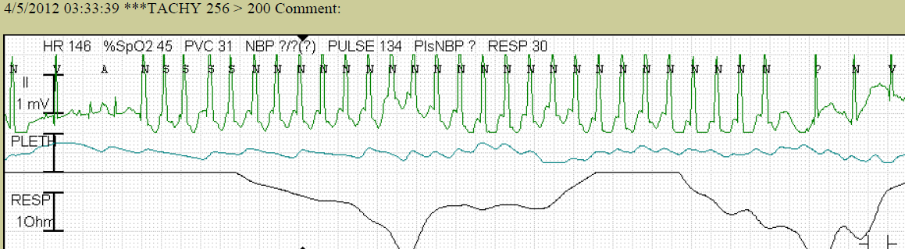
Notes:
Hamblin WCT

Slide 26
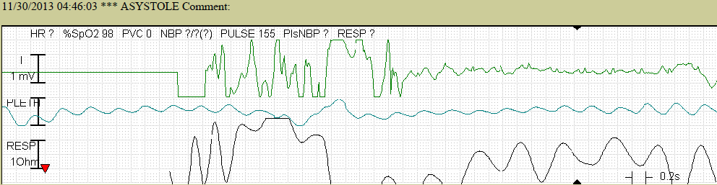
Asystole poor telemetry

Slide 27
Take home point…
Treat the patient not the monitor

Slide 28
Can we please turn off the @#$%^&* monitor!?!
Case 2
Notes:
Ectopy
PAC’s, PVC’s

Slide 29
Case 2
Called by Step-down Unit RN to come check a kid who central telemetry monitoring keeps alarming for bradycardia
The RN asks: “Please take this kid off the @#$%in’ monitor, it’s killing me!”

Slide 30
Case 2
When you arrive on the unit, you stop to see the patient.
16 year old girl, admitted by one of your partners for “near-syncope.”
Patient is sleeping comfortably.
HR 45, RR 12, BP 110/70

Slide 31
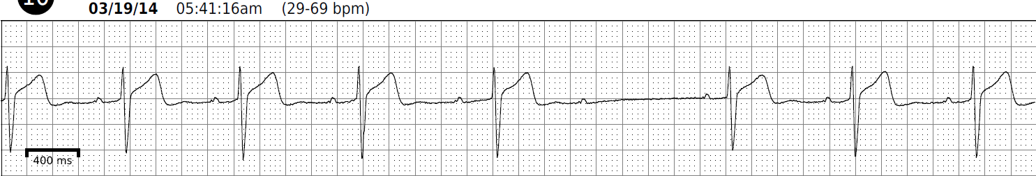
Case 2

Slide 32
What is wrong with the ECG?
1st degree AV block
2nd degree type I AV block
2nd degree type II AV block
3rd degree AV block
I don’t know

Slide 33
2nd degree AV block at a glance
2nd degree type I = Wenckebach, normal characteristic of the AV node.
2nd degree type II is NOT normal
How do you know if it’s 2nd degree I vs II?
  Variable PR interval is the key.
2:1 AV block is 2nd degree AVB
  Can be type I or type II

Slide 34
Case #3
16 year old athlete evaluated by PMD for sports clearance; you get a call for admission for bradycardia
HR 38bpm, BP 110/75mmHg, RR 12bpm, O2 sat 100% on room air.

Slide 35
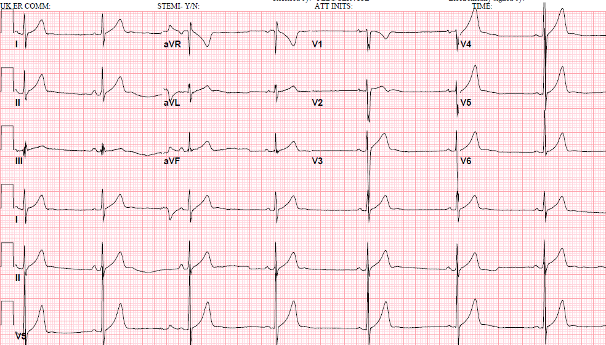
16 year old HR 41bpm

Slide 36
After reviewing the ECG, what do you do?
Call the on call cardiologist
Contact the PMD for more information
Admit to telemetry
Reassure the patient and send them home
I don’t know

Slide 37
16 year old HR 41bpm

Slide 38
After reviewing the ECG, what do you do?
Call the on call cardiologist
Contact the PMD for more information
Admit to telemetry
Reassure the patient and send them home
I don’t know

Slide 39
16 year old HR 41bpm

Slide 40
Case 4
3 year old girl
3 year old girl seen by PMD for well child visit, asymptomatic
HR 60bpm, BP 95/65mmHg, RR 20, O2 sat 100% on RA
Active and playing with siblings. Parents with no complaint
PMD sends to ED for evaluation
ED calls peds hospitalist to admit patient.

Slide 41
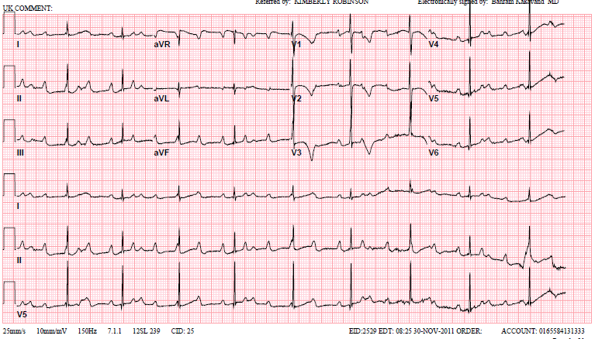
3 year old girl asymptomatic bradycadia

Slide 42
What is this rhythm?
Sinus Bradycardia
2:1 AV Block
3º AV Block
Long QT
Atrial flutter
I don’t know

Slide 43
3 year old girl asymptomatic bradycadia

Slide 44
What is this rhythm?
Sinus Bradycardia
2:1 AV Block
3º AV Block
Long QT
Atrial flutter
I don’t know

Slide 45
3 year old girl

Slide 46
Complete heart block
Evaluation by Pediatric Cardiology, including Holter and echocardiogram.
Consideration of pacemaker
  Structurally normal heart
    Neonate heart rate <55bpm
    Hydrops in fetal life
    Ventricular dysfunction
    Symptomatic/poor growth
    Age >15years
  Associated structural heart disease
    Neonate heart rate <70bpm
    Surgical heart block

Slide 47
Case 5
Called by ED physician for 16 year old with frequent ectopy
  Told to go to ED after seen by PMD for sports screening exam demonstrated irregular rhythm.
  HR 70, BP 110/70, RR 12, O2 sat 100% on RA
Notes:
Asymptomatic PVCs

Slide 48
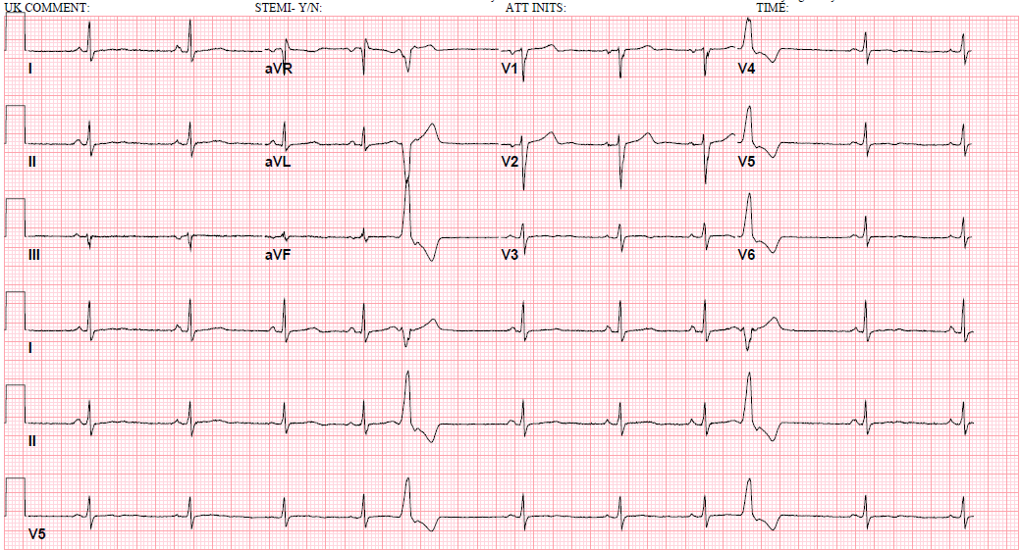
Case 5

Slide 49
What does this ECGs show?
Movement artifact
Myocarditis
PACs
PVCs
I don’t know

Slide 50
Case 5

Slide 51
What does this ECGs show?
Movement artifact
Myocarditis
PACs
PVCs
I don’t know

Slide 52
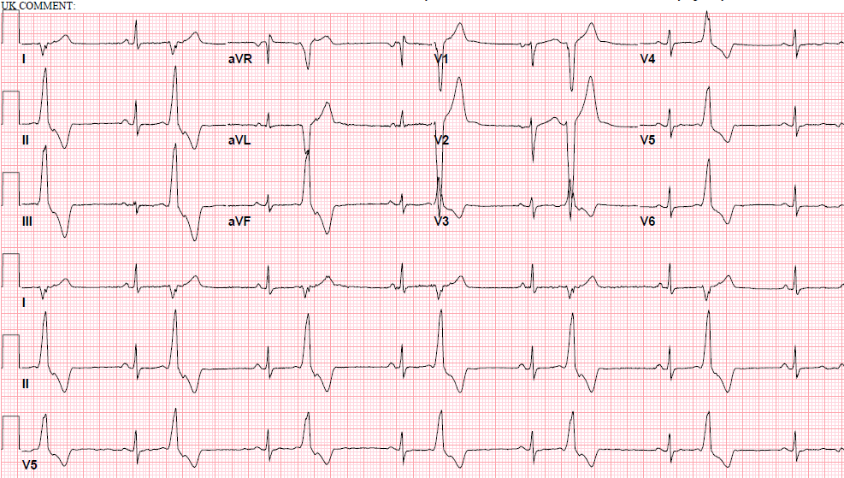
Case 5 – Same paitent…it’s worse…or is it?

Slide 53
Evaluation of PVCs
Referral to Pediatric Cardiology
History and Physical
Echo
24-48hr Holter to assess burden and morphology of PVCs
Consider exercise test

Slide 54
Evaluation of PVCs
Benign
Malignant
Monomorphic
Low burden
Structurally normal heart
Suppress with exertion
Multiple morphologies
Structural heart disease
Syncope
Increase with exercise

Slide 55
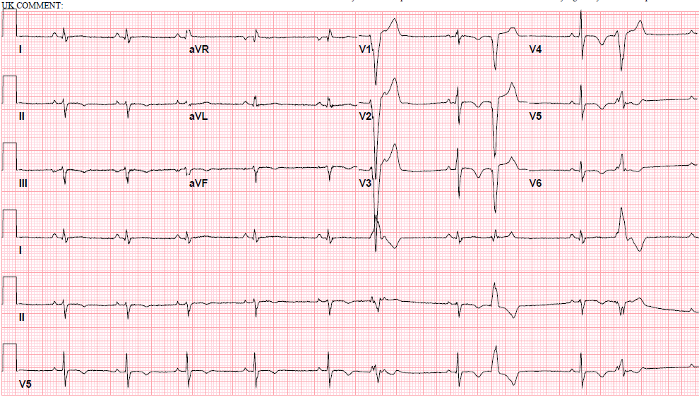
Asymptomatic Ectopy
PVCs – for comparison

Slide 56
Case 6
8 mos old boy
Called by ED physician for 8 mos old boy with frequent ectopy.
Sent to ED by PMD for evaluation after ectopy heard on well child visit
HR 120, BP 90/60, RR 24, O2 sat 100% on RA. Playful and interactive.

Slide 57
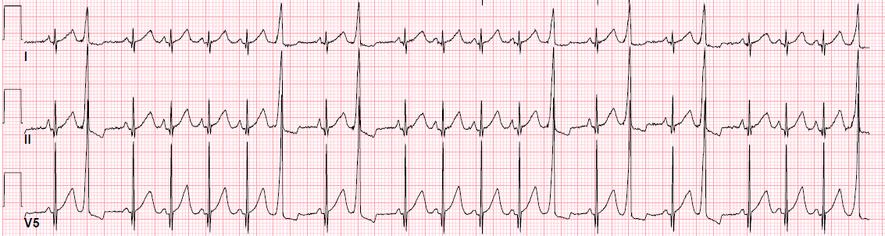
8 mo old boy
Rhythm strip from ECG
You decide to admit to telemetry

Slide 58
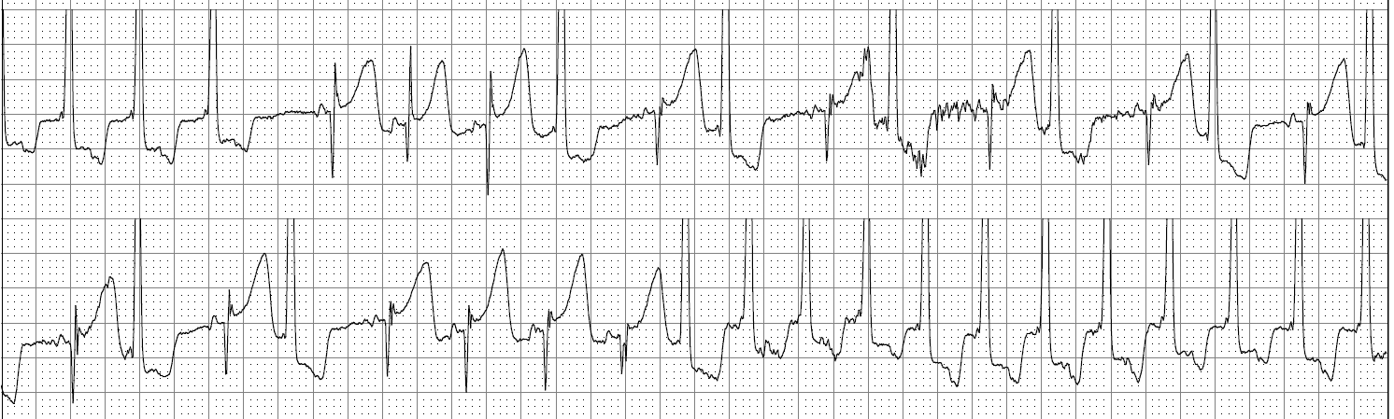
8 mo old boy
Admit to Telemetry Unit and get a call by central station 2 hours after admission

Slide 59
What is the diagnosis?
SVT
VT
Junctional tach
Artifact
I don’t know

Slide 60
8 mo old boy
Admit to Telemetry Unit and get a call by central station 2 hours after admission

Slide 61
What is the diagnosis?
SVT
VT
Junctional tach
Artifact
I don’t know

Slide 62
Infantile Idiopathic
Ventricular Tachycardia
Idiopathic VT with structurally normal heart is rare.
Always evaluated and followed by pediatric cardiology
If no other electrical cause, it is usually benign
Anti-arrhythmic therapy: propranolol, procainamide, amiodarone, none
Resolves with time
**Different considerations if associated with myocarditis

Slide 63
Asymptomatic Ectopy Case 7
14 year old girl
Well child visit at PMD after immigrating from Russia.
History significant for rare episodes of syncope
  Age 3 while playing in yard with friend
  Age 7 while swimming with grandfather
  Age 11 after frightened with surprise
HR 70bpm, BP 110/70, RR 14, O₂ sats 100% on room air

Slide 64
Asymptomatic Ectopy Case 7
14 year old girl
PMD refers to Pediatric Cardiology for non-urgent evaluation of syncope.
PMD initiates evaluation:
  12 lead ECG is normal
  Echocardiogram is normal
  PMD orders Holter monitor

Slide 65
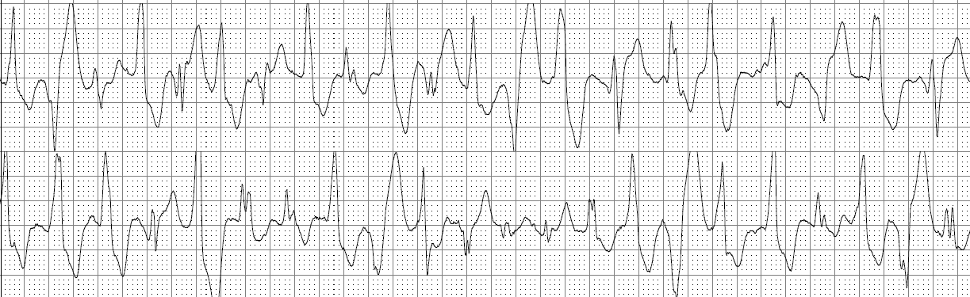
Asymptomatic Ectopy Case 7
14 year old girl

Slide 66
Catecholaminergic Polymorphic Ventricular Tachycardia
RyR2 – cardiac ryanodine receptor gene
  Autosomal dominant
Exercise induced syncope, seizures, and SCD
Normal resting 12 lead ECG
  Dx made based on suspicion of symptoms
Bidirectional ventricular tachycardia
Treatment
  Beta-blocker
  Flecainide
  ICD

Slide 67
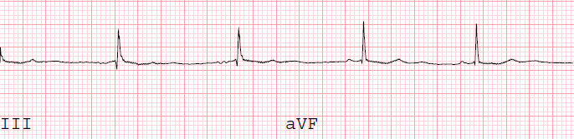
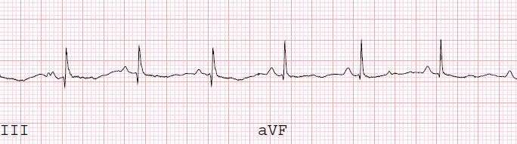
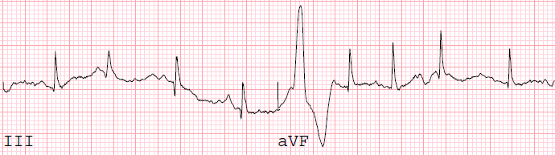
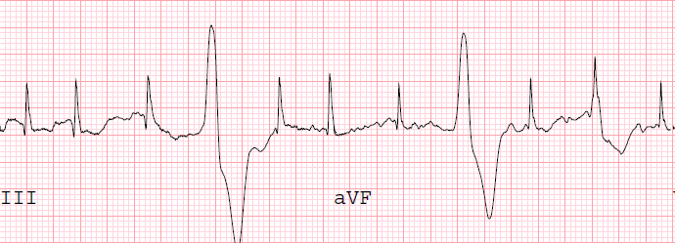
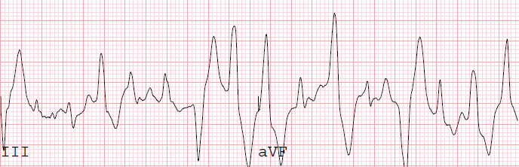
CPVT
Exercise test

Slide 68
Can we shock him, can we shock him, can we shock him?

Slide 69
Case 8
5 year old boy
Called to ED to see 5 year old boy
Asymptomatic, to ED because PMD noted fast heart rate on well child exam.
HR 150bpm, BP 95/65mmHg, RR 18bpm, 100% on room air
Afebrile. Normal BMP, CBC, TSH.

Slide 70
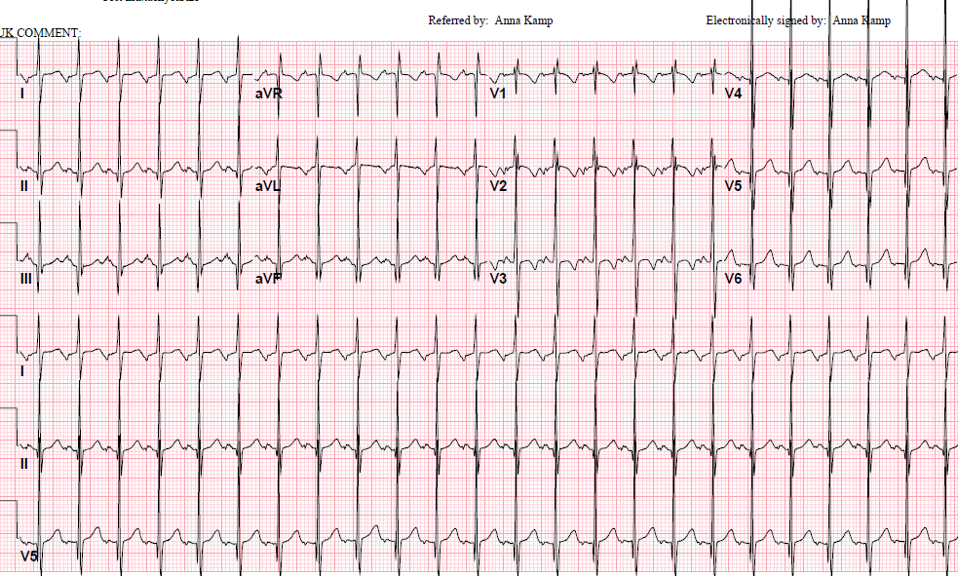
5 year old boy 150bpm

Slide 71
What’s the rhythm?
Focal atrial tachycardia
Junctional tachycardia
Reentrant SVT
Sinus tachycardia
I don’t know

Slide 72
5 year old boy 150bpm

Slide 73
What’s the rhythm?
Focal atrial tachycardia
Junctional tachycardia
Reentrant SVT
Sinus tachycardia
I don’t know

Slide 74
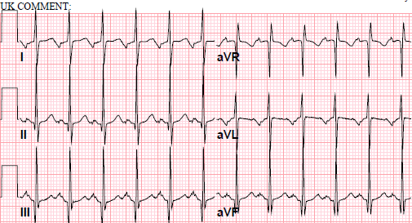
Asymptomatic tachycardia
5 year old boy 150bpm

Slide 75
Case 9
On call at a community hospital and called to the ED for a consult
The case is a 3 y/o boy who has been fussy all day the ED can’t figure out what to do
The only thing the history reveals is that for the past 6 hours, he has been crying “non-stop” and he has been slightly tachypneic and sweaty

Slide 76
Case 9
PE reveals a heart rate of about 200
BP = 88/43, RR = 38, Sat = 95% RA
CR = 2sec
What next?

Slide 77
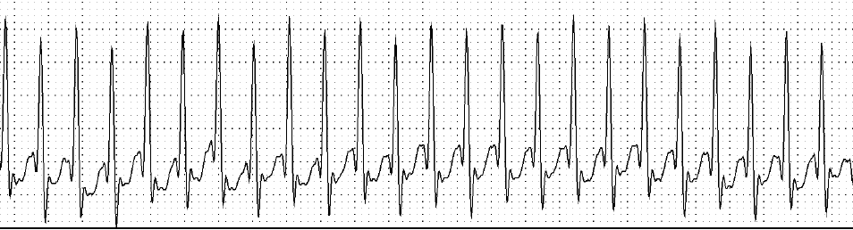
Case 9
Fussy 3 y/o
Bedside monitor 280bpm
Notes:
One lead SVT

Slide 78
What is wrong with him?
Atrial flutter
Junctional tachycardia
SVT
VT
I don’t know

Slide 79
Case 9
Fussy 3 y/o
Bedside monitor 280bpm
Notes:
One lead SVT

Slide 80
What is wrong with him?
Atrial flutter
Junctional tachycardia
SVT
VT
I don’t know

Slide 81
What do you do for treatment?
Defibrillation
Synchronized cardioversion
Vagal maneuvers
Adenosine rapid IV push
I don’t know

Slide 82
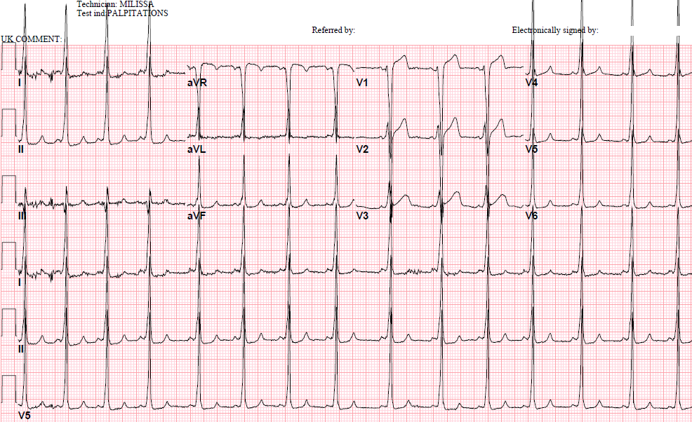
3 y/o ECG after adenosine

Slide 83
What is wrong with the child?
Atrial fibrillation
Ectopic atrial rhythm
Sinus with left bundle branch block
ST-T wave changes concerning for coronary anomaly
WPW
I don’t know

Slide 84
3 y/o ECG after adenosine

Slide 85
What is wrong with the child?
Atrial fibrillation
Ectopic atrial rhythm
Sinus with left bundle branch block
ST-T wave changes concerning for coronary anomaly
WPW
I don’t know

Slide 86
3 y/o ECG after adenosine

Slide 87
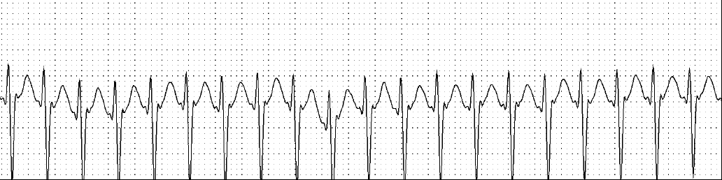
Next bed
15 year old boy with palpitations
Bedside monitor 220bpm
BP 98/42, RR 28, Sats 97%

Slide 88
What do you do for treatment?
Synchronized cardioversion
Defibrillation
Vagal maneuvers
Adenosine rapid IV push
Ice to his face
I don’t know

Slide 89
Next bed
15 year old boy with palpitations
Bedside monitor 220bpm
BP 98/42, RR 28, Sats 97%

Slide 90
What do you do for treatment?
Synchronized cardioversion
Defibrillation
Vagal maneuvers
Adenosine rapid IV push
Ice to his face
I don’t know

Slide 91
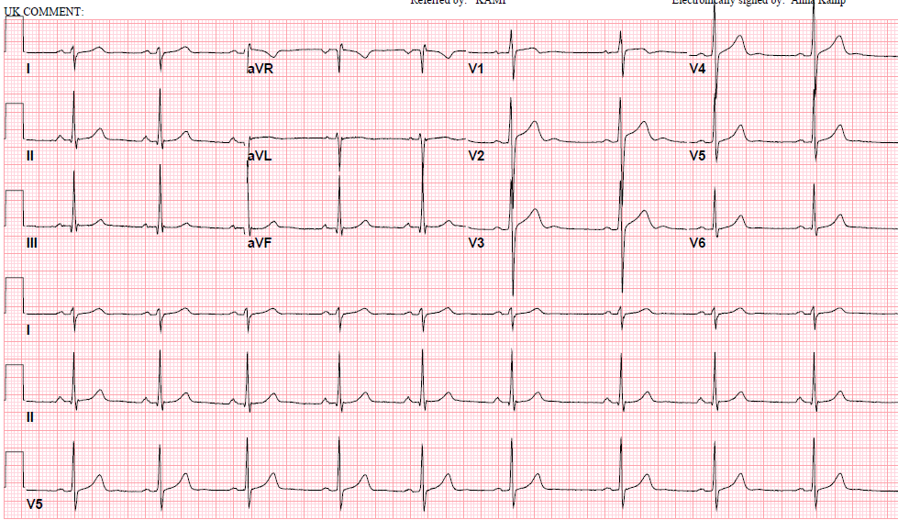
15 year old boy
ECG after adenosine

Slide 92
SVT and WPW are not the same both are accessory pathways
Wolff-Parkinson-White
Accessory pathway evident in sinus rhythm (pathway conducts antegrade from A to V)
Can present with narrow complex tachycardia (SVT – pathway conducts retrograde from V to A)
Can present with wide complex tachycardia (antidromic tachycardia)
Can present in atrial fibrillation
Risk of sudden death
Reentrant SVT – concealed pathway
Normal resting ECG - accessory pathway is “concealed” in sinus rhythm (no antegrade conduction)
Can present with wide complex tachycardia (SVT with bundle branch block)
No risk of sudden death

Slide 93
Tom Dolan, Medical Illustrator, University of Kentucky.

Slide 94
Case 10
16 year old girl
Called to ED for 16 year old with palpitations and dyspnea
Patient reports acute onset of symptoms
HR 170bpm, BP 100/70mmHg, RR 22bpm, O₂sat 98% on room air
No other medical history.

Slide 95
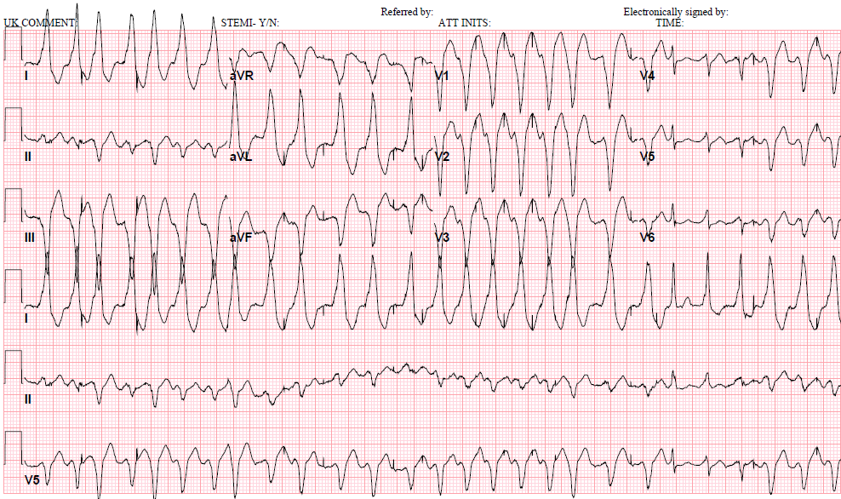
Case 10 16 year old

Slide 96
What is the diagnosis?
Atrial fibrillation
Atrial flutter
Junctional tach
Polymorphic VT
SVT
I don’t know

Slide 97
Case 10 16 year old

Slide 98
What is the diagnosis?
Atrial fibrillation
Atrial flutter
Junctional tach
Polymorphic VT
SVT
I don’t know

Slide 99
Case 10 16 year old

Slide 100
OMG, this kid is having an mi!

Slide 101
Case 11
Called by ED to facilitate transfer of a 17 y/o boy who “had CP for 3 days, a troponin of 8 and a STEMI.”
You think this sounds weird, so you say you’ll be right down.
What are your thoughts on the elevator ride down?

Slide 102
Case 11
A panicked ER doc who hates dealing with kids tells you: “the helo is ready to fly him to where ever you say, just remember, time is muscle!”
You walk in and find the child sitting up in bed, complaining of a headache that started after they made him take some pills under his tongue.

Slide 103
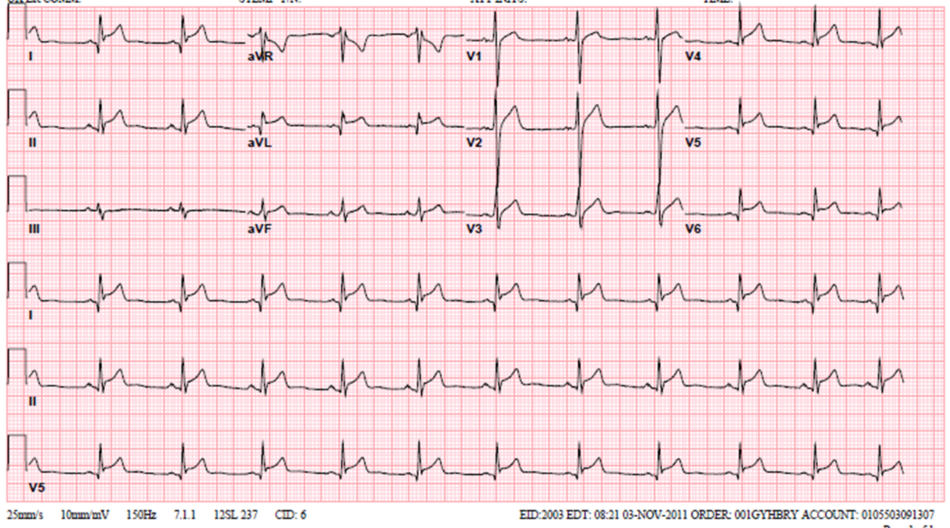
Case 11
T: 37.4, HR: 68, RR: 18, BP: 94/40, S: 99%
Troponin-I is 12
You look at the bedside monitor and see the following

Slide 104
What do you do next?
Expedite the air transfer
Contact local children’s hospital for transfer by ground
Get more history and 12 lead ECG
Activate adult cath lab
I don’t know

Slide 105
Case 11
T: 37.4, HR: 68, RR: 18, BP: 94/40, S: 99%
Troponin-I is 12
You look at the bedside monitor and see the following

Slide 106
What do you do next?
Expedite the air transfer
Contact local children’s hospital for transfer by ground
Get more history and 12 lead ECG
Activate adult cath lab
I don’t know

Slide 107
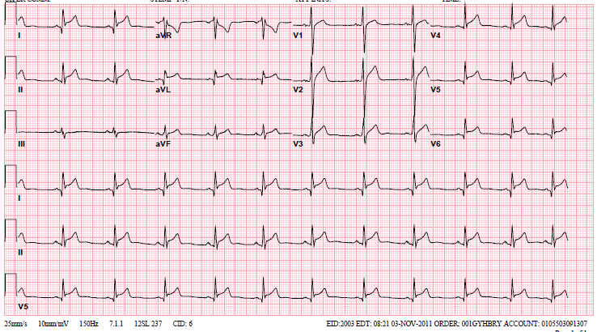
17 yo with resting CP elevated troponin

Slide 108
ST Segments in Kids
True pathology
  Pericarditis
  Rare, coronary anomalies
  Repaired congenital surgery patients should be considered differently
  Compare to prior ECG
J point elevation

Slide 109
Before you say
“it ain’t the heart…”
The Price of Consultation

Slide 110
Before you call…
Have a good H&P
  Especially FHx
Have a good tracing
Have a question you want answered

Slide 111
So what will you change
when you go back
to your hospital?

Slide 112
I feel confident in my ability to diagnose arrhythmias
Strongly agree
Agree
Neutral
Disagree
Strongly disagree

Slide 113
I feel confident in my ability to treat arrhythmias
Strongly agree
Agree
Neutral
Disagree
Strongly disagree

Slide 114
Summary
Know your hardware and software
Know who is looking at the monitors when you are not
Have a system to interpret
Correlate your monitor with your patient’s clinical data

Slide 115
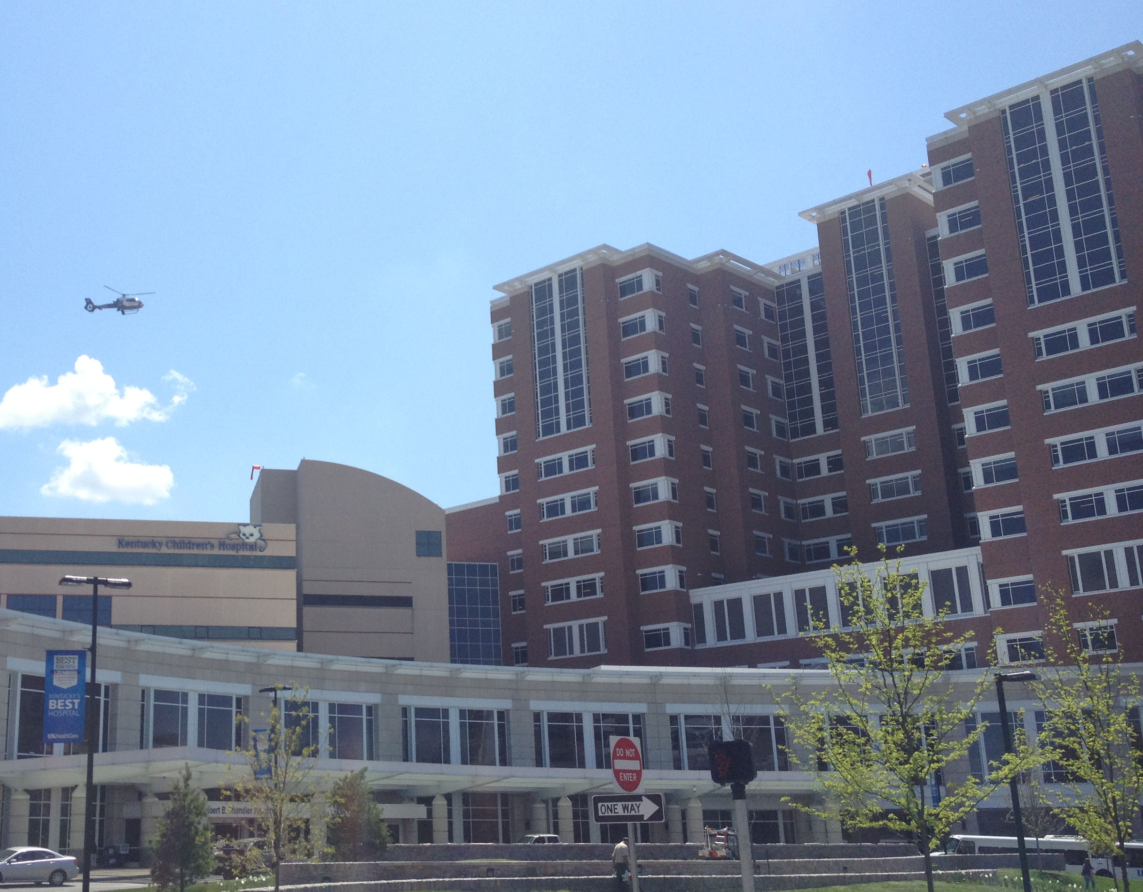
Questions, Comments, Complaints, Dirty Looks?

