Slide 1
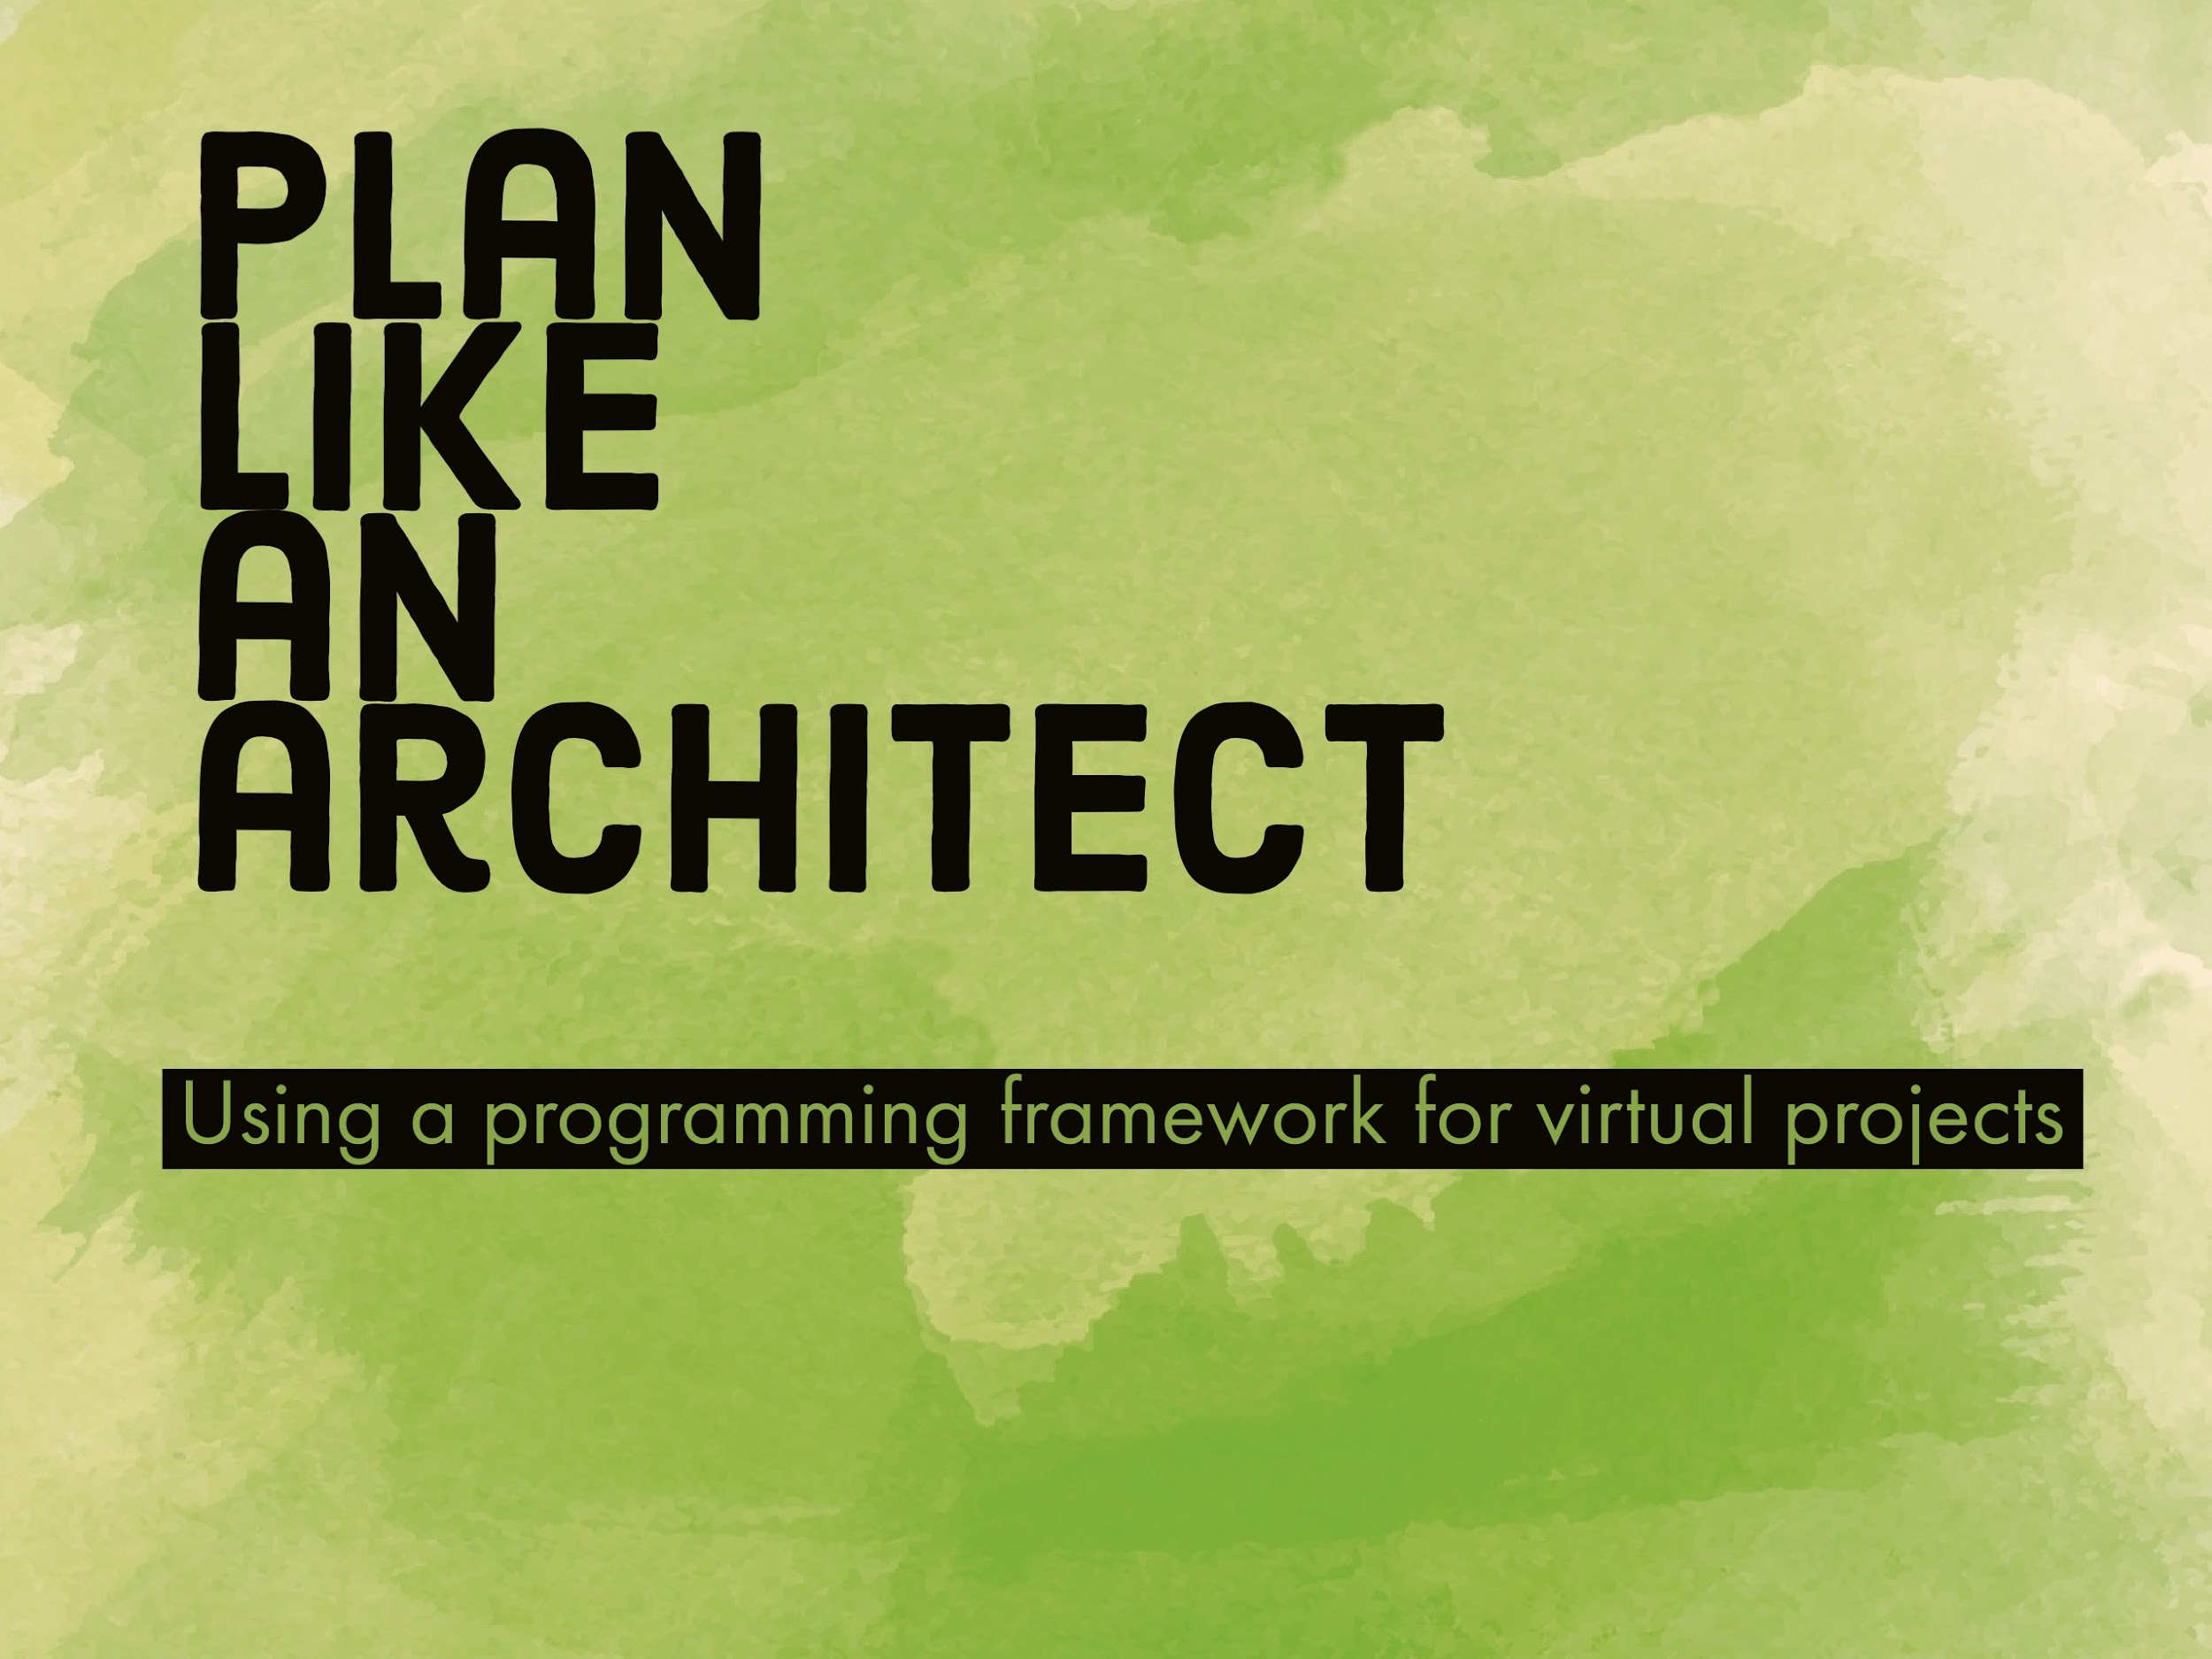
Plan Like An Architect
Notes:
Using a framework for analyzing physical space fordigital projects.
not near the first person to argue the transferability of physical design and managing physical space to that of virtual environments, but I was surprised at just how transferable and accessible these resources were to the work I am doing.
The first book I read on this is called, “Problem Seeking, An architectural programming primer” and much of today’s snapshot is taken from or inspired by that book, but I also found additional resources with the American Institute of Architects and the Whole Building Design Guide, and in Programming for Design by Edith Cherry.

Slide 2

Notes:
Another potential title for this talk could be lifted from an Architectural Record article from 1959: Analysis the Prelude to Good Design.
Architectural programming has its roots in the post-world war 2 era. And, this article was one of the first times architectural programming is introduced as a concept in the field.. Making an argument for establishing design criteria with the client before beginning any design process.

Slide 3
The research and decision-making process that defines a problem to be solved by a design.
Notes:
The most universally used definition seems to be: Architectural Programming is the research and decision-making process that defines the problem to be solved by design.

Slide 4
Establish goals
Collect and analyze facts
Uncover and test concepts
Determine needs
State the problem
Notes:
Slide 4: Procedures
What I say: These 5 (sometimes 6) Procedures are:
Establish Goals
Collect and Analyze Facts
Uncover and test Concepts
Determine Needs
State the Problem.
https://www.wbdg.org/design-disciplines/architectural-programming

Slide 5
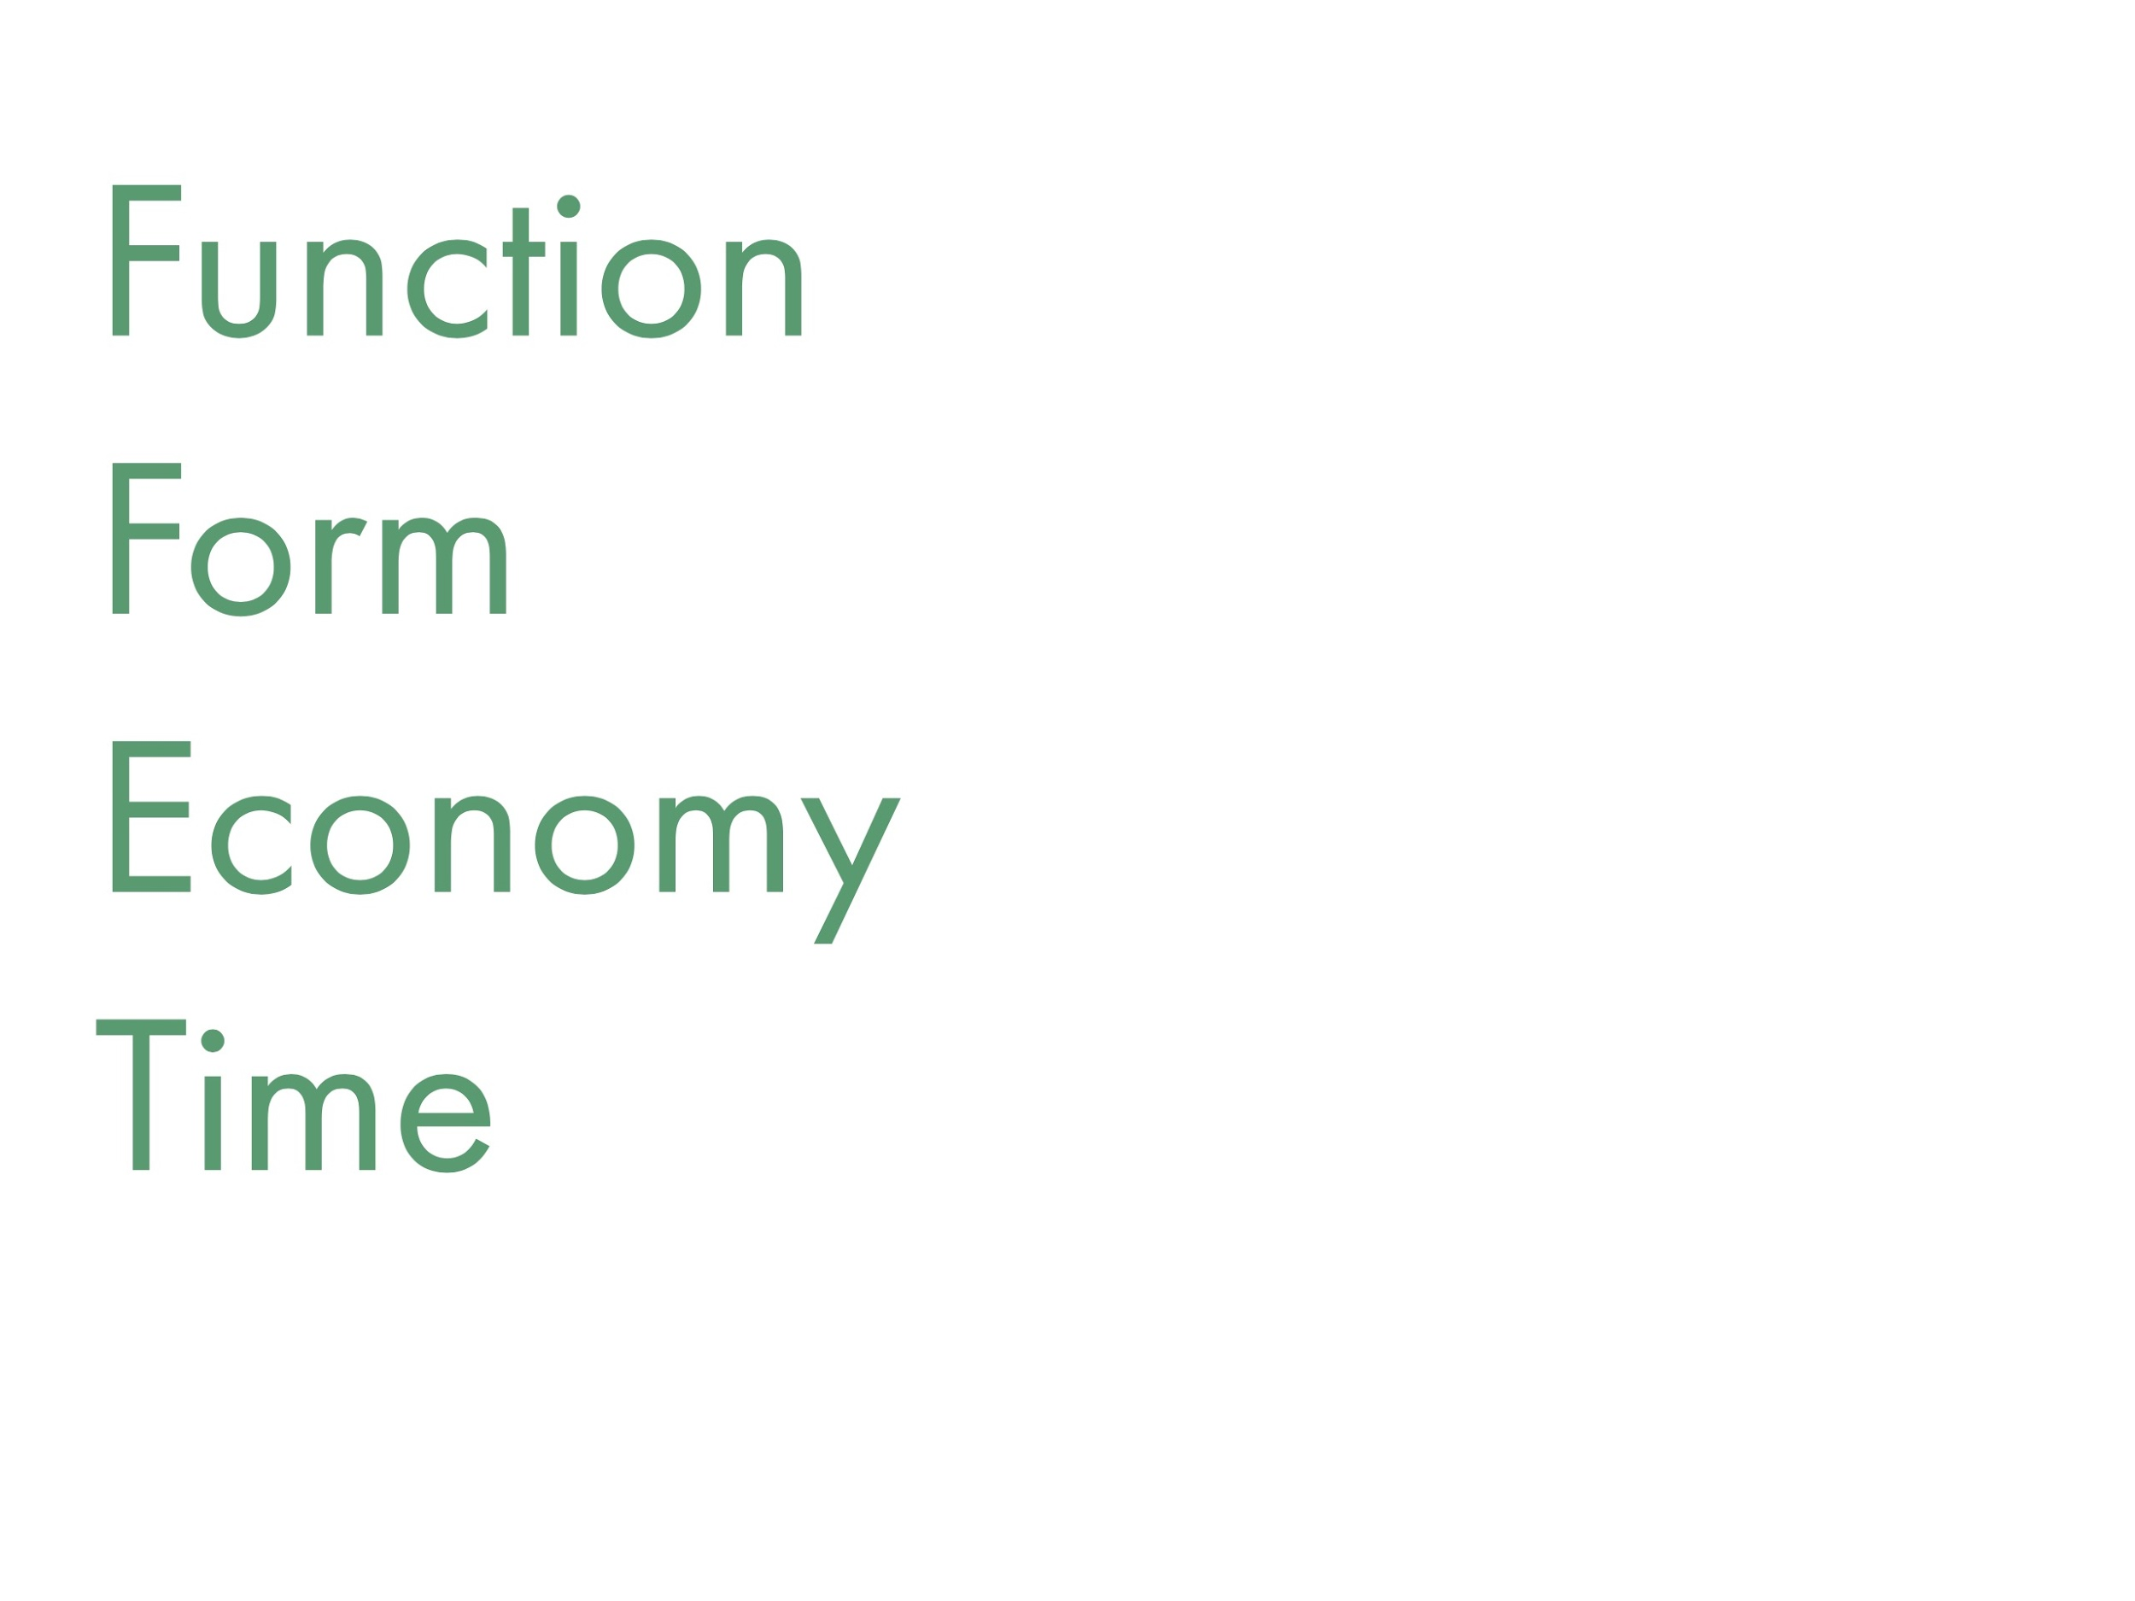
Notes:
Considering Function, Form, Economy and Time at every stage of the 5 (sometimes 6) stages of programming

Slide 6
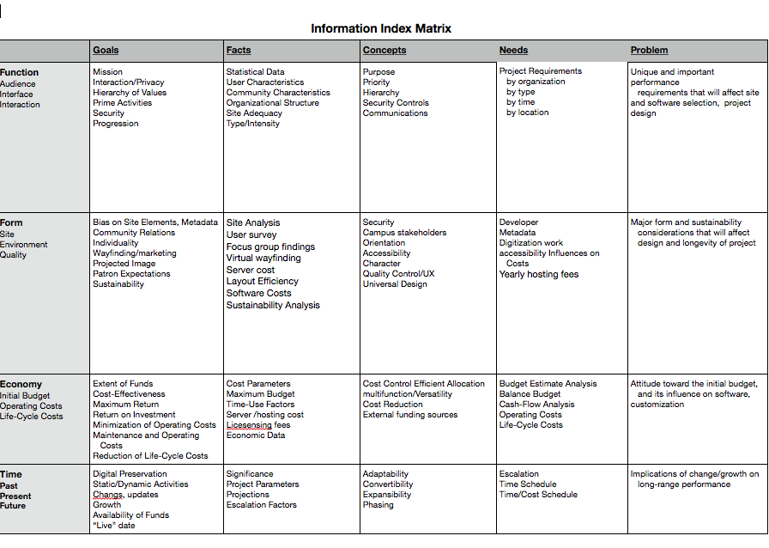
Notes:
What has been most useful for me is adapting an Information matrix that connects function, form, economy and time to the five procedures looking something like, this:
Information Matrix
https://docs.google.com/document/d/1Wn5ClzZvgCMOLs5KuAtxCjRTVkS-4nmWHHdXH0gK37w/edit?usp=sharing
There are many techniques and tactics for information seeking/filling out this matrix that lead to good programming and can include, Analysis cards, focus groups, client surveys, and other facilitated discussions where one periodically summarizes or recaps and keeps everyone on message!
better management planning as a participatory process, Better able to work with ideas that are “vague and pliable” because I understand what dealing with, Better able to articulate project goals internally and externally

Slide 7
"... organize the client’s vast world of information within a rational framework...has the sensitivity to know what information will be useful and what should be discarded."
Notes:
I’ll end with some quotes from Pena’s problem seeking, In the introduction to this book, He stresses the importance of information organization in programming.
“Programmers establish order so that information can make sense and be used effectively in discussions and decision making. Programmer organize and classify information. They extract information and display it … They organize the client’s vast world of information within a rational framework”. Last, A good programmer has “the sensitivity to know what information will be useful and what should be discarded.”

Slide 8
Thank You!
Resources
Caudill, William W. and William M. Pena. “Architectural Analysis: Prelude to Good Design.” Architectural Record, vol. 125, no. 5, May 1959, pp. 178–182.
Cherry , Edith, and John Petronis. “Architectural Programming .” Architectural Programming | WBDG Whole Building Design Guide, National Institute of Building Sciences, 11 Feb. 2016, www.wbdg.org/design-disciplines/architectural-programming.
Cherry, Edith. Programming for Design from Theory to Practice. John Wiley & Sons, 1999.
Pena, William, and Steven Parshall. Problem Seeking: An Architectural Programming Primer. John Wiley & Sons, 2012.

