Slide 1
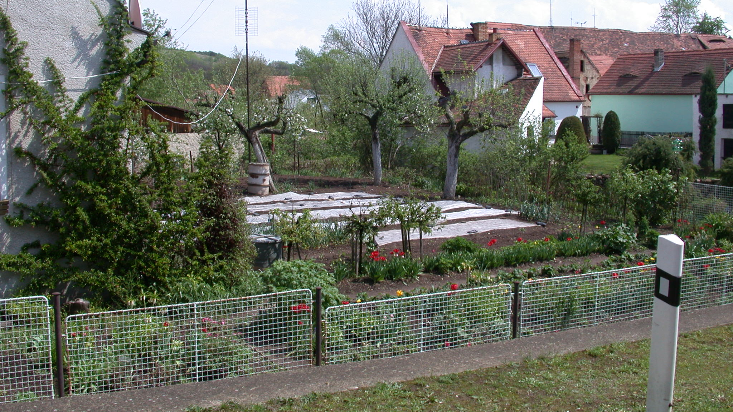
Cultural Landscapes and the
Florence Charter
Elizabeth Brabec
University of Massachusetts Amherst, USA
ebrabec@umass.edu
IFLA, Gwangjou, Korea, September 1, 2022

Slide 2
The Beginnings of Recognition
For Cultural Landscapes

Slide 3
ISCCL
International Scientific Committee on Cultural Landscapes
Is a scientific committee composed of ICOMOS and IFLA members
ICOMOS has 28 scientific committees, the ISCCL is unique in having a dual membership.

Slide 4
History of the ISCCL
The ISCCL was begun in 1971 at a meeting in Fontainebleu, France, with 14 Expert Members each representing a different country.
With a focus on gardens.

Slide 5
https://youtu.be/oTcqsE8SBb8

Slide 6
Recognizing Cultural Landscapes

Slide 7
Original Definition
"A historic garden is an architectural and horticultural composition of interest to the public from the historical or artistic point of view".

Slide 8
Original Definition
"A historic garden is an architectural and horticultural composition of interest to the public from the historical or artistic point of view. As such, it is to be considered as a monument.”

Slide 9
UNESCO
1972 Convention concerning the protection of the world cultural and natural heritage
"cultural heritage and the natural heritage are increasingly threatened with destruction not only by the traditional causes of decay, but also by changing social and economic conditions which aggravate the situation with even more formidable phenomena of damage or destruction;"
ICOMOS
"parts of the cultural or natural heritage are of outstanding interest and therefore need to be preserved as part of the world heritage of mankind as a whole"
Only tangentially includes landscapes as "sites: works of man or the combined works of nature and man,..."
1965 International Charter for the Conservation and Restoration of Monuments and Sites (The Venice Charter)
"Article 1. The concept of a historic monument embraces not only the single architectural work but also the urban or rural setting in which is found the evidence of a particular civilization, a significant development or a historic event. This applies not only to great works of art but also to more modest works of the past which have acquired cultural significance with the passing of time."
CATHM
1931 First International Congress of Architects and Technicians of Historic Monuments (Athens)
"7. Attention should be given to the protection of areas surrounding historic sites.”
"III. Aesthetic Enhancement of Ancient Monuments... the character and external aspect of the cities in which they are to be erected should be respected...Even certain groupings and certain particularly picturesque perspective treatment should be preserved. A study should also be made of the ornamental vegetation most suited to certain monuments or groups of monuments from the point of view of preserving their ancient character.... ”
1964 IInd International Congress of Architects and Technicians of Historic Monuments (Venice)
is adopted by ICOMOS in 1965 as the Venice Charter
"Article 7. A monument is inseparable from the history to which it bears witness and from the setting in which it occurs."
1982 The Florence Charter (Historic Gardens)
"Article 6. The term "historic garden" is equally applicable to small gardens and to large parks, whether formal or "landscape".
Article 7. Whether or not it is associated with a building in which case it is an inseparable complement, the historic garden cannot be isolated from its own particular environment, whether urban or rural, artificial or natural."

Slide 10
History of cultural landscapes in international law
The World Heritage Convention 1972 recognizes “the combined works of nature and man [sic].”
The Florence Charter, adopted by ICOMOS in 1982, solidified the recognition of the dynamic plat assemblages in historic gardens as a form of ‘monument.’
In 1992, UNESCO World Heritage added Operational Guidelines to recognize cultural landscapes.

Slide 11
World Heritage Operational Guidelines
Cultural landscapes are cultural properties and represent the "combined works of nature and of man" designated in Article 1 of the World Heritage Convention. They are illustrative of the evolution of human society and settlement over time, under the influence of the physical constraints and/or opportunities presented by their natural environment and of successive social, economic and cultural forces, both external and internal.

Slide 12
Comprehensive Review in 2002
10 years after implementation of the Operational Guidelines for cultural landscapes
1993 was the first year a cultural landscape was inscribed
In coordination with a study and meeting at Ferrara, Italy

Slide 13
Recommendations from 2002 review
1. Cultural landscapes inscribed on the World Heritage List be specifically identified as such at the time of inscription.
5. Particularly appropriate ways of managing World Heritage cultural landscapes should be positively pursued.
6. The scientific and educational potential of World Heritage cultural landscapes should be emphasized in nominations, evaluations and advice.
9. A project be undertaken to provide the basis for all major human cultures in the world to be represented, if possible, by at least one cultural landscape of outstanding universal value.

Slide 14
World Heritage Cultural Landscapes
2001
30
Others not indicated as cultural landscapes
Approx. 100

Slide 15
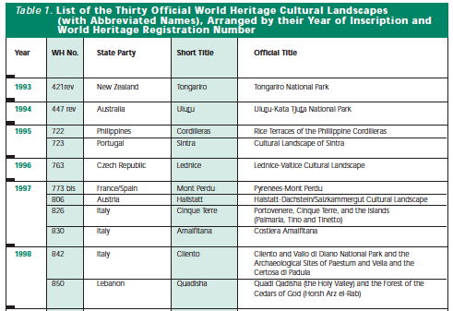

Slide 16
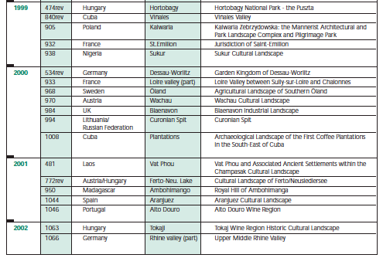

Slide 17
World Heritage Cultural Landscapes
2001
2011
30
74
Others not indicated as cultural landscapes
Approx. 100

Slide 18
World Heritage Cultural Landscapes
2001
2011
2021
30
74
121
Others not indicated as cultural landscapes
Approx. 100
??? Revised
??? Not nominated

Slide 19
Until the end of 2004, World Heritage sites were selected on the basis of six cultural and four natural criteria. With the adoption of the revised Operational Guidelines for the Implementation of the World Heritage Convention in 2005, only one set of ten criteria exists.

Slide 20
World Heritage Selection Criteria
(i) to represent a masterpiece of human creative genius;
to exhibit an important interchange of human values, over a span of time or within a cultural area of the world, on developments in architecture or technology, monumental arts, town-planning or landscape design;
(iii) to bear a unique or at least exceptional testimony to a cultural tradition or to a civilization which is living or which has disappeared;

Slide 21
World Heritage Selection Criteria (cont’d)
(iv) to be an outstanding example of a type of building, architectural or technological ensemble or landscape which illustrates (a) significant stage(s) in human history;
(v) to be an outstanding example of a traditional human settlement, land-use, or sea-use which is representative of a culture (or cultures), or human interaction with the environment especially when it has become vulnerable under the impact of irreversible change;
(vi) to be directly or tangibly associated with events or living traditions, with ideas, or with beliefs, with artistic and literary works of outstanding universal significance. (The Committee considers that this criterion should preferably be used in conjunction with other criteria);

Slide 22
World Heritage Selection Criteria (cont’d)
(vii) to contain superlative natural phenomena or areas of exceptional natural beauty and aesthetic importance;
(viii) to be outstanding examples representing major stages of earth's history, including the record of life, significant on-going geological processes in the development of landforms, or significant geomorphic or physiographic features;
(ix) to be outstanding examples representing significant on-going ecological and biological processes in the evolution and development of terrestrial, fresh water, coastal and marine ecosystems and communities of plants and animals;
(x) to contain the most important and significant natural habitats for in-situ conservation of biological diversity, including those containing threatened species of outstanding universal value from the point of view of science or conservation.

Slide 23
Designed
Evolved
Relict
Continuing
Associative
Cultural Landscapes

Slide 24
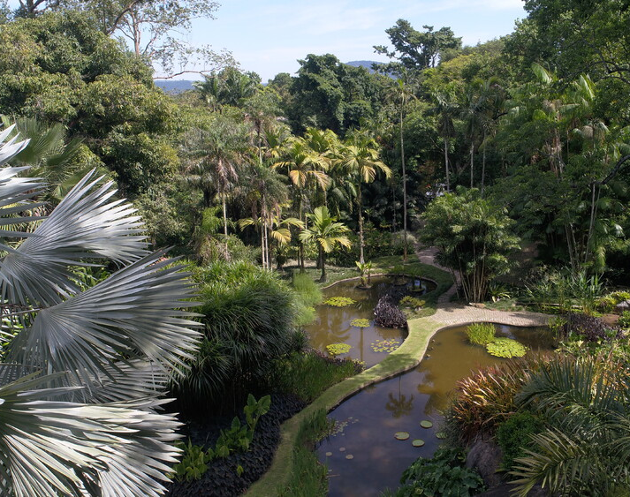
Designed
Sítio Roberto Burle Marx
Brazil 2021
Diego Rodriguez Crescêncio 2020
Iphan/SRBM https://whc.unesco.org/en/list/1620/gallery/

Slide 25
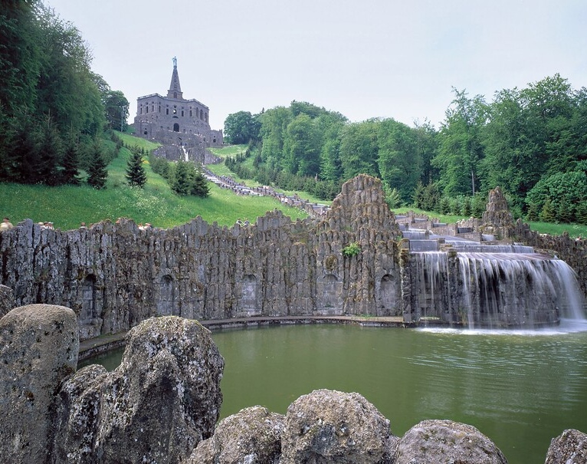
Bergpark Wilhelmshöhe
Germany 2013
Nic Barlo Jr. 2013
whc.unesco.org/en/documents/123502

Slide 26
Climate Change and Cultural Landscapes

Slide 27
Landscapes changed

Slide 28
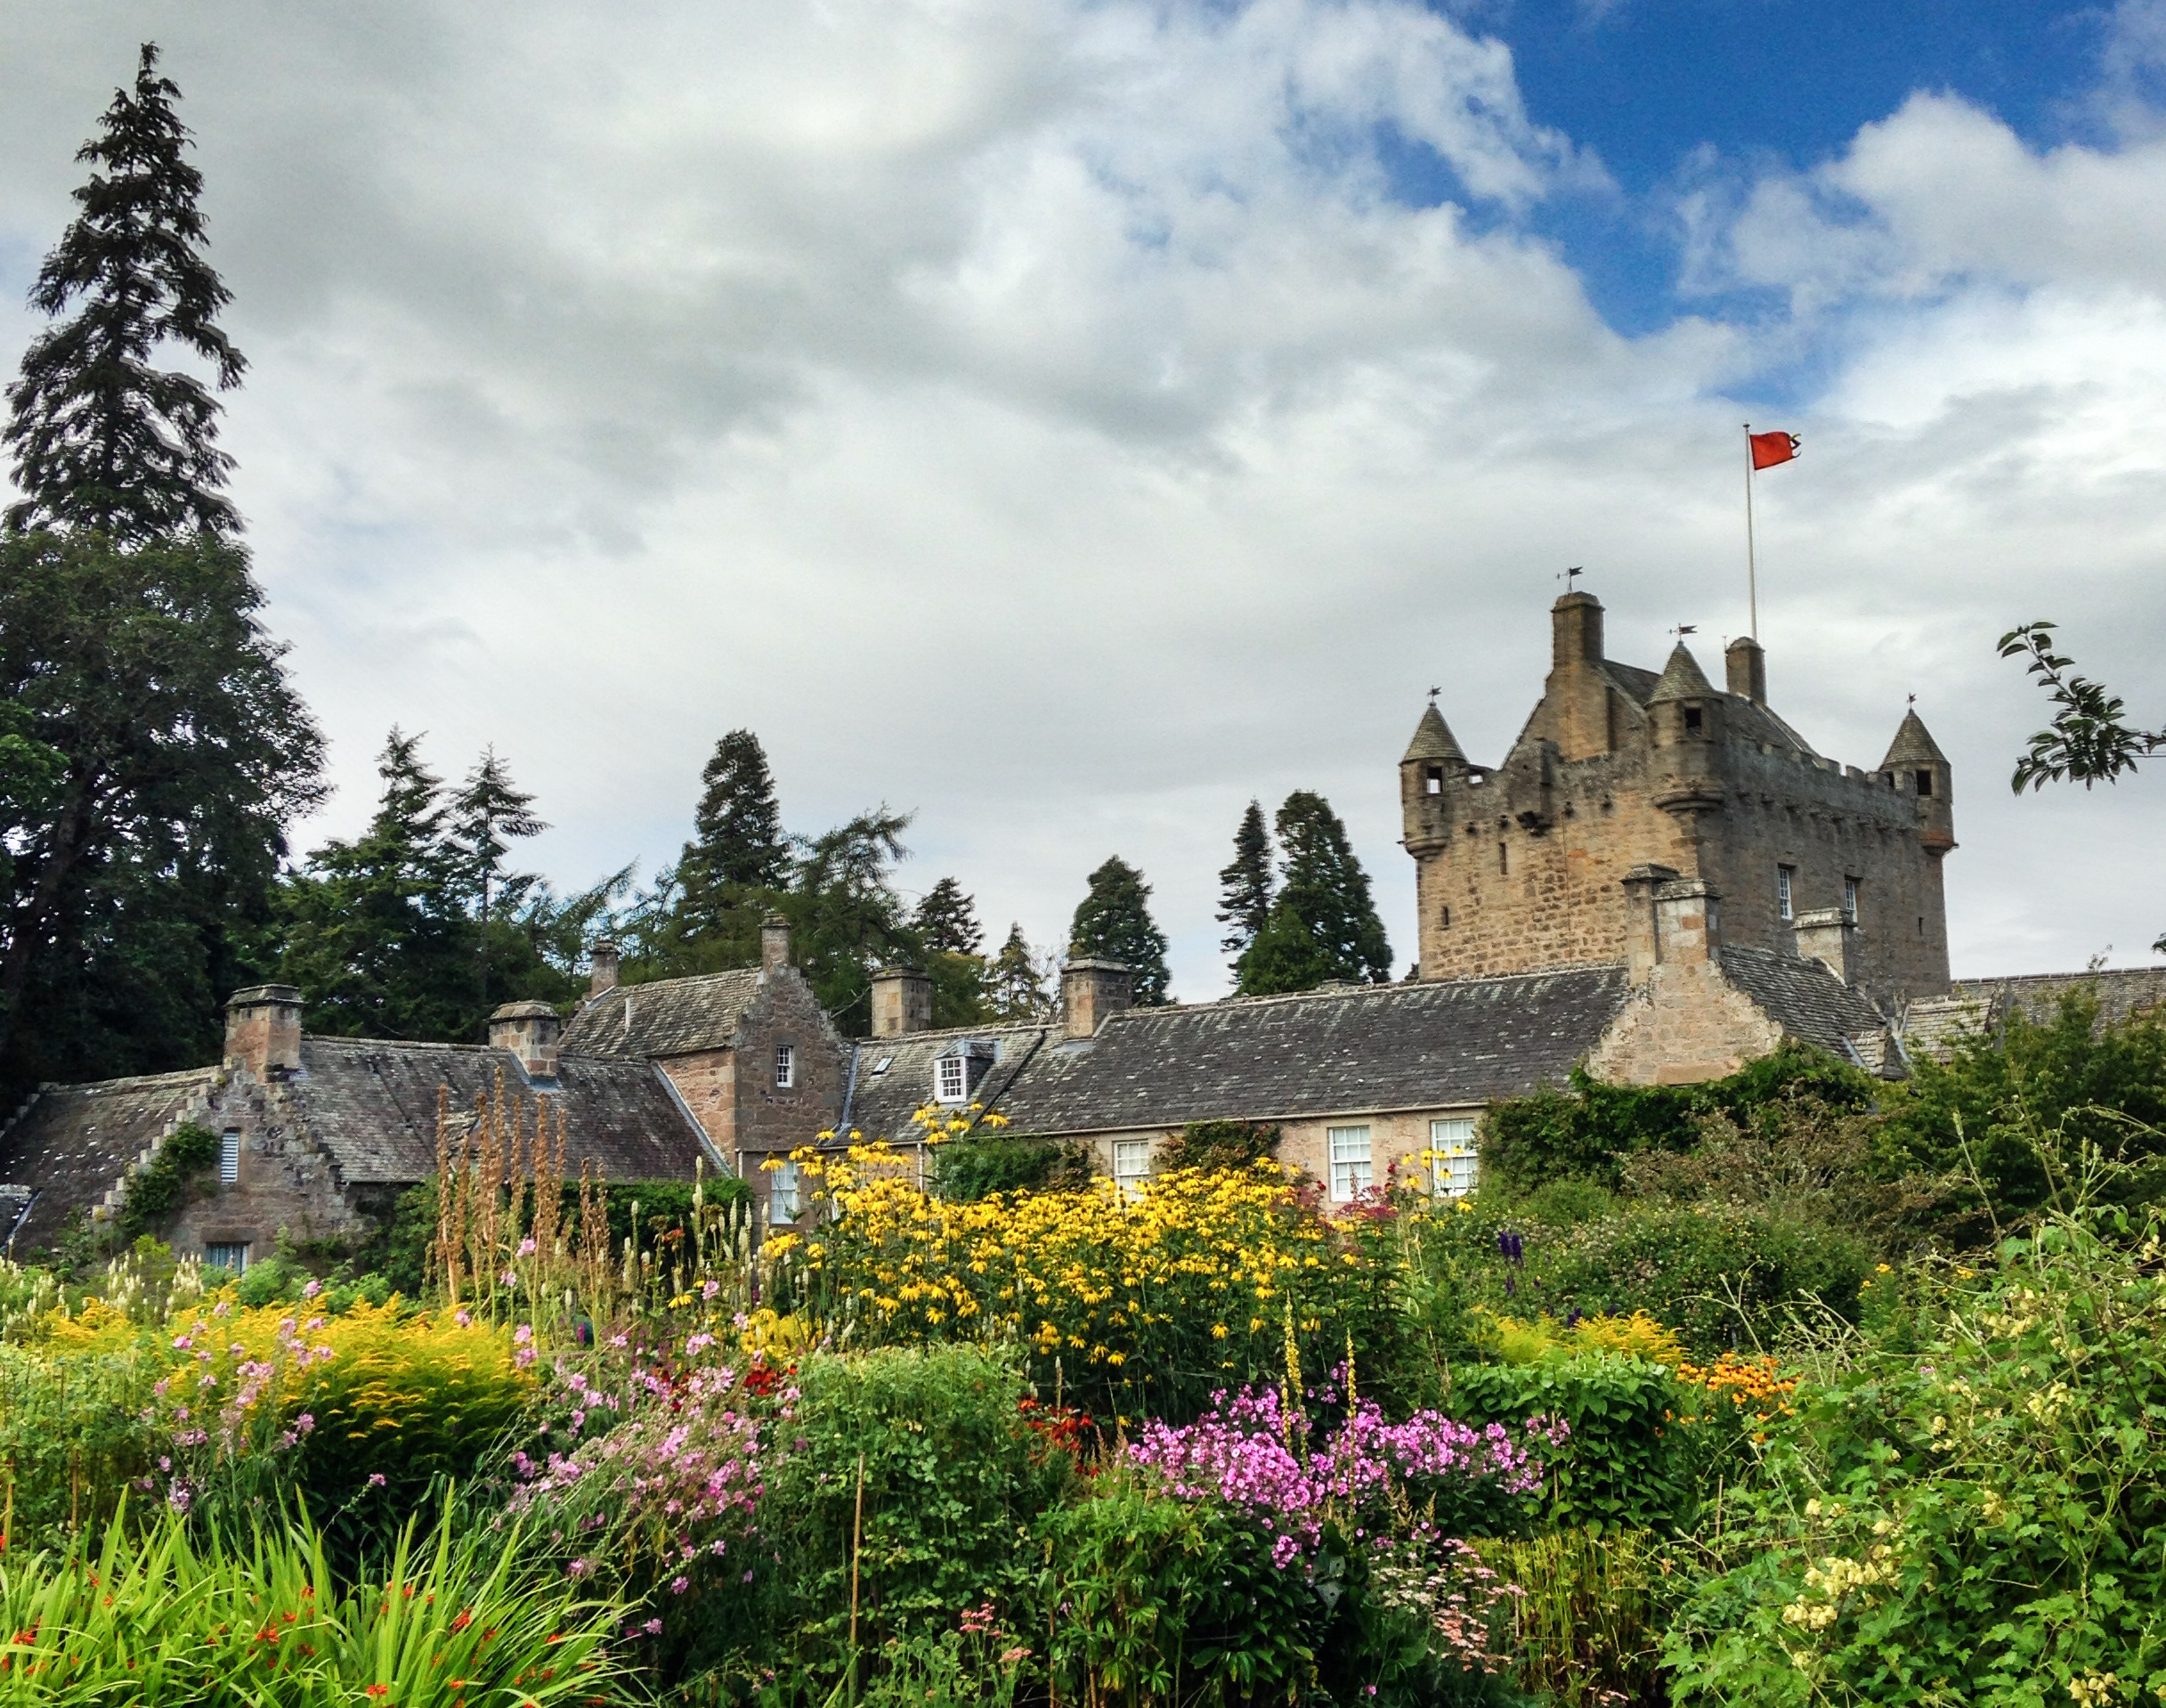
Iconic sites and landscapes that give us a sense of place will change and/or be lost

Slide 29
How do we use cultural landscapes as a climate action asset?
Impacts to sites stress urgency
The adaptation of heritage in cultural landscapes to climate changes can enhance community resilience

Slide 30
Landscapes left behind

Slide 31
How do we use cultural landscapes as a climate action asset?
Impacts to sites stress urgency
The adaptation of heritage in cultural landscapes to climate changes can enhance community resilience
Migration is a climate adaptation strategy – how do we re-create place?

Slide 32
Climate Change Relocation
Notes:
The town of Newtok, Alaska. 350 residents

Slide 33
sight, sound, taste touch, smell
5 Senses
Understand our Place in the world
Organize, process and remember

Slide 34
Current Refugee Camps
Notes:
Camp in DRC – look at the food security aspects of gardening in temporary settlements

Slide 35
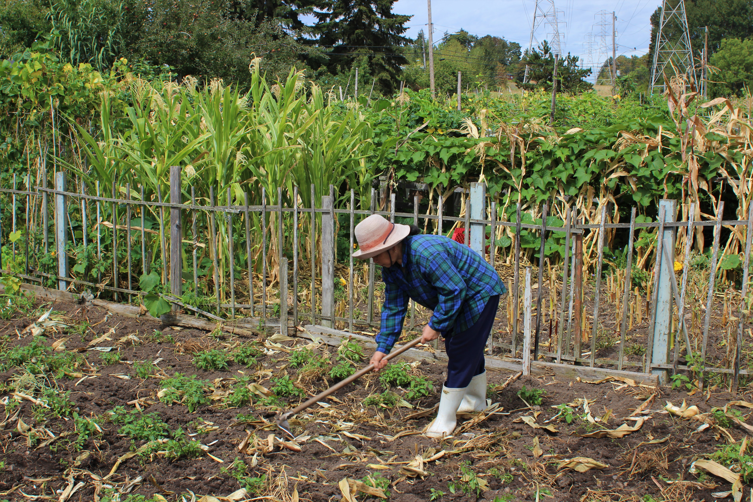
Resettlement Gardens

Slide 36
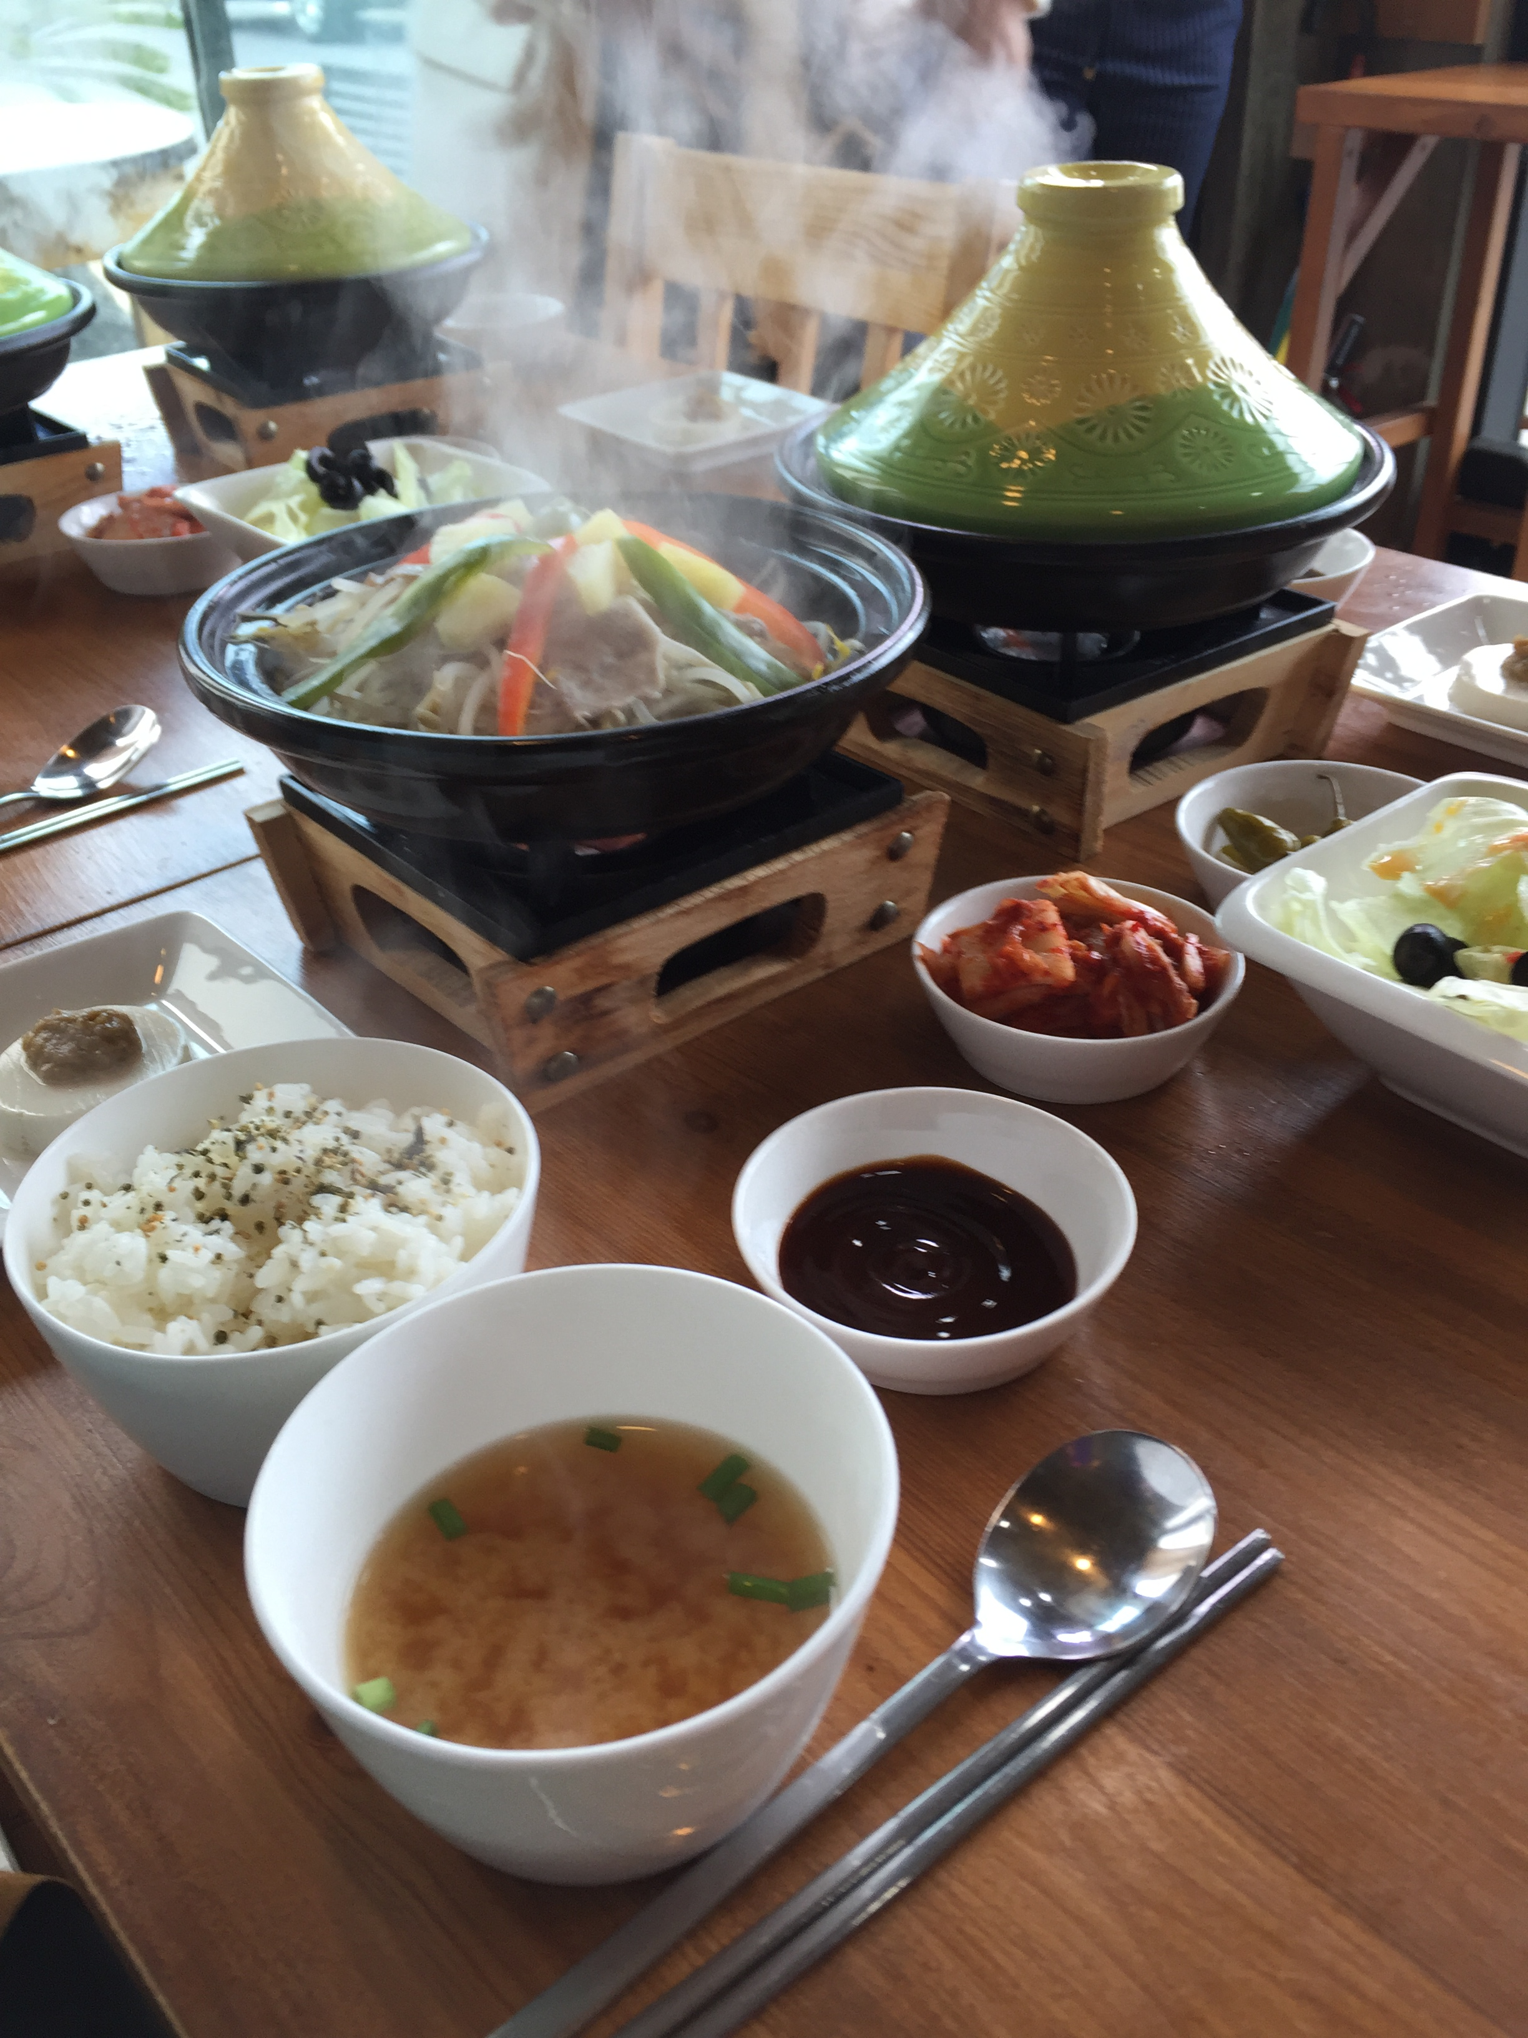
Food
How we cook and what we eat is intimately connected to the place – the cultural landscape we live in.

Slide 37
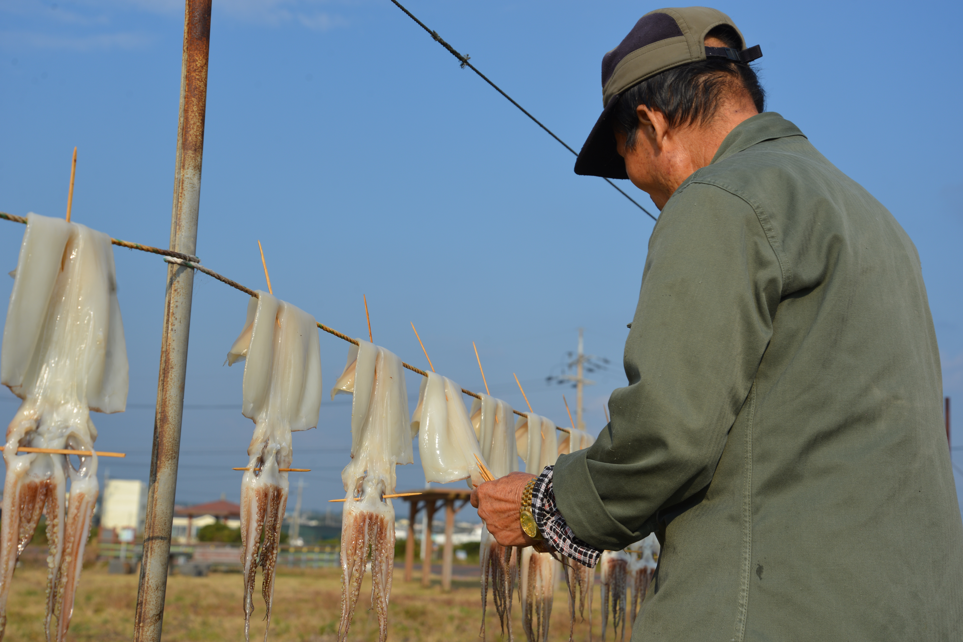
Food
How and where we source food, and how we preserve it is connected to the physical location - its parameters and constraints .

Slide 38
How do cultural landscapes improve resilience?
  Human beings need continuity
  Cultural landscapes teach us who we are and where we came from
  Heritage = the validity to exist, belong to locations, ownership of a certain place
  There is no single heritage, we re-write our heritage, bringing along the past into the future

Slide 39
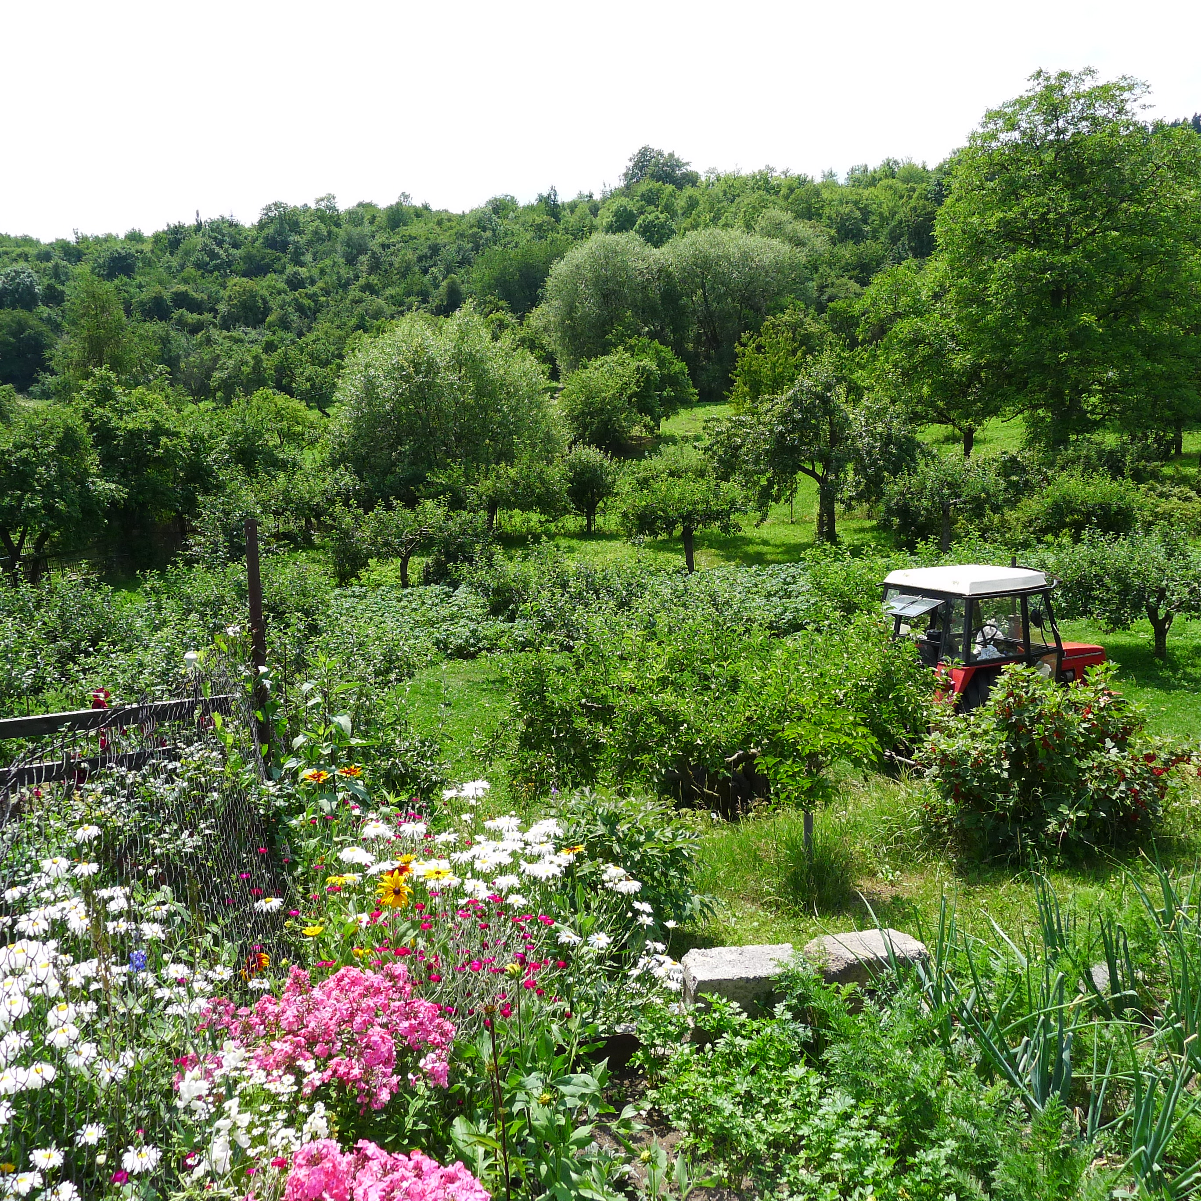
The key is agency: providing the tools for communities to recreate themselves, respecting the aspects of heritage that provide support, ontological security and sense of place.

Slide 40
Summary of issues for the future
Recognize existing World Heritage sites as cultural landscapes
Ensure new inscriptions are recognized as cultural landscapes
Strengthen the understanding of cultural landscapes as living systems under change
Maintain cultural landscapes as the “library” of technological innovation

