Slide 1



Where knowledge meets experience
Emphasizing
the library’s role
in an experiential learning initiative
Murray State University
Becky Richardson
and
Elizabeth
Price
medically_irrelevent/Flickr

Slide 2
Learning outcomes
At the end of the session, attendees will be able to:
Analyze existing information literacy courses to see where experiential learning could be added.
Identify possible library-community or library-university partnerships as part of a campus-wide initiative.
Identify ways librarians can be embedded into disciplinary experiential learning courses.

Slide 3
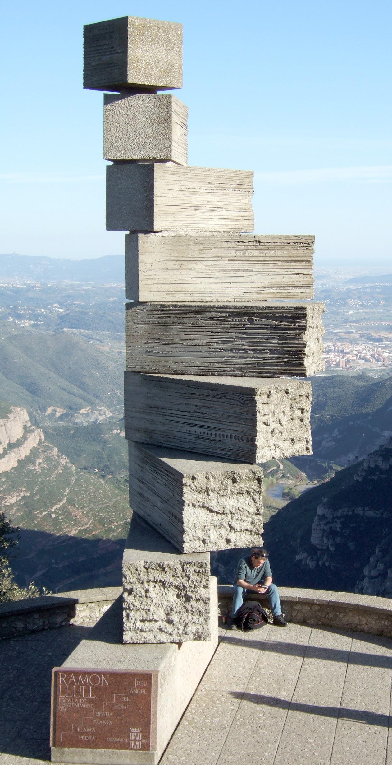
Outline of presentation
Definitions
Literature review
What we’ve done
  Helping students gain experience
  Integrating info lit instruction
  Providing outreach to campus
What we hope to do
Questions
degreezero2000/Flickr

Slide 4
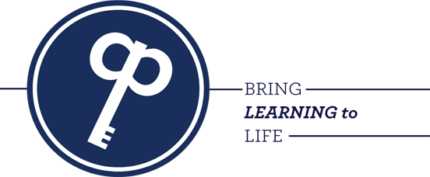
What is a QEP?
Regional accrediting
organization:
Southern Association of Colleges and Schools
Requires Quality Enhancement Plan (QEP)
Involve a variety of campus constituencies and plan how it will be implemented, completed and assessed (SACS, 2012)
Notes:
The parameters of the QEP topic are flexible, but the theme must pinpoint issues that affect student learning and develop a plan to address them (Southern Association of Colleges and Schools [SACS], 2012). An appropriate initiative must involve a variety of campus constituencies and explain how it will be implemented, completed and assessed.
Starts fall 2015 and runs for five years. So everything we’ve been doing up to now is groundwork.
Based on institutional assessment data and an environmental study that included feedback from external partners, a selection committee of students, faculty and staff overwhelmingly chose experiential learning as the topic.

Slide 5
What is experiential learning?
A process through which students develop knowledge, skills, and values from direct experiences outside a traditional academic setting.
Encompasses a variety of activities: internships, service learning, undergraduate research, study abroad, and other creative and professional work experiences.
(CU-Denver, 2015)
Notes:
Reflection, critical analysis and synthesis
Opportunities for students to take initiative, make decisions, and be accountable for the results
Opportunities for students to engage intellectually, creatively, emotionally, socially, or physically
A designed learning experience that includes the possibility to learn from natural consequences, mistakes, and successes
Stimulate academic inquiry by promoting
interdisciplinary learning, civic engagement,
career development, cultural awareness, leadership,
and other professional and intellectual skills.
Examples Montrose provided included: cooperative education, internships, clinical experience, service learning, outdoor leadership, organizational development, and activity-based learning.
“A pedagogy that actively engages the student in the phenomena that they are studying. … [It] engages students in a deliberate process of hands-on problem solving and critical thinking” (Montrose, 2002).
What is experiential learning?
UT Center for Teaching and Learning
Broadly, experiential learning is any learning that supports students in applying their knowledge and conceptual understanding to real-world problems or situations where the instructor directs and facilitates learning. The classroom, laboratory, or studio can serve as a setting for experiential learning through embedded activities such as case and problem-based studies, guided inquiry, simulations, experiments, or art projects (Wurdinger & Carlson, 2010).
However, when students are given opportunities to learn in authentic situations on campus or in the community like those provided in internships, field placements, clinical experiences, research and service-learning projects, the learning becomes significantly more powerful. By engaging in formal, guided, authentic, real-world experiences, individuals:
deepen their knowledge through repeatedly acting and then reflecting on this action,
develop skills through practice and reflection,
support the construction of new understandings when placed in novel situations, and
extend their learning as they bring their learning back to the classroom.
http://ctl.utexas.edu/teaching/engagement/experiential-learning/defined

Slide 6
It’s not simply active learning ...
Biology lab course is not considered
an experiential learning option.
To make it experiential, a biology course would have students apply knowledge to solve a problem about environmental cleanup or create a social media campaign to encourage community plasma donations
Notes:
Example in library context -
One shot session teaching students to search the databases and having them do it is active learning.
Helping students conduct research in a course with an end product outside of an academic context would be considered experiential. It might still involve teaching database searching. But the purpose of the research isn’t an academic paper or necessarily a class presentation. Examples might be a brochure, a community poster, a report for stakeholders/practitioners. Some of this is not in our control - it’s up to the instructor’s final project.

Slide 7
High-impact educational practices
10 teaching and learning practices
Shown to be beneficial for students from many backgrounds and at different levels.
Research suggests they increase rates of student retention and student engagement
George Kuh (2008)

Slide 8
What are the high impact practices?
Capstone courses
and projects
Collaborative assignments/projects
Common intellectual experiences
Diversity/global learning
First-year seminars
and experiences
Internships
Learning communities
Service learning and community-based learning
Undergraduate research
Writing intensive courses
(Kuh, 2008)
Notes:
The plan aimed to allow “students [to] apply principles learned in the classroom in a real-world setting” and provide faculty with “professional development opportunities related to … problem-solving, critical/creative thinking, and integrative learning” (Murray & Pervine, 2014, p. 7). The learning experiences were selected from Kuh’s high-impact educational practices (HIPs) that have been shown to increase student learning, engagement and retention (Kuh, 2008). The practices are:
Capstone courses and projects
Collaborative assignments and projects
Common intellectual experiences
Diversity/global learning
First-year seminars and experiences
Internships
Learning communities
Service learning and community-based learning
Undergraduate research
Writing intensive courses (Kuh, 2008)

Slide 9
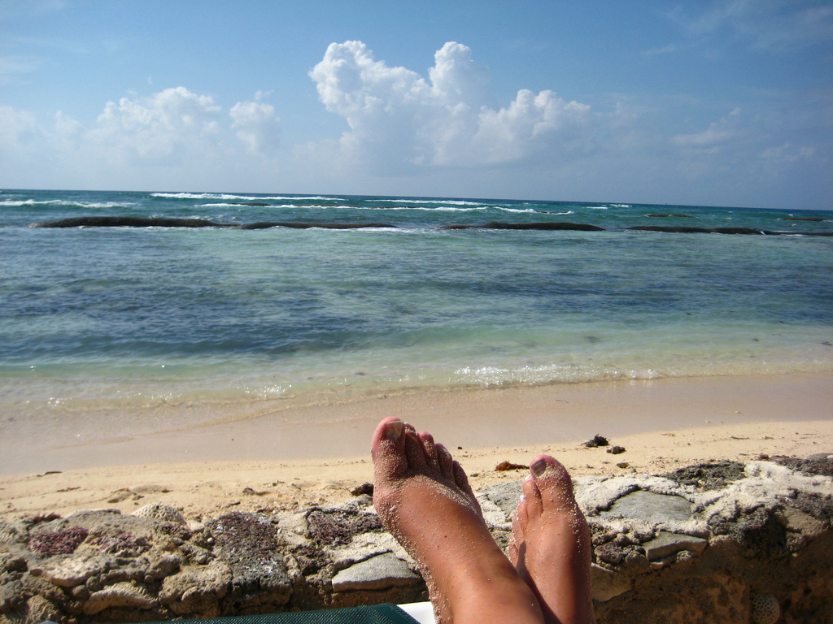
What role
can libraries
play in experiential learning?
jjjj56cp/Flickr

Slide 10
How did MSU define experiential?
Capstone courses
and projects
Collaborative assignments/projects
Common intellectual experiences
Diversity/global learning
First-year seminars
and experiences
Internships
Learning communities
Service learning and community-based learning
Undergraduate research
Writing intensive courses
(Kuh, 2008)
Notes:
The plan aimed to allow “students [to] apply principles learned in the classroom in a real-world setting” and provide faculty with “professional development opportunities related to … problem-solving, critical/creative thinking, and integrative learning” (Murray & Pervine, 2014, p. 7).

Slide 11
Lit review: “Experiential” libraries
Library's role in an experiential QEP
Middle Tennessee State University
  York, Groves and Black (2010)
Partnered with classes in diverse majors to provide hands-on experiences for students that also benefited the libraries
Created a student advisory board through a for-credit course taught by a librarian.
Notes:
Harris 2013 - described libraries’ roles in QEPs with info lit as primary or secondary component.
Only one that specifically detailed experiential QEP.
At MTSU:
art students participated in a public awareness project using waste paper from the library;
anthropology students conducted focus groups about how students use the library and its resources to complete assignments;
marketing students conducted an extensive student survey about possible additions or alterations to the library’s facility and services.
In addition, the library created a student advisory board through a for-credit course. Only four students enrolled.

Slide 12

Lit review: HIPs in action
Articles examining how libraries have embraced HIPs
Focuses on our HIPs:
  capstone courses
  internships
  service learning
  study abroad
  undergraduate research
Find it at http://tinyurl.com/HIPSlib
Ian Rees/Flickr

Slide 13
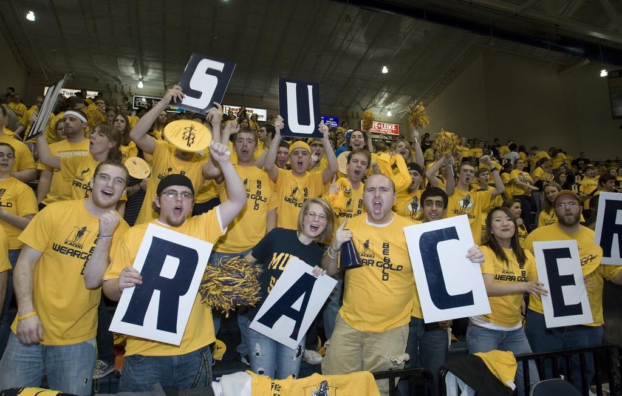
Case study: Murray State University
Notes:
Purpose of our talk today is to help you think about where your library can align itself in an experiential initiative. This can help demonstrate your value in student engagement and retention.
Four-year, master’s level university. About 10,000 FTE

Slide 14
The libraries’ involvement
Participated on QEP Committee
from development to implementation
Dean as QEP
Co-Chair
Topic selection committee member
Collegiate ambassador
Service learning coordinator
Notes:
Dean benefit
Topic selection from six to two.
Collegiate ambassador - libraries are considered the equivalent of a college for most purposes.
Committee approves Experience Rich Activities in each major. Also award mini-grants and faculty development fellowships to individuals on campus who are trying to integrate experiential learning. Valuable information about how it’s being applied on campus and whom to approch.
I am serving as the SL coordinator. I know of several others around the country who are doing this as well, which I think speaks to our profession’s dedication to serving others.

Slide 15
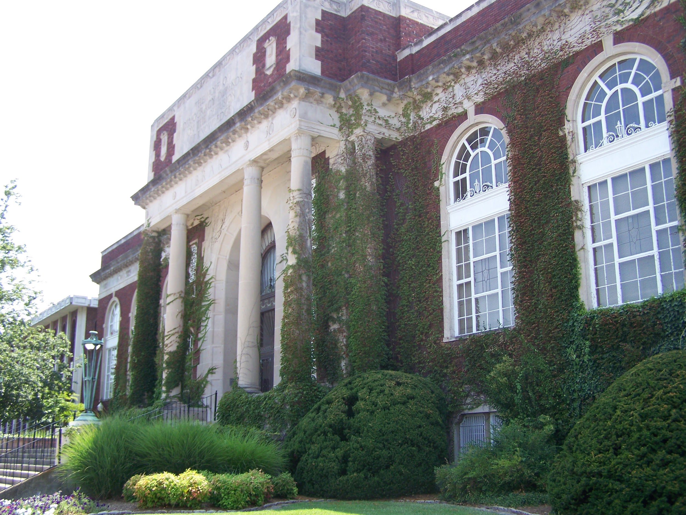
Pogue Library (Special Collections & Archives)
Internship opportunity for undergraduate history majors:
  public history
  archival experience
Notes:
For the last three years, it has provided an internship experience for History majors. These are typically undergraduate students who are considering an advanced degree in archival studies, museum studies or public history. These students work between 100-300 hours per semester and often participate in specialized projects such as conducting oral histories or digitizing print collections.

Slide 16
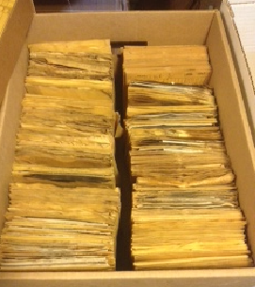
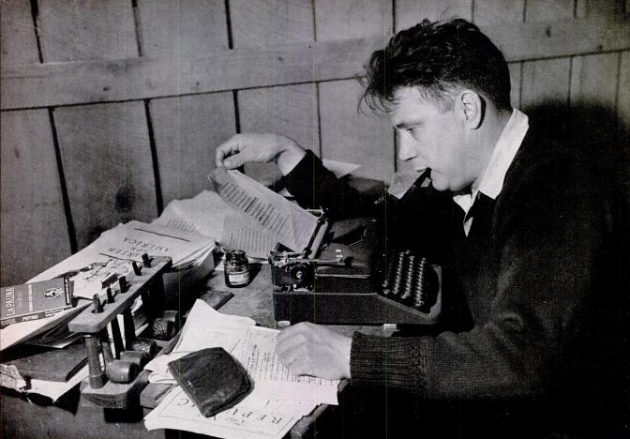
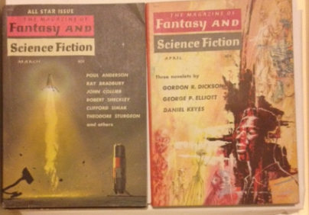
Directed Study @ Pogue Library
Creative Writing major from English Dept.
Mass Communications major
Future opportunities
Photo: Life Magazine (Vol. 15, No. 23), December 6, 1943, p. 127
Notes:
Lastly, Pogue Library is home to the Jesse Stuart Collection. This collection comprises handwritten manuscripts, correspondence, scrapbooks, etc. In Fall 2014, an English major wrote a biography of Stuart for use in the finding aid for this collection.
Pogue also has hosted directed studies that provided real-life applications of knowledge for undergraduate students in Mass Communications and English. The Mass Communication student worked with a specialized collection of vintage science fiction magazines. Her project was to create a marketing plan to make the public more aware of this collection that is housed out of the sight of the average visitor.
Pogue Library and Wrather Museum together comprise the special collections component of the University Libraries - within these two areas there are numerous opportunities for student internships and directed studies from many different departments on campus. Art - Wells Photography Collection / museum curration - History / Education - School Programs / Traveling Trunk - Theatre / Art - Costume Curation

Slide 17
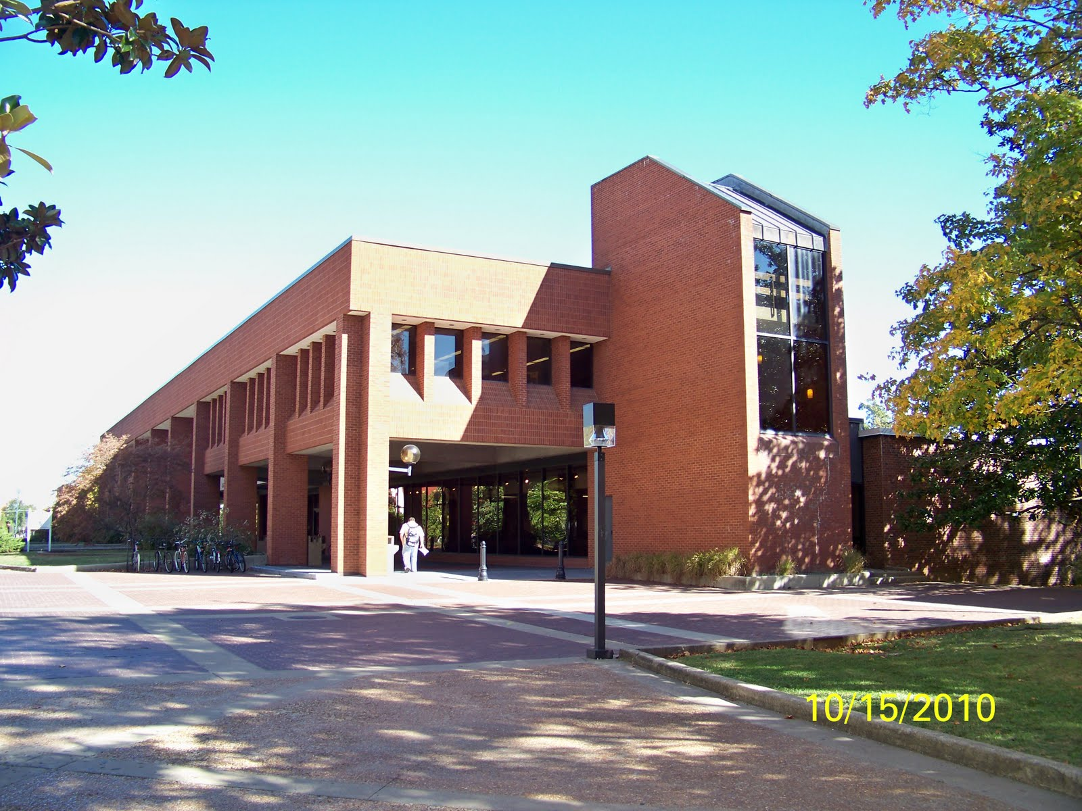
Helping students gain experience
Waterfield Library (traditional academic)
Internship and directed studies opportunities
Third-party client

Slide 18
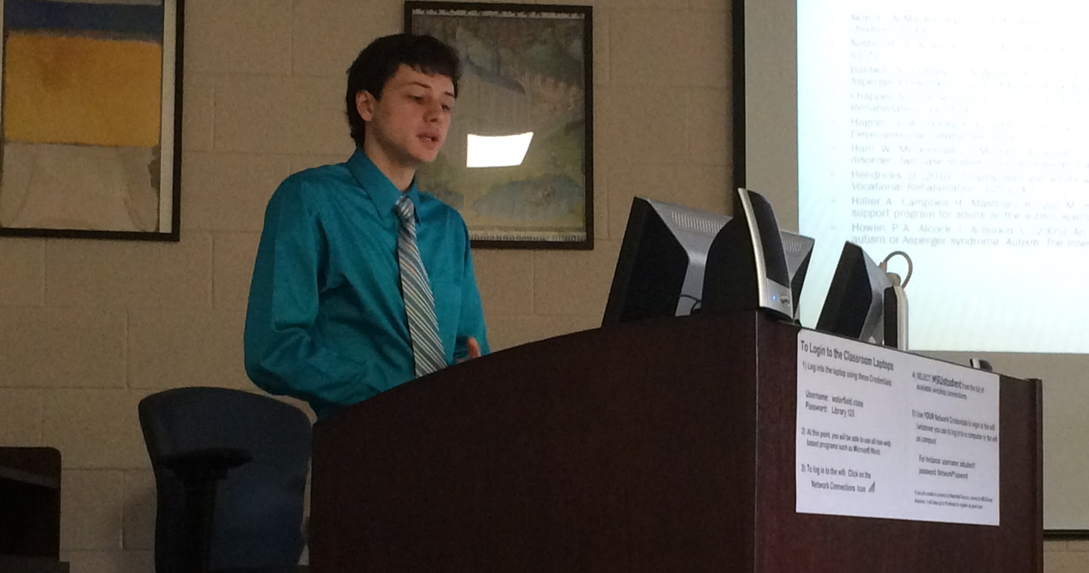
Autistic People in Libraries:
The Connection
Non-Profit Leadership Studies student
Library services for students on autism spectrum
Elizabeth, do you have a photo from this presentation?
Notes:
In Spring 2015, the University Libraries offered an internship for a non-profit leadership studies student. His interest centered on library services for students on the autism spectrum. He researched the library and education literature for best practices, observed at Waterfield Library’s information desk and an area public library.
Included observing interactions at the Information Desk in Waterfield Library
Observing for a couple of days at the Marshall County Public Library
Presenting findings to staff / faculty
and he is working on a library guide of resources on the topic for faculty / staff

Slide 19

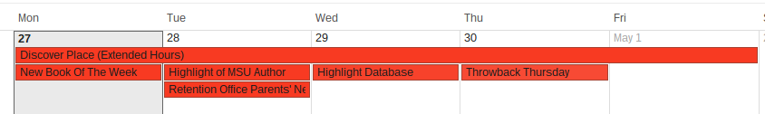
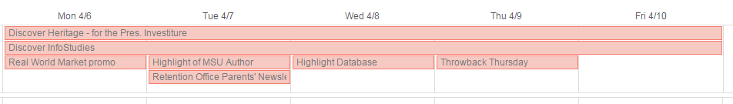
Advanced Public Relations course
Libraries serve as client
Four PR teams create plan book,
strategic communication campaign
Notes:
In Spring 2014, the University Libraries acted as the client for the capstone public relations course, Advanced Public Relations. Students created their own mini PR agencies that were tasked with creating a plan book and communication campaign for the libraries. The campaign also engaged students from capstone courses in Advertising and Television Production to develop commercials and advertising plans. Four PR teams ultimately presented their plan books to a panel of library employees, and we provided feedback on their final products. Elements of the campaigns were worked into the libraries’ 2014-15 marketing and social media campaigns.

Slide 20
Your turn
With others at your table, discuss:
  Possible partnerships with other areas of the university to help students gain professional experience or project management skills
OR
  Possible partnerships with community groups, events or businesses that help students apply knowledge in real-world settings

Slide 21
Integrating info lit instruction:
Two ways to approach
Librarian-taught course offerings
For-credit information literacy class (INF 101)
Information studies minor (21 hours)
One-shot sessions
Instruction scaffold
Two or three courses that liaison librarian targets for instruction in each major
Notes:
Explain instruction scaffold
-Series of classes that range from beginner to senior course.
-Determined by librarians and departments.
-One for each major
-Becky choose one - ESL

Slide 22
Integrating info lit instruction
Information Studies Minor
  INF 101
  University Studies Course
  Taught on the theme of Digital Footprints
  Experimental assignment
Digital Communications:
Social Media
Digital Rights
and Responsibilities
Have any of your online accounts ever been hacked?
SPEAK UP!
Your Life Matters
Notes:
In Spring 2015, one librarian decided to pilot a service learning assignment into the minor’s core course, INF 101. This University Studies elective is intended to educate students about “Social and Self-Awareness and Responsible Citizenship - Ethics, Social Responsibility and Civic Engagement.” University Studies courses are designed to provide “students with a broad-based, liberal arts and sciences foundation for their academic specialty” (Murray State University, 2015). This particular section has content structured around the theme “Digital Footprints,” and the end result of the assignment was to produce a visual object (a brochure, infographic poster, or slideshow) that would inform the campus community about various aspects of digital citizenship. This assignment comprised evaluating resources, producing an annotated bibliography related to their topic, and a visual. The visual products were presented to the Head of Public Services at Waterfield Library. And, following a discussion on copyright, the students were given the opportunity to license the visual to the library for reproduction and distribution.

Slide 23

Nine tenets of digital citizenship
Access
Literacy
Commerce
Law
Health & Wellness
Communication
Etiquette
http://www.njea.org/
Rights & Responsibilities
Security

Slide 24
Your turn
These are some courses in our minor:
Where could experiential learning be applied?
101 - Research in the Information Age
260 - Propaganda, Censorship, and Privacy
270 - Intellectual Property in the Information Age
310 - Medical Information for Practitioners and Consumers
320 - Examination of Scientific Communication
340 - Children’s and YA Literature and Storytelling
Notes:
Minor possibilities: INF 101 - Research in the Information Age - preparing visual resources using an annotated bibliography to share on campus.
INF 310 - Medical Information for Practitioners and Consumers - producing brochures or leading presentations for the local senior center or public library on health resources.
INF 340 - Children’s and Young Adult Literature and Storytelling - preparing and implementing a story time or book talk to a school, library or youth center.

Slide 25

Integrating info lit instruction
ENG 105
  Using instead of library databases
History
  Source gathering for seniors & grad students
Business
  Information strategies for graduating seniors
Philosophy / Engineering interdisciplinary
  Ethics of homebuilding: Habitat for Humanity
Notes:
The course that reaches the most students on campus is our basic composition course (ENG 105). In some sections, the liaison librarian for English has experimented with bypassing database searching altogether in her information literacy instruction. Instead, the librarian focuses the instruction on evaluating information from Google. The reasoning lies in the purpose of the course: to teach writing and improve communication for multiple purposes. These instructors aren’t focusing on traditional academic writing, but rather on professional writing skills. By using Google, the librarian was teaching students to re-learn a familiar resource in a way that could lead them to better sources that would serve them beyond their college careers.
In some upper-level classes within the College of Business, one librarian has worked with faculty to discuss information strategies for graduating seniors. In Strategic Management, the capstone course for management majors, the librarian discussed how to identify and access popular business periodicals, how to leverage Google News and social media to follow business news, and how to take advantage of alumni access to Business Source Complete after graduation. In the Communication Research course and the Advanced Public Relations course, the instructors have asked the librarian to discuss advanced Google search strategies relevant to their disciplines and the information services that a public library or academic library can provide once students depart campus.

Slide 26

Cultivating campus partnerships
Faculty Development workshop
  Information in the Real World: Building a bridge between academic and professional information needs
Service learning workshops
Posters in the Capitol
  Best undergraduate research
  Displayed in Waterfield afterward
https://flic.kr/p/82kA5
Notes:
In order to persuade faculty that students will have different information needs once they leave the academic environment, one librarian made several faculty development presentations during 2014-15. The content was based on a presentation given by librarian Megan R. Stark and discussed “Information in the Real World: Building a bridge between academic and professional information needs” (Stark, 2014). It also drew on studies about workplace information literacy from Project Information Literacy (Head, 2012) and the Association of American Colleges and Universities (Hart Research Associates, 2015).

Slide 27
Your turn
With others at your table, discuss:
  Senior (aka capstone) courses and/or projects at your university
OR
  Service learning courses or experiential learning courses at your university
  where you already are or might be able
  to target information literacy instruction

Slide 28

Where we want to go from here
Add service learning/study abroad in info studies minor, including INF 101
Add capstone & service learning courses to library instruction scaffold
“Elevator speech”
Student ambassadors program
Scholarly communication librarian
Center for Experiential Learning
Opportunities to serve as the “client”
© Copyright Andy Beecroft and licensed for reuse under this Creative Commons Licence
Notes:
QEP goes into effect this fall and runs through 2019
York, Grove, and Black recommend that libraries “actively seek out experiential learning partnerships on campus. Not only are there quantifiable benefits for both parties—the library gets free help on projects and students get real-life experience and often grades—but it also strengthens the library's role as a holistic learning place” (p. 201).

Slide 29

What sticks?
What is one role your
library could play in experiential learning?
Is this any different from
the initial role you thought libraries could play and how?
PeterIsB/Flickr

Slide 30
Contact information
Becky Richardson
Research & Instruction librarian, liaison to College of Humanities and Fine Arts
Murray State University
rrichardson5@murraystate.edu
Elizabeth Price
Research & Instruction librarian, liaison to College of Business
Murray State University
eprice4@murraystate.edu

Slide 31
References
Beile, P. M. (2007). Assessing an institution-wide information fluency program: Commitment, plan, and purposes. Public Services Quarterly, 3(1-2), 127-146. doi: 10.1300/J295v03n01_07
Bryan, J.E. (2014). Critical thinking, information literacy and quality enhancement plans. Reference Services Review 42(3), 388-402. doi: 10.1108/RSR-01-2014-0001
Crowe, K.M. (2015). Libraries and student success: A campus collaboration with high-impact educational practices. Proceedings from the 2015 Association of College and Research Libraries National Conference. Portland, OR: ACRL. 443-449.
Detmering, R., & Johnson, A.M. (2011). Focusing on the thinking, not the tools: Incorporating critical thinking into an information literacy module for an introduction to business course. Journal of Business & Finance Librarianship, 16(2), 101-107. doi: 10.1080/08963568.2011.554771

Slide 32
References
Kuh, G.D. (2008). High-impact educational practices: A brief overview. Association of American Colleges and Universities. Retrieved from https://www.aacu.org/leap/hips
Millet, M. (2010). Be prepared for the opportunity: Foundations, information literacy, and a QEP. LOEX Quarterly, 37(1), 5. Retrieved from http://commons.emich.edu/
Montrose, L. (2002). International study and experiential learning: The academic context. Frontiers: The Interdisciplinary Journal of Study Abroad, 8. 1-15. Retrieved from http://www.frontiersjournal.com/issues/vol8/vol8-08_montrose.htm
Murray, A.L. & Pervine, R. (2014). Quality Enhancement Plan: Bring learning to life. Murray: KY: Murray State University. Retrieved from http://murraystate.edu/docs/Strategic-Plan/QualityEnhancementPlan_BringLearningtoLife.pdf

Slide 33
References
Harris, B.R. (2013). Subversive infusions: Strategies for the integration of information literacy across the curriculum. The Journal of Academic Librarianship, 39(2), 175-180. Retrieved from http://digitalcommons.trinity.edu
Hart Research Associates. (2015). Falling Short? College Learning and Career Success. Washington DC: Association of American Colleges and Universities. Retrieved from http://www.aacu.org/leap/public-opinion-research/2015-survey-results
Head, A.J. (2012). Learning curve: How college graduates solve information problems once they join the workplace. Project Information Literacy. Retrieved from http://projectinfolit.org/images/pdfs/pil_fall2012_workplacestudy_fullreport_revised.pdf
Ireland, A. (2015). Information studies minor: For students. University Libraries. Retrieved from http://libguides.murraystate.edu/c.php?g=55154&p=353551

Slide 34
References
Harris, B.R. (2013). Subversive infusions: Strategies for the integration of information literacy across the curriculum. The Journal of Academic Librarianship, 39(2), 175-180. Retrieved from http://digitalcommons.trinity.edu
Hart Research Associates. (2015). Falling Short? College Learning and Career Success. Washington DC: Association of American Colleges and Universities. Retrieved from http://www.aacu.org/leap/public-opinion-research/2015-survey-results
Head, A.J. (2012). Learning curve: How college graduates solve information problems once they join the workplace. Project Information Literacy. Retrieved from http://projectinfolit.org/images/pdfs/pil_fall2012_workplacestudy_fullreport_revised.pdf
Ireland, A. (2015). Information studies minor: For students. University Libraries. Retrieved from http://libguides.murraystate.edu/c.php?g=55154&p=353551

Slide 35
References
Murray, A.L. (2014). The academic library and high-impact practices for student retention: Perspectives of library deans (doctoral dissertation). Retrieved from http://digitalcommons.wku.edu/diss/57
Murray State University. (2014). Academic bulletin. Murray, KY: Author. 60.
Murray State University. (2015). University Studies. Retrieved from http://www.murraystate.edu/academics/UniversityStudies/index.aspx
Riehle, C.F. & Weiner, S.A. (2013). High-impact educational practices: An exploration of the role of information literacy. College & Undergraduate Libraries, 20(2). 127-143. doi:10.1080/10691316.2013.789658

Slide 36
References
Southern Association of Colleges and Schools. (2012). The Principles of Accreditation: Foundations for Quality Enhancement (5th ed.). Decatur, GA: Author. Retrieved from http://www.sacscoc.org/pdf/2012PrinciplesOfAcreditation.pdf
Stark, M. R. (2014, August). Information in the Real World: Building a Bridge between Academic and Community Information through Service Learning. Presentation at Extending our reach: The Inaugural Colloquium on Libraries & Service Learning, Santa Clara, CA. Retrieved from http://digitalcommons.lmu.edu/libraries-and-service-learning/2014/sessions/18/
University Libraries at the University of North Carolina at Greensboro. (2013). UNCG University Libraries’ support of high impact practices. Greensboro, NC: K. Crowe, J. Dale, L. Kellam, S. Cramer, N. Ryckman, & R. Bazirjian.
York, A., Groves, C., & Black, W. (2010). Enriching the academic experience: The library and experiential learning. Collaborative Librarianship, 2(4), 193-203. Retrieved from http://collaborativelibrarianship.org/

