Slide 1

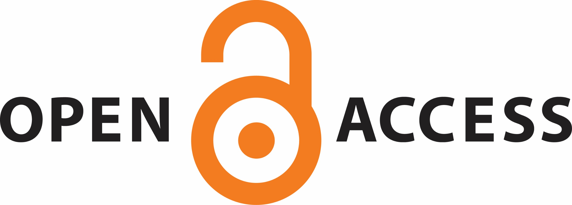
Open Access, Closed Minds?
Educating Faculty about Changing Scholarly Communication
Elizabeth Price, Leslie Engelson, Candace Vance, Rebecca Richardson and Jeffrey Henry, University Libraries
abstract
methods
Next steps
The presenters have encountered barriers—some expected, some not—as we have mounted a strategic campaign to educate faculty about how the open access (OA) movement affects them and how our four-year, public master’s level institution needs to respond to this changing landscape
Initial goals after meeting with pervine
Meet with the deans to discuss OA issues, with the ultimate goal of giving a presentation to each college’s or department’s tenure and promotion committee;
Write up an OA Policy proposal to be endorsed by the Research Policy Committee (RPC) for inclusion in the University Faculty Handbook;
Schedule copyright workshops for each college or department; and
Investigate implementation of an IR, including a possible consortial effort with the other libraries in the state to alleviate funding concerns.
Later goals we adopted
Plan our institution's first celebration for Open Access week
background
conclusions
Librarians are tasked with collecting, consuming, and providing access to scholarship, so it stands to reason that we are positioned to initiate a conversation on campus regarding OA and the evolving landscape of scholarly communications.
The authors, after exploring OA options for an article they had accepted in a Taylor & Francis journal, decided to explore what other faculty on campus were doing in terms of OA and whether there was a need for an institutional repository.
Del Toro, Mandernack, and Zanoni surveyed academic library directors/deans at medium, small, and very small Carnegie Classifications of Institutions of Higher Education, and 34% of respondents said they addressed issues related to scholarly communication in their library’s strategic plan or mission statement. Most libraries initially become involved with scholarly communications via an institutional repository, and nearly a third of the respondents have either a librarian or a staff member in charge of scholarly communication issues.
OA at smaller institutions? Kocken and Wical? Laughtin-Dunker
Because of the initial lackluster response to open access programming and the negative response to initiatives from some faculty, we thought that faculty were closed minded in regard to OA publishing.
After interactions with individual faculty and some positive responses to OA-related presentations, we realized that the lack of receptiveness was based more on misunderstandings about OA issues, faculty’s lack of connection between OA opportunities and their scholarly publishing needs, and the arrogance and presumptuousness of the librarians in our approach to faculty.
It was easy for us to place the fault on others who we felt were being closed-minded, but perhaps it was our minds that were closed. We will continue to position ourselves as allies and resources for our campus community without pushing an agenda on faculty or administrators. With this adjustment to our attitudes and goals, we hope that our university collectively will increasingly embrace OA opportunities.
Lessons learned
Surveys can be a great tool for initiating conversations
Must start with faculty first
Institutional climate can be tricky.
Loose group has it’s merits and drawbacks
References
objectives
Recognize ways to approach faculty with nontraditional scholarly communication options
Identify resources to assist faculty in evaluating OA journals
Construct arguments to persuade administrators that OA matters

