Slide 1


The Navigating the One-Shot Instruction Session:
Using Assessment to Drive Instruction
Elisa Slater Acosta
Reference Librarian / Instruction Coordinator
Loyola Marymount University

Slide 2
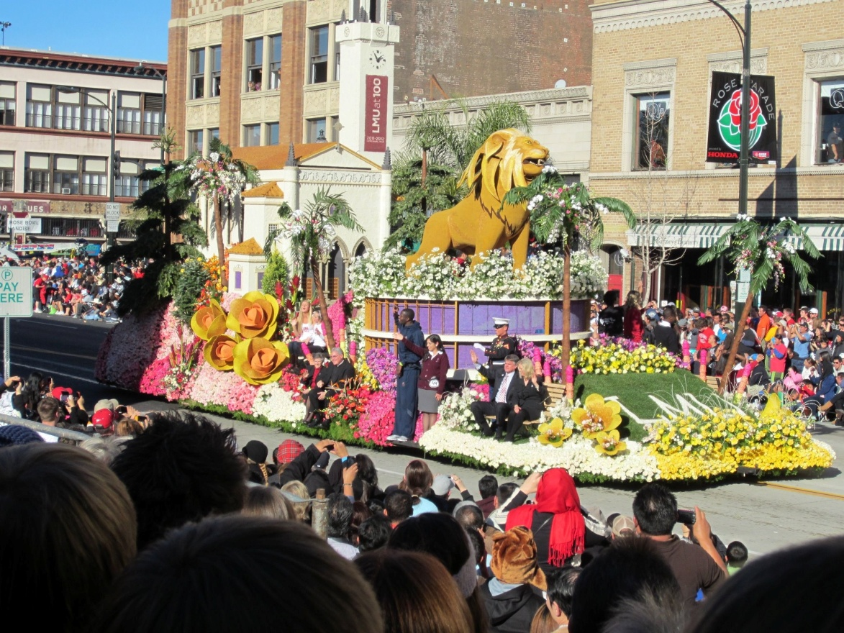
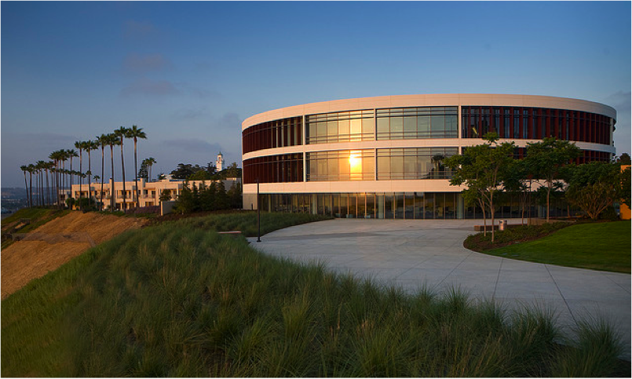
Loyola Marymount University
Private Jesuit and Marymount university in Los Angeles, CA
7758 students enrolled at LMU
English 110: Required library visit for freshmen

Slide 3
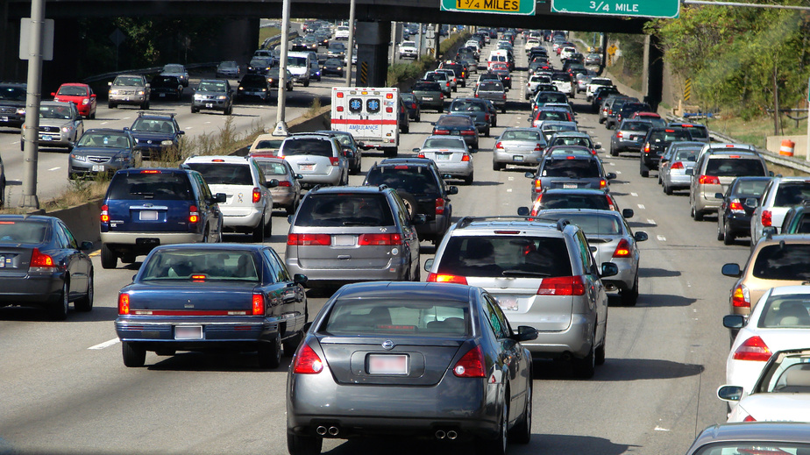
Instructionmageddon
No #@!!% research assignment!
Library Tour
No!
Online Tutorial
Gaming?
ACRL Standards
Standardized Lesson
Active Learning
Rubric
LIBRARIAN ON
BOARD!
Dude, Where’s my car!
I Assessment

Slide 4
The Assessment Cycle
“We plan. We develop. We deliver. We assess and evaluate the results of the assessment. We revise, deliver the revised material, and assess and evaluate again” (Grassian & Kaplowitz, 2001, p. 265).
* Grassian, E.S., Kaplowitz, J.R. (2001), Information Literacy Instruction, Neal-Schuman, New York, NY.

Slide 5

We Plan
Applied Jerilyn Veldof’s “One-Shot” instructional design methodology.
Prioritized content: “need-to-know” vs.. “nice-to-know”
Task Analysis: steps, teaching points, learning objectives

Slide 6
Student Learning Outcomes
Given a broad research topic, use the 4W questions (who, what, where, when) to write a research question.
Given a research topic, pick out the key concepts and compile a list of search terms or keywords.
Given background information about Google and the Library, list two differences between the two related to content, organization, quality, or access.
Given a research topic and access to the library's catalog, find 1 relevant book on your topic and record all relevant citation information.
Given a research topic and access to a general article index database, find 1 relevant article on your topic and record all relevant citation information.

Slide 7
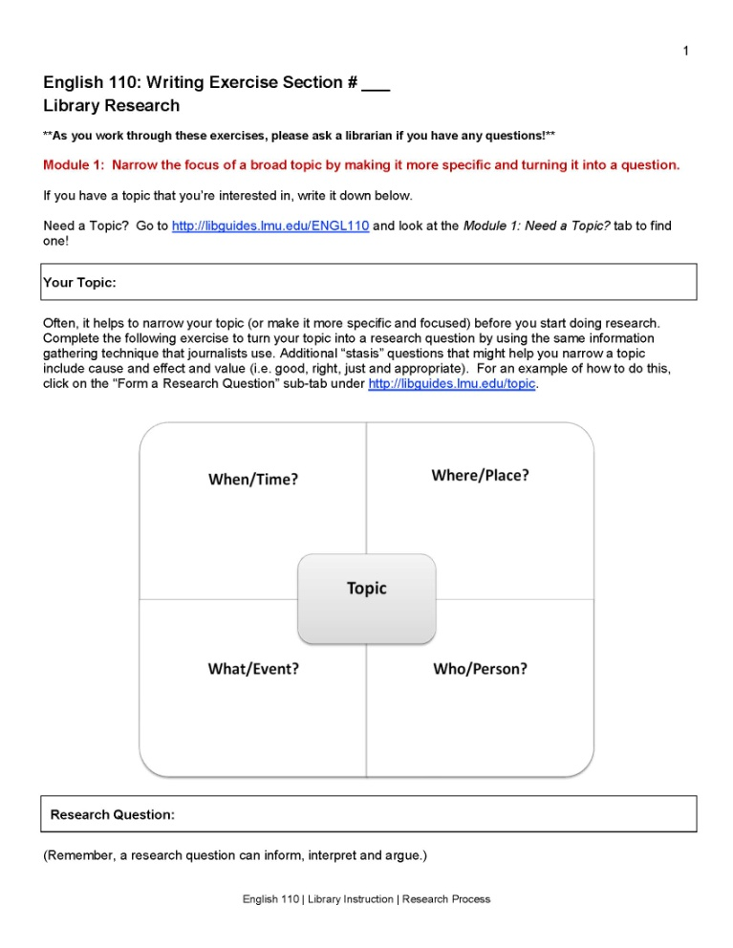
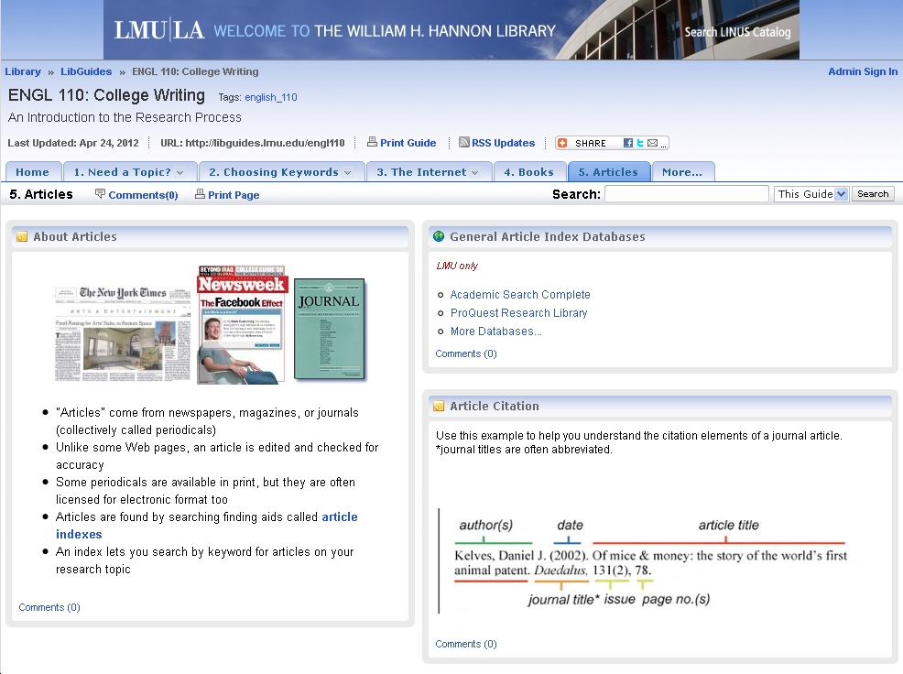
We Develop
Worksheet
LibGuide
(See Handout #1)
http://libguides.lmu.edu/engl110

Slide 8

We Deliver
Fall Semester
Freshman English
50 or 75 min. one-shots
65 classes
1,000+ students
7 librarians
Teaching Script

Slide 9
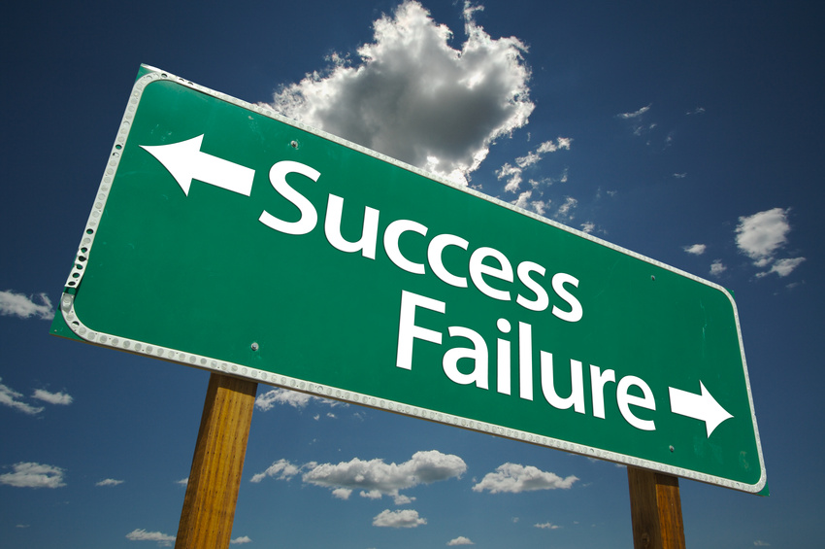
We assess and evaluate
Librarians collect worksheets at end of class
      Y1 = 755 worksheets
      Y2 = 587 worksheets
      Y3 = 910 worksheets
100 random worksheets single-graded using an analytic rubric
Graders recorded scores in Google form

Slide 10
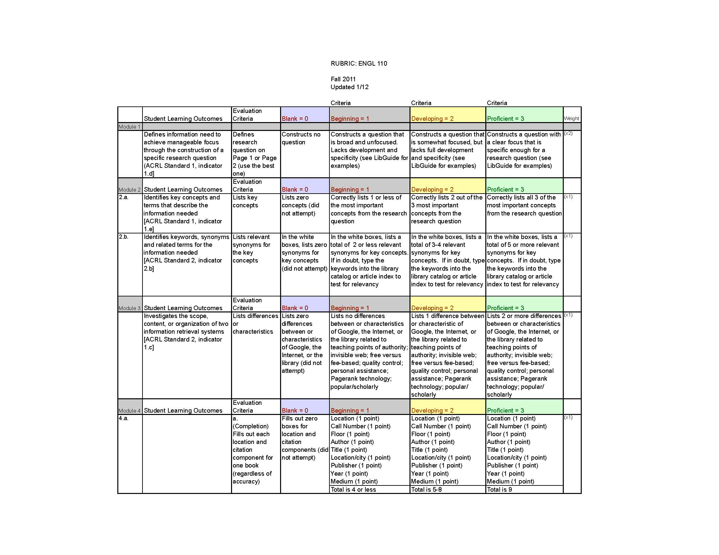
The Rubric
Grading Rubric
(See Handout #2)
http//:libguides.lmu.edu/ENGL110

Slide 11
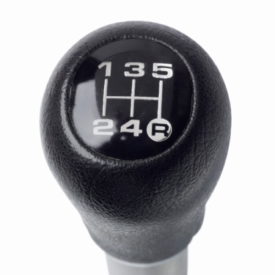
Using Assessment to Drive Instruction
“Closing the Loop”

Slide 12

The Hybrid Solution
…going beyond the 50 minute 1-shot

Slide 13
Online + F2F = Blended (Hybrid) Instruction
Assigning the entire worksheet as a homework assignment and then using the library class time for “review” might work best.
More buy-in from the English 110 instructors is needed to make the worksheet a graded assignment.

Slide 14

Problem Module 3
The Lemon

Slide 15
Module 3: Lowest scoring module
Discover Best Practices
Survey Librarians
Survey English 110 Instructors
Simplify LibGuide and Teaching Points
Peer Observation/Evaluation

Slide 16

Detour: Year 3
Some scores went down!

Slide 17
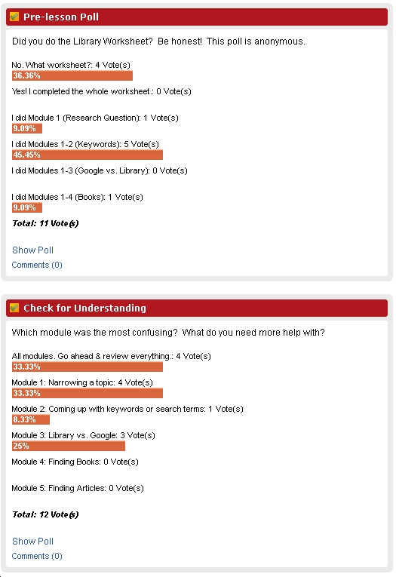
Pre-lesson Poll

Slide 18
Detour: Year 3
Pre-lesson Poll was misleading
Too focused on low scoring modules
Need to teach all modules equally
Revisit the “need-to knows” vs. “nice-to-knows”
Teach only what is needed to complete worksheet

Slide 19
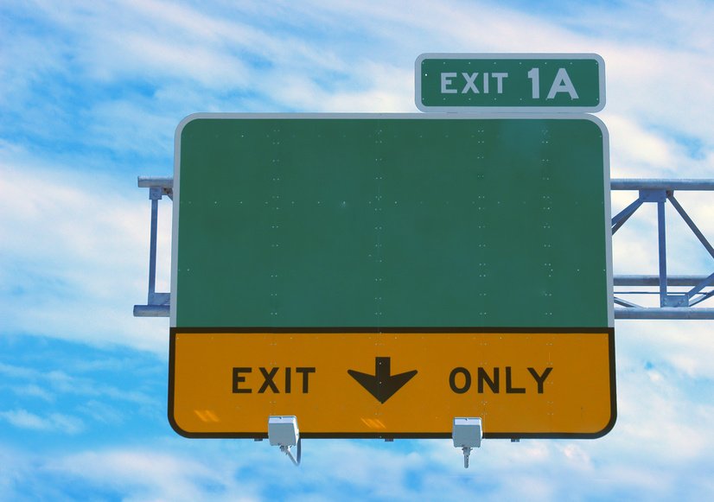
Back on Track for Year 4!
Begin
Assessment Cycle

Slide 20

Conclusions
Student Outcomes – Results were mixed
Led to some improvements in teaching material for lower-scoring modules
Led to greater communication of our instruction goals
Clearer teaching expectations
Meaningful & Manageable Assessment

Slide 21

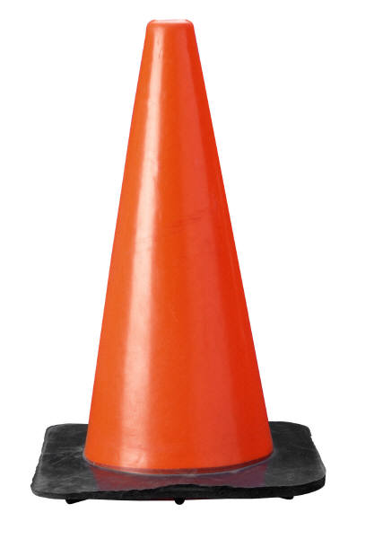

The Assessment Ride Share
Green Light
Worksheet
LibGuide
Rubric
Librarian Survey
Almost there…
Keyword Quiz
Peer Observation
Student Survey
Instructor Survey
Wrong Turn!
Pre-lesson Poll

Slide 22
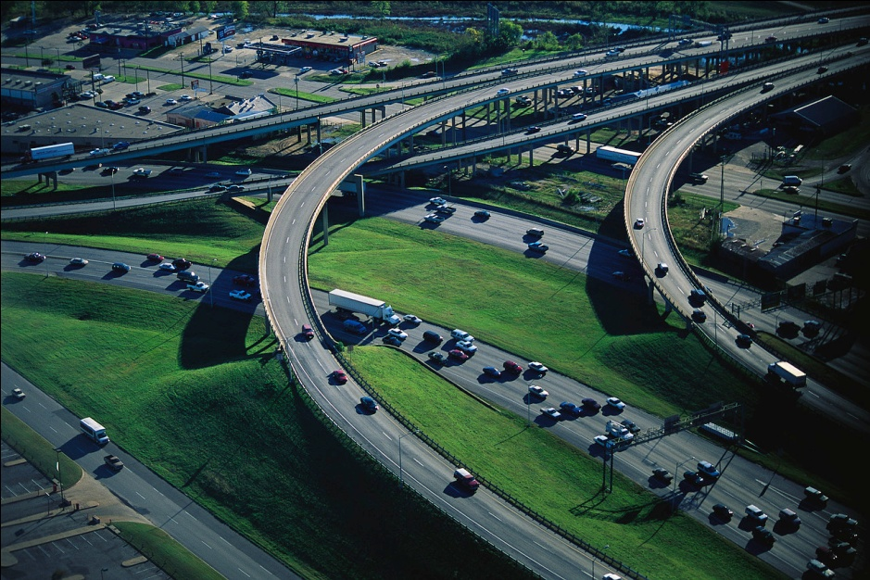
Selected Bibliography
Gardner, S., & Acosta, E.S. (2010) Using a rubric to assess freshman English library instruction. In S. Hiller, K Justh, M.
Kyrillidou, & J. Self (Eds.), Proceedings of the 2010 Library Assessment Conference: Building effective, sustainable,
practical assessment (pp.159-173). Washington, DC: Association of Research Libraries.
Grassian, E.S., & Kaplowitz, J.R. (2001), Information Literacy Instruction: Theory and practice.
New York: Neal-Schuman.
LMU Office of Assessment. (n.d.) Overview of Assessment. Retrieved from
http://www.lmu.edu/about/services/academicplanning/assessment/Overview_of_Assessment.htm
Oakleaf, M. (2009) Using Rubrics to Assess Information Literacy: An Examination of Methodology and Interrater
Reliability. Journal of the American Society for Information Science and Technology. 60(5), 969-983. doi:
10.1002/asi.21030
Oakleaf, M. (2009) The Information Literacy Instruction Assessment Cycle: A Guide for Increasing Student Learning
and Improving Librarian Instructional Skills." Journal of Documentation. 65(4), 539-560. doi:
10.1108/00220410910970249
Veldof, J. (2006) Creating the One-Shot Library Workshop: A Step-by-Step Guide. Chicago:
American Library Association.

Slide 23

Questions?
Notes:
I better stop because I’m out of time. Questions?
Assessment tells a story. I hope that you enjoyed our assessment trip. Feel free to use our materials.

Slide 24
For more information please visit…
http://libguides.lmu.edu/LOTW

