Slide 1
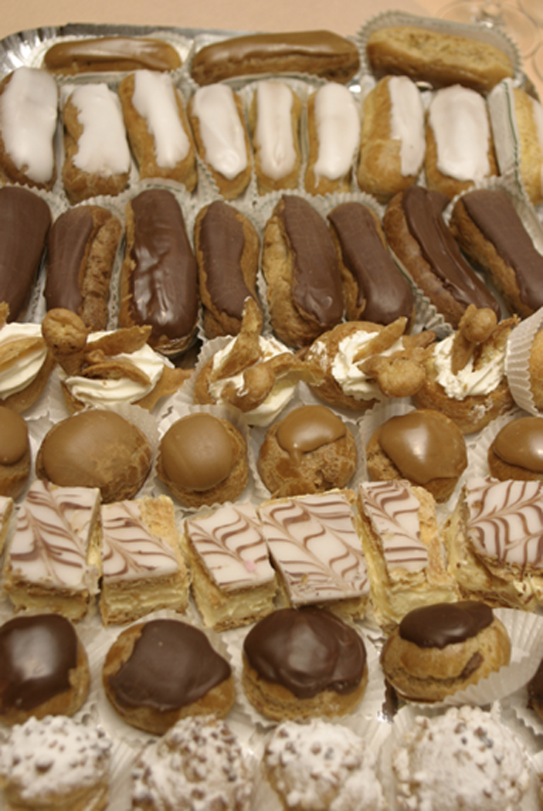

The Assessment Buffet,
Coming Back for Thirds
Yum-o!
Elisa Slater Acosta
Reference Librarian / Instruction Coordinator
Loyola Marymount University

Slide 2

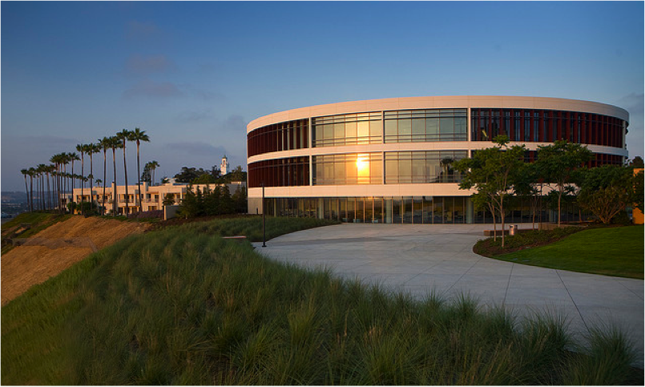
Loyola Marymount University
Private Jesuit and Marymount university in Los Angeles, CA
7553 students enrolled at LMU
English 110: Required library visit for freshmen
Notes:
97% of English 110 classes participated in LI for Fall 2011, 57 out of 59 classes.

Slide 3
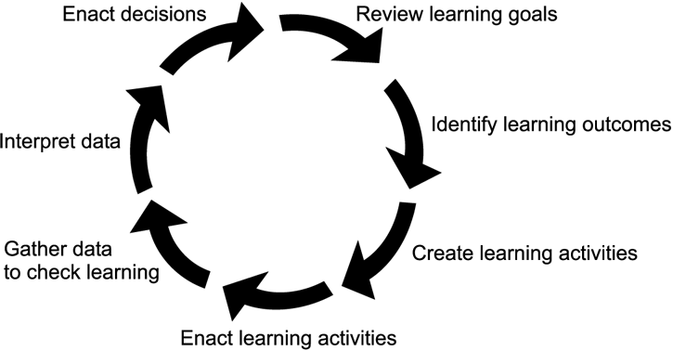
Information Literacy Instruction Assessment Cycle (ILIAC)*
*Oakleaf, Megan. "The Information Literacy Instruction Assessment Cycle: A Guide for Increasing Student Learning and Improving Librarian Instructional Skills." Journal of Documentation. 65(4). 2009.
Notes:
Our assessment cycle takes 1 year and has been repeated 3 times. We are closing the loop for Y3 and starting Y4.

Slide 4
Stage 1: Review Learning Goals
director of fep
library dean
reference librarians
(Talk to Stakeholders)
Create standardized intro to research process
Could apply to any topic
Develop learning outcomes and tie to ACRL Info Literacy Competency Standards
Active learning
Develop scoring rubric to evaluate skills
Notes:
English 110 – most do not have research assignment, before new E-classroom: lecture and PowerPoint, sometimes library tour, everyone taught English 110 differently, assessment = student & faculty satisfaction surveys only

Slide 5

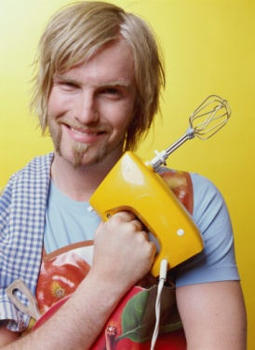
Stage 2: Identify Learning Outcomes
Applied Jerilyn Veldof’s “One-Shot” instructional design methodology.
Prioritized content: “need-to-know” vs.. “nice-to-know”
Task Analysis: steps, teaching points, learning objectives
What will I be able to do?
What will I know?
Notes:
I used Veldof’s book like a workbook. I wrote my notes on the Reference wiki. Click on the link if you are interested in seeing my thought process.
Veldof, Jerilyn. Creating the One-Shot Library Workshop: A Step-by-Step Guide. Chicago: American Library Association, 2006.

Slide 6
Student Learning Outcomes
Given a broad research topic, use the 4W questions (who, what, where, when) to write a research question.
Given a research topic, pick out the key concepts and compile a list of search terms or keywords.
Given background information about Google and the Library, list two differences between the two related to content, organization, quality, or access.
Given a research topic and access to the library's catalog, find 1 relevant book on your topic and record all relevant citation information.
Given a research topic and access to a general article index database, find 1 relevant article on your topic and record all relevant citation information.

Slide 7
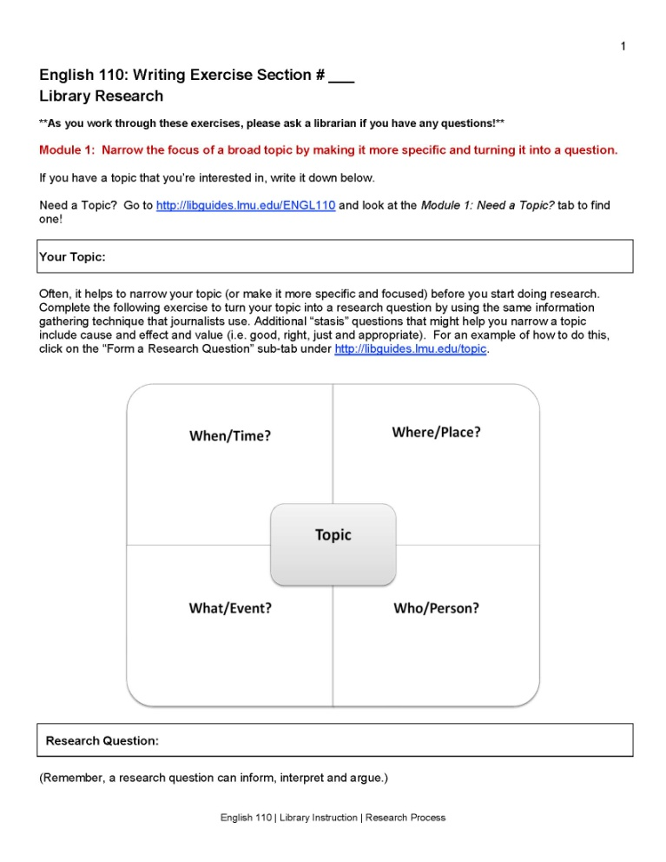
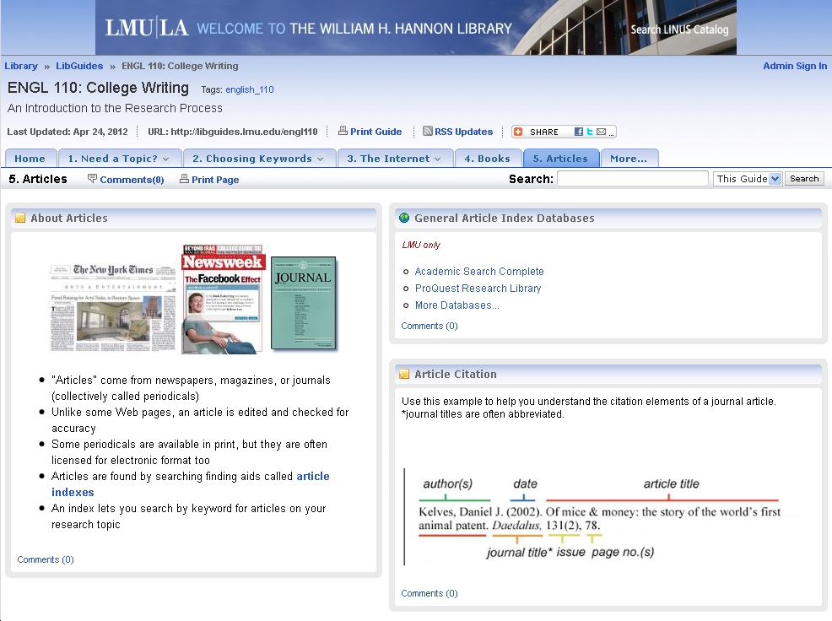
Stage 3: Create Learning Activities
Worksheet
LibGuide
http://libguides.lmu.edu/engl110

Slide 8
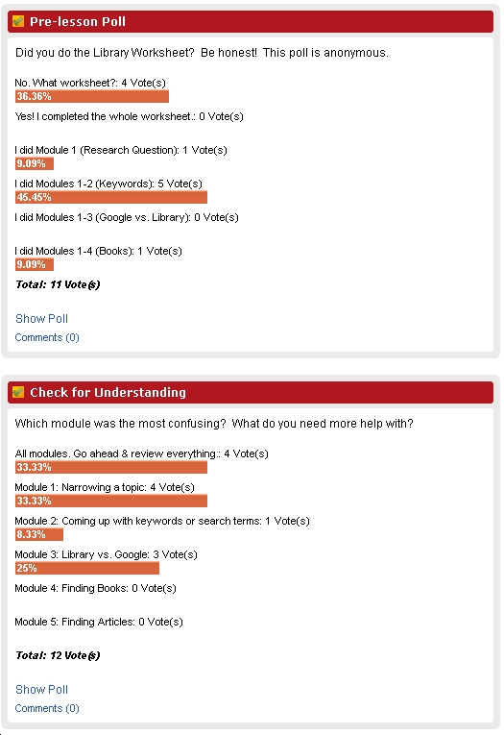
Stage 4: Enact Learning Activities
Teaching Script
Year 1 – Worksheets done in class
Year 2 – Modules 1&2 for homework
Year 3 – All modules for homework,
Pre-lesson poll
Notes:
Fall Semester: 50 or 75 minute 1-Shot in E-classroom, 19 students per class, about 1,000 students, 7 librarians so 8-9 classes per librarian

Slide 9
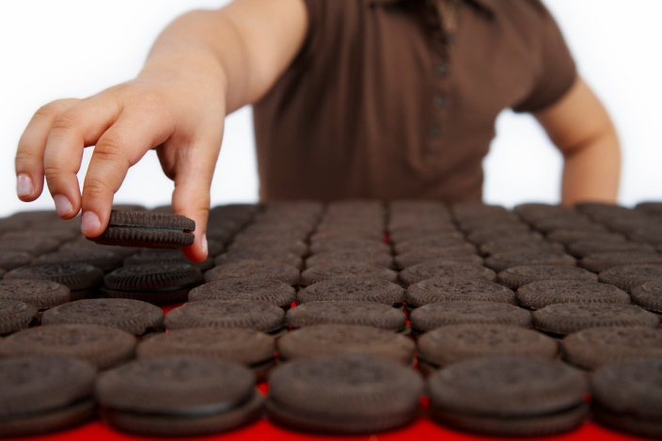
Stage 5: Gather Data to Check Learning
Librarian collects worksheet at end of instructional sessions
Photocopies them and gives to Library Instruction Coordinator
Originals are sent back to the English 110 Instructor via campus mail
      Y1 = 755 worksheets
      Y2 = 587 worksheets
      Y3 = 910 worksheets
Notes:
Why Y2 so low? Classes late to class, fire alarm, classes in November want to keep worksheets (they have a research assignment yay!), projector did not work, wireless/laptop batteries dead, librarians forgot to give me worksheets, etc. After Y2 I had a checklist of classes/worksheets collected.

Slide 10
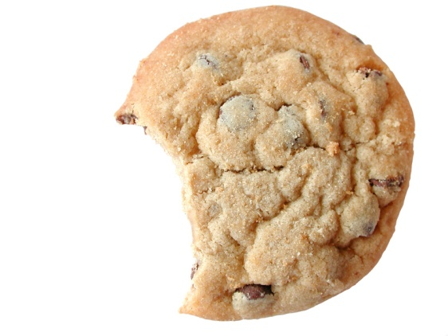
Stage 6: Review and Interpret Data
100 random worksheets single-graded using an analytic rubric
Graders recorded scores in Google form
Transferred data to Excel file- inserted formulas for weights
Average scores for all modules/subsections
Notes:
8 graders (7 librarians + Reference Assistant), very manageable, added comment box to Google form this year, we grade Spring Semester

Slide 11
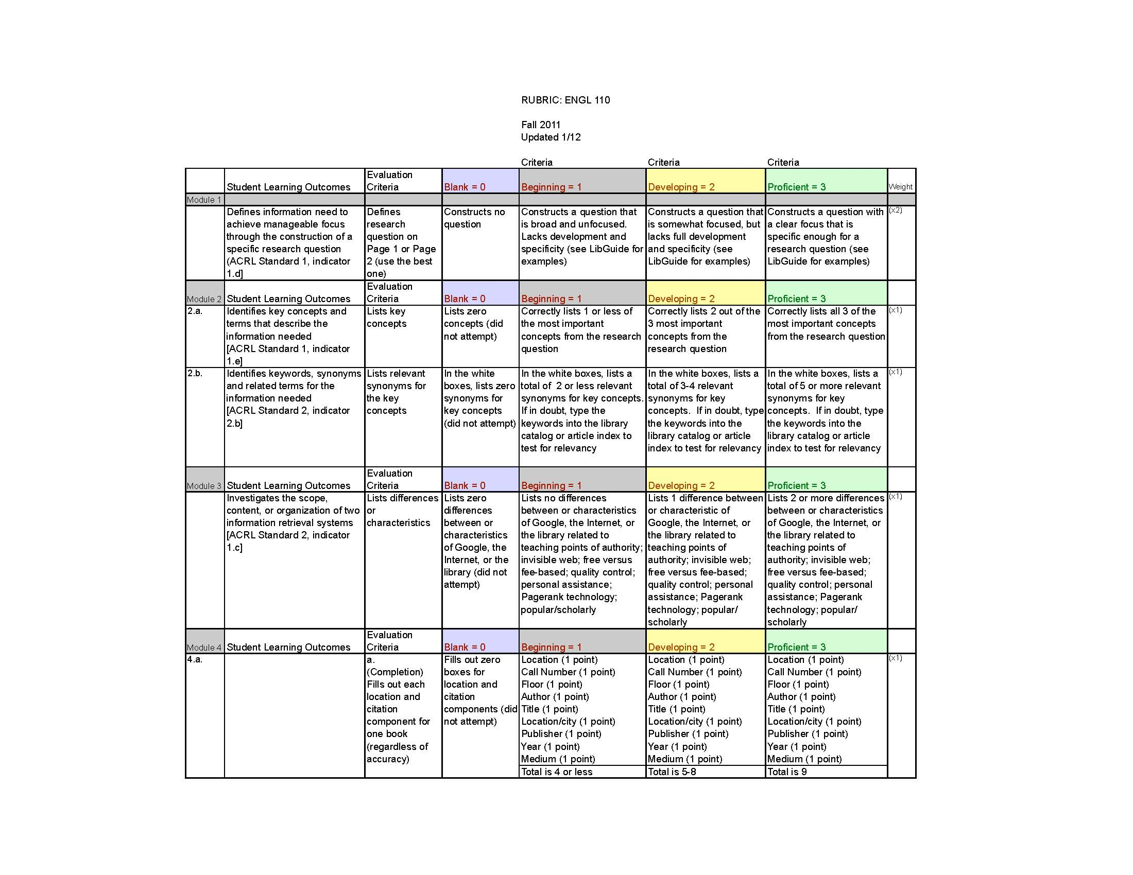
The Rubric
http//:libguides.lmu.edu/ENGL110
http://libguides.lmu.edu/engl110
Notes:
Analytic rubric, authentic assessment, direct measure, see bibliography for more information about norming/calibrating the rubric.

Slide 12
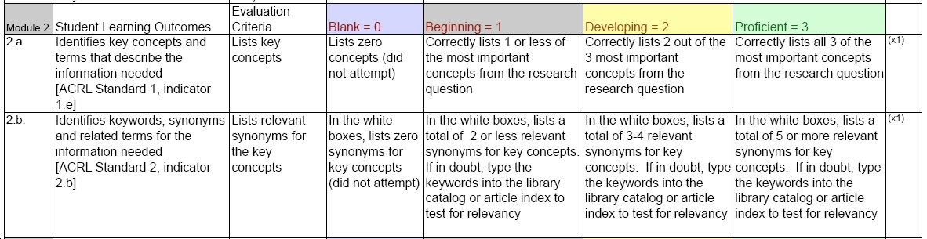
Rubric: Module 2

Slide 13
Module Averages
3 = Proficient
2 = Developing
1 = Beginning
 | Module 1 | Module 2 | Module 3 | Module 4 | Module 5
2009 | 2.55 | 2.47 | 2.06 | 2.6 | 2.6
2010 | 2.34 | 2.37 | 2.3 | 2.74 | 2.64
2011 | 2.23 | 2.4 | 2.06 | 2.41 | 2.36
Notes:
Mixed results: After Y1 focused on Module 3, and 1,2.
Y2 results 4 & 5 good, so we focused on 1,2,3. Perhaps too much because Y 3: 4 & 5 went down.
Y3 Assumed everyone did homework, perhaps librarian talked more or added “nice-to-know” instead of keeping to “needs-to-know.” Students still need time in class to complete Modules 4&5. The pre-lesson poll was misleading for the librarian. Some librarians taught the class based on the poll. (too much time on Module 1 & 2) Less teaching standardization for Y3? Need to keep to teaching points. Teach all modules equally.

Slide 14
Average per Subgroup
 | Module 1 | Module 2a | Module 2b | Module 3 | Module 4a | Module 4b | Module 4c | Module 5a | Module 5b | Module 5c
2009 | 2.55 | 2.47 | 2.47 | 2.06 | 2.43 | 2.39 | 2.78 | 2.65 | 2.65 | 2.55
2010 | 2.34 | 2.41 | 2.32 | 2.3 | 2.71 | 2.65 | 2.8 | 2.68 | 2.66 | 2.61
2011 | 2.23 | 2.4 | 2.4 | 2.06 | 2.5 | 2.36 | 2.38 | 2.42 | 2.47 | 2.27

Slide 15

Stage 7: Enact Decisions
“Closing the Loop”

Slide 16
General Decisions
Clearer directions added. More self-guided Y1
More buy-in from the English 110 instructors is needed to make the worksheet a graded assignment Y1
Assigning the entire worksheet as a homework assignment and then using the library class time for “review” might work best. Y2
Notes:
Instructor survey, “This was a useful worksheet for the students; completing it was relevant to their work so I didn’t feel the need to grade it.”
Graded assignment? English 110 Instructors-no, Director of FE-no.

Slide 17
The rubric will be modified across all modules to include a “0” score for blank answers, to differentiate a blank answer from an incorrect one. Y2
The worksheet will be redesigned for lower-scoring modules Y123
More consistent and precise instructions for the rubric and the worksheet Y123
Added additional examples to LibGuide Y23

Slide 18
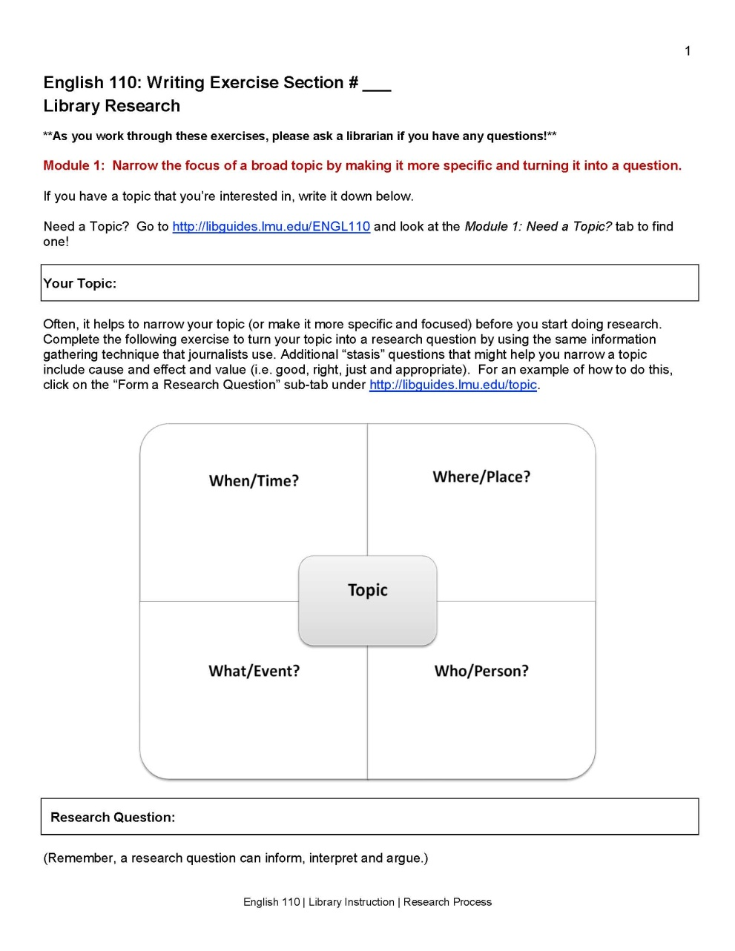
Worksheet: Module 1
Notes:
Get ENGL instructors more involved in helping students narrow down a research question
Rubric frustration – trying to quantify something that is subjective. Librarians asked for examples of what a 1, 2, or 3 research question looks like.

Slide 19
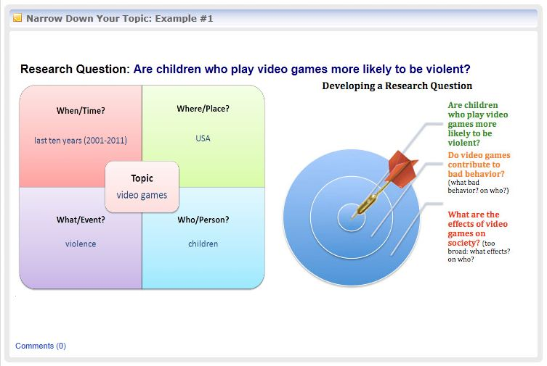
LibGuide: Module 1
Notes:
The 6 topic examples on the LibGuide will extend to illustrate for each “beginning” research question, a “developing” question, and a “proficient” question. A dartboard analogy getting closer to its target will be visually created.

Slide 20
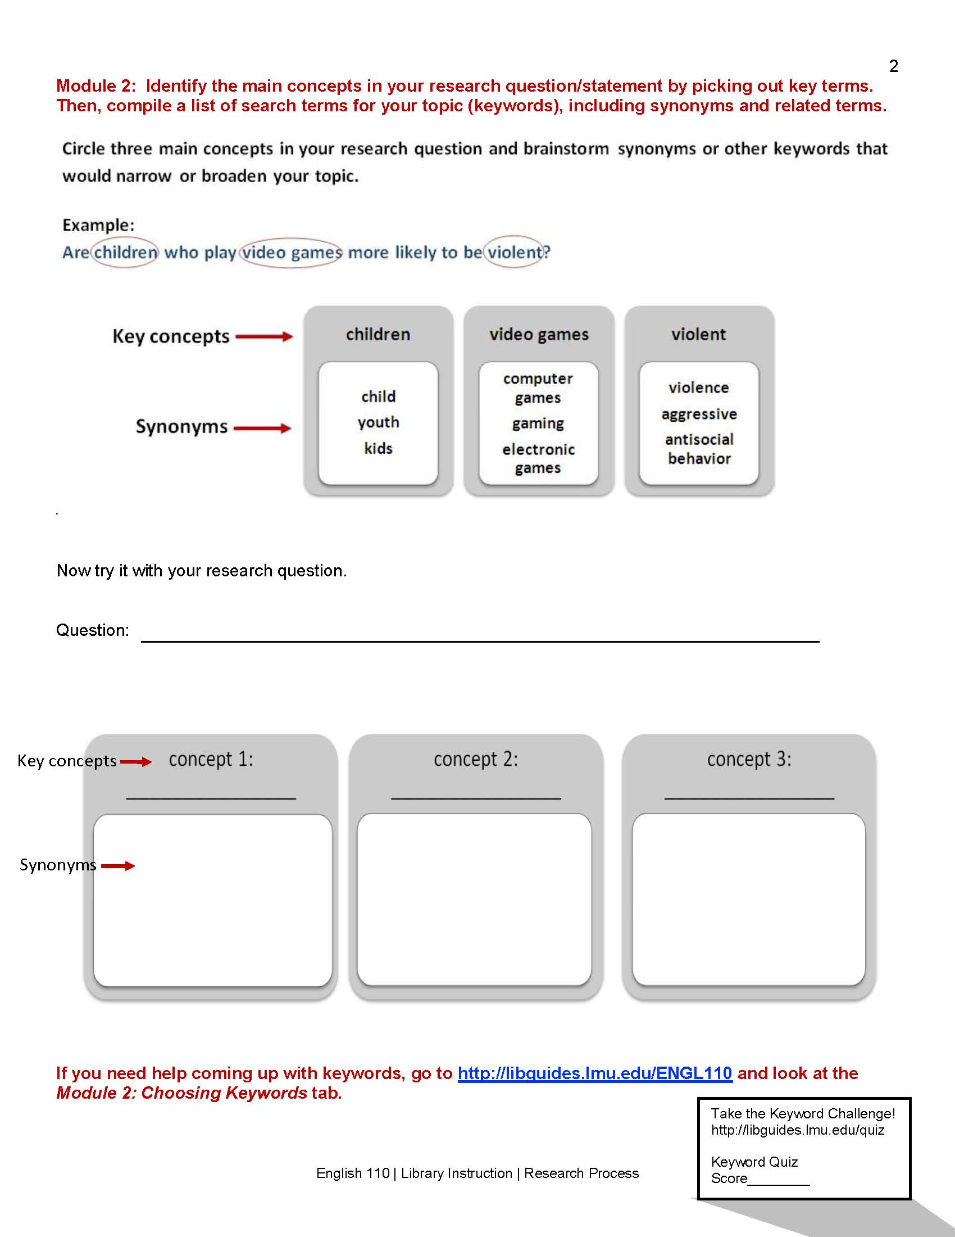
Worksheet: Module 2
Notes:
Keyword Quiz. We liked it but only 100 hits from LibGuide.
Better reflection of the cyclical nature of the research process by letting the research question and keywords evolve throughout the exercise
Not a single librarian liked teaching this module-survey (all other modules had a least 1 librarian rank as favorite – but not Module 2)

Slide 21
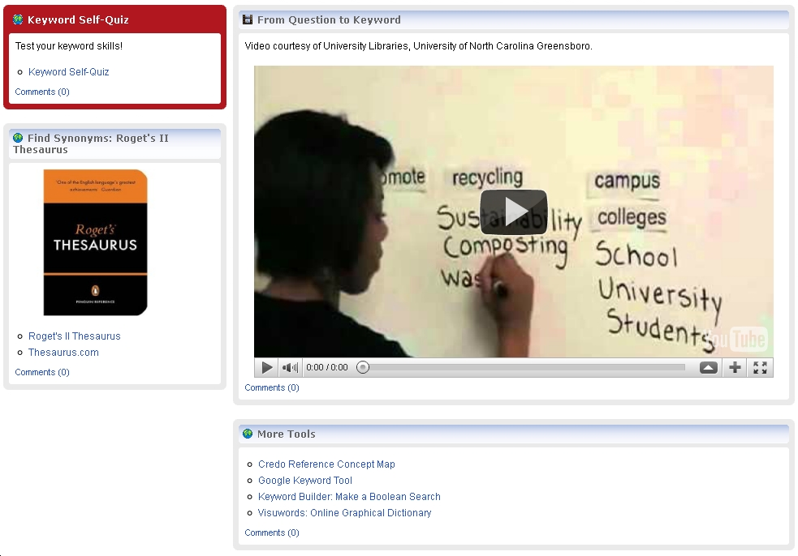
LibGuide: Module 2
Notes:
A practice keywords exercise.
Added more keyword practice tools and examples

Slide 22
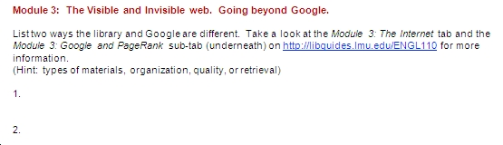
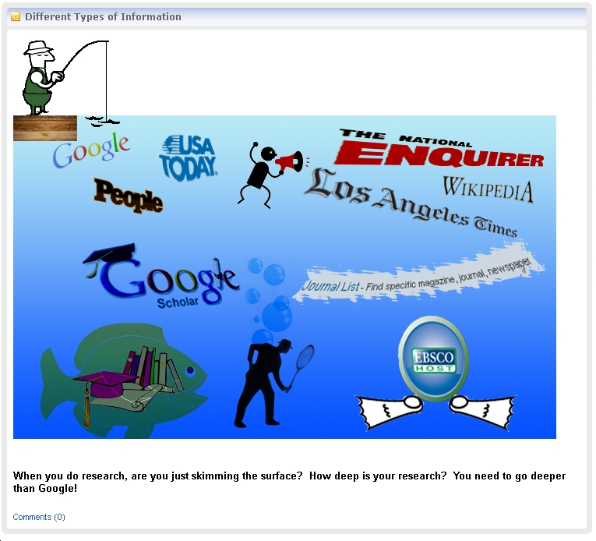

The Bad Cookie: Module 3
Notes:
Librarians not happy. Ranked low - librarian survey. However ENGL 110 Instructors and Director of FEP loved it. We are keeping it! Intern observed all 7 librarians and said that we all taught Module 3 differently.
Shortened Module 3 and standardized Y1

Slide 23
Peer Observation: Module 3
“I think that the English 110 series could also be improved by a process of peer observation and review of the English 110 courses. If all reference librarians are supposed to be teaching the same modules in the same way, some sort of review system could be put in place so that we can discuss as a group how we are doing it in individual sessions what's working, what isn't, etc.”
- Librarian Feedback (survey from Year 1)
Notes:
Peer review observations of Module 3 to check for standardization. Y2
This module should become Module 1. Change the order of the tabs in LibGuides and the worksheet. Y3
Need to do this again Y4. Discover best practices for this module.
ECHO 360 optional (record session) self evaluation

Slide 24
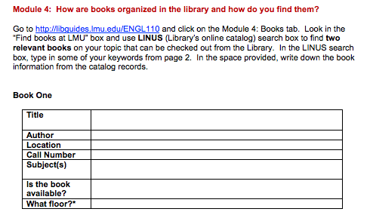
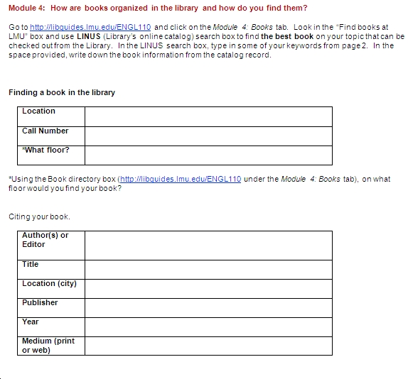
Worksheet: Module 4
Year 1
Year 3
Notes:
The separation of elements needed to cite and find a book.
Modified to only 1 book and 1 article rather than 2 (relevancy over quantity)
English 110 Instructors liked module 4 (and 3) the best

Slide 25
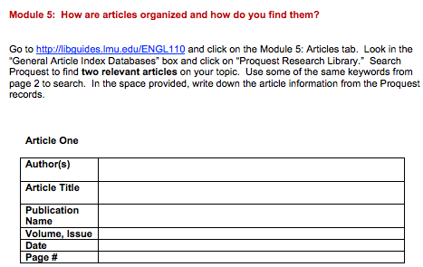
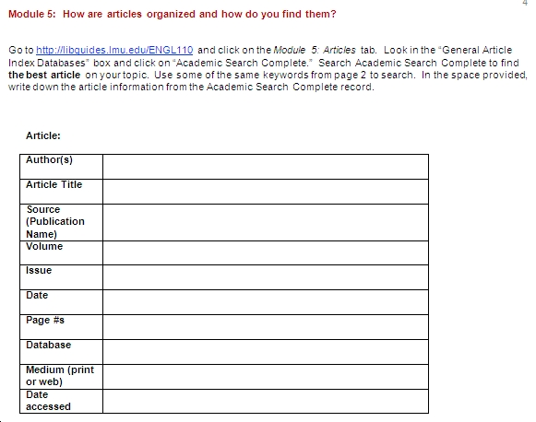
Worksheet: Module 5
Year 1
Year 3
Notes:
Changed Modules 4 and 5 to match stated learning outcome “lists citation elements in correct fields”
Oops! Make sure rubric and worksheet match! Did not discover until grading first year.

Slide 26

Stage 7: Continued
Share results:
Librarians
Director of Freshman English Program
English 110 Instructor Lunch
Office of Assessment
Center for Teaching Excellence
Notes:
Communicate Decisions
FEP meet before Y1 and Y2 added language from textbooks
ENGL 110 report and annual lunch (library pays for 1 lunch during 3-day orientation in Aug)
Office of Assessment “Assessment success story” , Information Literacy included in new LMU Undergraduate Learning Outcomes
Poster Sessions for: Center for Teaching Excellence and Student Affairs Research & Assessment Committee
Fall 2013
Information Literacy is now embedded in new Core Curriculum (graded assignment 10% of grade), and flagged course.
No more English 110

Slide 27

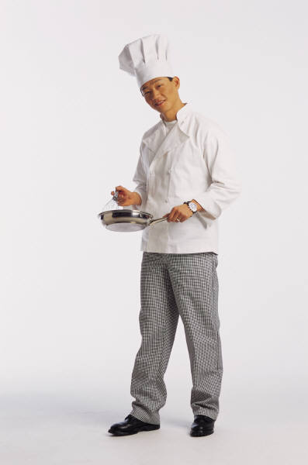

Assessment Buffet
Iron Chef
Worksheet
LibGuide
Rubric
Librarian Survey
Back to Test Kitchen
Keyword Quiz
Peer Observation
Student Survey
Instructor Survey
Half Baked
Pre-lesson Poll
Online Tutorial
Notes:
Worksheet, LibGuide, Rubric: Instruction/learning tool can also be your assessment tool
Librarian Survey = useful: favorite/least favorite, Module 3, peer-observation
Keyword Quiz= good, but how to get more students to take it?
Peer Observation= good idea, difficult to schedule, not the best execution last year late in the semester (2 librarians ran out of time/no observation)
Student Survey = time to bring back the student satisfaction survey? change pre-lesson poll into post-lesson evaluation
Instructor Survey = no graded, maybe, liked module 3 & 4 best, give survey out again
Pre-lesson Poll = going away
Online Tutorial = still need to grade 30 worksheets from 2 classes that did not come to the library. Half-baked status because work is not done.

Slide 28

Conclusions
Easier to connect our learning outcomes with ACRL standards
Led to greater communication of our instruction goals
Clearer teaching expectations
Increased standardization in library instruction for Freshman English
Librarians can now focus on delivery
instead of design

Slide 29

Conclusions
Student Outcomes - Results were mixed
Led to some improvements in teaching material for lower-scoring modules
New benchmarks for defining success
each year
Meaningful & Manageable Assessment
Assessment is no longer the “mystery ingredient”

Slide 30

Selected Bibliography
Gardner, S. & Acosta, E.S. (2010) Using a rubric to assess freshman English library instruction. In S. Hiller, K Justh, M.
Kyrillidou, & J. Self (Eds.), Proceedings of the 2010 Library Assessment Conference: Building effective, sustainable,
practical assessment (pp.159-173). Washington, DC: Association of Research Libraries.
LMU Office of Assessment. (n.d.) Overview of Assessment. Retrieved from
http://www.lmu.edu/about/services/academicplanning/assessment/Overview_of_Assessment.htm
Oakleaf, M. (2009) Using Rubrics to Assess Information Literacy: An Examination of Methodology and Interrater
Reliability. Journal of the American Society for Information Science and Technology. 60(5), 969-983. doi:
10.1002/asi.21030
Oakleaf, M. (2009) The Information Literacy Instruction Assessment Cycle: A Guide for Increasing Student Learning
and Improving Librarian Instructional Skills." Journal of Documentation. 65(4), 539-560. doi:
10.1108/00220410910970249
Veldof, J. (2006) Creating the One-Shot Library Workshop: A Step-by-Step Guide. Chicago:
American Library Association.

Slide 31
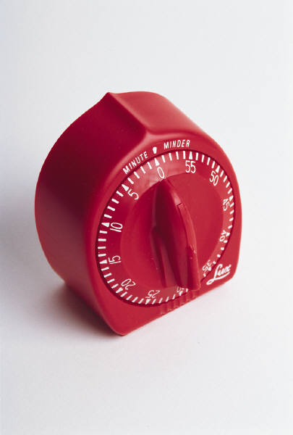
Questions?
Notes:
Assessment tells a story. I hope that you enjoyed our story. Feel free to use our materials.

Slide 32

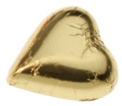
Thank you
Susan Gardner, Head of Reference & Instruction
LMU Reference Department
Meghan Oakleaf
LMU Office of Assessment

Slide 33
For more information please visit…
http://libguides.lmu.edu/loex
All images are from Microsoft Office clip art unless noted.

Slide 34
LOEX 2012
Conference theme and track info.
Dessert: Always leave room for this
Measuring the effectiveness of programs and learning
Assessment is critical for understanding how instruction librarians contribute to student success. How do you use assessment to measure the impact of your instruction program? How do you create and assess learning objectives for your instruction sessions. What do you measure and how do you collect that information?

