Slide 1

MeMBERSHIP Committee
Leadership Retreat 2.4.12

Slide 2
MeMBERSHIP Committee
Goals

Slide 3
Membership committee
Target & increase general awareness of new rolling membership year & two new
joint ALA/SCLA Paraprofessional & Student
membership categories

Slide 4
Membership Committee
Initiate the
    “Do You Know? Meet SCLA Members…”
series of short member bios

Slide 5
Membership Committee
Hold Membership Campaign 2012 entitled:
“Each One, Reach One”

Slide 6
Membership Committee
Create & post on the SCLA site
Membership
FAQs

Slide 7
Membership Committee
Study the possibility of creating
tiered Institutional Membership
levels to increase revenue

Slide 8
Membership committee
Publish by year’s end a
Membership List
by respective Sections, Committees or Roundtables

Slide 9
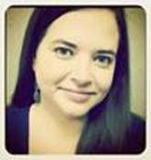
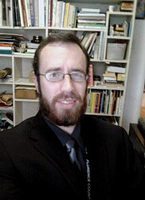
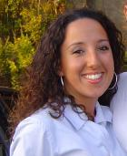
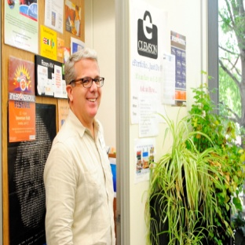
2012 Membership Committee
We welcome your input,
Georgia Coleman, Hunter Deas, Ed Rock, Michelle Rubino

