Slide 1
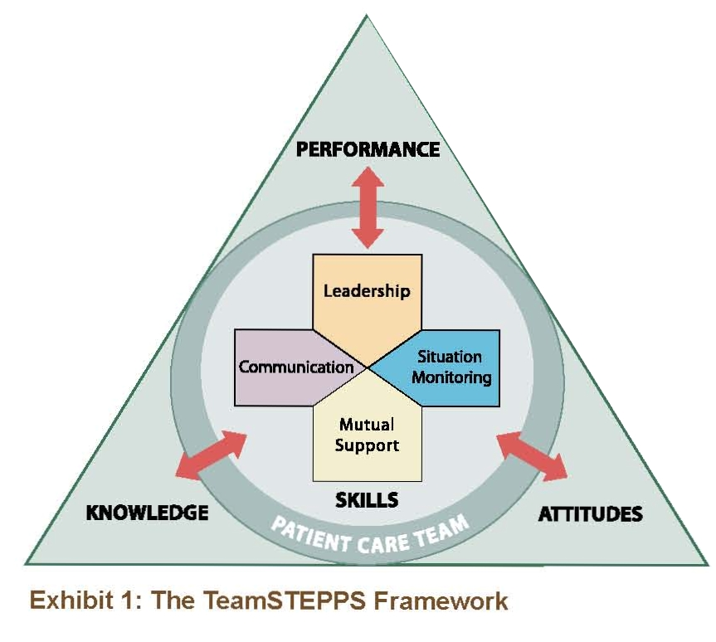
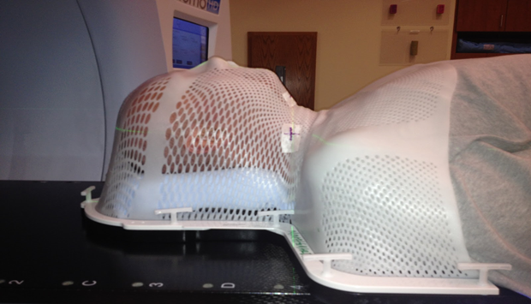
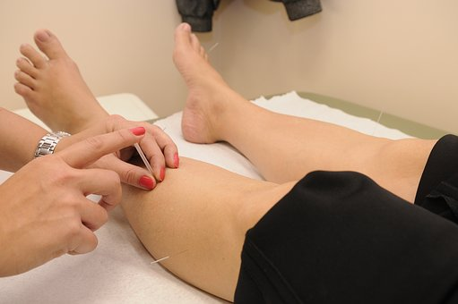

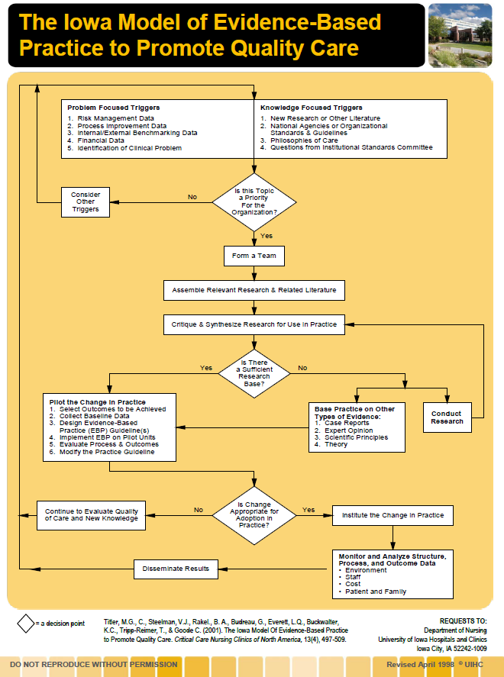
Process Review of an Innovative Interprofessional Inter-Agency Evidence-Based Practice (EBP): Clinical Scholar Team
Dorothea Hansmeyer MSN, RN, CNE, PHN, Alvina Brueggemann PhD, Brenda Frie MA, OTR/L CHT, Cynthia Dols Finn MN, RN, CNE, PHN, Suzanne Monahan, RN BSN, Laurie Sieve DNP, RN, PHN CNE
Abott Northwestern Hospital, Penny George Institute for Health and Healing, Dept of Nursing and Occupational Therapy and Women’s Health Intregrative St Catherine University,
PURPOSE AND RATIONALE:
The purpose of this case study is to describe the opportunities and challenges of participants in an evidenced-based interprofessional, inter-agency clinical scholar program team.
EVALUATION: PROCESS REVIEW
NEXT STEPS
Next Steps: Study implementation (“A pilot randomized controlled trial to assess feasibility, symptoms, and biobehavioral outcomes of acupuncture in patients undergoing radiation therapy for squamous cell carcinoma of the head and neck”)
SYNTHESIS OF EVIDENCE
Increasingly, healthcare organizations are strategizing to incorporate evidence-based practice into patient care (Iles, & Auluck, 1990; Ndoro, 2014; Salas & Rosen, 2013; Salas et al., 2009). Interdisciplinary and inter-agency teams provide a unique avenue for implementing evidence-based care to inform practice change (Moyers, Guthrie, Swan, & Sathe, 2014; Salas & Rosen, 2013; Zwarenstein, & Reeves, 2005).
Reprinted with permission from: TeamSTEPPS 2.0. (September 2015). Agency for Healthcare Research and Quality, Rockville, MD. http://www.ahrq.gov/professionals/education/curriculum-tools/teamstepps/instructor/index.html.
Leadership: Clear leadership structure, didactics, professional development through education, use of resources, shared leadership, shared vision
Situation Monitoring: Charter goals/roles revisited periodically, mentor identified problems and kept team informed, restructured after personnel changes, changed topics based on feasibility, monitored state of individuals on team
Mutual Support: Meditation check-ins, redistributed roles during challenging times, emotional support, interdisciplinary team support that drew on the strengths of thm, institutional support and funding,
Communication: Meeting minutes, Technology (D2L, Wiggio, Google, Email), Meeting schedule, Alternating Sites, Respectful communication
PRACTICE CHANGE AND IMPLEMENTATION STRATEGIES
CONCLUSIONS
Collaboration between different healthcare disciplines, educational institutions and a clinical facility enriches EBP projects to influence practice change. Teamwork is enhanced by continuous situation monitoring, communication, leadership, and mutual support. Therefore, this innovative interprofessional EBP teamwork model provides a framework for team engagement in an evolving healthcare system.
Challenges: Nursing Strike, Layoff of Research Infrastructure Staff, Change in technological supports, project timeline, Different levels of technology knowledge
Opportunities: Expand EBPs to other clinical sites with high need for healthcare innovation; increase student involvement; enhance relationships between faculty, students, and practitioners at clinical sites, strengthen teams through education, bridge gap between practice and evidence.
ACKNOWLEDGEMENTS
Abbott Northwestern Foundation
Interprofessional Clinical Scholars Program
St Catherine University Henrietta Schmoll School of Health
Abbott Northwestern Virginia Piper Cancer Institute
REFERENCES
Iles, P, & Auluck, R. (1990). From organizational to interorganizational development in nursing practice: improving the effectiveness of interdisciplinary teamwork and interagency collaboration. Journal of Advanced Nursing, 15, 50-58.
Moyers, P., Finch Guthrie, P., Swan, A., & Sathe, L. (2014). Interprofessional evidence-based clinical scholar program: Learning to work together. American Journal of Occupational Therapy, 68, S23–S31. doi:10.5014/ajot.2014.012609
Ndoro, S. (2014). Effective multidisciplinary working: The key to high-quality care. British Journal of Nursing, 23, 724-727.
Salas, E., Almeida, S. A., Salisbury, M., King, H., Lazzara, E. H., Lyons, R., Wilson, K., Almeida, P., & McQuillan, R. (2009). What are the critical success factors for team training in health care? Joint Commission Journal on Quality & Patient Safety, 35(8), 398-405.
Salas, E., & Rosen, M. A. (2013). Building high reliability teams: Progress and some reflections on teamwork training. BMJ Quality & Safety in Healthcare, 22(5), 369-373. doi: 10.1136/bmjqs-2013-002015
Zwarenstein, M., & Reeves, S. (2006). Knowledge translation and interprofessional collaboration: Where the rubber of evidence-based care hits the road of teamwork. The Journal of Continuing Education in the Health Professions, 26, 46–54.
The Iowa Model Collaborative. (In press). The Iowa Model Revised: Development and validation. Worldviews on Evidence-Based Nursing.

