Slide 1

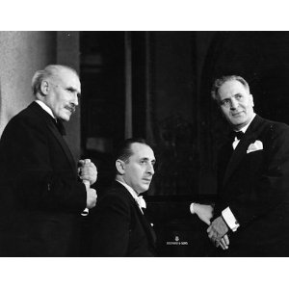
Vladimir Horowitz and Brahms’ Piano Concerto No. 2 in B-flat Major : 4/8/1948 with Bruno Walter and the New York Philharmonic
Diane Napert, Yale University
May 17, 2013
Photo available from Odd Couple Classics via Amazon for $65

Slide 2

The Historical Sound Recordings Collection at Yale
Comprised of historical recordings of performers important in the fields of Western classical music, jazz, American musical theater, drama, literature, and history (including oratory). HSR was founded by Mr. and Mrs. Laurence C. Witten II in 1960/1961 with their collection of early vocal recordings.

Slide 3
The Papers of Vladimir and Wanda Toscanini Horowitz.
The papers are part of the music library
http://www.library.yale.edu/musiclib/ archival.htm#horowitz
The sound recordings were separated and became part of the Historical Sound Recordings Archive (HSR) (before HSR reported in to the music library)
Currently the sound recordings are not part of the finding aid

Slide 4
Sound Recordings
1986 – 218 12” and 16” recordings, mostly from Mr. Horowitz’s private collection were donated to Yale
The hope is that these will be digitized and cataloged in the near future

Slide 5
Horowitz and Bruno Walter
Longstanding relationship as evidenced by a letter and Christmas cards in Yale’s Archive.

Slide 6
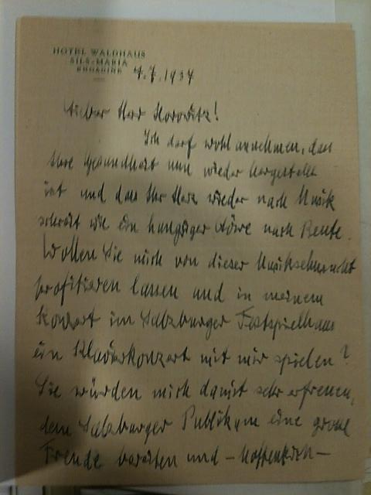

Page 1 of 1937 Letter Yale Archive
MSS 55, The Papers of Vladimir and Wanda Toscanini Horowitz in the Irving S. Gilmore Music Library of Yale University.

Slide 7
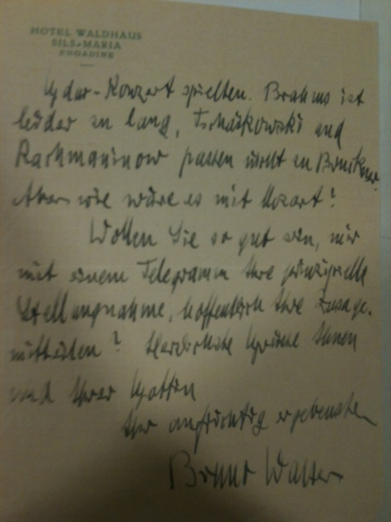
Page 3 of 1937 Letter Yale Archive
MSS 55, The Papers of Vladimir and Wanda Toscanini Horowitz in the Irving S. Gilmore Music Library of Yale University.

Slide 8

Bruno Walter
Favorite conductor
Recorded in Chicago, November 8, 1977
Courtesy of Oral History of American Music, Yale University
Material Donated by Elyse Mach

Slide 9
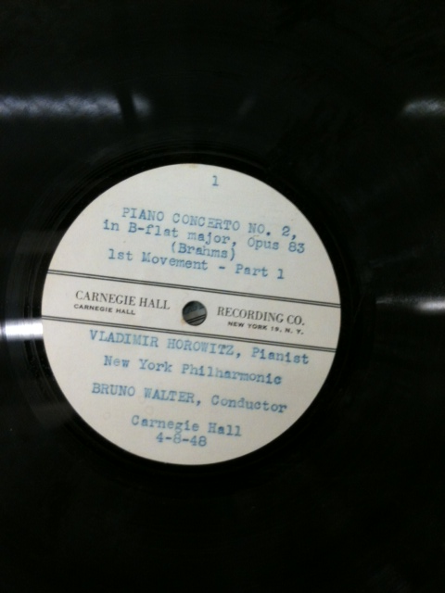
Brahms’ Piano Concerto No. 2 in B-flat Major
There are six records, twelve sides

Slide 10
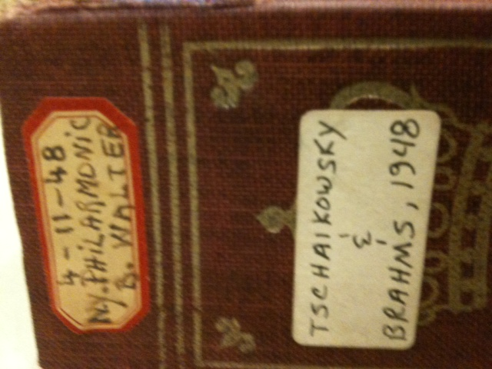
Private recording kept in an album
The Brahms is from 4/8/48, but there is also a 4/11/48 Tchaikovsky with Bruno Walter

Slide 11
Brahms
There are scores of several other pieces by Brahms in his collection

Slide 12
Horowitz Scores
Examined the full score and the 2 piano score, also first stand, first violin part
Not many markings

Slide 13
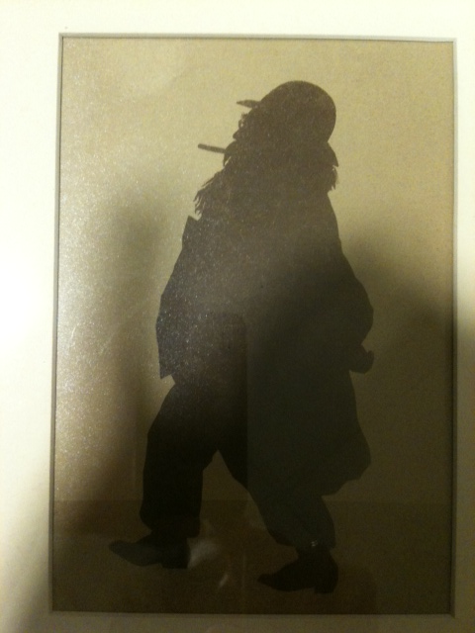
Brahms Silhouette
MSS 55, The Papers of Vladimir and Wanda Toscanini Horowitz in the Irving S. Gilmore Music Library of Yale University.

Slide 14
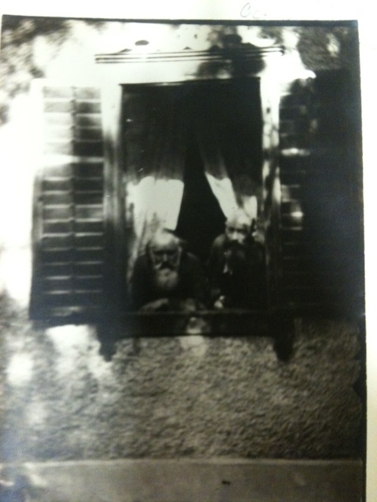
Johannes Brahms and Ignaz Brüll
MSS 55, The Papers of Vladimir and Wanda Toscanini Horowitz in the Irving S. Gilmore Music Library of Yale University.

Slide 15
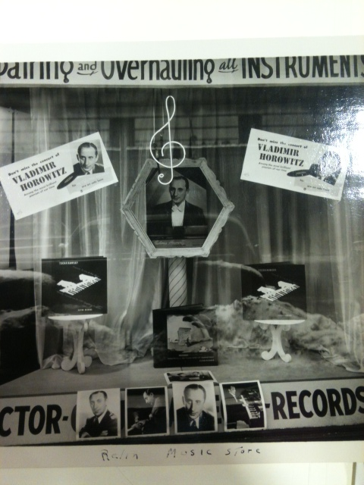
On way to concert
MSS 55, The Papers of Vladimir and Wanda Toscanini Horowitz in the Irving S. Gilmore Music Library of Yale University.

Slide 16
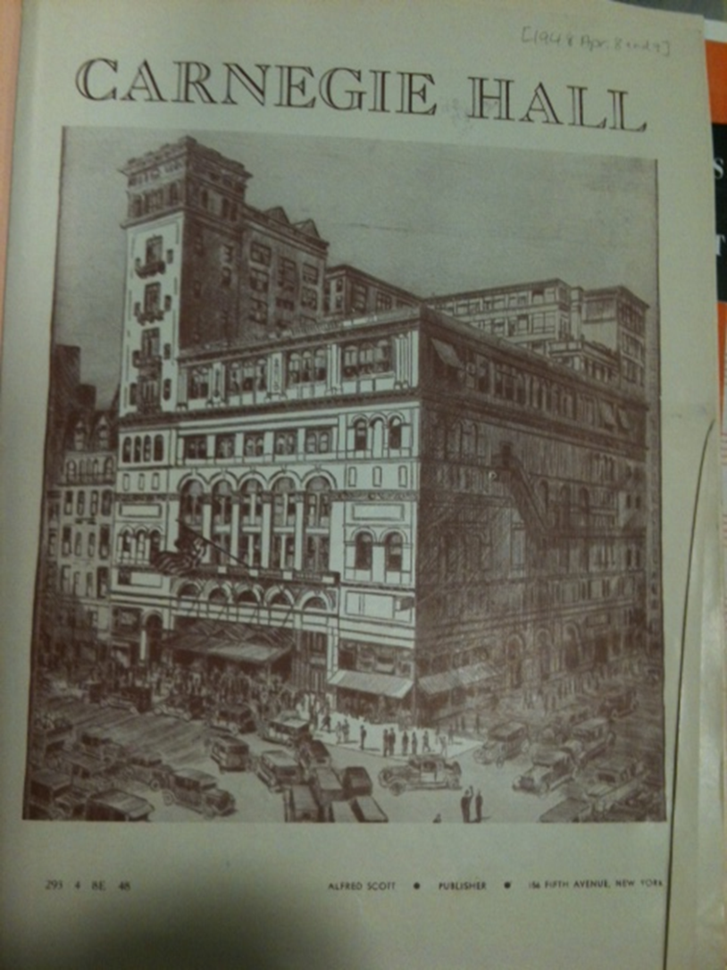
Get your program
MSS 55, The Papers of Vladimir and Wanda Toscanini Horowitz in the Irving S. Gilmore Music Library of Yale University.

Slide 17
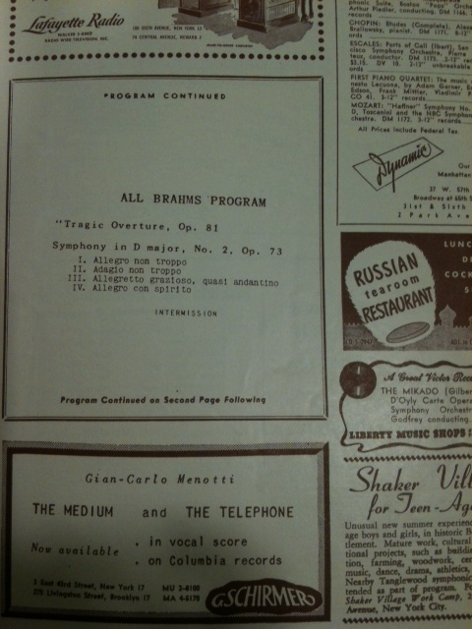
Page through program
MSS 55, The Papers of Vladimir and Wanda Toscanini Horowitz in the Irving S. Gilmore Music Library of Yale University.

Slide 18
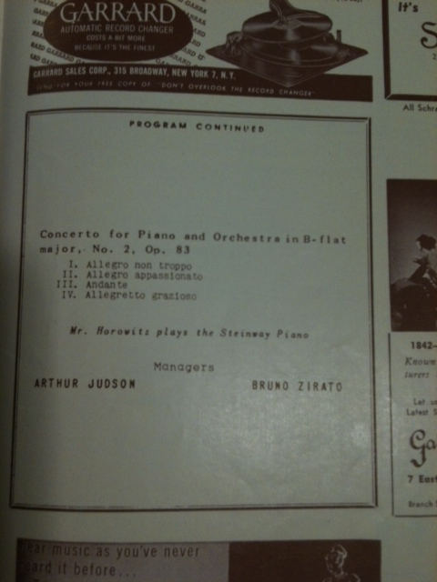
Best for last

Slide 19

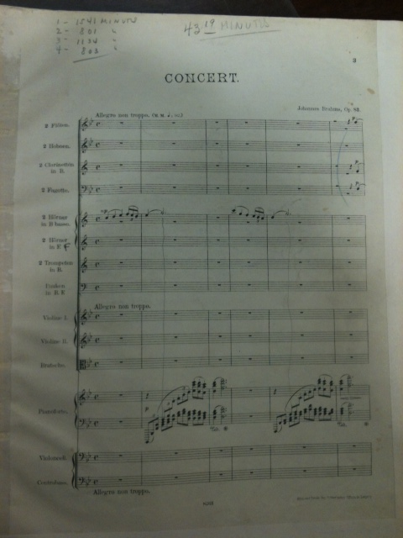
Horowitz’s Score of the Brahms No. 2

Slide 20
1948 Version
Bruno Walter 1948 version is almost as fast as 1940 version with Toscanini
A bit freer

Slide 21
1940 Version with Toscanini

Slide 22
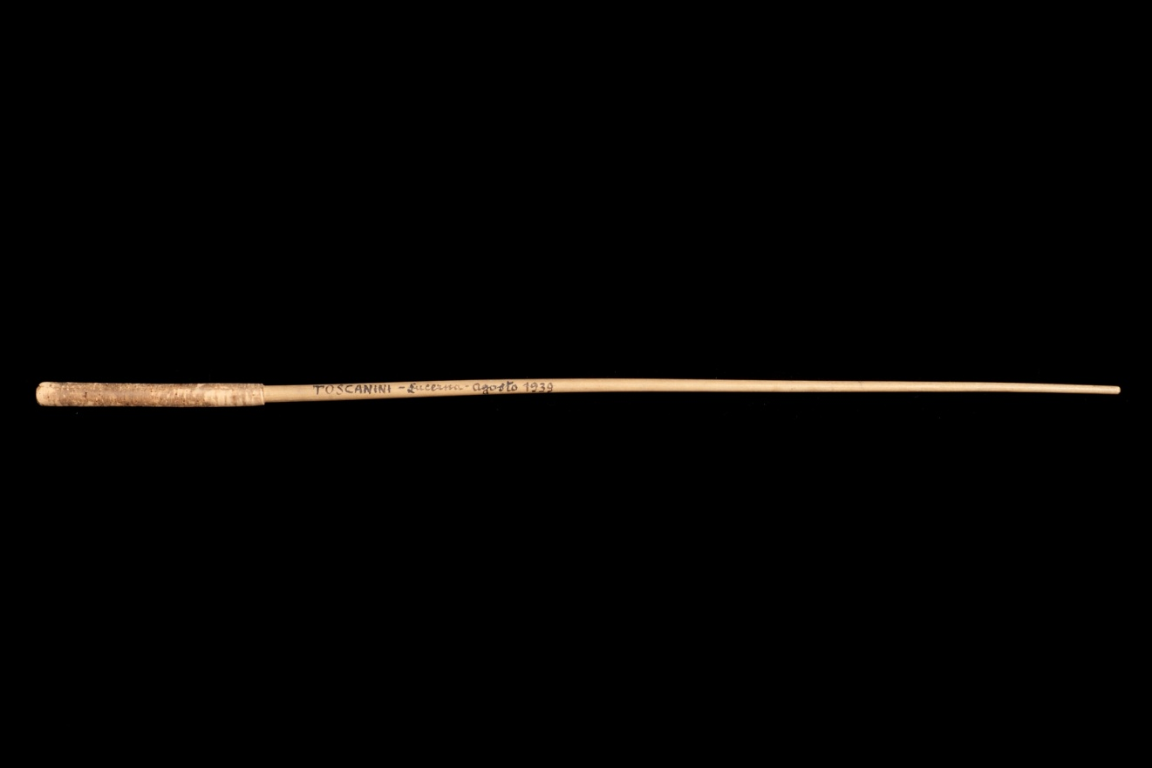
The baton
MSS 55, The Papers of Vladimir and Wanda Toscanini Horowitz in the Irving S. Gilmore Music Library of Yale University.

Slide 23
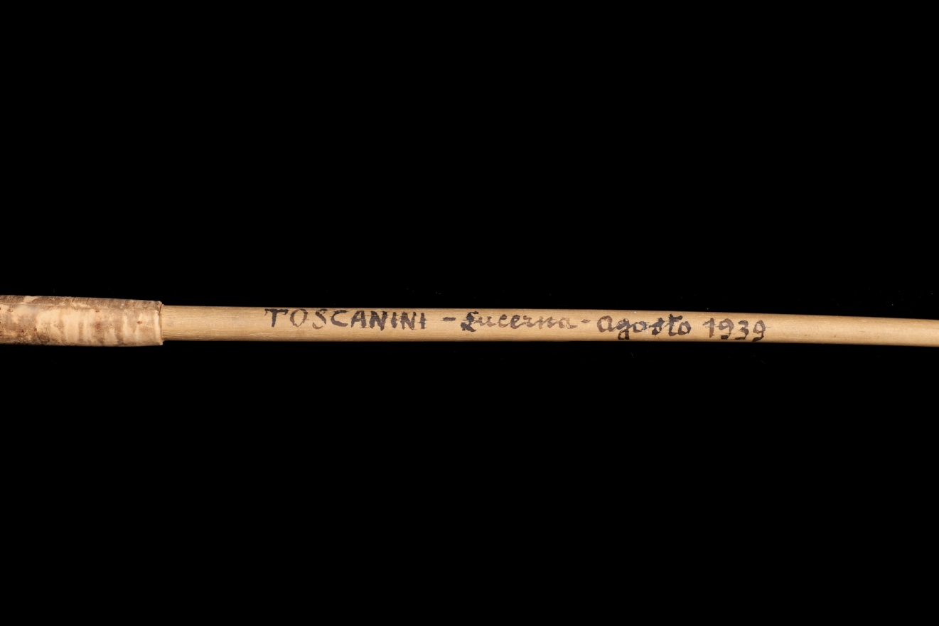
The baton up close and personal
MSS 55, The Papers of Vladimir and Wanda Toscanini Horowitz in the Irving S. Gilmore Music Library of Yale University.
Photographer: Bill Sacco

Slide 24
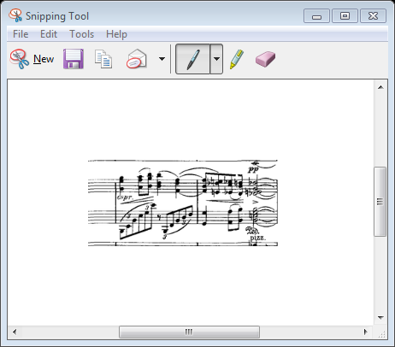
4/8/48 Brahms No. 2 - 1st Movement Measure 100
Underplays expressivo

Slide 25
4/8/48 Brahms No. 2 - 2nd movement
Pushes tempo
Not collaborative
Triplets not articulated

Slide 26
4/8/48 Brahms No. 2 - 2nd movement measure 241
Difference from 1940 Toscanini recording
Phrase more rounded

Slide 27
4/8/48 Brahms 3rd movement Piano Entrance 3rd measure
More cantabile than 1940 Toscanini recording

Slide 28
4/8/48 Brahms No. 2 - 3rd movement End into 4th movement
Goes straight into 4th movement

Slide 29
4/8/48 Brahms No. 2 - 4th movement
Clapping goes on for over 2 minutes

Slide 30
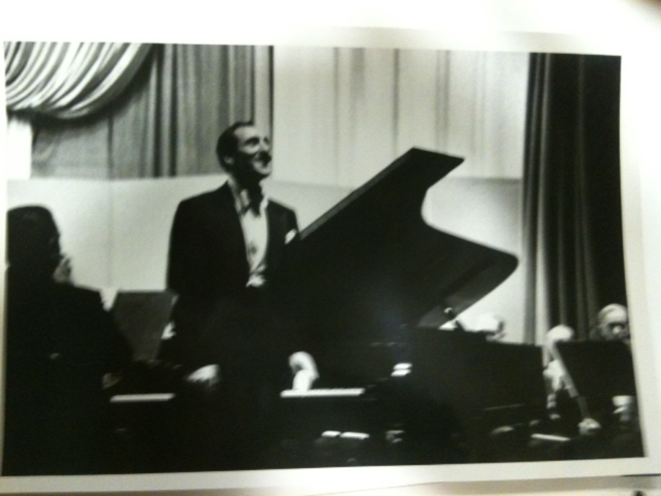
January 12, 1953 with New York Philharmonic, George Szell
MSS 55, The Papers of Vladimir and Wanda Toscanini Horowitz in the Irving S. Gilmore Music Library of Yale University.

Slide 31
The Horowitz Recordings of Brahms No. 2
8/29/39 - with Toscanini, Lucerne, Orchestra of the International Music Festival - live
5/9/40 - with Toscanini, NBC Symphony Orchestra, recorded in Carnegie Hall – days after live performance
2/19/45 - with Toscanini, NBC orchestra, Carnegie Hall, Private Benefit Concert, unpublished live recording on Youtube http://www.youtube.com/watch?v=YBGK_GKK1-Q
4/8/48 - with Bruno Walter, New York Philharmonic, Carnegie Hall - live
10/23/48 – with Toscanini, NBC Symphony Orchestra - live

Slide 32
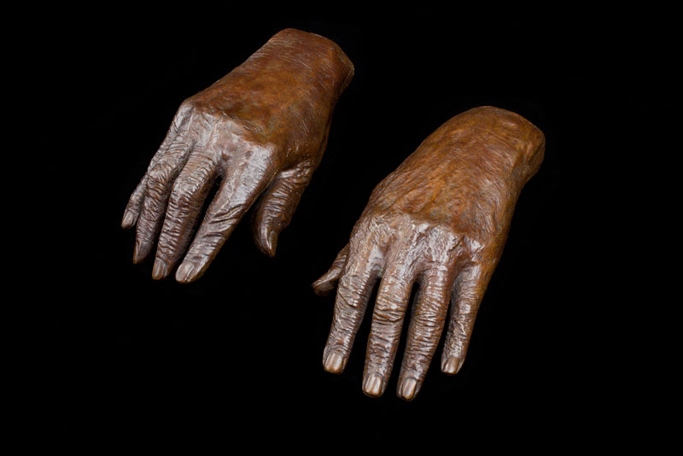
Cast of Horowitz’s Hands
MSS 55, The Papers of Vladimir and Wanda Toscanini Horowitz in the Irving S. Gilmore Music Library of Yale University.

Slide 33
Sources
Dubal, David. Remembering Horowitz : 125 Pianists Recall a Legend. Schirmer Books, 1993.
Plaskin, Glenn. Horowitz : A Biography of Vladimir Horowitz. William Morrow and Company Inc., 1983.
MSS 55 - The Papers of Vladimir and Wanda Toscanini Horowitz, Yale University
Historical Sound Recordings Collection, Yale University
Oral History of American Music, Yale University

Slide 34
Thank you!
David Andrews, Munich, Germany, for help with the translation of the Bruno Walter letter
Richard Boursy, Archivist, Yale University Irving S. Gilmore Music Library for help with the Horowitz Archive material and insight into its users
Professor Ira Braus, for help in understanding the nuances for the performing of Brahms and for listening to the Horowitz recordings of Brahms No. 2
Professor Dan Roman for help with software to create sound clips
Jon Samuels for transferring the reel-to-reel tapes to CD
Mark Bailey and Steven Oyler for listening to the piece with me and sharing their opinions
To Vladimir Horowitz and Johannes Brahms for creating such beautiful music

Slide 35
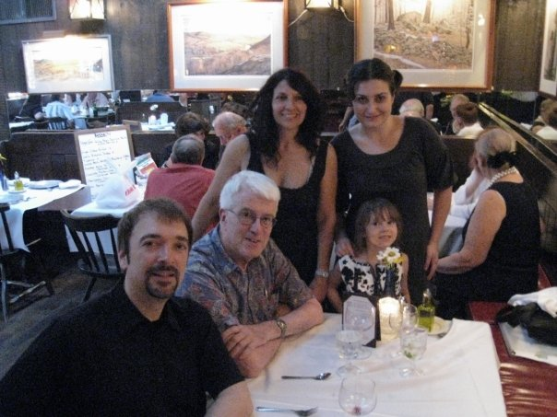
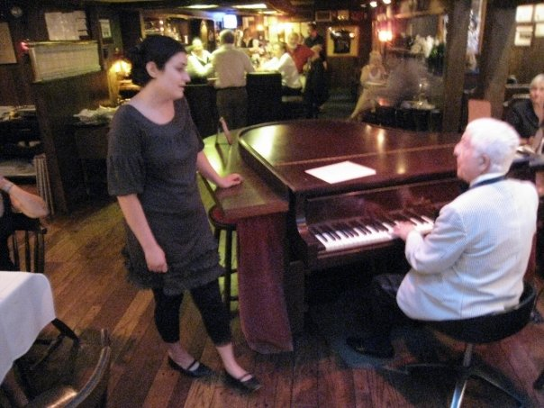
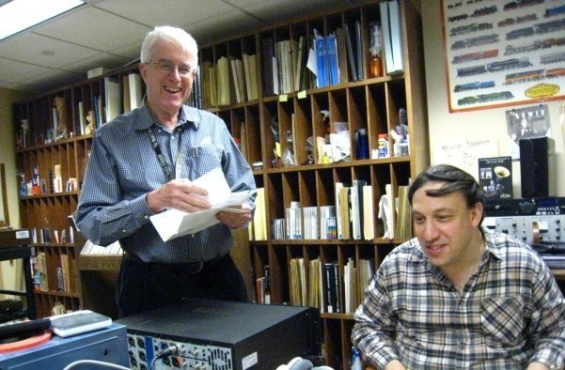
Dedicated to Richard Warren

