Slide 1

$100 Lots & NORA Reinvestment in the
Lower 9th Ward/Holy Cross
GIS Day November 19, 2014 Derreck B. Deason
Notes:
Name
Senior obtaining a:
Bachelor of Science in Urban Studies and Planning w/
Minor in Geography and concentrations in GIS and Land Use
WhoData GIS Program Associate and Intern sense June 2014

Slide 2
Content
Introduction
About WhoData
Overview of Research Project
Questions & Next Steps

Slide 3
About WhoData
WhoData is a public participation geographic information systems (PPGIS) organization that looks to provide mapping analysis and community development tools primarily in the greater New Orleans area. WhoData works with a large network of public, private and community development organizations with the common goal of helping to create and maintain livable communities. For more information go to: www.whodata.net. The community data information system is located at www.whodata.org.
“Partnering with leaders and stakeholders across public, private, and nonprofit sectors. Placing data in service to strengthen and benefit communities.”
Analyzing
Mapping
Informing Communities

Slide 4

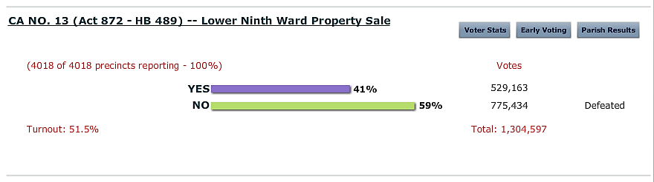
$100 lots in the Lower 9th Ward/Holy Cross Mapping Project
CA NO. 13 (Act 872 – House Bill 489)
Lower Ninth Ward Property Sale 2014 Ballot Item
[1]
Louisiana Secretary of State | Tom Schedler. (2014). Official Results. [Web Screenshot].
Retrieved November 16, 2014, from http://electionresults.sos.la.gov/graphical/
State Representative Wesley T. Bishop
Democrat District 99
[1] Louisiana House of Representatives. (n.d.). Representative Wesley T. Bishop. New Orleans, LA, USA. Retrieved November 16, 2014, from http://house.louisiana.gov/h_reps/members.asp?ID=99
Notes:
Background:
NORA acquired land in the Lower 9th Ward through the Hazard Mitigation Grant Program (HMGP) & Road Home
A proposed constitutional change was under consideration to allow the city of New Orleans to sell the empty lots in the Lower 9th Ward for $100 and went before voters statewide Nov. 4. It was listed on the ballot as "Proposed Amendment No. 13".

Slide 5
$100 Lot Project Overview
Task:
    Map the identified NORA properties and distribute it to State Representative Bishop, Greater New Orleans Housing Alliance, and Lower 9th Ward Neighborhood Empowerment Network Association (NENA).
Goal:
    Provide an informational resource for policy initiatives and community engagement, respectively.
Second Phase:
    Focus on mapping all 600 NORA properties, identified or confirmed blighted properties and conduct interviews with state/local municipal administrators, community-based organizations and residents in response to the Article 13 vote, expanded Lot Next Door program and proposed NORA auction and reinvestment plans.
[1] Metadata Source:
PDF downloaded: https://tribwgno.files.wordpress.com/2014/08/available-lower-ninth-ward-properties.pdf
From: WGNO/ABC’s property list as of 8/7/2014 http://wgno.com/2014/08/07/norato-sell-more-than-600-lots-for-100-each/
Notes:
Our Goals:
To create a Service Learning project demonstrating the type of research that undergrads at UNO can provide and showcase an example of PPGIS work that aids community education through the use of public data. Help to put the L9W back on the radar in a positive way.
Limitation:
Based upon the information collected NORA’s properties total 600; however, only 550 are posted in the data set

Slide 6
$100 Lot Map Limiting Conditions
567/600 of the properties are listed
5 duplicate addresses, identifiers, and GEOPINS
73 of the listed properties had multiple addresses listed for one GEOPIN
11 missing GEOPINS
10/11 of the missing GEOPINS were located
The map showcases 92% of the available properties
[1] Metadata Source:
PDF downloaded: https://tribwgno.files.wordpress.com/2014/08/available-lower-ninth-ward-properties.pdf
From: WGNO/ABC’s property list as of 8/7/2014 http://wgno.com/2014/08/07/norato-sell-more-than-600-lots-for-100-each/
Notes:
Our Goals:
To create a Service Learning project demonstrating the type of research that undergrads at UNO can provide and showcase an example of PPGIS work that aids community education through the use of public data. Help to put the L9W back on the radar in a positive way.
Limitation:
Based upon the information collected NORA’s properties total 600; however, only 550 are posted in the data set

Slide 7
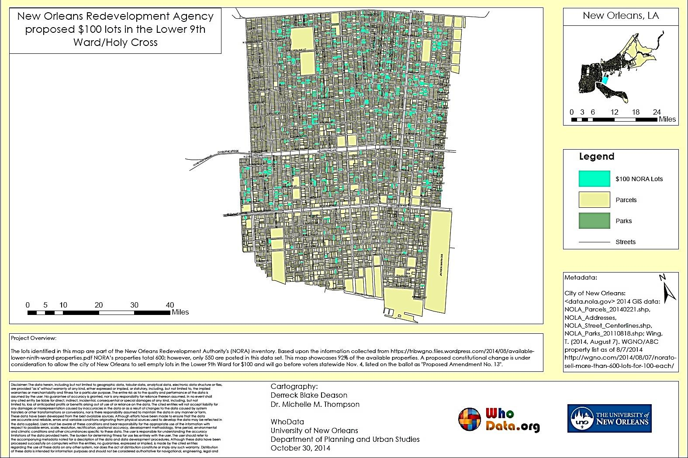
New Orleans Redevelopment Agency proposed $100 lots in the Lower 9th Ward/Holy Cross
Next Steps

Slide 8
Questions?
Derreck Blake Deason
WhoData, GIS Program Associate
DDeason@uno.edu
205.454.4591

