Slide 1
Getting Started with Digital Commons
Denise O’Shea
Access Services Librarian
digitalcommons@montclair.edu
Updated September 25, 2018

Slide 2
Today, we’ll cover...
What is Digital Commons?
What will you need to get started?
What can be included?
Uploading or linking your works.
Setting up your Selected Works profile.

Slide 3
What is Digital Commons?

Slide 4
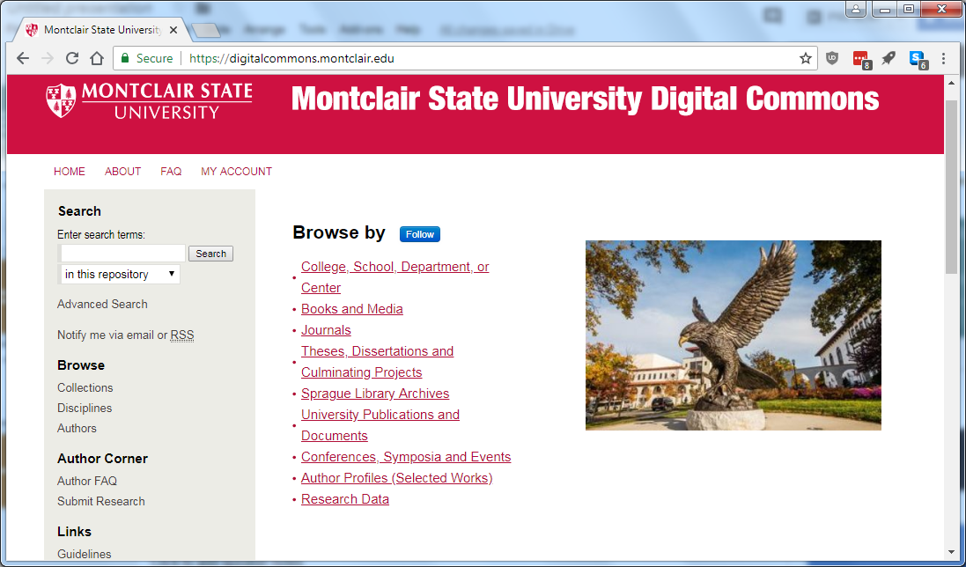
An Institutional Repository

Slide 5
What is an Institutional Repository?
Institutional repositories are online archives that collect, preserve, and disseminate the intellectual output of the university.

Slide 6
MSU Institutional Repository
Goals
Represent every school, college, center and institute at MSU
  Faculty and staff scholarship and research
  MSU-produced publications (journals and departmental)
  MSU events and conferences
  Electronic dissertations, theses and culminating projects
  Collections from the Sprague Library Archives
Features:
  Worldwide readership map and download reports
  Journal and conference editorial management tools
  Selected Works profile pages

Slide 7
Content
Articles
Books
Book Chapters
Conference Proceedings, Presentations and Lectures
Monographs / Publications
Reports
Open Education Resources
Oral Interviews
Datasets
https://digitalcommons.montclair.edu/

Slide 8
But I have a ResearchGate account...?
Digital Commons
Green Open Access, “legal” option for self-archiving
Not-for-profit, licensed by Montclair State to collect research output
Ability to share data sets
Valid repository for depositing works as mandated by grants
Long-term preservation
ResearchGate
Not Open Access
Encourages illegal file sharing
Commercial website, harvests address books and profile data for sale to advertisers
Social network, “Walled Garden”
Subject to regular legal action from publishers

Slide 9
Get Ready to Get Started

Slide 10
What you’ll need:
Your CV, or list of publications
Your author manuscripts, pre-prints, or post-prints
A photograph for your Selected Works profile*
An ORCID iD*
* Technically optional, but REALLY helpful.

Slide 11
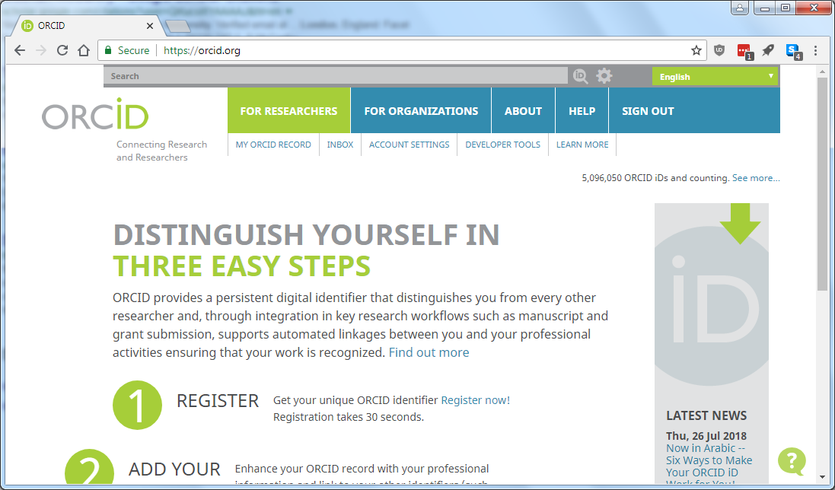
Why an ORCID iD?

Slide 12
Why an ORCID iD?
Unique identifier to track your publications and works
Differentiate yourself from other researchers with similar names
Automatically updates via Crossref metadata search
Required by many publishers when submitting manuscripts
Gives you the ability to export your citations in a sortable format *
* If you e-mail us this file, we can check your copyright permissions for you!

Slide 13
Copyright and Digital Commons
What is Green Open Access, aka Self-Archiving?
Author manuscript, pre-print, post-print vs. Publisher PDF
Different publishers, different rules
Checking SHERPA/RoMEO, or your Author Copyright Agreement
Confused? 100% understandable. E-mail digitalcommons@montclair.edu for assistance.

Slide 14
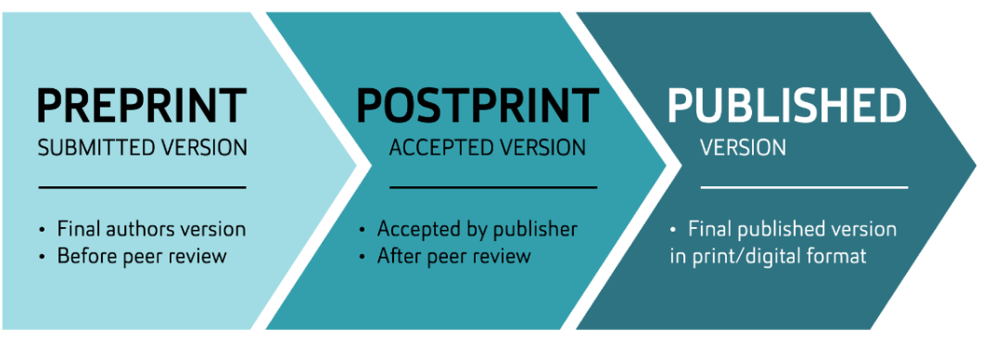
Pre-print, Post-print, Publisher PDF
Source: Auckland University of Technology, Retrieved from: http://aut.ac.nz.libguides.com/c.php?g=205078&p=1352501

Slide 15
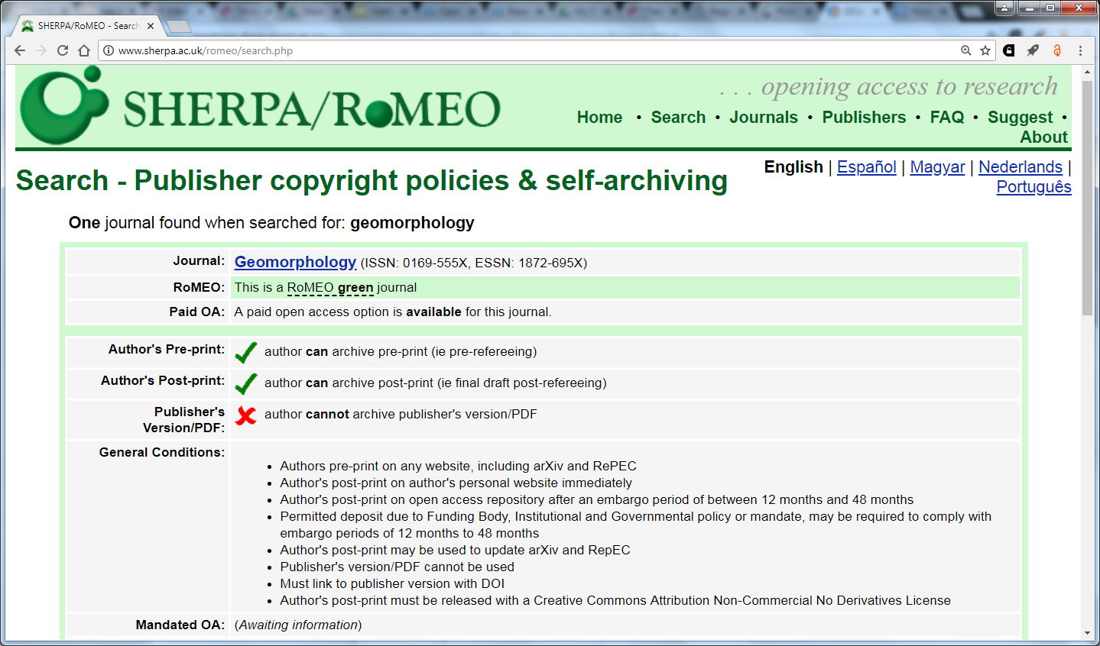
Checking Permissions

Slide 16
No pre-prints? No problem. Alternatives:
Add citations to Digital Commons, link to publisher PDF
Contact Publisher for permissions *
Upload alternate material you do have permissions for
(e.g. teaching material, conference proceedings, posters, etc.)
* Form letters available, don’t reinvent the wheel!

Slide 17
Uploading your works

Slide 18
Ready, set, upload:
Essential metadata:
  Title, authors, abstract
Pre- or post-print PDF file (cover page will automatically generate)
Leave blank:
  Digital Commons citation (automatically generates)
  DOI (refers to Digital Commons, NOT publisher DOI)
Allow 24-48 hours for system processing

Slide 19
Uploading your files
digitalcommons.montclair.edu

Slide 20
Creating your Selected Works profile

Slide 21
Selected Works, aka Author Gallery
Serves as an online CV (in lieu of your directory profile)
Import PDFs from the Digital Commons Network
  Got co-authors? Your works might already be available
Searchable by those outside Montclair State University
Provides monthly download statistics and other readership data
ORCID iD metadata will be available to import (soon…)

Slide 22
Adding your files to Selected Works
Step 1: Upload files to Digital Commons
Step 2: Create your Selected Works profile*
Step 3: Import
Warning: Don’t upload files directly to your Selected Works! This will bypass Digital Commons, and not accrue download statistics.

Slide 23
Selected Works
works.bepress.com

Slide 24
Questions?
digitalcommons@montclair.edu

