Slide 1
Research Data and
MSU Digital Commons
Denise O’Shea

Slide 2
What is an Institutional Repository?
Institutional repositories are online archives that collect, preserve, and disseminate the intellectual output of the university.

Slide 3
MSU Digital Commons
Goals
Represent every school, college, center and institute at MSU
  Faculty and staff scholarship and research
  MSU-produced publications (journals and departmental)
  MSU events and conferences
  Electronic dissertations, theses and culminating projects
  Collections from the Sprague Library Archives
Features:
  Worldwide readership map and download reports
  Journal and conference editorial management tools
  Selected Works profile pages

Slide 4
Content
Articles
Books
Book Chapters
Conference Proceedings, Presentations and Lectures
Monographs / Publications
Reports
Open Education Resources
Oral Interviews
Datasets
https://digitalcommons.montclair.edu/

Slide 5
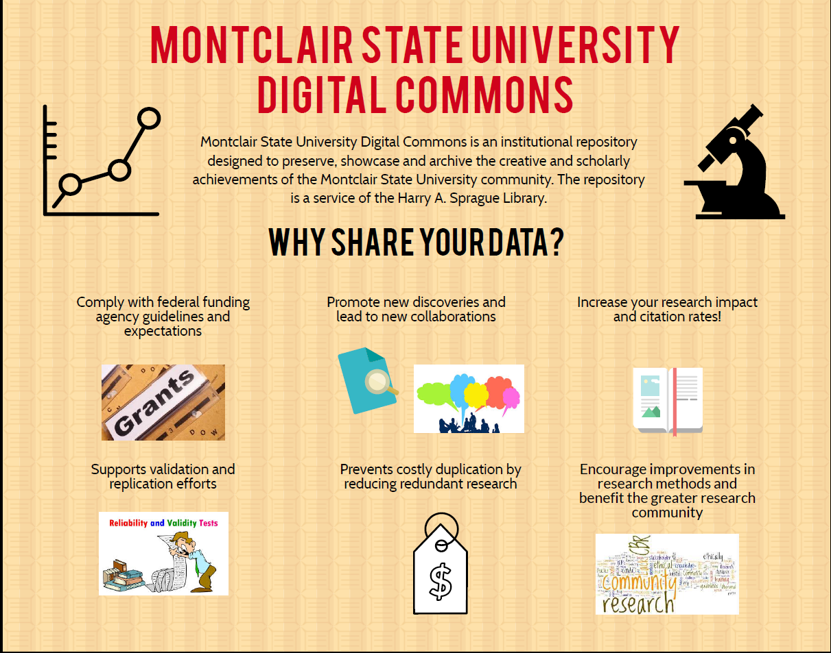
Produced by the Office of Research Compliance and Regulatory Programs

Slide 6
Common Misconceptions About Data
Myth
Data files are HUGE
It’s all statistics and numeric data
Data producers on campus are in the hard sciences departments only
Fact
File sizes vary
Data comes in a variety of formats
Data producers are everywhere on campus

Slide 7
Sprague Library Can Help Manage Datasets
Sprague Library helps faculty and research staff manage datasets and grant reporting requirements by:
  Hosting research data on our Digital Commons publishing platform.
  Advising on Disciplinary Repositories -- see
https://montclair.libguides.com/digitalcommons/
  Advising on Metadata.
Notes:
The Library saves faculty time and money:
No need to search for suitable hosting solutions
No more Dropbox fees

Slide 8
Three Common Needs
Data related to an article or monograph
Compliance with grant funder’s requirements
Project-related data

Slide 9
Examples of Data in Digital Commons

Slide 10
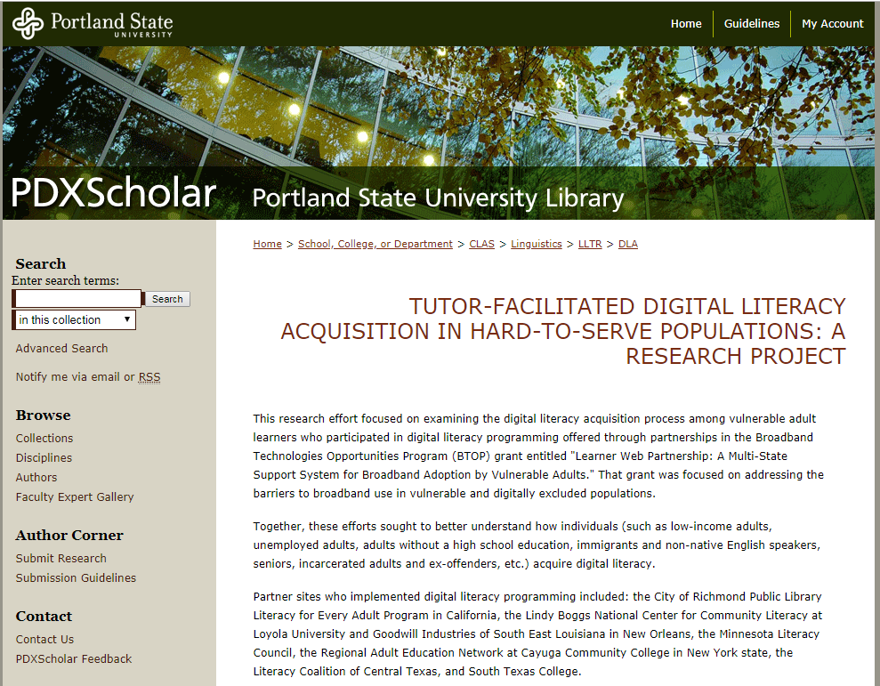
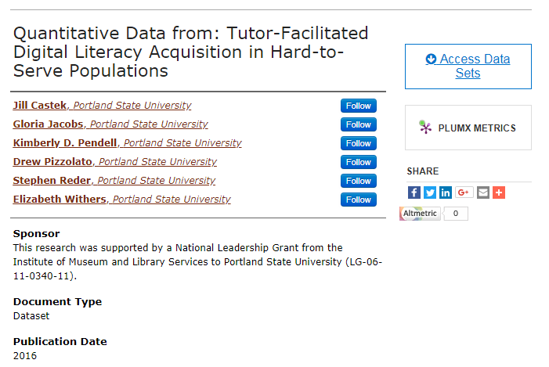
Complete archive of project
Complies with IMLS data sharing guidelines
Detailed metadata
Grant-Related Data
Notes:
Supporting grant requirements

Slide 11
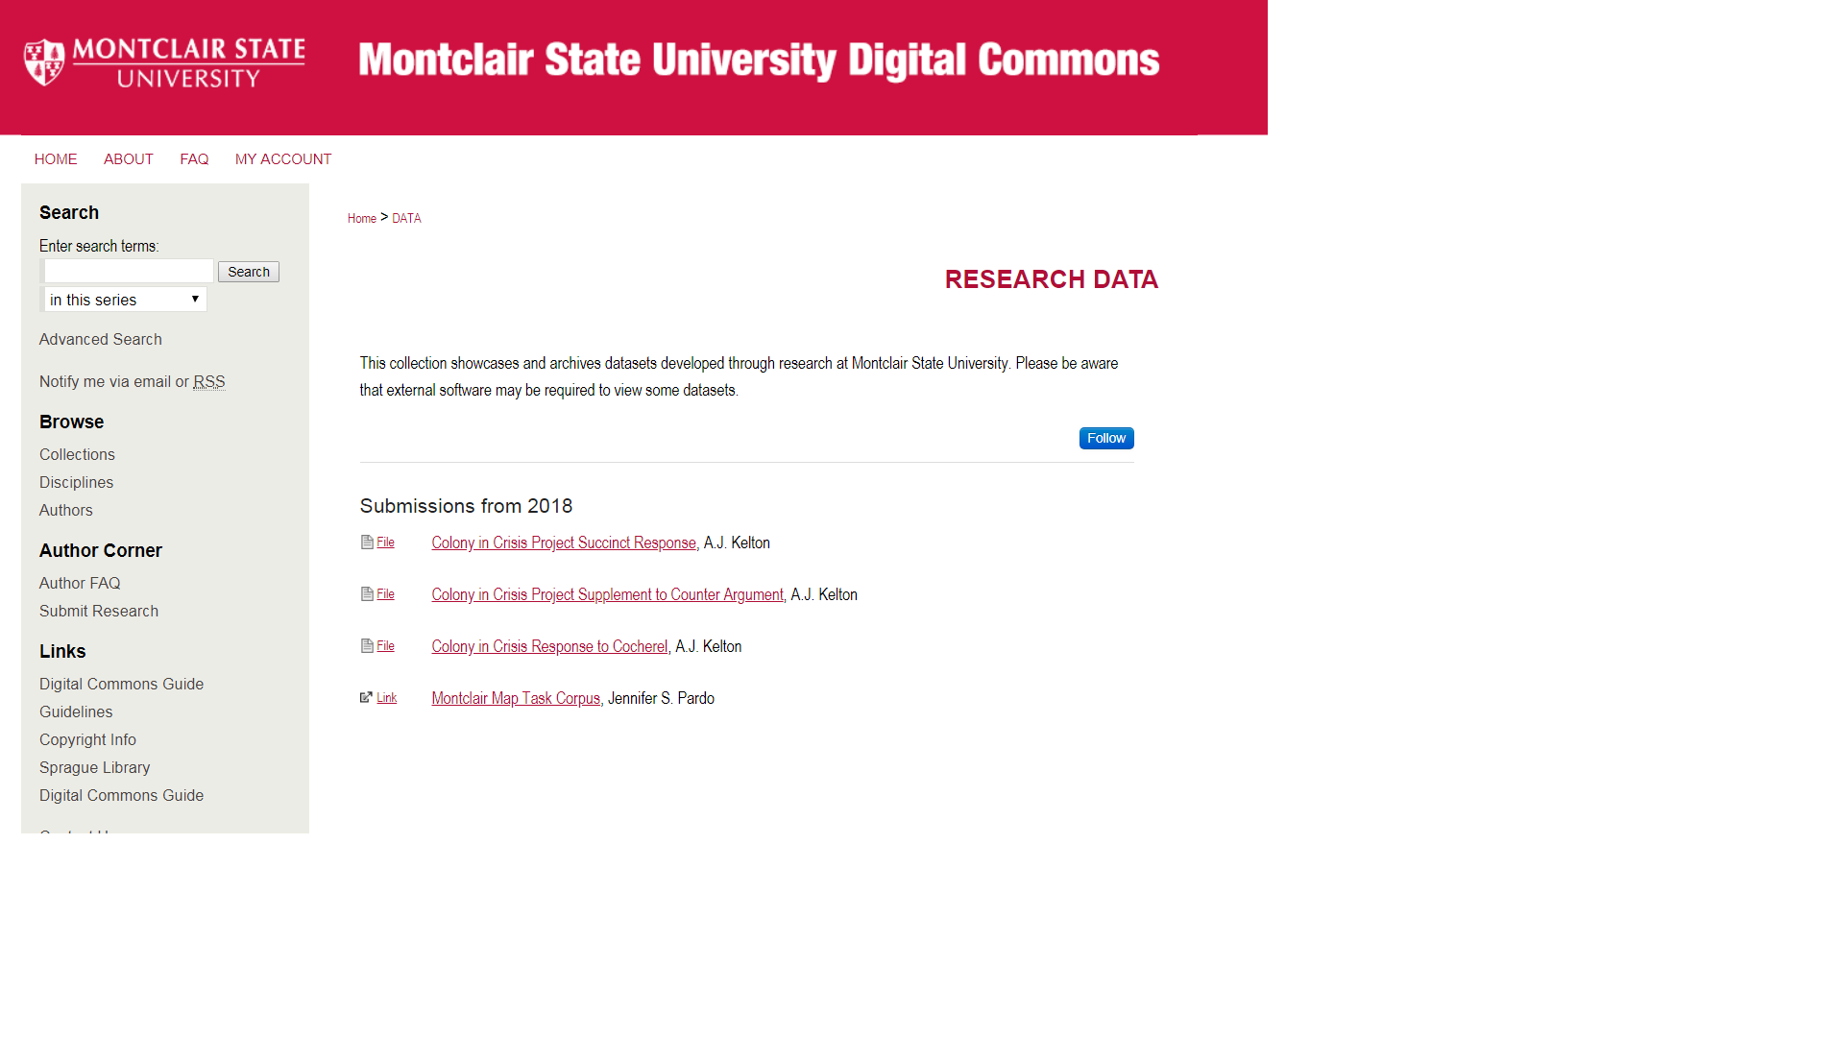
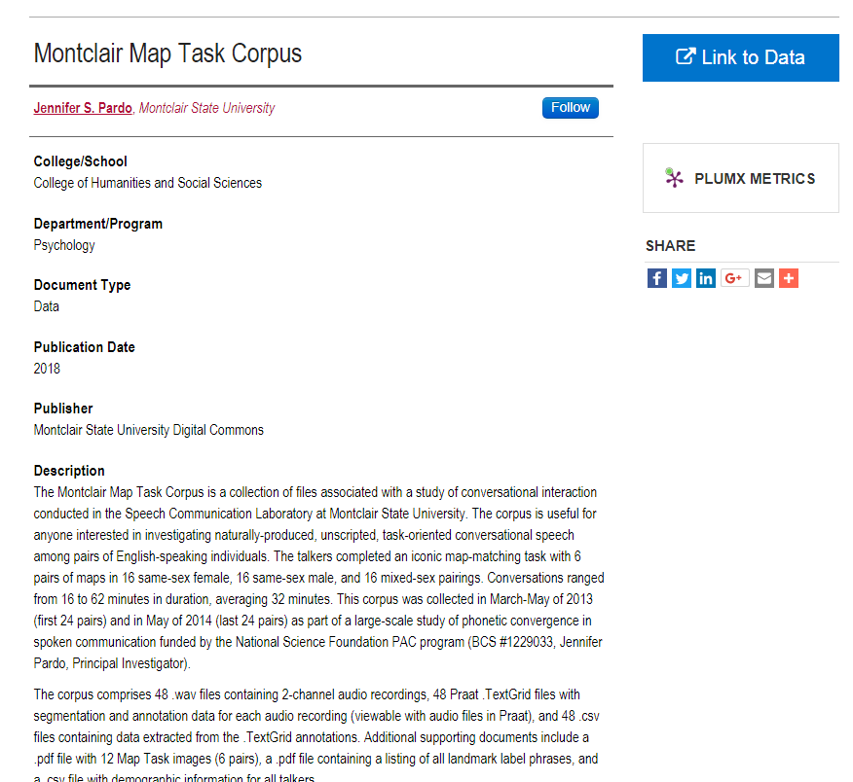
National Science Foundation (NSF) funded project
Increases research impact and citation rates
Encourages data reuse
Grant-related Data

Slide 12
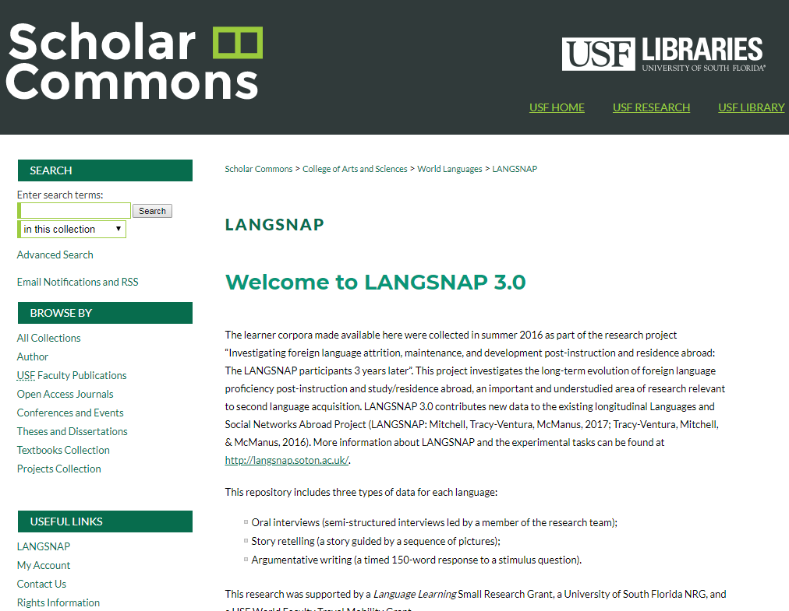
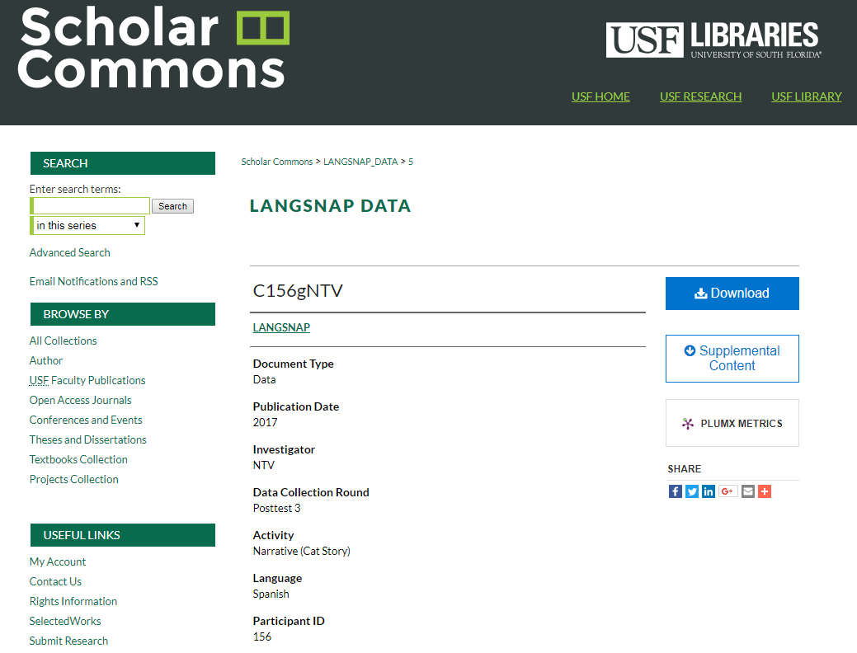
Promotes collaboration
Searchable archive
Variety of file types
Project-specific data

Slide 13
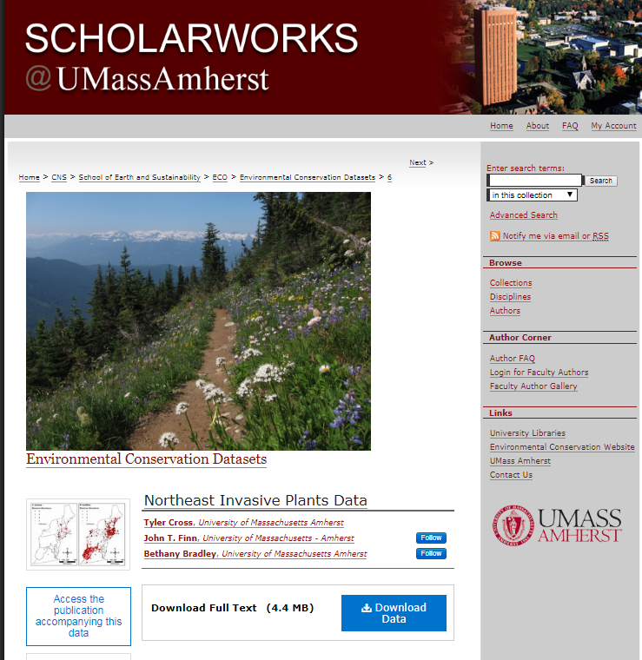
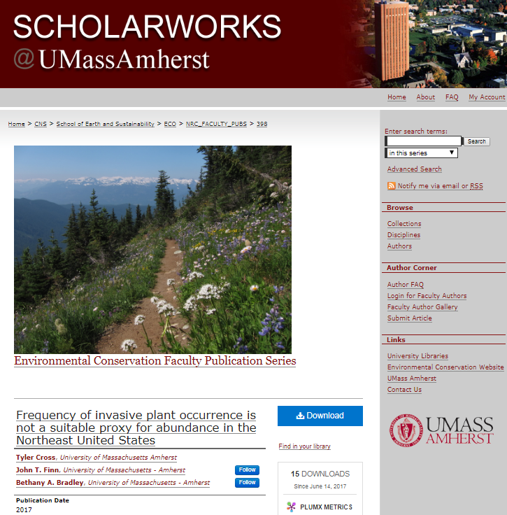
Complies with NSF funding guidelines
Connects to related scholarship
Data sharing encouraged by publisher
Data related to article or monograph

Slide 14
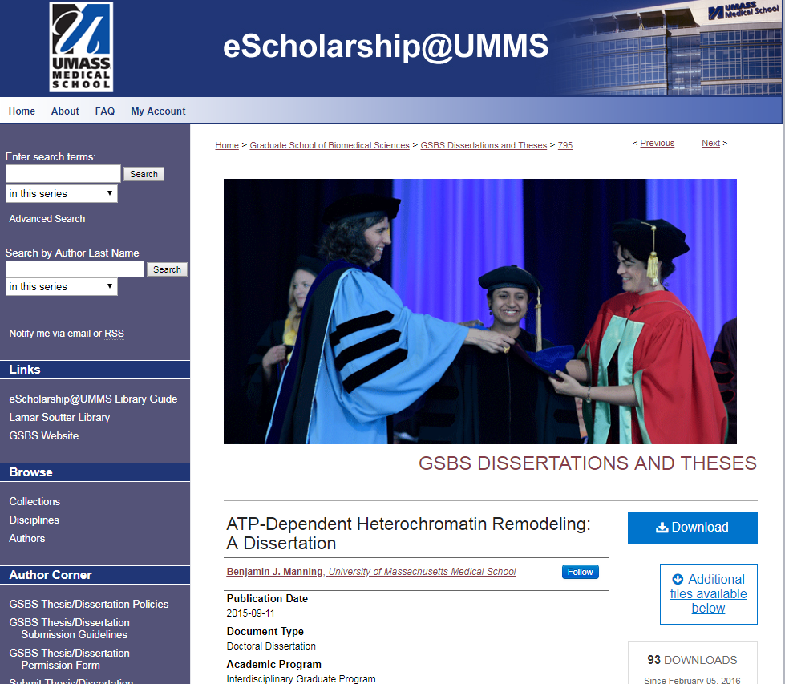
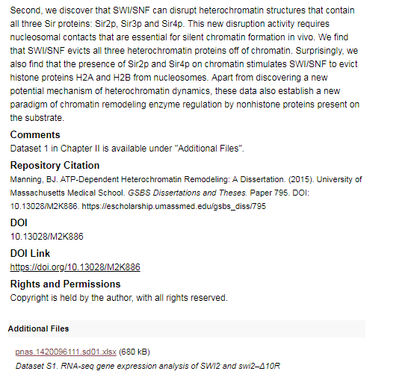
Promotes new discoveries
Increases research impact and citation rates
ETD with data uploaded as ‘additional files’

Slide 15
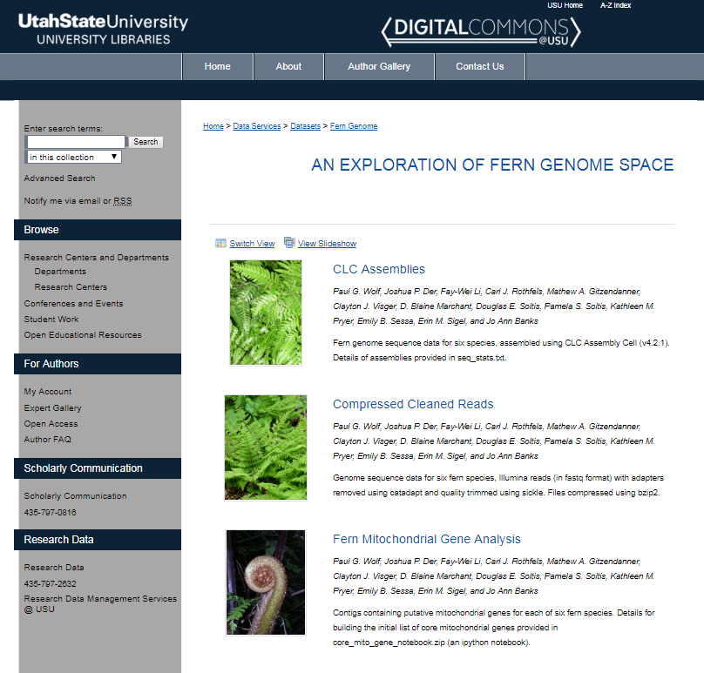
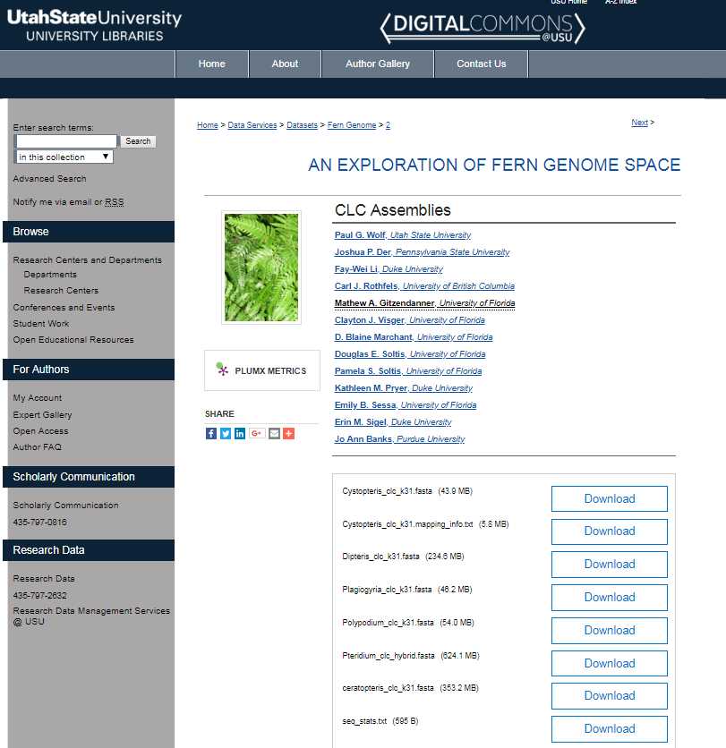
Encourages improvements in research methods
Prevents costly duplication by reducing redundant research
Supports a variety of formats

Slide 16
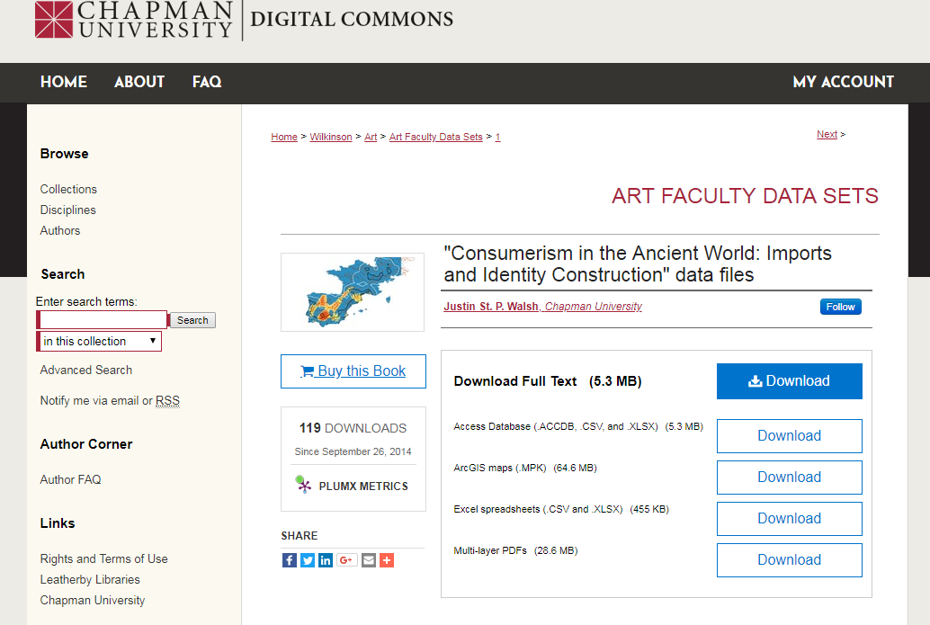
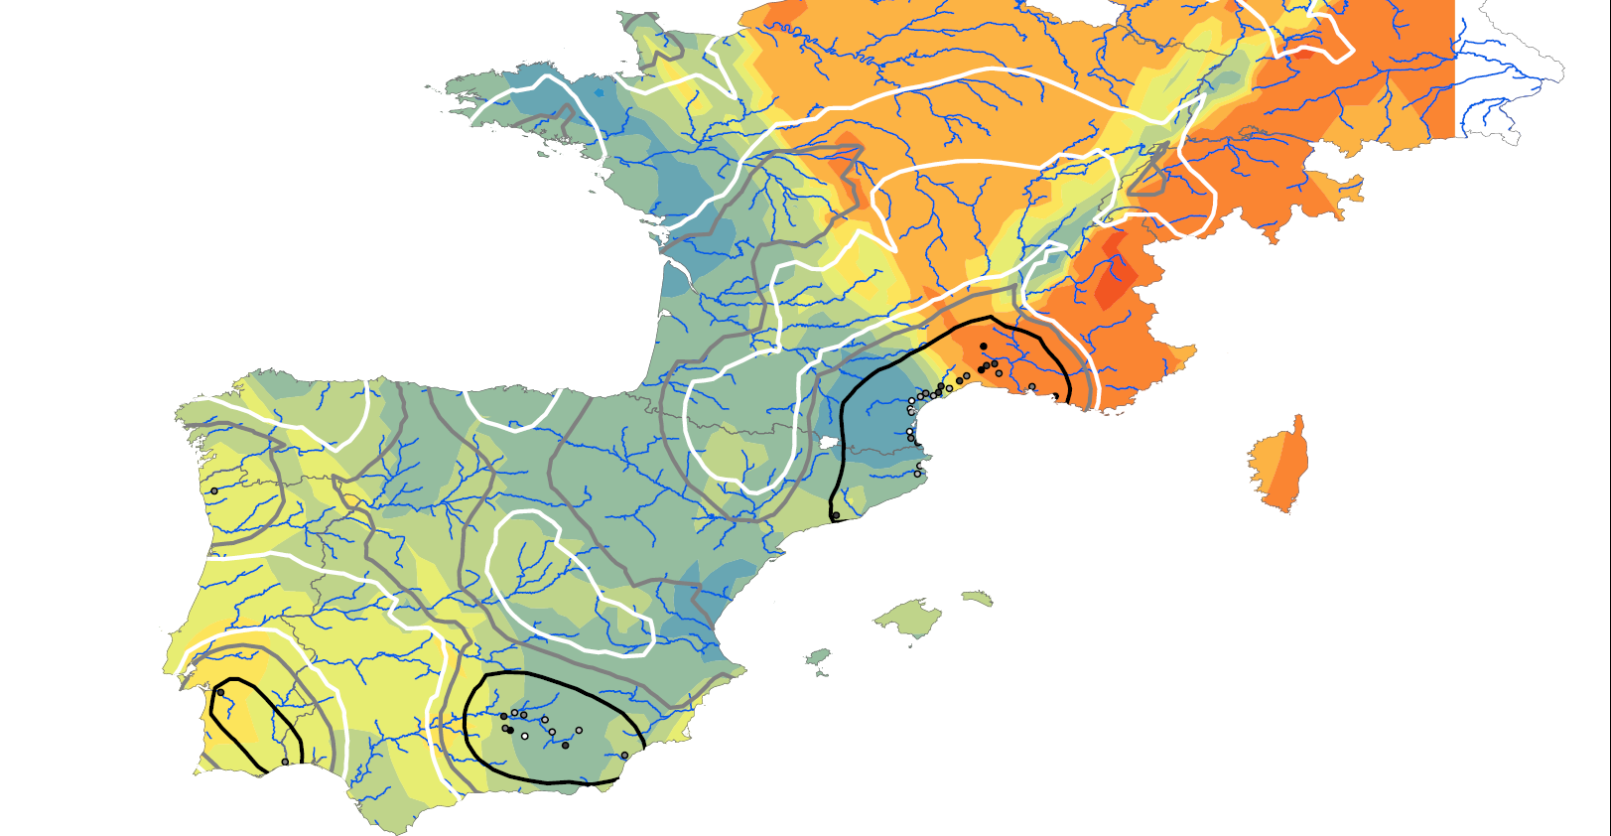
Supports validation and replication efforts
Can handle different data formats
Art dataset

Slide 17
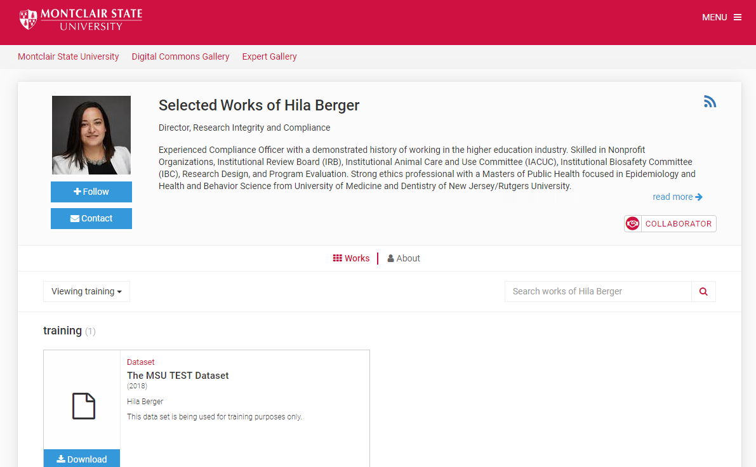
Leads to new collaborations
Has detailed policies and guidelines
Data in Selected Works

Slide 18
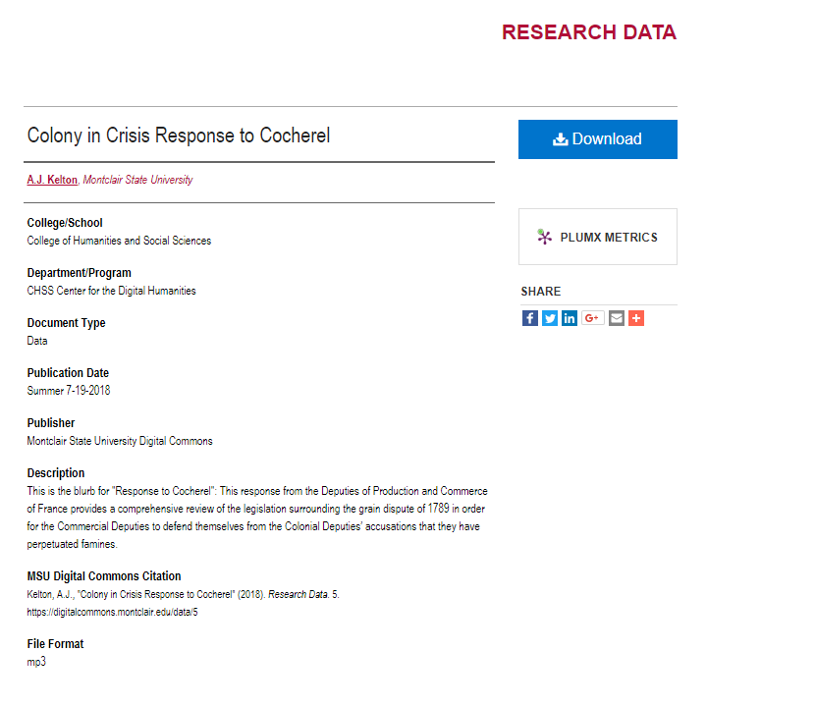
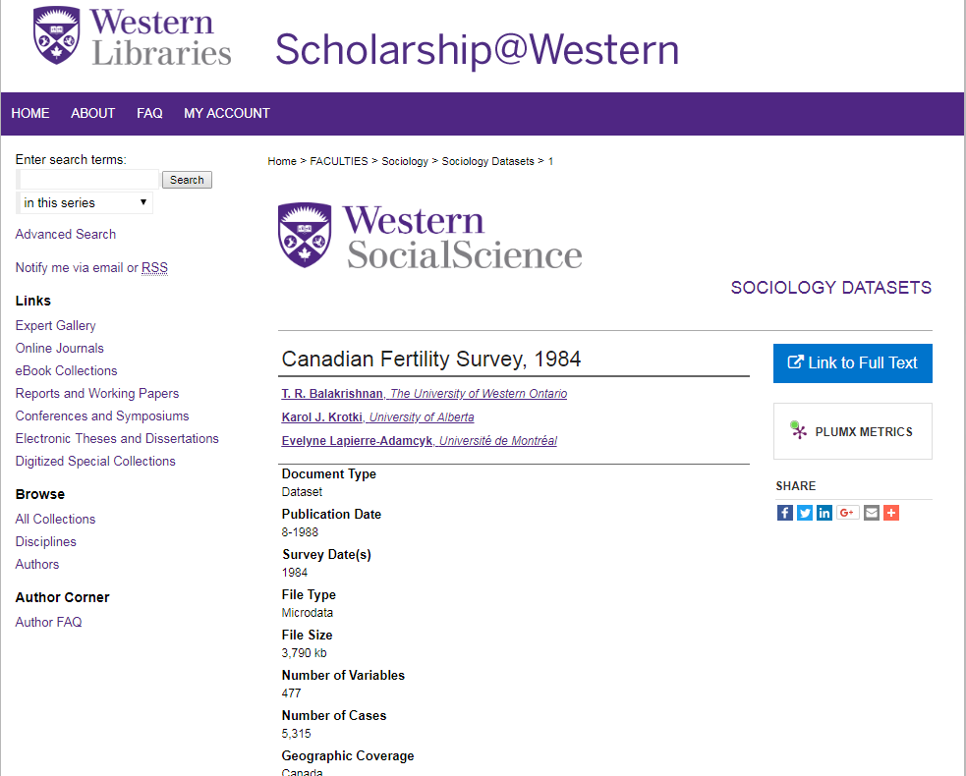
Metadata for datasets

Slide 19
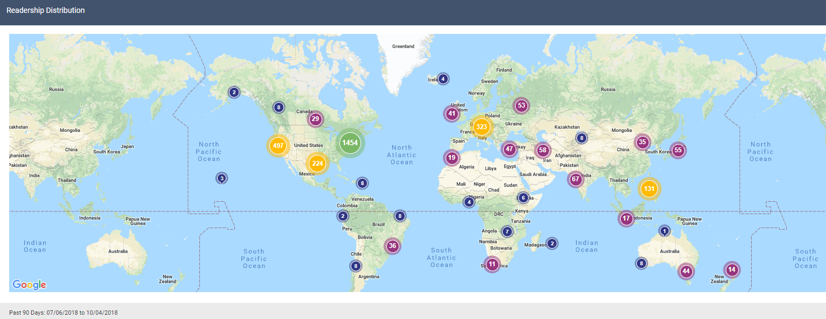
Showcase departmental and institutional datasets and their usage

Slide 20
Data and MSU Digital Commons
Open access
Has policies and guidelines
No storage limits
Support for all file types
Free for the researcher
Access control options
High search engine visibility
Customizable metadata
Shareable links
Stable URL, DOI
Usage statistics
Data storage and preservation
Library and MSU investment
Notes:
Addressing possible Faculty concerns: There may be a concern about losing research data due to user error (deleting a file accidentally, manipulating data in a way that renders it unusable for the rest of the researchers, etc). There may also be a concern about someone publishing data before it is ready to be published.
SOLUTION: Data Backup: All production servers are maintained at a high availability colocation facility with multiple backbone connections and back-up generators. The facility is secure and requires physical tokens (badges) for access. Bepress maintains failover web, database, and storage servers to continue to serve content in case of failure. The MSU Repository has a real-time redundancy that runs continuously, and bepress takes full nightly backups of the entire database. The backups are stored away from the colocation facility in a separate physical location. All of the uploaded files are stored in triplicate in a redundant storage cluster, as well as being backed up offsite to a 3rd-party cloud service that specializes in data archiving and backup.
User Level Access: Access control can be added at the collection level or the record level and be based on IP address, email domain, or specific email address. The primary file of access controlled records will only be available to a designated group. The metadata and any supplemental content added to a record will be available open access at all times and crawled by search engines.
Version Control: data is never erased. New copies are made with time and date stamps, but you can go back into older versions at anytime.
We realize that not all datasets may/can be open access. We believe that embargoes can be placed on datasets stored within our system so that the information can be seen in the future.
REALIZATIONS:
•The MSU Repository is an open access repository. It is open to everyone. It is searchable on Google. The datasets hosted in the Repository, in some way, shape, or form, will be OA too.
•Only final versions of data need to be published. The original raw data can stay locked away forever, if you need it to.
•It’s important to understand that this is a very easy and cost effective solution to storage issues for your research, but OA is a requirement of the system.

Slide 21
The Future
Continue expanding datasets within MSU Digital Commons from all departments and colleges at MSU through faculty outreach by liaison librarians
Continue working with bepress to enhance our capabilities within the Repository to provide the most up-to-date solutions for storing scholarly output
Continued collaboration with:
  Office of Research and Sponsored Programs (ORSP)
  Director of Research Compliance, Hila Berger
  Vice Provost for Research, Scott Herness
  Division of Information Technology

Slide 22
Ready to get started?
digitalcommons@montclair.edu
Contact Sprague Library for options for publishing datasets in MSU Digital Commons.

Slide 23
Thank you!
Questions?

Slide 24
Credits
Gibney, M. & Baker, K. (2015). Big Data in NSUWorks. Available at:
https://nsuworks.nova.edu/library_laff/winter2015/laf/1/
Barron-Lutzross, M. (2017). Data Decoded: Easy Ways to Support Campus Data Needs. Available at:
https://www.bepress.com/wp-content/uploads/2017/10/Data-webinar-slides-10-2017.pptx

