Slide 1

Self-Directed Learning in the program of legal education
Michele Struffolino
Associate Dean and Professor of Law Michele Struffolino and
Associate Dean and Professor of Law Debra Moss Vollweiler

Slide 2
Our Project: overview and process
In 2019, we proposed the following project:
Assessing the College of Law Self Directed Learning Outcome (Working title).
The College of Law is one of a minority of law schools that has adopted a program wide learning outcome with a self-directed learning objective. Our objective states that, “students completing the JD Program are expected to . . .[d]emonstrate self-directed learning practices for life-long learning.”
As with all our learning outcomes we are required to assess whether it is being met. The purpose of this grant is the following
1. Take the next steps to develop a process to assess this outcome.
2. Evaluate whether this outcome is being met in the curriculum
3. Develop ways to ensure this outcome is being met if determined it is not
Our Process and Findings:
1. Review the data from the assessment portal.
2. Determine the scope and depth of assessments being used currently.
3. Compare number of assessments and type to those being used for other core, programmatic learning outcomes.
4. We determined both the number of courses using, and the types of assessments were neither broad enough across curriculum nor specific enough tools to isolate this learning outcome and assess success.
5. As a result, we developed a plan for the COL to better ensure that this learning outcome was met.

Slide 3
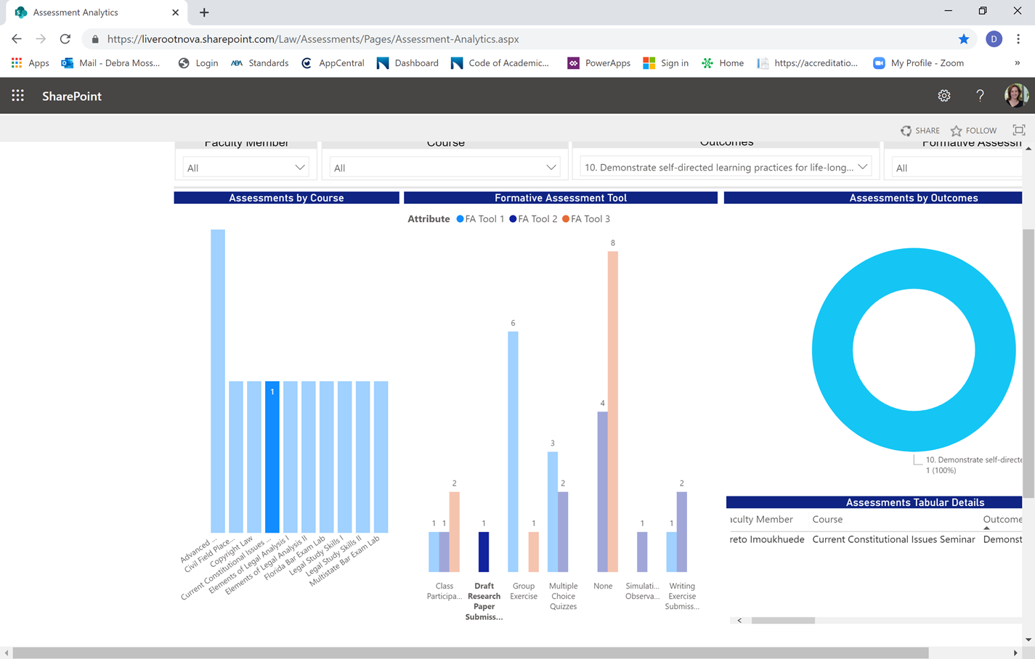
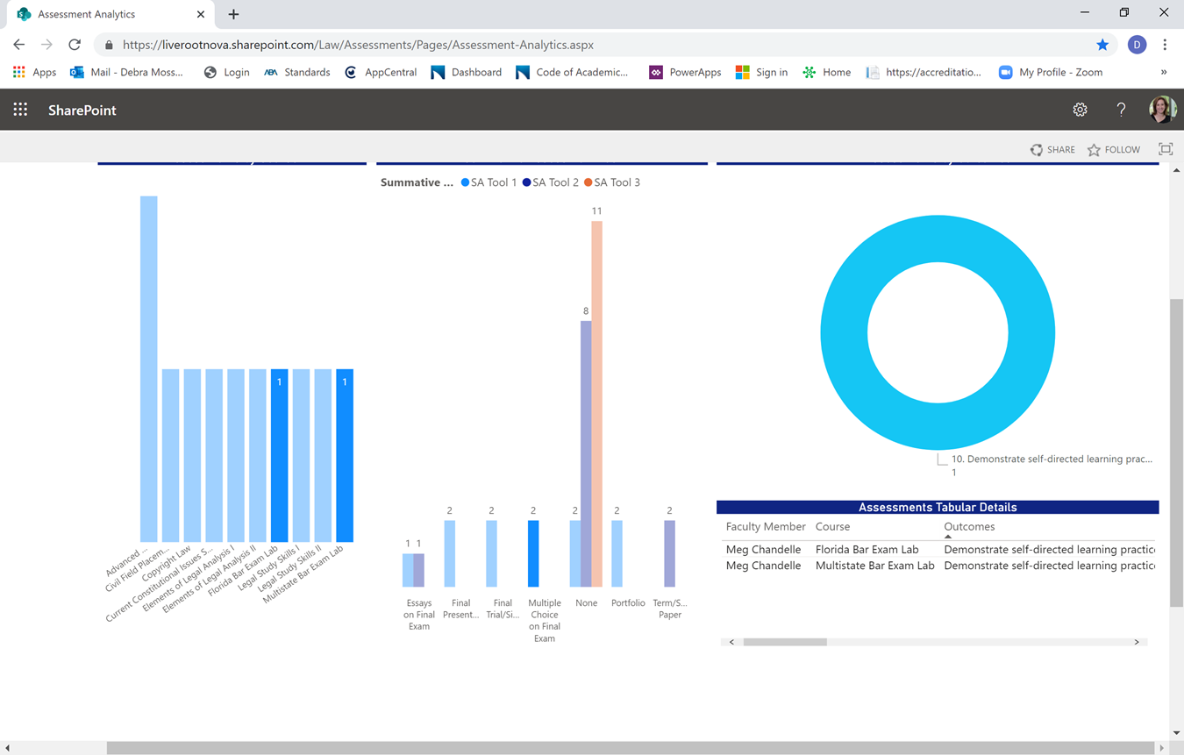
Overview of data on our teaching of self-directed learning
Review of Formative Assessments:
Review of Summative Assessments:

Slide 4
Overview
Part I: What is Self-Directed Learning and Why is it Important?
Part II: How do You Create Self-Directed Learners?
Part III: Closing the Loop—How do you Assess if You are Meeting your Goal?

Slide 5
Part I: What is self directed learning?
“[A] process in which individuals take the initiative, with or without help from others, in diagnosing their learning needs, formulating learning goals, identifying the human and material resources for learning, choosing and implementing appropriate learning strategies, and evaluating learning outcomes.”
Malcolm Knowles, Self Directed Learning: A Guide for Learners and Teachers 18 (1975)

Slide 6
Self-directed learning shifts the “responsibility for driving the educational process from the teacher to the learner.”
Neil W. Hamilton & Jerome M. Organ, Each Law Student Must take Increasing Ownership Over Professional Development During Law School, PD Q., Aug. 2018, at 27, 28.

Slide 7
Self-Directed learners
DO THE FOLLOWING:
“Self-regulated learners . . . view . . . academic learning as something they do for themselves rather than as something that is done to or for them.”
  Plan and strategize for learning
  Reflect on their experiences
  Identify strengths and weaknesses in skills and are able to build them appropriately
  Monitor and control their thought processes in learning
  Problem solve
  Take responsibility for their own learning process
  Utilize “cognitive” insights and techniques
Michael Hunter Schwartz, Teaching Law Students to be Self-Regulated Learners, 2 Mich. St. DCL L. Rev. 447, 452 (2003) (quoting Barry J. Zimmerman, Developing Self-Fulfilling Cycles of Academic Regulation: An Analysis of Exemplary Instructional Models, in Self- Regulated Learning: From Teaching to Self-Reflective Practice 1 (Dale H. Schunk & Barry J. Zimmerman eds., 1998).

Slide 8
why build self-directed learners?
When you drive a shift in responsibility for learning to students you:
Discovered Special Need: Self-Directed Learning in COVID
Increase general Institutional Benefits—overall performance across several metrics
Help increase employability of law school graduates
Comply with accreditation Standards-Learning Outcomes
Set up students for lifelong personal fulfillment and professional success.
Empower students to commit to an “ethic of excellence” in serving clients and society.

Slide 9
Why: Covid-19 crisis raising the importance of self-directed learning
Conversion to online learning requiring more self-direction of time and energies
No matter the modality, more self-direction needed for Canvas interactions, discussion board usage, asking questions
Exam schedule—flexible 48-hour scheduling requiring discipline in schedule
Clinical or work experiences—remote operations requiring more self-direction
Students need to be resilient in the time of change and take responsibility for their actions and learning
*More than ever before, our students must have this skill for success in their studies and in the profession*

Slide 10
WhY: Institutional Benefits of a successful self-directed learning student population
Improvement in academic performance in general:
  Success in individual courses
  Depth of analysis across coursework
  Self-reflection and professionalism
Happier law students who measure success on their personally set goals based on their ideals and values
Early realization of students at risk and the need and ability to create a plan of action
Increased probability of bar passage success
Increased probability of post graduation employment
Accreditation Standards met

Slide 11
WhY: Increase employability of law school graduates
Factors measuring lawyer effectiveness in the legal profession:
Strategic planning for success
Organizing and managing one’s own work
Organizing and managing others
Evaluation, development, mentoring
Problem solving
Practical judgment
Marjorie M. Schultz & Sheldon Zedeck, Predicting Lawyer Effectiveness: Broadening the Basis for Law School Admission Decisions, 36 Law & Soc. Inquiry 620, 630 (2011).

Slide 12
WhY: Increase employability of law school graduates
What do Legal Employers Want in New Associates?
“Character”
  Professionalism—honor commitments
  Strong work ethic
  Attention to detail
  Diligence
Competencies
  Prepared and timely
  Promptly respond to inquires and requests
  Listening attentively and respectfully
  (From the list of the top 10 Foundations Categorized as Necessary in the Short Term, The Whole Lawyer and the Character Quotient)
Self-directed learners are successful in the profession

Slide 13
WHY: Accreditation standards—NSU College of law adoption of self-directed learning as a learning outcome
ABA Standard 302 provides in part:
A law school shall establish learning outcomes that shall, at a minimum, include competency in the following:
(d) Other professional skills needed for competent and ethical participation as a member of the legal profession
COLLEGE OF LAW LEARNING OUTCOME NUMBER 10 (2016):
Demonstrate self-directed learning practices for lifelong learning.
Part of core competencies for all students for graduation

Slide 14
Why: self-directed learning outcome at Nsu law mapped to curriculum
Learning Outcome #10 Students completing this instructional offering are expected to: Demonstrate self-directed learning practices for life-long learning
 | Required Courses | Elective Courses | Seminars (Satisfy Writing Requirement) | Experiential Opportunities (Workshops, Clinics, Field Placements) Satisfy Experiential Learning Requirement
FIRST LEVEL EXPOSURE: | Legal Skills and Professionalism I and II
SECOND LEVEL EXPOSURE: | Elements of Legal Analysis I and II | Advanced Legal Research Techniques; Copyright Law; Legal Reasoning and Analysis | Current Constitutional Issues Seminar | Bankruptcy Workshop; Criminal Pre-Trial Practice; Negotiating Workshop
THIRD LEVEL/CAPSTONE EXPOSURE: | Florida Bar Exam Lab; Multistate Bar Exam Lab | Blockchain and Cryptocurrency Law; Internet Law |  | Civil Field Placement Clinic; Dispute Resolution Clinic

Slide 15
Why: self-directed learning outcome at nsu mapped to Non-curricular efforts
ORIENTATION
STUDENT SERVICES—MANAGING RECORDS
CURRICULUM GUIDES
FACULTY ADVISORS
CAREER AND PROFESSIONAL DEVELOPMENT

Slide 16
Why: Self-directed learners become personally fulfilled self-directed professionals
Self-directed learning enhances Professional Identity Formation
Goal-setting based on internal ideals and values rather than on extrinsic measures or success
Self-directed professionals able to adapt to increasing changes in the law, the legal profession, and client needs.
Self-directed professionals are more fulfilled in their professional lives
More able to find the best fit between their skills and passions and the available opportunities

Slide 17
Why: Empower students to commit to an “ethic of excellence” in serving clients and society
“Before serving and leading, one must be able to serve and lead one’s self. ”
“The student and people close to her . . . all gain strength from the fuller realization of human potential and a deepened commitment to an ethic of excellence in service.”
Louis D. Bilionis, Bringing Purposefulness to the American Law School’s Support of Professional Identity Formation, 14 U. St. Thomas L.J. 480, 496 (2018).

Slide 18

Part II:
How to CREATE SELF-DIRECTED LEARNERS
THREE STEPS TO TEACHING STUDENTS TO BECOME SELF-DIRECTED LEARNERS:
Step 1: PRE-LEARNING
Step 2: DURING LEARNING
Step 3: POST-LEARNING
THIS MODELING, DEMONSTRATION, AND REINFORCEMENT ENSURES STUDENTS KNOW HOW TO BUILD THIS SKILL, AND CAN USE IT THROUGHOUT THEIR STUDIES AND IN THE PROFESSION

Slide 19

Step 1: PRE-LEARNING modeling and preparing STUDENTS TO LEARN
Faculty model for students what they want them to be able to do
"What will it look like when I am able to demonstrate my learning?"
Example: Show students an example of a good finished product, such as an exam answer, a case brief, a memo, which students must absorb and interact with to understand what they are seeing.
See handout for takeaway ideas!
A. Modeling

Slide 20
Step 1: PRE-LEARNING STEP: modeling and preparing them
IRAC: IRAC
GREEN: ISSUE
RED: RULE
BLUE: APPLICATION
YELLOW: CONCLUSION
SAMPLE ONE
What rights does Alex have?
In a Fee Simple Absolute (FSA), the possessor has the greatest rights in land recognized in the law. These rights are measured by duration and rights and responsibilities associated with ownership. A FSA is transferable inter vivos and at death by devise or intestate succession.
The facts tell us that Alex has a FSA so we know that Alex has title to the property in FSA. Alex has all rights, title, and interest in the property because it’s a fee simple absolute. If Alex has rights in a FSA he has all of the power for all of the time and these right are transferable.

Slide 21
Step 1: PRE-LEARNING STEP: modeling and preparing them
Students plan the components of the learning activity.
"What will I need to accomplish?"
Examples: Students develop a project checklist of skills to be completed to accomplish the task, such as questions to answer in a case brief or sections of a memo.
B. Progress Checklist Planning

Slide 22

Step 1: PRE-LEARNING STEP: modeling and preparing them (Checklist)
FOR EACH CREAC
Assertion: (C of CREAC)
❑ Does the discussion of each issue or sub-issue begin with a well-written positive assertion that tells the Court how you want it to rule and why,
or does it state a point you want the Court to agree with and why?
Rules
❑ Have you presented the rules in the light most favorable to your client?
Rule Explanation
❑ Have you organized the explanation in a way that allows you to emphasize the strongest parts of your arguments?
❑ Does the section begin with a thesis sentence that contains a reference to the facts of your client’s case?
❑ Is the rest of the explanation section free of references to your client’s case?
❑ Do all paragraphs begin with a thesis sentence?
❑ Have you presented the cases in the light most favorable to your client?
❑ Have you explained where the rule comes from so the judge is satisfied your rule statement is accurate?
❑ Are appropriate cases used to explain the rules?
❑ Are the cases appropriately described? (Use facts, holding, rationale, as appropriate for each individual case.)
❑ Have you chosen the appropriate form of case discussion? (A textual explanation or a parenthetical.)
❑ Did you rebut any counter-explanation by a preemptive discussion if necessary?
❑ If policy arguments will be included, have you discussed the policy from the cases?
❑ Have you done your best to present the explanation persuasively?
❑ Are your arguments logical, internally consistent, and thoroughly developed? (Use the self-editing exercise—have you kept your focus?)

Slide 23
Step 1: PRE-LEARNING STEP: modeling and preparing them
C. Understanding the Parameters of the Work
Students should know how their work will be evaluated.
Example: Sharing a rubric for assessment of the final product gives the students a target for understanding what is expected of the end-product. Students ask questions to understand what is expected of them, and they engage with the rubric before the assignment is due.

Slide 24
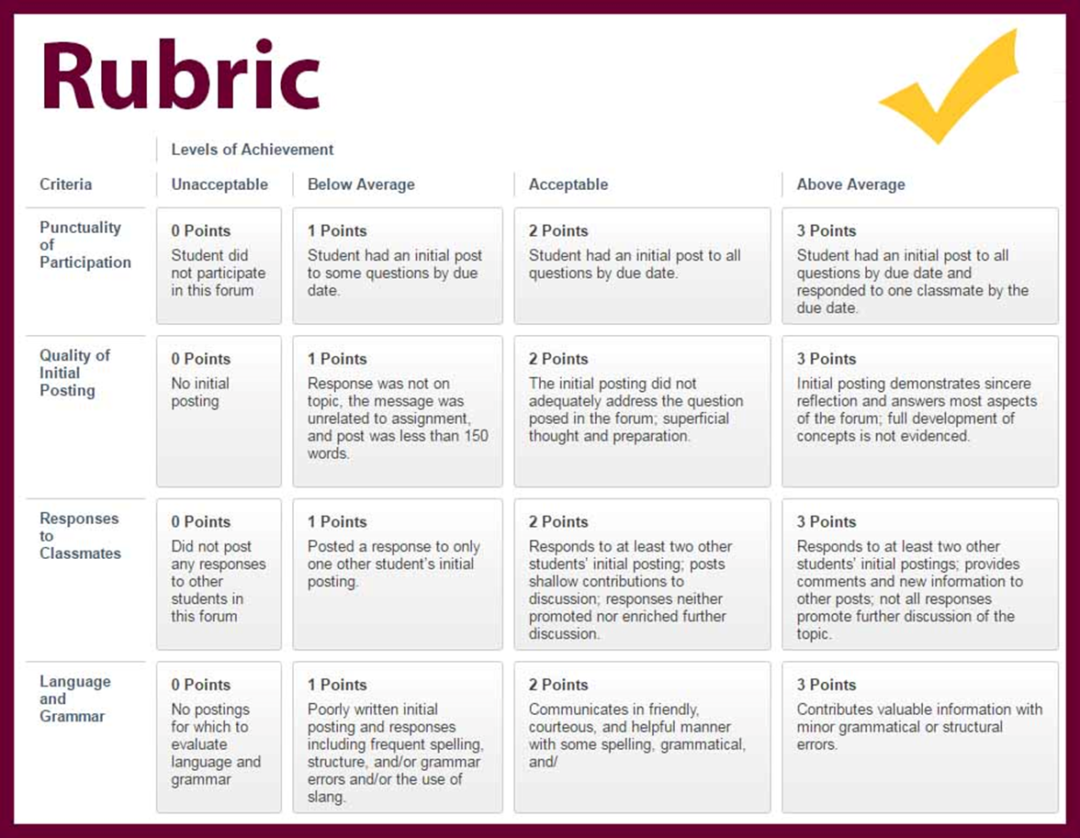
Step 1: PRE-LEARNING STEP: modeling and preparing them
Understanding the Parameters of the Work
*Rubric Courtesy of Dean Duhart at Adjunct Training Fall 2018
Give example of grading rubric here

Slide 25

Step 2: DURING LEARNING STEPS
A. Self-Monitoring
Students keep track of their progress in an activity.
"What does being on task look like?”
Examples: Engaging with the checklist and meeting any deadlines, whether self-imposed or required
Starting with more supervision and transitioning out to model what good task management looks like

Slide 26
Step 2: DURING LEARNING STEPS
Example: Can students explain the holding of a case or did they just copy down a sentence to fill in that blank? Can they explain their analysis in a memo conference?
Example: Interact further with students to determine whether they completed a practice essay or discussion board post just to get a checkmark or whether they engaged and learned with the material?
B. Reflecting on Work versus Learning
Students contrast and evaluate completing a task with learning content:
“Did I get it, or did I just get it done?”

Slide 27
Step 2: DURING LEARNING STEPS
C. Learning Log
Students keep track of new learning
Through reinforcement activities where appropriate
Examples: Outlining of course materials only when understood and not simply copying notes; answering review questions and documenting problem areas

Slide 28


Step 3: POST LEARNING STEPS
Students evaluate their own performance on various metrics of performance, including but not limited to:
Meeting deadlines
Mastering skills of assignment
Engaging in learning, not merely tasks
Asking Questions
*Faculty can create a self assessment rubric for these skills, not just the substance of assignments*
A. Self-Assessment by Students of Various aspects of performance:

Slide 29

Sample Self- assessment
Self-Assessment Reflection
Name _____________________________________
Your answers to these questions are designed to assist you in improving your learning by having you review your performance on the last writing assignment. This reflection does not focus on the substance of the law or analysis that you will need to master for this course, but instead focuses on your personal process in completing the assignment to assist you to improve your performance and to be able to better assess your progress and achievement in the future.

Slide 30


Step 3: POST-LEARNING STEPS
Students actively reflect on where they could make improvements in the learning activity, whether substance or the process of learning through it
Example: Acknowledging that they met deadlines but under great stress and at the last minute, and that they need to reevaluate how to meet deadlines without causing stress or disruption, develop a plan how to meet deadlines more smoothly next time
B. Reflection and Learning by Students regarding their own learning

Slide 31
PART iii: Closing the loop:
HOW DO WE KNOW IF THE EFFORTS ARE WORKING? (ASSESSMENT OF THE OUTCOME)
How do you determine if you are effectively creating self-directed learners for life?
Tracking and evaluation of resources used by students (academic and auxiliary) to determine if they are accessing them in their learning
In-depth review and analysis of self-reflection tools by students for growth during the semester and program. Using data from these forms to make adjustments to teaching self-directed learning in the future
Tracking progress in areas requiring self-direction for success (i.e., bar studies)
Debriefing students when they interview for jobs and/or are hired regarding the employers’ needs, and their readiness for them
Surveying alumni at various intervals regarding professional satisfaction, preparedness, ability to handle ethical issues, and work/life balance and management

Slide 32
ASSESSMENT OF THE OUTCOME: Institutionally—a potential model
 | Not effective | Somewhat Effective | Effective | Very Effective
Faculty Use of Tools in Classes | Self-assessment tools used sporadically or inconsistently | Some use of self-assessment tools in classes | Consistent use of self-assessment tools in classes | Widespread use of self-assessment tools in classes
Student Feedback of Tools in Classes as Reported by Faculty | Students are not completing assignments in meaningful ways | Some students are reflecting on their process of learning | Many students are reflecting on their process of learning | Most students are reflecting on their process of learning
Bar Studies Feedback and Passage | Bar studiers are sporadically or inconsistently engaging with self-directed materials | Some students are engaging with self-directed materials and correlating to bar success | Many students are engaging with self-directed materials and correlating to bar success | Most students are engaging with self-directed materials and correlating to bar success
Readiness for Job Interviews and Employer Expectations | Students report unreadiness both for process and skills for positions | Some students report readiness both for job interview process and skills for position | Many students report readiness both for job interview process and skills for position | Most students report readiness both for job interview process and skills for position
Alumni Reporting of Readiness for Job Performance and Satisfaction | Few alumni report readiness in jobs, and /or little ability to find work satisfaction in work/life balance and time management of work | Some alumni report readiness in jobs and some ability to find work satisfaction in work/life balance and time management of work | Many alumni report readiness in jobs and some ability to find work satisfaction in work/life balance and time management of work | Most alumni report readiness in jobs and some ability to find work satisfaction in work/life balance and time management of work

Slide 33
conclusions
We have the basic tools to ensure self-directed learning is part of our curriculum and entire program of legal education
We must expand the use of these tools across the curriculum and ensure that producing self-directed learners is an effective outcome for all students
We must more intensively evaluate the efficacy of these tools to ensure we are truly creating self-directed learners and setting up our graduates for professional success
  QUESTIONS?

