Slide 1

Math in Action 2016
Grand Valley State University
Saturday, 27 February
Can You Tell CR**P
from Crayolas?:
Evaluating Information Sources for Researched Projects
Session B8, 9:50-10:50am
Debbie Morrow
Liaison Librarian – Math & Statistics
morrowd@gvsu.edu
University Libraries, GVSU

Slide 2
Introductions
Who are you?
What do you teach?
Do you make any kind of “researched assignments”?
What do you want your students to understand about “information”?

Slide 3
CCSS Math Practice standards
CCSS.Math.Practice.MP3 Construct viable arguments and critique the reasoning of others.
Mathematically proficient students understand and use stated assumptions, definitions, and previously established results in constructing arguments. They make conjectures and build a logical progression of statements to explore the truth of their conjectures. They are able to analyze situations by breaking them into cases, and can recognize and use counterexamples. They justify their conclusions, communicate them to others, and respond to the arguments of others. They reason inductively about data, making plausible arguments that take into account the context from which the data arose. Mathematically proficient students are also able to compare the effectiveness of two plausible arguments, distinguish correct logic or reasoning from that which is flawed, and—if there is a flaw in an argument—explain what it is. Elementary students can construct arguments using concrete referents such as objects, drawings, diagrams, and actions. Such arguments can make sense and be correct, even though they are not generalized or made formal until later grades. Later, students learn to determine domains to which an argument applies. Students at all grades can listen or read the arguments of others, decide whether they make sense, and ask useful questions to clarify or improve the arguments.
http://www.corestandards.org/Math/Practice/

Slide 4
CCSS English Language Arts >>
College and Career Readiness Anchor Standards for Writing
Research to Build and Present Knowledge:
CCSS.ELA-Literacy.CCRA.W.7
Conduct short as well as more sustained research projects based on focused questions, demonstrating understanding of the subject under investigation.
CCSS.ELA-Literacy.CCRA.W.8
Gather relevant information from multiple print and digital sources, assess the credibility and accuracy of each source, and integrate the information while avoiding plagiarism.
CCSS.ELA-Literacy.CCRA.W.9
Draw evidence from literary or informational texts to support analysis, reflection, and research.
http://www.corestandards.org/ELA-Literacy/CCRA/W/

Slide 5
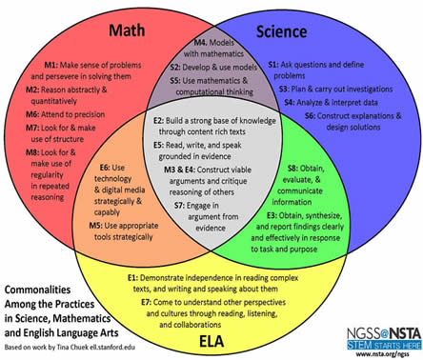
Getting interdisciplinary:
http://teachingcommons.cdl.edu/ngss/science_math/

Slide 6
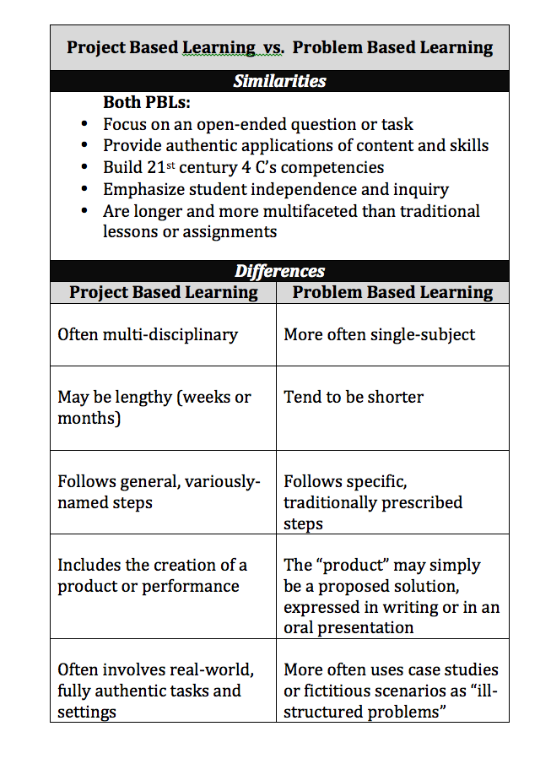
Getting real-life:
21st century 4 C’s competencies
Communication
Collaboration
Critical Thinking
Creativity
http://2.bp.blogspot.com/-G8G58tpaSLY/UoU3m9JgLSI/AAAAAAAAAQ0/-OE13RZ1-WY/s1600/Screen+Shot+2013-11-14+at+12.39.40+PM.png

Slide 7
Finding stuff (“sources”) …
… in your school’s library/media center:
Grandville H.S. - Library Media Center + Kent ISD system
Allendale Public Schools - Media Center Research & Study Tools
Holland Public Schools - Student Links: Media Center Library Catalogs + Muskegon ISD system

Slide 8
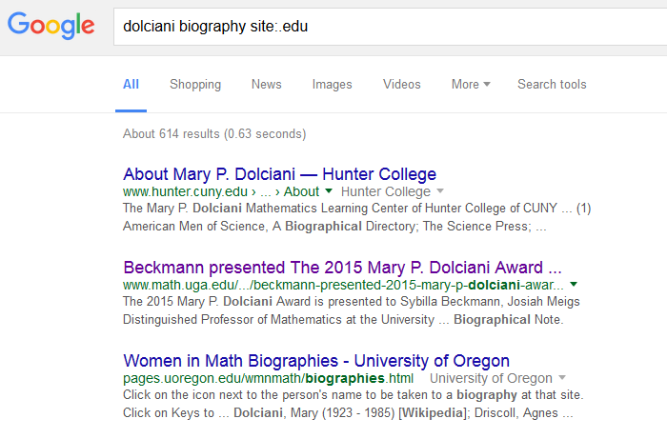
Finding stuff (“sources”) …
… out on the Web:
MeL Homework Help, part of the MeL Teens gateway
PBS Learning Media
Wikipedia
Google
  site:.[domain]

Slide 9
Evaluating “stuff”
You can find something about just about anything out on the Web …
… but is it any good??

Slide 10
Evaluating “stuff”
Let’s see how well you do!
go to:
“The True Cost of Owning a Car”
http://tinyurl.com/MIAcrayolas

Slide 11
Evaluating “stuff”
Query a potential source before you decide to use it. Is it good enough?
C urrency
R elevance
A uthority
A ccuracy
P urpose

Slide 12
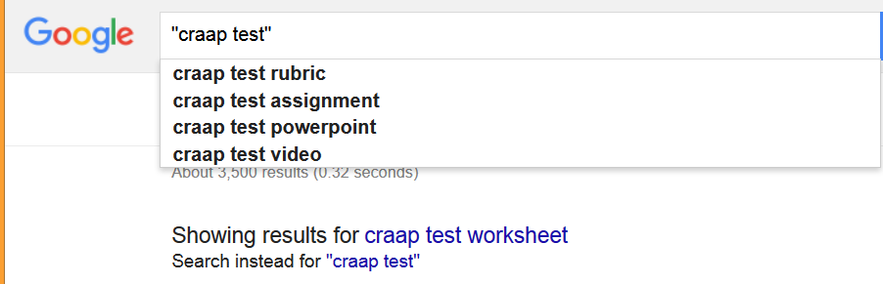
Evaluating “stuff” – apply…
…the CRAAP Test!

Slide 13

Thank you for your attention!
--Debbie Morrow
GVSU University Libraries
morrowd@gvsu.edu

Slide 14
Currency the timeliness of the information
• When was the information published or posted?
• Has the information been revised or updated?
• Is the information current or out-of-date for your topic?
• Are the links functional?

Slide 15
Relevance the importance of the information for your needs
• Does the information relate to your topic or answer your question?
• Who is the intended audience?
• Is the information at an appropriate level?
• Have you looked at a variety of sources before choosing this one?
• Would you be comfortable using this source for a research paper?

Slide 16
Authority the source of the information
• Who is the author/publisher/source/sponsor?
• Are the author's credentials or organizational affiliations given?
• What are the author's credentials or organizational affiliations given?
• What are the author's qualifications to write on the topic?
• Is there contact information, such as a publisher or e-mail address?
• Does the URL reveal anything about the author or source?

Slide 17
Accuracy the reliability, truthfulness, and correctness of the content
• Where does the information come from?
• Is the information supported by evidence?
• Has the information been reviewed or refereed?
• Can you verify any of the information in another source?
• Does the language or tone seem biased and free of emotion?
• Are there spelling, grammar, or other typographical errors?

Slide 18
Purpose the reason the information exists
• What is the purpose of the information?
• Do the authors/sponsors make their intentions or purpose clear?
• Is the information fact? opinion? propaganda?
• Does the point of view appear objective and impartial?
• Are there political, ideological, cultural, religious, institutional, or personal biases?

