Slide 1

Weaving Connections: Utilizing a Library – Social Work Partnership to Build Information Literacy Skills
David Vess, MLIS, User Experience Librarian & Social Work Liaison Librarian, Assistant Prof., Libraries & Educational Technologies
Laura Trull, Ph.D., Assistant Professor, Department of Social Work
March 17, 2018
2018 Annual Conference
Association of Baccalaureate Social Work Program Directors

Slide 2
Presentation Objectives
Participants will be exposed to a model of information literacy activities designed collaboratively by social work and library faculty.
Participants will discuss opportunities for engaging students in interactive experiences focused on skill development.
Participants will receive an outline of interactive lessons and are encouraged to implement activities in the future and share with presenters.

Slide 3
Context
JMU Social Work Department
  8 Fulltime Faculty; 250 students
JMU Libraries & Educational Technologies
  Liaison Librarians to Departments – collection development; research consultations; and Information Literacy Instruction
Notes:
JMU Department of Social Work (Laura)
Libraries & Educational Technologies - (David)
Prior to our project, my work involved conducting library instruction sessions (i.e. one-shots) in classes. I visited two classes each semester - Introduction to Social Work and Social Work Research Methods. These sessions were lecture-style with demonstrations. Prompting questions were used to try to keep students engaged. My visits were always mapped to the expectations of the main course assignments, but they were not scaffolded between the two classes. We also only had an anecdotal sense of impact.
The department gives graduating seniors an information literacy skills test. That is a great thing to have, but I hoped to get a better sense of student skills before and after library instruction.
Also, librarians are often not trained as teachers or in assessment practices. Over the summer of 2016 I planned to improve my instruction by learning about: assessment and active learning practices. I already do work in user experience and computer interface design. I also am familiar with principles of universal design which helped me create exercises (and plan classroom experiences) that were transparent to students. My goal was to help students improve their information literacy skills though well-crafted experiences with minimum cognitive load.
I should note that JMU’s Center for Assessment & Research Studies (CARS) is an assessment powerhouse on our campus. They cultivate a culture of assessment in a number of ways and I have benefited greatly from their expertise.

Slide 4
The Problem
Evidence continues to build that information literacy (IL) is taught across university and college curricula at all student levels (Junsbai, Lowe & Tagge, 2016).
Challenges connecting IL to those curricula in meaningful ways persist (Julien, Gross, & Latham, 2018; Klomsri & Tedre, 2016; Bombaro 2013).
Blending IL into social work education beyond traditional one-shot library sessions also remains a challenge as evidenced by the dearth of literature demonstrating sound instruction and assessment practices of IL in social work programs (Bausman & Ward, 2016; Kayser, Bowers, Jiang, & Bussey 2013; Johnson, Whitfield, & Grohe, 2011; Ismail, 2009; Brustman & Bernnard 2007; Bellard, 2005).
Notes:
Speaking both languages -

Slide 5
Information Literacy
Saunders (2017) definition of Information Literacy:
  defining an information need;
  locating and accessing information efficiently;
  evaluating information; and
  using information in ethical ways.

Slide 6
ACRL Framework for Information Literacy for Higher Education
Authority is constructed and contextual
Information creation as a process
Information has value
Research as inquiry
Scholarship as conversation
Searching as strategic exploration
Framework for Information Literacy for Higher Education (2016). http://www.ala.org/acrl/standards/ilframework
Notes:
The Association of College and Research Libraries’ Framework document is 18 pages. ACRL moved away from a rigid set of standards or learning outcomes to the Framework which are interconnected concepts allowing flexible implementation.
The frames are “threshold concepts which are those ideas in any discipline that are passageways or portals to enlarged understanding or ways of thinking and practicing within that discipline.”
Threshold concepts are core or foundational concepts that, once grasped by the learner, create new perspectives and ways of understanding a discipline or challenging knowledge domain. Such concepts produce transformation within the learner; without them, the learner does not acquire expertise in that field of knowledge. Threshold concepts can be thought of as portals through which the learner must pass in order to develop new perspectives and wider understanding. Jan H. F. Meyer, Ray Land, and Caroline Baillie. “Editors’ Preface.” In Threshold Concepts and Transformational Learning, edited by Jan H. F. Meyer, Ray Land, and Caroline Baillie, ix–xlii. (Rotterdam, Netherlands: Sense Publishers, 2010).
The Framework is meant to guide the development of information literacy programs AND to spark conversation about the key concepts each frame provides in any discipline.
The Framework consists of 6 frames (or lenses) thorough which to view information literacy and each offers suggested knowledge practices and dispositions an information literate student should develop.
knowledge practices, “ . . .are demonstrations of ways in which learners can increase their understanding of these information literacy concepts.” Additionally, the ARCL Framework document states, “Knowledge practices are the proficiencies or abilities that learners develop as a result of their comprehending a threshold concept.”
Dispositions, “. . . describe ways in which to address the affective, attitudinal, or valuing dimension of learning.” Additionally, the Framework document states, “Generally, a disposition is a tendency to act or think in a particular way. More specifically, a disposition is a cluster of preferences, attitudes, and intentions, as well as a set of capabilities that allow the preferences to become realized in a particular way. Gavriel Salomon. “To Be or Not to Be (Mindful).” Paper presented at the American Educational Research Association Meetings, New Orleans, LA, 1994.

Slide 7
Connections Between
CSWE & Information Lit. Framework
Association of College Research Libraries (ACRL)
Framework for Information Literacy in Higher Education
Council on Social Work Education Framework
+

Slide 8
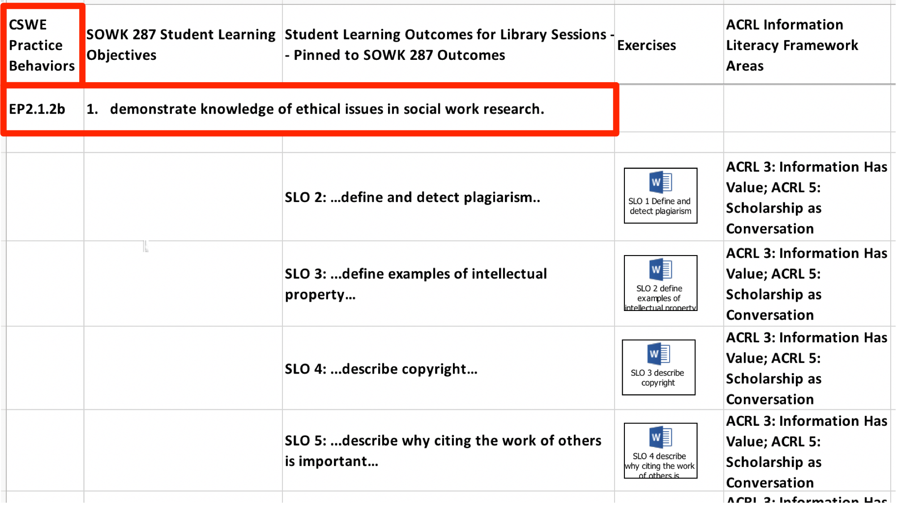

Slide 9
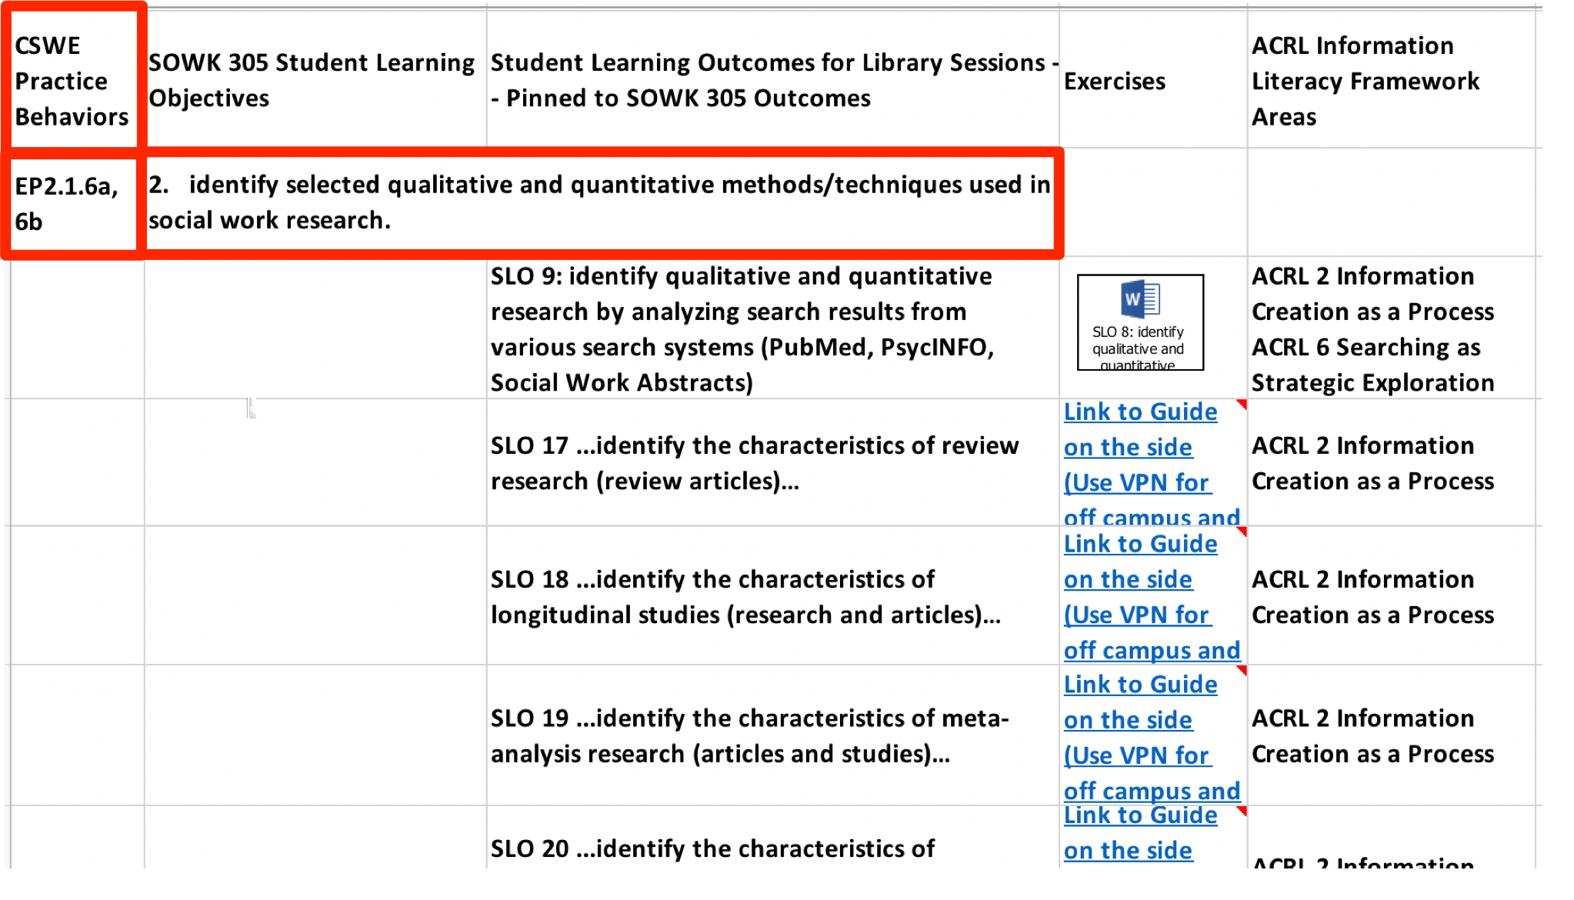

Slide 10
Active Learning in Library Sessions
Information literacy instruction is probably not what you think of as library instruction
  Before our project: focused on demonstrations of services
  After our project: we focus on teaching students how to: define an information need, find, evaluate, and use information in ethical ways
Traditional library instruction is often demonstration not teaching
Evaluating our experience & writing learning outcomes
Inspired by active learning techniques and flipped classroom method
Began implementing multiple sessions into the class to experiment

Slide 11
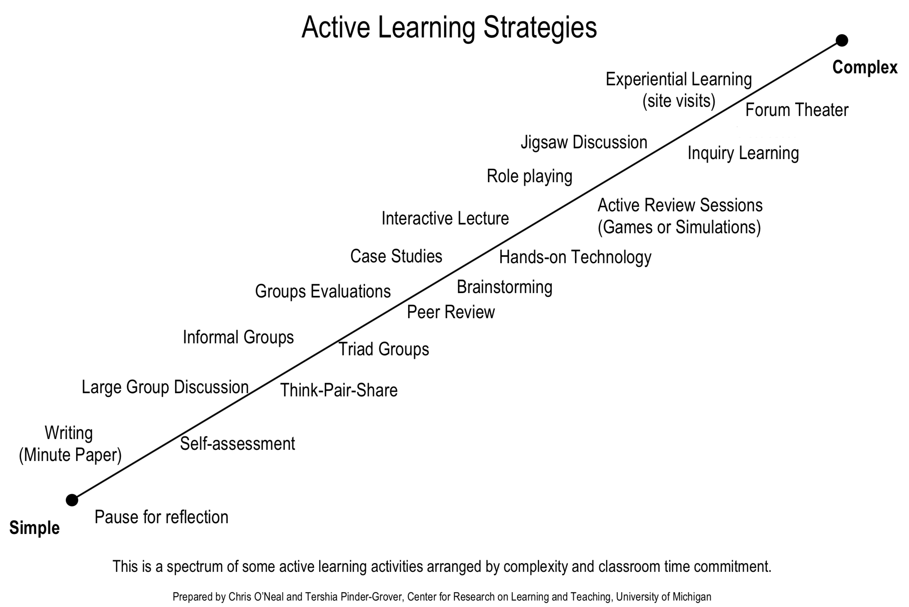
Notes:
We used the central region of this spectrum (ADD A CIRCLE)
This is where to unpack the characteristics of our exercises

Slide 12
Areas of this spectrum we touch on with our classroom experiences.
Notes:
We used the central region of this spectrum (ADD A CIRCLE)
This is where to unpack the characteristics of our exercises

Slide 13
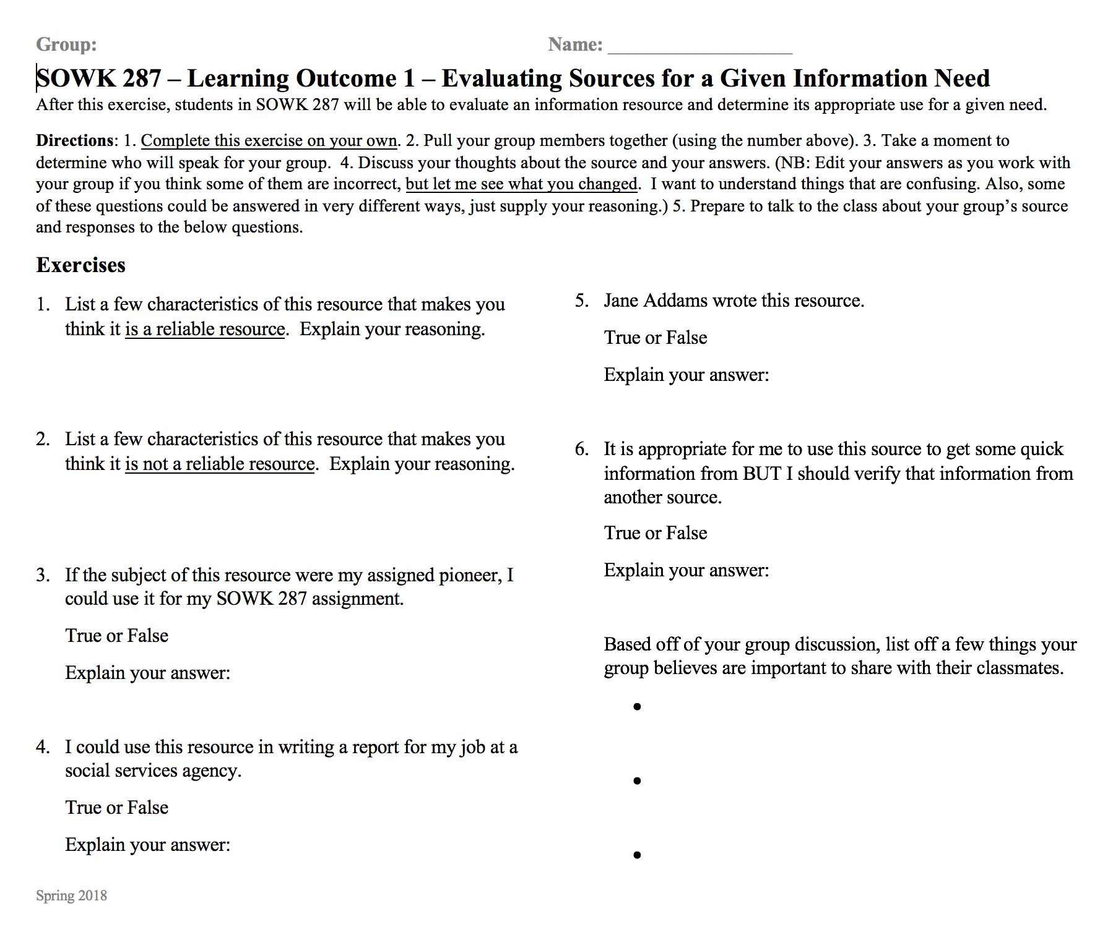
Notes:
You don’t need technology. All the exercises can be used in a digital tool or in print.
Have them do this exercise in a few minutes in pairs.
Discussion on answers
BJ’s Ideas:
PechaKucha (Slide presentation) Exercise with images that show 20 seconds in 6 minutes.). This is an important thing to think about in your evaluation purposes.
Team-based learning practices (Pharmacy schools).

Slide 14
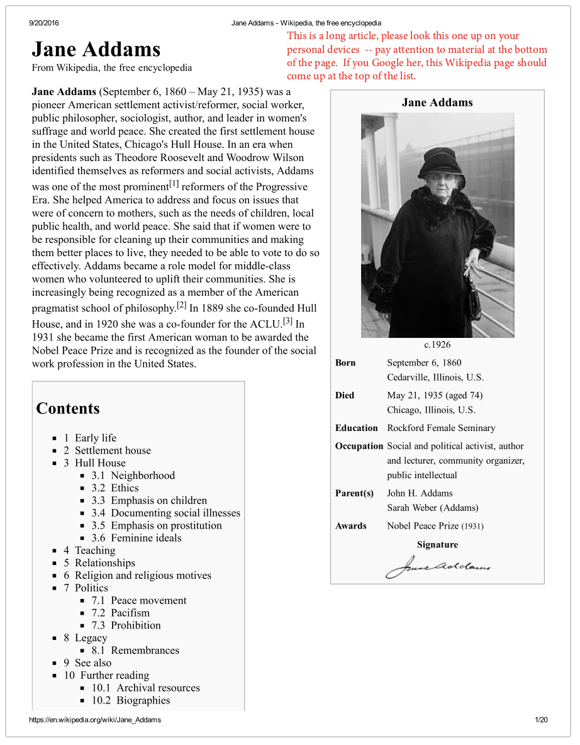
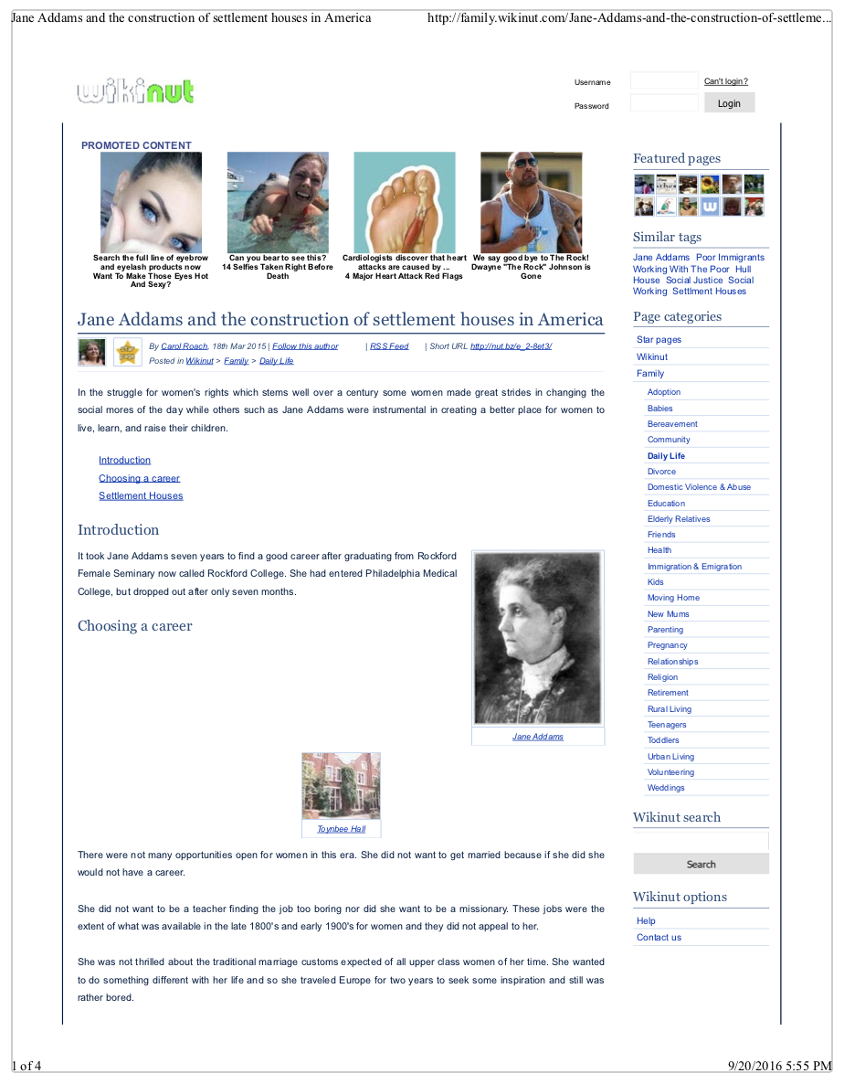
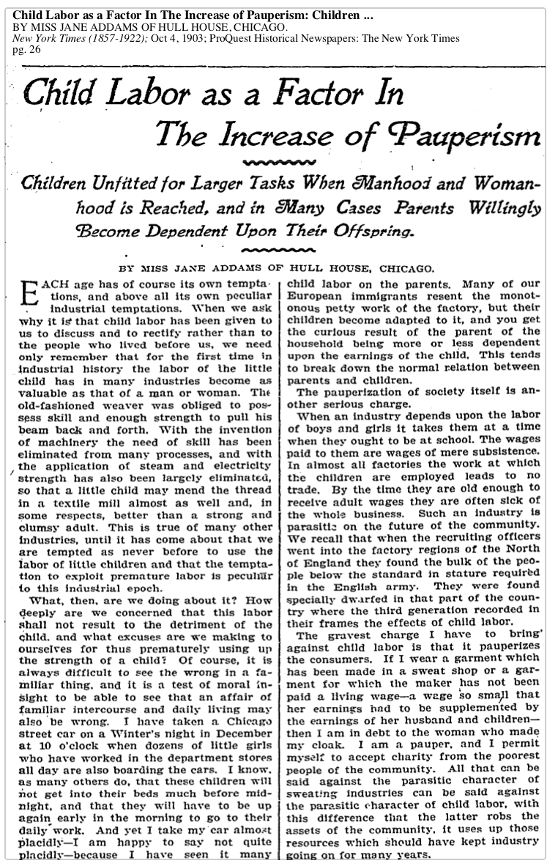
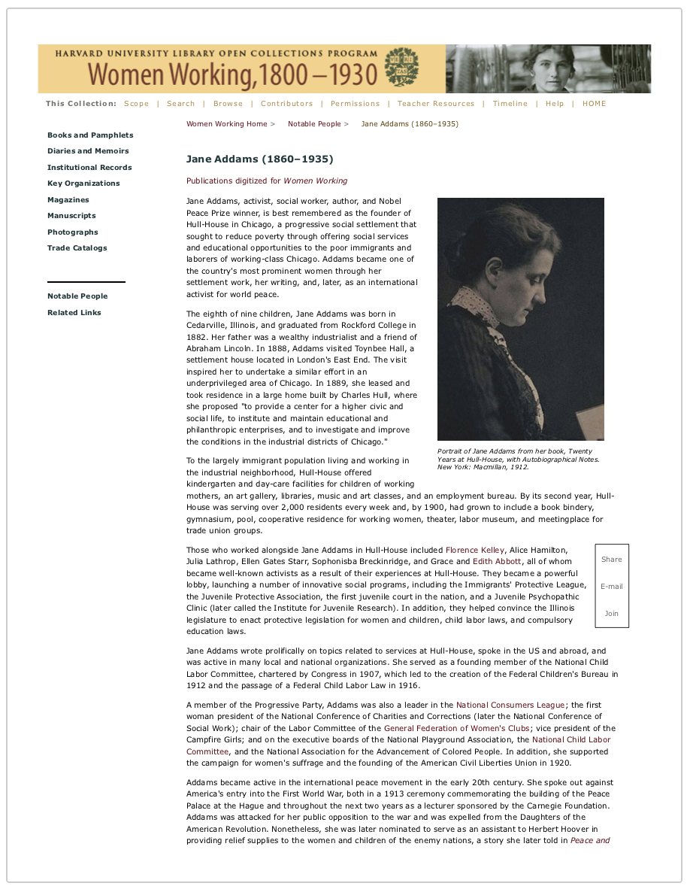
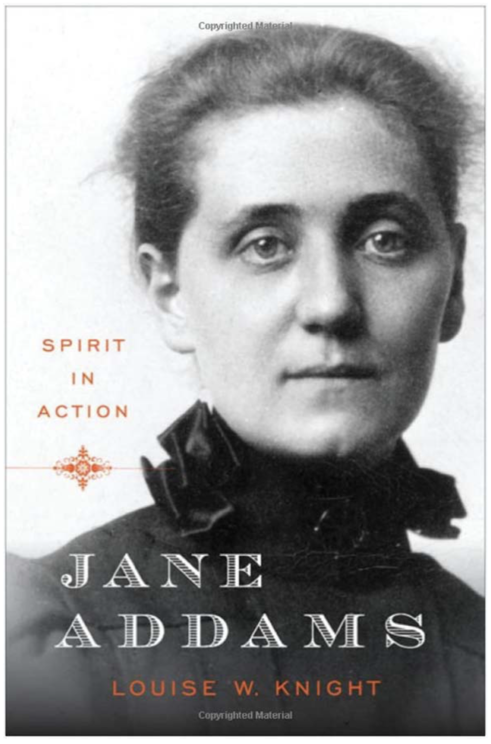
Notes:
These are examples of the resources that student teams use to do the exercise in the previous slide. I sent them to the online resource.

Slide 15
Video Demonstration of an Online Teaching Tool
Guide on the Side:
  https://youtu.be/4M1UHEW7788
Notes:
This is a video demonstrating an exercise in Guide on the Side from the University of Arizona Libraries.
You can create a similar experience with a survey tool like Qualtrics or Survey Monkey. Using either of them, you could create a learning experience linking to readings. We have also had success with printed exercises paired with information resources to evaluate.

Slide 16
Exercises Outline
SLO 1: ……evaluate an information resource and determine its appropriate use for a given need…
SLO 2: …define and detect plagiarism..
SLO 3: ...define examples of intellectual property…
SLO 4: ...describe copyright…
SLO 5: ...describe why citing the work of others is important…
SLO 6: ...identify the elements of citations for journal articles and books…
SLO 7: ...construct citations from source information (book front matter and the first page of a journal article)…
SLO 8: ...be able to employ citations to: 1) distinguish between books and articles and 2) locate the resource…
Notes:
The Association of College and Research Libraries’ Framewoih framework document is 18 pages. ACRL moved away from a rigid set of standards or learning outcomes to the Framework which are interconnected concepts allowing flexible implementation.
The frames are “threshold concepts which are those ideas in any discipline that are passageways or portals to enlarged understanding or ways of thinking and practicing within that discipline.”
Threshold concepts are core or foundational concepts that, once grasped by the learner, create new perspectives and ways of understanding a discipline or challenging knowledge domain. Such concepts produce transformation within the learner; without them, the learner does not acquire expertise in that field of knowledge. Threshold concepts can be thought of as portals through which the learner must pass in order to develop new perspectives and wider understanding. Jan H. F. Meyer, Ray Land, and Caroline Baillie. “Editors’ Preface.” In Threshold Concepts and Transformational Learning, edited by Jan H. F. Meyer, Ray Land, and Caroline Baillie, ix–xlii. (Rotterdam, Netherlands: Sense Publishers, 2010).
The Framework is meant to guide the development of information literacy programs AND to spark conversation about the key concepts each frame provides in any discipline.
The Framework consists of 6 frames (or lenses) thorough which to view information literacy and each offers suggested knowledge practices and dispositions an information literate student should develop.
knowledge practices, “ . . .are demonstrations of ways in which learners can increase their understanding of these information literacy concepts.” Additionally, the ARCL Framework document states, “Knowledge practices are the proficiencies or abilities that learners develop as a result of their comprehending a threshold concept.”
Dispositions, “. . . describe ways in which to address the affective, attitudinal, or valuing dimension of learning.” Additionally, the Framework document states, “Generally, a disposition is a tendency to act or think in a particular way. More specifically, a disposition is a cluster of preferences, attitudes, and intentions, as well as a set of capabilities that allow the preferences to become realized in a particular way. Gavriel Salomon. “To Be or Not to Be (Mindful).” Paper presented at the American Educational Research Association Meetings, New Orleans, LA, 1994.

Slide 17
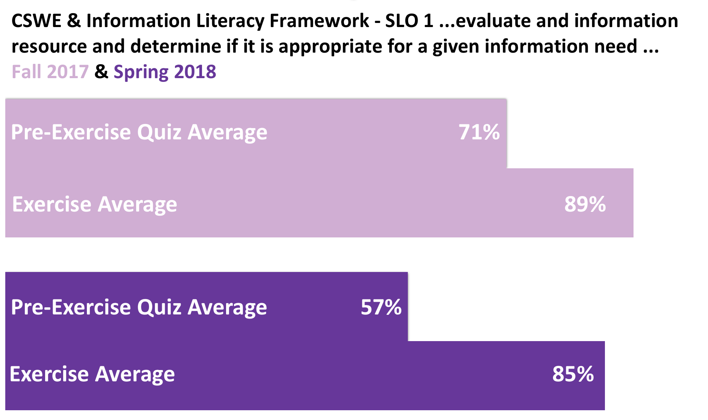
Data
CHARTS HERE

Slide 18
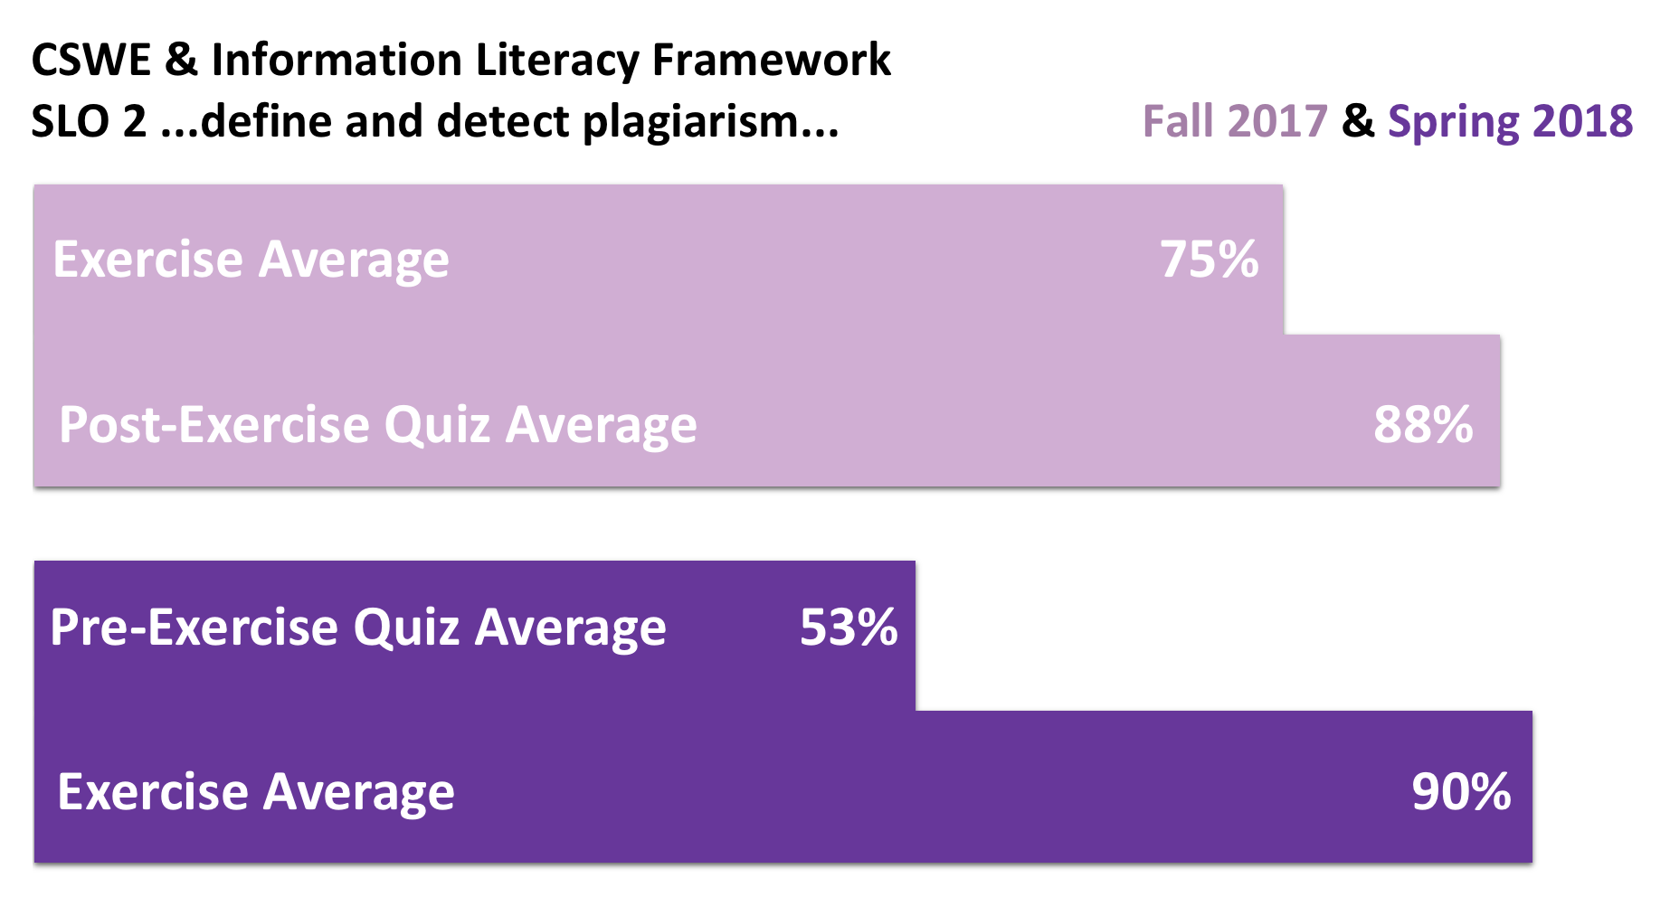

Slide 19
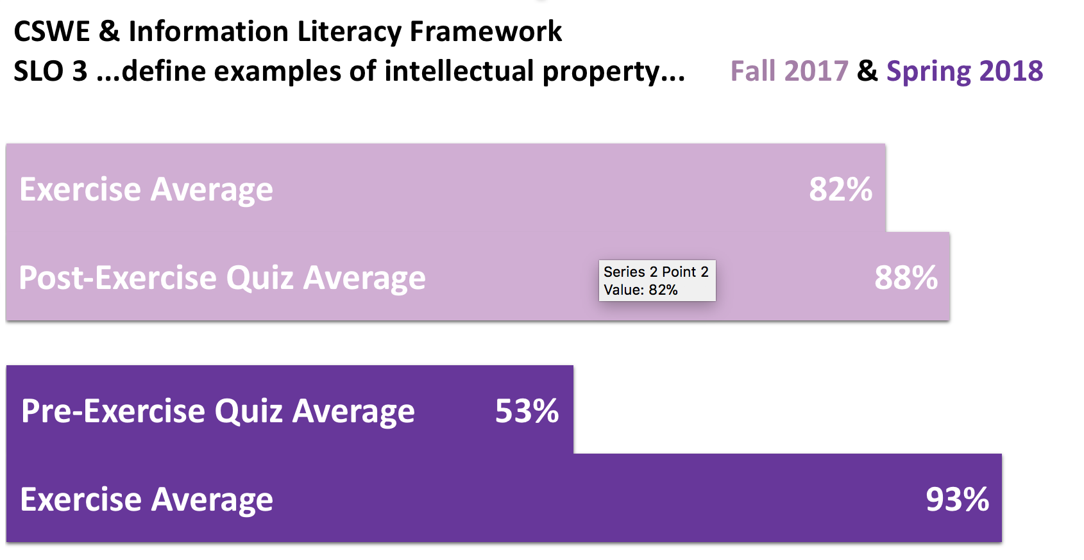

Slide 20
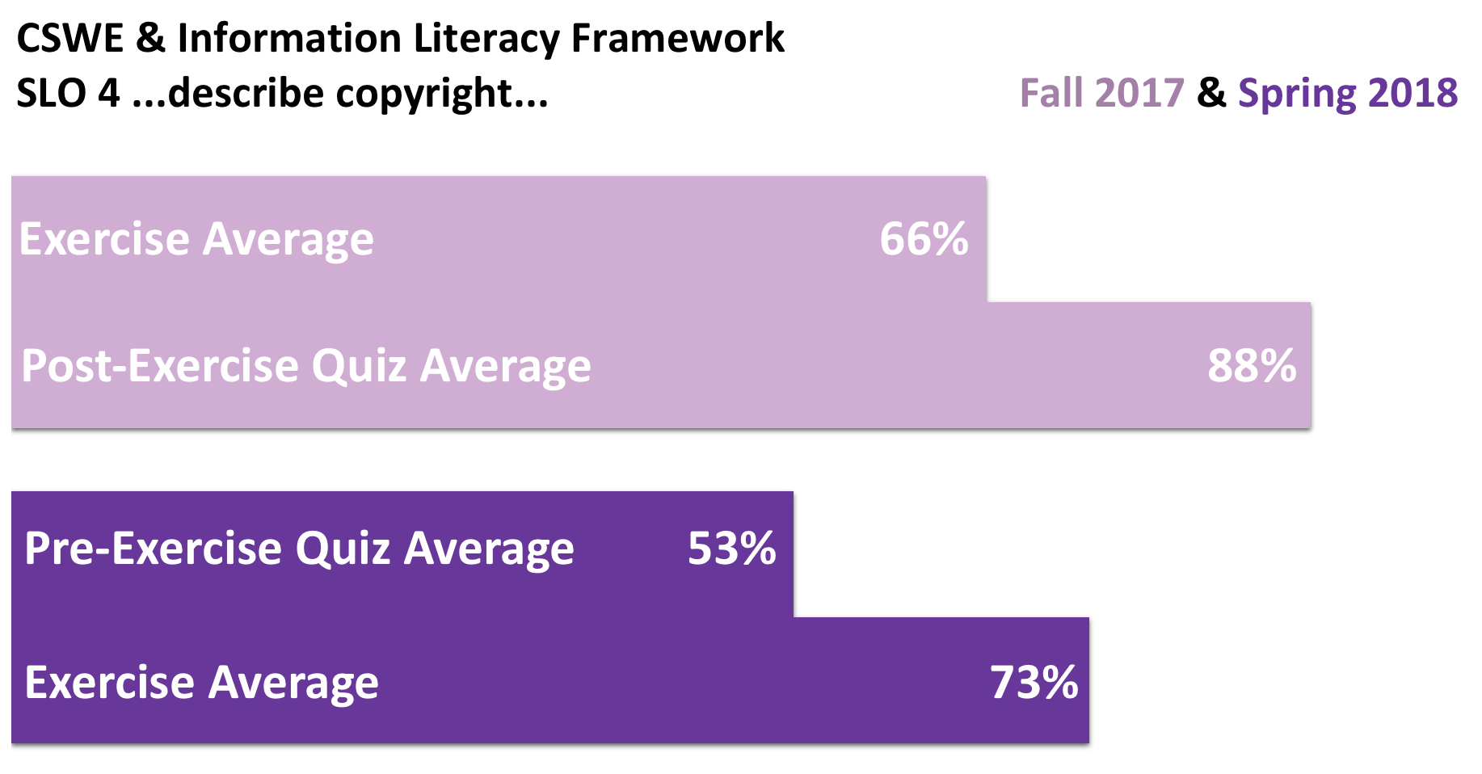

Notes:
We have work to do on this area. My goal is an 80% average for each area.

Slide 21
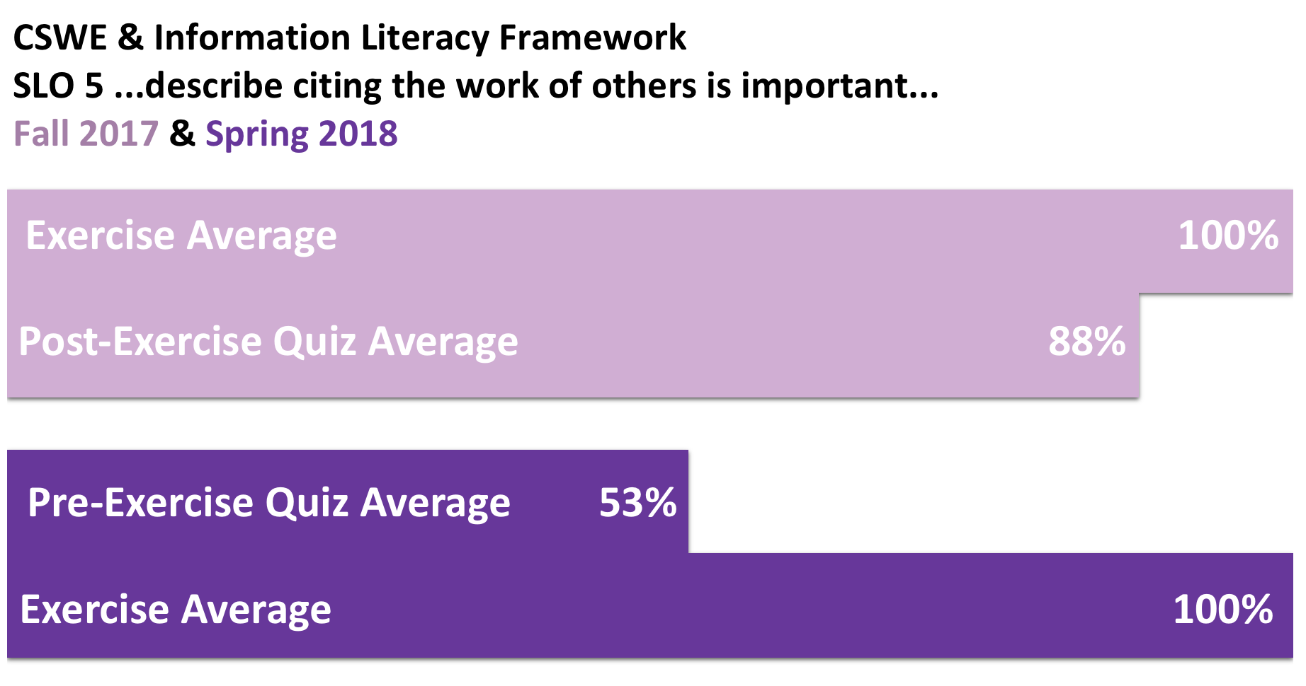

Slide 22
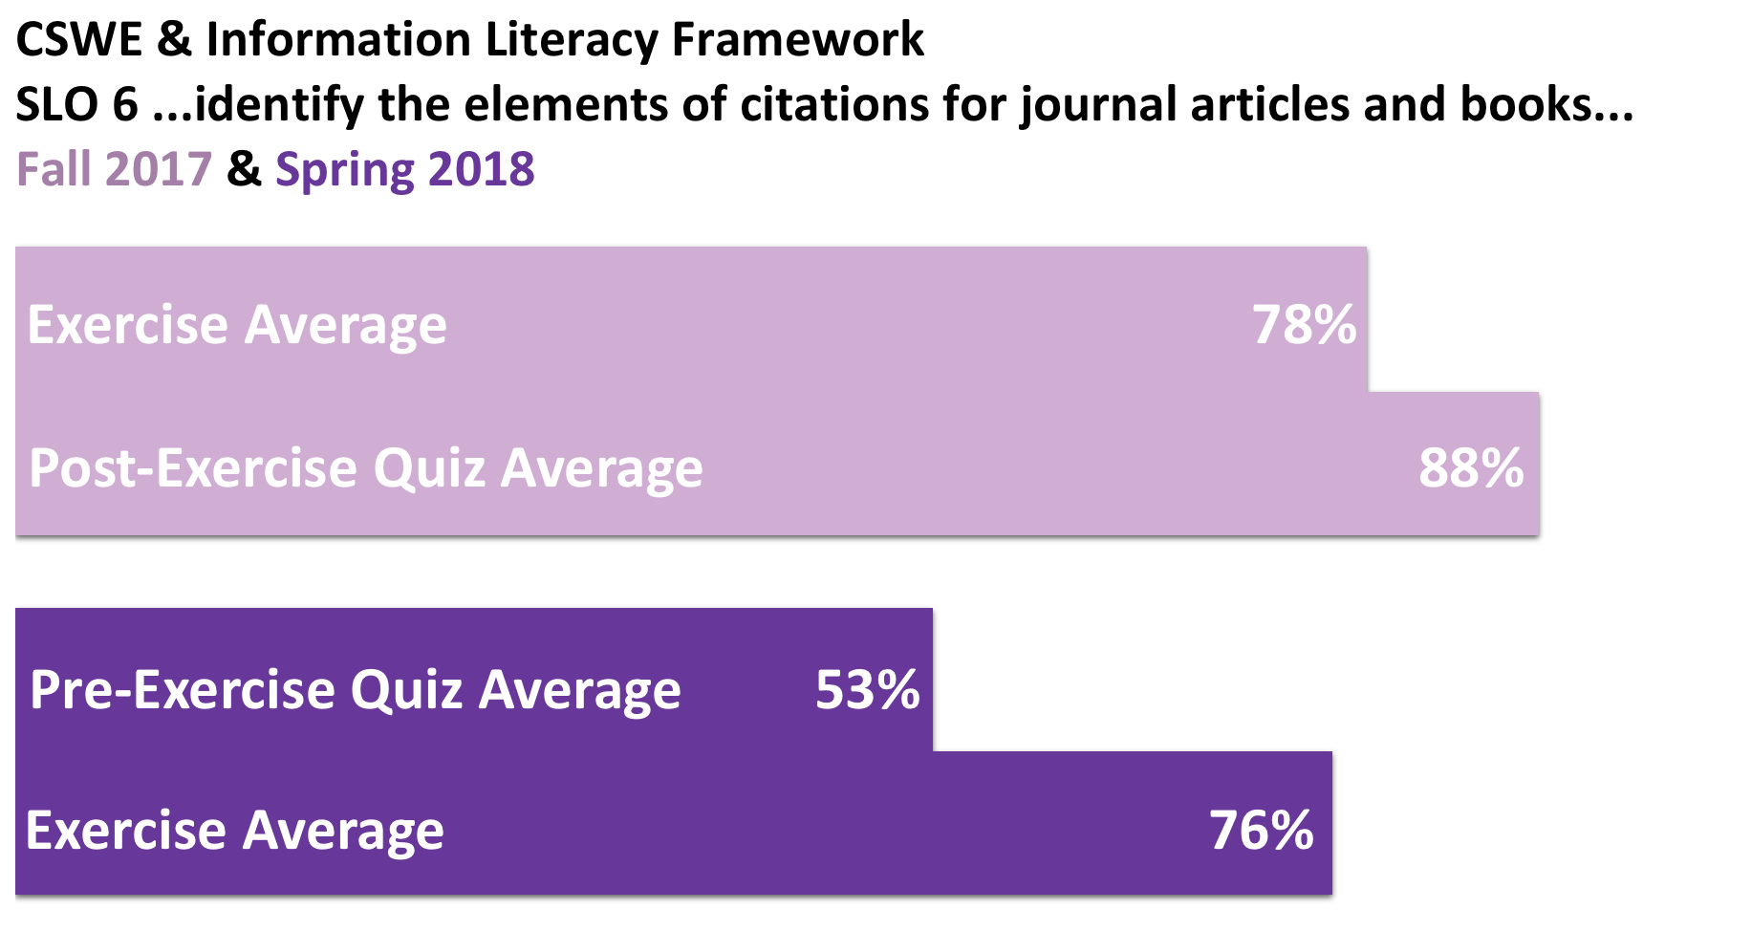

Slide 23
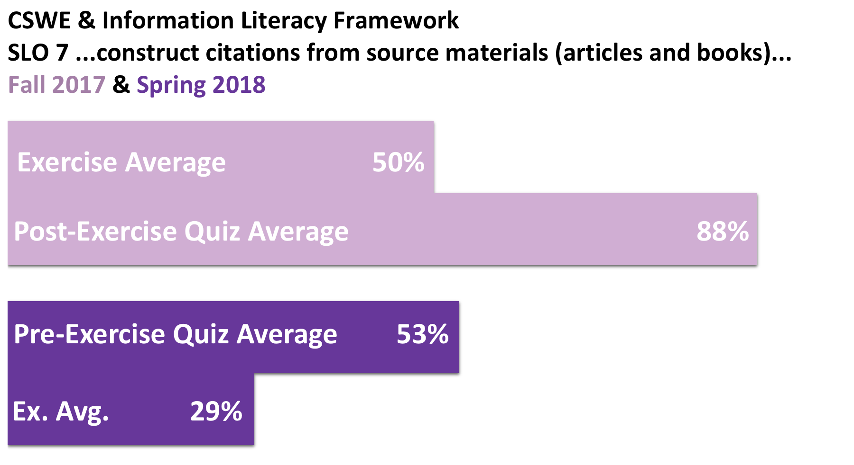
Notes:
We have work to do on this area. My goal is an 80% average for each area.

Slide 24
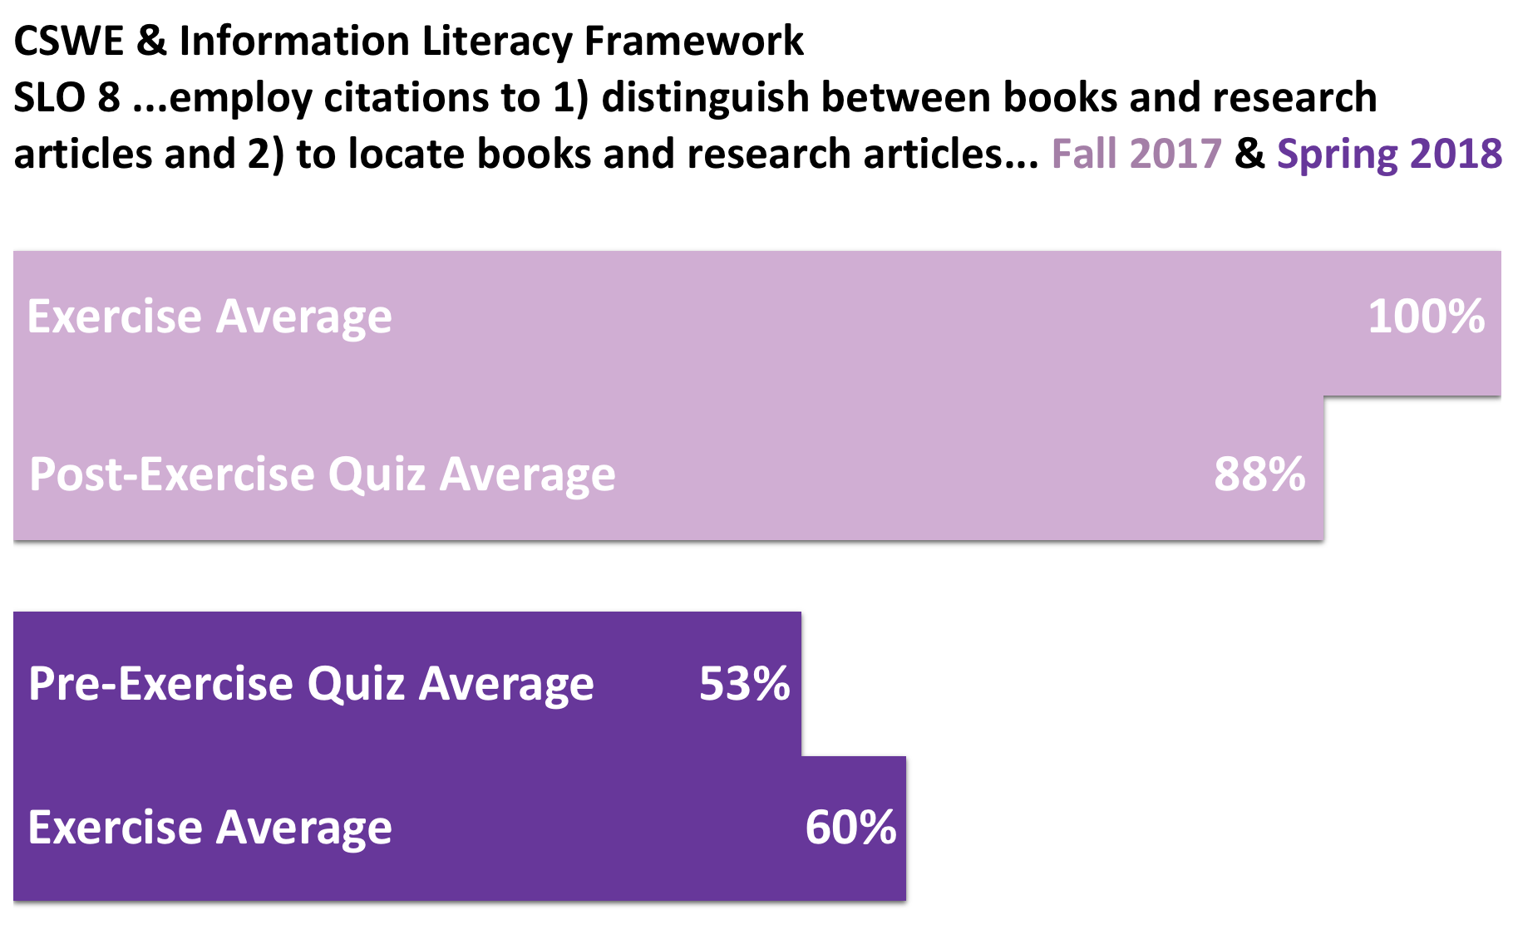
Notes:
We have work to do on this area. My goal is an 80% average for each area.

Slide 25
Let’s Talk Briefly
Do you have opportunities to engaging students in interactive experiences?
Would connecting the standards, along with your course objectives help you see how things fit together?

Slide 26
Questions?

Slide 27
Contact
David Vess, vessds@jmu.edu
Laura Trull, trulllh@jmu.edu

Slide 28
References
American Library Association, Association of College & Research Libraries. (2000). Information literacy competency standards for higher education. Retrieved from http://www.ala.org/acrl/sites/ala.org.acrl/files/content/standards/standards.pdf
American Library Association, Association of College & Research Libraries. (2016). Framework for information literacy for higher education. Retrieved from http://www.ala.org/acrl/standards/ilframework
Bausman, M., & Ward, S. L. (2016). The social work librarian and information literacy instruction: A report on a national survey in the United States. Behavioral & Social Sciences Librarian, 35(3), 109-122. doi:10.1080/01639269.2016.1243439
Bellard, E. M. (2005). Information literacy needs of nontraditional graduate students in social work. Research Strategies, 20(4), 494-505. doi:10.1016/j.resstr.2006.12.019

Slide 29
References
Bingham, T. J., Wirjapranata, J., & Chinnery, S. (2016). Merging information literacy and evidence-based practice for social work students. New Library World, 117(3/4), 201-213. doi:10.1108/NLW-09-2015-0067
Bombaro, C. (2014). Overcoming the barriers to information literacy programs. Reference Services Review, 42(2), 246–262. doi:10.1108/RSR-10-2013-0050
Brustman, M. J., & Bernnard, D. (2007). Information literacy for social workers: University at Albany Libraries prepare MSW students for research and practice. Communications in Information Literacy, 1(2), 89-101.
Ismail, L. (2009). What they are telling us: library use and needs of traditional and non‐traditional students in a graduate social work program. The Journal of Academic Librarianship, 35(6), 555-564. doi:10.1016/j.acalib.2009.08.019

Slide 30
References
Johnson, O. J., Whitfield, J. S., & Grohe, B. (2011). Improving social work students’ information literacy skills: A faculty and librarian collaboration. Journal on Excellence in College Teaching, 22(3), 5–21. Retrieved from http://celt.muohio.edu/ject/fetch.php?id=505
Julien, H., Gross, M., & Latham, D. (in press). Survey of information literacy instructional practices in U.S. academic libraries. College & Research Libraries.
Junisbai, B., Lowe, M. S., & Tagge, N. (2016). A pragmatic and flexible approach to information literacy: Findings from a three-year study of faculty-librarian collaboration. The Journal of Academic Librarianship, 42(5), 604–611. doi:10.1016/j.acalib.2016.07.001
Kayser, J. A., Bowers, J., Jiang, L., & Bussey, M. (2013). Increasing MSW students? Information competencies through online tutorials, application exercises, and course assignments. Journal of Teaching in Social Work, 33(4–5), 578–593. doi:10.1080/08841233.2013.831391
Klomsri, T., & Tedre, M. (2016). Poor information literacy skills and practices as barriers to academic performance: A mixed methods study of the University of Dar es Salaam. Reference & User Services Quarterly, 55(4), 293. doi:10.5860/rusq.55n4.293

