Slide 1
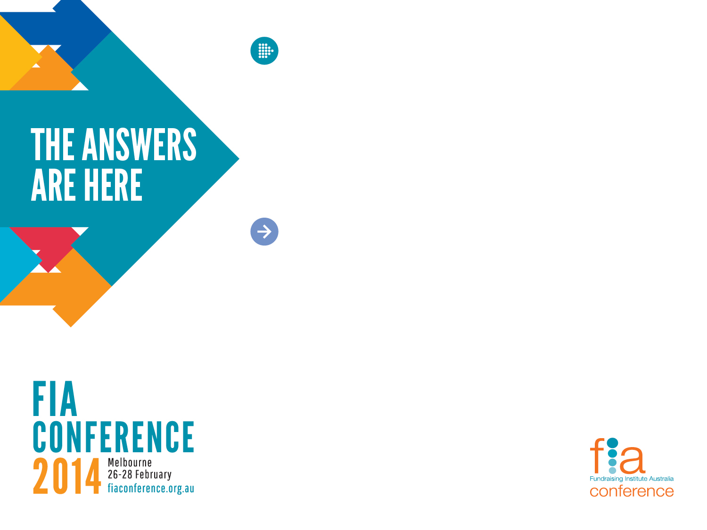

^{Corporate Fundraising:}
What’s the key to unlocking corporate wealth?
^{Dr David Cooke}
^{Managing Director}
Konica Minolta Business Solutions

Slide 2

Seeking corporate support
Why do profit-making corporations support the not-for-profit sector?
Knowledge based on research undertaken with Australian companies clearly demonstrates why
Understanding this motivation is the key to maximising corporate giving

Slide 3





Australian case studies

Slide 4
Corporate positions
LEAST
None of our ‘business’
No participation
Wait and see
Minor participation
COMMITMENT
Get involved
Active participation
Strategic involvement
MOST
Full participation

Slide 5

None of our business
Does a company really have a responsibility to help others in society?
“The business of business is business”.
“The social responsibility of business is to make a profit”.
Milton Friedman 1970
Nobel Prize winning economist

Slide 6
Further support for this view
“The directors of companies are appointed by shareholders to make money for shareholders, not to donate it to other people. Companies should not be deciding what to do with shareholders’ money. They should return as much of it as possible to the shareholders and let them decide what to do with it”
Stan Mather, 2002
Director Australian Shareholders Association
“...companies should not be donating money to a region in which it has no commercial interests”.
Chairman, Australian Shareholders Association

Slide 7



The South East Asian Tsunami

Slide 8
Post the tsunami
“Our view now, which is perhaps more reflective of public opinion, is that until individuals give more towards areas of need in society, then companies have to bridge that gap”.
Anywhere in the world? ... “anywhere in the world”.
CEO, Australian Shareholders Association

Slide 9
Motivation to participate
1. It’s the right thing to do
Moral imperative
Compliance
2. Risk mitigation
Commercial orientation
3. Enlightened self-interest

Slide 10

1. It’s the right thing to do
“The corporation truly has to represent it’s capital, it’s shareholders, it’s community and it’s employees”
Geraldine Doogue
ABC Broadcaster & Journalist
“The idea of a sharp separation between responsibility to shareholders and to the community has never made a lot of sense to me”
Michael Traill
Founder Social Ventures Australia
ex Macquarie Bank

Slide 11
What about shareholder dividends?
“It’s not clear to me that the company’s money does in fact belong to the shareholders...I think it is arguable that it is not the shareholders money that is being spent anyway... That means that the money a company has is its money... The obligation (of the directors) is to act in the interests of the company as a whole”.
Simon Longstaff
Director, St James Ethics Centre

Slide 12
2. Risk mitigation
“The banks are seen by many as faceless, cold-hearted, fee generating machines”
Stuart Wilson
CEO Aust Shareholders Assoc
“I wrote the words ‘Spirit of Australia’. I wrote it at a time when I thought it was true. I now feel like going around and scraping those words off every aircraft”
Phillip Adams
Broadcaster, journalist

Slide 13
3. Enlightened self interest
Corporations today have realised that there are tangible benefits from forming alliances with the not-for-profit sector, so they need partners
In the same way that the not-for-profit sector requires assistance from the for-profit world so too the for-profit world needs assistance from the not-for-profit world
An environment of mutually beneficial exchange exists and it is on that basis that any approach should be made

Slide 14


Reputation building
Gaining a licence to operate
Building shareholder and market confidence
Brand rebuilding, regaining market share
Market positioning, brand awareness

Slide 15


Valuable internal assets motivation & morale
“You could see the development that they had experienced when they came back. You could see it on their faces”
Westpac Manager
“It’s hard to measure but you know when it’s there. It’s how it gets it’s soul”
Dennis Tracey
Swinburne University

Slide 16
Competitive advantage
Recruitment & retention
PricewaterhouseCoopers
Response to Gen Y
Best and brightest
Surveyed confirmation
Retention strategies
Matched giving programs
Volunteering days off
Charitable sponsorships

Slide 17

Competitive advantage
Consumer attitudes
“I think many consumers are saying ‘how we make our purchasing decisions has deep regard as to whether we believe the organisations we are buying goods and services from are ethical and are contributing to the community’.”
Michael Traill
Founder Social Ventures Australia
ex Macquarie Bank

Slide 18

The old paradigm
“We’re doing God’s work, you’re bastards. So give us the money, go away and let us do God’s work. Well that’s the old fashioned philanthropy; just get the money, give the receipt and move on”
Dennis Tracey
Swinburne University

Slide 19

The new paradigm
The moral imperative for giving has given way to value creation through mutually beneficial partnerships backed by solid business cases demonstrating a return on investment

Slide 20
More than just financial benefits
Corporate skills that benefit the not-for-profit sector
Strong commercial focus
Financial growth and stability
Short-term results focus
May be necessary and appropriate at times
Negotiating ability
Managerial expertise
Strengthen management systems and outcomes
Secure better outcomes for the organization
Marketing strategies
Facilitate growth of public awareness
Sophisticated PR strategies
Gain potentially valuable contacts in press / media
Strong networks
Tap into networks to secure increased support
Technology infrastructure
Share knowledge and potentially even infrastructure

Slide 21
Reciprocal benefits for corporations
Not-for-profit skills that benefit the corporate sector
Strong societal focus
Gain genuine respect and loyalty from domain
Tireless long-term focus
Maintain focus during adverse cycles
Staff commitment
Provide role models and inspiration for staff
Ability to influence
Knowledge and skills to achieve outcomes
Unsophisticated PR strategies
Marketing strategies
Ability to operate effectively on shoe-string budgets
Strong networks
Access to potentially valuable contacts in government and community
Maintenance of core values
Understand the relationship between espoused values, enacted values and trust.
Maintenance of reputation
Re-evaluate accepted brand management paradigms

Slide 22
How to develop corporate interest
Giving is the answer to many of the challenges faced by corporations today
But what if the company hasn’t realised this?
What can I say to make them realise?

Slide 23
How to sell the message
Most importantly - selling is not telling
Stop talking and start listening
Seek to understand the company
Uncover needs with high gain questions
Gain insight into challenges or problems that the company is facing
Don’t jump in, be patient and keep listening
Resist telling your story and listen to theirs
Let them tell you why they need you

Slide 24
Building sustainable partnerships
Most people like talking about themselves more than listening to others and are more likely to believe themselves than believe you!
The key lies in asking questions not in making statements
In the Commercial world this is called Solution Selling. Uncovering needs and mutually discussing if forming a partnership with your organisation for the provision of your product or service may assist with the alleviation of that need
Companies understand this process and language and will feel more comfortable with it. It will also build your credibility

Slide 25
Sample questions
What are some of the main business challenges that you’re facing today?
Then ask more questions around these, depending on what is said….
Competitive market: How do you differentiate your product / service from your competitors?
Getting good staff: May I ask what strategies you have for ensuring you recruit and retain the best staff?
Staff turnover: Do you have any specific strategies to build pride in the company and ensure maximum staff engagement?

Slide 26
Need payoff questions
Would you be interested in hearing of some case studies where companies were able to:
Enhance their corporate reputation?
Improve their branding?
More effectively recruit and retain staff?
Use innovative executive leadership and staff team building strategies?
Positively influence client buying decisions?
Position themselves to win large contracts?

Slide 27

Heart and mind
There are many logical financial reasons to participate in corporate social investment however this approach may seem clinical.
However a company can still approach the decision from a compassionate perspective and it still makes bottom line sense.
There is no incompatibility between heart and mind, emotion and logic. Often the heart prompts us to make a logical decision.

Slide 28


References
The Philanthropic Contract: building social capital through corporate social investment
Thesis: http://works.bepress.com/david_cooke/
Email: david.cooke@konicaminolta.com.au
drdavidcooke
http://au.linkedin.com/in/drdavidcooke/
Thank You

