Slide 1

Leveraging human capital
through engaged leadership
Visionary Leadership Conference Kuala Lumpur August 2015
Dr David Cooke
Chairman & Managing Director
Konica Minolta Business Solutions Australia

Slide 2
Who are you?
What do you stand for?
What sort of company are you building?
Where are you taking us?
Why should I follow you?

Slide 3
The old leader
Telling: top down, authoritarian

Slide 4
Listening: bottom up, harnessing the creativity of others
But aren’t leaders supposed to lead?
The new leader

Slide 5

Born to be me…who am I again?
Laura Kinsler,
International Coaching Psychology Review, 2014

Slide 6

Self awareness
Openness & honesty
Values based courage
Objective decision making
Interest in success & development
of others

Slide 7

aut
h
enticity
tr
u
st
co
m
passion
v
a
lues
ki
n
dness
pass
i
on
Integri
t
y
humilit
y
Humanity in Business

Slide 8

Everyone helped me map how to get there
Company wide survey
Cross functional workshops
One on one meetings

Slide 9
Painting a picture
A company that cares;
cares about its customers,
cares about its people &
cares about its community
My leaders vision

Slide 10


Slide 11
more communication
more involvement in decision making
more trust & empowerment
more senior management customer immersion
more involvement with the community
less bureaucracy
less blame between departments
fewer silos
Their ideas?

Slide 12
A NEW PARADIGM,
SHARED
VALUE
Two modes of giving.
Corporate philanthropy based on the moral imperative; “you are working to improve society, we’ll support you”
Corporate social investment; “together we create shared value which helps us build our social capital, lets partner”.

Slide 13

COMPETITIVE ADVANTAGE:
CONSUMER ATTITUDES
“I think many consumers are saying ‘how we make our purchasing decisions has deep regard as to whether we believe the organisations we are buying goods and services from are ethical and are contributing to the community’.”
Michael Traill
Founder Social Ventures Australia
ex Macquarie Bank Director

Slide 14
GIVING
OR
INVESTING?
Q. “Do you do the same due diligence on funding for community programs as you do for any other commercial initiatives? Do you look for an ROI?”
David Morgan
Westpac managing director, 2006
A. “I can look any shareholder in the eye at any annual general meeting and tell them that I am investing the bank’s money wisely when we invest in the community”.

Slide 15
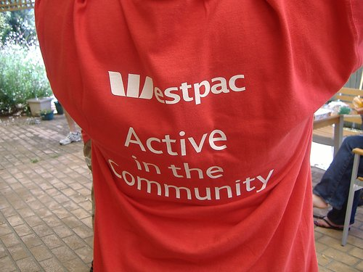

Slide 16


Slide 17
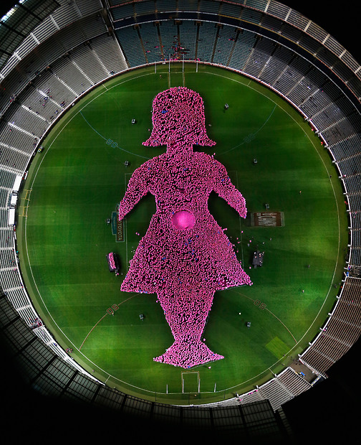

Slide 18


