Slide 1
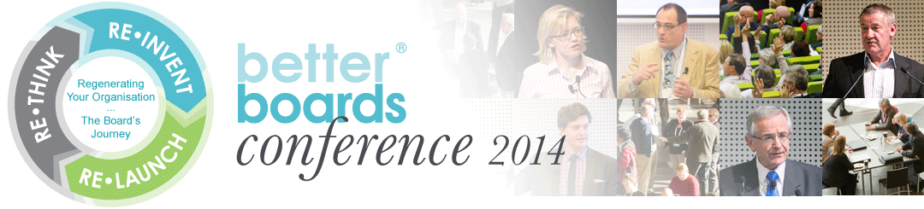
Presentation
Dr David Cooke
A New Paradigm in Corporate Partnerships
August 2014

Slide 2
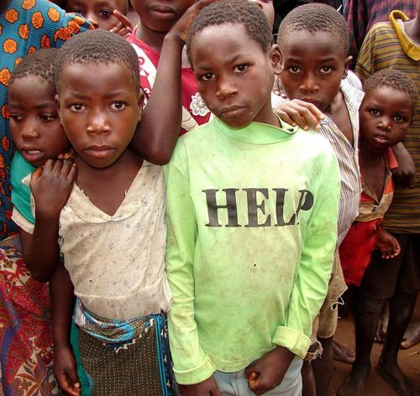

Slide 3
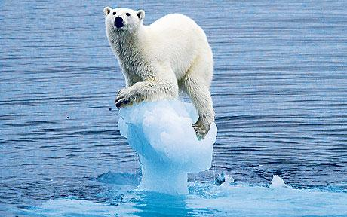

Slide 4
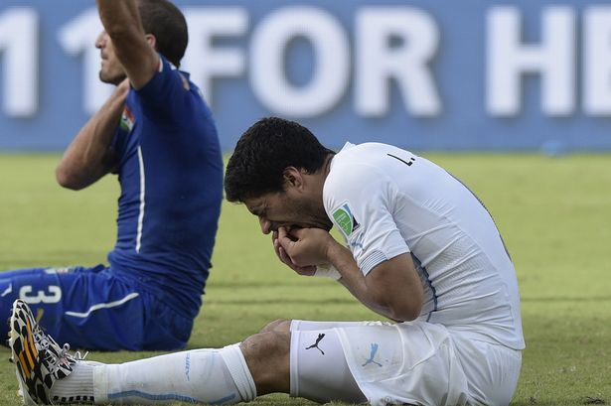

Slide 5
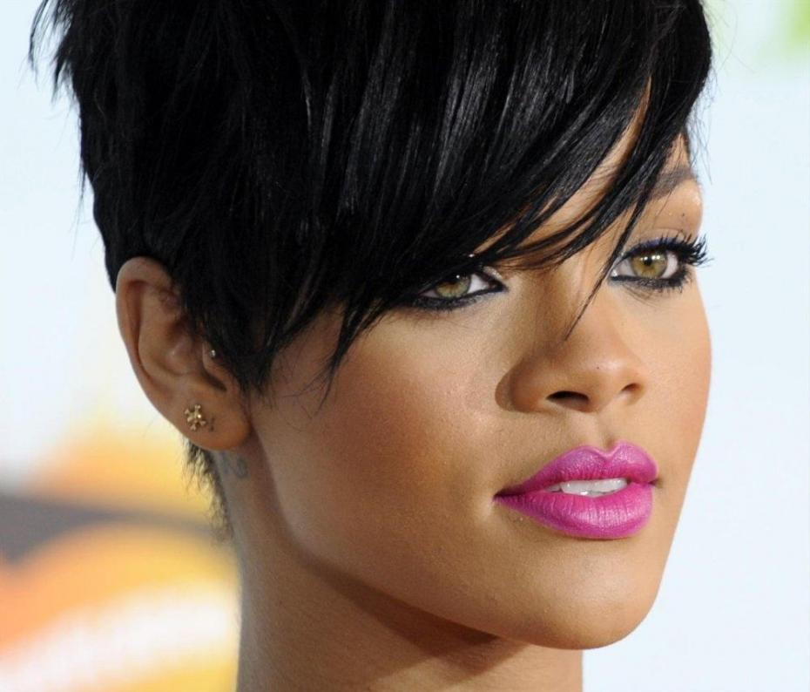

Slide 6
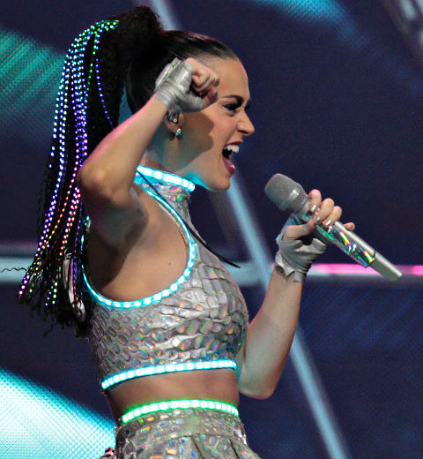

Slide 7
An Old World View
“The directors of companies are appointed by shareholders to make money for shareholders,
not to donate it to other people.
Companies should not be deciding what to do with shareholders’ money. They should return as much of it as possible to the shareholders and let them decide what to do with it”
Stan Mather, 2002
Director Australian Shareholders Association

Slide 8
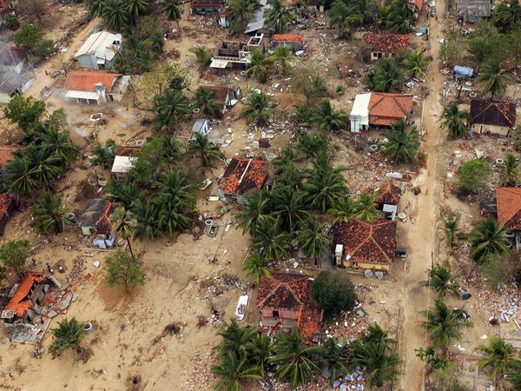

Slide 9
Post South East Asian Tsunami
“Our view now, which is perhaps more reflective of public opinion, is that until individuals give more towards areas of need in society, then companies have to bridge that gap”.
Anywhere in the world, even if they have no commercial interests?
“Yes, anywhere in the world”
CEO, Australian Shareholders Association - 2008

Slide 10
Corporate positions
MOST INVOLVED
Strategic involvement
Major participation
Getting involved
Increasing participation
COMMITMENT
Wait and see
Minor participation
None of our business
LEAST INVOLVED
No participation

Slide 11
Motivation to participate
1. It’s the right thing to do
Moral
imperative
Compliance
2. Risk mitigation
Commercial orientation
3. Enlightened self-interest

Slide 12
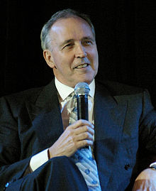
“In a two horse race
always back self-interest
because at least you know
it’s trying.“

Slide 13
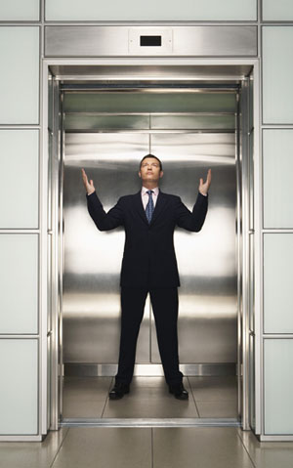

Slide 14
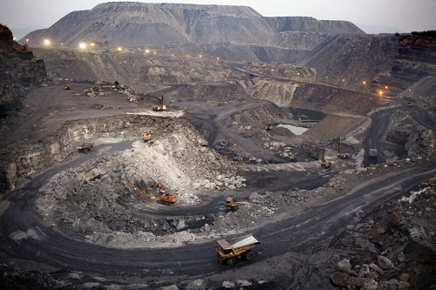

Slide 15
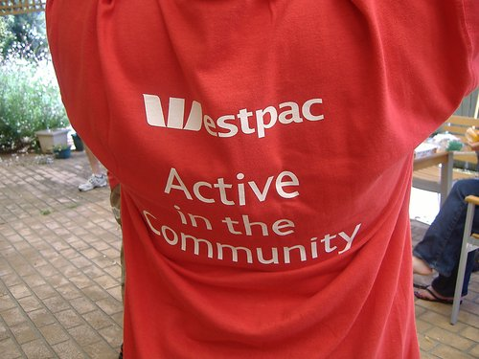

Slide 16


Slide 17
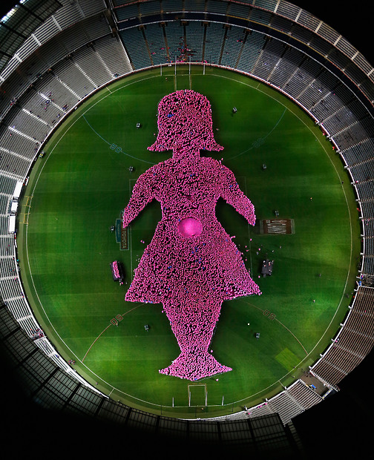

Slide 18
The New Paradigm
The previous approach based on the moral imperative for giving, “we are working to improve society, please support us”, has given way to the proposition of “we create new value and social capital for our partners, lets talk”.

Slide 19
Building Sustainable
Partnerships
“Enlightened self interest is the only genuinely sustainable motive (for corporate giving)” - McKinsey Consulting
“If our company thinks that something is strategic then we resource it like its strategic” - Dow Chemicals

Slide 20


References
Thesis: The Philanthropic Contract: building social capital through corporate social investment
Google: david cooke thesis
Email: david.cooke@konicaminolta.com.au
@drdavidcooke
http://au.linkedin.com/in/drdavidcooke/

