Slide 1
The Open/Closed Boundary
Smith, D. A., & Sojka, J. J. (2019). Model-Based Properties of the Dayside Open/Closed Boundary: Is There a UT-dependent Variation? Space Weather, 17. doi:10.1029/2019SW002299

Slide 2
The Open/Closed Boundary
Purpose: Determine if OCB is a suitable proxy for cutoff latitude
Method: Use T96 to trace field lines under varying geomagnetic conditions
Result: 1) OCB exhibits UT-dependent variation
2) For low-energy protons (1-20 MeV) OCB may be suitable proxy
3) For high-energy proton (above 20 MeV) OCB is not suitable
Outcome: Manuscript accepted for publication.
Dear Dr. Smith:
Thank you for submitting your work to Space Weather. I am pleased to accept your manuscript, "Modeled properties of the dayside open/closed boundary: Is there a UT-dependence?" [Paper #2019SW002299R], for publication in the journal…
Personal email from T. Paul O’Brien, Editor of the AGU Journal, Space Weather received Nov. 8, 2019 @ 8:23 AM.

Slide 3
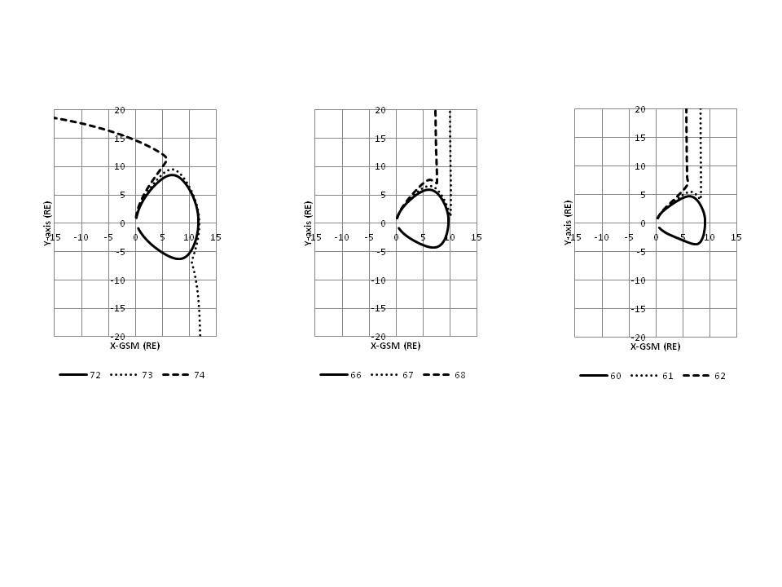
The Open/Closed Boundary
Quiet Moderate Severe
Example of open and closed field lines generated by T96
Smith, D. A., & Sojka, J. J. (2019). Model-Based Properties of the Dayside Open/Closed Boundary: Is There a UT-dependent Variation? Space Weather, 17. doi:10.1029/2019SW002299

Slide 4
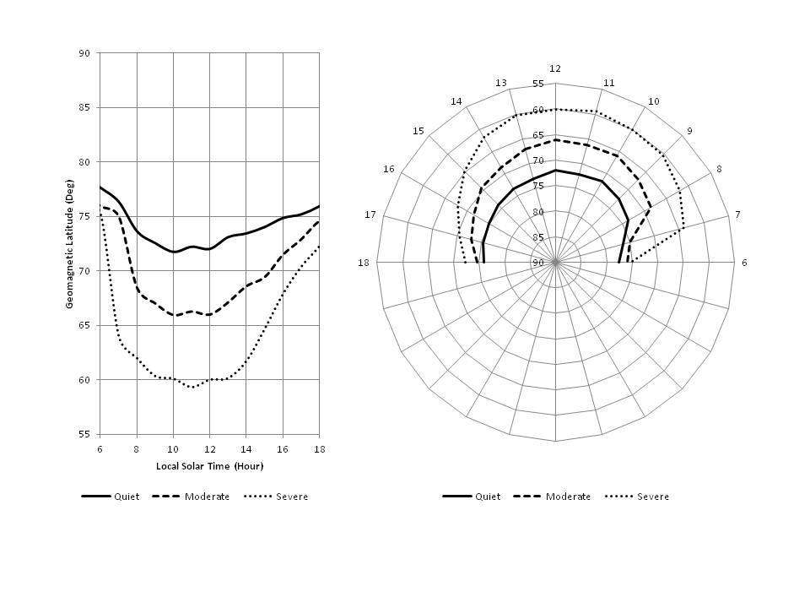
The Open/Closed Boundary
Dayside geomagnetic latitude of the OCB for three levels of geomagnetic activity at 0500 UT
Smith, D. A., & Sojka, J. J. (2019). Model-Based Properties of the Dayside Open/Closed Boundary: Is There a UT-dependent Variation? Space Weather, 17. doi:10.1029/2019SW002299

Slide 5
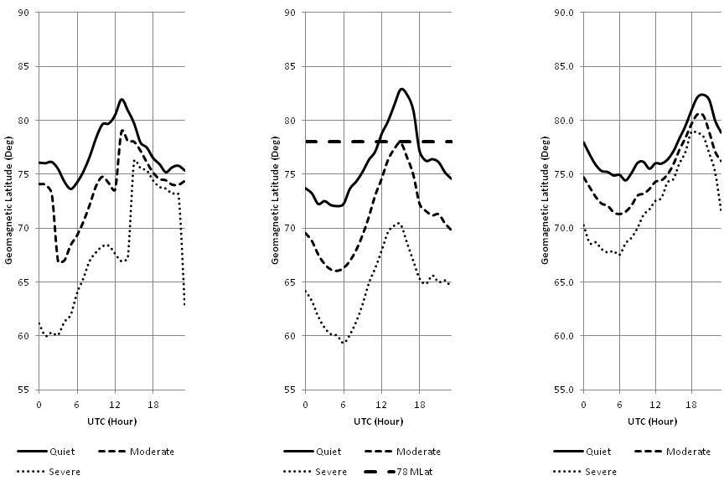
The Open/Closed Boundary
Polar Cusp
08:00 LT 12:00 LT 16:00 LT
Universal time dependence of the OCB at 3 levels of geomagnetic activity at 0800, 1200, and 1600 LT. In much of the current literature the cusp is defined as being near 78 deg geomagnetic latitude.
For example, see Russell (2000); Hunsucher & Hargreaves (2003); Coxon et al., (2016)

Slide 6
The Open/Closed Boundary
Quiet Moderate Severe
(a)
(b)
(c)
Dayside polar projection for 4 specific UT hours under
quiet, moderate, and severe conditions. Geomagnetic latitude, LT.
Smith, D. A., & Sojka, J. J. (2019). Model-Based Properties of the Dayside Open/Closed Boundary: Is There a UT-dependent Variation? Space Weather, 17. doi:10.1029/2019SW002299

Slide 7
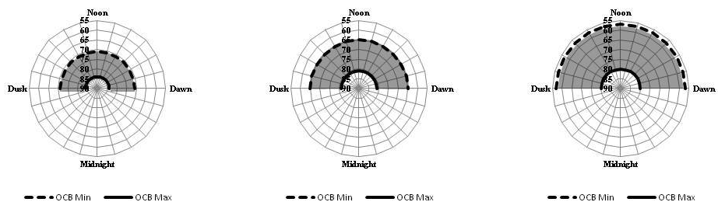
The Open/Closed Boundary
Quiet Moderate Severe
Polar projection of the dayside OCB minimum/maximum
values for quiet, moderate, and severe conditions over 24 hours UT.
Geomagnetic Latitude, LT.
Smith, D. A., & Sojka, J. J. (2019). Model-Based Properties of the Dayside Open/Closed Boundary: Is There a UT-dependent Variation? Space Weather, 17. doi:10.1029/2019SW002299

Slide 8
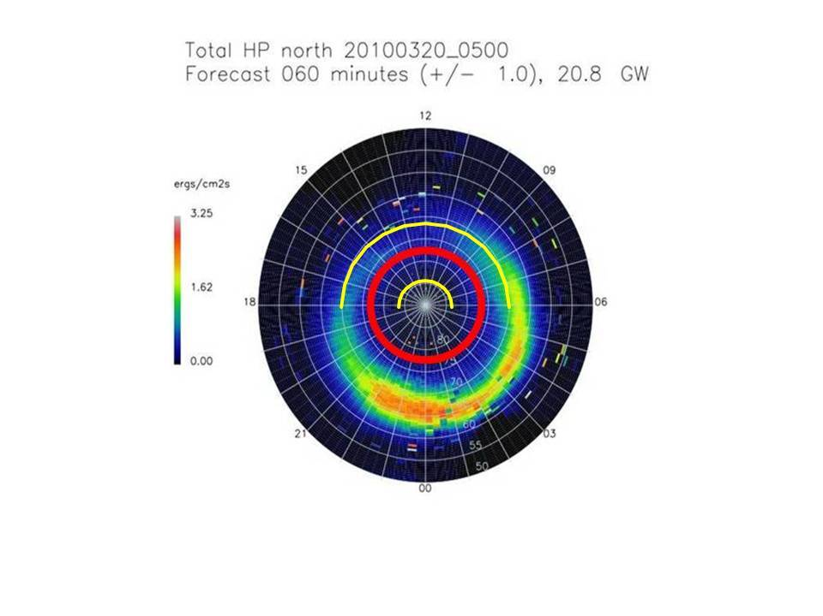
The Open/Closed Boundary
OCB typically at poleward edge of dayside oval
OPRT auroral energy flux in a magnetic latitude/magnetic local time polar projection for conditions optimized for the quiet conditions defined in this study. The heavy red circle represents the OCB located over the 75-78 degree range. The solid yellow semicircles represent the OCB min/max values during conditions similar to those used to obtain the OPRT prediction (OVATION Prime Real-Time, 2018).
Newell, P. T., Sotirelis, T., & Wing, S. (2009). Diffuse, monoenergetic, and broadband aurora: The global precipitation budget.
Journal of Geophysical Research, 114, A09207. doi:10.1029/2009JA014326

Slide 9
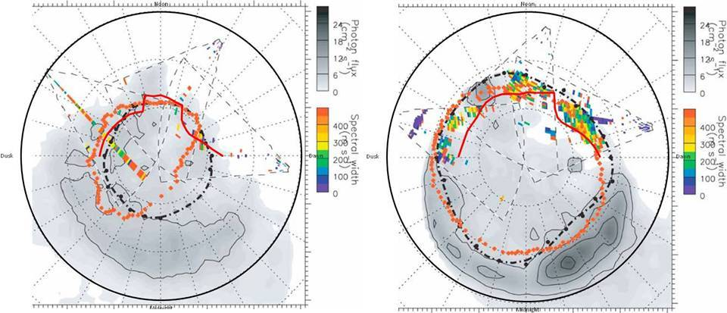
The Open/Closed Boundary
T96 OCB (red) superimposed over Figure 3a and 3b from Rae et al., (2010). Dotted orange line shows BATS-R-US OCB; dotted black line shows observed OCB as described in Rae et al., 2010.
Rae, I. J., Kabin, K., Lu, J. Y., Rankin, R., Milan, S. E., Fenrich, F. R., . . . DeZeeuw, D. L. (2010). Comparison of the
open-closed separatrix in a global magnetospheric simulation with observations: The role of the ring current. J. Geophys. Res.
doi:10.1029/2009JA015064

Slide 10
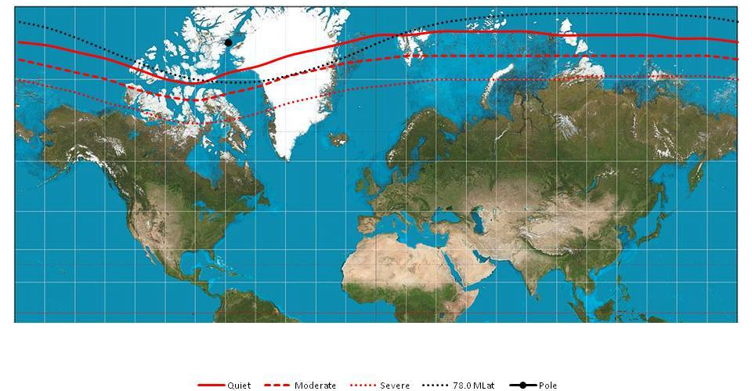
The Open/Closed Boundary
Northern hemisphere Mercator projection in geographic coordinates with OCB shown at noon
LT for each longitude. Solid red line represents quiet conditions, dashed and dotted red lines show moderate and severe conditions respectively. Dotted black line represents OCB at 78 degrees magnetic latitude. Black dot approximates the location of geomagnetic north pole.
Smith, D. A., & Sojka, J. J. (2019). Model-Based Properties of the Dayside Open/Closed Boundary: Is There a UT-dependent Variation? Space Weather, 17. doi:10.1029/2019SW002299

Slide 11
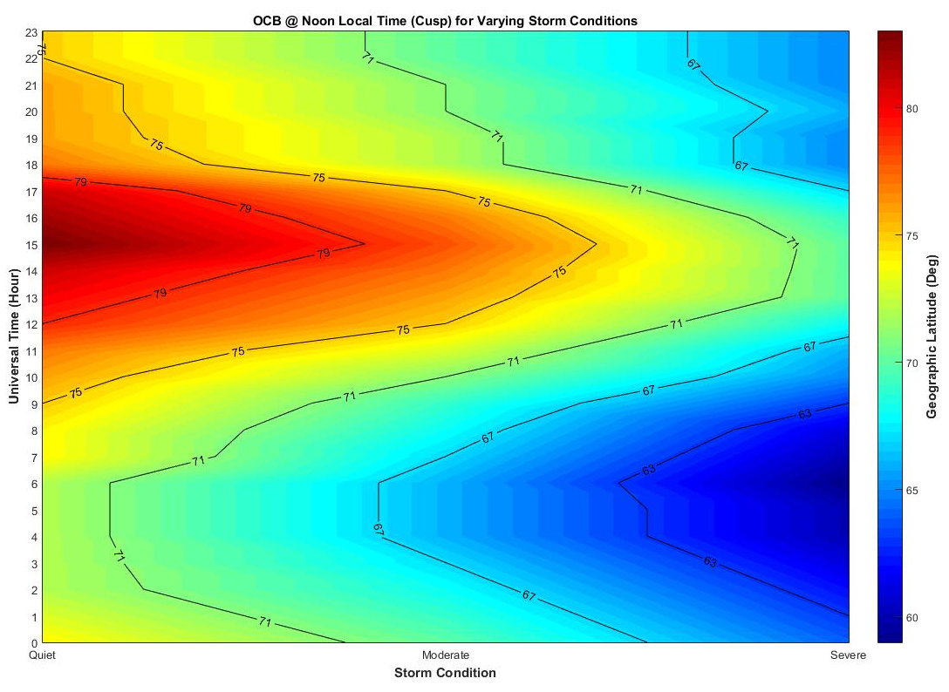
The Open/Closed Boundary
OCB at noon LT as function of geomagnetic conditions.
Smith, D. A., & Sojka, J. J. (2019). Model-Based Properties of the Dayside Open/Closed Boundary: Is There a UT-dependent Variation? Space Weather, 17. doi:10.1029/2019SW002299

Slide 12
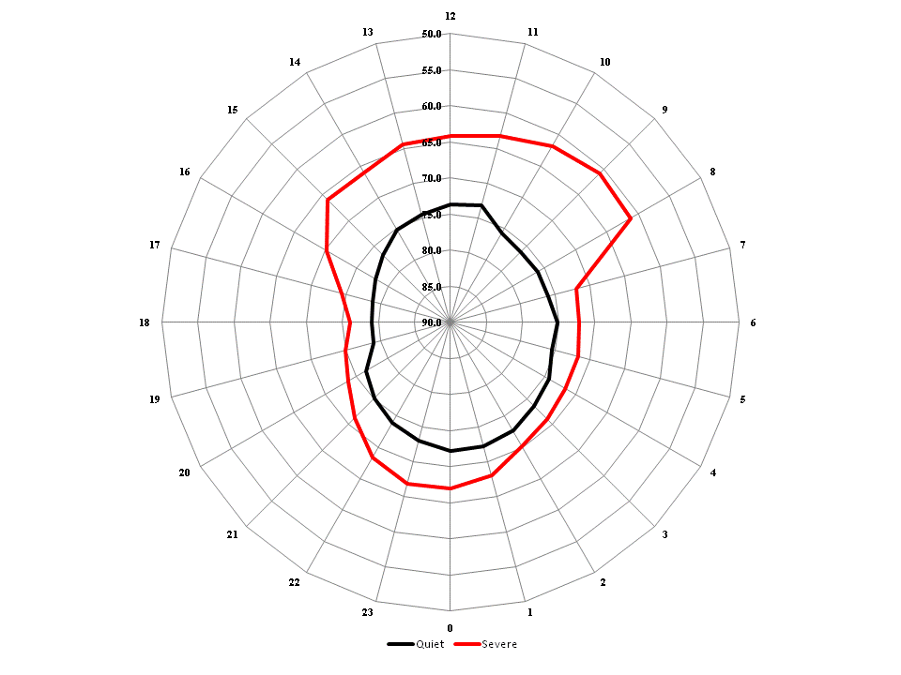
Polar Axis: Geomagnetic Latitude
Azimuthal Axis: Local Time
Smith, D. A., & Sojka, J. J. (2019). Model-Based Properties of the Dayside Open/Closed Boundary: Is There a UT-dependent Variation? Space Weather, 17. doi:10.1029/2019SW002299

Slide 13
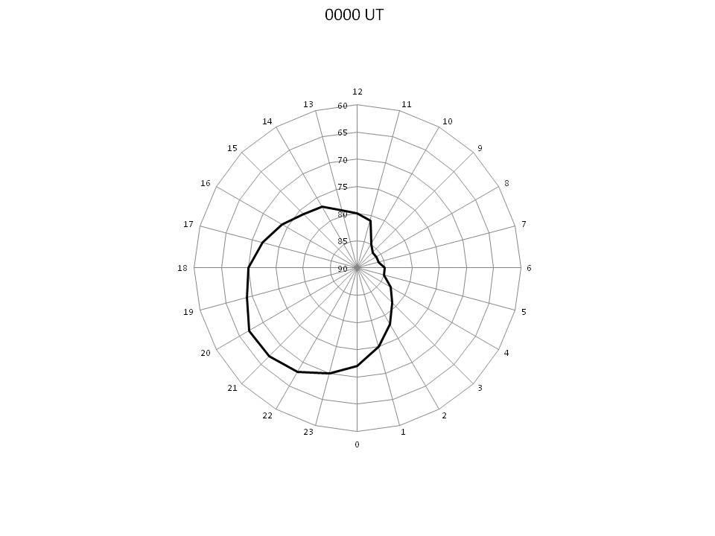
Polar Axis: Geographic Latitude
Azimuthal Axis: Local Time
Smith, D. A., & Sojka, J. J. (2019). Model-Based Properties of the Dayside Open/Closed Boundary: Is There a UT-dependent Variation? Space Weather, 17. doi:10.1029/2019SW002299

Slide 14
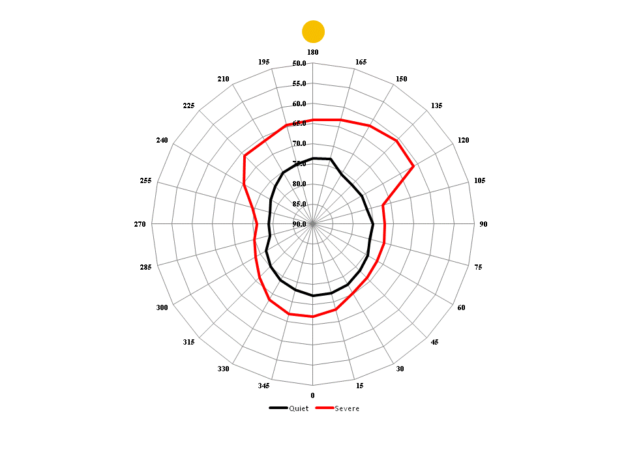
Polar Axis: Geomagnetic Latitude
Azimuthal Axis: Geographic Longitude
Smith, D. A., & Sojka, J. J. (2019). Model-Based Properties of the Dayside Open/Closed Boundary: Is There a UT-dependent Variation? Space Weather, 17. doi:10.1029/2019SW002299

Slide 15
The Open/Closed Boundary
Significant Findings
Latitude of polar cusp region is UT-dependent
Latitude of OCB is UT-dependent
OCB may serve as viable proxy for 1-20 MeV protons.
Significant because PCA mostly caused by 1-20 MeV protons.
Cutoff latitude for 1-20 MeV protons may show UT-dependence
Smith, D. A., & Sojka, J. J. (2019). Model-Based Properties of the Dayside Open/Closed Boundary: Is There a UT-dependent Variation? Space Weather, 17. doi:10.1029/2019SW002299

