Slide 1



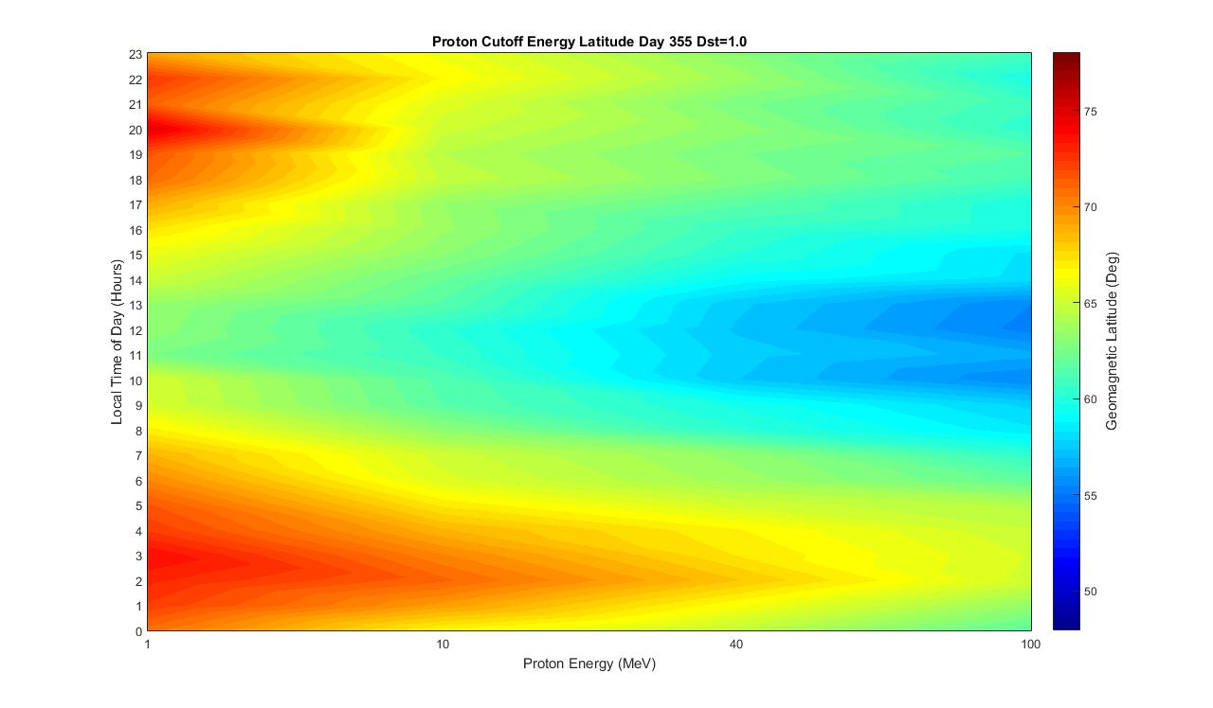
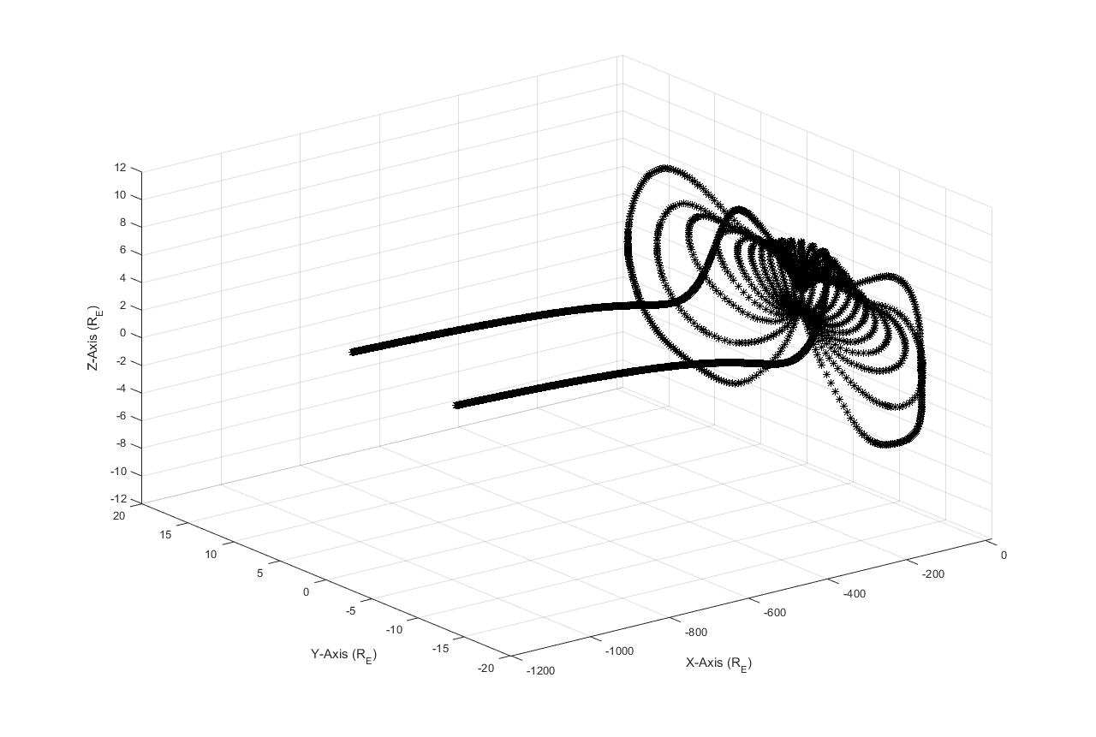
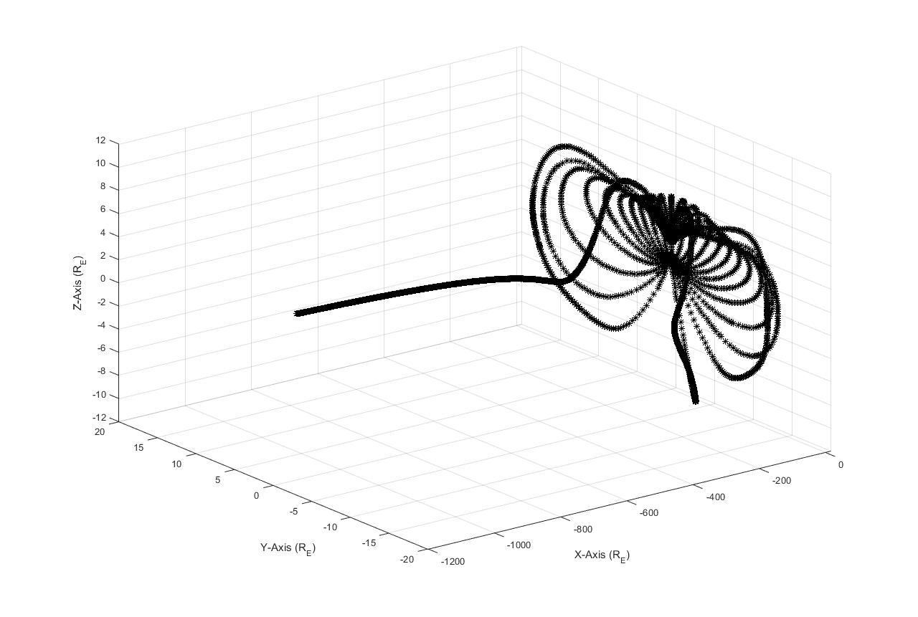
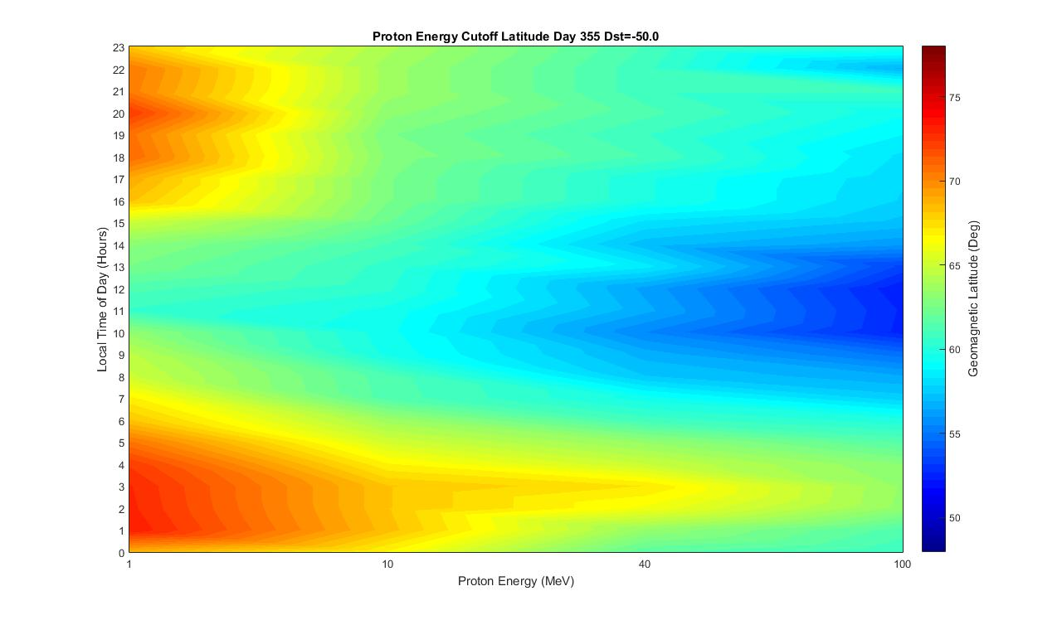
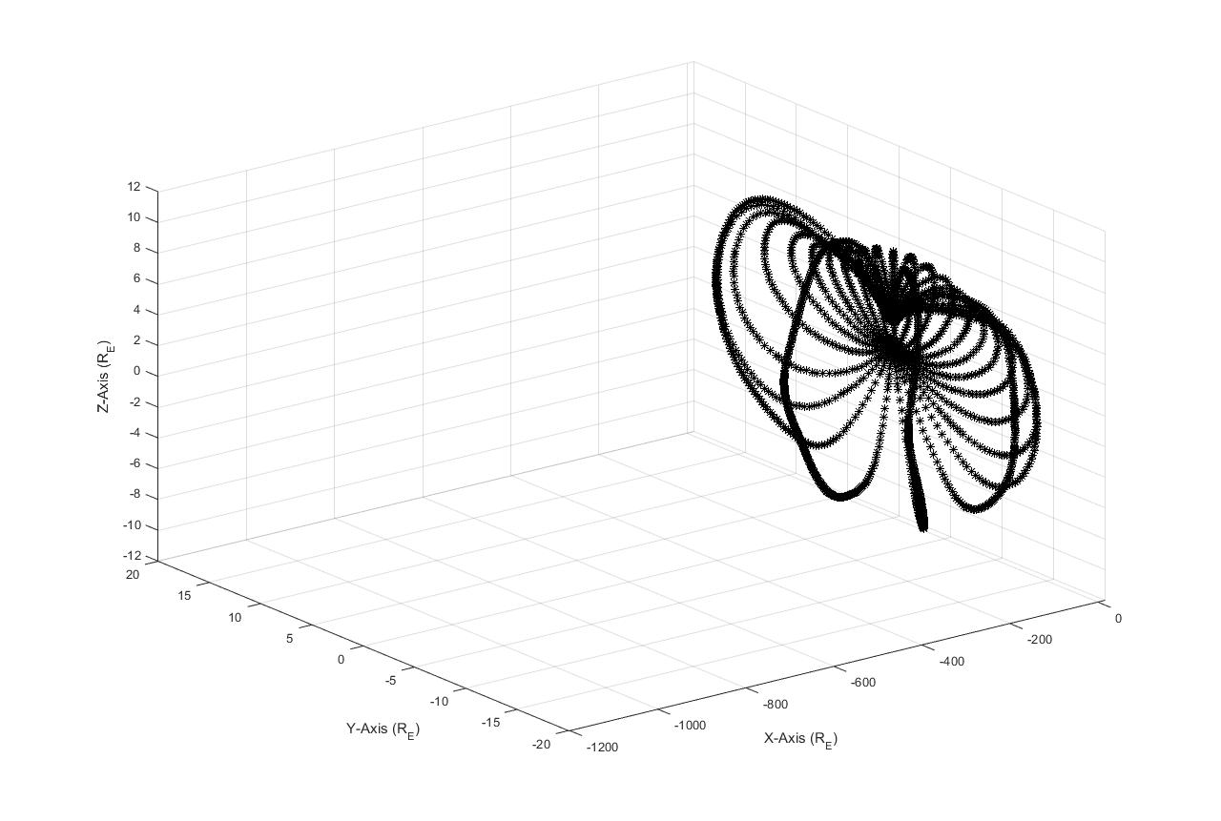
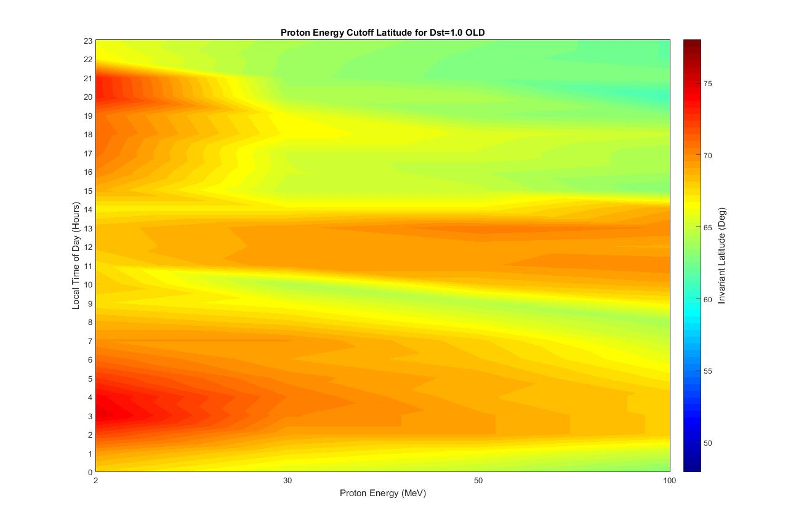
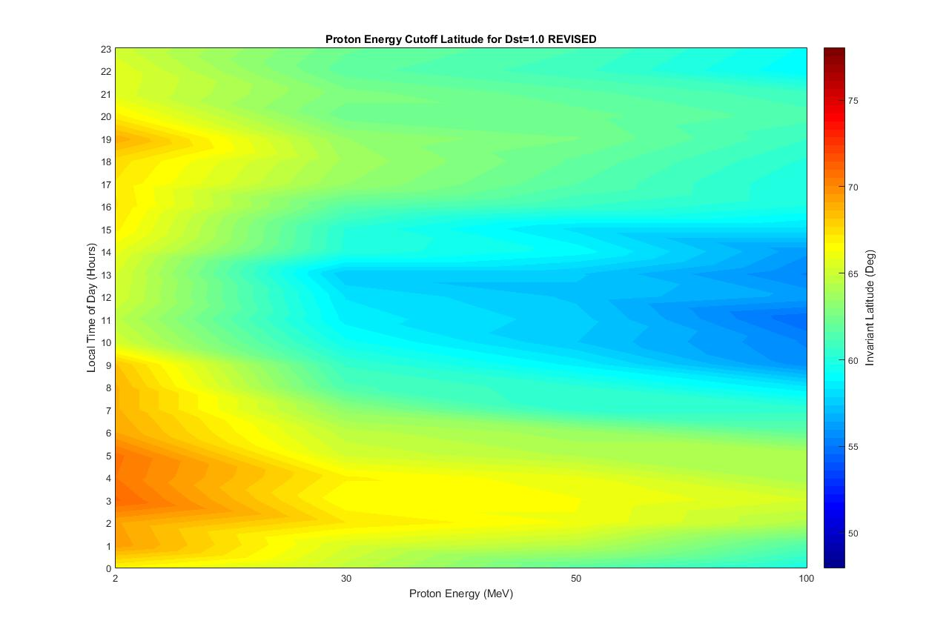
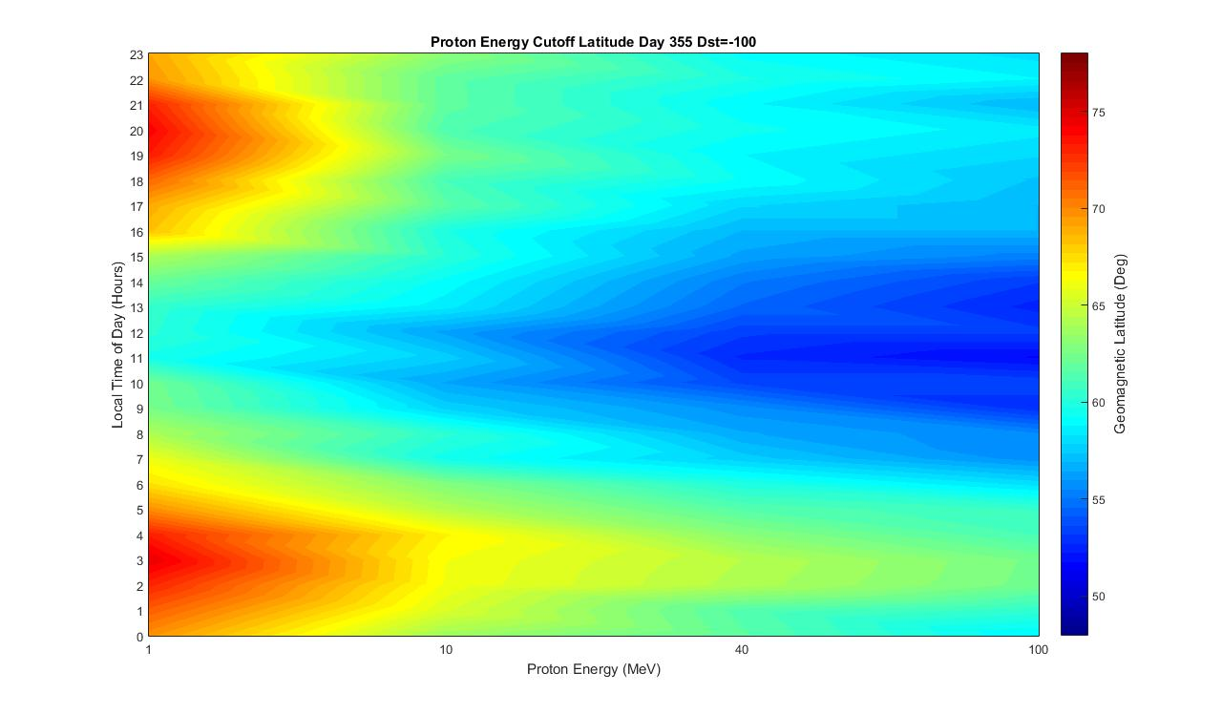
Open/Closed Boundary and Energy Cutoff Latitude for Varying Dst Indices
David Alan Smith (W6EY)
Center for Atmospheric and Space Sciences, Utah State University, Logan, UT USA davidalan.smith@aggiemail.usu.edu
Scan the QR code for the written report and presentation associated with this poster.
The Basics
3-D Projection of Geomagnetic Field Lines
From the Tsyganenko Model of the Geomagnetic Field:
Approximation of the Geomagnetic Field
Estimate Open/Closed Boundary (OCB)
Reverse Engineer Proton Trajectories (Allowed vs. Forbidden)
Estimate Proton Energy Cutoff Latitudes
Dst=1.0 nT
Open/Closed Boundary as Function of Dst Index
Dst=-50 nT
Open/Closed Boundary (OCB)
Latitude of last closed field line when moving pole-ward.
Closed line has foot points in Northern/Southern hemispheres.
Difficult to define on night-side due to stretching of magnetotail.
Magnetotail "open" line extends past 70 Earth radii.
Establishes shape of Polar Cap region.
Dst=-100 nT
Difficulties
The above plots show 3-D renderings of geomagnetic
field lines based on the Tsyganenko model.
The magnetotail poses an interesting
problem when attempting to determine
allowed vs. forbidden trajectories.
When using the reverse engineering method, an important consideration is the determination of allowed vs. forbidden trajectories. The above plots show the effect a slight adjustment can make in determining
energy cutoff latitudes.
References
Future Work
Further study will include SEP/PCA connection
Can we improve our understanding of PCA events by examining solar energetic protons, their interaction with the geomagnetic field, how they precipitate down to the D-region, and their interaction with neutral species within the D-region?
Smart, D. & Shea, M., 2001. A Comparison of the Tsyganenko Model Predicted and Measured Geomagnetic cutoff Latitudes. Adv. Space Res., 28(12), pp. 1733-1738.
Smart, D., Shea, M. & Flückiger, E., 2000. Magnetospheric Models and Trajectory Computations. Space Science Reviews, Volume 93, pp. 305-333.
Sauer, H. H. & Wilkinson, D. C., 2008. Global mapping of ionospheric HF/VHF radio wave absorption due to solar energetic protons. Space Weather, 6(S12002)
Tsyganenko, N., 2016. Modeling the Earth's Magnetosphere Using Spacecraft Magnetometer Data.
[Online] Available at: http://geo.phys.spbu.ru/~tsyganenko/modeling.html
[Accessed 28 February 2018]
The above plots illustrate the energy cutoff latitude’s
dependence on geomagnetic conditions.
Each was generated with the Tsyganenko model
varying only the Dst index.

