Slide 1
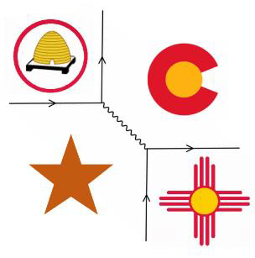

Fall 2018 Four Corners Section Meeting
of the American Physical Society
Topology of Earth's Magnetic Shield
David A. Smith and Dr. Jan. J. Sojka
Center for Atmospheric and Space Sciences,
Dept. of Physics,
Utah State University, Logan, UT

Slide 2
Outline
Introduction
Tsyganenko Geomagnetic Field Model
The Open/Closed Boundary (OCB)
Open vs. Closed Field Lines
Why Are Open Field Lines Important
Diurnal Variation of the OCB
Summary

Slide 3
Introduction
“Returning Student”
PhD Candidate Utah State University
Amateur Radio Operator, W6EY
Research Interests:
  HF Propagation
  HF Absorption
  D-region
  Polar Cap Absorption (PCA) Events

Slide 4
Tsyganenko Geomagnetic Field Model
Semi-empirical best-fit representations of geomagnetic field
Based on large number of satellite observations
Outputs include:
    Field line tracing
    Geomagnetic field vector at selected point
https://ccmc.gsfc.nasa.gov/models/modelinfo.php?model=Tsyganenko%20Magnetic%20Field

Slide 5
The Open/Closed Boundary
Defines region where geomagnetic
field lines transition from closed to open
Experiences Diurnal Variation – “UT Effect”
What is an open field line?
Why is it important?

Slide 6
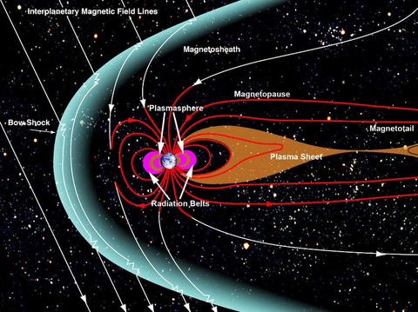
Why are Open Field Lines Important
Open field lines connect Earth’s upper atmosphere with Solar Wind
http://www.q-mag.org/old-african-huts-reassure-us-about-the-geomagnetic-field.html

Slide 7
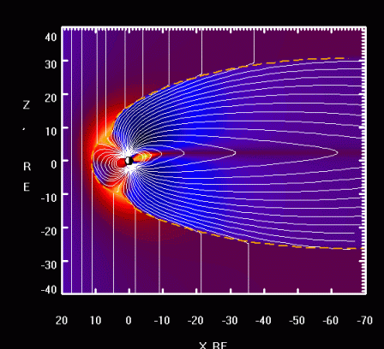
Why are Open Field Lines Important
Open field lines connect Earth’s upper atmosphere with Solar Wind
http://geo.phys.spbu.ru/~tsyganenko/modeling.html
Notes:
It is this connection with the SW that allows solar energy to enter Earth’s geomagnetic field and upper atmosphere.

Slide 8
Diurnal Variation of the OCB
Geomagnetic Latitude
Local Time
Dipole Offset 0 Deg.

Slide 9
Diurnal Variation of the OCB
Equinox, Quiet Conditions
0500 UT 1100 UT 1700 UT
Geomagnetic coordinates, local time for each UT
Notes:
This plot was made using T96.

Slide 10
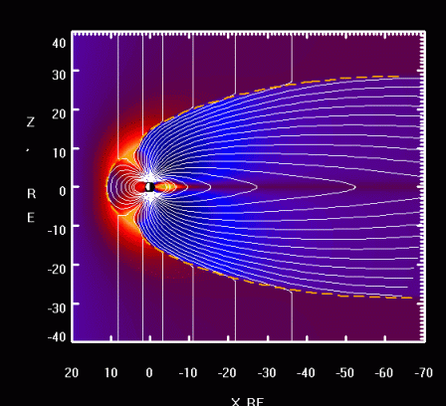
Diurnal Variation of the OCB
As OCB Changes, topology of open field lines changes
http://geo.phys.spbu.ru/~tsyganenko/modeling.html
Notes:
Kink means a current flowing. Magnetopause current sheet.

Slide 11
Diurnal Variation of the OCB
OCB Movie 1
OCB Movie 2

Slide 12
Why the Diurnal Variation is Important
0500 UT 1100 UT 1700 UT
New York City → Tokyo via great circle route
Flight time about 14 hours
Geographic coordinates, local time for each UT

Slide 13
Summary
OCB Shows Diurnal Variation – “UT Effect”
UT Effect an important consideration:
    Transiting Polar Regions
    Modeling D-region characteristics
    HF absorption.

Slide 14
References
Chisham, G., Abel, G. & Milan, S., 2004. Whose field line is it anyway?. Astronomy and Geophysics, 45(3), pp. 3.36-3.38.
Hunsucker, R. & Hargreaves, J., 2003. The F region at high latitude. In: The High-Latitude Ionosphere and its Effects on Radio Propagation. First ed. Cambridge: Cambridge University Press, pp. 237-239.
Kabin, K. et al., 2004. Open-closed Field Line Boundary position: A Parametric Study Using MHD Model. Journal of Geophysical Research, Volume 109, p. A05222.
Mende, S. B., Frey, H. U. & Angelopoulos, V., 2016. Sourcce of the dayside cusp aurora. Journal of Geophysical Research: Space Physics, Volume 121, pp. 7728-7738.
Newell, P. T., Sotirelis, T. & Wing, S., 2009. Diffuse, mono-energetic, and broadband aurora: The global precipitation budget. Journal of Geophysical Research, Volume 114, p. A09207.
Tsyganenko, N., 2016. Modeling the Earth's Magnetosphere Using Spacecraft Magnetometer Data. [Online]
Available at: http://geo.phys.spbu.ru/~tsyganenko/modeling.html [Accessed 3 October 2016].
Tsyganenko, N. A., 1995. Modeling the Earth's magnetospheric magnetic field confined within a realistic magnetopause. Journal of Geophysical Research, 100(A4), pp. 5599-5612.
Tsyganenko, N. A., 2002. A model of the near magnetosphere with a dawn-dusk asymmetry 2. Parameterization and filling observations.. Journal of Geophysical Research, 107(A8).
Tsyganenko, N. A. & Russell, C. T., 1999. Magnetic signatures of the distant polar cusps: Observations by Polar and quantitative modeling. Journal of Geophysical Research, 104(A11), pp. 24939-24955.
Wild, J. A. et al., 2004. The Location fo the Open-closed Magnetic Field Line Boundary in the Dawn Sector Auroral Ionosphere. Annales Geophysicae, Volume 22, pp. 3625-3639.

Slide 15
OCB and Energy Cutoff Latitude
ECL Movie 1

