Slide 1







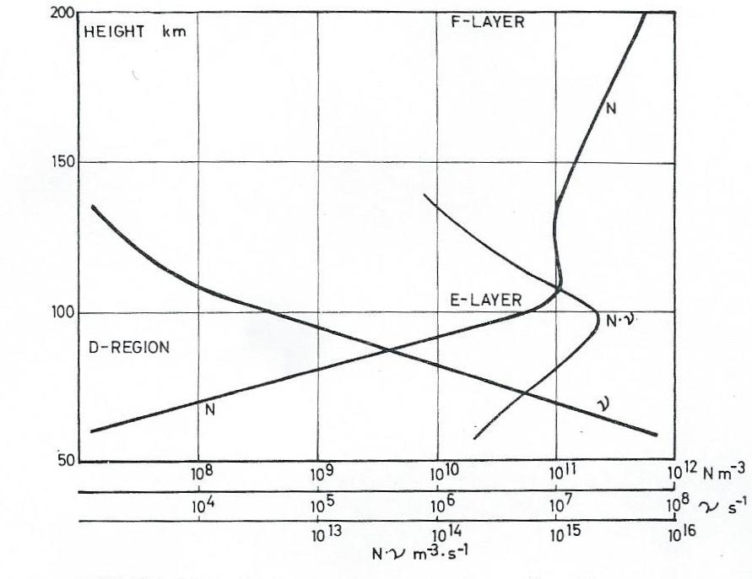
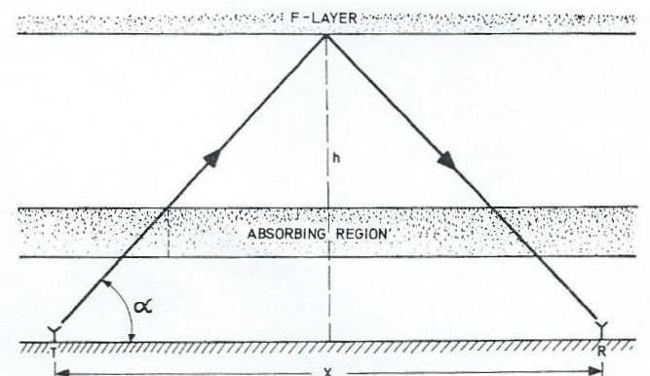
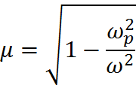

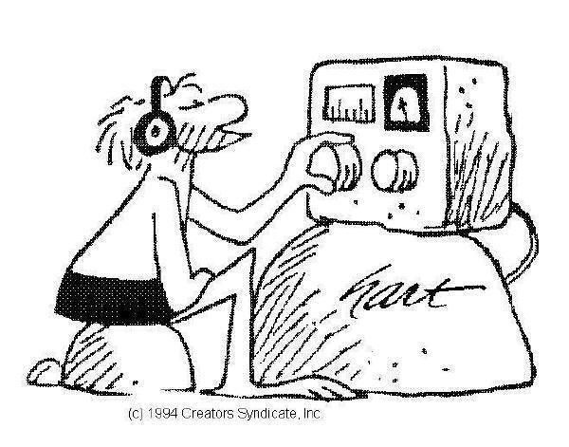


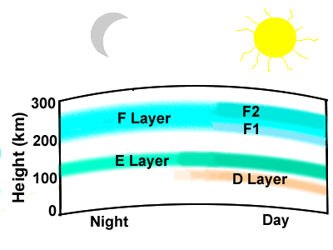

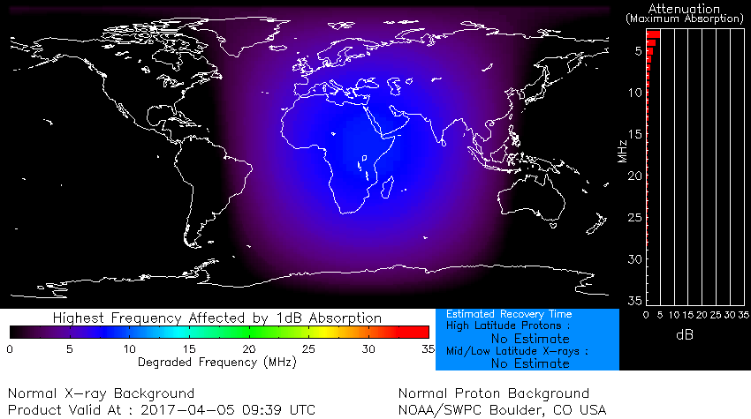
A review of high-frequency radio wave absorption
David Alan Smith (W6EY)
Center for Atmospheric and Space Sciences, Utah State University, Logan, UT USA davidalan.smith@aggiemail.usu.edu
Scan the QR code for the written report and presentation associated with this poster.
The Basic Question
How do storm-related energetic precipitation
events impact the ionosphere?
The Specific Question
How do these impacts effect
high-frequency communications?
The Absorption Equation
Electron density, Collision frequency
Angular frequency of radio wave
Collision Frequency
Density of neutrals much greater than ions
Neglect electron/ion collisions
Transmit
Path
Receive
Motivation/Findings
Thorough review of high-frequency radio wave absorption
  HF spectrum 3-30 MHz
  Frequency dependent
  Most HF absorption occurs in D-region
  Two types
Absorption
Electron Density
Most critical component of the absorption equation
Altitude dependent
Significant diurnal variations
Enhanced by solar flare/CME emissions
Max at upper
range of D-region.
Index of Refraction
How does max change during solar flare/CME?
Radio Wave Propagation
Ionosphere - Sufficient number of free electrons - 3 regions
Types of Absorption
From Lied [1967]
1 dB min perceptible change
Why can’t we hear distant AM broadcast stations during local daylight hours?
Frequency (MHz) | D-region Absorption (dB) | Percent of Total (%)
3.0 | 29.9 | 100
6.0 | 9.78 | 91
10.0 | 3.79 | 91
20.0 | 1.06 | 91
30.0 | 0.50 | 92
Increase due to
X-ray/SEP
At HF within D-region non-deviative absorption dominates
References
Bain, W. C. & Harrison, M. D., 1972. Model ionosphere for D-region at Summer noon during sunspot maximum. Proc. IEEE, 119(7), pp 790-796
Davies, K., 1965. Ionospheric Radio Propagation. National Bureau of Standards
Lied, F. 1967. High Frequency Radio Communications with Emphasis on Polar Problems, The Advisory Group for Aerospace Research and Development
Rawer, K., 1952. Calculation of Sky-wave Field Strength. The Wireless Engineer,
Vol. 19, pp. 287-301
Future Work
Currently investigating solar flares/absorption
Hard x-ray emissions, energetic protons
Further study will include SEP/PCA connection
Can we improve our understanding of PCA events by examining solar energetic protons, their interaction with the geomagnetic field, how they precipitate down to the D-region, and their interaction with neutral species within the D-region?
Notes:
Please contact Michele Sager (6-1897) with any format questions

