Slide 1

What factors into the educational process to advance learning?
Notes:
I would like to ask you to think about the factors in the educational process that advance learning.
We have models and icons of success:

Slide 2
PEOPLE

Slide 3
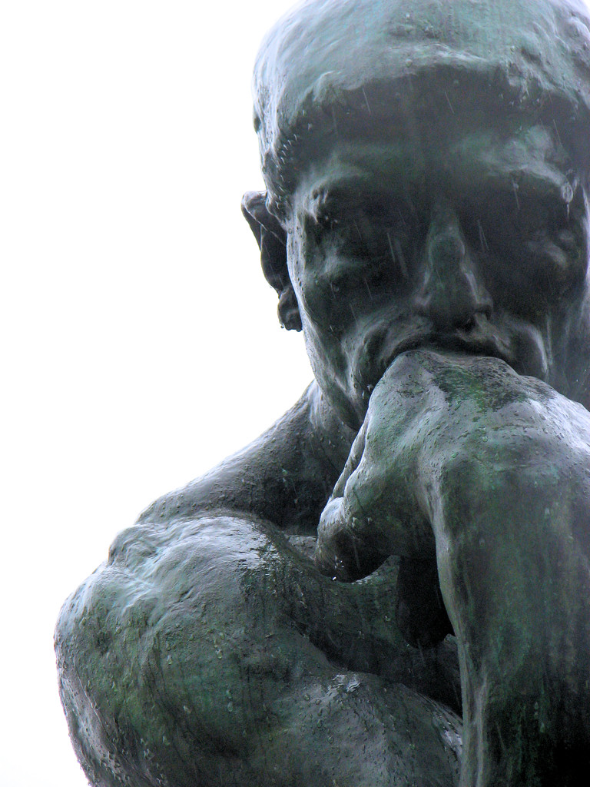
Notes:
Great thinkers-Rodin’s The Thinker/Le Penseur, 1902. Musee Rodin in Paris

Slide 4
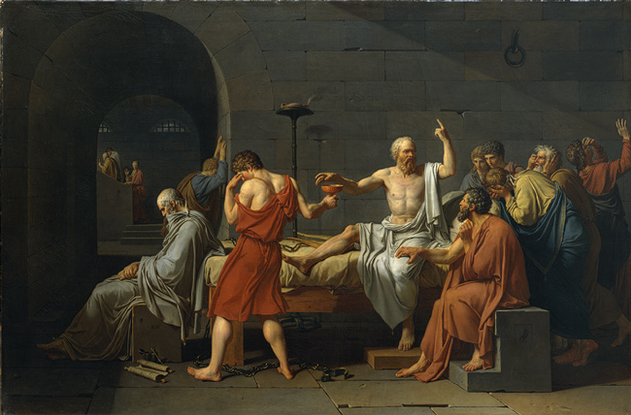
Notes:
Philosophers – Death of Socrates by Jacques-Louis David (1748-1825), Metropolitan Museum of Art, NYC

Slide 5
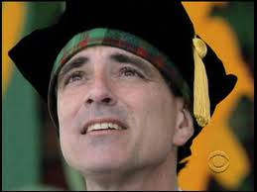
Notes:
Teachers – Randy Pausch, Computer Scientist, Carnegie Mellon University, Pittsburg, PA. The Last Lecture, 2007.
Died of pancreatic cancer. 1960-2008.

Slide 6
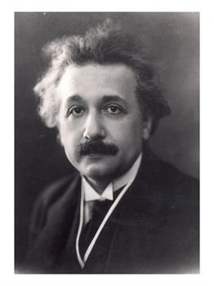
Notes:
Theoreticians, Albert Einstein circa 1922

Slide 7
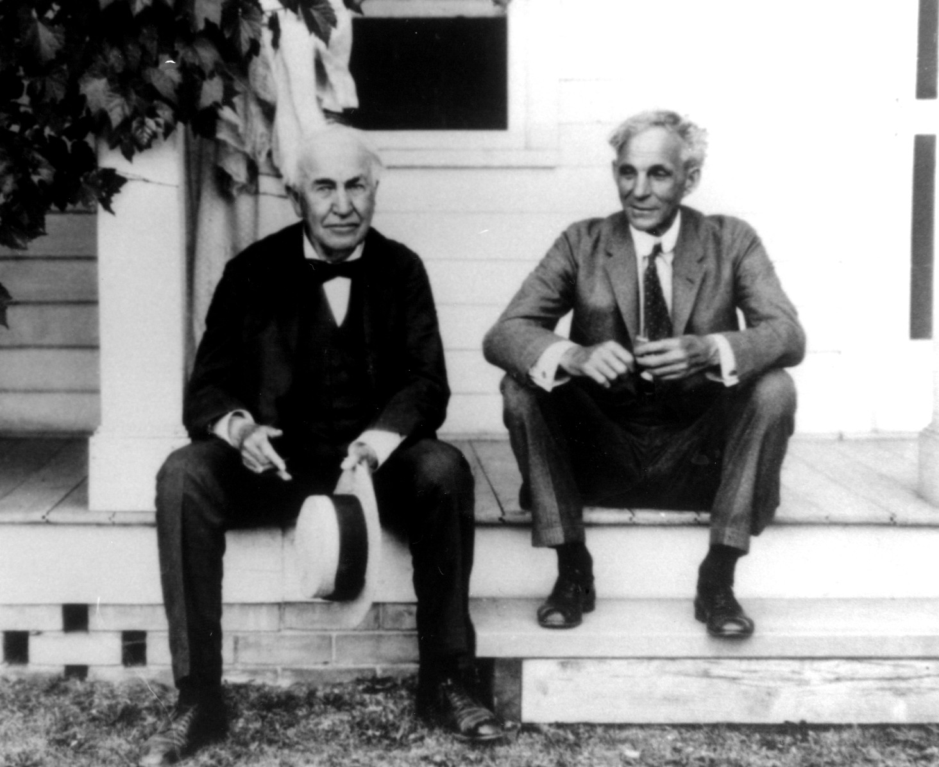
Notes:
Engineers and inventors. Thomas Alva Edison and Henry Ford, in Ford Myers Florida, the Winter Retreat circa 1930

Slide 8
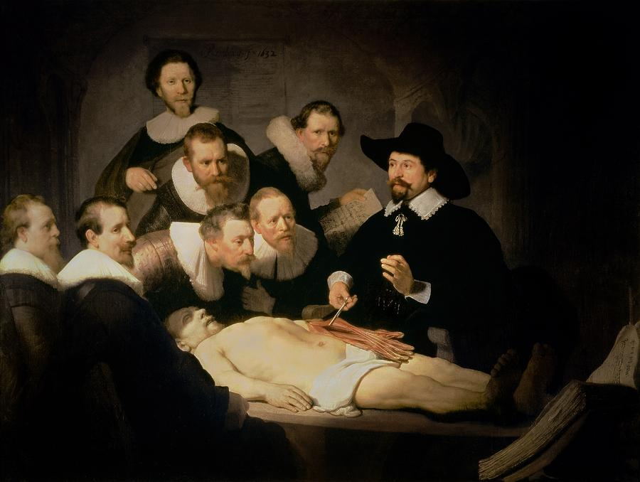
Notes:
Doctors and scientists Rembrandt von Rijn, The Anatomy Lesson of Dr. Nicolaes Tulp, 1632. Mauritshuis, The Hague
We may think about inventions --

Slide 9
TOOLS
Notes:
Let’s consider tools that advanced learning

Slide 10
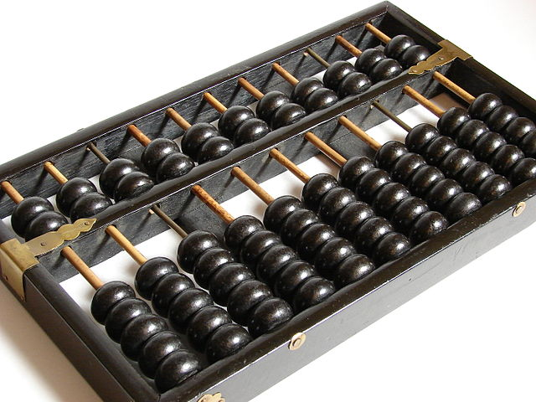
Notes:
Chinese abacus, or counting frame, earliest documentation dates to the 2nd century BC. Greeks and Romans used a not-too-distant form of this tool.

Slide 11
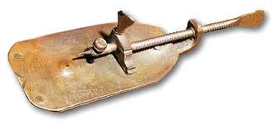
Notes:
Antonie van Leeuwenhoek’s microscope, 1670s

Slide 12
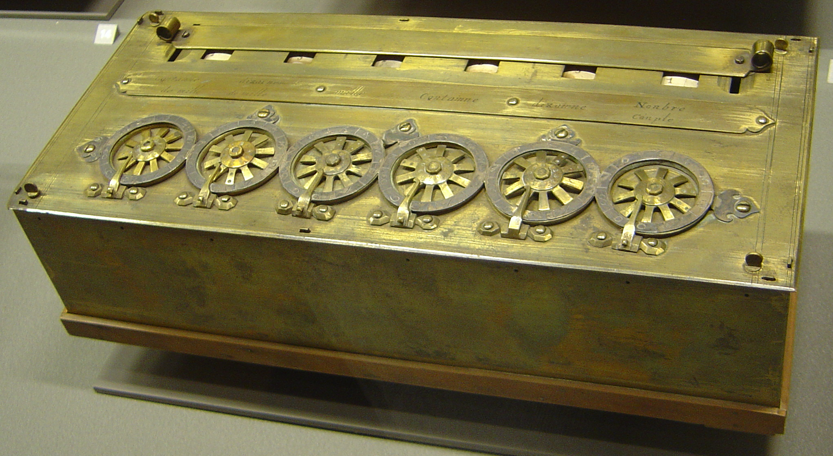
Notes:
Pascaline, mechanical calculator, Blaise Pascal, 1652. Musee des Arts et Metiers, Paris.

Slide 13

Notes:
ENIAC – Electronic Numerical Integrator and Computer, 1946, University of Pennsylvania
When the ENIAC was completed in 1946 it weighed over 27 tons and took up 680 square feet. The logic components of the computer consisted of 17,468 vacuum tubes, 72,000 diodes, 1,500 relays, 70,000 resistors, 10,000 capacitors, and 5 million hand-soldered joints. Input into the computer was done with switches and cards, some of the more complex programs requiring over a million cards. Each card would have to be input by hand into the machine, a process that could take weeks depending on the complexity of the program. The ENIAC was not the first computer built but it was one of the first to utilize a programmable, electronic architecture.

Slide 14

Notes:
Hubble Telescope, launched 1990 by NASA on the Space Shuttle

Slide 15

Notes:
We celebrate our brightest men who become famous for excellence in their field. We admire the products of their effort and imagination that push learning forward.

Slide 16

Notes:
But, I suggest we have overlooked someone – someone who is influential in many ways in the advancement of learning.

Slide 17
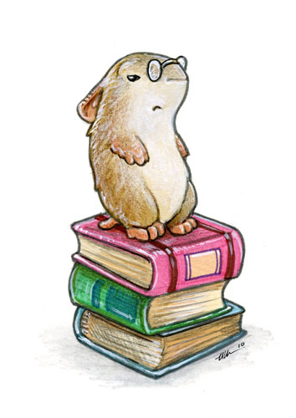
Notes:
The librarian. I think this oversight is unfortunate.
You may wonder what is a librarian good for in an age when we are rapidly leaving paper behind and moving toward electronic information access.

Slide 18
Librarian:
  organizes information
  finds information
  teaches information skills
  builds collections
  assists patrons with their work
Notes:
These are core functions of librarians since time immemorial.

Slide 19

Notes:
Until about thirty years ago, librarians kept control of the information in the academic library.
George Peabody Library – Baltimore, Maryland

Slide 20
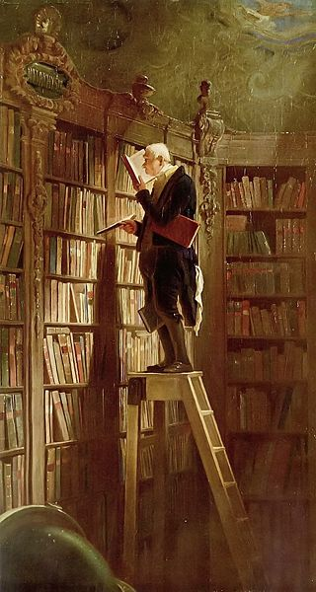
Notes:
The Bookworm, by CARL SPITZWEG 1808-1885. Milwaukee Public Library
In a paper-based information society, they selected information for collections, they classified it and they kept it in order. A good librarian knew his or her collections.

Slide 21
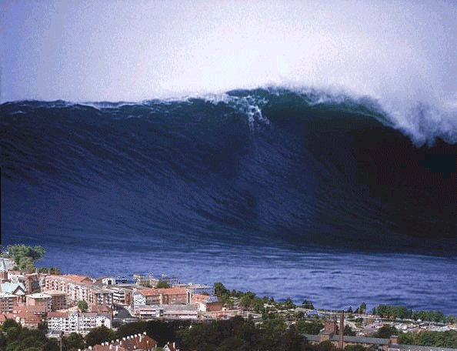
Notes:
The advent of personal computers, coupled with the ability to post and retrieve information from the internet unleashed a tsunami of user-created information.

Slide 22
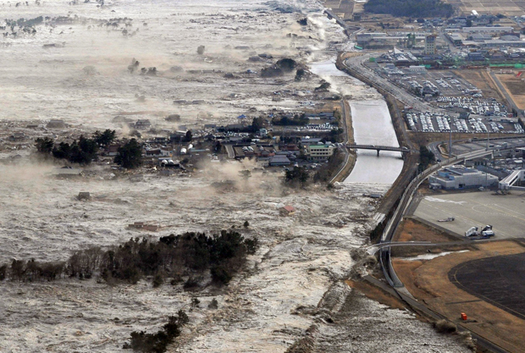
Notes:
...that dramatically changed the landscape and the availability of information. Japan, March 11, 2011

Slide 23

Notes:
...and the neat organization of information as we had known it was largely bypassed and ignored.

Slide 24

Notes:
The library had lost its lock on information. Celsus library at Ephesus, Turkey

Slide 25
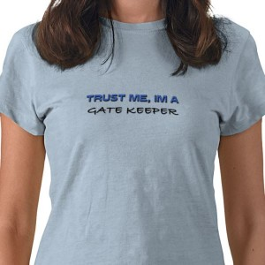
Notes:
In response to the vast quantities of untested and questionable information that was suddenly available, the librarian’s role changed: Librarians went from gate keepers...

Slide 26
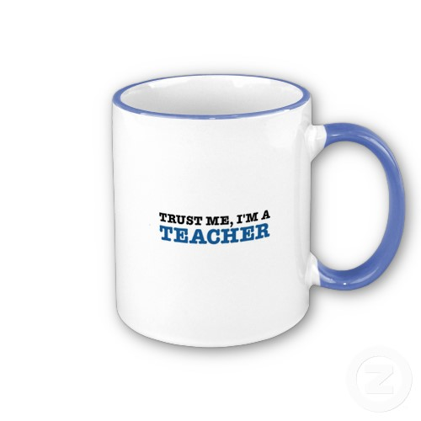
Notes:
to teachers.

Slide 27
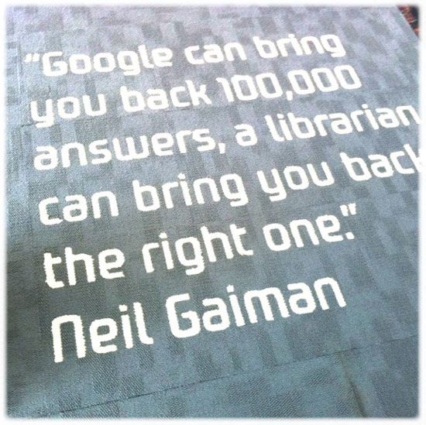
Notes:
In the ever-expanding world of Google, anyone may pose a question and get a variety of answers. Librarians have taken-on a new role: to teach students to examine critically the information that is so readily at hand. Neil Gaiman, ne 1960. British author

Slide 28
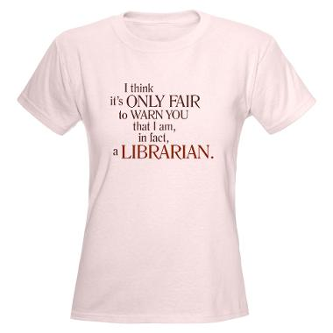

Slide 29

Notes:
As teachers, we teach students how to look for information in books and online

Slide 30

Notes:
...and how to evaluate the stuff they find so they can determine whether is valuable and worth keeping

Slide 31

Notes:
…or whether it is toxic.

Slide 32

Notes:
Librarians are still in the information business, but now we teach users to be independent and self-sufficient learners amidst the oceans of information swirling around on the internet.

Slide 33
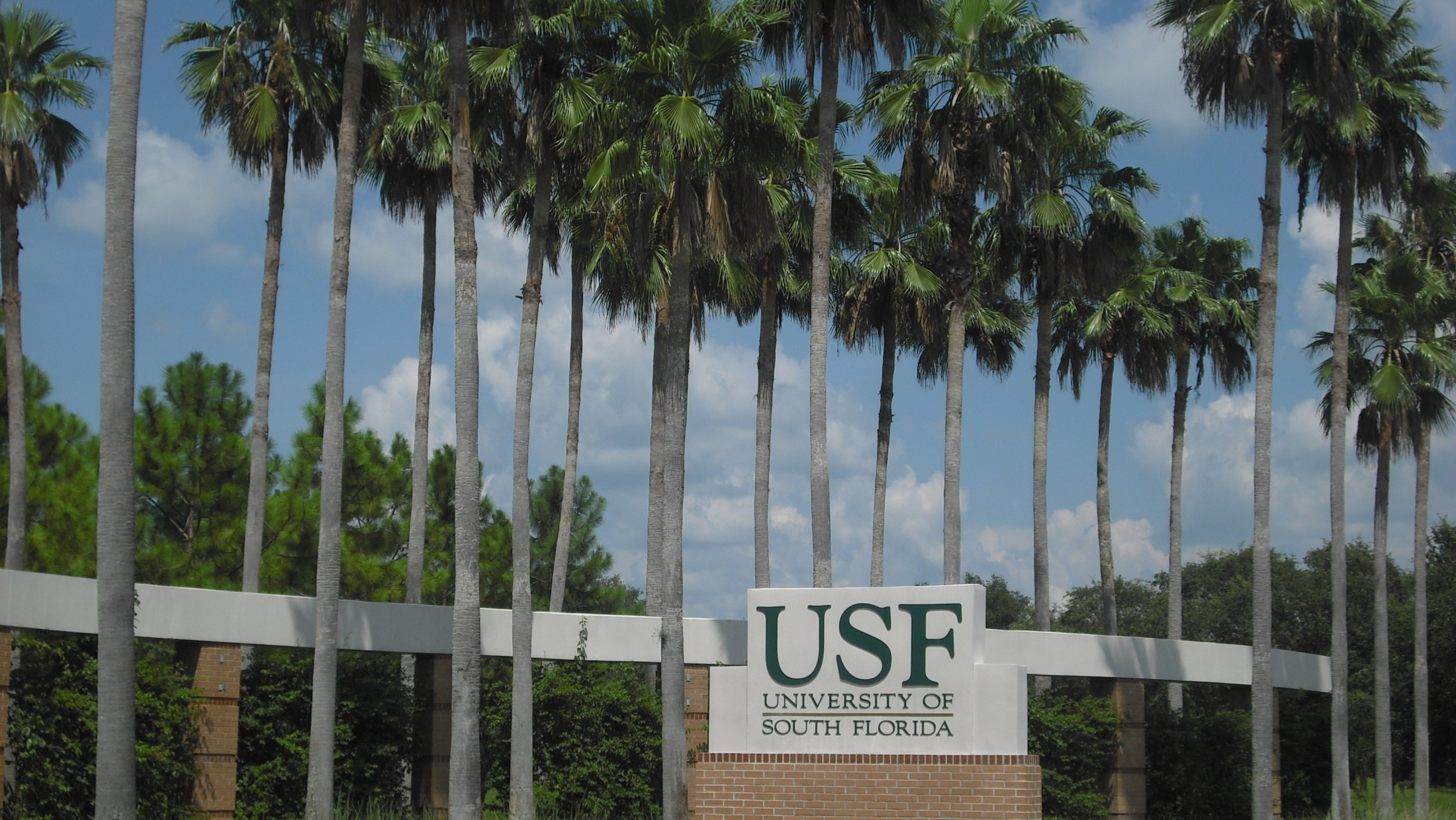
Notes:
At my university....

Slide 34
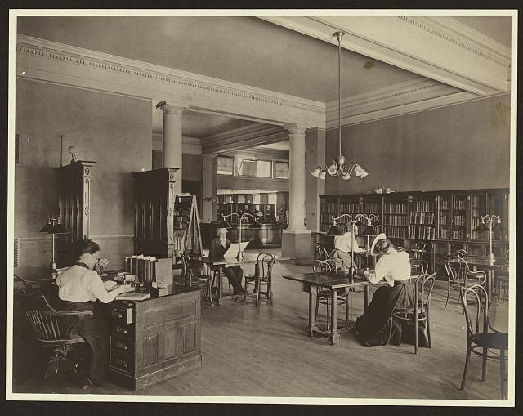
Notes:
…and even today most librarians are ladies…

Slide 35
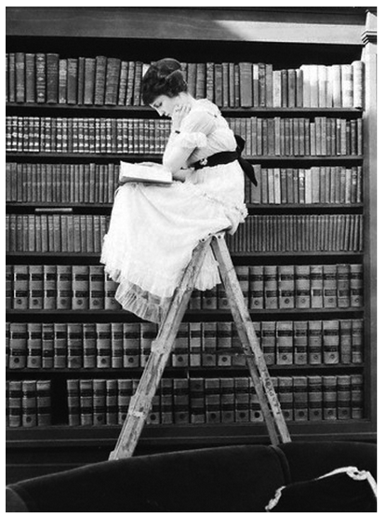
Notes:
librarians are also scholars.
We are assigned to various departments and expected to develop a knowledge base in order to work with faculty and students, from undergrads through post-docs.

Slide 36
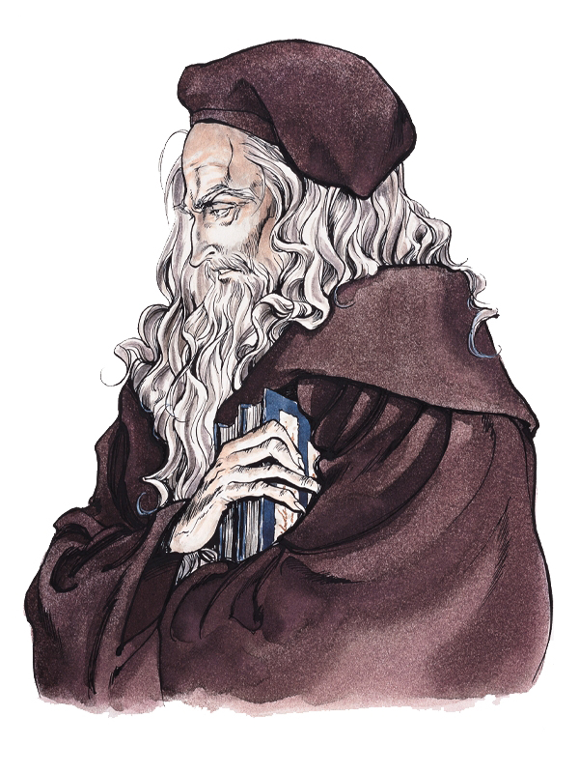
Notes:
It is normal for librarians to have expertise in an academic field, and to have some proficiency in another languages.

Slide 37

Notes:
Librarians collaborate with other scholars in various fields; we publish in ranked scholarly journals in both librarianship and in other disciplines. We conduct and evaluate research, just like other faculty members.

Slide 38
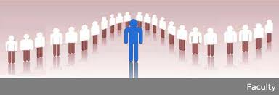
Notes:
At my university, librarians work as gate keepers, teachers, scholars, and collaborators with faculty and with students, across the traditional campus divisions. Our expertise is in the location, evaluation, and responsible use of information in an academically-oriented manner, in order to solve complex problems.

Slide 39
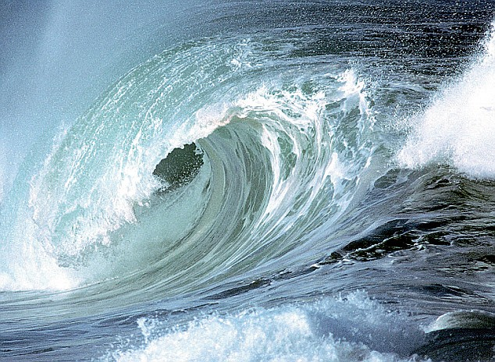
Notes:
I want to emphasize that all of these functions are bundled into my academic role as faculty, to advance and support student learning.

Slide 40
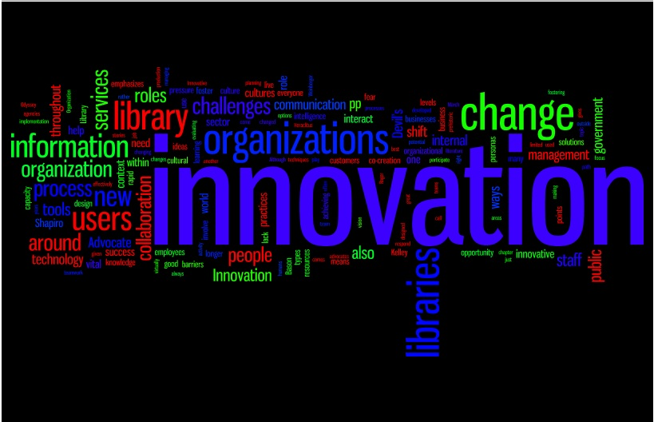
Notes:
I would like to suggest that a librarian be invited to the table to discuss curricula, program development, and academic goals, whenever educators and professionals meet. Good library skills are essential to academic success, and the librarian is charged with both developing the university collections and teaching students effective ways to find, evaluate, and properly use information in a responsible manner. Current trends include embedded librarian, planning a curriculum to incorporate the structured learning of research and writing skills essential to a particular field, online instructional videos tailored to a department’s students...

Slide 41
Therefore, in answer to
the initial question,
“What is a librarian good for?,”
I ask you to consider
navigating the world
without an understanding of useful information.

Slide 42

Life without a librarian is unthinkable.

