Slide 1
Departing the Desk: Reference, Change and the Art of Letting Go
Illinois Library Association
Annual Conference 2011, Rosemont, Illinois
Stephanie Davis-Kahl, Sue Stroyan, Chris Sweet
The Ames Library, Illinois Wesleyan University
October 20, 2011

Slide 2

Photo by Bentley Smith, http://www.flickr.com/photos/superciliousness/29609713/
Notes:
Story of how we transitioned from a face-to-face reference desk model to a consultation, on call model of research assistance. We’ll cover several aspects of the changes, focusing on information literacy and student training, and we’ll wrap up with some questions that we’re still grappling with.

Slide 3
Demand for Services
Instruction
Reference
Notes:
Story begins with a steady drop in reference statistics over at least the past five years – drop was across the board – research-oriented questions, technical questions and directional. At the same time, the librarians had been working to raise awareness of information literacy and its connections to critical thinking, with colleagues in the faculty and administration with increased outreach to departments. We also hired an Information Literacy Librarian to lead our efforts on campus.

Slide 4
Student Needs
Service
Norms
Shift in Quantity/Quality of Work

Slide 5
Transitions
Re-Defining Reference
Librarians
Student Assistants
Notes:
Given the observations and challenges we noted, we had a series of discussions over a period of 2-3 years about how we wanted our reference model to look and how we wanted it to function. For starters, we realized that students don’t know what “reference” is – the word is not part of their lexicon. We also realized that a re-vision of our model necessitated broadening the service to in-person, phone, chat and email – all of which we had been doing, but it hadn’t been pulled together as one holistic service both on our website and in our conversations. We decided to create a logo that connected the different medium of help we offer AskAmes.
We also discussed what it meant to operate within a consultation model rather than the traditional reference model, and realized that with our office hours, we already had a solid foundation for understanding how that would look and the positive and negative aspects of a consultation model – among the positives were more time to spend one-on-one with students focused on a specific research issue, and the ability to more effectively multitask to maximize our time.
But we still were concerned about moving away from the desk, and looking back, I think we spent the most time discussing how we would interact with our student assistants – not only day-to-day, but how would we create a work environment for them that was supportive but without our immediate presence? The answer in part lies in the training program that was developed by Sue Stroyan, and At this point, I’ll turn it over to her to share that with you.

Slide 6

Notes:
http://t2.gstatic.com/images?q=tbn:ANd9GcQIxaPpdaVB8FUOixR7b3IihpzOueiuSGUM1qgYY47BPZggSPYR
Training Student Assistant Program started with the concept of having good workers to assist the library faculty.
It evolved into a program of first responders
What the students needed to know, and how they responded changed as the goals of the program changed

Slide 7
Outcomes
Better prepared to respond to technical questions
  Higher level technical questions including some software issues
  Higher level hardware issues from training of troubleshooting
Better prepared to respond to directional questions
  Stronger knowledge base of building spaces
  Stronger knowledge base of what is happening in building
  Stronger Ability of where to find out what is happening
Better prepared to respond to basic research needs
  Knowledge of library web page
  Know when to ask for help
  Stronger sense of own ability.

Slide 8
Student Assistant Skill Set
General
  All Questions dealing with content will be referred to librarians.
  If they don’t know the answer, ask staff/librarians for help.
  All questions will be tracked in reference questions data base.
  Students will be mentally and physically alert providing proactive assistance as needed.
Catalog
  Find items in on-line catalog
  Renew books
  Locate items on shelves
  Locate patron ID number to use for interlibrary loan
  Know I-Share and World Cat
Notes:
Librarians were interviewed and a composit of their ideal students skills were created for developing training modules

Slide 9
Student Assistant Skills cont.
Technical
  Set up Wireless network
  Basic Microsoft Office products
  Basic troubleshooting of computers in Info Commons
  Proxy server Log-in procedures
  Copier & Fax machine troubleshooting
  Printer troubleshooting
  Room reservation system
  Telephone procedures
  Events Calendar
  Non-IWU users details
Notes:
Big Picture: I determined from this list that a one shot early in the semester training session was not going to be enough – we needed an training that was throughout the year if we were going to be successful.

Slide 10
Student Assistant Skills cont.
Library Web page
  Familiarity with library home page
  Find A-Z list of databases
  Know where passwords for e-reserves
  Be able to point students to Research Guides (libguides)
  Be aware of style manuals ( where electronic and print ones are)
  Find specific journal titles
  Familiarity with Quick Facts page for
Notes:
Much of what were asking the students to know was in-depth knowledge that would require deeper longer lasting training modules

Slide 11
Ames Basic skills:
all assistants receive
this training
Public Service Desk skills
Departmental example – T.S.
Individual position
Notes:
The Overall training concepts within the library is for all the students to receive the same basic skills (outer circle): include time clock, library of Congress knowledge, library tour, identification of library staff and librarians, basic homepage knowledge, and basic emergency procedures. The Training team is responsible for helping make sure this training is consistent across the entire 70 plus students .
The four public service desk each have a distinct service they provide – they develop their own training modules but share some training such as customer service, telephone answering, interlibrary loan, and helping patrons find materials in the stacks.
At the department level training will be unique and modules are developed specific to each department such as opening and closing procedures.
Individual positions may have procedure manuals so each position is easy to train a new person

Slide 12
INFO Common Student Training & Work Concepts
Group Training Session
  Every Wednesday - required
Individual Training Sessions
  One Hour per week fit into their schedule
Actual Work Hours
  Eight hours per week
  Everyone works four week-end rotations /semester
Notes:
All work study on our campus is 10 hours per week.
How to get training into this limited time frame?
Hire more students to work and have them actually work less hours but train some of the hours they were supposed to be working.
Week-end 6 rotations . They choose which week-end(s) they want to work out of the fourteen week end (84 time slot)
Training Program is an on-going program. Many of the training modules are housed in Moodle, a program similar to blackboard but very easy to use. We started small and grow the program each year. Students contribute to the modules each year.

Slide 13
New Student Assistant Orientation
Fall 2011
Getting to Know You
  Meet Faculty and Staff
Getting to Know the Culture of the Library
  Mission & Vision - video
  Confidentiality – Theatre in the Round
  Outstanding Service is Our Business – video
Team Work is Library Work
  The Amazing Race
Notes:
Training can be fun. This semester for our new students we had three workshops.

Slide 14
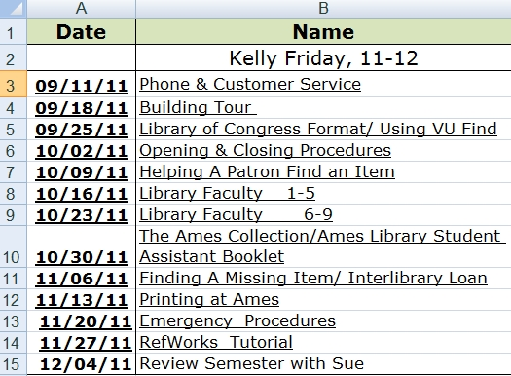
Notes:
First year students semester long individual training schedule
First year here is an example of their training program for the first semester:
They also have a check sheet they must complete the first month of training
This is provided to them to work with the on-call librarians and other returning students.
It is basic info on how to work the desk, fix a printer jam, answering the telephone, etc
I test them on this check list at the end of September

Slide 15
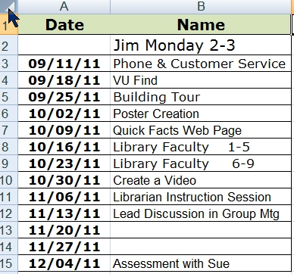
Notes:
Returning students both 2nd and 3rd year students: they would have some refresher training modules and some new training modules for their work in the semester.
It is also meant for them to work with the new students to help them learn these tasks

Slide 16

Notes:
Putting all the pieces of the puzzle together is the challenge. And it is an on-going process.
I’d like to show you one of the modules created by our students on customer service – it is about 1 half minutes long. It’s about going the extra mile.
This video is an example of one of the Moodle modules on customer service the students watch before they answer a quiz on good customer service.

Slide 17
http://www.youtube.com/watch?v=PrbQlNF_i78&feature=player_embedded#!
Notes:
We can also just sign on to Moodle that day is internet is working

Slide 18
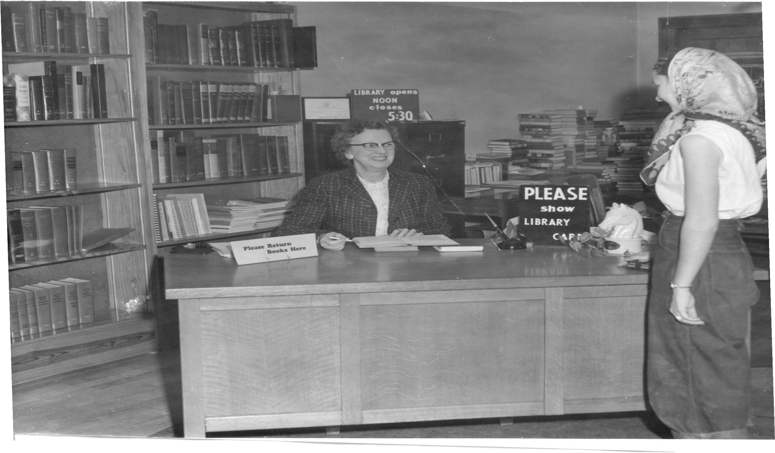
How Does Departing the Desk Fit With The Ames Library Information Literacy Plan?
Notes:
http://www.ebatesville.com/library/andres%20desk.jpg
The training video you just saw is one concrete example of how training is delivered to students. My main duty as information literacy librarian is to coordinate IL efforts in the library and on our campus. How does departing the reference desk fit with our broader information literacy plan?

Slide 19
The Ames Library Information Literacy Plan (March, 2011)
Goal #2 Integrate library instruction and Information Literacy throughout the curriculum and throughout all four years.
Goal #3 Provide Information Literacy continuing education / developmental opportunities for faculty, staff and student workers campus‐wide.
Notes:
Goal #2: Integrate library instruction and Information Literacy throughout the curriculum and throughout all four years.
How does departing the desk support this goal? Prioritizing Instruction and Instruction Prep (Being on-call frees up time to better prepare for instruction sessions)
Goal #3: Provide Information Literacy continuing education / developmental opportunities for faculty, staff and student workers campus‐wide.
The student assistant training program is one way of delivering info lit instruction to library student workers, but what are the IL needs of the rest of campus?

Slide 20
How is Information Literacy Integrated into Student Assistant Training?
Moodle Modules
  Embedded Quizzes
  Written responses, reflective activities
Interactions between student assistants and librarians/library staff
  Attending a library instruction session as additional training
  Training sessions that incorporate one-on-one
  Meebo interactions as teachable moments

Slide 21

What Do Our Student Library Assistants Think?
About the Librarian On-Call Model?
About the Student Assistant Training Program?

Slide 22
What has been the most useful aspect of your Information Desk Training?
How do you decide when to refer a question on to a librarian versus answering it yourself?
Do you feel that having a librarian on-call vs. at the Info Desk is beneficial or detrimental to providing good customer service?
How did attending an instruction session with one of the Ames Librarians help you with your work at the Information Desk?
Notes:
What has been the most useful aspect of your Information Desk Training?
I think becoming familiar with the librarians and the services available in the library has been the most useful part of working at the Information Desk. I feel more comfortable going in to talk to a librarian if I have a question…
The most useful part so far has been getting to know the librarians.
Having an upper clansman teaching and showing me my duties. The Moodle modules
How do you decide when to refer a question on to a librarian versus answering it yourself?
I refer to a librarian when I do not feel that I could give the best answer possible. Simply put, if I don't know the answer myself, I don't try and give a patron weak information. Instead I refer them directly to someone who can help more than I can.
Typically I try my best to answer questions at the desk myself. I can usually answer questions about which databases to use or where to begin researching myself. I tend to refer questions to librarians only when a student needs help narrowing down a topic or has a basic idea of how to start researching but needs direction on where to go from there.
Do you feel that having a librarian on-call vs. at the Info Desk is beneficial or detrimental to providing good customer service?
I think it's beneficial because I think a lot of students are more comfortable approaching one of their peers with a question they might think is stupid than they would be when approaching a librarian.
I prefer having a librarian on-call instead of at the Information Desk as it gives me a chance put my training to work. Most of the questions we usually receive are either very simple or basic directional questions… Having a librarian at the Information Desk, I think, will make student workers too reliant on the librarians.
How did attending an instruction session with one of the Ames Librarians help you with your work at the Information Desk?
The session I attended was in a gateway class, so I had been to a very similar session when I was a freshman and didn't really learn anything I hadn't already heard. I did, however, get to see how students interact with librarians and how they evaluate sources. This helped me to be more aware of how to help the patrons who come to the desk with questions because I have a better understanding of their research and evaluation process.
I've already had to attend multiple training sessions for classes so attending one for training was a unnecessary. In addition, a lot of the points that the librarians cover are also covered more in depth in our training

Slide 23
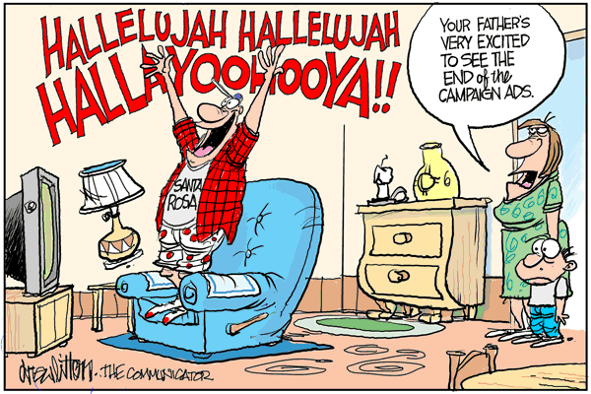
What Do the Librarians Think?
Notes:
Clarify This!
http://www.drewlitton.com/categories-2/drews-views/2010/11/04/the-hallelujah-chorus/

Slide 24
What Do the Librarians Think?
Can be more engaged with students who bring questions to office
Better alignment with teaching faculty office hour model
Students seem more willing to seek us out in our office than on the desk (private vs public)
Interaction with Info Desk students on desk improved
More time in office means increased productivity
Total Library Instruction Sessions have doubled since the ’07/’08 school year.
Notes:
“develop better working relationships with the students who work at the Info desk, as we explore our mutual roles. Being on Meebo at the same time provides excellent learning opportunities. Whether on Meebo or in person, when I get involved in a research question, I try to work with the student at the desk to help them understand the general nature of the question and how I approach it.”

Slide 25
Lingering Questions
How to assess new model?
How to best market librarian research assistance to students?
What’s next as technology and students continue to evolve?

Slide 26

Questions & Thanks
Sue Stroyan, sstroyan@iwu.edu
Chris Sweet, csweet@iwu.edu
Stephanie Davis-Kahl, sdaviska@iwu.edu

