Slide 1
Selecting, Implementing and Teaching a Web-Scale Discovery Tool
Chris Sweet
Illinois Wesleyan University
ISU Information Literacy Summit
4/30/12

Slide 2
What do most students expect from library search tools?
What is federated searching?
What is web-scale searching?
What is a library discovery tool?

Slide 3
IWU Background / Context
Liberal Arts Institution with 2100 undergraduates
ERIAL Project (2008-2010)
  Library resources are too fragmented
  Students are not persistent when researching
  Students don’t want to learn multiple interfaces
  Recommended exploring Discovery tools
We had many costly databases with good content that had low usage statistics

Slide 4
Selection Process
In the fall of 2010, Illinois Wesleyan University reviewed all the major web-scale discovery tools available to libraries.
  WorldCat Local (2007)
  Serial Solutions Summon (2009)
  Ebsco Discovery (2010)
  Exlibris Primo Central (2010)
  CARLI-Extensible Catalog
  Google Scholar?

Slide 5
Selection Process
Note:
Features, content, ability to customize , etc. have all been evolving on almost a monthly basis
What worked for us, might not work as well for you
New ILS systems from OCLC, Ex Libris and Innovative Interfaces won’t have a traditional OPAC- they will be based on a Discovery-type system

Slide 6
Selection Process
What led us to choose EDS?
IWU already had many EBSCO subscriptions
Familiarity with the interface (Academic Search Premier)
Ability to include things outside EBSCO licensed content (Federated)
Access to more deep or “thick” metadata than much of the competition. This can include: full-text, abstracts, subject indexing. *Critical when comparing discovery tools.
Peer-reviewed limiter
Decent relevancy rankings (from a librarian perspective)
Costs were comparable bet. EDS, Summon and Primo. “Around” $20K a year with a 3 year contract

Slide 7
Some questions to ask when selecting a discovery tool
How many of our current library resources can be included?
For items that are included do we get thick or thin metadata?
Do we have any options for including resources for which you do not have a licensing agreement?
How does the system handle consortial records and borrowing?
What features of the tool are customizable?

Slide 8
Implementation
Very good EBSCO support during this phase, no major problems.
Consortial borrowing issues (do we want all I-Share content searched by default?)
Similarly, what free content should be included?
Deciding what to do about resources that are not included in the base index (what to federate?)
Developing an understanding of the tool and buy in from the librarians and teaching faculty
Testing, marketing
Integrating the tool into the website

Slide 9
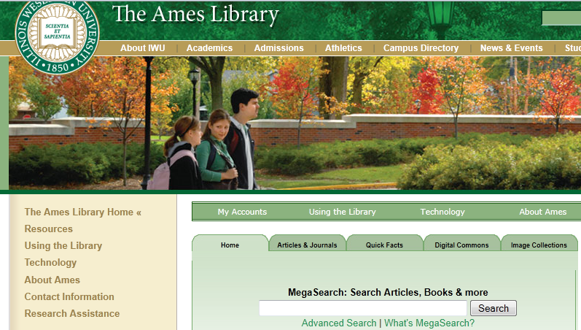
Ames Library Homepage

Slide 10
Problems
We’re establishing an EBSCO monopoly of sorts (relevancy rankings, metadata)
Known item searching wasn’t great
Statistics- (below)
ProQuest databases don’t play nice
Lexis-Nexis: not yet part of the index
Many small, one-off issues with linking, metadata problems, etc.

Slide 11
Successes
Adoption was very quick
Response has been overwhelmingly positive
Almost all of our major resources are included in the main index
Works when I-Share is down!
In general, students are finding good resources more quickly

Slide 12
Evaluation
IWU Student usability study
  Students were far more successful using EDS than other resources
  Never used the right-hand federated resources
  Occasionally applied left-hand limiters
  Students searched every box like a Google box
Usage statistics in a discovery environment
  Jul-Dec 2011 28,000 sessions and 17,000 downloads, 11,000 SFX links to full-text articles not in EDS
  Problematic for evaluating impact on stand-alone databases, because every EDS search counts as 1 search

Slide 13
Evaluation
Results from a Student/Faculty Anonymous Survey
  Overall ease of use 92% (Very Good or Excellent)
  Speed of searches 100% (Very Good or Excellent)
  Relevancy of Results 85% (Very Good or Excellent)
  Would you recommend this tool to a friend or colleague? 100% said Yes
  “I really like this. To test it, I ego-searched and MegaSearch came up with almost all of my publications, including book reviews, almost without duplication. I don’t know of a single database that is able to do this. Very Impressed.”
  “Thanks for this! I didn’t know I needed it and now I wouldn’t search without it. I’ve only been using it for a week or so, so perhaps I haven’t discovered weaknesses yet.”

Slide 14
Evaluation
Paths of Discovery: Comparing the Search effectiveness of EBSCO Discovery Service, Summon, Google Scholar, and Conventional Library Resources
Andrew D. Asher, Lynda M. Duke, Suzanne Wilson
(Accepted for publication in College & Research Libraries, available for pre-print in early May)
Study compared the effectiveness of these tools at IWU and Bucknell Universities
General Findings: EDS outperformed Summon and other search systems in almost every category.

Slide 15
Teaching EDS
Did our general approach change?
  Discovery Tools are not a magic bullet
  Frees us up to focus on teaching research skills instead of multiple interfaces
  Usually still teach VU Find/I-Share separately
Issue of federated connectors (have to be taught to be used)
Discipline-specific database dilemma, can also limit to a single database from within EDS

Slide 16
Closing Thoughts
There’s no going back now!
Interdisciplinary searching is outstanding.
Getting the most out of a discovery tool is not a passive process
If Google Scholar could be customized to include additional local library holdings it could be a “killer app”
Death of A&I databases?
A survey of incoming students this past fall discovered that none of them used their mobile devices for research. (Mobile interfaces are not as important as we thought)

Slide 17
Questions?
Demo Searches:
Wesleyan EDS http://www.iwu.edu/library/
ISU EDS http://library.illinoisstate.edu/
Summon at Arizona State: http://lib.asu.edu/

