Slide 1

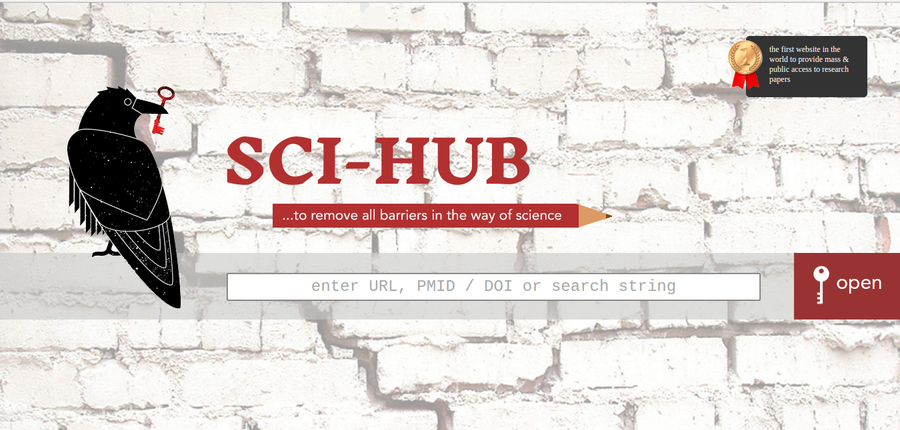
Wrestling with Pigs: The Ethical Dilemmas of Teaching Sci-Hub
Information Literacy Summit
4/29/2021
Chris Sweet (he, him, his)
Information Literacy and Scholarly Communications Librarian
Illinois Wesleyan University

Slide 2
My contention
If you came here today thinking:
that you would never use Sci-Hub in a million years because it is an evil, unethical, communist hive of villainy (or)
that you are super-woke and think Sci-Hub is the open access gods’ gift to humankind, (then)
I think you will be sorely disappointed in the lack of clear-cut answers this presentation provides. If you appreciate a good ethical dilemma, then stick around.

Slide 3
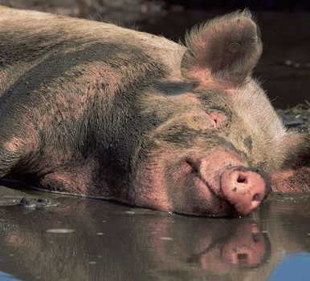
My Other contention
“Never wrestle with a pig. You both get dirty, and the pig likes it.”

Slide 4
Context Matters!
Scholarly Publishing Before Sci-Hub
1990s: growth of the internet and concurrently early e-books and e-journals.
Library budgets were finally going to catch a break. Digital resources were going to save money since there were no printing costs, required no paper, and did not need to be mailed.
Morgan Freeman narrator voice: As it turns out library budgets did not catch a break.
To the contrary, journal subscription costs increased far more rapidly than the inflation rate.

Slide 5
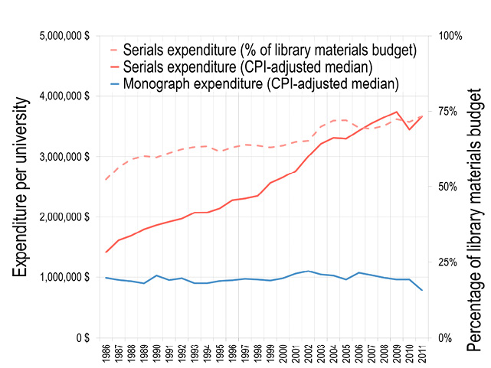
The Serials Crisis
“The average price of U.S. academic journals has increased more than eightfold between 1984 and 2010, while the U.S. national inflation rate was only 110 percent during that same 25-year period.”
Library Expenditures by Type of Material (1986–2011)

Slide 6
The Serials Crisis, Continued
Historically, most scholarly journals were published by university presses and academic societies.
Over the last thirty years, for-profit publishers have created near-monopolies in some areas of academic journal publishing.
Today, five major commercial publishers— Elsevier, Springer, Wiley, Taylor & Francis, and Sage— account for more than half the market for scholarly journals.
In the sciences, they have acquired an even greater market share.

Slide 7

How bad is it?
2018, RELX, the parent company of Elsevier had revenues of $9.8 billion and an extraordinary 31.3% profit margin— similar to Apple and Microsoft.
Profits derived from Elsevier account for about 40% of this total, or $3.9 billion dollars.
These exorbitant journal costs undermine core principles of research and scholarship since knowledge needs to be shared in order to continue advancing.

Slide 8

Guerilla Open Access Manifesto
“Information is power. But like all power, there are those who want to keep it for themselves. The world's entire scientific and cultural heritage, published over centuries in books and journals, is increasingly being digitized and locked up by a handful of private corporations. ”
“Those with access to these resources - students, librarians, scientists - you have been given a privilege. You get to feed at this banquet of knowledge while the rest of the world is locked out. But you need not - indeed, morally, you cannot - keep this privilege for yourselves. You have a duty to share it with the world. And you have: trading passwords with colleagues, filling download requests for friends.”
Aaron Swartz, 2008

Slide 9
Enter Sci-Hub!

Slide 10

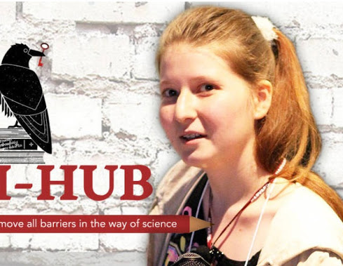
Russian neuroscience graduate student, Aleksandra Elbakyan, was struggling to locate the research articles she needed to complete her degree.
Initially she resorted to clumsy workarounds such as asking friends at better-funded universities for articles or posting requests to Twitter using the hashtag: #icanhazPDF.

Slide 11
Sci-Hub background
Sci-Hub was created in 2011, after Elbakyan utilized her coding skills to begin building a free, worldwide repository of scholarly articles.
Unlike previous free digital libraries such as Archive.org, which relied heavily on out-of-copyright materials and open access journals, Sci-Hub asked users to voluntarily share their credentials (e.g., the User ID and password that an academic uses to log-in remotely to their university’s network) to access private virtual private networks (VPNs)
The system works like this: whenever an article request comes in through the simple search box on the Sci-Hub homepage, the system checks the request against the existing archive of articles. If a given article is not contained in this massive database, the system uses credentials that other users have provided to locate the article. Once located, this article is copied into the main archive.

Slide 12
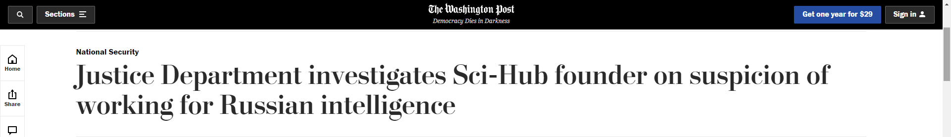
“It’s unclear whether Elbakyan is using Sci-Hub’s operations in service of Russian intelligence, but her critics say she has demonstrated significant hacking skills by collecting log-in credentials from journal subscribers, particularly at universities, and using them to pilfer vast amounts of academic literature.”
(We know some of these credentials were provided voluntarily)
“I know there are some reasons to suspect me: after all, I have education in computer security and was a hobby hacker in teenage years…But hacking is not my occupation, and I do not have any job within any intelligence, either Russian or some another.”
https://www.washingtonpost.com/national-security/justice-department-investigates-sci-hub-founder-on-suspicion-of-working-for-russian-intelligence/2019/12/19/9dbcb6e6-2277-11ea-a153-dce4b94e4249_story.html

Slide 13
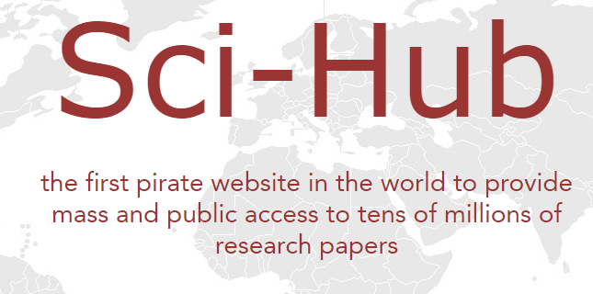
Currently the Sci-Hub archive claims to have 85 million scholarly articles.
For comparison, the Web of Science Core Collection contains 79 million records.
A 2017 analysis found that the Sci-Hub database contained an estimated 68.9% of all scholarly articles and 96.9% of all articles from the publisher Elsevier.

Slide 14

This made Elsevier deeply unhappy
In 2015, Elsevier sued Sci-Hub and Elbakyan (Elsevier et al. v. Sci-Hub et al.).
Sci-Hub did not defend the lawsuit, and in 2017 the court awarded Elsevier $15 million in damages and an injunction against Sci-Hub.
Rather meaningless since Sci-Hub has no fixed location or assets.

Slide 15
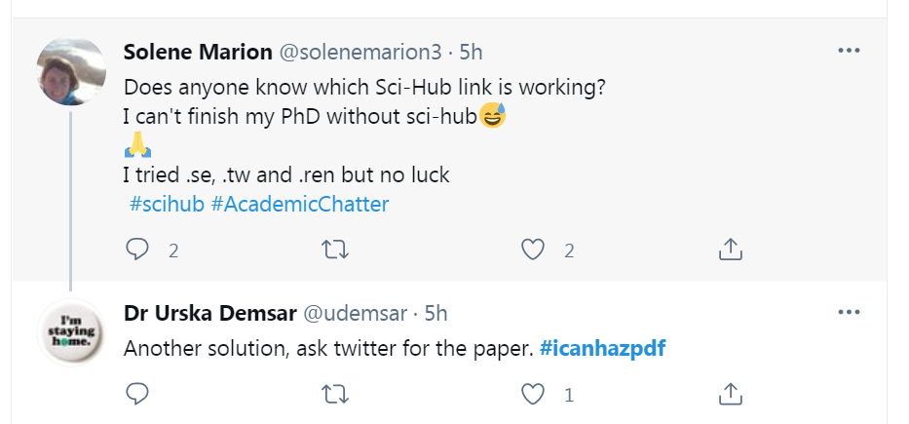
Where is Sci-Hub?
Due to multiple lawsuits, various Sci-Hub URL’s have been shut down over the years.
The archive just migrates to a new URL.
If Google doesn’t return the current URL, the Sci-Hub Wikipedia entry usually has it.
Note: Some (many?) campuses actively block Sci-Hub’s URL.

Slide 16
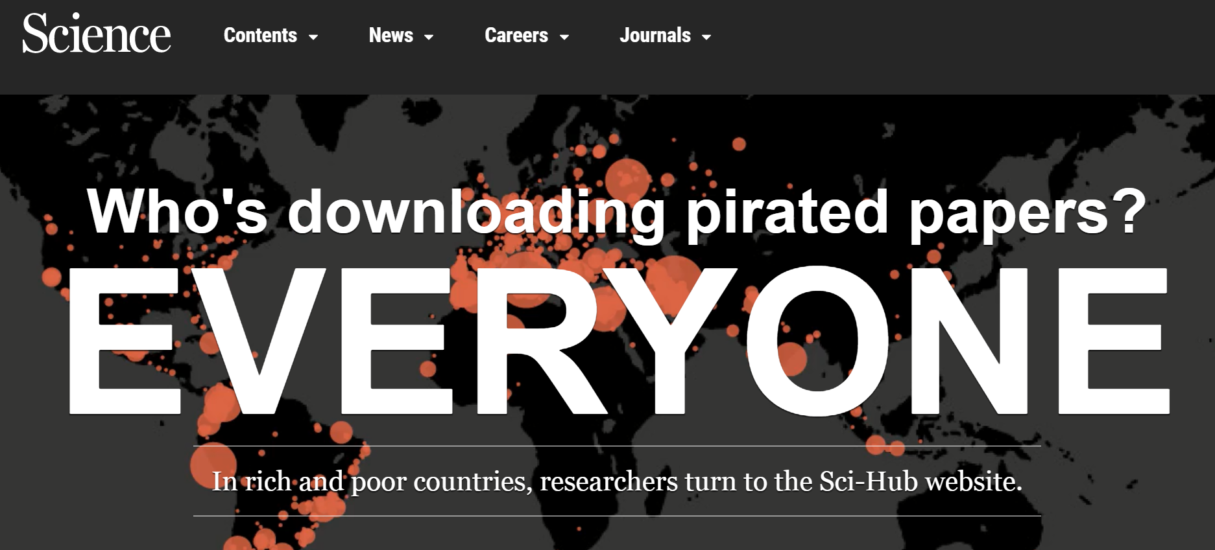
Whether libraries recognize it or not, Sci-Hub is very popular.

Slide 17
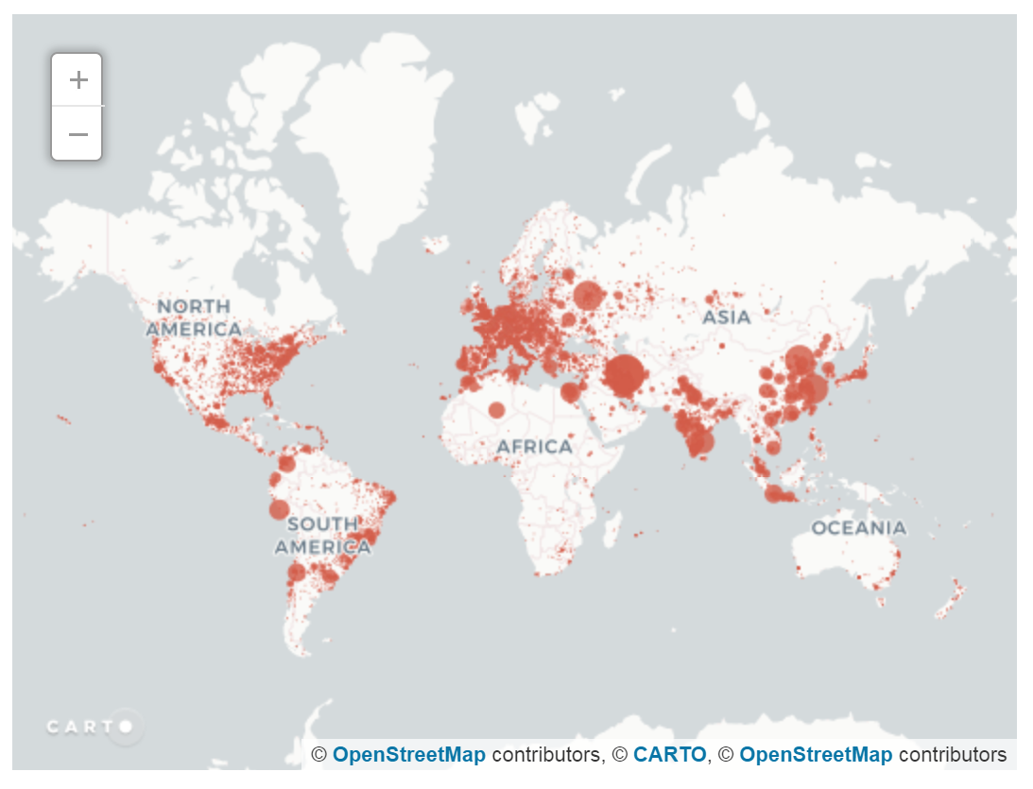
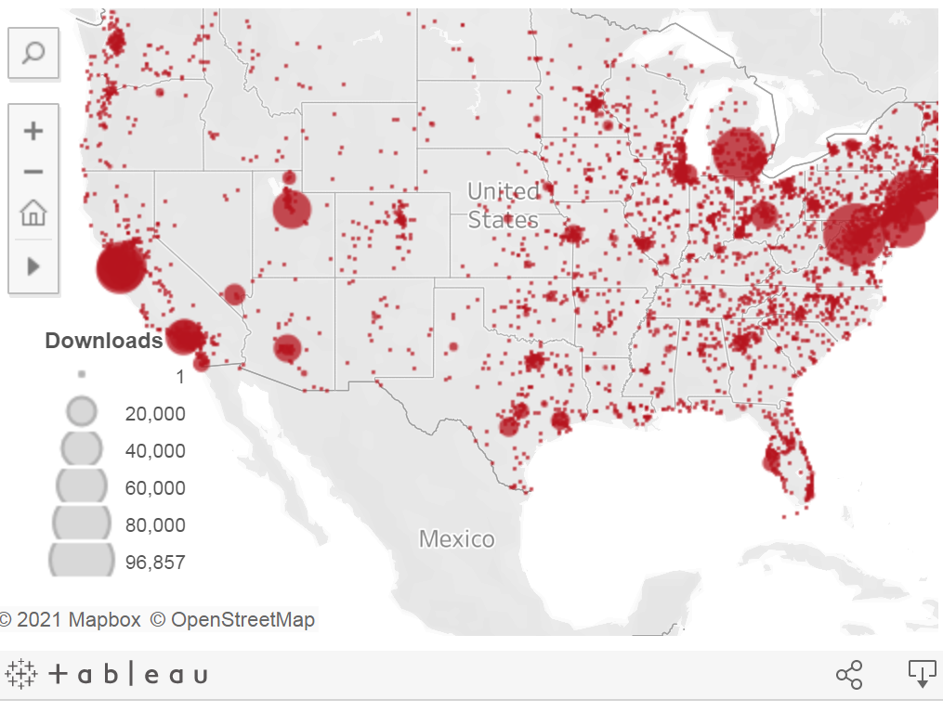
6 months of downloads in 2015 (28 million)

Slide 18

So, you are telling me that almost anyone, anywhere with an internet connection can access most of the world’s scholarly articles for free?
Yup.
Is this a utopia or dystopia?

Slide 19
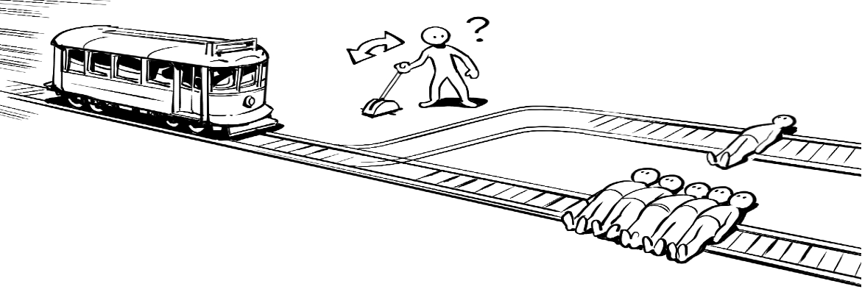


ethical dilemma n. a situation in which a person must choose between two courses of action of (apparent) equal moral importance, so that the choice necessarily entails the transgression of an important moral principle. (Oxford English Dictionary)

Slide 20
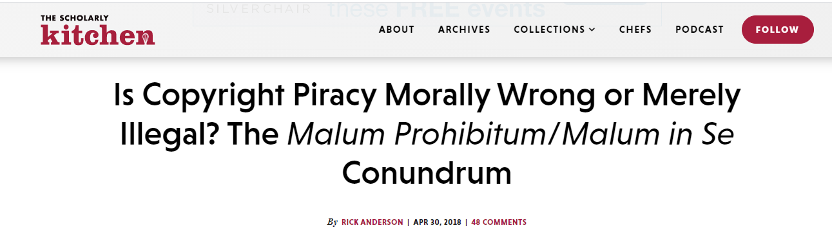
Malum Prohibitum: Acts that are technically illegal but not morally wrong
Examples: jaywalking, speeding, forgery, illegal immigration
Malum in Se: Evil in and of themselves
Examples: murder, robbery, assault, child abuse
Where should copyright infringement / using Sci-Hub fall?
“When someone raises the objection that piracy is wrong, the response among many librarians — though not all, and not usually expressed in so many words — is basically “No, what’s genuinely wrong is restricting access to knowledge; copyright piracy as a method of opening up access to knowledge is not ‘wrong’ — it’s merely illegal.”

Slide 21
ALA Code of Ethics (updated 2008)
The ALA Code of Ethics, explicitly tells librarians that “We have a special obligation to ensure the free flow of information and ideas to present and future generations.” http://www.ala.org/tools/ethics
Cool beans.
I’m all about Sci-Hub.
I’m going to leave your presentation and start updating all my Libguides right now.
But wait, there’s more ethics where that came from!

Slide 22
ALA Code of Ethics
“We respect intellectual property rights and advocate balance between the interests of information users and rights holders.” http://www.ala.org/tools/ethics
Shite.

Slide 23
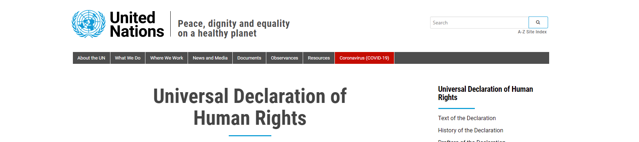
Article 19: “Everyone has the right to freedom of opinion and expression; this right includes freedom to hold opinions without interference and to seek, receive and impart information and ideas through any media and regardless of frontiers” https://www.un.org/en/about-us/universal-declaration-of-human-rights
So, when campus IT calls about an alarming number of article downloads from the Sci-Hub domain to my IP, I can just say the UN has my back, right?!

Slide 24
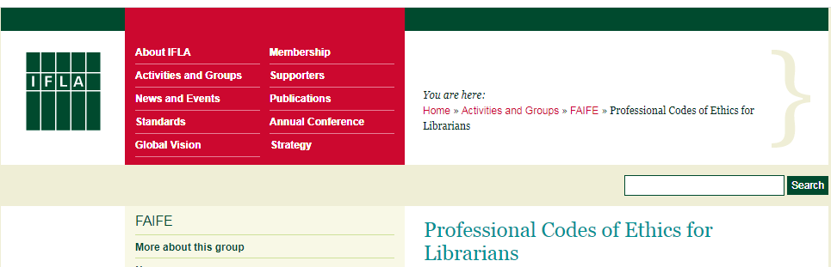
https://www.ifla.org/publications/node/11092

Slide 25
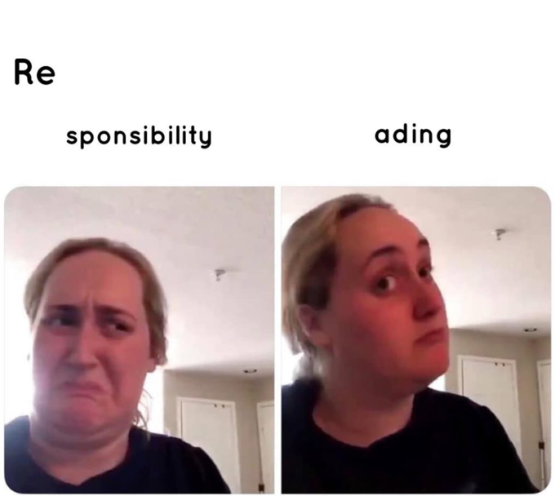
“…support for the principles of open access, open source, and open licenses”
Using Sci-Hub:

Slide 26
“Librarians and other information workers are partners of authors, publishers and other creators of copyright protected works. Librarians and other information workers recognise [sic] the intellectual property right of authors and other creators and will seek to ensure that their rights are respected”
Using Sci-Hub:

Slide 27
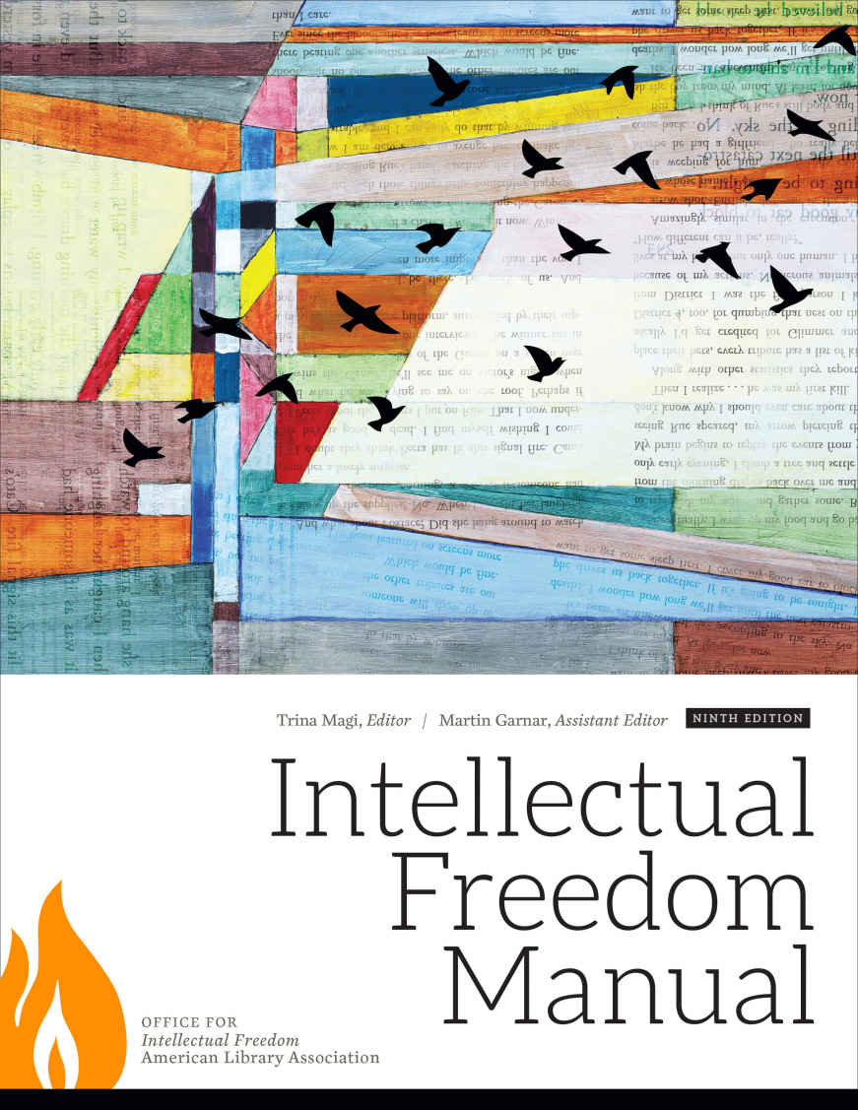
“Intellectual freedom can exist only where…society makes an equal commitment to the right of unrestricted access to information and ideas regardless of the communication medium used, the content of work, and the viewpoints of both the author and the receiver of information"

Slide 28
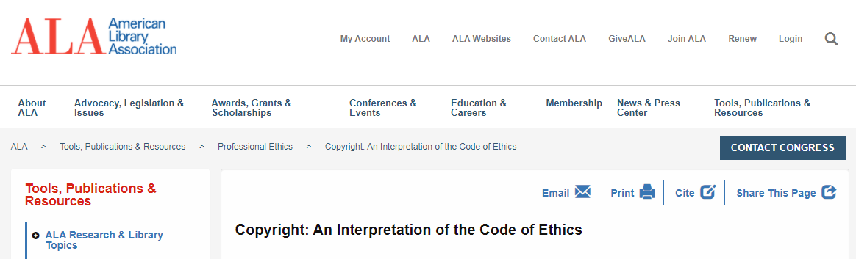
“When the balance between rights holders and information users’ needs to be restored, library workers should engage with rights holders and legislators to advocate on behalf of their users and users’ rights” (ALA, 2019).

Slide 30
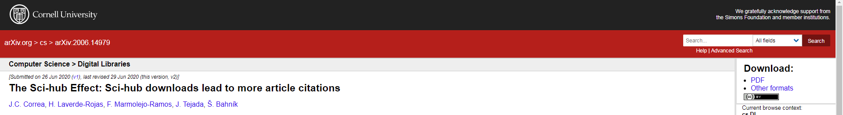
“Using data from 12 leading journals in economics, consumer research, neuroscience, and multidisciplinary research, we found that articles downloaded from Sci-hub were cited 1.72 times more than papers not downloaded from Sci-hub and that the number of downloads from Sci-hub was a robust predictor of future citations…The results suggest that limited access to publications may limit some scientific research from achieving its full impact.” (2020) https://arxiv.org/abs/2006.14979

Slide 31
If We Have Time!
https://sci-hub.se/
10.1108/RSR-03-2020-0014

Slide 32
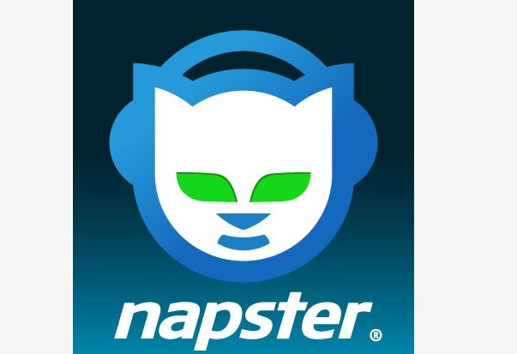

Takeaways?
Sci-Hub is not going away.
We should stay informed about Sci-Hub in case students or faculty ever bring it up.
We can continue to push for open access and open educational resources in all their forms.
We can advocate for a reasonably-priced comprehensive scholarly article database model that provides access to all research in the form of the Napster to Spotify model.

Slide 33

At its peak, #ICanHazPDF was very popular. In general, we felt good about sending our friends articles they couldn’t get. This is what librarians do: connect users to information. Other than being slower and more cumbersome than Sci-Hub is #ICanHazPDF really any different?

Slide 34
What if a student has identified an article that they really need, but they don’t have time to wait for an interlibrary loan request to be filled?
Too bad, so sad, right?
What if we helped the student make the ILL request so that proper fees are paid and copyright regulations are upheld, but right after that sent them the same article accessed via Sci-Hub?

Slide 35
Would you ever discuss Sci-Hub in an information literacy session?
Only if a student brought it up?

Slide 36
For more information:
Christopher A. Sweet. "An Introduction to Sci-Hub and its Ethical Dilemmas" LOEX Quarterly Vol. 45 Iss. 3 (2018) p. 7 - 10 ISSN: 1547-0172
https://commons.emich.edu/loexquarterly/vol45/iss3/4/
Csweet@iwu.edu
Questions?

