Slide 1

Library Leadership of a Campus-Wide Intellectual Theme
Special Library Association Education Division / ACRL's EBSS Education Committee Professional Development Webinar
4/9/2021
Chris Sweet
Information Literacy and Scholarly Communications Librarian
Illinois Wesleyan University

Slide 2

About me:
Information Literacy and Scholarly Communications Librarian
Currently the library liaison to: Accounting, Anthropology, Business Administration & Marketing, Design & Entrepreneurship, English, Environmental Studies, Film, International Studies, Philosophy, Physical Education, Political Science, & Sociology (we’re a bit short on library faculty!)
Proposed and led the ‘19-’20 Fact or Fiction Intellectual Theme

Slide 3

1600 students
Private, liberal arts
Central Illinois
Primarily residential
Undergraduates only

Slide 4
Overview of Annual Intellectual Themes at Illinois Wesleyan
Highly interdisciplinary to appeal to include a wide range of disciplines
Shared reading for first year students
Course clusters each semester that incorporate the theme
Theme kick-off events each semester for course clusters
Library-hosted “open house” featuring research and creative works from students enrolled in course clusters
Speaker series
Workshops
Film Screenings
Student group events

Slide 5




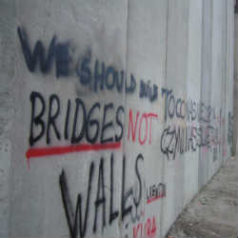

Current and Past Themes
Nations Divided?
Walls and Bridges

Slide 6
In 2016, the Oxford Dictionaries selected “post-truth” as their Word of the Year and the White House coined the term “alternative facts.” Enabled by social media platforms, the rapid spread of fake news has deepened political polarization and undermined basic democratic processes. The cornerstones of democracy rest on the principle of education that creates an informed citizenry. In this day and age, it is essential that an informed citizenry be equipped to discern between fact and fiction. This often requires us to think about the very nature of truth. How do we know what we know? What is knowledge? Moreover, how should we deal with the massive gray areas that often exist between the dichotomies of fact or fiction? The Fact or Fiction intellectual theme asks us to think deeply and seriously about these issues.
Illinois Wesleyan University’s Mission Statement tells us that “A liberal education at Illinois Wesleyan fosters creativity, critical thinking, effective communication, strength of character and a spirit of inquiry.” Critical thinking and a spirit of inquiry are at the very heart of the Fact or Fiction intellectual theme. Cultivating curiosity and a spirit of inquiry can do a great deal to stem the tide of misinformation.

Slide 7




Slide 8

Common Reading for First Year Students
Book discussion as part of orientation
Gateway courses incorporate the reading
In the past, the book author has spoken to the campus
Differences from One School/Community/City One Book

Slide 9
Course Clusters
ANTH 274: Native Americans and the Environment
ANTH 380: Visual Ethnographic Methods
BIOL 216: Foundations of Evolution
CS 338: Artificial Intelligence
EDUC 225: Education and Social Justice
ENST 120: Ecology and Environmental Problems
ENST 200: Introduction to Geographic Information Systems
ENST 240: Health and the Environment
GW 100 / FYE: Analytic Titans
GW 100 / FYE: Creativity Scholars
GW 100 / FYE: Wrongful Convictions
GW 100: Human Nature
GW100: How We Think (2 sections)
GW100: Protest USA
HIST 212: Ancient Greece
HLTH 230: Human Nutrition
HLTH 330: Human Sexuality
MATH 400: Math Modeling
NURS 214: Nursing and Society
PHYS 407: Introduction to Quantum Mechanics
PSCI 104: Multiculturalism and its Critics
PSYC 227: Statistics (2 Sections)
PSYC 369: Introduction to Counseling
REL 310: Cults
SOC 201: Social Problems
SOC 328: Criminology
Theme interwoven through entire class or at least one major assignment
Fact or Fiction theme had the largest number of courses ever
Represented almost one quarter of the student body
Required attendance at lunchtime kick-off
Required participation or attendance in theme open house
Given the nature of the theme the library saw a small increase in information literacy instruction sessions

Slide 10
Kick-Off
Dean of Students office provided lunch.
“Required” attendance
Fact or Fiction questions solicited from faculty teaching courses involved in the course cluster.
Test your knowledge (use chat):
Fact or Fiction: Eyewitnesses are better able to identify a criminal if they saw a weapon at the scene of the crime.

Slide 11
Fiction
Eyewitness are actually worse at identifying criminals if a weapon is present, likely because their focus goes to the weapon instead of the perpetrator’s face.

Slide 12
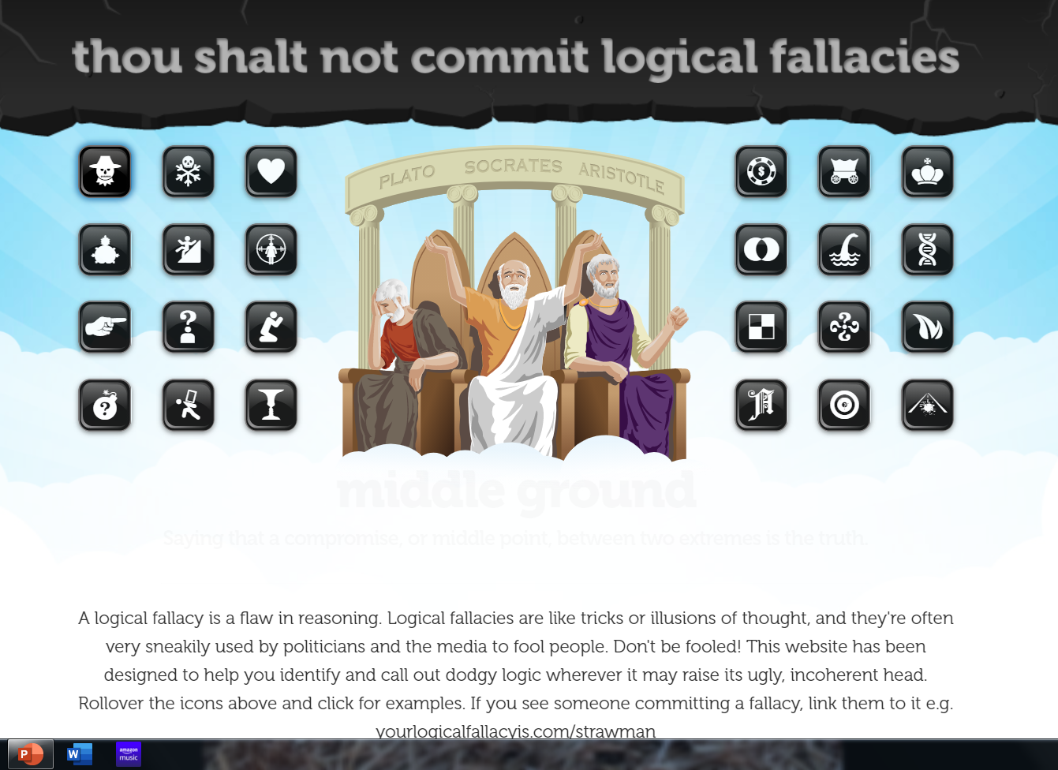
What’s Your Logical Fallacy?
https://yourlogicalfallacyis.com/

Slide 13
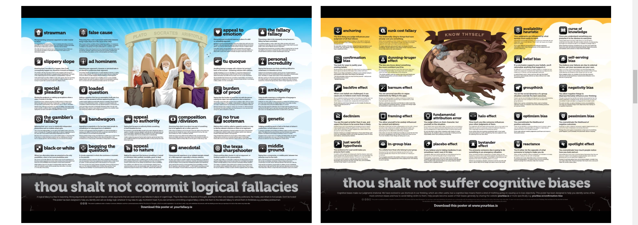
Logical Fallacies and Cognitive Biases posters, cards, downloads

Slide 14
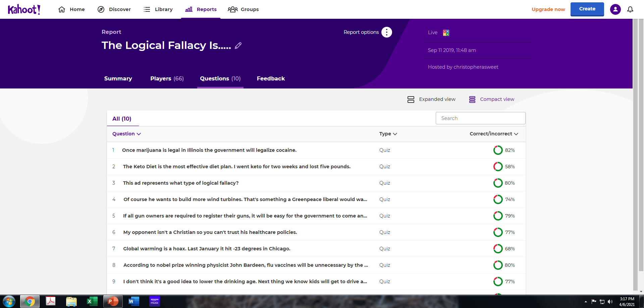
Logical Fallacy Kahoot quiz for 400 students at One time!

Slide 15
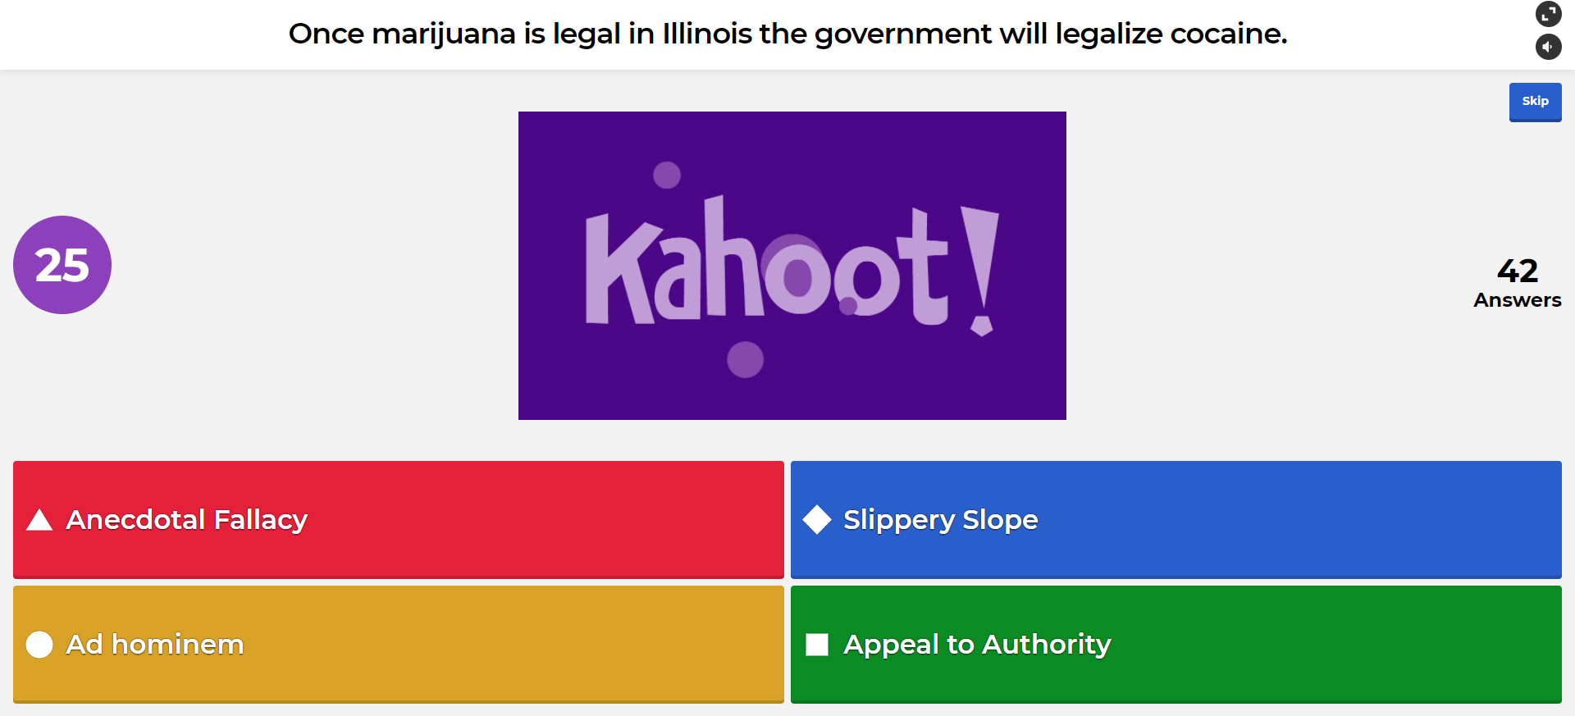
How Would You Do?

Slide 16
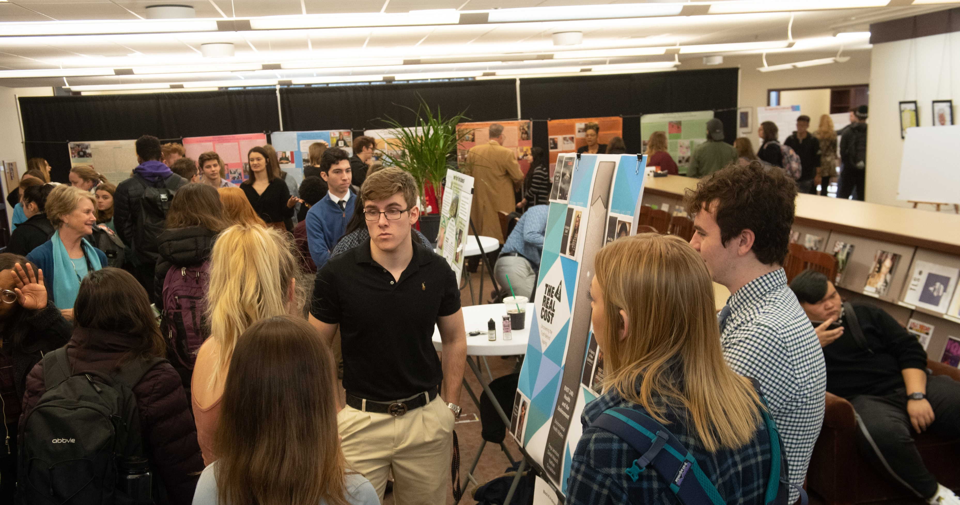
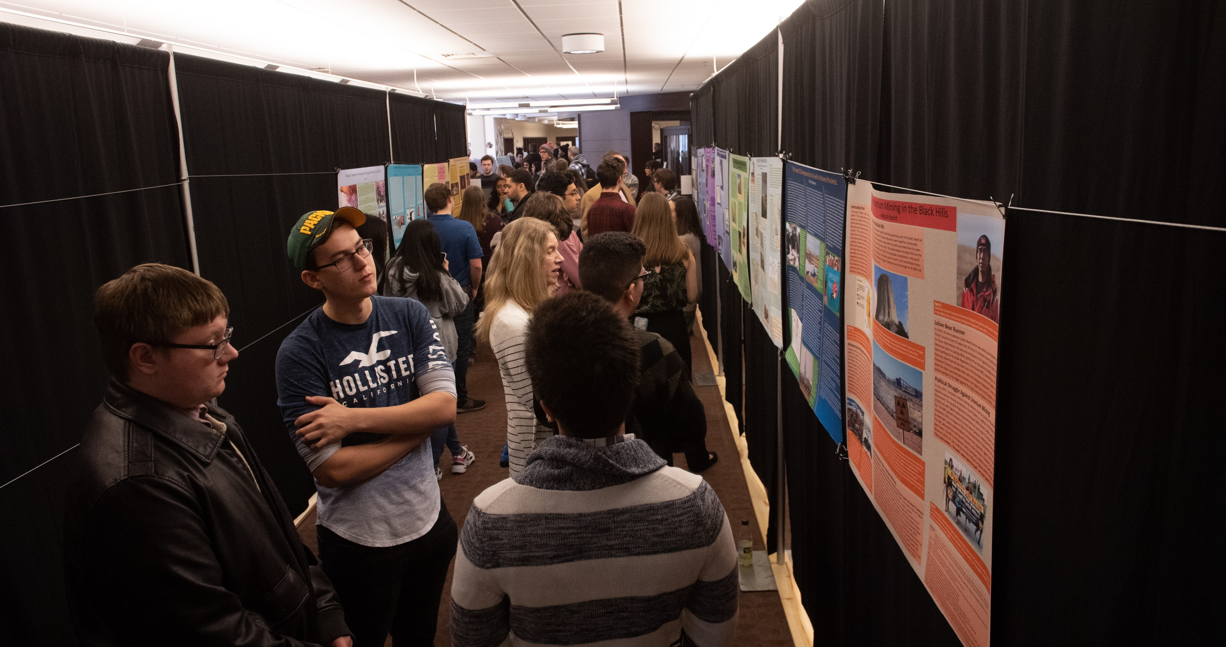
Library Open House

Slide 17
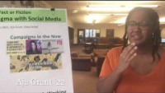
Fact or Fiction Open House Video
Alternative link: https://fb.watch/4L7Y1gXRUH/

Slide 18
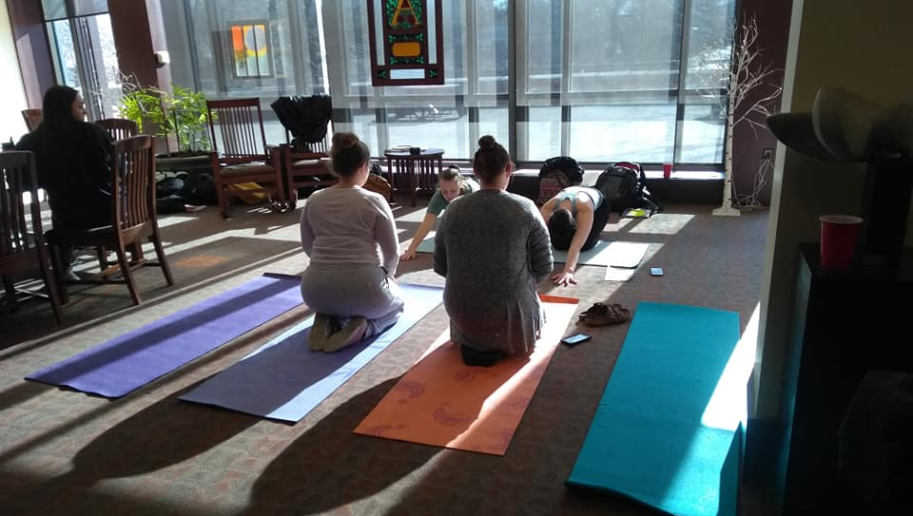
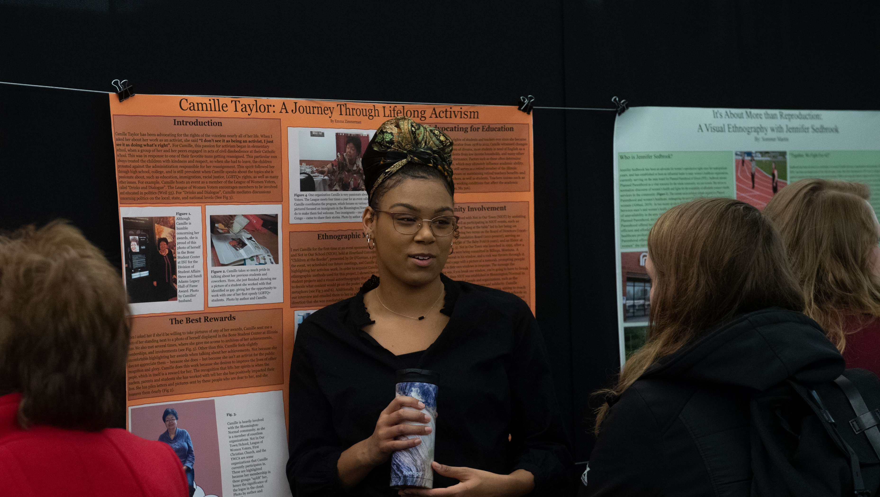
From the library perspective, the open houses usually yield the highest daily gate count of the year for our library.
The fall 2019 open house saw 1,275 people enter the library.
Daily average of 498.
Open houses highlight students’ undergraduate research.

Slide 19
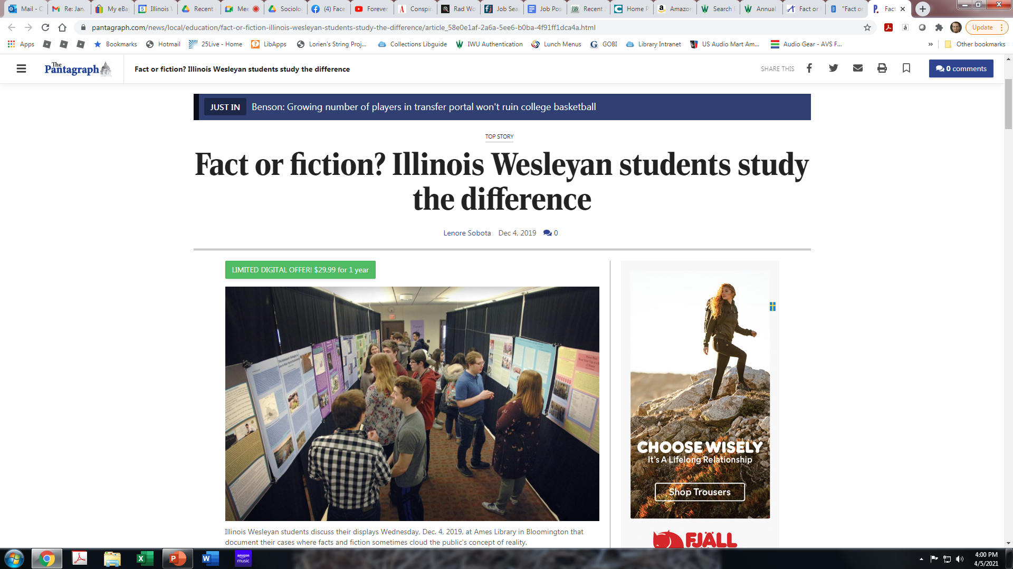
Pantagraph Coverage

Slide 20
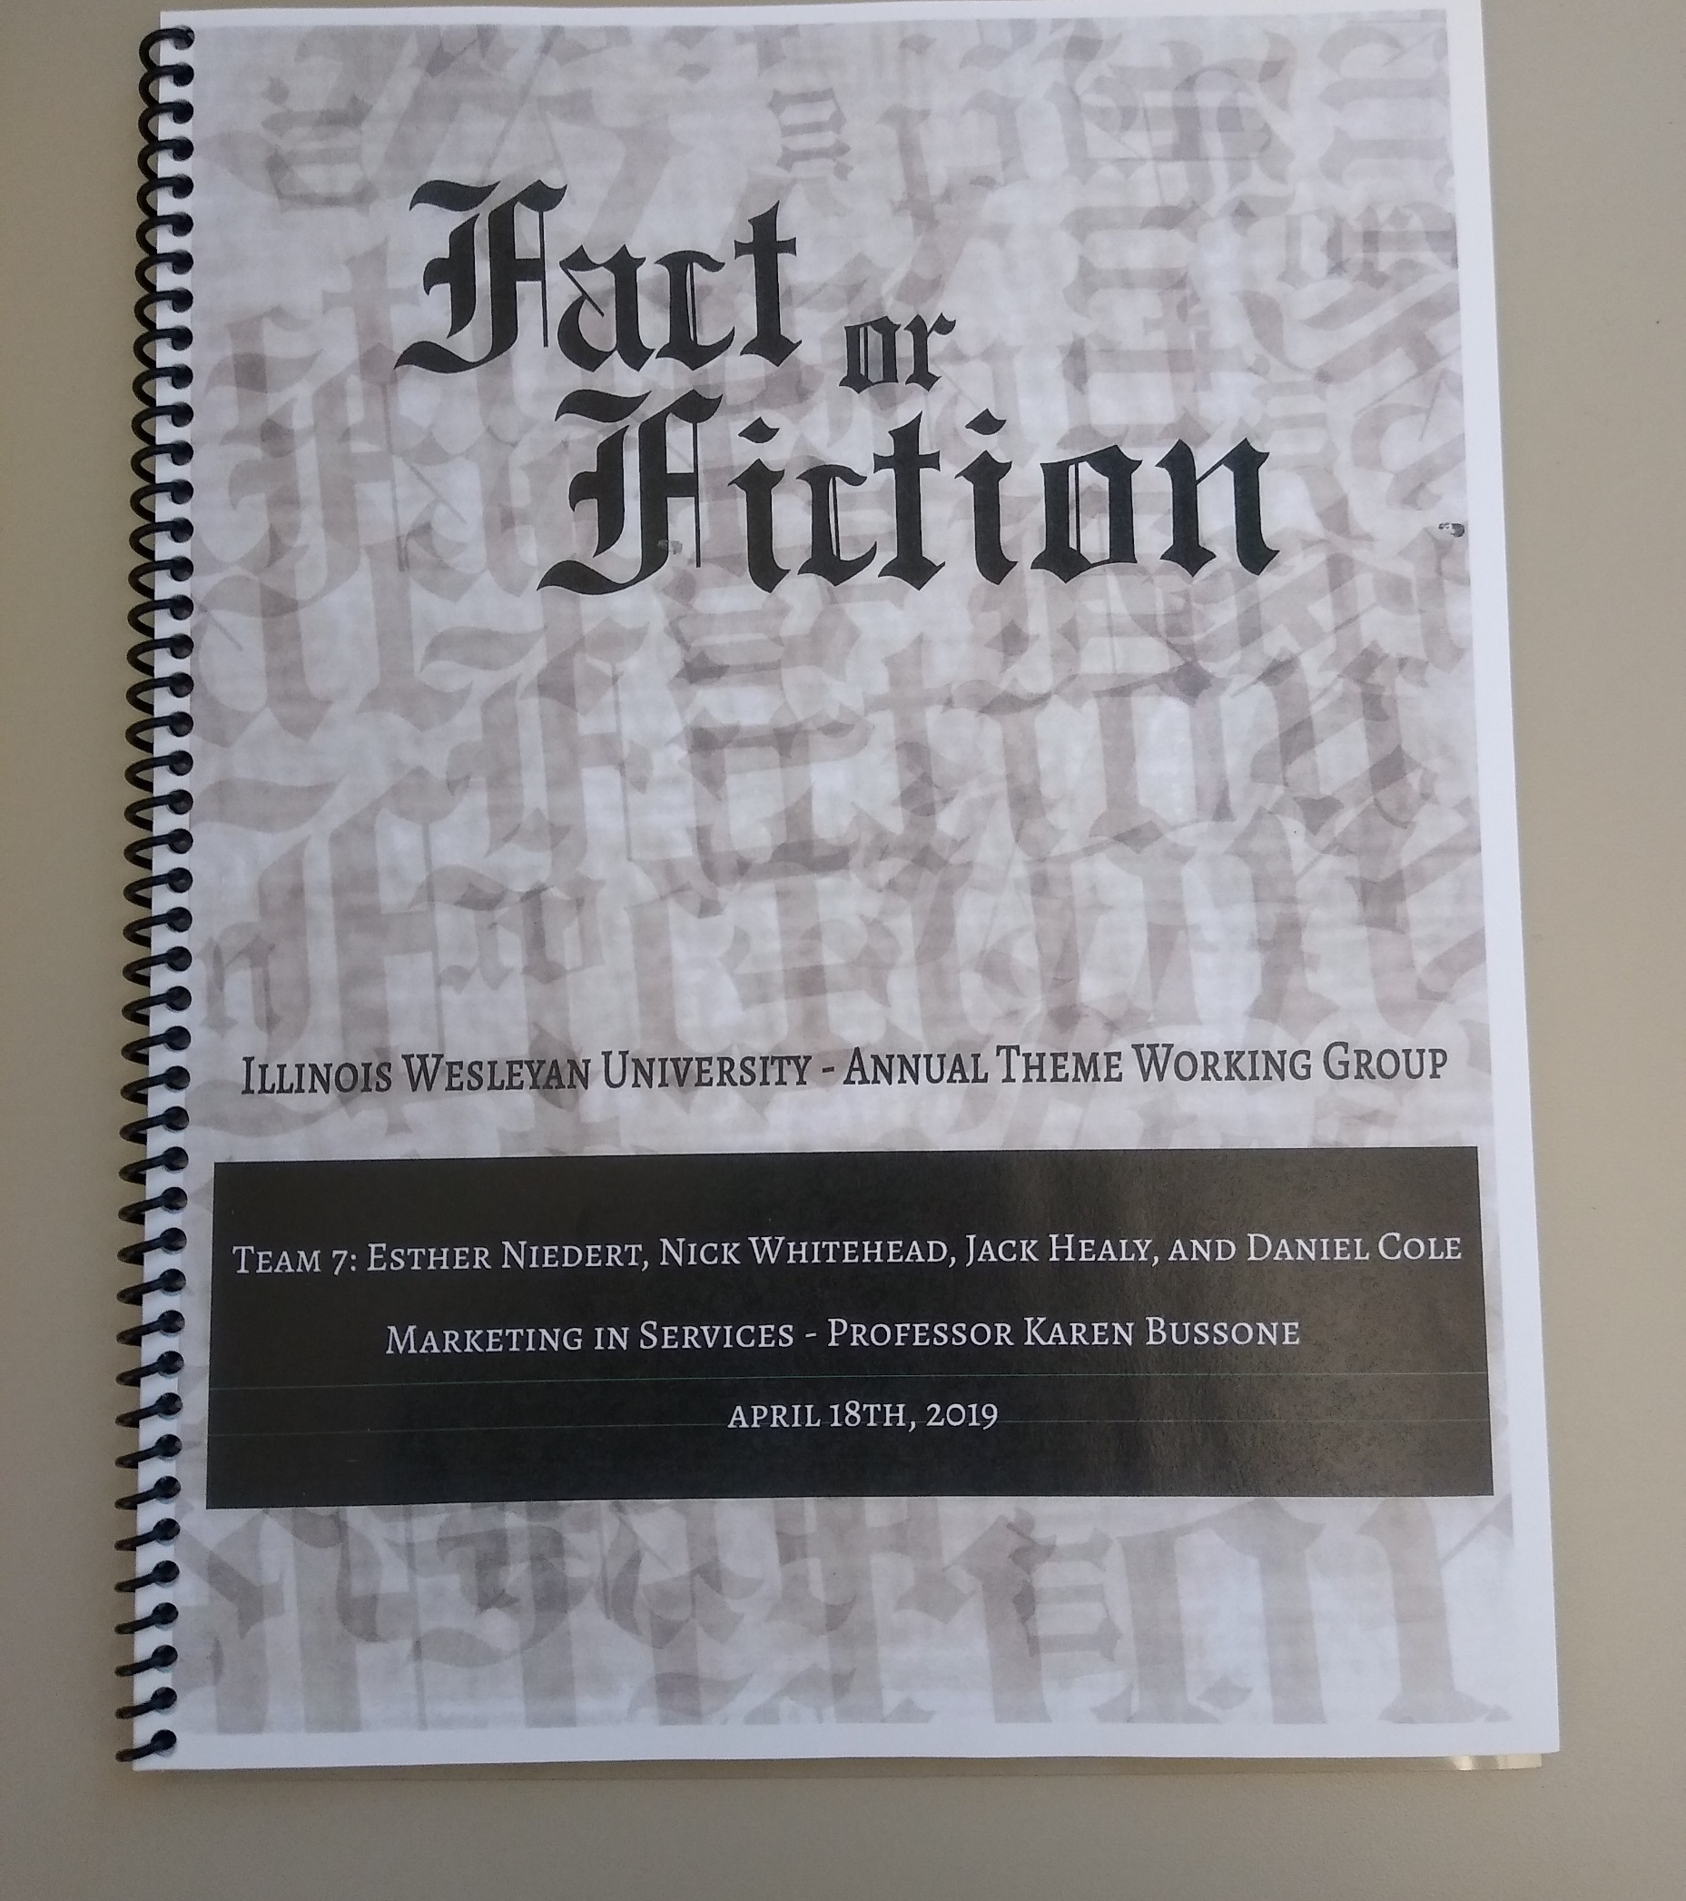
Marketing in Services Industries and Not-for-Profit Organizations (300-level Course)
Graphic Arts
Specific tasks
Market research
Social Media
Formal presentation

Slide 21
Annual Theme Intern
Employed by Dean of Students Office
Manages Social Media accounts
Creates marketing material
Helps coordinate events

Slide 22
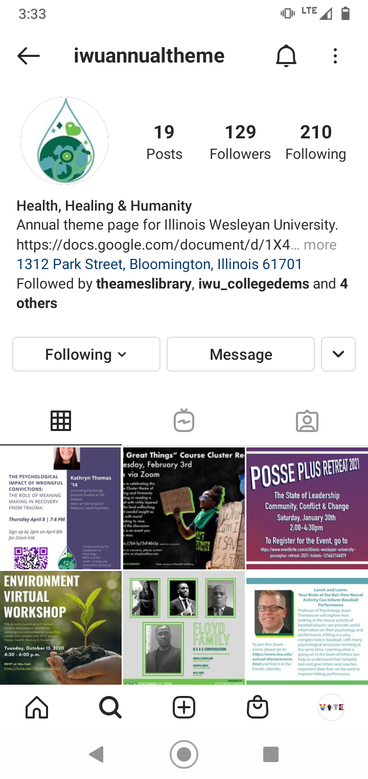
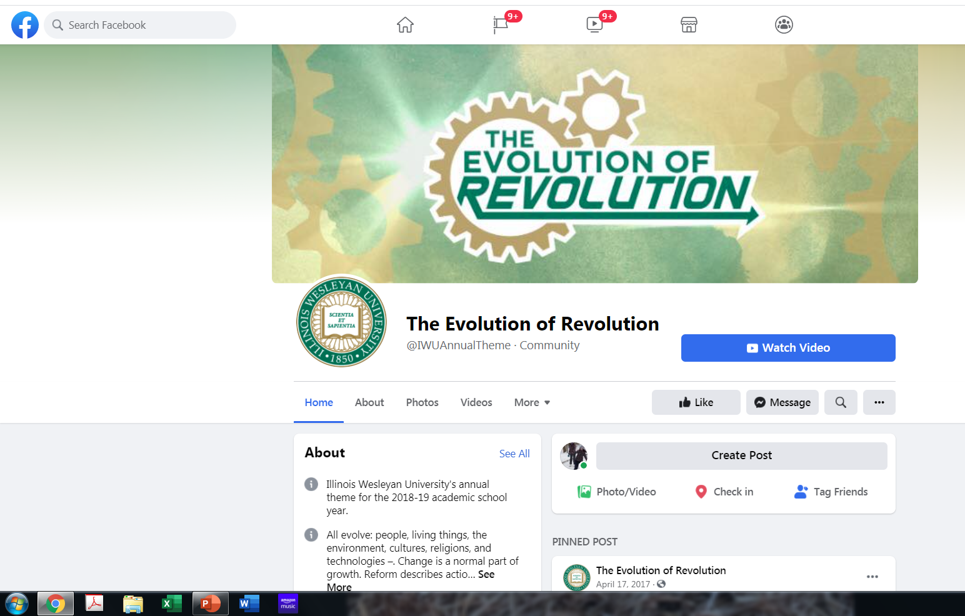
Marketing: Social Media
“Man on the street” interviews…………

Slide 23
Budget? What Budget?
Ran on a shoestring with help from the Dean of Student’s Office: marketing materials, student lunches at kick-offs, pizza at open house.
Major speakers are part of long-standing university events, they are just tied to the theme. Paid for by the President’s office.
Departments have small annual budgets for speakers/workshops. Work with them to tie to the theme.

Slide 24
Challenges
Besides no budget?
Managing intern: employed by Dean of Students Office, but interfaces frequently with the theme leader
Enthusiasm and participation drop-off during spring semester
Large time commitment from coordinator. Ideally there would be one course release for coordinator

Slide 25
Takeaways for Libraries
Take the one book, one school/city/community and run with it. Build more layers around the idea.
Leverage student assignments to generate “real world” products (marketing class)
Acknowledge / reward faculty for participating in course clusters. Courses on website, promotion and tenure cases, end-of-year social.
As always be creative with budgets and budget sharing

Slide 26
Questions and More Information
Sweet, Christopher. "Fact or fiction? Library leadership of a campus-wide intellectual theme." College & Research Libraries News [Online], 81.11 (2020): 550. Web. https://crln.acrl.org/index.php/crlnews/article/view/24730/0
Illinois Wesleyan Annual Themes: https://www.iwu.edu/annual-theme/
Chris Sweet: csweet@iwu.edu

