Slide 1
Leading a Revolution
Comrade Chris Davis

Slide 2
Change Revolutions
The Change Imperative
Responses to Change
Why a Revolution
Why Revolutions Fail
How to Lead Successful Revolutions

Slide 3
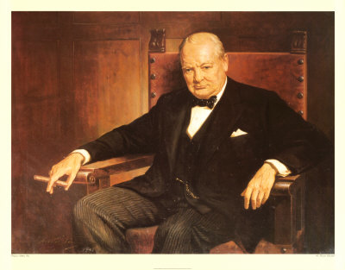
To improve is to change; to be perfect is to change often.
Winston Churchill

Slide 4
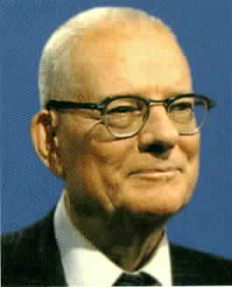
It is not necessary to change. Survival is not mandatory.
W. Edwards Deming

Slide 5
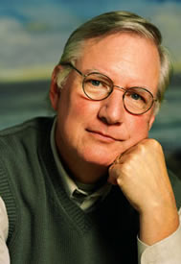
Excellent firms don't believe in excellence - only in constant improvement and constant change.
Tom Peters

Slide 6
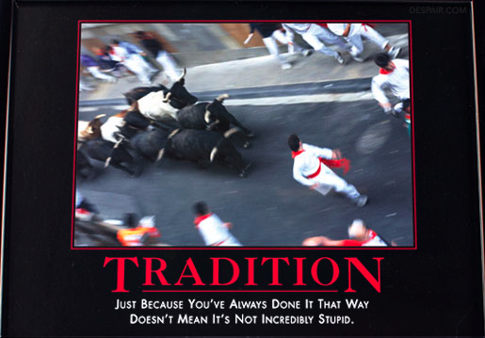

Slide 7
When our internal model of reality is in conflict with rapidly changing external realities, there are three fundamental ways to respond.
----Dee Hock, Birth of the Chaordic Age, p. 238-239

Slide 8
First: we can cling to our old internal model and attempt to impose it on external conditions in a futile attempt to make them conform to our expectations. That is usually what our institutions compel us to attempt and what we continually dissipate our ingenuity and ability to achieve.

Slide 9
Second: we can engage in denial. We can refuse to accept the new external reality. We can pretend that external changes are not as profound as they really are, or deny that we have an internal model, or that it bears examination. When the world about us appears to be irrational, erratic, and irresponsible, it is all too easy to blame others for the unpleasant, destructive things we experience, abandon meaning, and engage in fantasy and erratic behavior. The world is filling with such people.

Slide 10
Third: we can attempt to understand and change our internal model of reality. That is the least common alternative, and for good reason. Changing an internal model of reality is extremely difficult, terrifying, and complex. It requires a meticulous, painful examination of beliefs. It requires a fundamental understanding of consciousness and how it must change. It destroys our sense of time and place. It calls into question our very identity. We can never be sure of our place or our value in a new order of things. We may lose sight of who and what we are. It requires an enormous act of faith, for new internal concepts of reality require time to develop, and we require time to grow into them.

Slide 11
“Organizational identities are embedded and emergent in conversation. Project planning discussions, strategic planning meetings, selection interviews, performance reviews and staff meetings are all conversations through which the identities of an organization, its products and services and its members are crafted. The efforts of change agents toward development – personal and organizational – can best be understood as interventions into the conversational processes and relational realities of the organization.”
----Diana Whitney, Let’s change the subject and change our organization: an appreciative inquiry approach to organizational change. Career Development International Bradford: 1998. Vol. 3, Iss. 7, p. 314

Slide 12
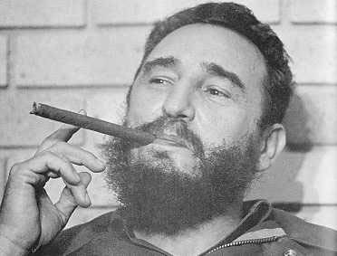
A revolution is a struggle to the death between the future and the past.
Fidel Castro

Slide 13
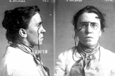
No real social change has ever been brought about without a revolution... revolution is but thought carried into action.
Emma Goldman

Slide 14
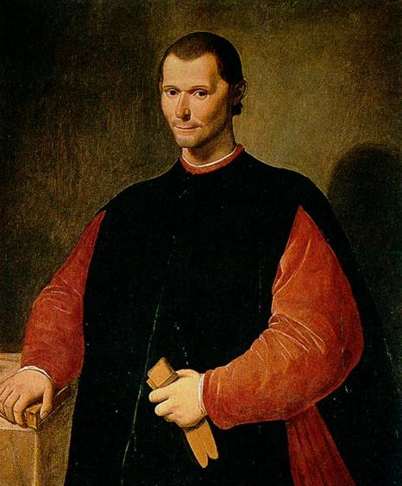
"There is nothing more difficult to plan, more doubtful of success, nor more dangerous to manage than the creation of a new order of things…"
--Niccolo Machiavelli, The Prince

Slide 15
Fail
70% of organizational change programs fail
Miller, D. (2002). Successful change leaders: what makes them? what do they do that is different?, Journal of Change Management, 2(4), 359-368.

Slide 16


Slide 17
Field of Dreams Philosophy
“Build it, and they will come.”

Slide 18
The FUD Factor
Fear
  “I do not want to be the first on the block.”
Uncertainty
  “I don’t believe it will do me any good.”
Doubt
  “I don’t know if I can do it.”

Slide 19
Stages of a Revolution
Establishing the vision
Recruitment of volunteers
Reaching critical mass

Slide 20
Stage One:
Establishing the Vision

Slide 21


Slide 22
Two Ingredients for Change
An Opportunity
  A problem, need, or benefit
A Solution
  A product or service

Slide 23
Visioning Process
Incremental Innovation
  Existing approach to follow
  Research what others have done or are doing (best practices)
Disruptive Innovation
  Wicked problems
  Delphi Technique with individuals and small groups

Slide 24
Delphi Technique
Ask questions
Ask for referrals
Share ideas of others to build shared vision (white papers and plans)
Name drop shamelessly
Give credit and ownership to 3rd parties
Practice editorial control

Slide 25
Questions
What do you think the problem/need is?
What do you think the solution should do?
What do you think the solution is?
How could you use the solution?
What are the benefits of the solution?
What problem could the solution solve?
Who else should I talk to about this?

Slide 26
Results of Visioning Process
Makes networks and norms explicit
Builds buy-in from start
Identifies potential barriers early
Identify pioneers
Defines product and message

Slide 27
Stage Two:
Recruitment of Volunteers

Slide 28
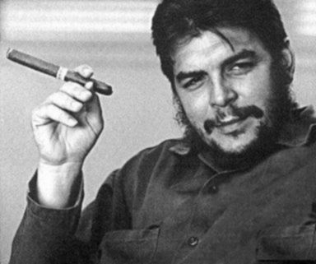
The revolution is not an apple that falls when it is ripe. You have to make it fall.
Che Guevara

Slide 29
Marketing:
Three Stages of Communication
Awareness
  If I do not know that something exists, I cannot do it.
Motivation
  I need to know why I should use it.
Ability
  I need to know how to use it.

Slide 30
Awareness Building
Print Media
  Brochures, Flyers, and Letters
  Articles and Newsletters
Websites
Events
  Meetings
  Training Sessions
Word of Mouth

Slide 31
Motivation:
Two Groups of People
High potential for change
  Pioneers (2.5%)
Low potential for change
  Settlers (97.5%)

Slide 32
Pioneers
“The pioneers are the ones with the arrows in their back.”
  XEROX PARC

Slide 33
Pioneers
Motivated by change for sake of change
Can live without modern conveniences
Generally self-reliant

Slide 34
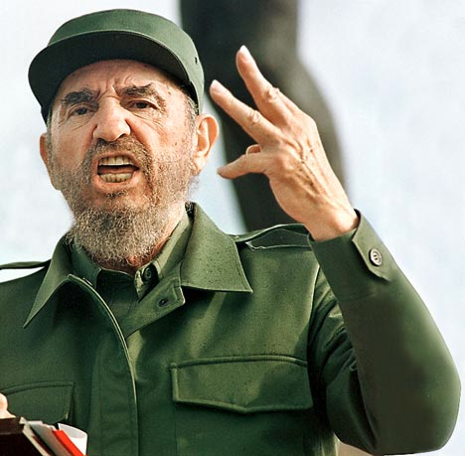
I began revolution with 82 men. If I had to do it again, I do it with 10 or 15 and absolute faith. It does not matter how small you are if you have faith and plan of action.
Fidel Castro

Slide 35
Evaluation and Improvement
Formal and informal data collection
What is not working?
  Fix it
What is working?
  Can I quote you on that?

Slide 36
Stage Three:
Reaching Critical Mass

Slide 37
Expansion
Pioneers don’t build towns, settlers do
Goal is Critical Mass/Tipping Point (20% of population)

Slide 38
Critical Mass
“The part of the diffusion curve from about 10 percent adoption to 20% adoption is the heart of the diffusion process. After that point, it is often impossible to stop further diffusion of a new idea, even if one wished to do so.”
--Everrett Rogers, Diffusion of Innovations, p. 259

Slide 39


Slide 40
Barriers to Expansion
Different motivations of pioneers and settlers
Perceived benefits do not out weigh perceived costs
Resistance to change

Slide 41
Overcoming Resistance
Ask the empowerment question
  “What can be done to address your concern?”
Baby steps and frog soup
  Information Overload Paralysis
Actions are more persuasive than words…argue less and do more.
  Columbus did not prove that the earth was round with arguments!

Slide 42
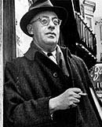
Change means movement. Movement means friction. Only in the frictionless vacuum of a nonexistent abstract world can movement or change occur without that abrasive friction of conflict.
Saul Alinsky

Slide 43
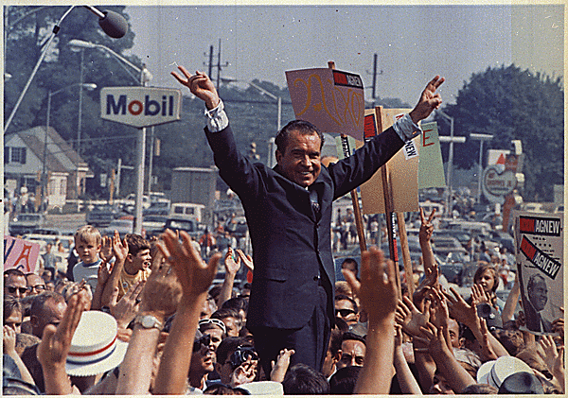
Any change is resisted because bureaucrats have a vested interest in the chaos in which they exist.
Richard M. Nixon

Slide 44
Peer Pressure
In the end, not everyone will agree with you (right away).
Some will, some won’t, so what?
People do not want to be the first on the block!
There is a minimum number of people who must act before a specific person will

Slide 45


Slide 46
Spread an Idea Virus
An idea virus is a concept, such as a product or service, that spreads from person to person by word of mouth and example, creating an environment where customers market to each other.

Slide 47
What is the Virus?
The name of the change
A message that explains why someone should support change
Repeatable by satisfied customers and others

Slide 48
How to Create Messages
Create word pictures:
  Metaphors
  Analogies
  Similes
  Stories
Use repetition repeatedly

Slide 49

Stories are propaganda, virii that slide past your critical immune system and insert themselves directly into your emotions.
--Cory Doctrow, Eastern Standard Tribe

Slide 50
Simplicity Equals Power
“…to make [an idea] contagious … alter it in such a way that extraneous details are dropped and others are exaggerated so that the message itself comes to acquire a deeper meaning.”
--Malcolm Gladwell, The Tipping Point: How Little Things Can Make a Big Difference, p. 203

Slide 51
Simplicity Equals Power
“In communication, as in architecture, less is more. You have to sharpen your message to cut into the mind. You have to jettison the ambiguities, simplify the message, and then simplify it some more if you want to make a long-lasting impression.”
--Al Ries and Jack Trout, Positioning: The Battle for Your Mind, p. 8

Slide 52
The Invitation
If you don’t ask, the answer is always no
Ask for action appropriate to audience
Be clear about what you expect to happen next and when
Offer options and flexibility
Be expedient…use sign up sheets!

Slide 53
Manage Expectations
Do not make promises you can not keep.
Under promise then over deliver.

Slide 54
Capacity Building:
Training Must attack FUD
Build case for use
Increase ability to use product
Increase ability to apply product

Slide 55
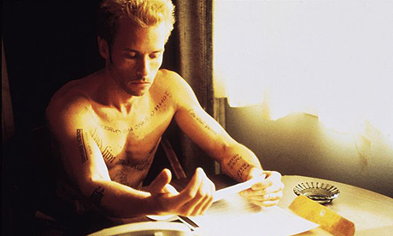
Guerilla Style Training
Quick and easy
Focus on essentials
  Multiple levels of training
MEMENTO tools

Slide 56
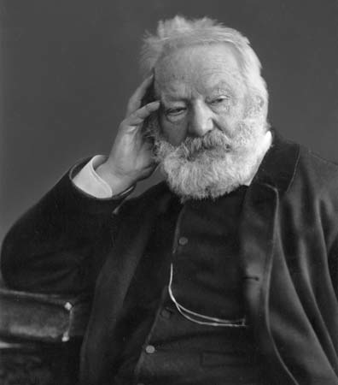
Resistance is Futile
“An invasion of armies can be resisted, but not an idea whose time has come.”
  --Victor Hugo

Slide 57
Predict the Future
“The best way to predict the future…is to create it.”
  --Allan Kay

Slide 58
Final Piece of Advice 1
“Your parents were right. Say ‘Thank You.’ Often.”
--Harry Beckwith, Selling the Invisible: A Field Guide to Modern Marketing

Slide 59
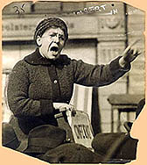
Final Piece of Advice 2
“If I can't dance - I don't want to be part of your revolution”
--Emma Goldman

Slide 60
Questions?

