Slide 1
CORAL Workflows for New Acquisitions and Renewals
Christine N. Turner
Electronic Resources Librarian
cturner@library.umass.edu
ALA Midwinter – Boston
January 10, 2016

Slide 2
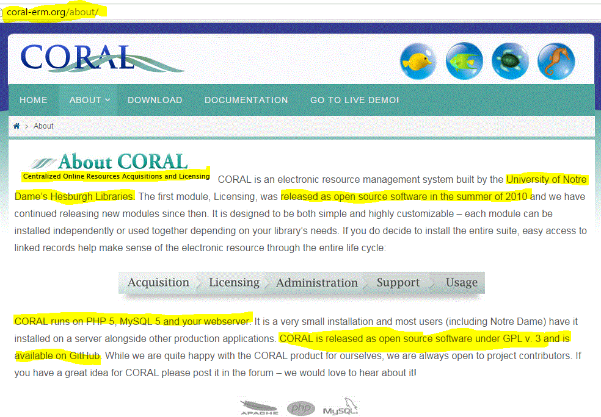
Notes:
About CORAL
University of Notre Dame in 2010
UMass Amherst Libraries instance installed by Steve Bischof, Five College Libraries ILS Coordinator
Open source
Maintenance = customizations and installation of new versions

Slide 3


Rationale for Adoption
Integrated modules for organizations, resources, licenses and usage data
Centralized repository for interrelated data previously distributed…widely among files, platforms
Focus here on workflows in Resources module, not entire e-resources management system
Notes:
More than an app; integrated modules for organizations (provider, consortia, vendor, platform, publisher, etc.), resources, licenses and usage statistics
To bring together in centralized repository interrelated data that had previously been distributed among network drives, wiki pages, email accounts, spreadsheets, ILS (ALEPH), paper files, gray matter, etc.

Slide 4
Why Workflows?
Opaque, disjointed processes for acquiring and renewing resources
Scattered responsibilities for tasks among acquisitions staff
Timely access to new resources provided inconsistently
Needed better support for renewal decisions
Notes:
opaque, disjointed processes for acquiring and renewing resources
scattered and muddled responsibilities for tasks, ie. sometimes one person shepherded resource through entire process and sometimes tasks were passed off
failure to make accessible in timely fashion those resources we’d acquired
need for better support of renewal decisions, data provided to appropriate person in timely way, ie. with time to cancel according to license requirements

Slide 5
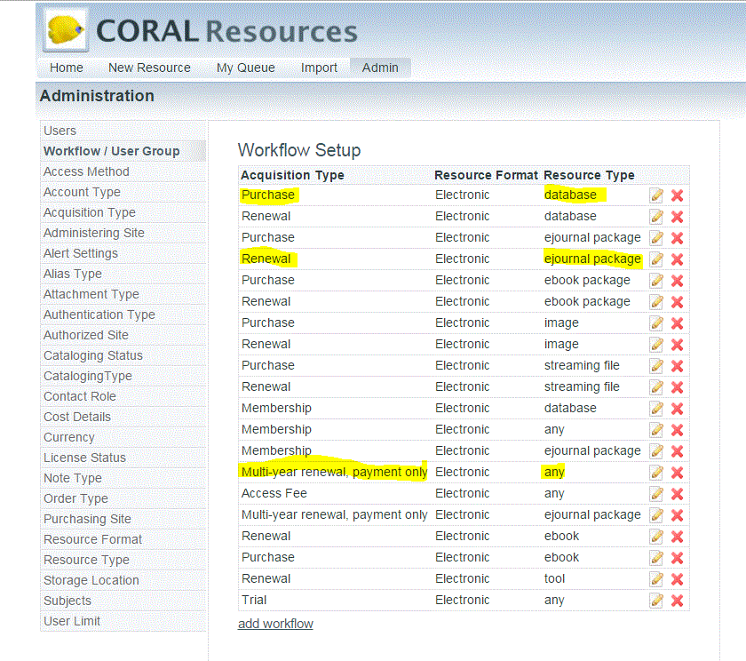
How Workflows Work
Notes:
First implemented workflows in March of 2015
Based on Acquisition and Resource types
We’ve added to and adjusted these through trial and error, now with 20 different ones, and counting
Database purchase - Library of Latin Texts Complete
E-journal package renewal - IOPScience Extra
Multi-year renewal, payment only - Arts Premium Package
Some workflows require us to change the acquisition type at the end of the workflow, e.g. from purchase to renewal, multi-year renewal to renewal
Can make steps sequential, or not. Would like to be able to make multiple prerequisites, e.g. license completion and selector confirmation prior to invoice payment
To make responsibilities clear, we assigned tasks to individuals rather than groups

Slide 6
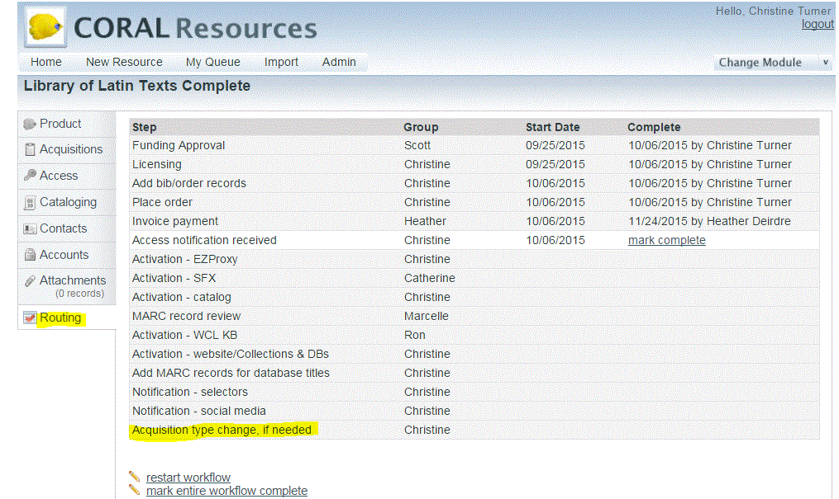
Database Purchase

Slide 7
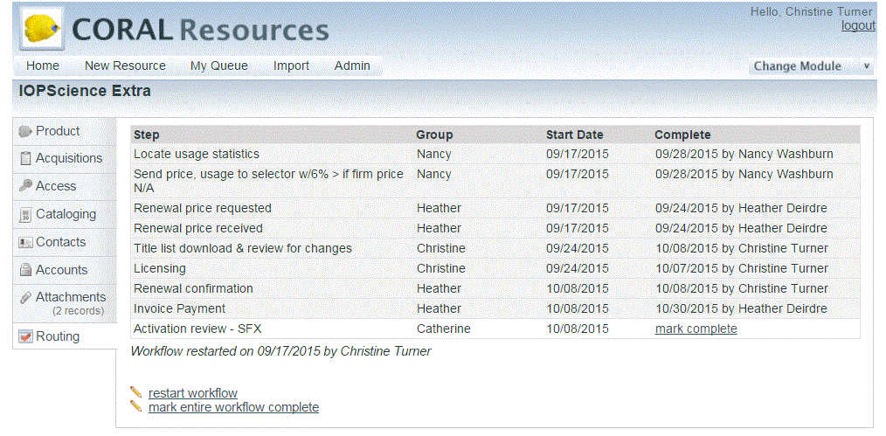
E-Journal Package Renewal

Slide 8
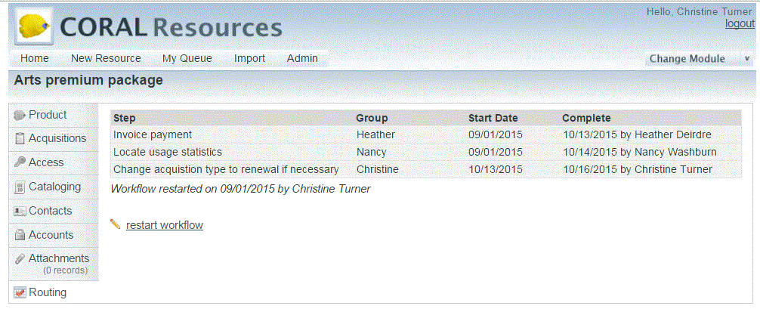
Multi-year Renewal, Payment Only

Slide 9
Degree of Difficulty
Cost – free = easy
Technical - ?
  Reportedly easy, good support network
  Our guy is good (and very pleasant)
Personnel
  Conceptual challenges
  Customizing processes
  Practical approaches
Notes:
Cost was easy
Technical challenges - ?. Reportedly easy. And our guy is good (and very pleasant).
People, yes challenges
Conceptual - breaking down the tasks involved in different acquisition (order through access) & renewal (cost, usage, review, confirmation) processes
Customizations - easy, mostly. Would like to be able to customize at resource level rather than just at type level
Practical - adopting use of “My Queue”, alerts & leaving old practices behind

Slide 10
Meeting Our Needs?
as a central repository for data – YES
to make transparent workflows that trigger task for responsible staff in timely manner - Mostly.
as tool to support renewal decisions...To a point, but we need more data and awareness (adoption)
Still a work in progress. Next up: individual e-journal subscriptions

