Slide 1



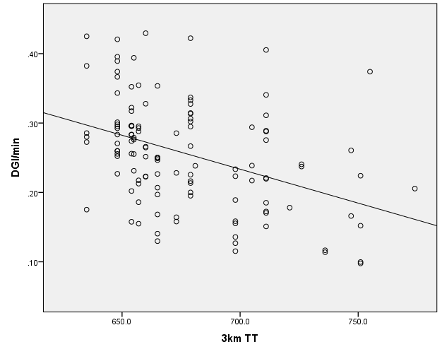
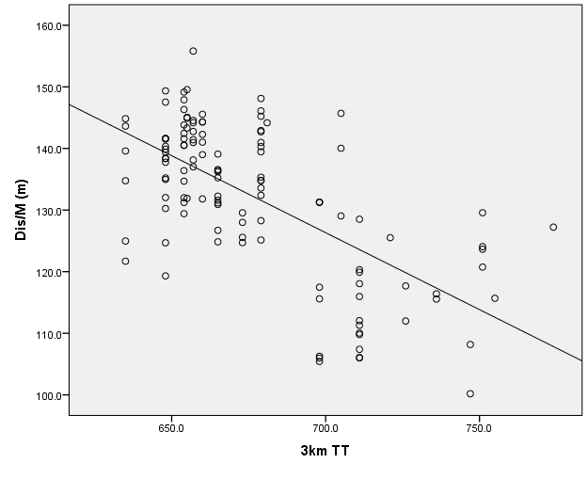
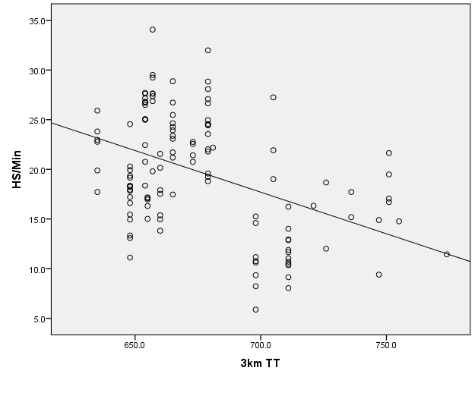
The Relationship Between Two Measures of Physical Capacity and Match Performance in Semi-Professional Australian Rules Football
¹Toby Edwards, ¹Ben Piggott, ¹Dr. Christopher Joyce and ²Dr. Paola Chivers
¹School of Health Sciences, University of Notre Dame Australia, Fremantle, WA
²Institute for Health Research, University of Notre Dame Australia, Fremantle, WA
Background
Results
The evolution of Australian Rules Football (ARF) in terms of rule changes, team tactics and professionalism have influenced the physical demands of athletes in matches (1).
The mean running velocity of a professional ARF athlete has increased from 6.8 ± 0.6 km/h in 2005 to 7.3 ± 0.7 km/h in 2008 (1).
Traditionally a 3km time trial (3KM TT) is used to measure athletes’ aerobic capacity. This measure of aerobic capacity is used to identify elite talent at the national draft camp held each year (2).
In professional ARF, Yo-Yo Intermittent Recovery Level 2 (YYIR2) performance has recently been discovered to have a significant relationship with match performance (3).
Debate exists regarding which fitness test (3KM TT or YYIR2) is best suited to ARF.
Table 1. Description of physical capacity and match performance measures.
Variable | Mean | SD
3km TT (sec) | 676.87 | 31.59
YoYo (m) | 651.06 | 101.95
DGI/min | 0.26 | 0.07
DIS/min (m) | 132.11 | 12.17
HS/min (m) | 19.64 | 5.97
Experience | 59.26 | 44.88
Table 2. LMM: Physical capacity measurements and match performance variables.
Figure 1. Proportion of low and high religiosity mothers with discomfort discussing sexual health issues
Purpose
Model | Variable | Estimate | SE | P Value
1)DGI/min | Intercept | 0.918 | .0136 | < .001
 | 3 km TT | -0.001 | 0.001 | < .001
2)DIS/min | Intercept | 302.849 | 21.042 | <.001
 | 3 km TT | -0.248 | 0.027 | <.001
 | Experience | -0.052 | 0.018 | .005
3)HS/min | Intercept | 77.905 | 9.592 | < .001
 | 3 km TT | -0.082 | 0.014 | < .001
 | Experience | -0.048 | 0.009 | < .001
Figure 2. Median values of religiosity groups for comfort discussing condoms and masturbation with adolescents
To identify the physical capacity measure that is best related to individual match performance in semi-professional ARF.
Methods
Participants: Twenty-three semi-professional footballers (n=23) from the same WAFL Club were invited to participate in this study.
Physical Capacity Measures: Each participant completed both the 3 km TT and YYIR2 prior to the first game of the season.
Match Performance Measures:
Direct Game Involvement (DGI/min):
  Summation of kicks, handballs, marks and tackles per minute.
Physical measures from GPS indices:
  DIS/min and HS/min (> 18 km/h).
Data: A data entry was made for an individual player if they recorded a YYIR2 score, 3KM TT, GPS indices and a DGI/min for a match. A total of 123 samples were collected.
Data Analysis: Linear mixed models (LMM) were used to analyse the data (p < 0.05).
Players’ experience (reflected by number of senior games) were controlled for in the LMM.
Figure1. Scatterplots and line of best fit of 3 km TT and match performance variables
LMM Interpretation Example
For Model 2, the prediction formula is: DIS/min = intercept + 3 km TT + Experience
As an example, using mean values from Table 1 and parameter estimates from Model 2 in Table 2 DIS/min can be predicted.
DIS/min = 302.85 + 676.87(-.248) + 59.26(-.052)
= 132.11 metres/min
Summary
References
3 km TT performance is a significant predictor of DGI/min, DIS/min and HS/min during a match in semi-professional ARF.
Results create doubt to the efficacy of using the YYIR2 in a semi-professional environment.
Less experienced players have greater movement output with similar involvements with the ball than more experienced players.
Overall, the 3km TT is a more practical measure of physical capacity in semi-professional ARF and is also a stronger predictor of match performance than the YYIR2.
Wisbey, B., Montgomery, P. G., Pyne, D. B., & Rattray, B. Quantifying movement demands of AFL football using GPS tracking. Journal of Science and Medicine in Sport. 13(5): 531-536. 2010
Burgess, D., Naughton, G., & Hopkins, W. Draft-camp predictors of subsequent career success in the Australian Football League. Journal of Science and Medicine in Sport. 15(6): 561-567. 2012.
Mooney, M., O’Brien, B., Cormack, S., Coutts, A., Berry, J., & Young, W. The relationship between physical capacity and match performance in elite Australian football: a mediation approach. Journal of Science and Medicine in Sport, 14(5): 447-452. 2011
Contact Details
Toby Edwards
20112863@my.nd.edu.au
Results
LMM results found significant associations between 3 KM TT for each of the three match performance variables investigated. YYIR2 was investigated in each of the models but was non-significant.

