Slide 1


Does flexibility correlate with crunch factor in golf and produce faster clubhead speed?
2015 ASICS Sports Medicine Australia Conference
Intercontinental Sanctuary Cove, Gold Coast
21 – 24 October, 2015
Chris Joyce PhD AEP
chris.joyce@nd.edu.au
Angus Burnett PhD

Slide 2
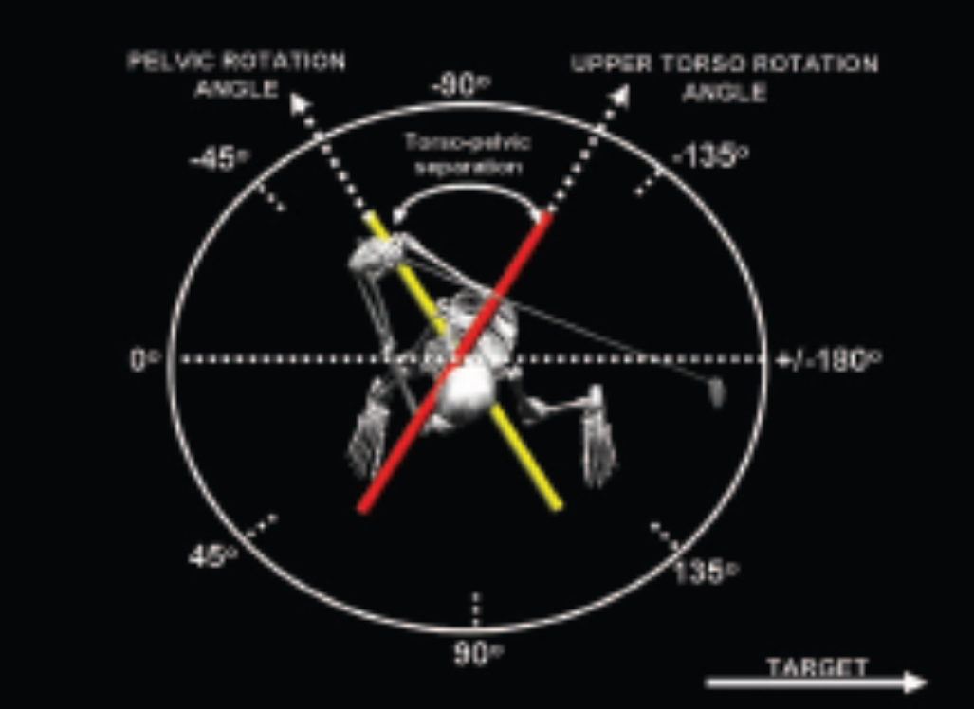
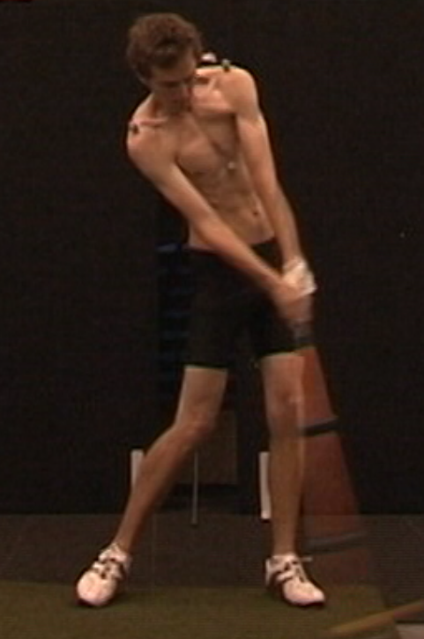
Background
Myers et al. (2008)
Golfers who are more flexible have shown to increase clubhead speed (CHS). This has been reported for golfers who are able to increase their axial trunk rotation, also known as the ‘x-factor’
It is also suggested that by increasing trunk lateral flexion at the point of ball impact, this can also increase CHS. The term ‘crunch-factor’ (CF) is the product of trunk lateral flexion and axial rotation velocity
Although CF has implications for performance, the effect of lateral flexion combined with axial rotation velocity could be the causation of LBP

Slide 3
Aims
Therefore, the aims of this study were;
Firstly, to see if flexibility (or, AROM) enabled golfers to maximise CF at ball impact
Secondly, to see if AROM variables helped to produce CHS

Slide 4
Methods
15 male high-level golfers (22.7 ± 4.3 yrs, HC: 2.5 ± 1.9 score)
  No history of LBP
Vicon 10-camera 3D motion capture system, operating at 250 Hz
Validated custom 3D model was used to report trunk (shoulder relative to pelvis) and lower trunk (lower thorax relative to pelvis) kinematic data
Golfer AROM measured for both segments:
  Flexion & extension
  Lateral flexion (left & right)
  Axial rotation (left & right)
Relative ROM measured for five-iron golf swings (golf swing kinematics)

Slide 5
Methods
Golfers hit from an artificial turf surface in to a net 5m in front
Positioned behind them, a validated launch monitor was used to measure clubhead speed
Bivariate correlation analysis used to report between-segment kinematic relationships for CF variables
Regression analyses used to report;
  Which AROM variables were associated with CF, for each segment
  Which kinematic variables (including AROM) were associated with clubhead speed
  All statistical analyses were undertaken using IBM SPSS for Statistics Version 22.0 (Armonk, New York)

Slide 7
Results
Bivariate correlation analysis reported AROM moderate +ve rel’shps (trunk & lower trunk flexion, lower trunk left lateral flexion) and moderate –ve rel’shps (lower trunk left axial rotation) with CF variables
The AROM regression model for trunk CF reported lower trunk flexion and lower trunk left axial rotation as significantly (p < .01) associated variables, explaining 57.4% of variance
The AROM regression model for lower trunk CF reported trunk right lateral flexion although, it was not-significant (22.5 % , p > .05)
The final regression model for CHS reported trunk lateral flexion at ball impact and lower trunk CF as significantly (p < .01) associated variables, explaining 63.6% of variance

Slide 8
Discussion
Only the AROM variable, left lower trunk axial rotation was shown to be negatively associated with CF in both bivariate correlation and regression model. This would suggest an ability to be flexible in the lower trunk (at the top of the backswing), is possibly undesirable for maximising CF. This could be due to the fact that modern golf swings utilise more shoulder turn, and stable hips
Although no AROM variables appeared in the CHS regression model, their correlations with CF variables suggest specific joint flexibility is important for golf

Slide 9
Conclusion
As mentioned, reduced axial rotation in the lower trunk is a key factor in the modern golf swing. The modern golf swing however, increases CF at ball impact
A limitation of this study may be that although the golfers in this study were flexible for left axial rotation of the lower trunk, it was not utilised due to the use of the modern golf swing
Also, golfers in this study were relatively young and had no history of LBP, comparison of a LBP group may explain kinematic differences
EMG was not measured which also relates to LBP in golf swings
However, the majority of research agrees that excessive spinal loading associated with increased CF should be managed through exercise intervention

Slide 10
References
Cheetham, P., Martin, P., & Mottram, R. (2001). The importance of stretching the “X-factor” in the downswing of golf: The “X-factor stretch”. In: Thomas, P. R. (4th Ed). Optimising Performance in Golf. (pp.192-199). Brisbane, QLD: Australian Academic Press Ltd.
Cole, M.H., & Grimshaw, P.N. (2008).Trunk muscle onset and cessation in golfers with and without low back pain. Journal of Biomechanics, 41(13), 2829-2833.
Cole, M.H., & Grimshaw, P.N. (2014).The crunch factor’s role in golf-related low back pain. The Spine Journal, 14(5), 799-807.
Chu, Y., Sell, T.C., & Lephart, S.M. (2010). The relationship between biomechanical variables and driving performance during the golf swing. Journal of Sports Sciences, 28(11), 1251-1259.
Gluck, G.S., Bendo, J.A., & Spivak, J.M. (2007). The lumbar spine and low back pain in golf: a literature review of swing biomechanics and injury prevention. The Spine Journal, 8(5), 1-11
Joyce, C., Burnett, A., Reyes, A., & Herbert, S. (2014). A dynamic evaluation of how kick point location influences swing parameters and related launch conditions. Proceedings of the Institution of Mechanical Engineers Part P: Journal of Sports Engineering and Technology, 228(2), 111-119.
Joyce, C., Burnett, A., & Ball, K. (2010). Methodological considerations for the 3D measurement of the x-factor and lower trunk movement in golf. Sports Biomechanics, 9(3), 206-221.
Morgan, D., Sugaya, H., Banks, S., & Cook, F. (1997). A new twist on golf kinematics and low back injuries: the crunch factor. In: Farrally, M.R., & Cochran, A.J. (Eds.), Science and Golf III: Proceedings of the World Scientific Congress on Golf. (pp. 120-126). Leeds, UK: Human Kinetics.
Sugaya, H., Tsuchiya, H., Morgan, D.A., & Banks, S.A. (1999). Low back injury in elite and professional golfers: and epidemiologic and radiographic study. In: Farrally, M.R., & Cochran, A.J. (Eds.), Science and Golf III: Proceedings of the World Scientific Congress on Golf. (pp. 83-91). Leeds, UK: Human Kinetics.

