Slide 1

Integrating Technology into Marketing Education
Kim Donahue, Indiana University AT IUPUI
Chris Huseman, Liberty University
Melissa Nemeth, Indiana University at IUPUI
Julio Rivera, Carroll University
Scot Squires, Ferris State University

Slide 2

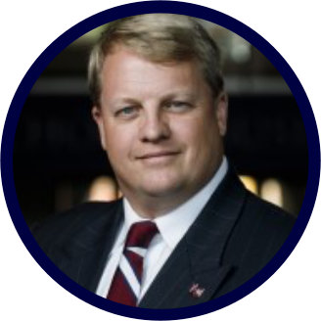
Chris Huseman, Ph.D.
2021 MMA Fall Educators Conference
“Embedding Certifications and Sites to Reach Digital Marketing Heights”
Associate Professor of Marketing
Liberty University
Ph.D. – Organization & Management with emphasis on Marketing
Master of Science – Marketing / Digital Marketing
Master of Business Administration - Emphasis in Marketing
Bachelor of Science – Business Administration – Emphasis in Marketing
Professional Certified Marketer – Digital Marketing
American Marketing Association
Professional Certificate – Digital Marketing
The Wharton School

Slide 3
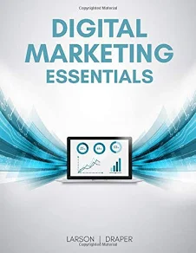
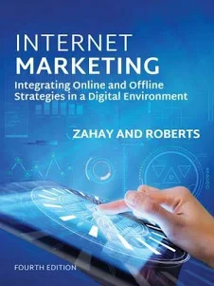
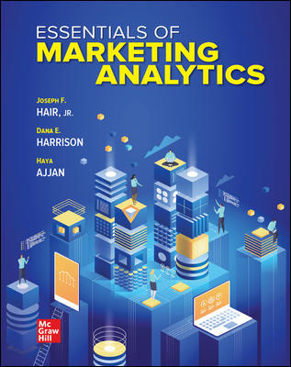
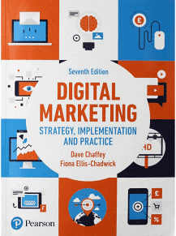
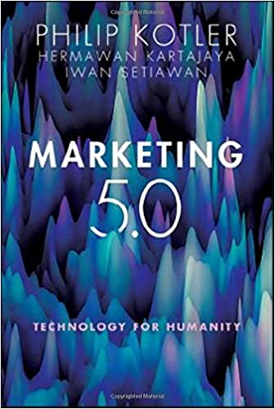
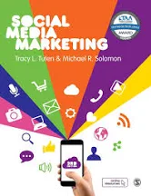
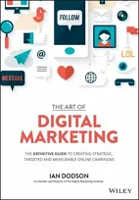
The Gap – Traditional Publishers vs. Change Pace of Digital Marketing
Getting hands dirty vs. talking about dirt
Software & platform applications bridge the gap.
“Markets always change faster than marketing.”
-Dr. Phillip Kotler

Slide 4








The Tools
Free website
builder tool and host
Websites for various applications
Free Keyword Tool
Search volume, CPC, Competition
Free Search Volume / Content Marketing Idea
Competitive traffic,
Keywords, links, etc.
Free Limited Access
Free Design Software

Slide 5
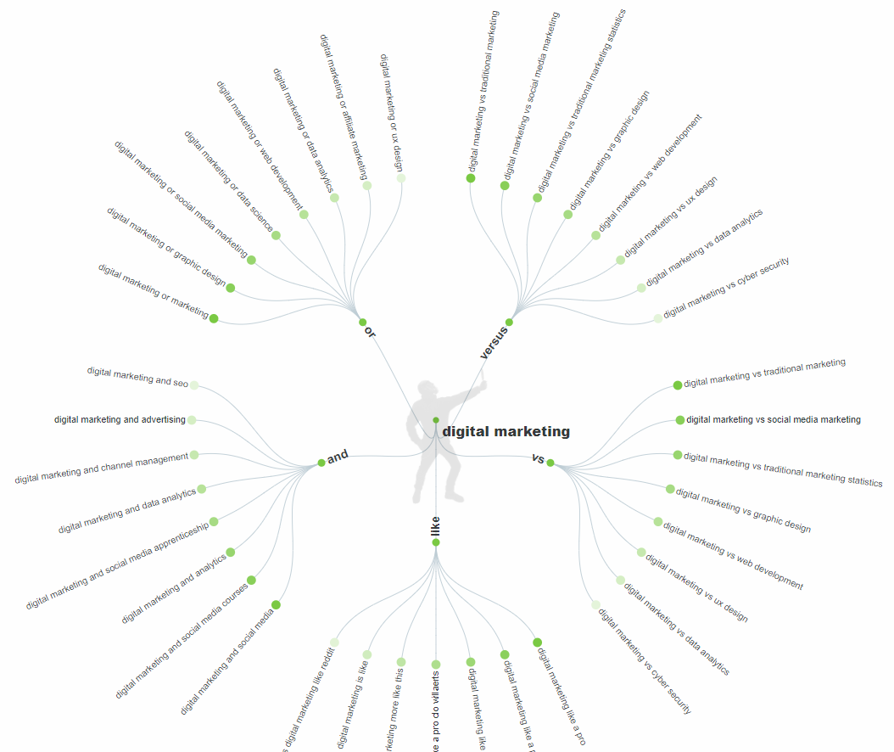
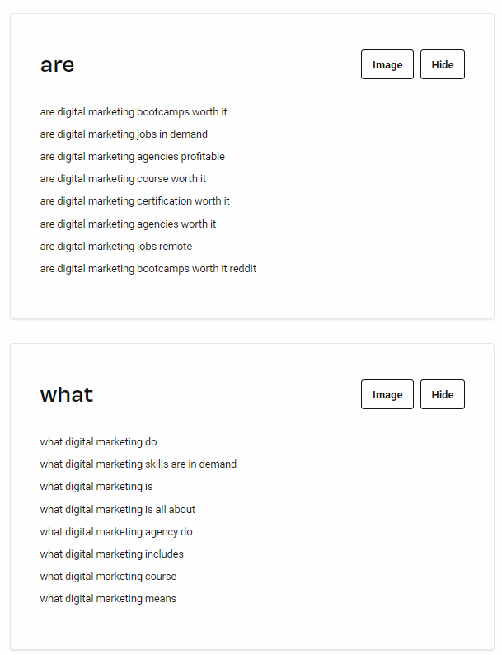
Free Search Volume / Content Marketing Idea

Slide 6



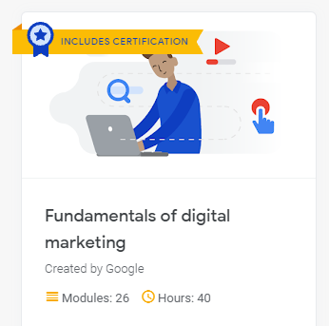

The Platforms & Certifications
Google Ads Video Cert.
Google Ads Search Cert.
Google Ads Display Cert.
Shopping Ads Cert.
GAIQ Cert.
Certifications are résumé builders
Academy
Free
…too many to list
Free
…too many to list
$199 – Free for some courses
…and many for from $99 to $999

Slide 7
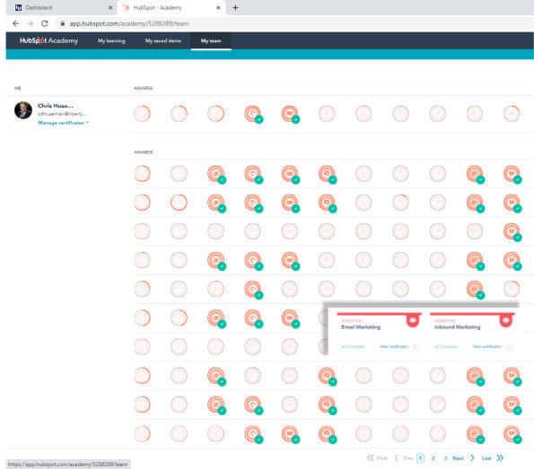
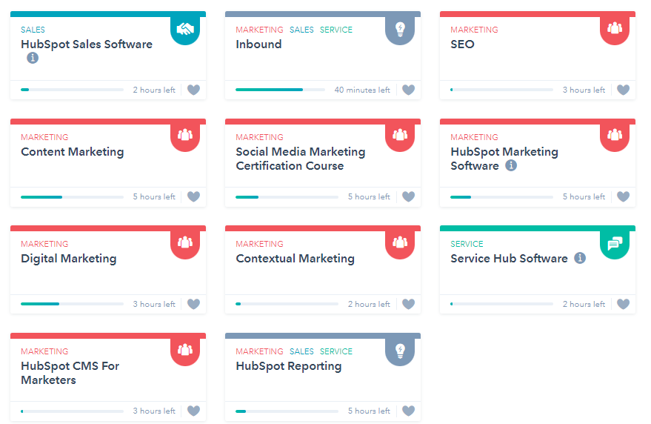
Watch your students progress as they complete the lessons – take the exams in class.

Slide 8
Certifications
Instructors who have walked the path can better educate about the journey.
Students
Teacher
Student
Student
Teacher
Student
Student
Teacher
Student
Student
Teacher
Teacher
Student
Teacher
Student
Student
Faculty

Slide 9

Future Research
How many professors are achieving certifications?
How are they implementing various certifications into the classroom?
What extent of collaboration between professional websites, certifying platforms and academics would be useful?
Where are the future gaps developing and how will they be filled?

