Slide 1
Grace vs. Grades and the Effects on Students as Future Business Leaders
2022
Round Table Discussion with brief introductory thoughts
by Chris Huseman, Ph.D.

Slide 2
Introduction
2022
The purpose of this roundtable is to explore the roles and responsibilities of teachers in extending grace to students while trying to maintain a high academic and professional standard for them to work towards. Does abundant grace given today negatively impact students' future roles as employees or business owners?
The Question

Slide 3
Josh Wymore
“One of the most formative things we can do for students is to provide them with the opportunity to fail. But most importantly, we have to give them responsibility after they fail. Calling out our students to take ownership of their foibles (weaknesses) and flaws says two critically important things that all students need to hear: life has consequences, but those consequences do not have to define you.
Choosing to believe in students -- especially amid their failures -- can be transformative for them.
Had someone not taken a chance on me -- or rather multiple chances on me -- I would not be where I am today. My wife recently asked me why anyone who knew me as an undergrad would seriously consider hiring me now, and that’s a good question.
My only answer is that those saints have a worldview that understands failure to be a necessary part of growth. College is one of the safest places for students to fail, dust themselves off and jump back into the fracas. Let’s not fail our students by robbing them of the opportunity to do so themselves.”
2022
Perspective #1
Research Assistant, Center for the Study of Higher Education, Pennsylvania State University

Slide 4
Seth Gershenson
“Grade inflation is pervasive in American high schools. Over the past 20 years, grade point averages have soared while SAT scores and other measures of academic performance have held stable or fallen. As a result, supposedly “good” grades have become unreliable markers of knowledge and skills.
Is rampant grade inflation cause for concern? On the one hand, students who receive favorable marks despite struggling to master academic content may be encouraged in their studies; surely, many teachers who are generous in assigning grades have this logic in mind. On the other hand, grade inflation may be yet another manifestation of the “soft bigotry of low expectations” that President George W. Bush famously warned about. When students who have not mastered the material receive passing marks, they may become complacent and fail to reach their full potential.
....Educators and school leaders may be tempted to satisfy (parents and students), which is part of how the grade-inflation problem was created to begin with. But policymakers and other decision makers would deserve a genuine A if they reminded parents, principals, and teachers that they aren’t doing students any favors by depriving them of appropriate academic challenges or an accurate picture of their knowledge, skills, and abilities.”
2022
Perspective #2
Associate Professor of public policy at the School of Public Affairs at American University.

Slide 5
The Role of Business in Society: An Agenda for Action
2022
By Niall Fitzgerald KBE and Mandy Cormack
“Company owners are not only leaders of business but leaders within society. We are a part of society not apart from it.”
“This then is the role of business in society: To innovate and deliver products and services, to use resources efficiently so that value is created and to conduct operations so that they are performed profitably and accepted by society. What is different today is that the impact of companies has grown out of all proportion to what could have been envisaged in the eighteenth century. What has also changed is the social context in which companies are operating, where populations are increasingly educated and accustomed to participation and less willing and amenable to take things on trust. Healthy skepticism can easily, through the ill-considered action of business leaders, evolve to a deeper cynicism which in time will corrode confidence in the market economy itself.”
https://www.hks.harvard.edu/sites/default/files/centers/mrcbg/programs/cri/files/report_12_CGI%2BRole%2Bof%2BBusiness%2Bin%2BSociety%2BReport%2BFINAL%2B10-03-06.pdf

Slide 6
The Role of Business in Society: An Agenda for Action
2022
By Niall Fitzgerald KBE and Mandy Cormack
“Healthy skepticism can easily, through the ill-considered action of business leaders, evolve to a deeper cynicism which in time will corrode confidence in the market economy itself.”
The opposite of a market economy is a planned economy, also called a command economy. In this model, government assumes a leading role in deciding what goods and services should be produced and who the producers will be.
https://www.practicalmoneyskills.com/resources/economy_101/market_economy

Slide 7
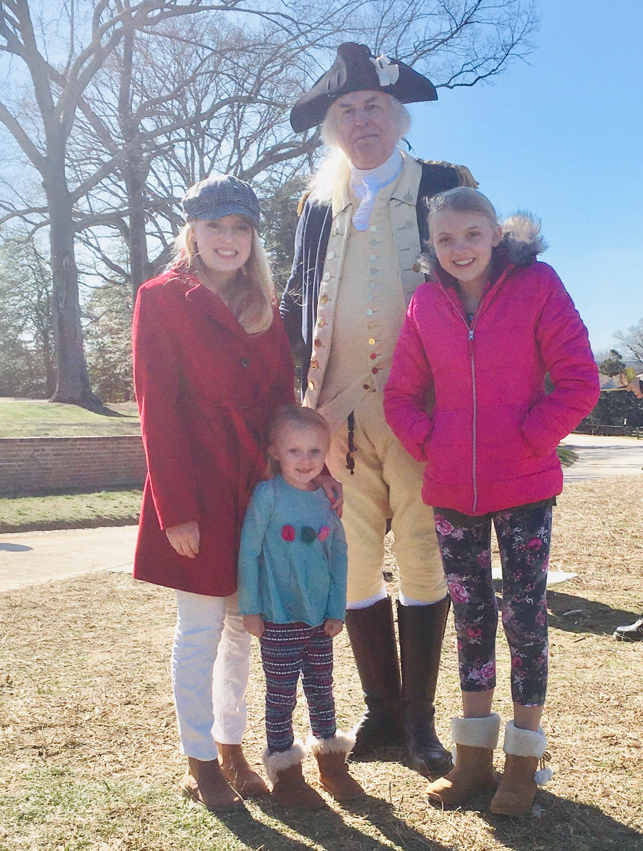
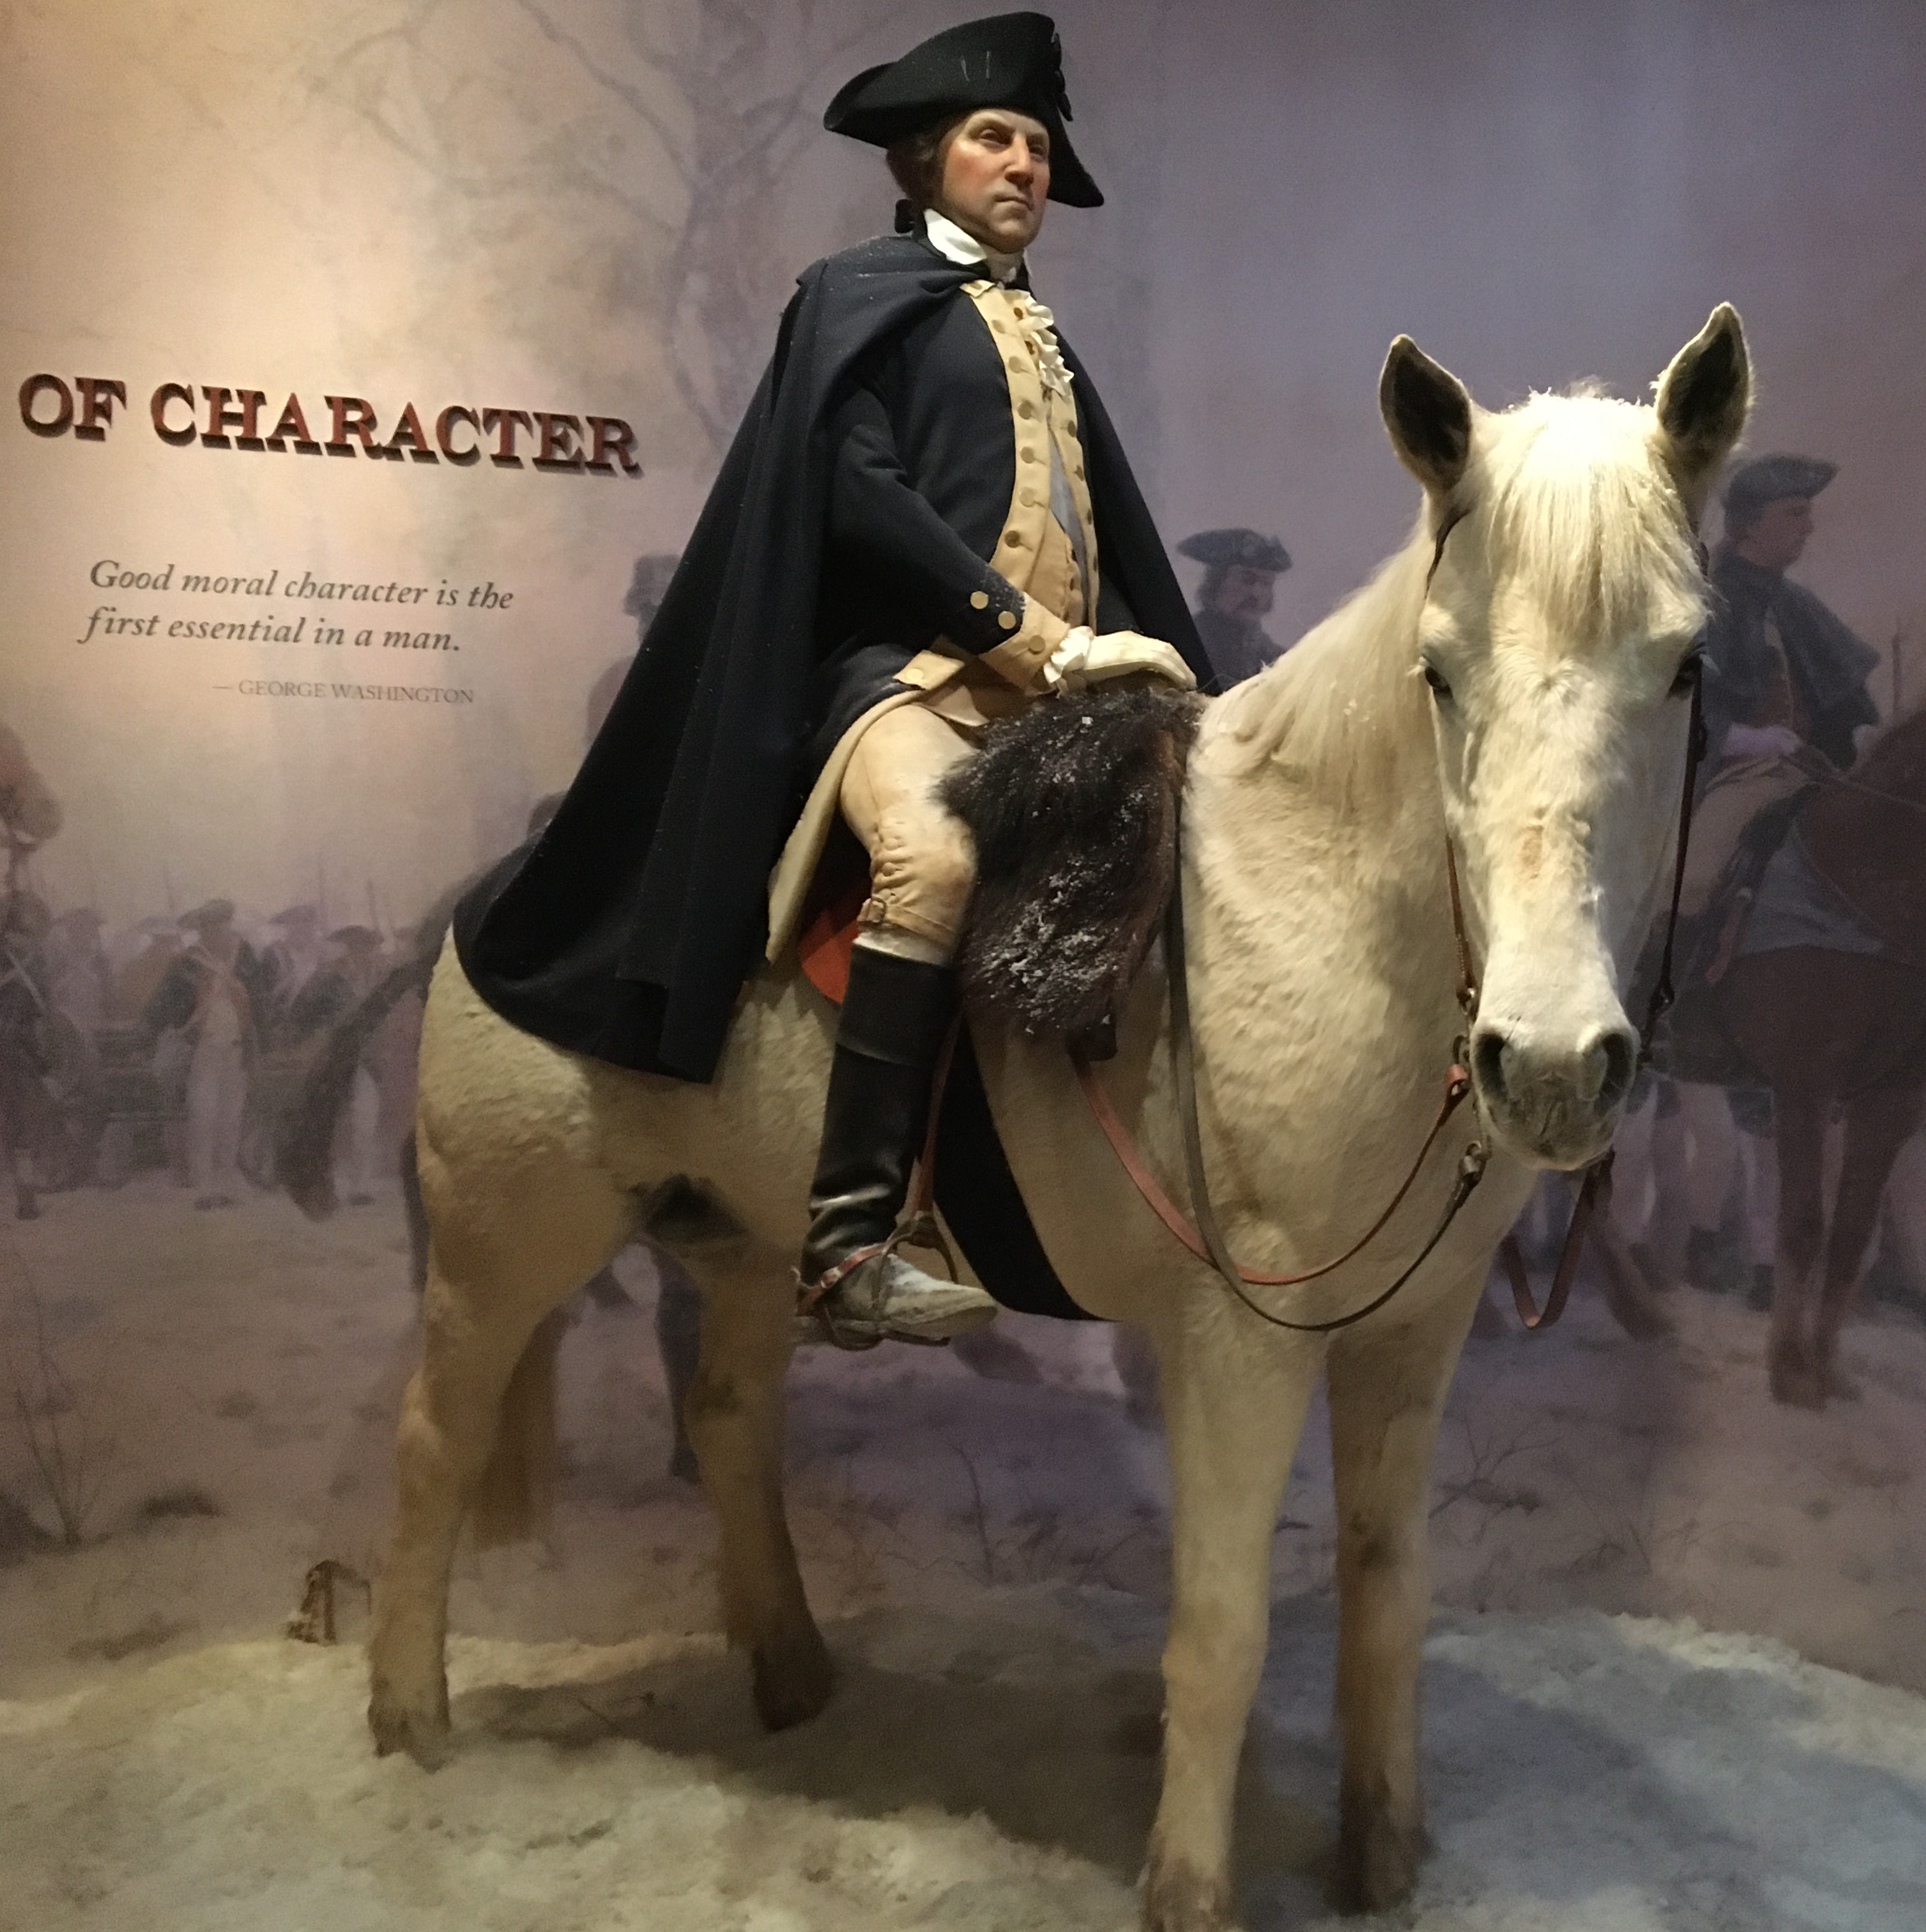
“No People can be bound to acknowledge and adore the invisible hand, which conducts the Affairs of men more than the People of the United States. Every step, by which they have advanced to the character of an independent nation, seems to have been distinguished by some token of providential agency. And in the important revolution just accomplished in the system of their United Government, the tranquil deliberations and voluntary consent of so many distinct communities, from which the event has resulted, cannot be compared with the means by which most Governments have been established, without some return of pious gratitude along with an humble anticipation of the future blessings which the past seem to presage.”
(presage – a sign or warning that something bad will happen)
-George Washington
The first inaugural address of George Washington
2022

Slide 8
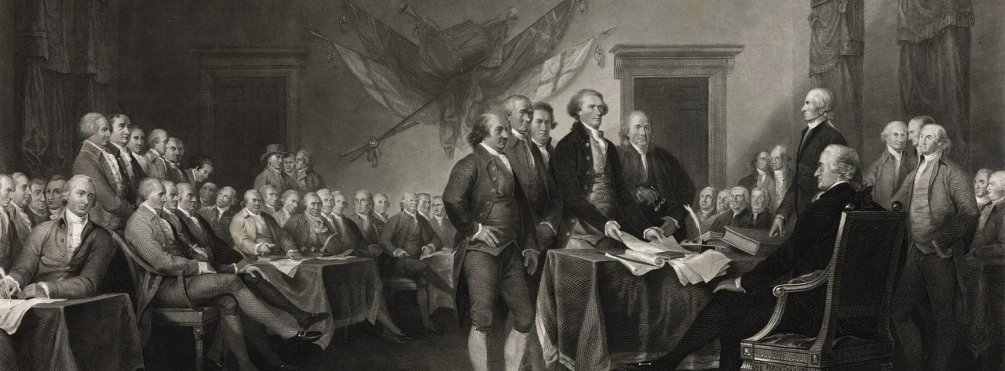
“I predict future happiness for Americans if they can prevent the government from wasting the labors of the people under the pretense of taking care of them.”
-Thomas Jefferson
2022
“A wise and frugal government… shall restrain men from injuring one another, shall leave them otherwise free to regulate their own pursuits of industry and improvement, and shall not take from the mouth of labor the bread it has earned. This is the sum of good government.” — Thomas Jefferson
First Inaugural Address, March 4, 1801
“A people… who are possessed of the spirit of commerce, who see and who will pursue their advantages may achieve almost anything.”
– George Washington

Slide 9
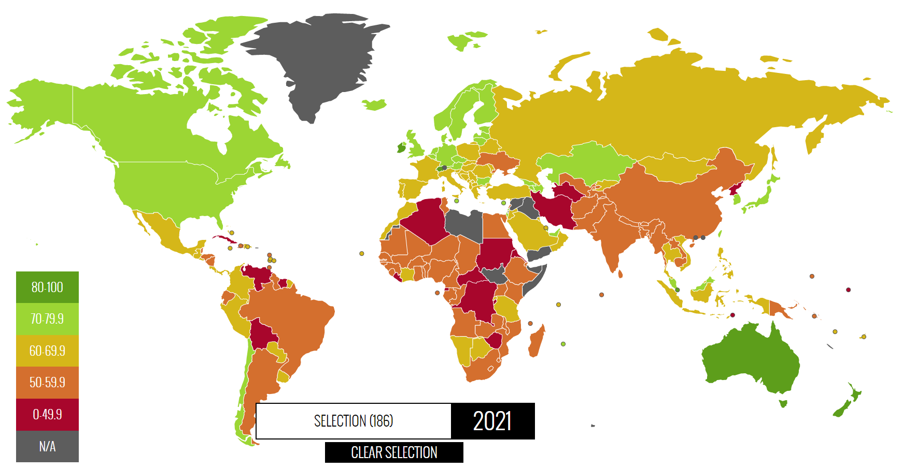
Rewards of Economic Freedom
2022
Source: 2021 Index of Economic Freedom; The Heritage Foundation
Researched areas of Business, Trade, Governance and Policy contexts and scored, specifically :
Key markers included Business Friendly Tax Code and
Governments that encourage innovation and entrepreneurship
-Higher levels of financial prosperity
-Longer Lives
-Are in better health
-Are more educated
-Are better protectors of the environment
Economic freedom has a powerful affect on improving society
Rewards
https://www.heritage.org/index/about

Slide 10
BUSINESS LEADERS
2022
"The secret of success is to do the common thing uncommonly well." -- John D. Rockefeller Jr.
"I am not a product of my circumstances. I am a product of my decisions." -- Stephen Covey
"I never dreamed about success, I worked for it." -- Estee Lauder
"People who are unable to motivate themselves must be content with mediocrity, no matter how impressive their other talents." -- Andrew Carnegie
"I'm convinced that about half of what separates the successful entrepreneurs from the non-successful ones is pure perseverance." -- Steve Jobs

Slide 11

HOW SHOULD WE BEST SUPPORT OUR FUTURE BUSINESS LEADERS?
The World is depending on us.
2022

