Slide 1
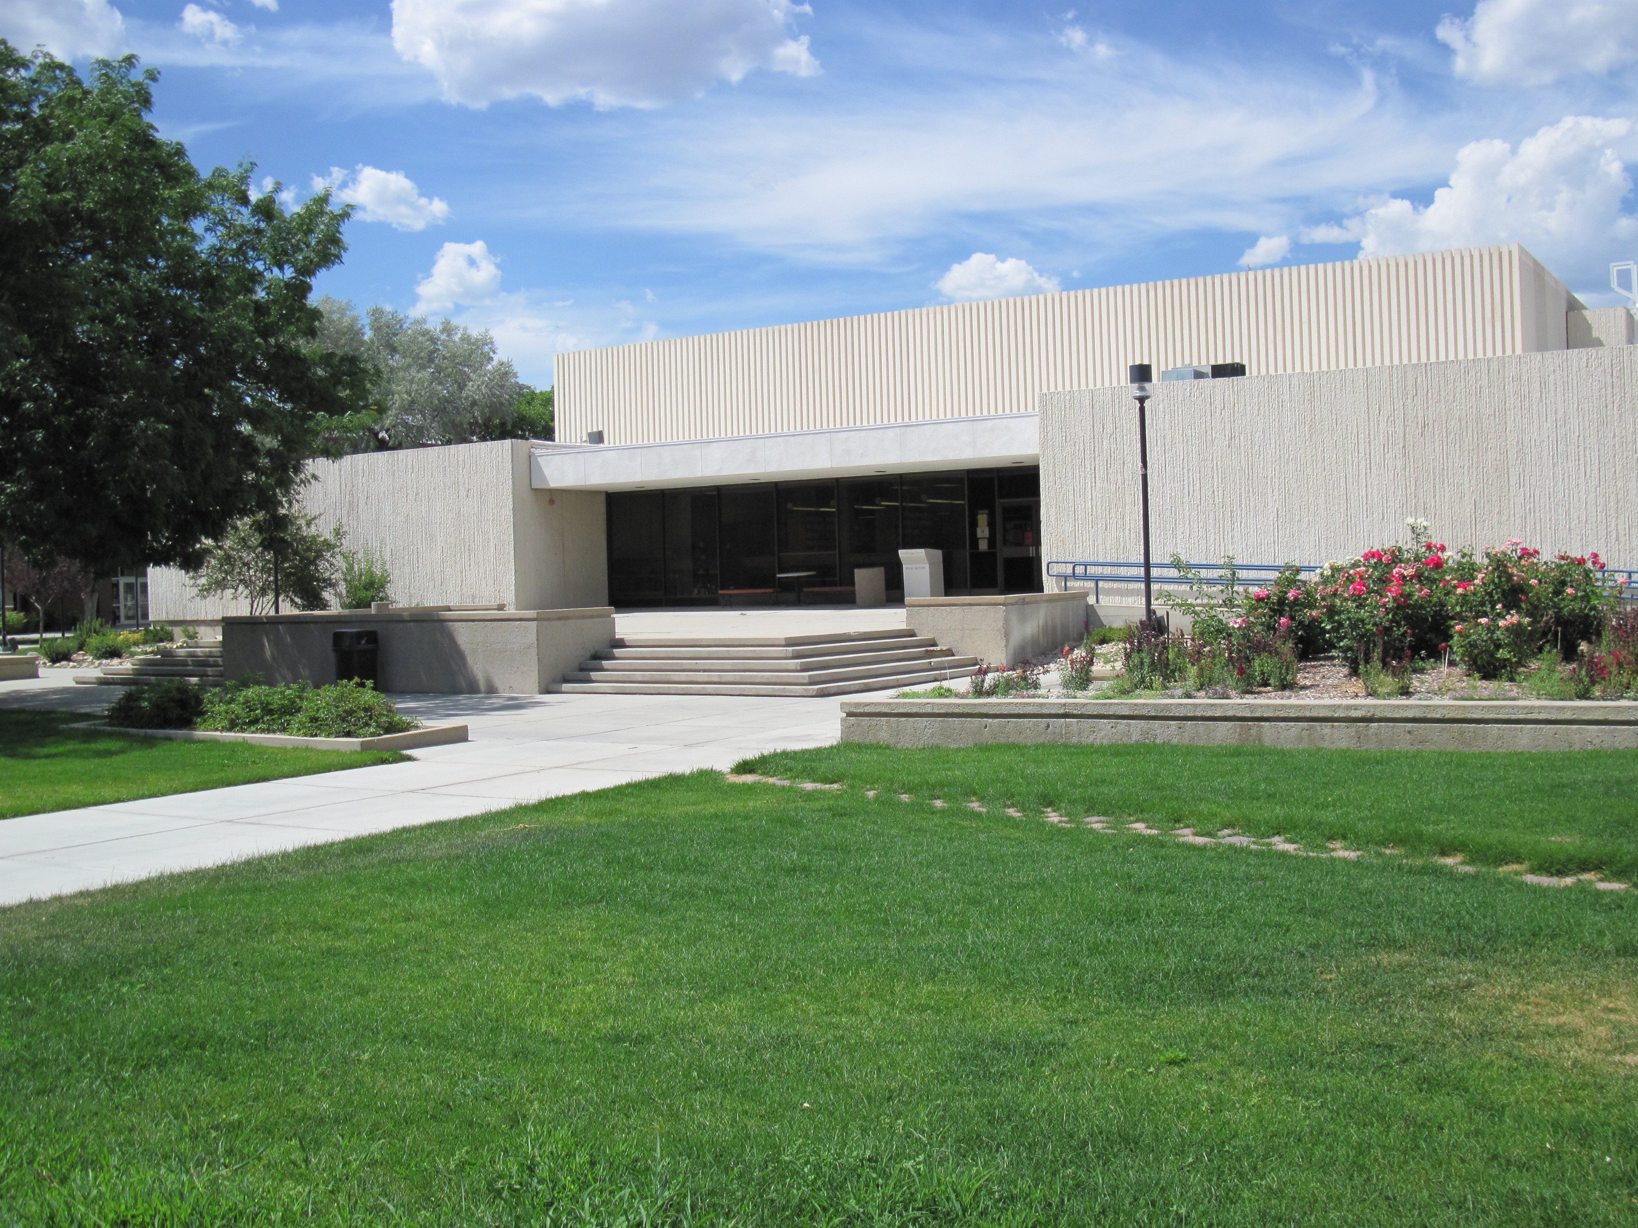
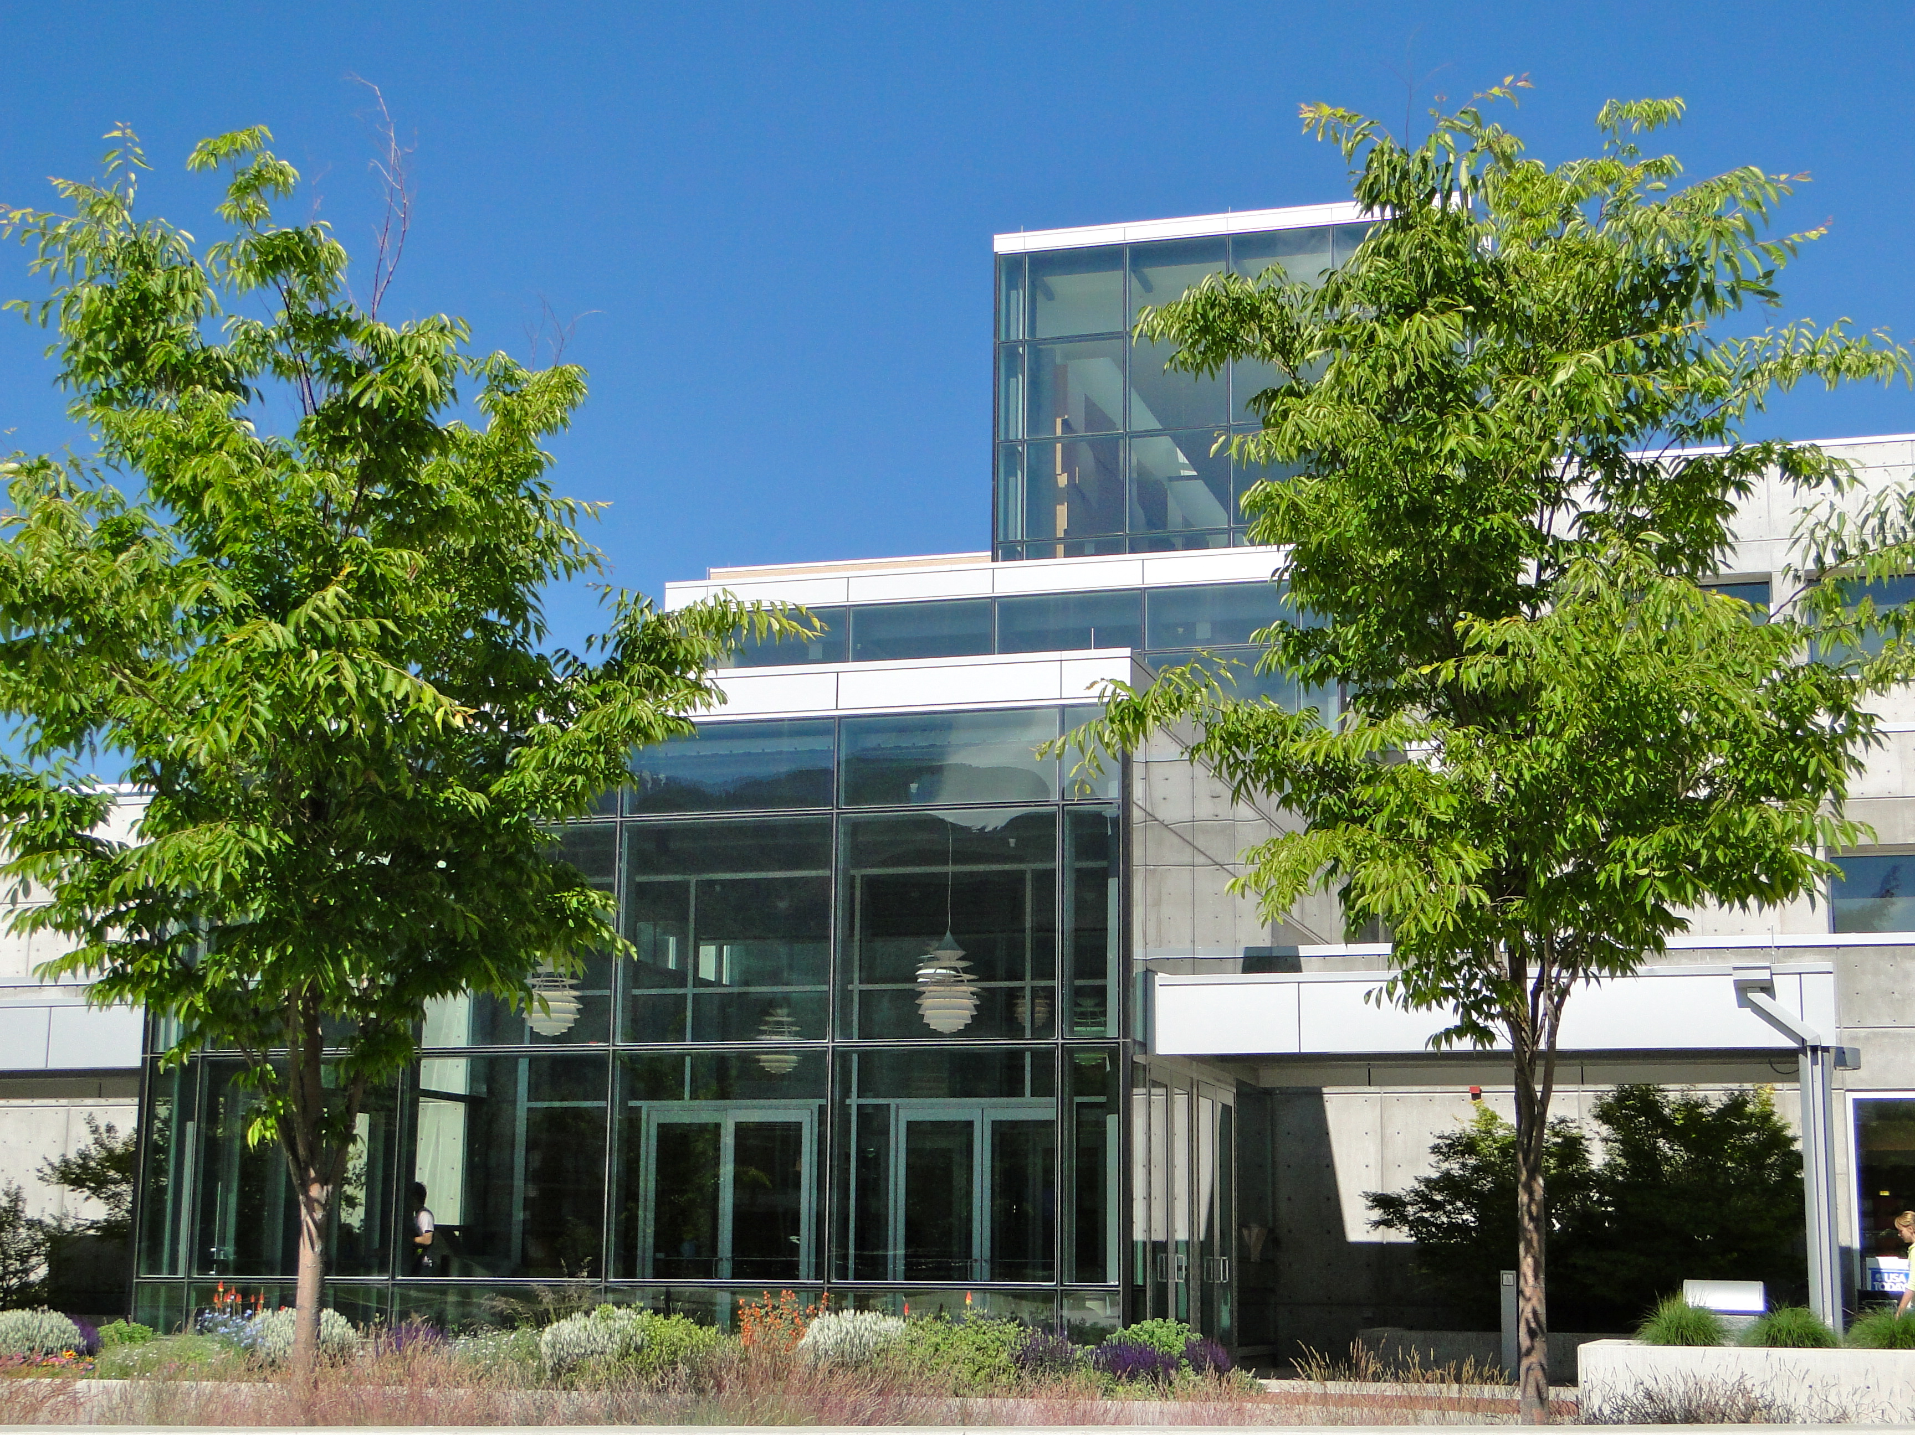
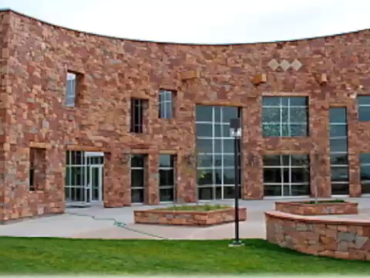
Blended Libraries: Becoming One Family
Cheryl Adams
Lori Brassaw
Angela Dresselhaus
Betty Rozum

Slide 2
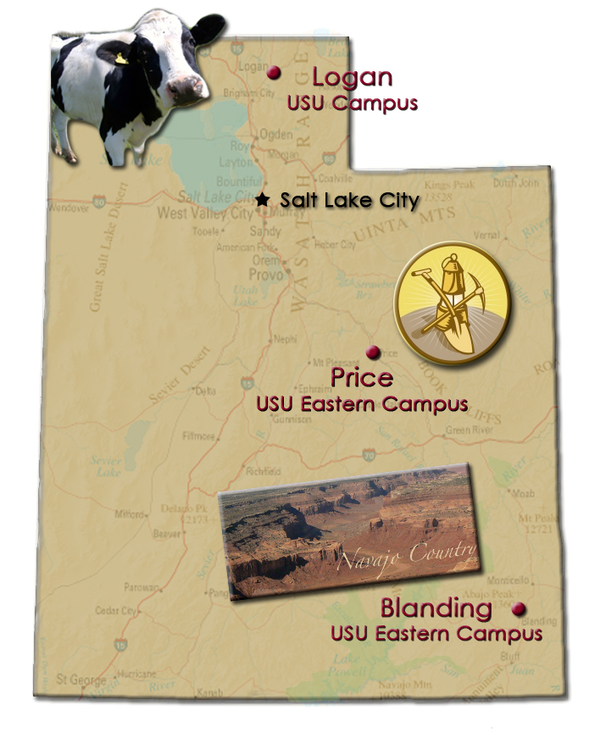
Overview
Two institutions, geographically distant, each with their own mission, identity, culture, were legislatively mandated to merge.

Slide 3
The Institutions
  Utah State University Eastern (the institution formerly known as College of Eastern Utah)
      Campuses and libraries in Price and Blanding
      Comprehensive two-year community college
      Vital vocational technology education mission
      Total library staff of 6 FTE
      FTE 1,605

Slide 4
The Institutions
    Utah State University
      Main campus in Logan with small satellite campuses in Brigham City, Tooele, and the Uintah Basin
      Large, research intensive, doctoral granting institution
      Library staff of 65 FTE
      FTE 16,314

Slide 5
Merger Basics
Legislatively mandated effective July 2010
One Dean, but each library manages their own staff and budgets
USU Logan Campus Library charged with
      Extending access to all existing resources, both print and electronic
      Facilitating and promoting the use of resources to the USU Eastern campuses
      Streamlining operations to maximize staffing efficiencies
No new ongoing funding

Slide 6
I’m sure that sounded so easy to those in charge…
What this really meant for the Libraries
  Migrate the USU Eastern catalog into the USU Logan catalog
  Consolidate technical services functions (perform acquisitions, cataloging, electronic resource management, and ILL at the Logan campus)
Still sounds relatively simple…

Slide 7
Catalog Migration
USU Eastern’s catalog was hosted by the University of Utah in Salt Lake City
  Prior to the merger, U of U was preparing to migrate USU Eastern to their new Aleph system
Decided to take a leap of faith that the merger would happen, and USU paid to migrate USU Eastern to their Symphony catalog
  USU Eastern was extremely accommodating, allowed us to use our existing codes and conventions for their items and collections, which made things much easier
  Migration took about two months
  Price and Blanding campuses have collections in separate “libraries” in system

Slide 8
Migration – growing pains and bonding
Growing Pains
  USU Logan was unfamiliar with the USU Eastern’s item types, collection codes, circulation policies, etc.
    Data was housed on a third institution’s server
    Limited access to server
  USU Eastern had a new ILS thrust upon them
    Training has been difficult due to distance
  USU Eastern was asked to make many decisions in a very short time about their collections and mission

Slide 9
Migration – growing pains and bonding
Bonding
  USU Logan gained in depth knowledge of USU Eastern's collections
  All the records are in one shared catalog
  There’s nothing like a migration to bring you closer together

Slide 10
Providing Access: the Catalog
Decisions made
  Cataloging centralized
  Separate bib records
Post-migration, pre-merger challenges
  Couldn’t set holdings in OCLC
  No collection development discussions yet taking place
Cataloging at a distance
  From photocopies to electronic files
  Shipping books via FedEx
  Not-so-secret agents (OCLC agent authorization)

Slide 11
The Catalog: to share or not to share (e-books)
Some ebook collections were licensed only for USU Eastern, some only for USU Logan, some for both campuses
A challenge, but a beautiful solution!
  Created a new library (location) in our ILS which houses the records accessible to both USU Eastern and USU Logan
  Batch edited records to the shared location
  Left unshared records in the original online library location
  Set default OPAC search to query shared online library with the home library

Slide 12
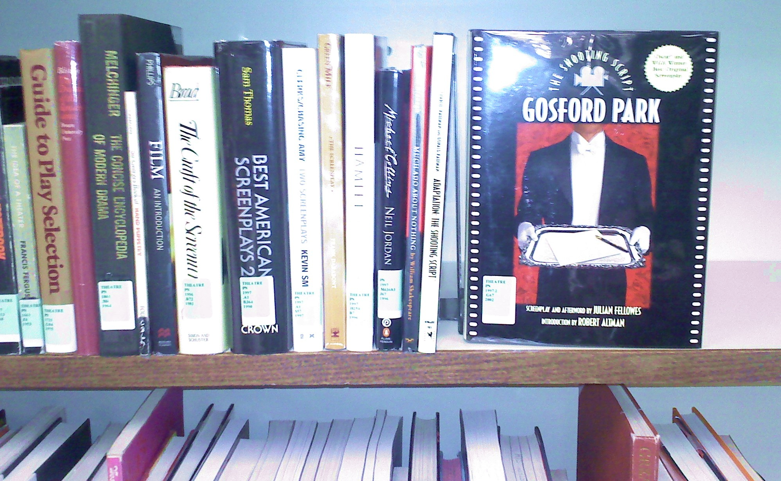
Providing Access: Communication and the Catalog
Communication and flexibility are essential!
  Examples:
    Book jackets
    Theatre collection

Slide 13
Providing Access: Electronic Resources
Early on, before the merger was official
  Incredible pressure to provide a figure for what it would cost to bring USU Eastern in under the licenses for all of our electronic resources – but without informing vendors of a merger
  For safety’s sake, we provided very high estimates to central administration

Slide 14
eResources: the process
License Review
Prioritize the most useful resources for USU Eastern
Ask permission to add USU Eastern
Send IP ranges to vendor & check access issues

Slide 15
eResources: License Review
  Identify journals and databases provided through a state wide deal
  Identify resources with agreements that were likely to allow us to add USU Eastern at no additional charge:
    FTE based models where our combined FTE did not bump us into a higher pricing tier
    Concurrent user model
    One time purchases with small maintenance fee
  Usually not the following language:
    Contiguous geographic area
    Single site

Slide 16
eResources: Prioritizing
Large journal deals
eReference book collections
Databases and journals that enhanced USU Eastern’s collection according to curriculum needs
Special requests
  ArtStor
  Sage

Slide 17
eResources: Mother May I?
A detailed letter was drafted carefully outlining the merger
  Described the legislative mandate
  Indicated that USU Logan will be the sole point of contact for troubleshooting, payment, and other administrative tasks
  Described the nature of the college
    FTE
    Curriculum
    2 yr degree programs
    IP ranges

Slide 18
eResources: Sharing
USU Eastern’s IP range was added to our accounts
Many journals and databases were seamless
Some ongoing access issues with a handful of databases
Off campus access via EZproxy
Troubleshooting is difficult from Logan
Journals not available to USU Eastern have a note placed in Serials Solutions that directs the patron to ILL

Slide 19
Collection Development: The Big Picture
Existing collection and collection policies at time of the merger were not in sync between the libraries
  USU Eastern’s collection did not support its academic mission
    Popular reading
    Popular DVD’s (TV series, popular movies)
USU Eastern’s collections would need to support proposed four-year degree programs

Slide 20
Providing Access: Coordinating Collection Development
Nuts and Bolts
  Logan staff runs reports for collection analysis
  Head of Collections at Logan reviews all orders
  Logan staff can rush order items and have them to USU Eastern within a week
  Subject librarians at the Logan campus are encouraged to purchase in e-format whenever possible

Slide 21
Providing Access: Coordinating Collection Development
USU Logan aggressively purchases in electronic format in order to support our distance education students and encouraged the Price and Blanding Libraries to follow suit to facilitate sharing
  Blanding concerns
    Many patrons live in remote areas of the Navajo Reservation which lack electricity in homes
    Educational centers are located throughout and are equipped with high speed internet
    Still investigating impact, but it appears that e-format is accepted and that students view using educational centers as routine

Slide 22


Going from 65k to 1.7M “overnight…”
Information explosion for USU Eastern
How do we increase awareness of new resources?
  Fall presentations at USU Eastern campuses,
  Distributed a survey
    Small sample size
    Most people were unaware of the newly available resources
    Respondents expressed concerns about how to use the resources

Slide 23
Information Overload?
Spring Survey
  Survey posted on the web sites of both USU Eastern Price and Blanding Libraries
  Slightly larger response rate, fairly evenly split between sites, and among students, staff, faculty:
    Only half of the respondents have accessed resources remotely
    60% discovered new resources since the start of fall semester
    Very few take advantage of requesting material from USU Logan or ILL
    66% feel they are “confident” or “very confident” in their ability to effectively utilize library resources
    40% say their use of e-journals has increased significantly

Slide 24
The Mood at USU Eastern Price
Most of the campus community was supportive of the merger
BIG changes in the library – not just from the merger
    Library leadership changed
    Library policies changed

Slide 25
Costs
State Legislature gave USU Logan one time funds to help with the merger
  Library received a portion – cover some costs such as ILS system, computers, supplementary materials
Costs in staff time have been huge and not taken into consideration in any of the cost tracking we report

Slide 26
Benefits to the Libraries
USU Logan
  Library is seen as a leader in the merger efforts
    Has garnered us political good will with campus administration
  Library can better serve its Land Grant Mission
  We are able to offer advanced education to underserved portions of the state
USU Eastern
  Huge expansion to resources
Both
  Opportunity to develop new skills
  Opportunity to “think outside the box” and be creative
  Opportunity to re-examine workflows

Slide 27
Lessons Learned
Take a lesson from home remodeling – whatever budget you set for time and money, double or triple it
Communication is essential. We do fairly well, but could do better. Logan staff plan on at least four visits to the USU Eastern campuses this next year, from various members of the Logan staff, and have a staff exchange planned
The more training, the better, all around
Be sensitive to each other's needs and practices. Keep an open mind. We each have our unique culture

Slide 28
What Lies Ahead
  Delivery of resources
    Redesign of USU Eastern Price and Blanding Library Home Pages
    Implementation of E-reserves
  Collection Development and Assessment
    As new Bachelor’s programs are identified, we need to assess and develop collections (physical and virtual)
    USU Eastern Price and Blanding have special collections materials that require assessment

Slide 29
What Lies Ahead
  Library Instruction
    Now that there are all these great resources, we need to focus on making sure faculty incorporate them into their courses and students know how to use them
    How to deliver a robust program with only one professional librarian in Price and none at Blanding?
  Other
    Technical services workflows are still evolving
    Additional surveys at the Eastern campuses to assess how well integrated the library resources are becoming
    Involved additional USU Logan library staff in USU Eastern library functions as appropriate

