Slide 1
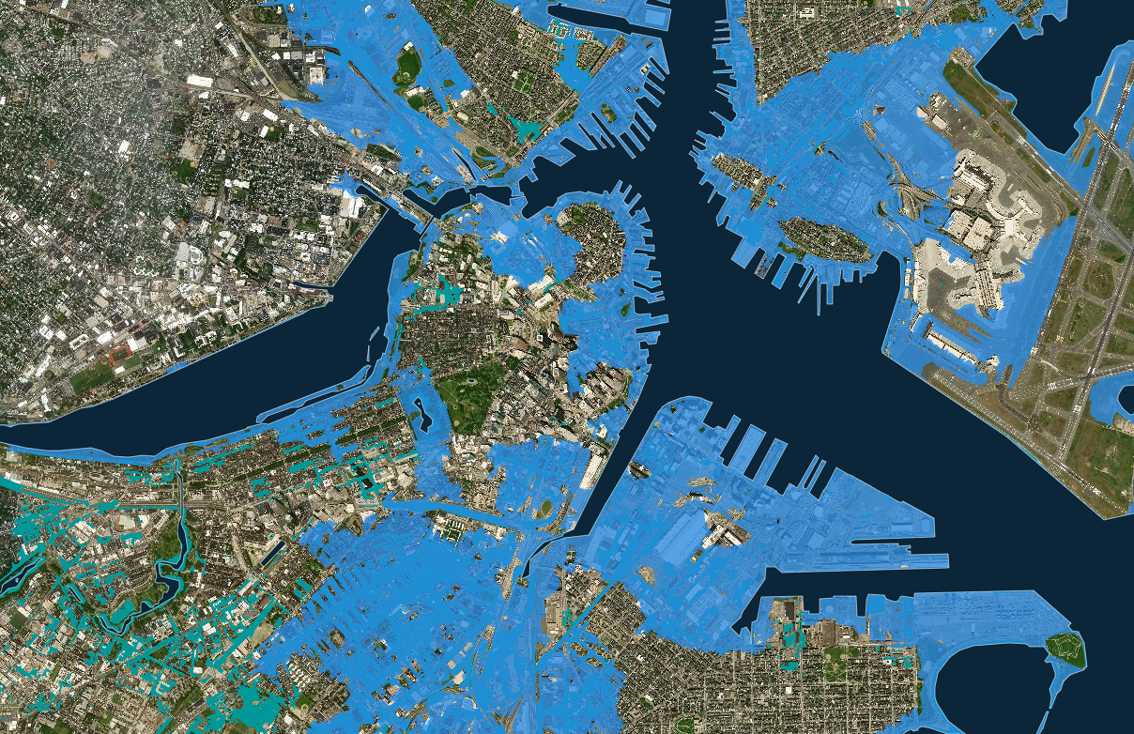

Collapse & Rebirth
Librarians as Architects of a New Humanity
Boston, 3 ft.sea level rise, estimated 2070
October 23, 2018
New England Library Association conference
Madeleine Charney

Slide 2
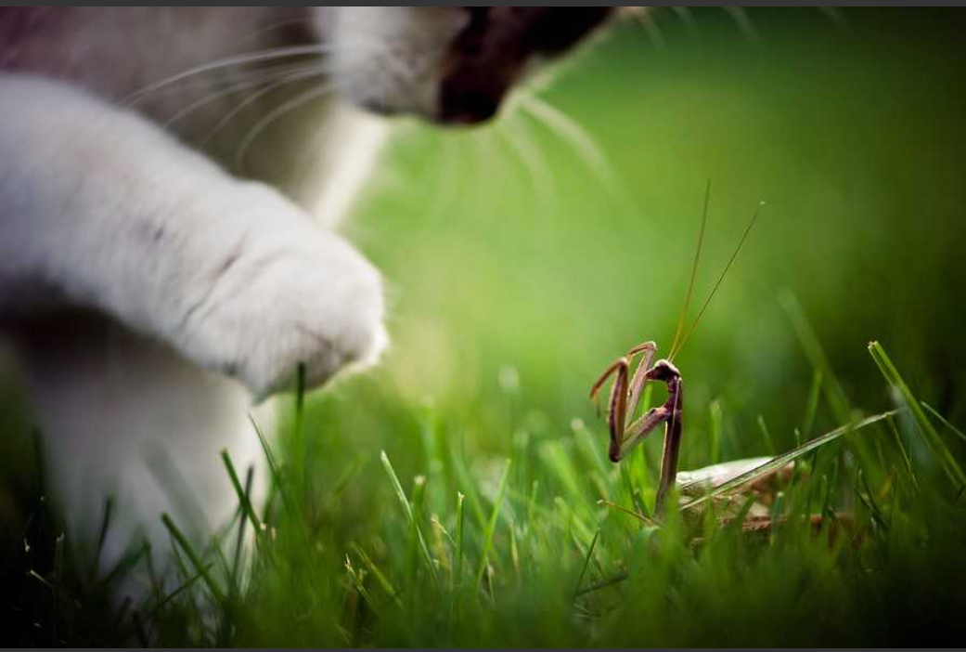
“Not everything that is faced can be changed, but nothing can be changed until it is faced.”
- James Baldwin
Notes:
http://amandabauer.blogspot.com/2012/05/bravery.html

Slide 3


Slide 4
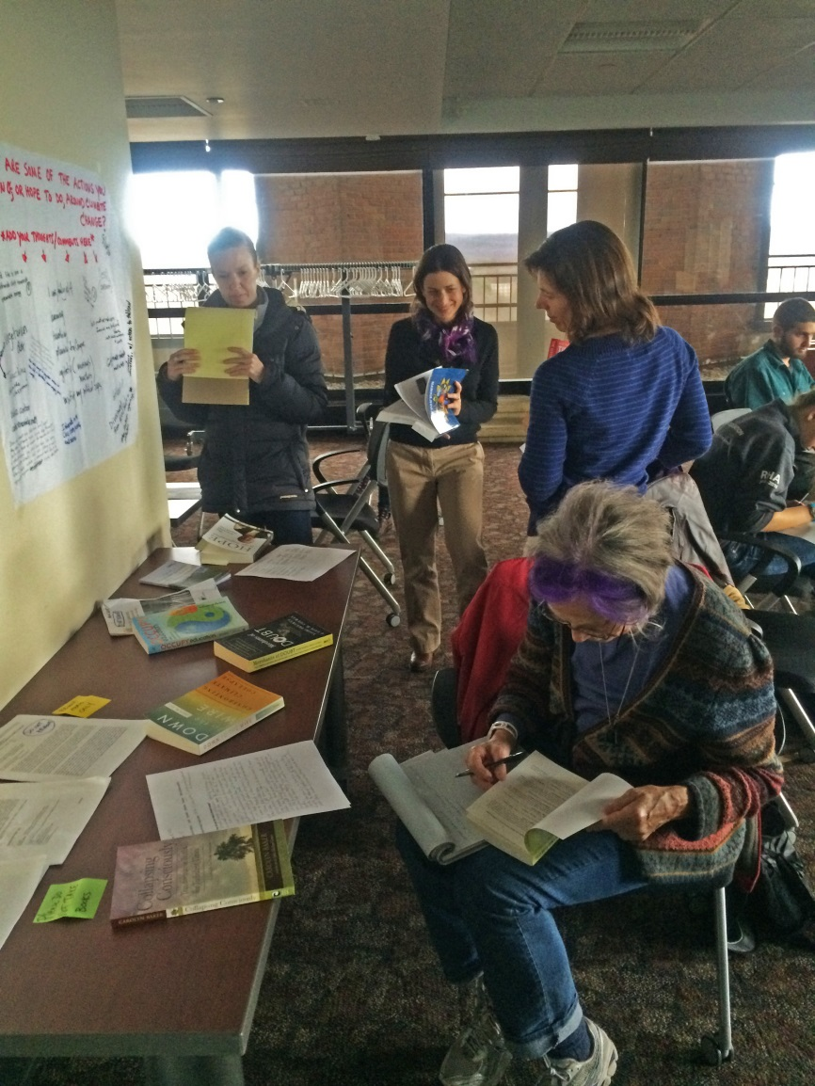
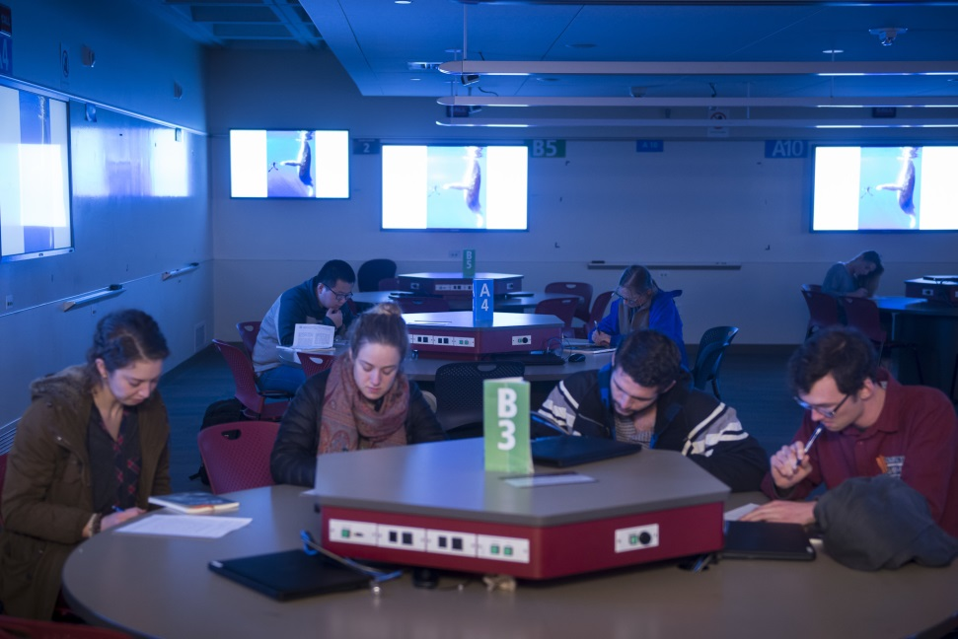
Talking Truth:
Finding Your Voice Around the Climate Change Crisis
(at UMass Amherst)
Story telling
Reflective writing
Art making
Films and discussions
Author readings
Meaning making
Career exploration
Contemplative exercises

Slide 5
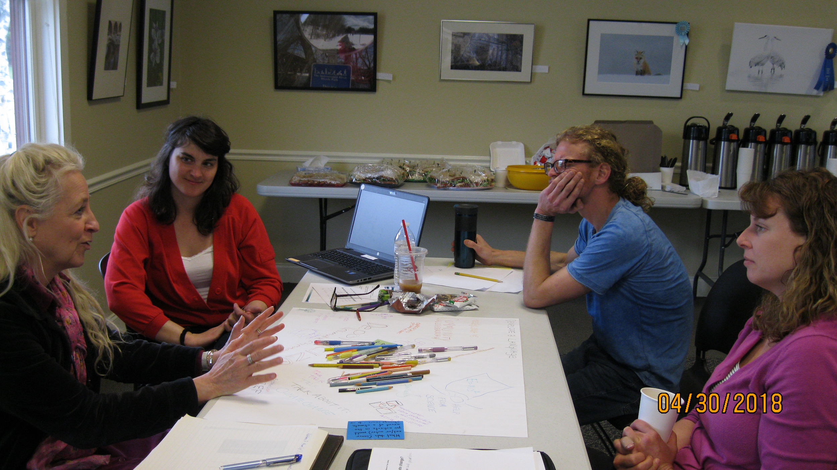
World Cafe
106 New England librarians trained this spring
1. What tools (inner and/or outer) would you activate in a climate change crisis -- to support yourself and others in your community?
2. To whom would you turn in your community in a climate change crisis?
3. What do you feel called to do re: climate change?

Slide 6
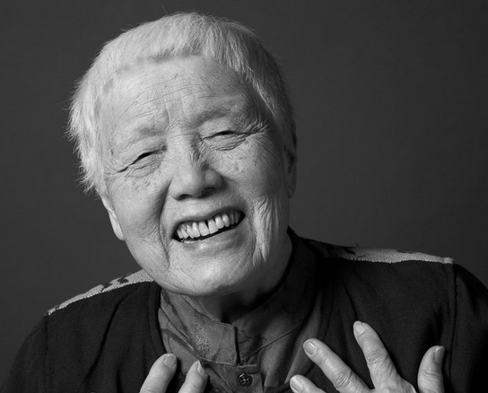
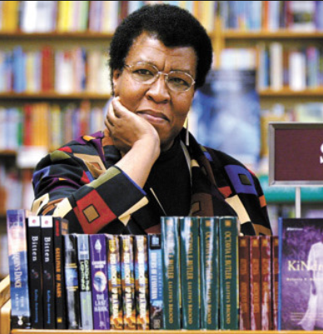

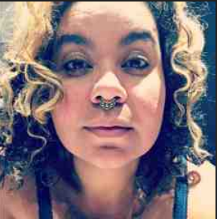
We have to change ourselves in order to change the world.
All that you touch
You Change.
All that you Change
Changes you.
The only lasting truth
Is Change.
Grace Lee Boggs
Octavia Butler
Emergent Strategy: Shaping Change, Changing Worlds
adrienne maree brown

Slide 7
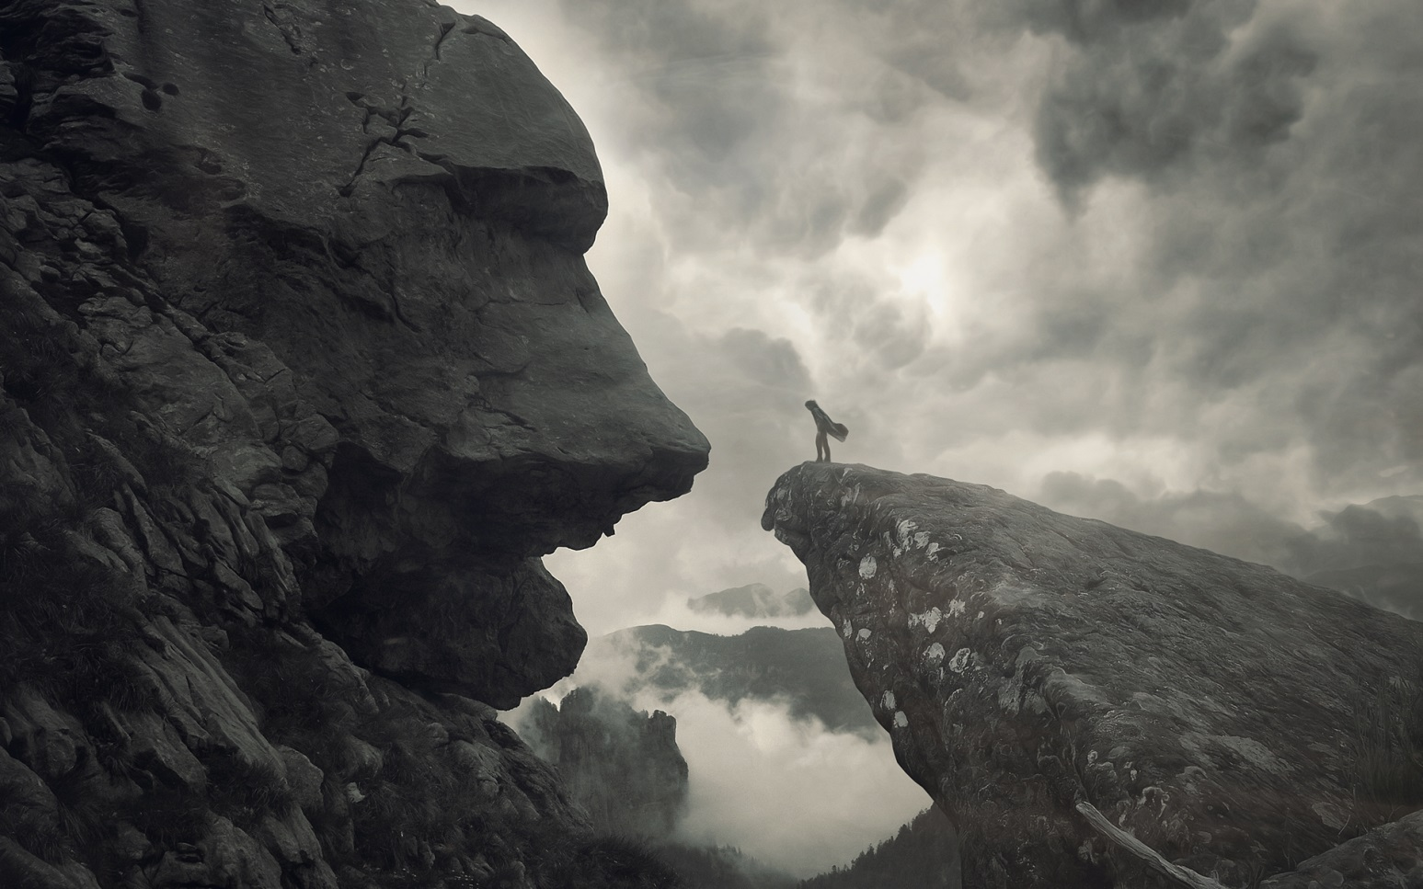
“We are living in impossible times...
However...
Our visions are ropes through the devastation. Look further ahead, like our ancestors did, look further. Extend, hold on, pull, evolve.” -- amb
Notes:
adrienne maree brown on Facebook

Slide 8
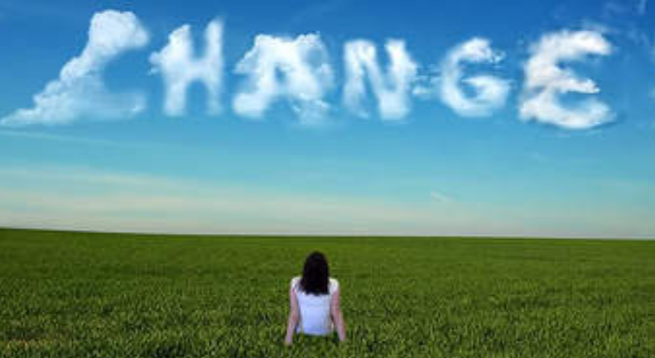
Adapt
“Change is definitely going to happen… We will adapt to that change, or we will become irrelevant.” - amb
Think of a time when you felt empowered by a change in your life.
Notes:
Adapted from https://www.colorlines.com/articles/three-lessons-adrienne-maree-browns-emergent-strategy

Slide 9
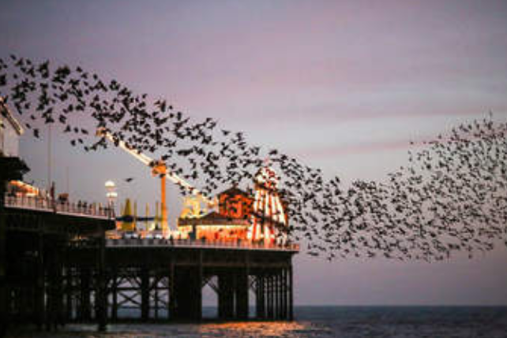
Flock
“There is an art to flocking: staying separate enough not to crowd each other, aligned enough to maintain a shared direction...” - amb
Think of a successful and satisfying collaboration (e.g. with a friend, partner, co-worker). What made it work so well?
Notes:
Adapted from https://www.colorlines.com/articles/three-lessons-adrienne-maree-browns-emergent-strategy

Slide 10
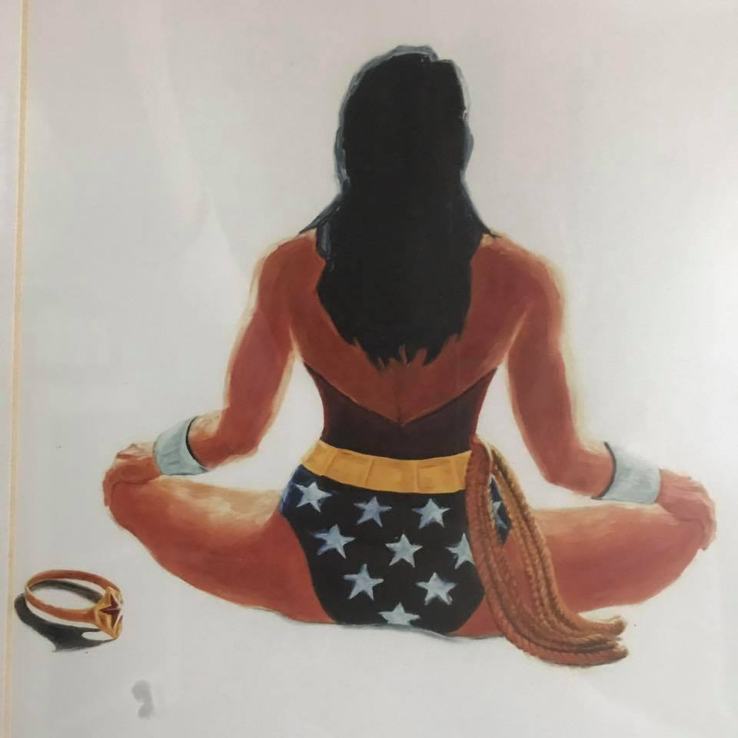
Fellow librarians, I ask you...
Who do you choose to be for this time?
Are you willing to use whatever power and influence you have to create islands of sanity that evoke and rely on our best human qualities to create, relate, and persevere?
Will you consciously and bravely choose to reclaim leadership as a noble profession that creates possibility and humaneness in the midst of increasing fear and turmoil?
--Margaret Wheatley
Notes:
From Who Do We Choose to Be? Facing Reality, Claiming Leadership, Restoring Sanity

Slide 11
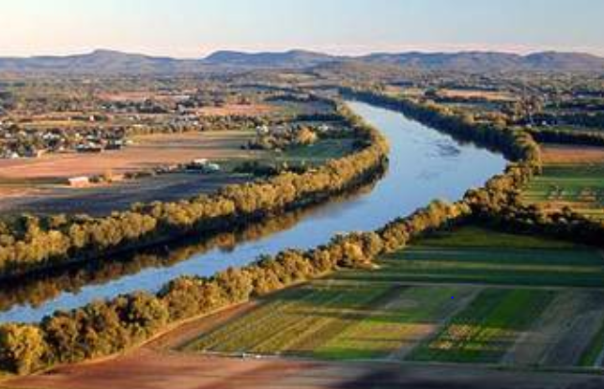
Invitation: Climate Change Conversations in Libraries
Online flock of New England librarians
Share ideas for climate change conversations
Solidarity
Abundant resources
Want to join? mcharney@library.umass.edu

Slide 12
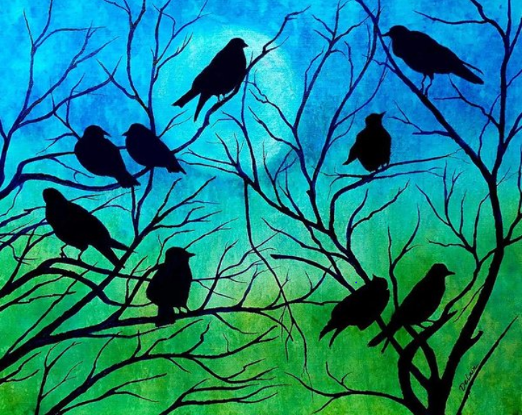
Invitation: May retreat in Amherst, Massachusetts
Spend the day with a small flock of librarians
Dive deep into climate change reality
Solo & group work
Nature & mindfulness practices
Want to come?
mcharney@library.umass.edu
Notes:
https://fineartamerica.com/featured/roosting-birds-susan-delain.html?product=poster

