Slide 1
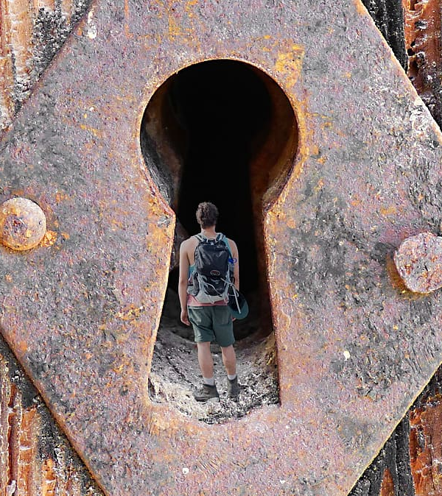
Inner Development Goals
An exploration for the sake of life on Earth
Madeleine Charney
UMass Amherst Libraries
Sept. 9, 2022
ENSULIB webinar

Slide 2
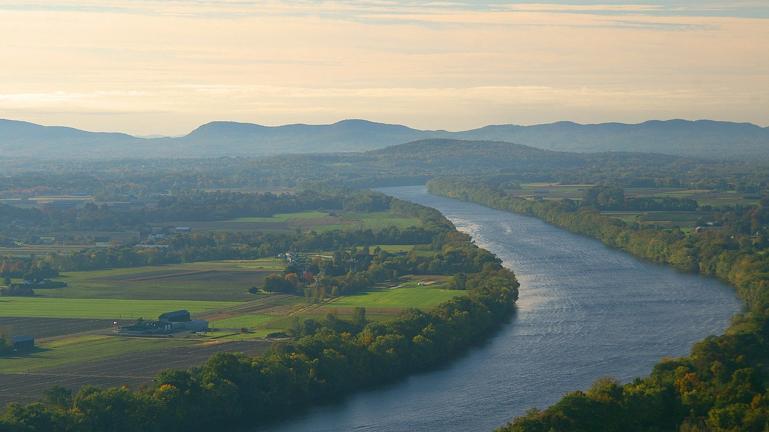
Land Acknowledgement
Homelands of the Pocumtuck and Norwottuck peoples
(now known as Amherst, Massachusetts, U.S.A.)

Slide 3
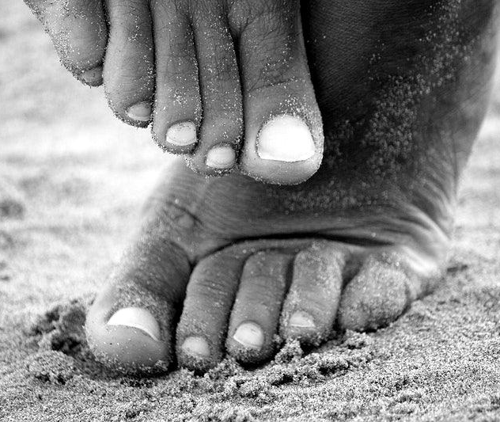
Grounding moment
Where are your feet touching the ground right now?

Slide 4


Slide 5
What are the Inner Development Goals?
A research-based framework that aims to develop our
inner capacity to manage
the increasingly complex
environment
and challenges.
The IDG framework is fundamental in the work to reach
the Sustainable Development Goals.

Slide 6
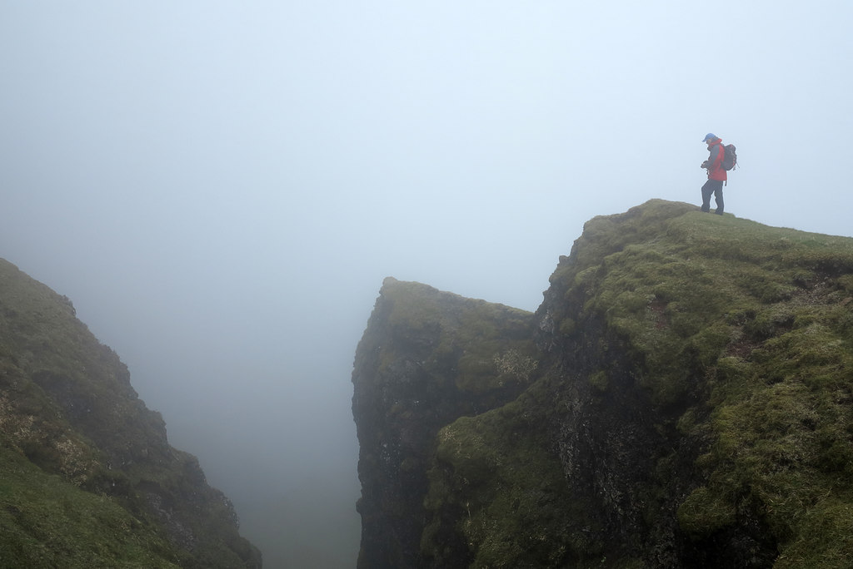
“Protect the Flame: Circles of Radical Shared Presence in Times of Collapse”
Article just published by Otto Scharma, from IDG’s leadership (and MIT)
3 themes he is noticing:
1) We’re living in a time of accelerated breakdown and collapse.
2) The sinking feeling that arises when taking all of this in (i.e. a pervasive collective depression)
3) The paradox that we know almost everything necessary to prevent civilizational collapse (technologies + financial means) and yet we are not doing it.
The massive knowing-doing gap
has been embodied in our collective behavior
over the past 50+ years.
https://medium.com/presencing-institute-blog/protect-the-flame-49f1ac2480ac

Slide 7
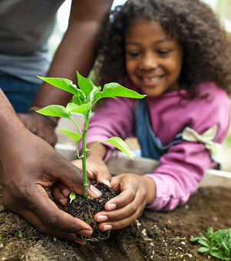
What do these 3 themes tell us?
They tell us that we live in a moment of transition where one civilization is ending and dying and another one is being born. And as custodians of planet earth and all its species, we are called to protect the flame of our highest future possibilities.
https://medium.com/presencing-institute-blog/protect-the-flame-49f1ac2480ac

Slide 8
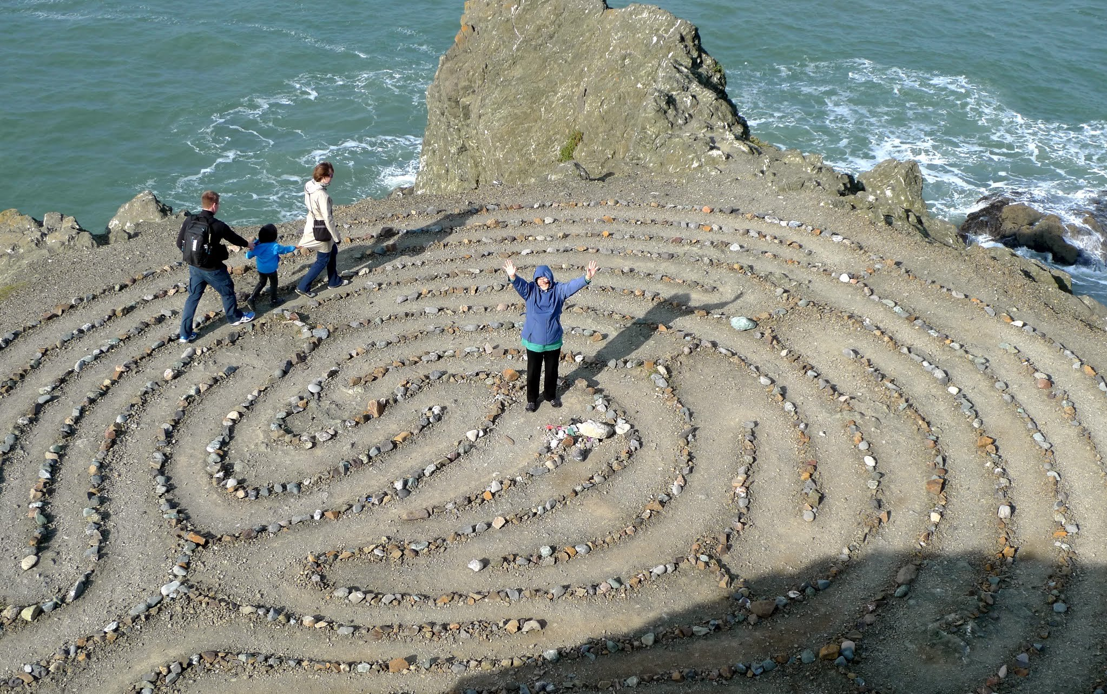

Slide 9

Notice: 17 spaces, to mirror the 17 SDGs

Slide 10
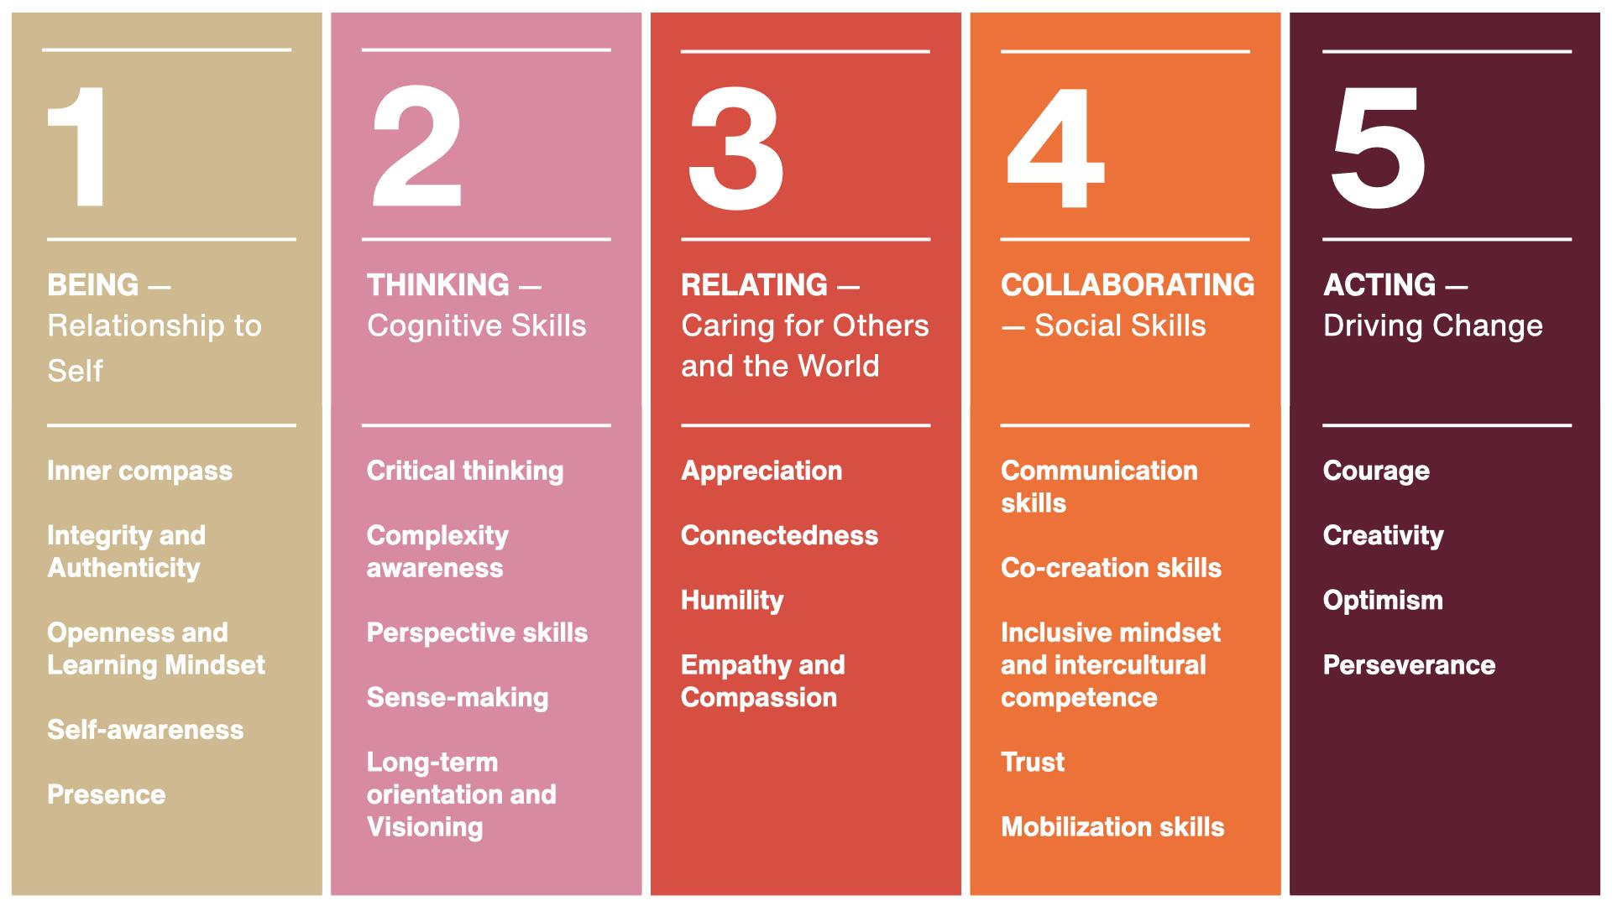

Slide 11
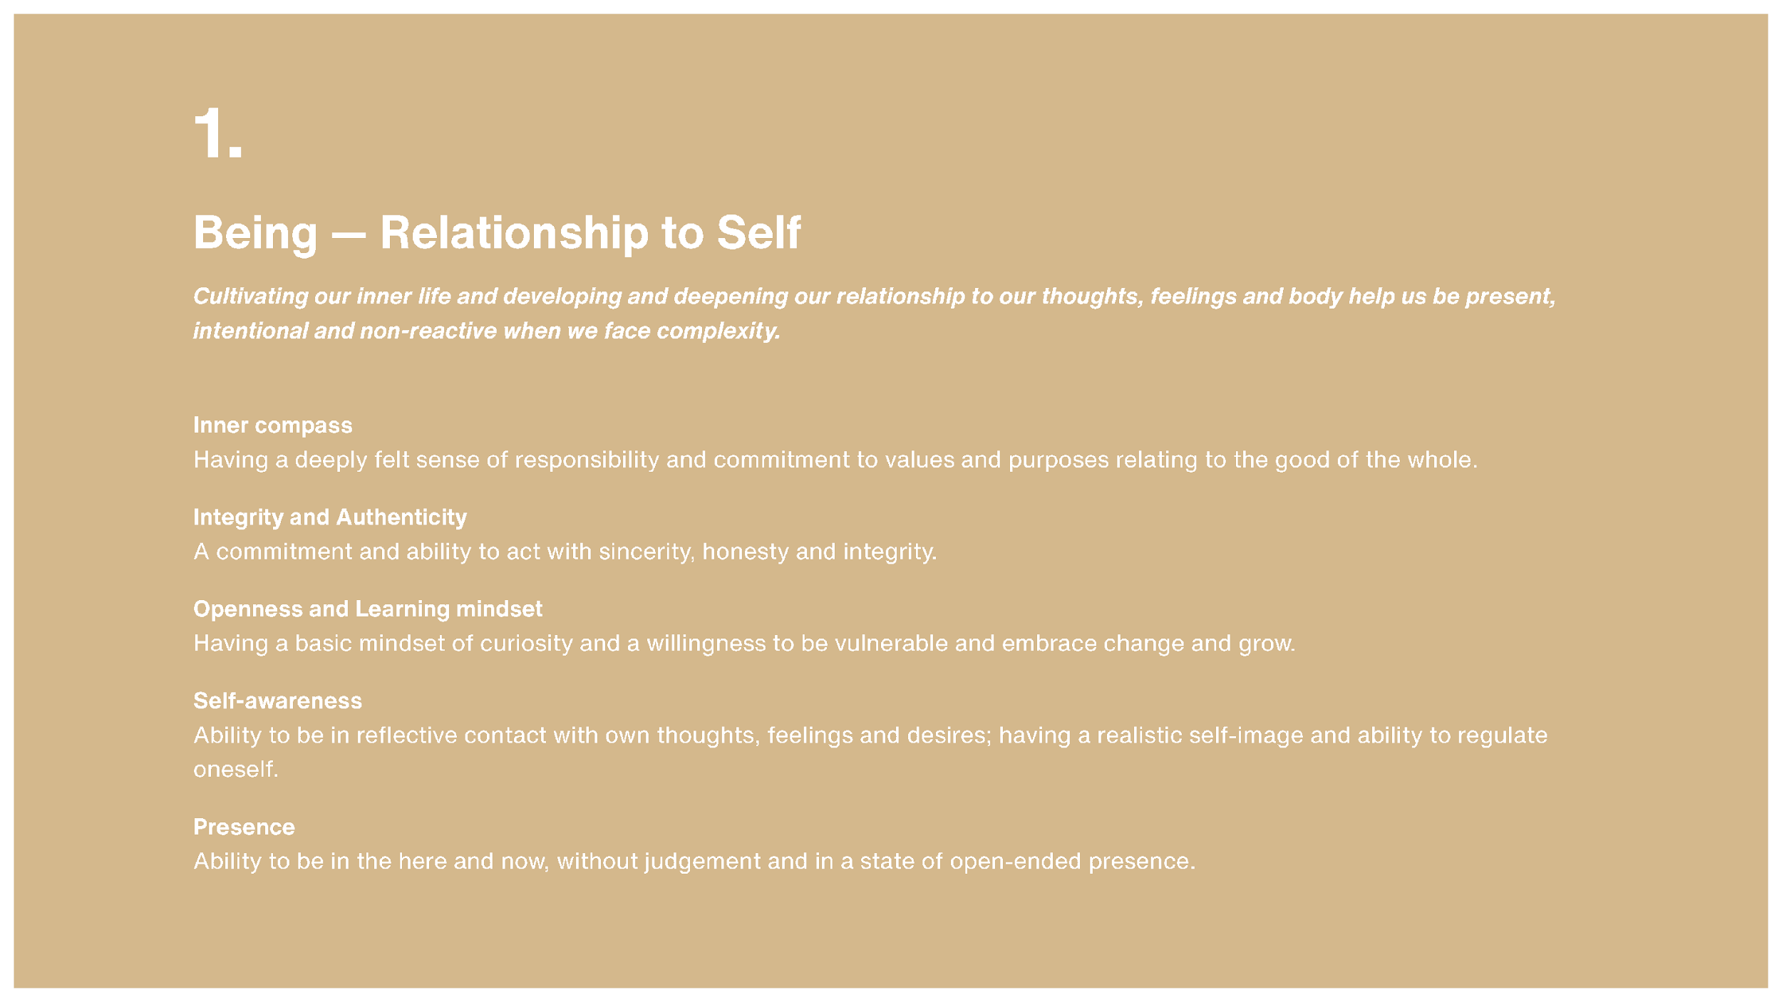

Slide 12
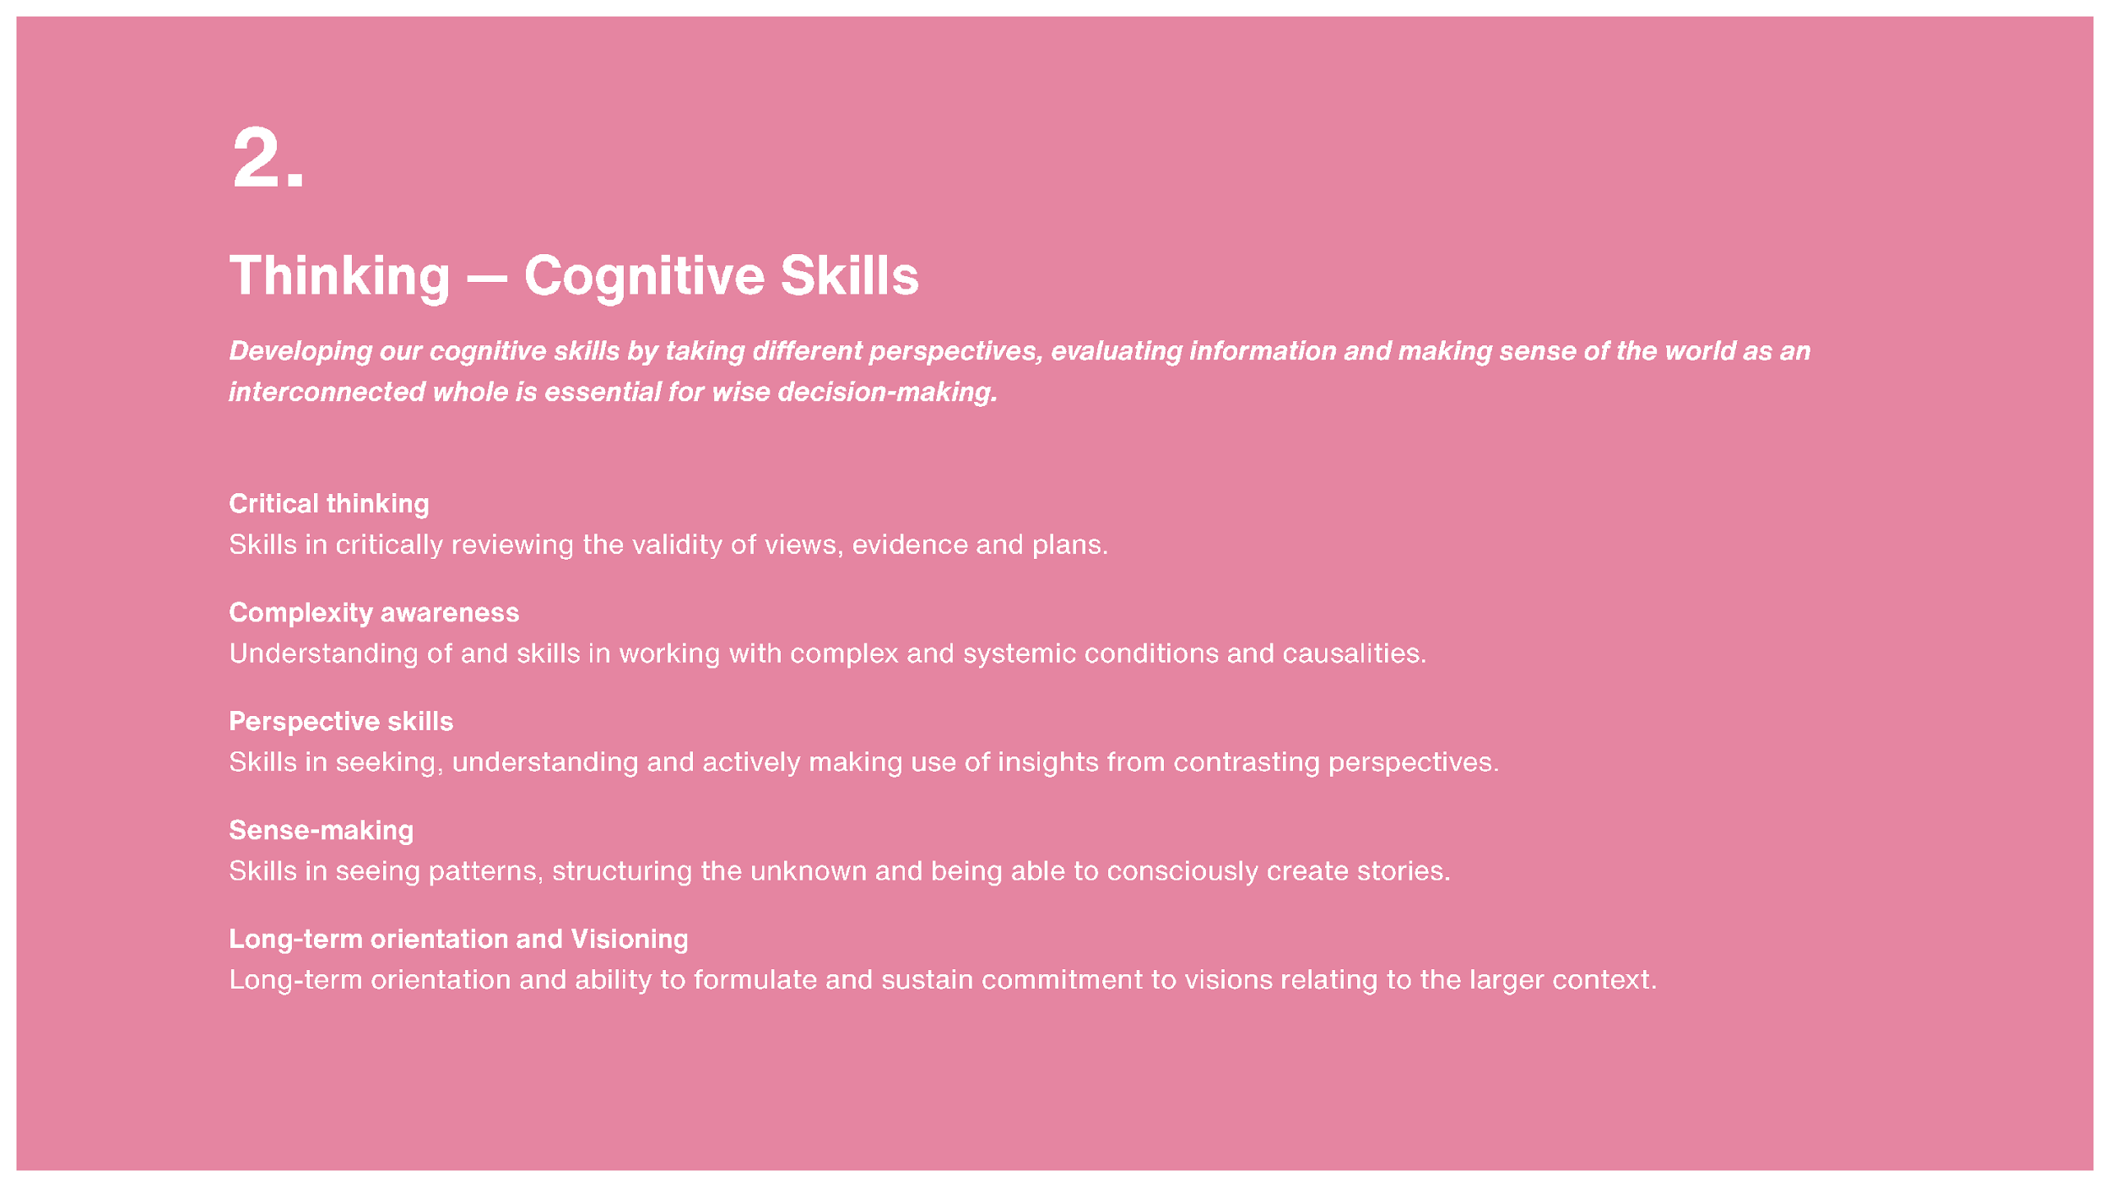

Slide 13
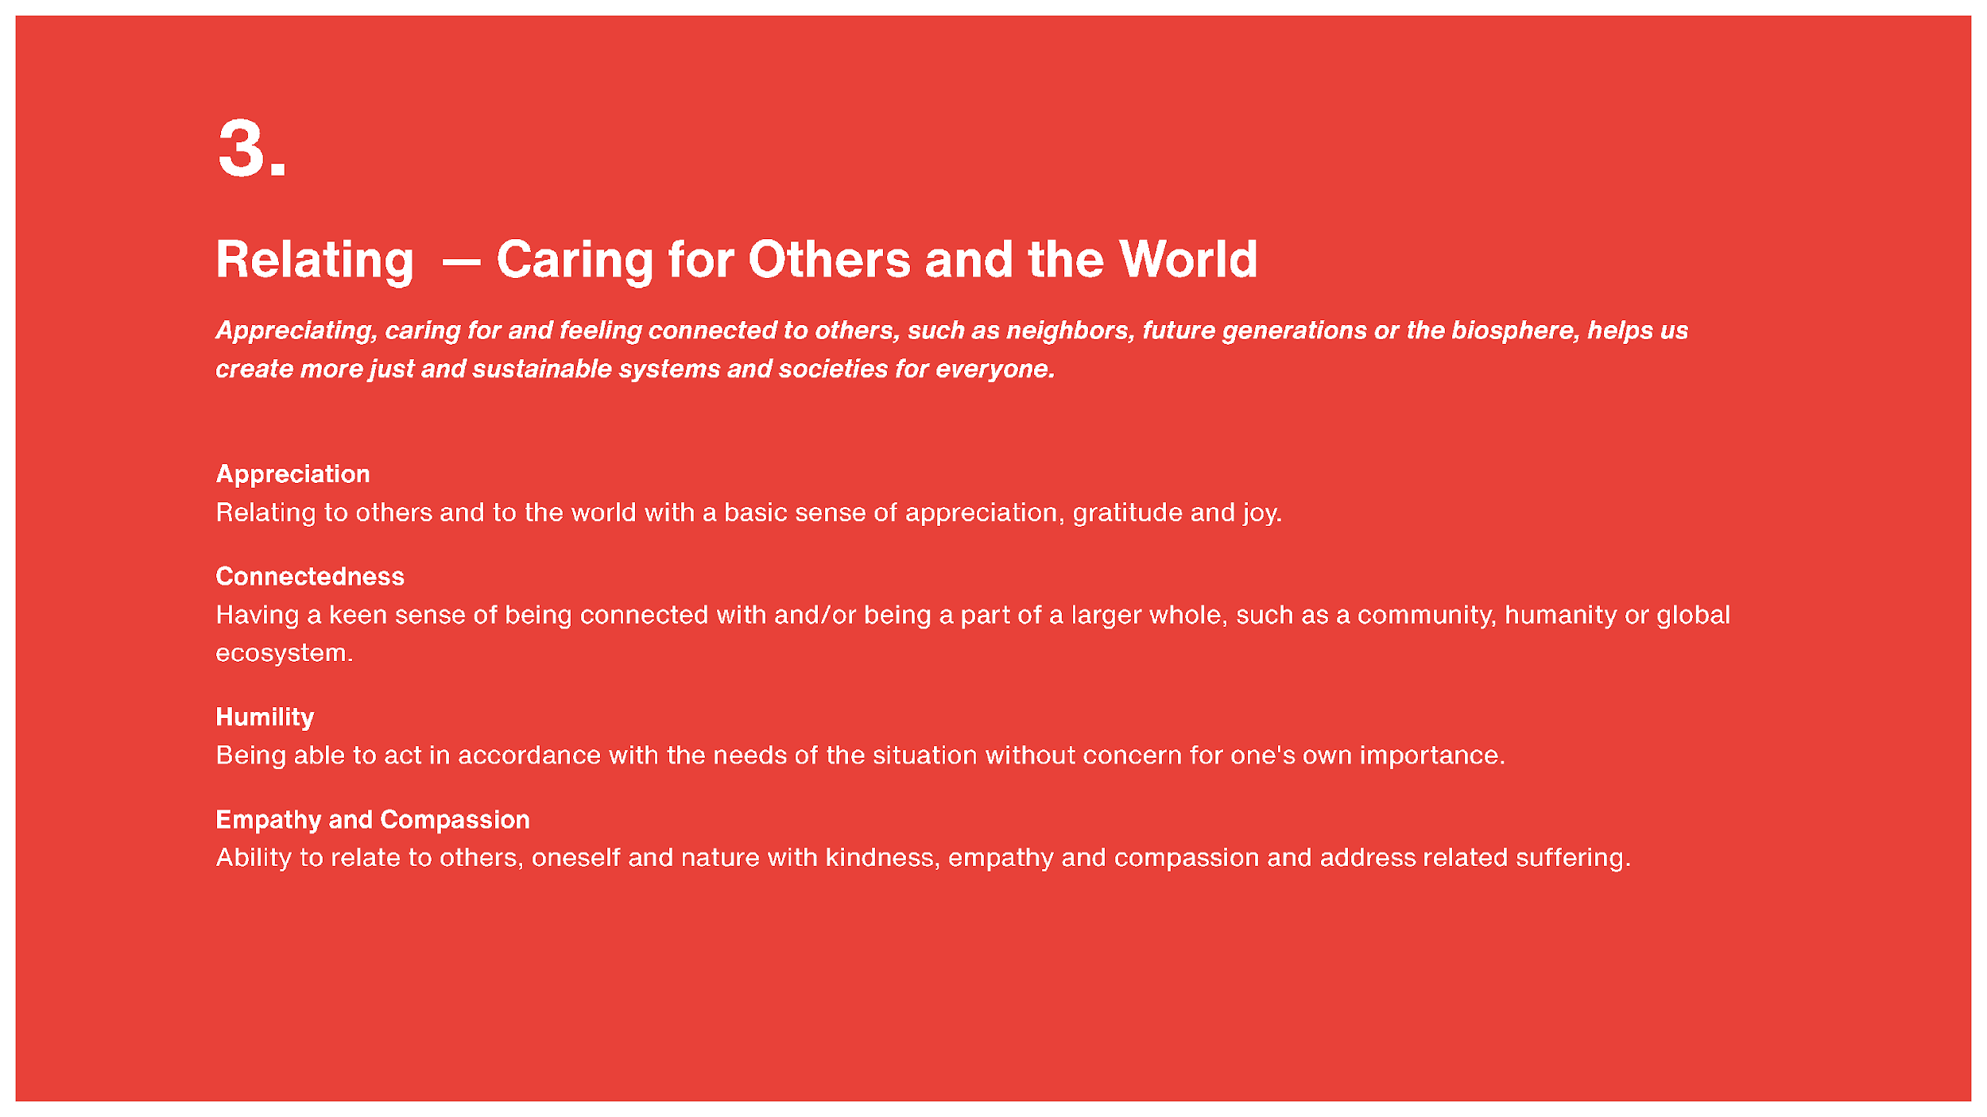

Slide 14
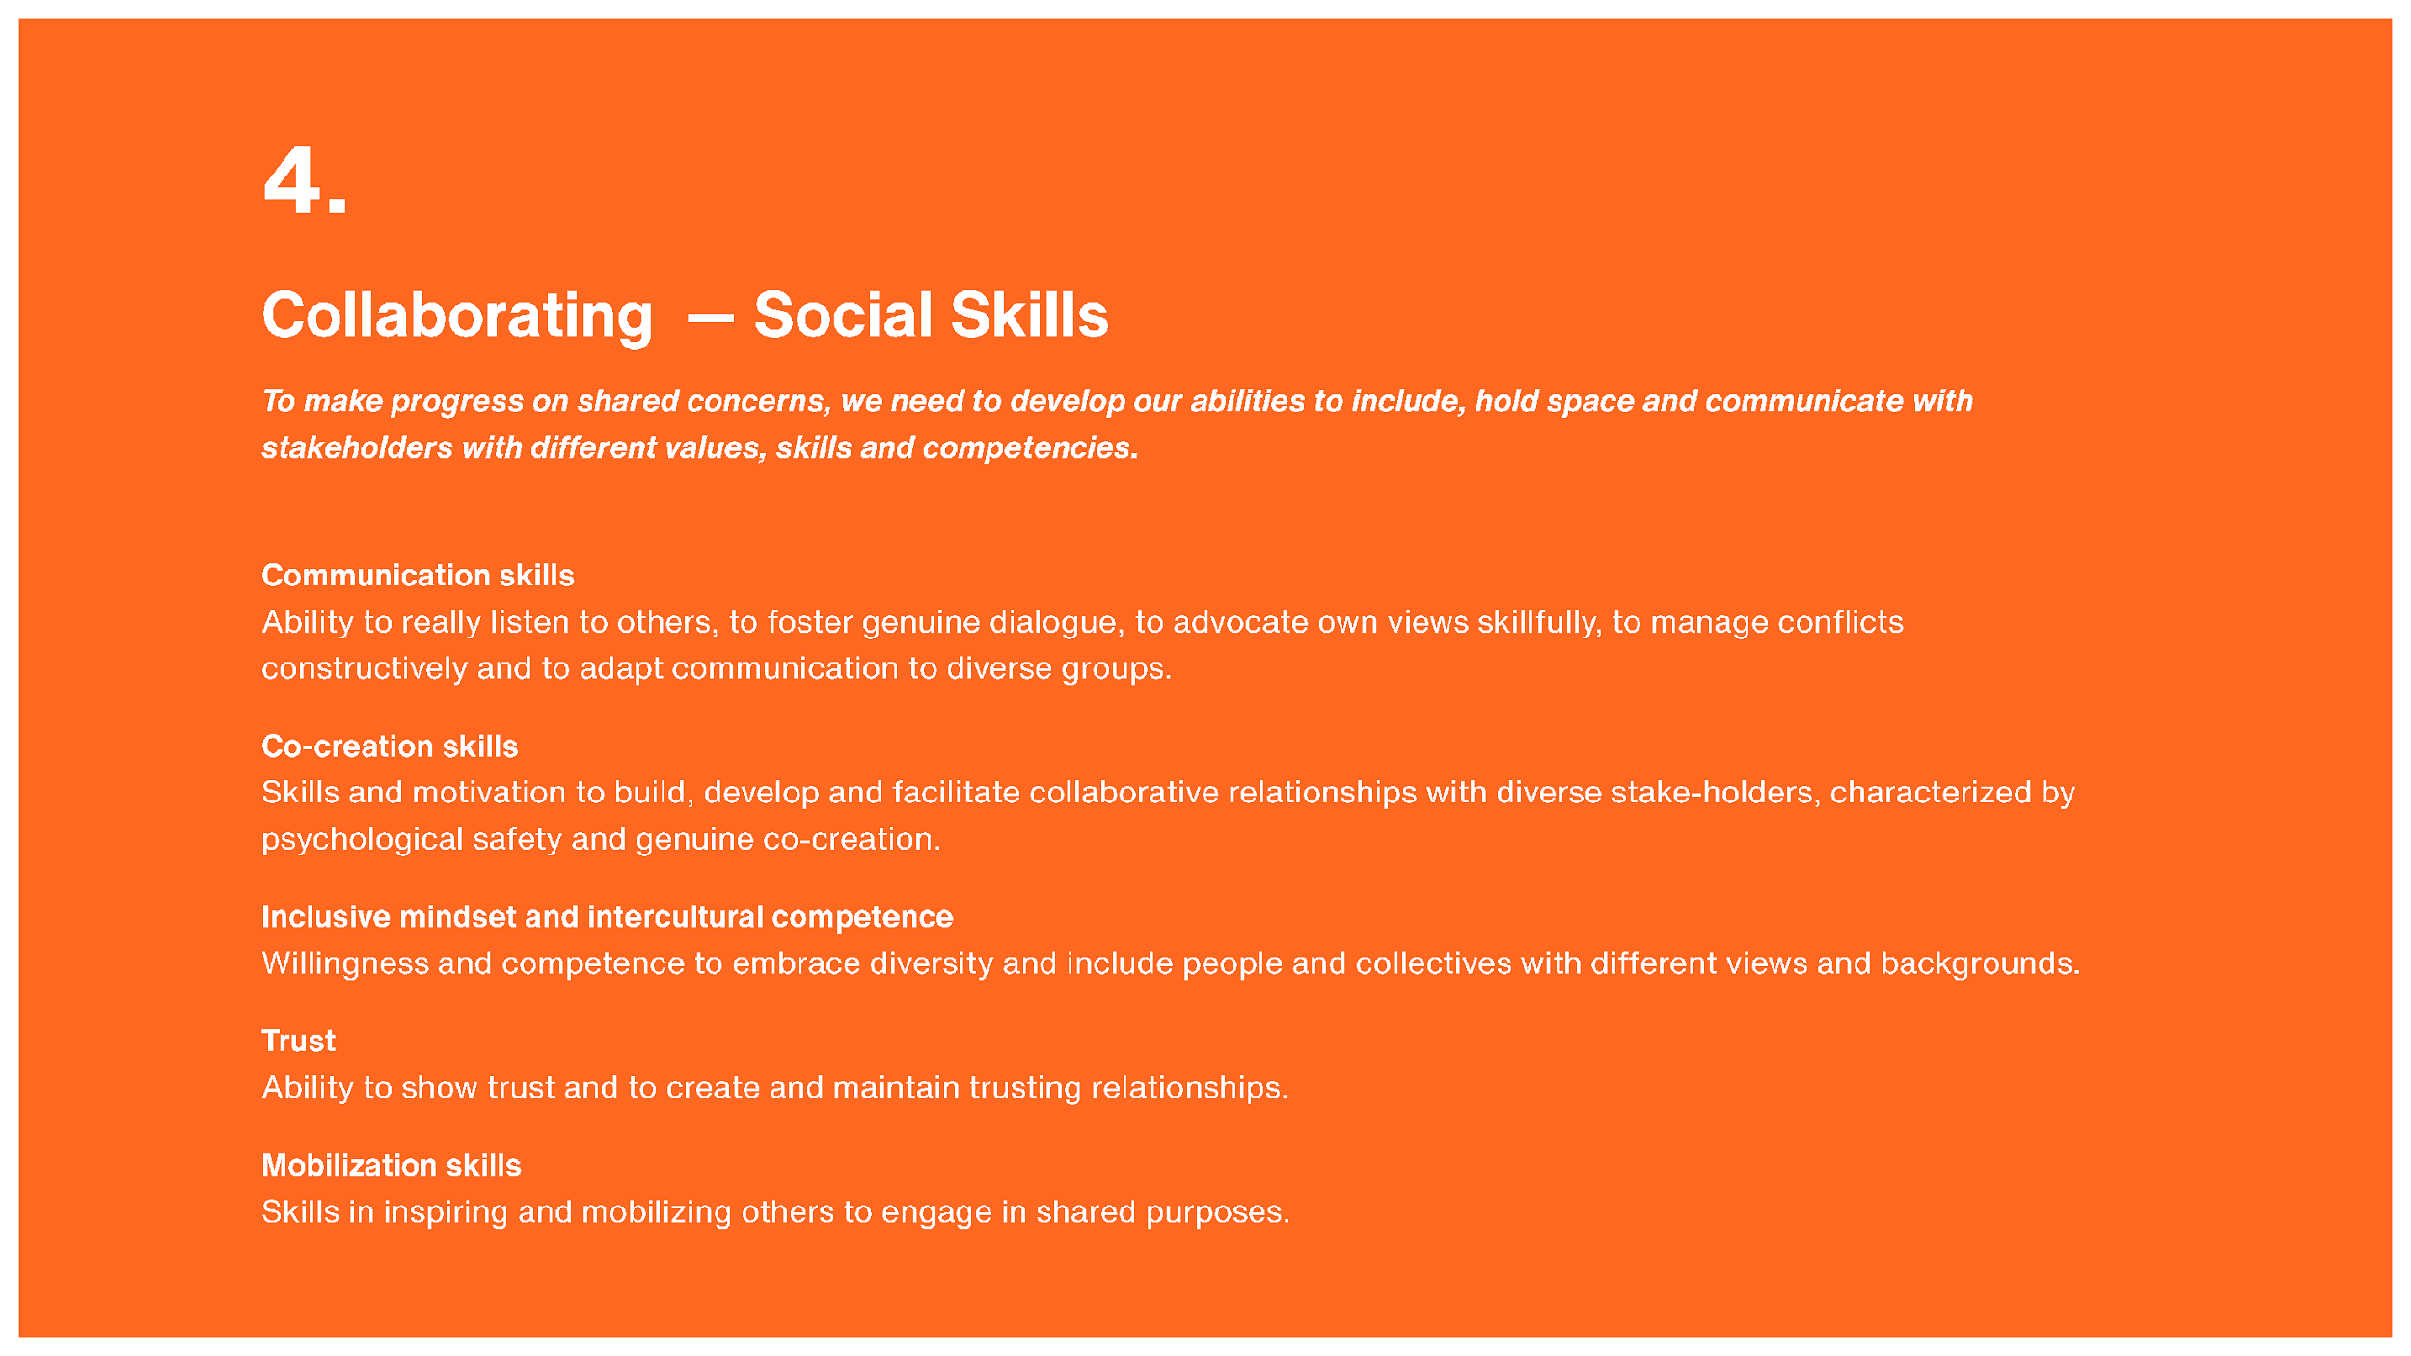

Slide 15
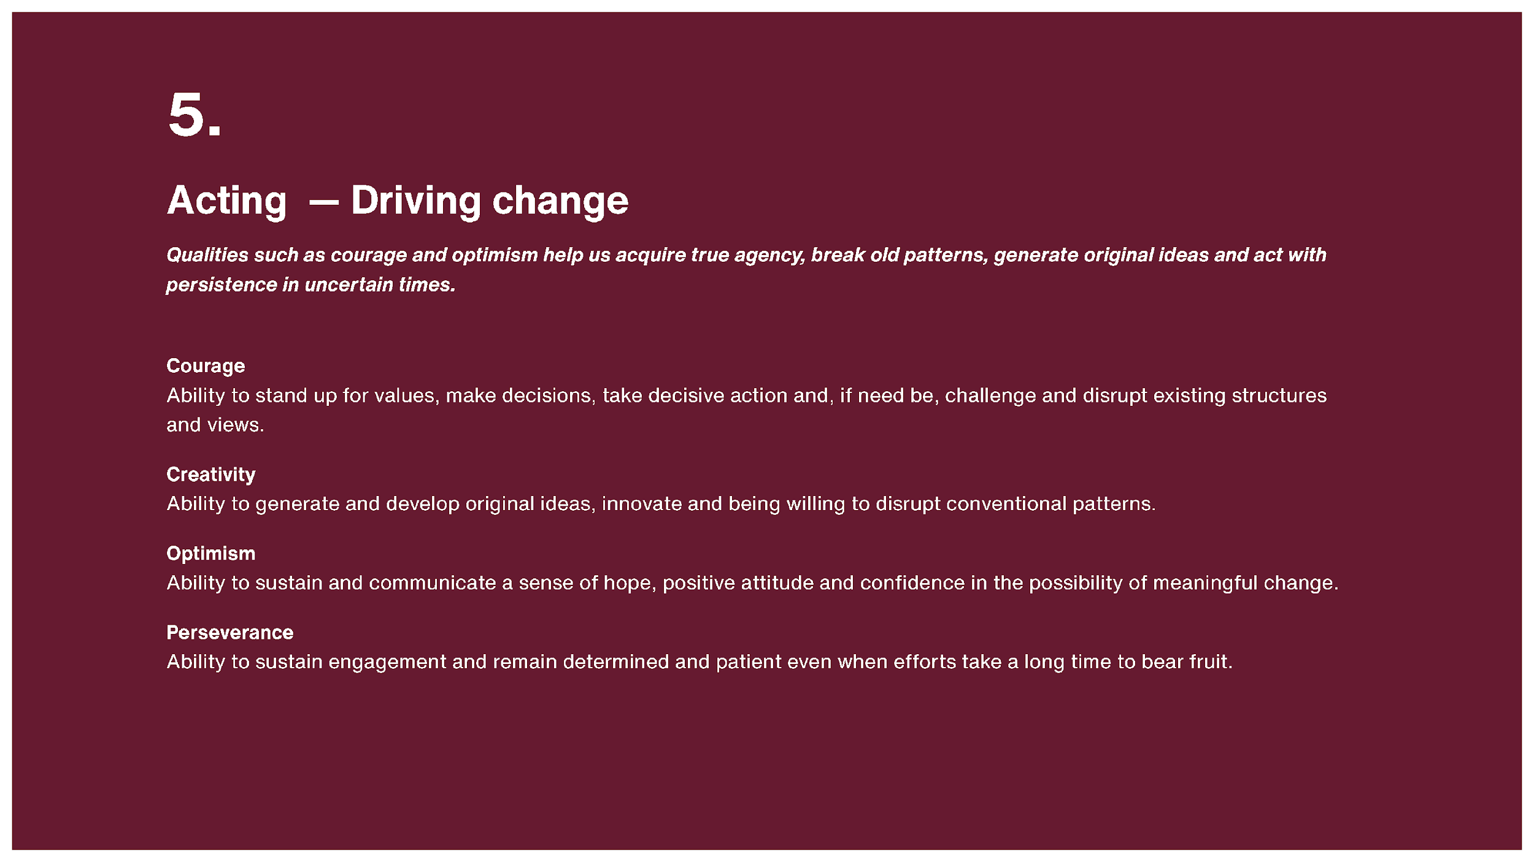

Slide 16
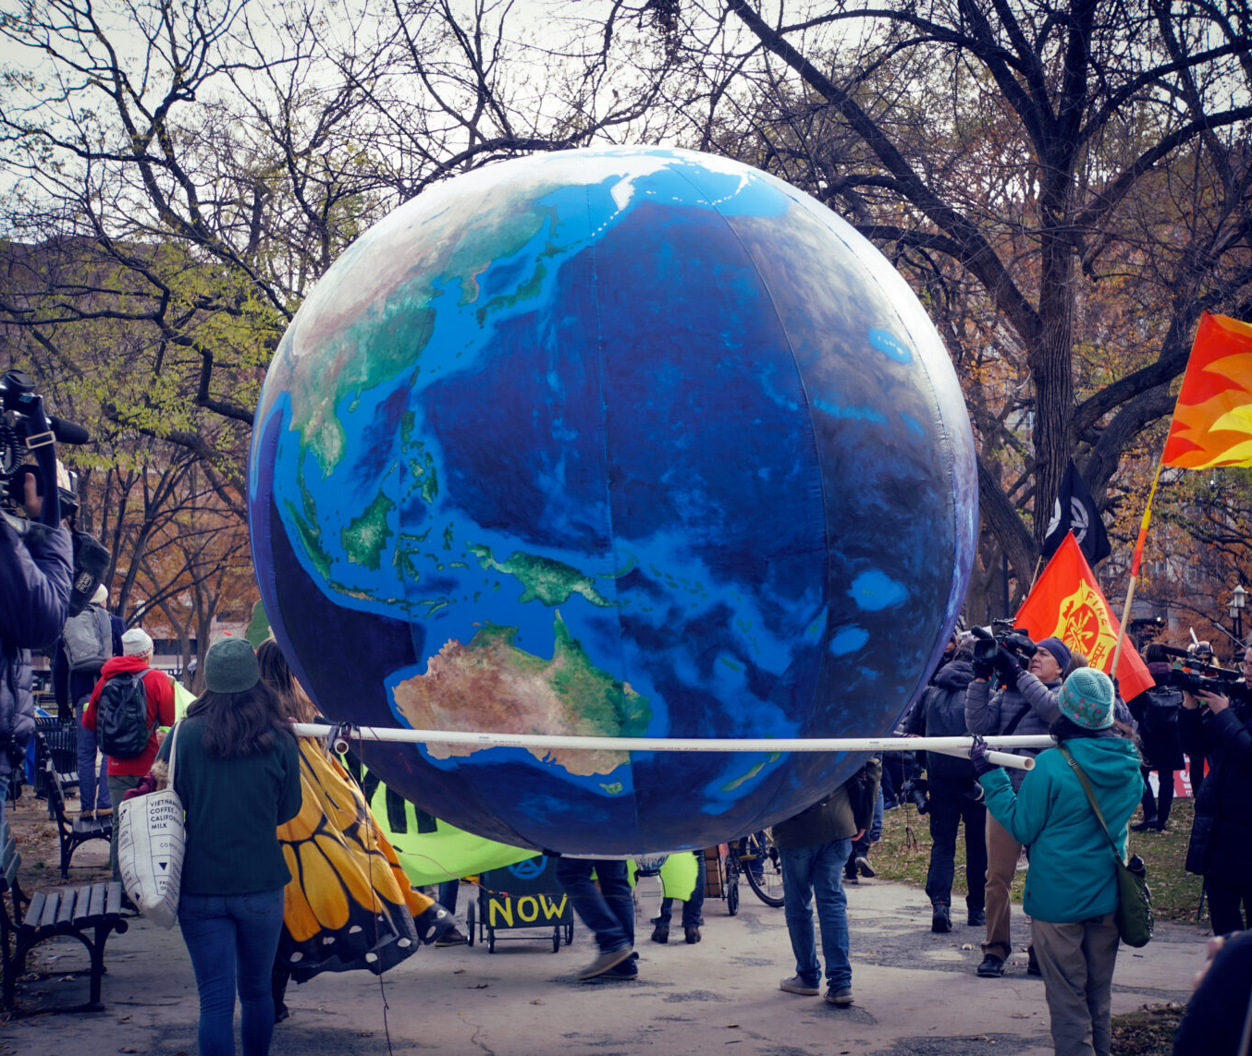
Respond in chat
What inspires me about the Inner Development Goals? Any of them in particular?

Slide 17
Break out 1 of 2
What is a project, real or imagined, in which the IDGs
could play an important role?
Slides: https://docs.google.com/presentation/d/1umXiFEqT87Wlr-CHhbqvnerwuR0G8s6R/edit?usp=sharing&ouid=112847779141705789810&rtpof=true&sd=true

Slide 18
Break out 2 of 2
Who else (individuals or groups) in my workplace or elsewhere might be interested in learning about the IDGs? Where/how can I imagine sharing these frames?
Slides: https://docs.google.com/presentation/d/1umXiFEqT87Wlr-CHhbqvnerwuR0G8s6R/edit?usp=sharing&ouid=112847779141705789810&rtpof=true&sd=true

Slide 19
Wrap up exercise
Take a minute to free write about your thoughts from this session.
Identify 1-3 next steps you’d like to take in relationship to the IDGs (on your own or with others).
Share a step(s) in the chat

Slide 20
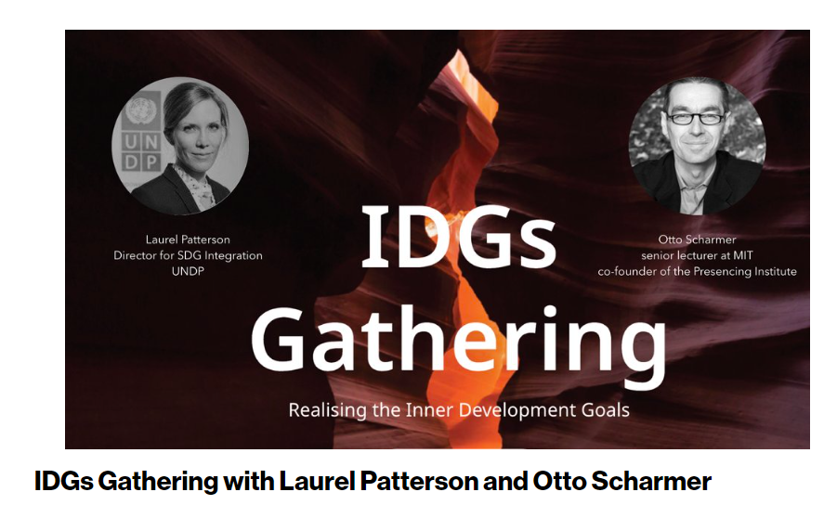
A deep dive into how we can build infrastructures of connection for awareness-based collective action.
Led by Otto Scharmer, MIT/Presencing Institute and Laurel Patterson, UN Development Program will guide us through different angles of the IDGs.
September 26, 15.30-17:00 CEST
Registration: idg-gathering-26-sep-2022.confetti.events

Slide 21
Let’s be in touch
mcharney@library.umass.edu

Slide 22
Images
Keyhole: https://www.wallpaperflare.com/man-standing-inside-the-keyhole-exploration-adventure-lock-wallpaper-ukxmx
Feet: https://www.rawpixel.com/image/5924147/photo-image-public-domain-person-beach
River valley: http://cloud.tpl.org/pubs/local_ct_river_report.pdf
Earth https://wisconsinexaminer.com/2022/04/22/do-not-abandon-hope-climate-solutions-are-possible/
Cliff https://www.geograph.org.uk/photo/3995159
Labyrinth https://commons.wikimedia.org/wiki/File:Lands_End_Labyrinthe.jpg

