Slide 1
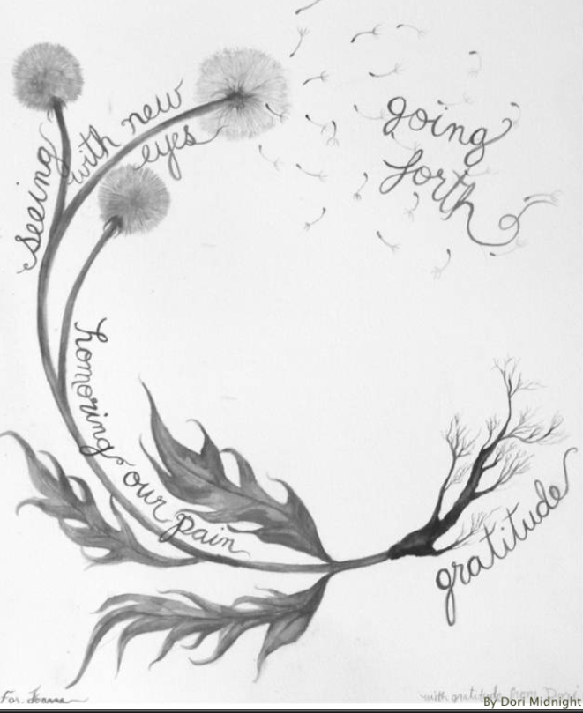

Work That Reconnects
September 30, 2020
https://workthatreconnects.org/spiral/
Notes:
Despair and Empowerment

Slide 2
Climate Preparedness Week in Massachusetts
A collaboration of:
CREW (Communities Responding to Extreme Weather)
Massachusetts Library System
Blue Marble Librarians
Today’s facilitators:
Madeleine Charney, UMass Amherst Libraries
Rebecca Schmidt, Library & Information Science graduate student, SImmons College

Slide 3
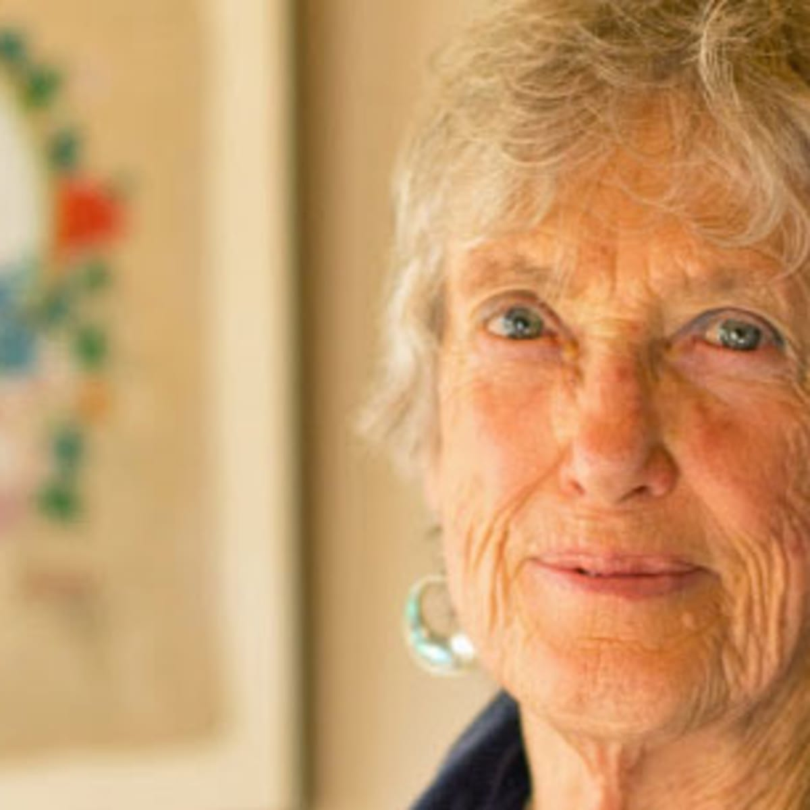
Joanna Macy
Buddhist scholar
Systems thinker
Deep ecologist
Active Hope: How to Face the Mess We’re In
Without Going Crazy (with Chris Johnstone)
https://www.joannamacy.net/
.

Slide 4
The Spiral and “Open Sentences”

Slide 5
Group Agreements
1. Share your responses with spontaneity & an open heart
2. Listen with an open heart
3. Rather than commenting on what others share -- listening is what’s called for
4. Stick to your allotted sharing time (there will be a message to prompt you all)
………………………………………..
You can leave a breakout room (and return to the Main Room) at any time.

Slide 6
Trusting the Spiral (p.35)

Slide 7
Gratitude
Someone who helped me believe in myself is/was…

Slide 8
Honoring Our Pain for the World
When I see what is happening to the natural world, what breaks my heart is…

Slide 9
Seeing with New/Ancient Eyes
Healing the world means…

Slide 10
Going Forth
My commitment to being a changemaker
takes the form of...

Slide 11
Stepping into new ground…
...involves frequent encounters with not knowing.
We need to make friends with this feeling.
It will be a companion on our journey.
--Joanna Macy

Slide 12
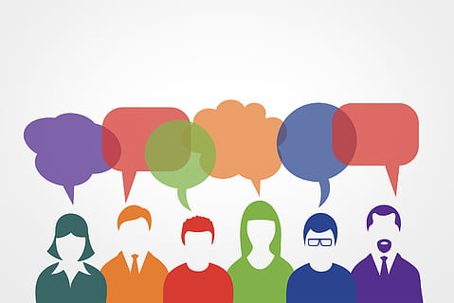
If you would like to linger…
For informal conversation...

