Slide 1
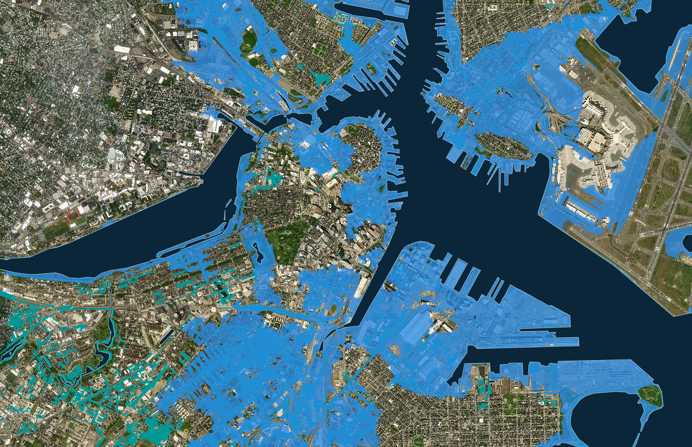
Climate Change Conversations in Libraries:
Stabilizing Ourselves & Our Communities
Madeleine Charney with Kristen Mastel
Sustainability Round Table
June 22, 2019 – Washington, D.C.
American Library Association, Annual Conference
Boston, 3 ft.sea level rise, estimated 2070

Slide 2
Land acknowledgement
The land we are meeting on during this conference is built within the traditional homelands of the Anacostans, a tribe that lived on land that became the nation’s capital and from which the Anacostia River gets its name. The Anacostans’ name is a Latin version of their original name, the Nacotchtanks. The name came from the Indian word “anaquashatanik,” which means “a town of traders.” They were known for trading throughout the Chesapeake area, including trading fur with the Iroquois of New York. The Nacotchtank tribe had about 300 members in the early 1600s. They lived in villages along the eastern banks of what is now the Anacostia River, before merging with nearby tribes in the early 1700s including the Pamunkeys, Piscataways and Rappahannocks. We recognize all these peoples and strive to make efforts to educate ourselves about their history and our use of this land.

Slide 3
What this workshop is NOT about:
Science of climate change
Debating climate change
Dealing with climate change skeptics

Slide 4
What this workshop IS about:
Libraries supporting transformational resilience
Conscious brave leadership and collaboration
Self care and Community care

Slide 5
Overview of this event
1st part 1:00-2:30
Climate change threats
Barriers to talking about climate change
Why libraries?
Being change agents
MA libraries and Climate Prep Week: A model
Stabilizing our nervous system
Pair-Share exercises
…………………………..
2nd part 2:45-5:00
World Cafe

Slide 6
Hoped for outcomes
Tools for stabilizing the inner core
Renewed sense of purpose in change making
Ideas for climate change programming
Dynamic World Cafe experience
Identify your take home SEED(S) OF ACTION!

Slide 7
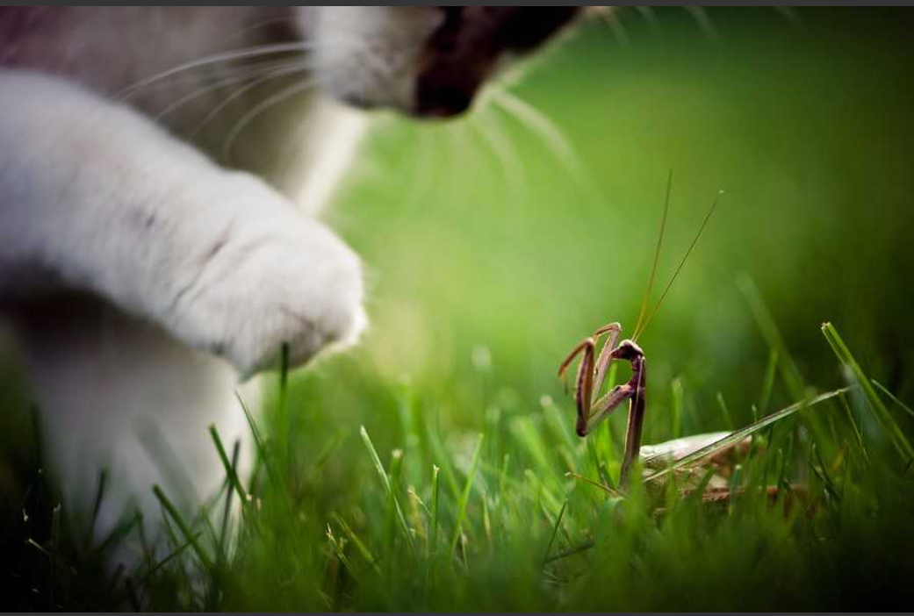
“Not everything that is faced can be changed, but nothing can be changed until it is faced.”
— James Baldwin
Notes:
http://amandabauer.blogspot.com/2012/05/bravery.html

Slide 8


Slide 9
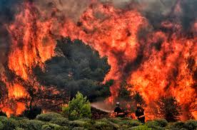
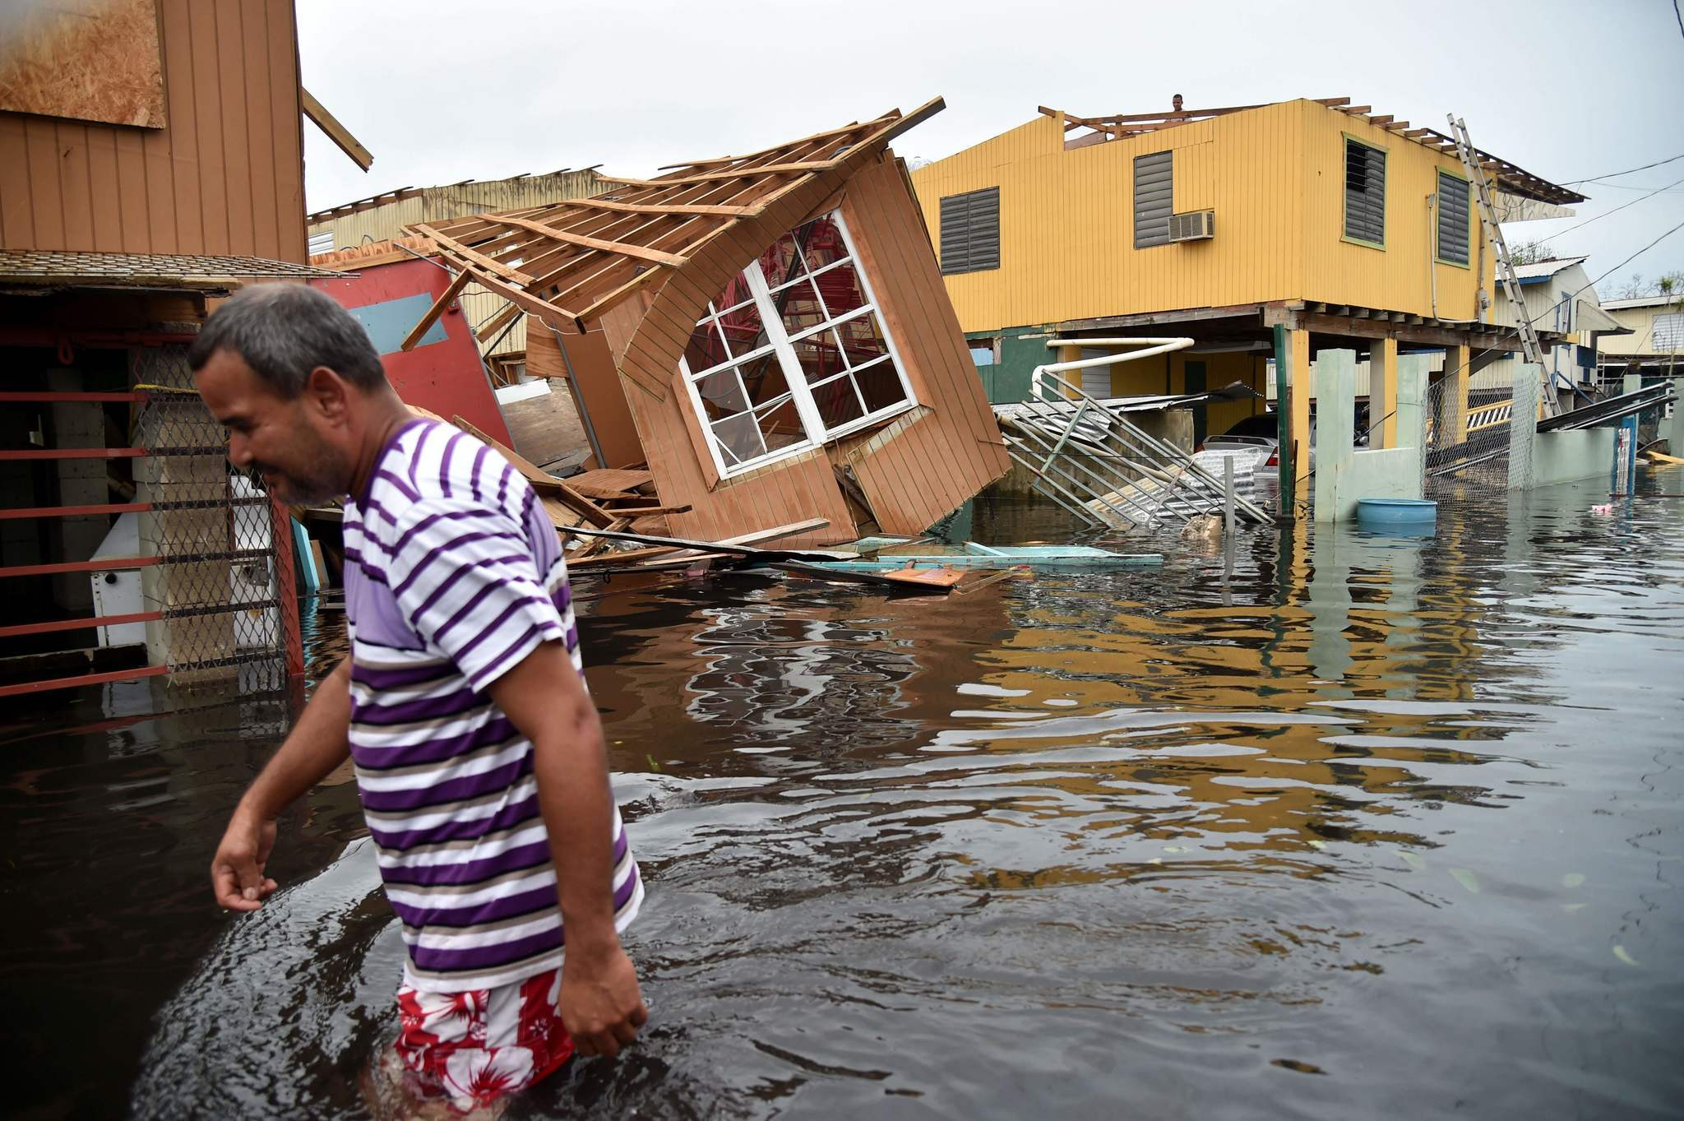
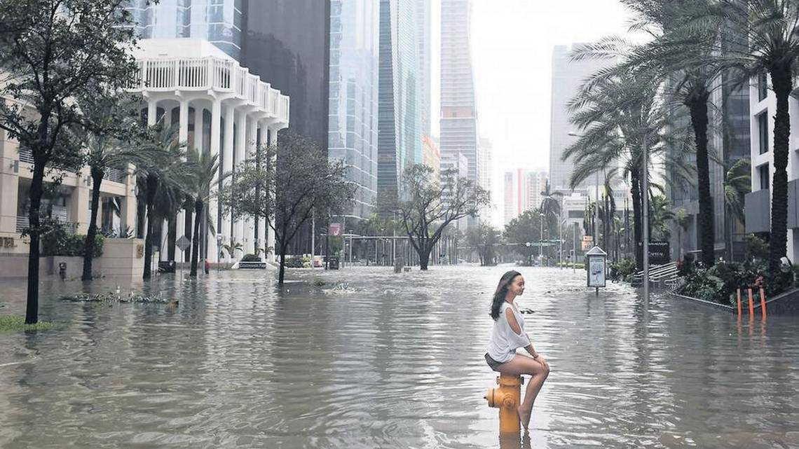
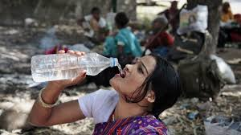
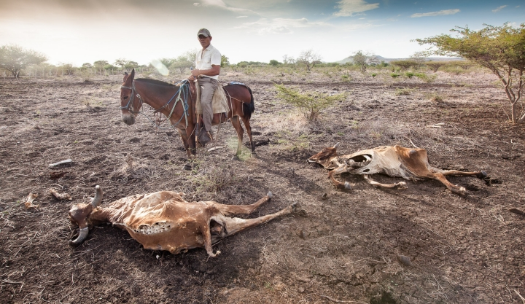
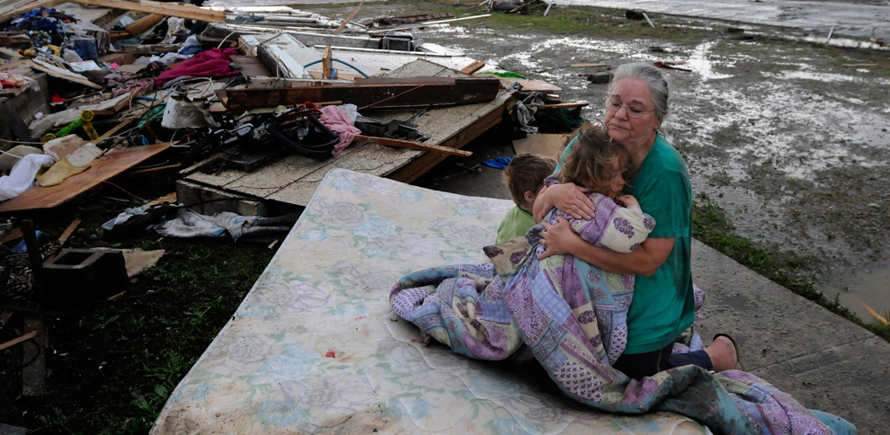
More frequent and extreme disasters

Slide 10
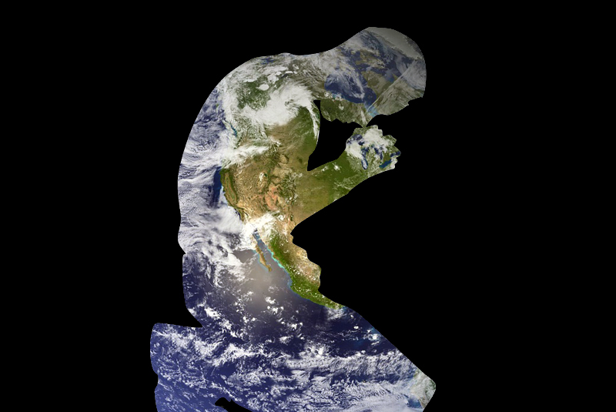
Ourselves, our communities & the effects of climate change
Loss of place, community, culture and natural environment
Disruption of close family and friend social support networks
Involuntary migration
Water, food and other resource shortages
Economic disruption and job loss
New illnesses and diseases
Disaster-triggered crime and violence
Intensified racism, sexism, and other systemic oppressions
(Adapted from Bob Doppelt’s webinar slide)

Slide 11
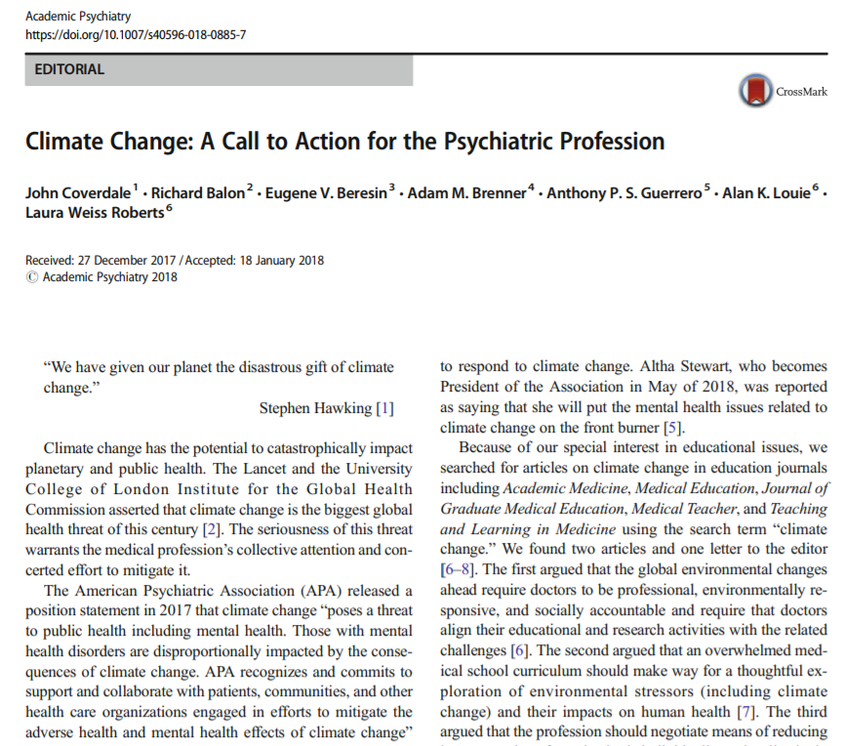

Slide 12
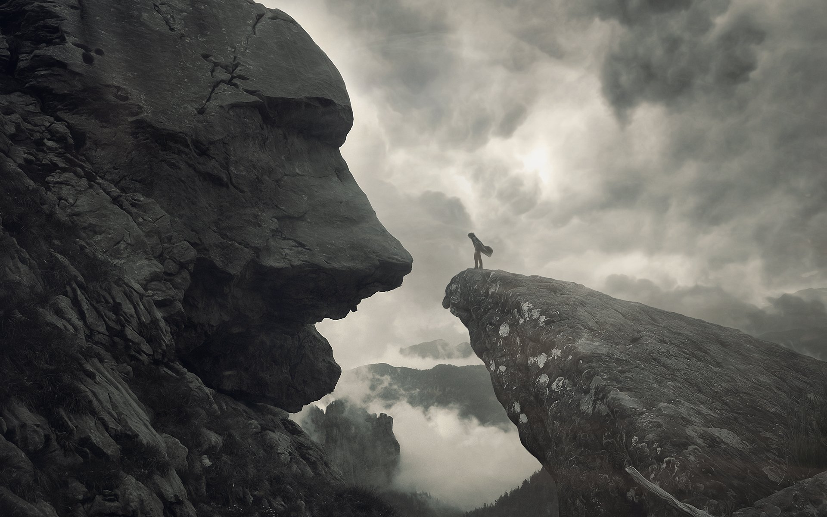
“We are living in impossible times...
If it were fiction it would be critiqued as hyperbolic.
If it were nightmares we would never sleep.
We are living in times created by our own species.
Our visions are ropes through the devastation.
Look further ahead, like our ancestors did, look further.
Extend, hold on, pull, evolve.”
— adrienne maree brown
Notes:
adrienne maree brown on Facebook

Slide 13
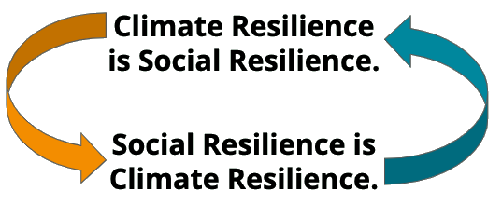
Notes:
CREW’s model equips community-based teams of volunteers with the training, local&regional organizational structures,&technological support needed to build climate resilience. Each CREW will engage in three main types of activities to build resilience: education, service,&planning.

Slide 14
Green Gulch Farm
We live by the sun, We feel by the moon, We move by the stars,
We live in all things, All things live in us,
We eat from the earth, We drink from the rain, We breathe of the air,
We live in all things, All things live in us,
We call to each other, We listen to each other, Our hearts deepen with love and compassion,
We live in all things, All things live in us,
We depend on the trees and animals, We depend on the earth, Our minds open with wisdom and insight,
We live in all things, All things live in us,
We dedicated our practice to others, We include all forms of life, We celebrate the joy of living-dying,
We live in all things, All things live in us,
We are full of life, We are full of death, We are grateful for all beings and companions.
— Stephanie Kaza

Slide 15

Some time to breathe...

Slide 16
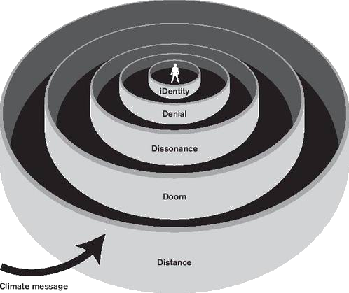
Barriers to talking about climate change
The “Five D’s” - Per Epsen Stoknes
Notes:
Concentric circles for a reason - the innermost layer (iDentity) being the most stubborn one, and “distance” being the weakest..
Norwegian Scholar: Per Epsen Stoknes https://www.weadapt.org/knowledge-base/using-climate-information/climate-psychology
He is also the author of What We Think About When We Try Not to Think About Global Warming (Chelsea Green, 2015)
https://www.bi.edu/research/business-review/articles/2015/12/five-ways-to-climate-action/

Slide 17
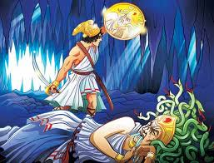
What is this reflective shield that can show us the danger without turning us to stone?
The answer, of course, is art, this magic reflective shield.
— Kathleen Dean Moore

Slide 18
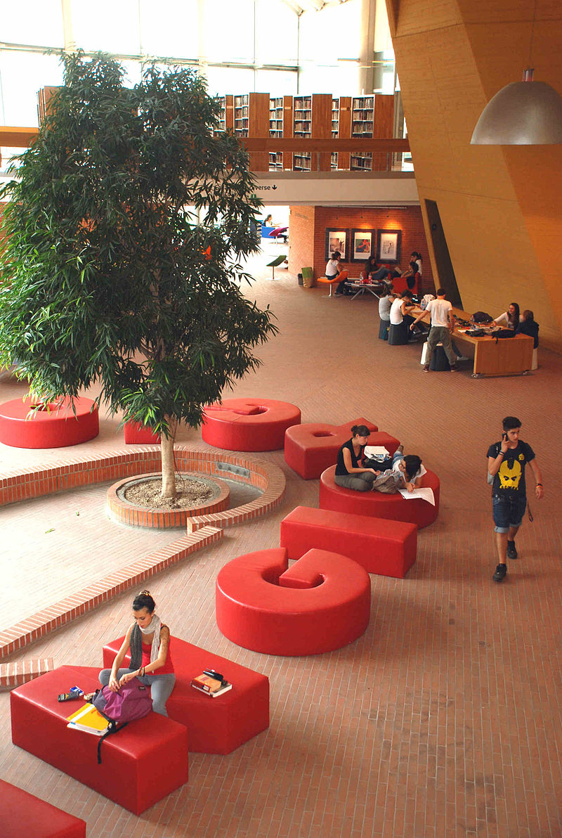
Why libraries? Why us?
Culture of trust
Accessible space / 3rd space
Resources
Connectors
Amplify our partners’ work

Slide 19
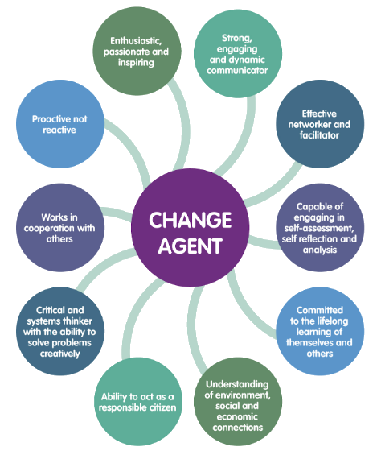

Slide 20
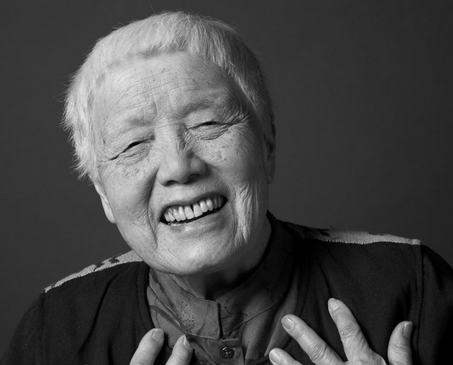
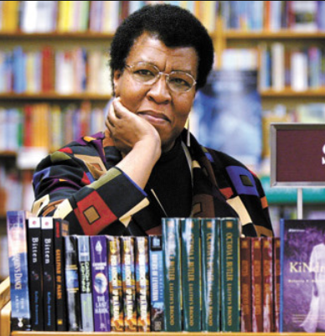
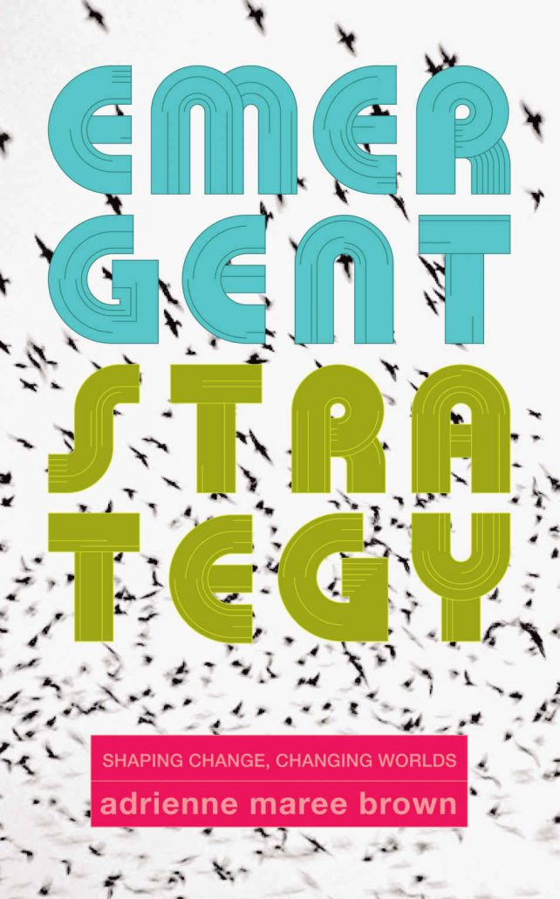
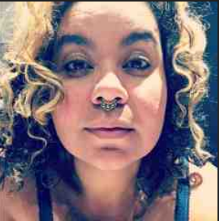
Transform yourself to transform the world.
All that you touch
You Change.
All that you Change
Changes you.
The only lasting truth
Is Change.
Grace Lee Boggs
Octavia Butler
Emergent Strategy: Shaping Change, Changing Worlds
Adrienne Maree Brown

Slide 21
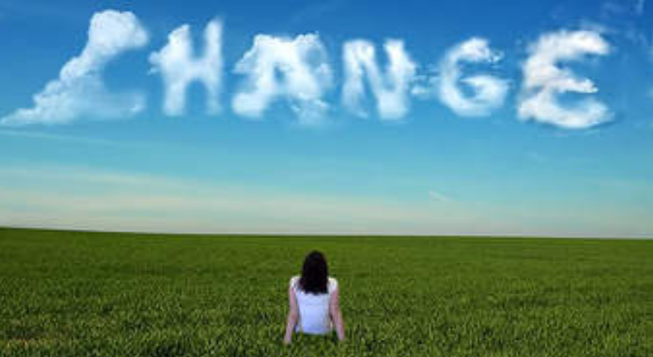
Adapt
“Change is definitely going to happen, no matter what we plan or expect or hope for or set in place. We will adapt to that change, or we will become irrelevant.”
—adrienne maree brown
PAIR-SHARE
Think of a time when you felt empowered by a change in your life.
Notes:
Adapted from https://www.colorlines.com/articles/three-lessons-adrienne-maree-browns-emergent-strategy

Slide 22

Massachusetts Libraries Partner with Climate Prep Week
A model for your state?
Coordinated by Communities Responding to Extreme Weather (CREW)
Goal: 50 library events hosted the last week of Sept. 2019
World Cafe & other formats
Partnerships key

Slide 23





…………………………….………………………………………………...

Slide 24
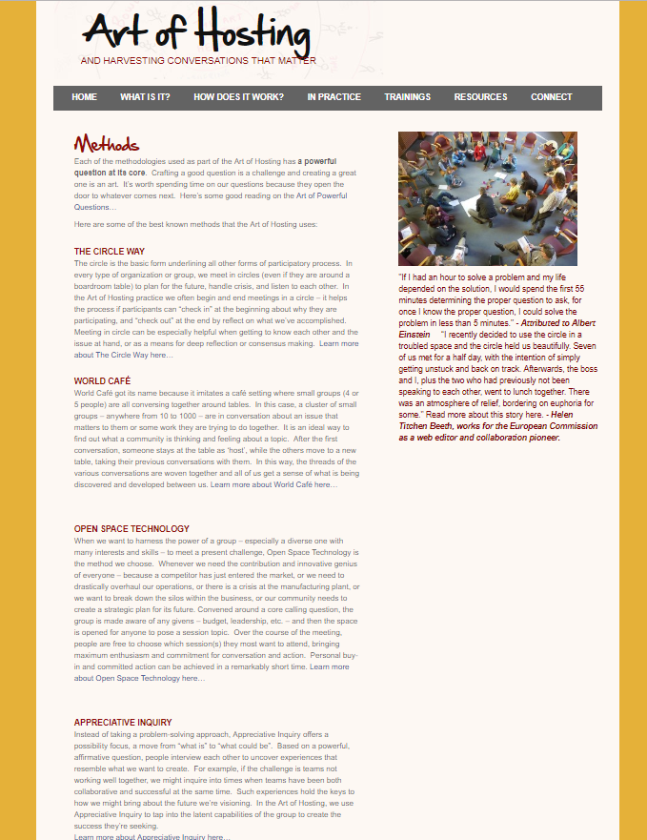
The Art of Hosting offers a blend of powerful methods to create open and meaningful conversation that leads to commitment and good results.
Working with a range of collaborative methods – like Circle, World Café, Appreciative Inquiry, Open Space Technology, ProAction Café, storytelling and more – practitioners can tailor the approach to their context and purpose.

Slide 25
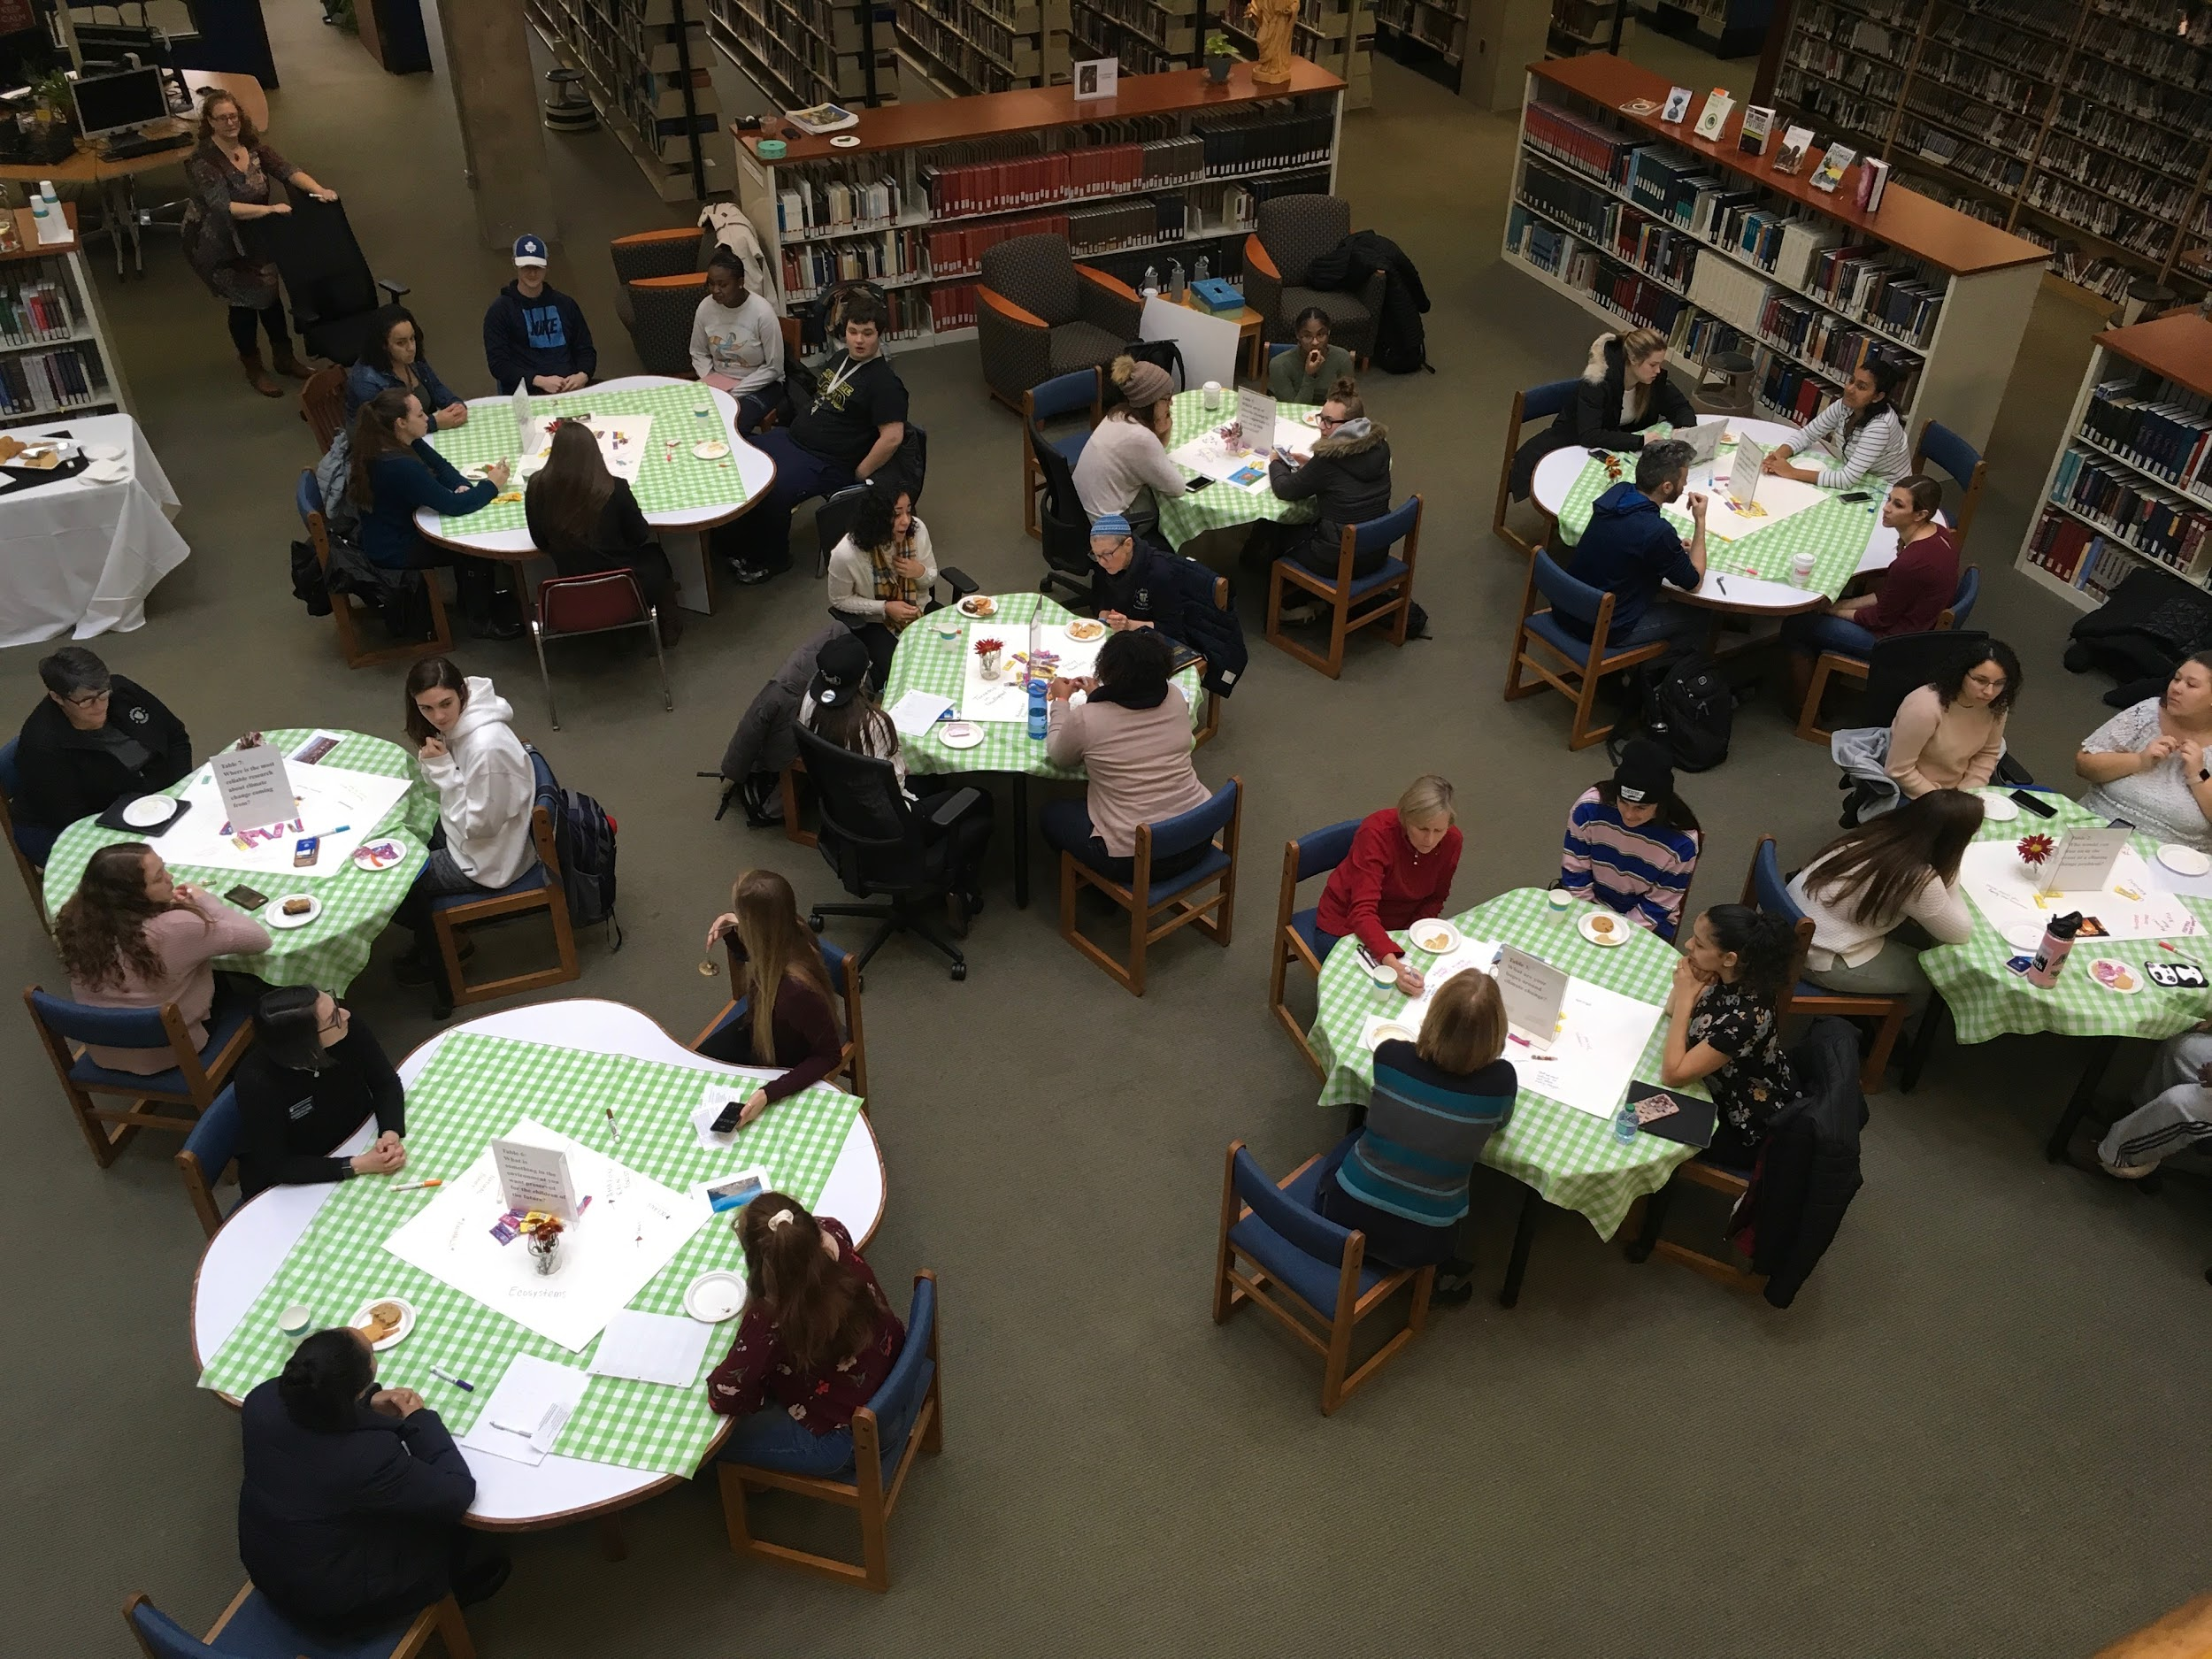
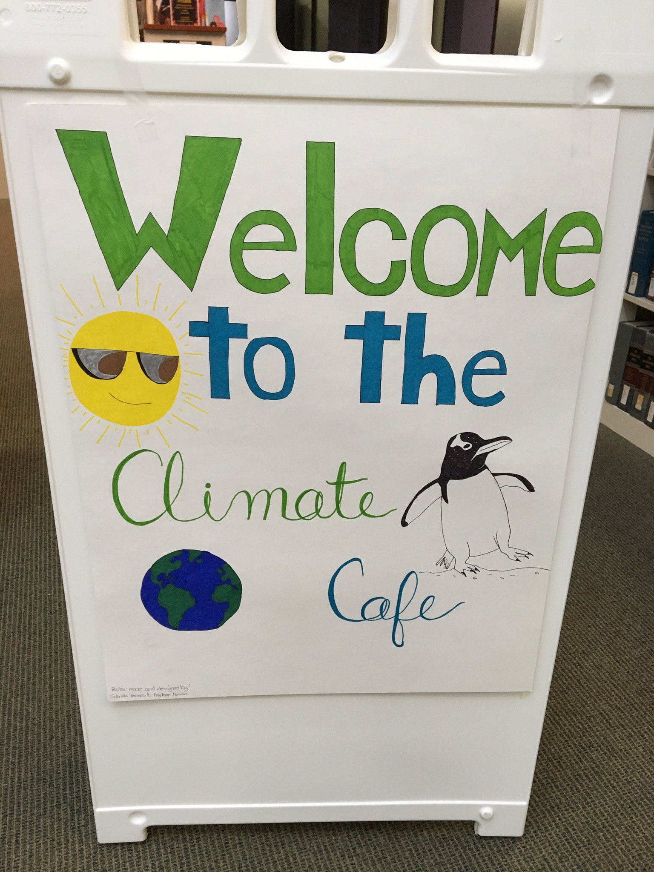
Merrimack College Library: World Cafe

Slide 26
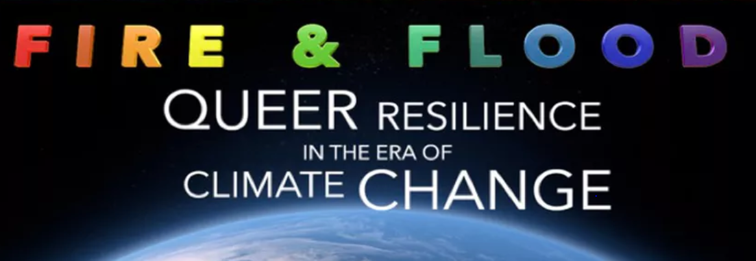
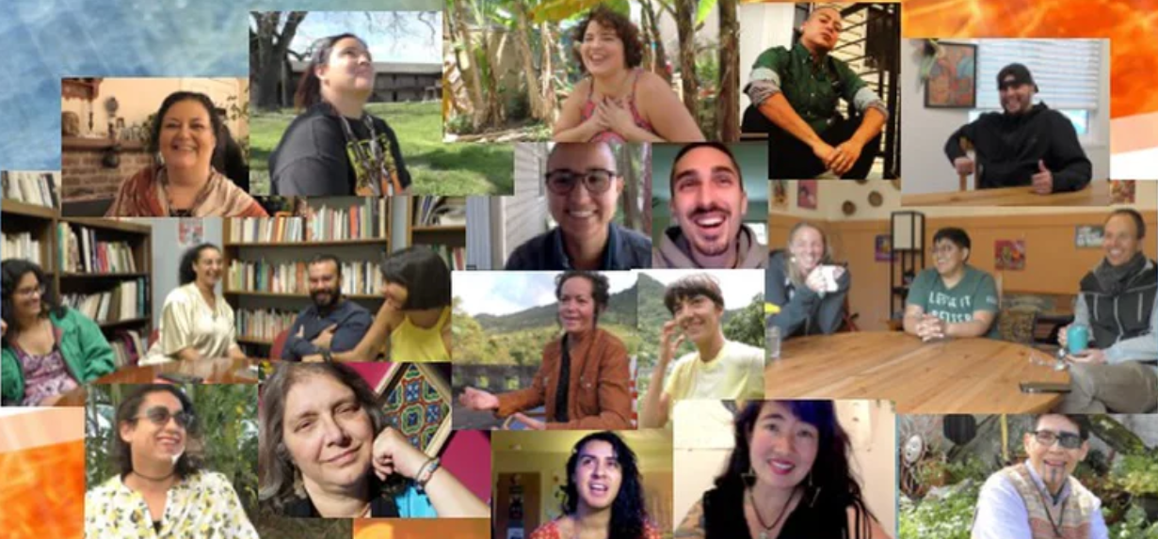
UMass Amherst Libraries: film screening/discussion

Slide 27
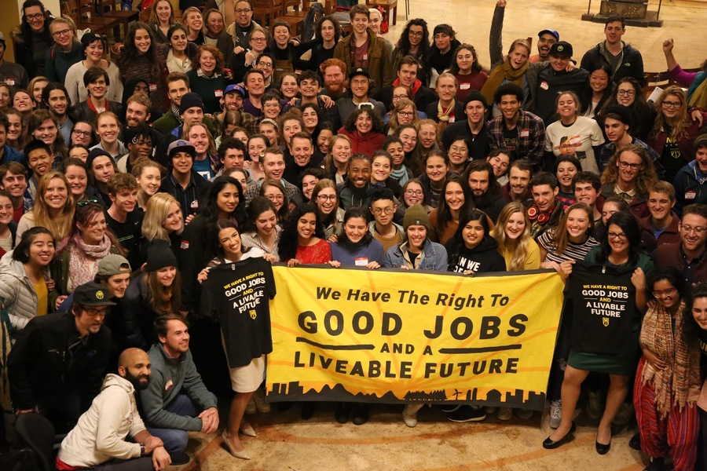
Wellfleet Public Library: Green New Deal Town Hall

Slide 28
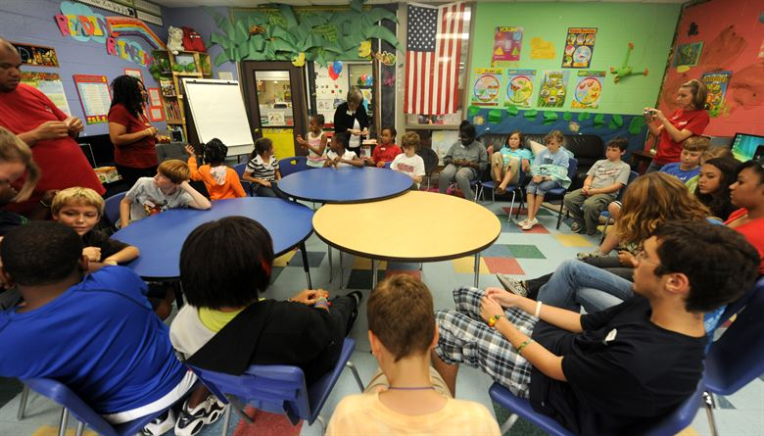
Youth empowerment circle

Slide 29
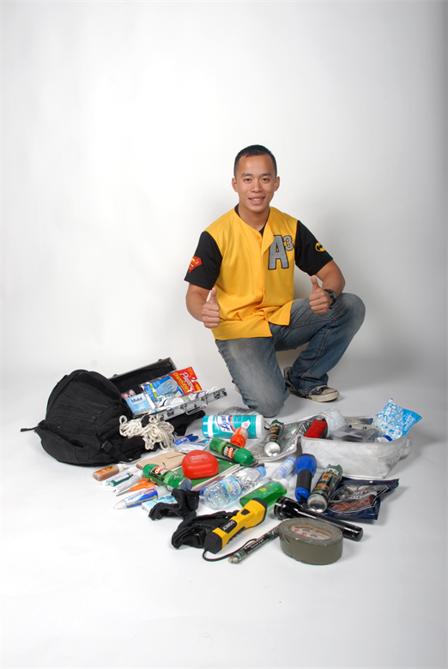
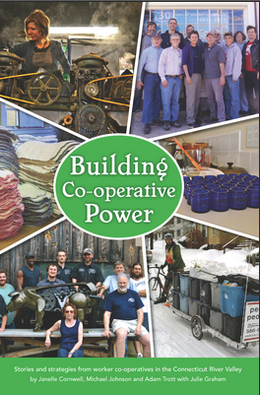
Go Bag Workshop
Learn about Energy Democracy

Slide 30

Meeting Our Ancestors:
Explore the Future through the Present Moment
Image: https://wall.alphacoders.com/big.php?i=864719&lang=Russian
A sacred deep time practice
From Joanna Macy’s “Work That Reconnects”

Slide 31
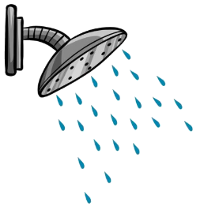
A shower of other ideas
Art exhibit; performance
Resilience reading group
Information fair
Tour of town/campus waste management facilities
Mindfulness practices
Human Library
Community service activity (e.g. tree planting)
Story slam
Makerspace (e.g. composting toilet, solar oven)

Slide 32
A shower of potential partners
Outdoor recreation
Municipal government
Book store
School -- K-12 & higher ed
Climate change activist group
Mental health agency
Public health agency
Community garden; food justice group
Music, theater, dance, art group
Mindfulness center
Community center
Farmers, foresters, fisherpeople
Faith groups
Non-profit organizations
Chamber of commerce
Local businesses/cooperatives
Alternative energy groups
Social services

Slide 33
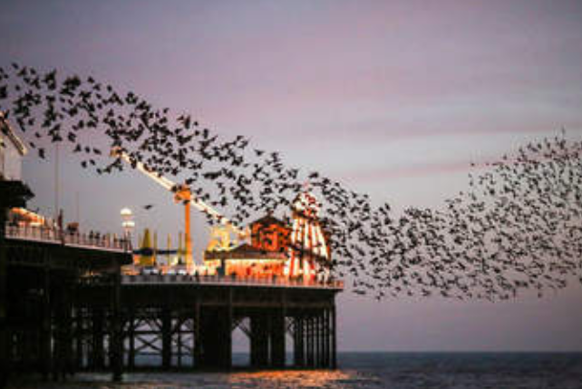
Flock
“There is an art to flocking: staying separate enough not to crowd each other, aligned enough to maintain a shared direction...”
- adrienne maree brown
PAIR-SHARE
Think of a successful and satisfying collaboration (e.g. with a friend, partner, co-worker).
What made it work so well?
Notes:
Adapted from https://www.colorlines.com/articles/three-lessons-adrienne-maree-browns-emergent-strategy

Slide 34
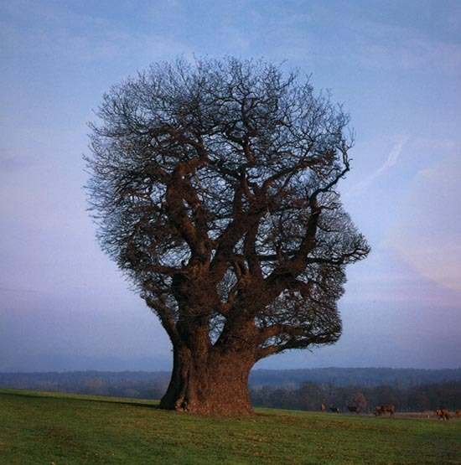
Why pair mindfulness with climate change?
Notes:
JS

Slide 35
Benefits of mindfulness practices
Decrease stress; stabilize nervous system
Increase concentration
Improve decision making/problem solving
Inspire compassion, commitment to social justice
Social/emotional growth
More meaningful interactions/experiences

Slide 36
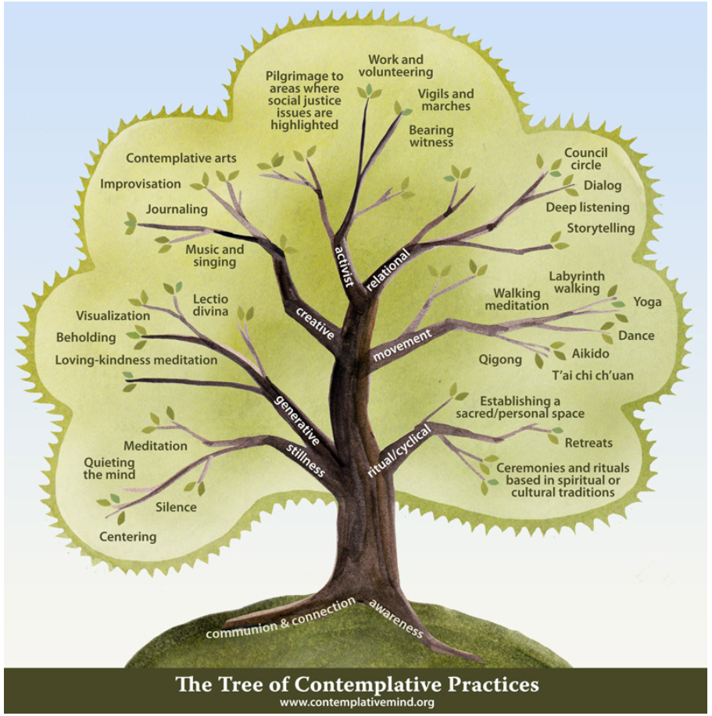

Slide 37
On meditation (adrienne maree brown, Emergent Strategy)
Meditation is about choosing where my attention goes. Training my attention.
If we haven’t cultivated mindfulness in our attention, how do we ever expect to break out of the cycle of crisis responses?
How will we ever put our attention onto solutions, put our attention onto the new practices we need?
When I am overcome by sadness, loss, anger, joy, desire, restlessness…it helps to be able to drop into myself and choose – to be with the emotions, to listen for what’s needed.
Meditation kept waiting for me, around every corner, in every room. Grief was the gift that finally let me understand meditation.
The more I listen, the more I understand the interconnectedness of the world, and my place in it. My insignificance, my wholeness, our collective potential and beauty.
Notes:
From Emergent Strategy

Slide 38
GROWTH model (Bob Doppelt)
Ground - and center yourself by stabilizing your nervous system
Remember - your personal strengths, resources and social support network
Observe – your reactions to and thoughts about the situation non- judgmentally and with self-compassion
Watch – for new insights and meaning in life in climate-enhanced hardships
Tap – into the values you want to live by in the midst of climate adversity
Harvest – hope for new possibilities by making choices that increase personal, social, and environmental possibilities
From Bob Doppelt’s Transformational Resilience: How Building Human Resilience to Climate Disruption Can Safeguard Society and Increase Wellbeing

Slide 39
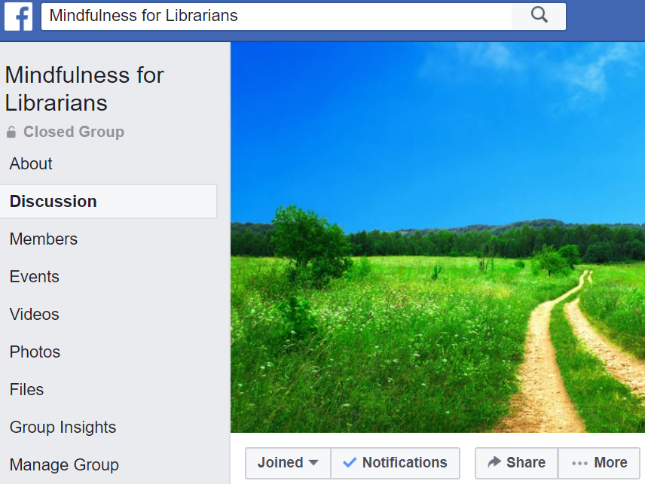
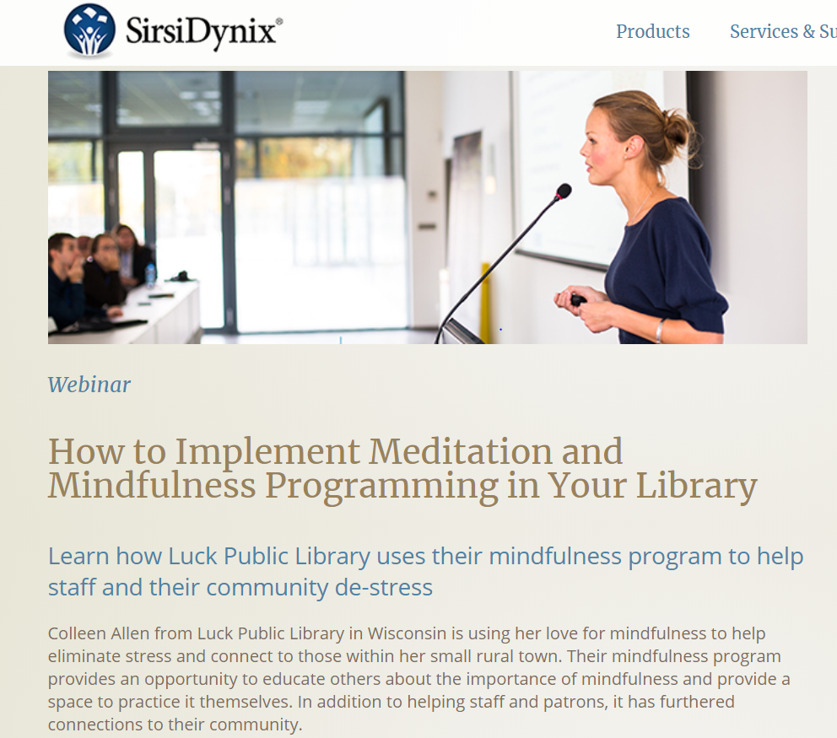



Slide 40

Ground
We need to change our habits of thought, belief and doing, as well as change our systems. Each level reinforces the other.
— Charles Eisenstein
PAIR-SHARE
How do you manage your thoughts and feelings, recharge/ground, connect to others, and stay curious and open and functional…
in the midst of social, economic, and environmental uncertainty and injustice that we face?

Slide 41
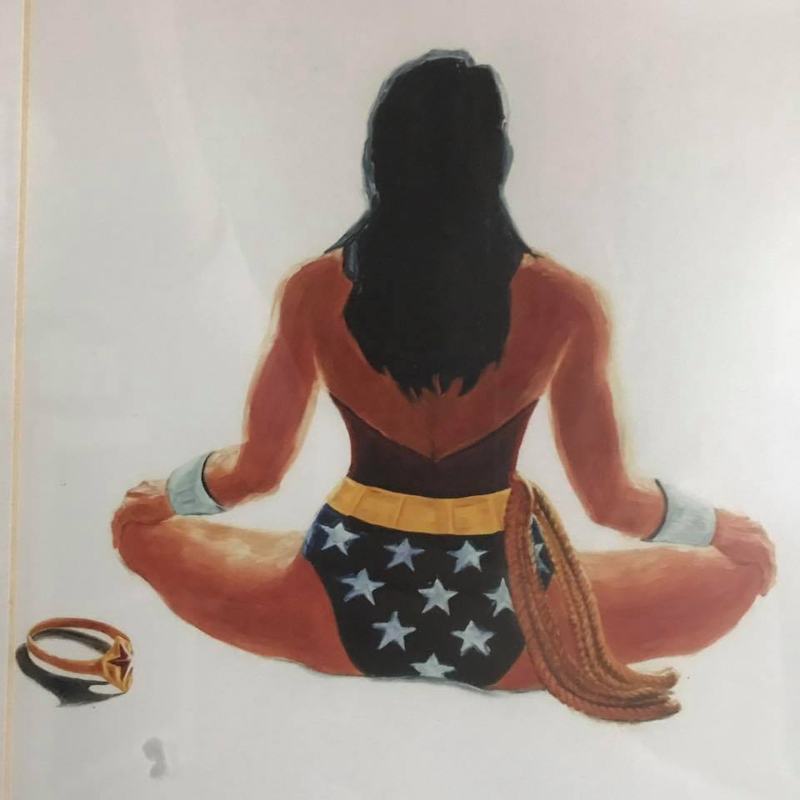
What are your librarian super powers?
Make welcoming spaces
Get funding
Take risks
Connect people to resources
Teach
Advocate
Facilitate
Create art, music, stories
Humor
Your passion here...

Slide 42
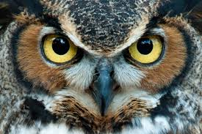
Fellow librarians, we ask you...
Who do you choose to be for this time?
Are you willing to use whatever power and influence you have to create islands of sanity that evoke and rely on our best human qualities to create, relate, and persevere?
Will you consciously and bravely choose to reclaim leadership as a noble profession that creates possibility and humaneness in the midst of increasing fear and turmoil?
— Margaret Wheatley
Notes:
From Who Do We Choose to Be? Facing Reality, Claiming Leadership, Restoring Sanity

Slide 43
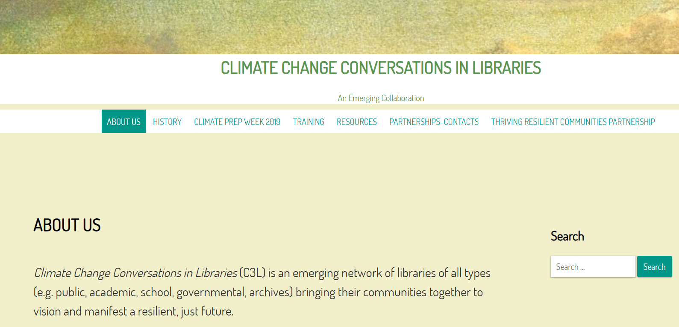
https://climatechangeconversationsinlibraries.umasscreate.net/

Slide 44
Images
Extreme weather:
http://earth-chronicles.com/natural-catastrophe/in-india-a-heat-wave-killed-500-people.html
https://www.danchurchaid.org/articles/drought-emergency-in-central-america-s-dry-corridor
https://www.miamiherald.com/opinion/editorials/article224405100.htmlhttps://www.miamiherald.com/opinion/editorials/article224405100.html
Climate resilience https://www.climatecrew.org/resilience_hubs
Perseus: https://greekmythology1o1.wordpress.com/2015/05/02/who-are-some-famous-heroes-in-greek-mythology/
Clouds https://cosmosmagazine.com/climate/why-do-clouds-float
Shower https://making-the-web.com/cartoon-shower
Fire & Flood https://queerecoproject.wixsite.com/qollective/fire-and-flood-film-project
Green New Deal https://actionnetwork.org/event_campaigns/town-halls-for-a-green-new-deal/
Youth Circle https://www.moody.af.mil/News/Article-Display/Article/210648/families-learn-to-overcome-challenges-of-military-life/
World Cafe http://www.theworldcafe.com/tools-store/hosting-tool-kit/
Go Bag https://www.af.mil/News/Features/Display/Article/142593/charlie-the-guy-with-the-backpack/
Change Agent http://d-demaree.blogspot.com/2011/12/agent-of-change.html
Libraries Transforming Communities: Models for Change: http://www.ala.org/tools/librariestransform/libraries-transforming-communities/ltc-models-for-change
Owl: http://www.jessalmlie.com/wiseleader/

