Slide 1
Fellows Forum
Library Publishing Forum 2018
Minneapolis, Minnesota
Charlotte Roh, University of San Francisco, 2017-2018 LPC Fellow
CC-BY

Slide 2
We are on
Anishinabek (ᐊᓂᔑᓈᐯᒃ) land.
Notes:
Thank you to the Library Publishing Forum planning committee and the Library Publishing Coalition for having me here. I want to first acknowledge that we’re on native land – a NISH eh NA bek actually means “people of this place”. In Minnesota, there are seven Anishinaabe (Chippewa, Ojibwe) reservations and four Dakota (Sioux) communities, so eleven federally recognized tribes today.

Slide 3
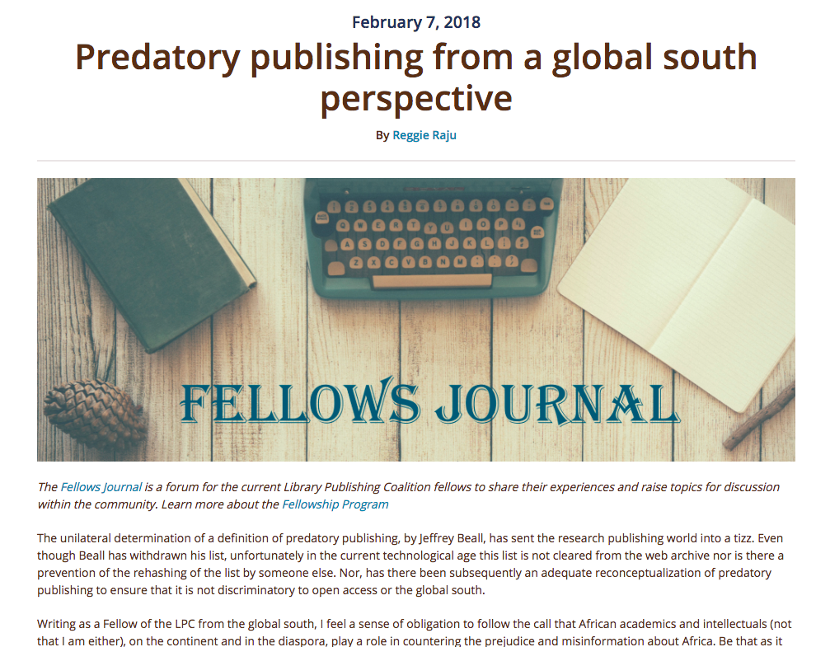
Notes:
It’s been an incredibly rewarding year as one of the inaugural LPC Fellows, and one of the reasons is the proximity to Reggie Raju and his energy around open access and library publishing in the Global South. We both agree on the need for a decolonized scholarly communication system, and many of you have already heard me talk, several times, on the topic of the biases in the scholarly communication ecosystem and the lack of representation that we have in our culture that privileges the white, heteronormative, able-bodied, and wealthy.

Slide 4
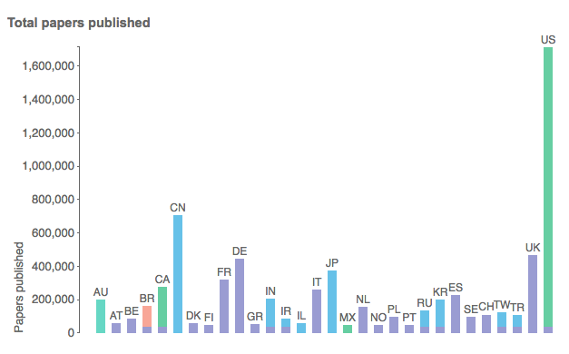
“Scientists in these 30 countries contributed the largest shares of the more than 5 million papers published between 2008 and 2012.”
Larivière, V., Ni, C., Gingras, Y., Cronin, B., & Sugimoto, C. R. (2013). Bibliometrics: Global gender disparities in science. Nature, (7479), 211. doi:10.1038/504211a
Notes:
These are not easy issues to address, but I think one of the silver linings of the current political climate is that these issues are no longer considered ancillary. One of the analogies that I’ve been using is the mold that you’ll find on cheese versus the mold on bread. For example, for a long time, I thought that racism was like the mold on cheese, you can learn that it exists, cut if off, and the rest is good. But I’m realizing more and more, embarrassingly late in my life, how it’s really more like mold on bread, and I think in today’s media coverage we’re seeing the full ugly bloom. And that’s a more difficult problem, because how do you fix an entire system that has been compromised? We all know that our universities were built as extensions of empire, quite frequently with human labor and lives as the cost, and even now are paid for through what are sometimes ethically suspect ways – investment in private prison systems, as an example. We all know that our scholarly communication system is compromised: that peer review can be biased and just flat out not work; that authorship and citations are predominantly male, white, and Western; that people with the wrong kind of names and the wrong kind of English are not treated fairly.
And to be fair, over the past two years, I’ve seen real proof of the desire to change some of the problems. The American Geophysical Union, for example, made an effort to include more women in their peer reviewer pool, which resulted in more female first authors. Beacon Press has a commitment to 30% minority representation in their staff. AAUP has a diversity fellowship that’s actually resulted in permanent hires, SSP has a diversity and inclusion committee, and here at the Library Publishing Coalition, we’ve just finished the Ethical Framework for Publishing, which is open for comment now. I learned so much working on the Ethical Framework, and incredibly grateful for that opportunity as well as proud to call myself a library publisher and part of an organization that makes this kind of effort. I really hope that the framework becomes as important to publishers generally as the COPE guidelines, but I will also acknowledge that it’s a very U.S.-centric document and therefore doesn’t even begin to address some of the real problems highlighted by Reggie today. And I am not qualified to speak on these global issues, first because the education that I received was sadly inadequate, but also because I shouldn’t for the same reason that the West can’t create a decolonized curriculum, and as Reggie just said, only African texts can address this need in Africa and only African texts should.

Slide 5
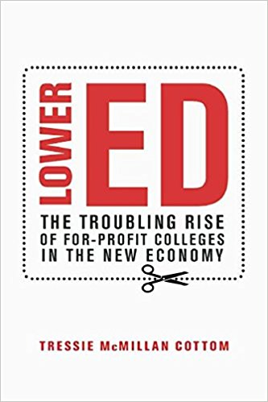
“We live in an age of colorblind delusions, so it is possible to think that intent makes something sexist or racist. I’m a sociologist. For me, perpetuating the inequalities resulting from intergenerational cumulative disadvantage doesn’t require intent. In fact, racism and sexism work best of all when intent is not a prerequisite.”
- Tressie McMillan Cottom, Lower Ed: The Troubling Rise of For-Profit Colleges in the New Economy. The New Press, 2017, Page 187
Notes:
So what is our role as Western publishers, with Western educations, who are privileged and want to use that privilege in constructive ways? The first step is to teach ourselves, about our own histories and our own problems, and that’s something I’m sure you’ve heard before and that we’re all at work on now, myself included. I almost want to say that along with the ethical framework for library publishers, we should have cultural competencies for library publishers, but there already exists a textbook for cultural competencies for librarians and several disciplines with academic literature around American/Western history. That said, if someone wants to work with me on a curriculum or reading list, please get in touch.
The second is to support the efforts of decolonizers. Again, many of us are already doing this work, through our publishing of intersectional cutting edge works that might have been told elsewhere that they don’t have an audience. These are valuable efforts, but I worry about two things: First, that our efforts are inadequate, and second, that our efforts will be co-opted. And these are not groundless fears. I’d like to read a quote from VCU OpenCon last year in which the keynote speaker, Tressie McMillan Cottom, talked about how, in her program, they really wanted to make the entire program open educational resources, but they simply couldn’t because:
“[O]ne of the things we noticed, is that what we were really lagging in, even more so than like quality and rigor, were the open educational resource materials that deal in things we really care about, particularly race, class, and gender. And/or slash inequality. What we did not have were open educational resources that look at African American experiences, the experiences of women, gender wage gap, almost nothing about sexualities, almost nothing about sort of queer theory, some of the major sociological theories that have emerged over the last 30 years that are really driving the discipline. There were almost no materials about intersectionality, et cetera. Again really important things, critically open, to critical sociology. There was almost nothing. So we couldn’t use open educational resources in that context.”
OpenCon: Tressie McMillan Cottom: Open in the Age of Inequality, starting at 21:30 https://youtu.be/v0omZY-z0yw
This is an example of a successful academic who believes in open access, in open education, who is well supported by her library, and who couldn’t find any resources that were contemporary and critical of inequality. This is why it is important, as open access advocates who do care, and who have dual roles as gatekeepers and enablers, that we learn more about the injustices around us. We have an opportunity, as we remake scholarly publishing, to look beyond the traditional systems of value and power for more inclusive, intersectional publishing processes for sustainable social justice outcomes.

Slide 6
Open access for sale
2011: Springer acquires twelve open access journal titles from Hindawi
2011: Wolters Kluwer Health acquires Medknow PVT Ltd., a leading Scientific, Technical & Medical (STM) journal publishing operation headquartered in Mumbai, India and one of the largest open access publishers in the world
2012: De Gruyter acquires Versita and becomes third-biggest international Open Access publisher
2013: Elsevier acquires Mendeley
2015: Elsevier acquires National Autonomous University of Mexico (UNAM) journals
2016: Elsevier acquires SSRN
2016: SAGE Publishing acquires Libertas Academica
2017: Elsevier acquires BePress
Notes:
The other fear that I mentioned, the co-opting of our work by others, is also a fear that isn’t new to anyone. We all know that Elsevier buys journals, platforms, and tools, but they’re not the only ones. This is just a short list, but if you look at the press releases of any of the big five, you can see examples of purchases of open access journals, poaching of publications from Hindawi and the National Autonomous University of Mexico. These journals are and have always been open access, like all of the academic publications in Latin and South America have always been open access because they are through publicly funded, now they have been contracted to Elsevier under terms that have not been made public. When our colleagues put out a statement about this contract, where were we? I think we should be more aware and more outraged that companies like Elsevier aren’t just co-opting our labor, time, and resources, but the labor and output of countries and universities around the world. And this isn’t new, we know that so many researchers perform colonial research, going into countries for fieldwork, mining local information, and reporting on knowledge in academic English in a way that legitimizes their lens over the actual owners.

Slide 7
Version 1 and Version 2 of Elsevier’s Sponsorship Message
As a CARL President's Circle level sponsor, Elsevier has opted to provide a promotional message to be read at the beginning of this session:
Elsevier would like to thank the CARL committee members for the opportunity to support their development in leadership education. Elsevier's Research Intelligence solutions answer the most pressing challenges researchers and research managers face, with innovative solutions that improve an institution's and individual's ability to establish, execute and evaluate research strategy and performance. We work in collaborative partnership to meet your specific needs using SciVal tools, the Pure system, rich data assets, and custom Analytical Services. Our solution supports the three primary pillars of strategic research management workflow by providing reliable data and information to facilitate better decision making. We look forward to learning more about you and how we can work together to address your research management needs.
Elsevier would like to thank the CARL members for this opportunity to support their development and advocacy of the library community. As a global information analytics company, Elsevier is strongly interested in supporting library programs that provide educational and innovative forums that will serve to strengthen research and scholarly communities. We hope you were able to attend the two sessions led by Linda Galloway, customer consultant from Elsevier, and also a recent librarian. The topics were “Responsible Use of Metrics: the Library can help”, and “Librarians’ role in research performance analytics.” If you missed it or have any questions, feel free to look for Linda or any member of the team.
Notes:
Commercial publishers, who now brand themselves as information and technology experts, are doing this very thing, performing the colonial mining of knowledge to sell it back to us, libraries and institutions in the Global North, just like the clothes that I buy and wear and the cell phone that I carry are the results of labor and resources, that are not ethically sourced and produced.
And I don’t have a solution for this, and certainly our solution isn’t going to be Elsevier’s solution, which is to hire a corporate consultant to audit its environmental practices and its diversity across all its global offices. Some of you are familiar with the UK gender pay gap reports. Elsevier’s report said, “The reason for the total pay gap at Elsevier Limited, is that there are more men than women in senior roles, which are higher paid roles, and more women than men in lower paid roles…. Many factors contribute to this. For example, Elsevier Limited recruits a lot of employees from STEM (science, technology, engineering and maths) industries, which attract more men than women.”
https://www.thebookseller.com/news/elsevier-reports-40-gender-pay-gap-759606

Slide 8
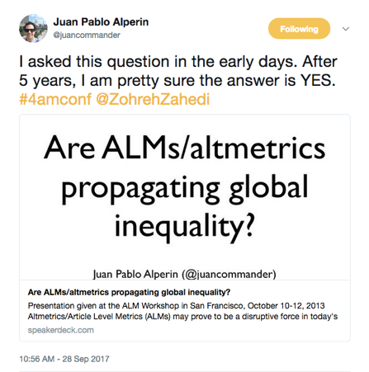
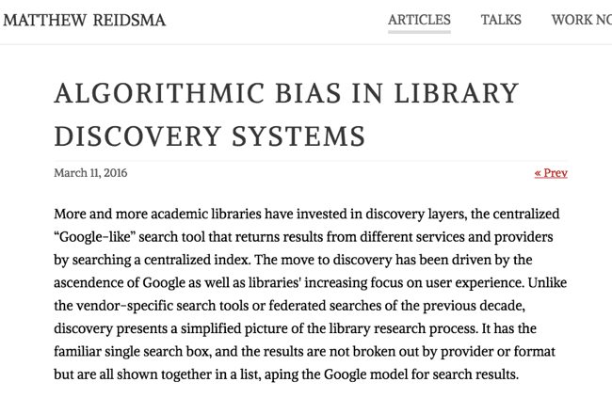
Publishers as technologists
https://matthew.reidsrow.com/articles/173
Notes:
This attitude, that it’s not the fault of people, but of roles, or machines, is a familiar one to me, as someone who lives and works (and at some point tried to date), in Silicon Valley. Once I actually got into a conversation with someone at Facebook who refused to believe that data ethics was a thing, because math is neutral. I’m not proud of what I said in that conversation, but I wasn’t able to convince this person otherwise, either.

Slide 9
My To-Do List versus My Concerns
Educate ourselves
Work for decolonization of scholarly communication
Inadequate efforts
Co-opting of good work/labor
Notes:
This is all to say that sometimes I’m discouraged, because I am not doing enough and even though my campus just passed an open access policy, our repository is still owned by Elsevier, who has a gender pay gap twice the UK national average.

Slide 10
Examples of Action
Library Publishing Coalition’s Ethical Framework for Library Publishing
Association of American University Presses (AAUP) Diversity Fellowships, funded by Mellon
Martin Paul Eve, co-director of the Open Library of the Humanities
  “[D]iversity of participation is important to our platform … we will actively monitor and release reports on demographics across our platform (particularly with respect to editors), taking measures, where necessary, to remove barriers to participation and to ensure breadth of representation.”
OpenCon Diversity Statement available at https://sparcopen.org/wp-content/uploads/2017/07/Diversity-Equity-and-Inclusion-Report-July-10-V1-Release.pdf
Society for American Archivists’ Cultural Heritage Working Group has new protocols on the rights of cultural groups
Notes:
But I shouldn’t be discouraged, because as Amy Buckland noted earlier, we have come so far! So far in the last 10 years, in the last 5 years, just since last year in the number of people who are here at this conference and oh my gosh we had a keynote around diversity and accessibility in scholarly communication. So I’ll end on that note, with the hope that all these issues that Reggie and I are bringing to you today might actually be solvable, that we as a community can work together and partner with others in order to accomplish a more just scholarly communication system.

Slide 11
Questions and Discussion?

Slide 12
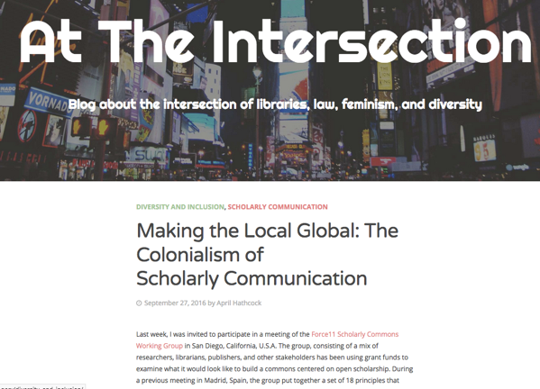
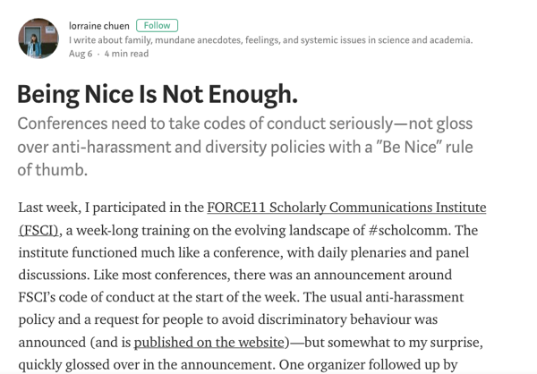
https://aprilhathcock.wordpress.com/2016/09/27/making-the-local-global-the-colonialism-of-scholarly-communication/
https://medium.com/@lorraine_chu3n/being-nice-is-not-enough-b9f4f9184707

Slide 13
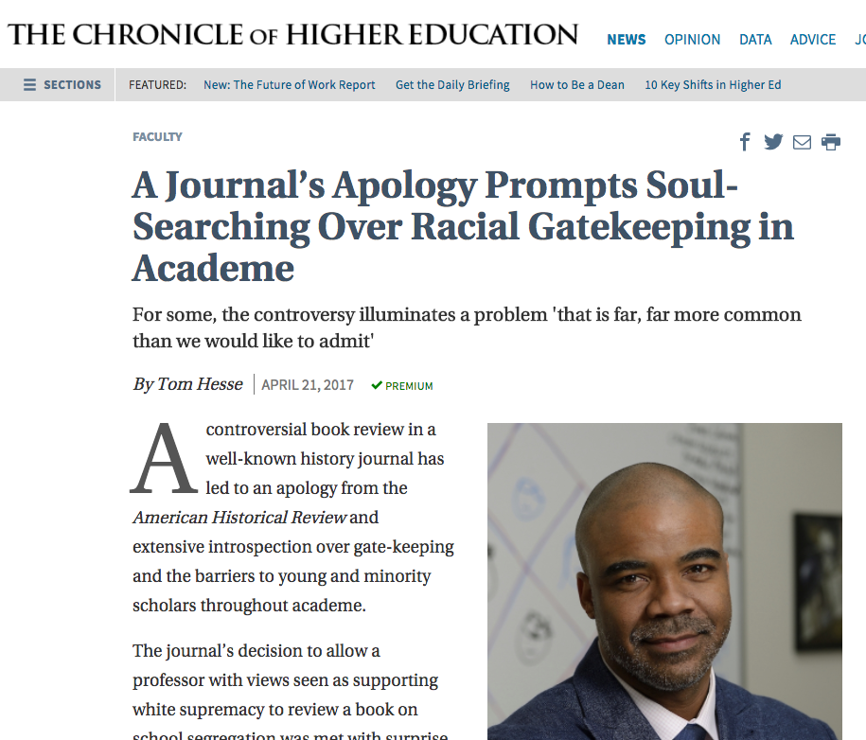
In 2017 alone…
American Historical Review, a leading history journal, apologized for assigning a review to a white supremacist.
  Jaschik, Scott, “The Wrong Reviewer,” Inside Higher Ed, April 18, 2017. https://www.insidehighered.com/news/2017/04/18/history-journal-apologizes-assigning-review-book-urban-education-and-inequality
Hypatia, a feminist philosophy journal, apologized for and retracted a paper that analogized Rachel Dolezal to transgender people.
  Anderson et al, “Statement by the Board of Hypatia” Hypatia, May 18, 2017, http://hypatiaphilosophy.org/Editorial/index.html#boardstatement
The Journal of Political Philosophy apologized for an issue devoted to the Black Lives Matter movement that included zero black authors.
  Krishnamurthy, Meena, “Open Letter from the Editors of the Journal of Political Philosophy” Philosopher, May 25, 2017. https://politicalphilosopher.net/2017/05/25/open-letter-from-the-editors-of-the-journal-of-political-philosophy/.
  Third World Quarterly had 15 members of its editorial board resign because an article espousing colonialism that was rejected by peer reviewers was still published.

