Slide 1
What is access?
American University Colloquium on Scholarly Communication
Charlotte Roh, University of San Francisco
@charlotterock |croh2@usfca.edu

Slide 3
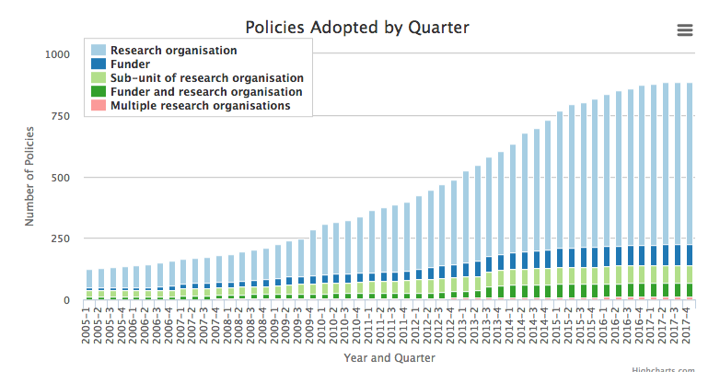
Registry of Open Access Repository Mandates and Policies (ROARMAP) November 2017

Slide 4
Policy from SPARC
Executive Directive on Public Access
2013: requires U.S. Government agencies with annual extramural research and development expenditures over $100 million make the results of taxpayer-funded research—both articles and data—be made freely available to the general public with the goal of accelerating scientific discovery and fueling innovation
California Taxpayer Access to Publicly Funded Research Act (AB 609)
2014: Requires researchers receiving a state-funded grant from the California Department of Public Health to submit an electronic copy of articles resulting from that grant and accepted for publication to a publicly accessible online database
U.S. National Cancer Moonshot Initiative
2016: Make U.S. National Cancer Institute funded articles and data open access upon publication
FASTR: Fair Access to Science & Technology Research Act (H.R. 3427 / S. 1701)
Re-introduced in Congress this year: Making articles reporting on publicly funded scientific research freely accessible online for anyone to read and build upon
The OPEN Government Data Act (S. 760 / H.R. 1770)
Reintroduced in Congress this year: Bill to codify former President Obama’s Executive Order making “open and machine readable” the default for all government data
Department of Education Open Licensing Rule
2017: The U.S. Department of Education has adopted an open licensing policy for grant-funded educational resources. The policy requires by default that recipients of competitive grants apply an open license and have a plan to publicly disseminate educational resources and other works created with grant funds.
The Affordable College Textbook Act (H.R. 3840 / S. 1864)
Reintroduced in Congress this year: Grant program supporting OERs and tracking of price trends of textbooks
https://sparcopen.org/what-we-do/active-policy/

Slide 5
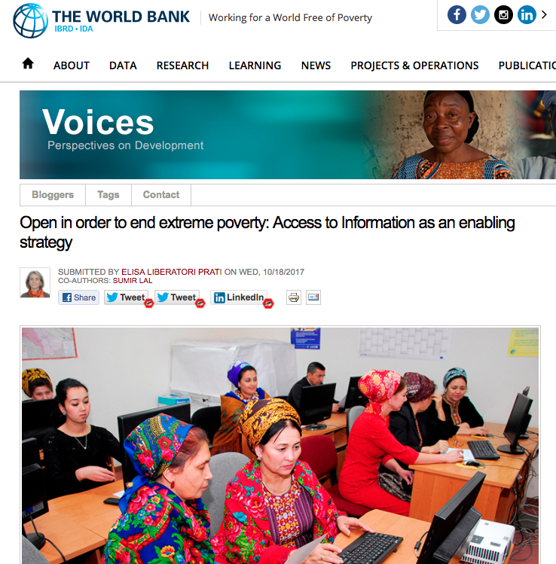
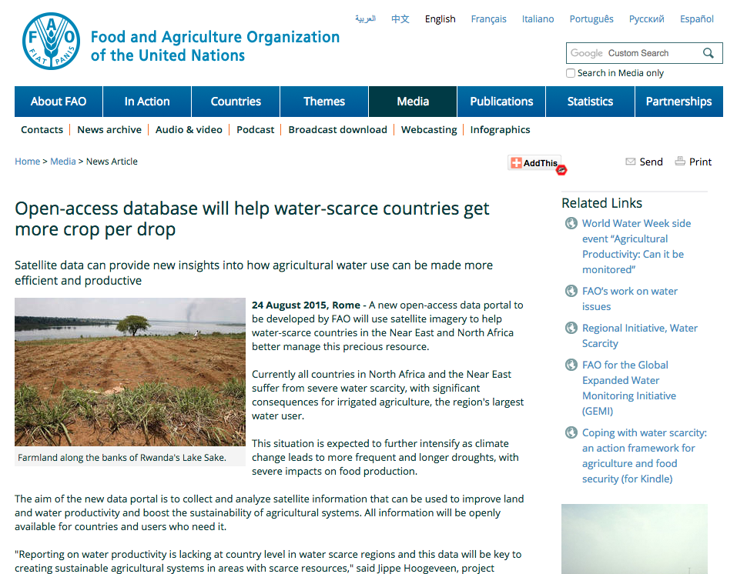
Notes:
Here are a couple stories featured on the SPARC website, on how open access resources help to end party and help countries grow crops with less water.

Slide 6
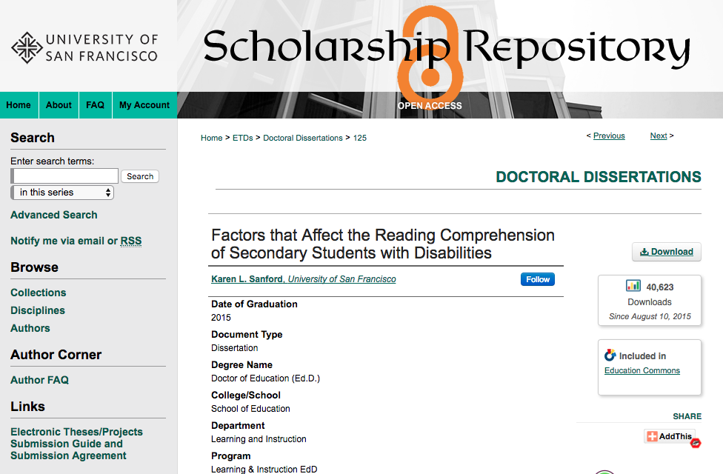
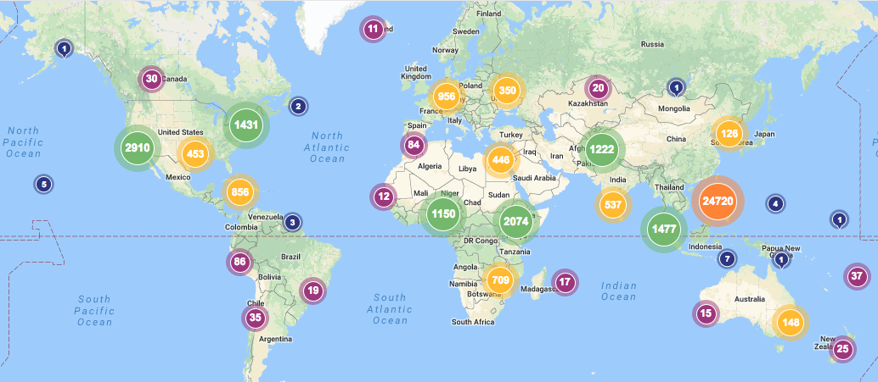
Notes:
Here’s an example from our Scholarship Repository. The number one downloaded paper is about reading comprehension for students with disabilities, and has over 40,000 downloads.
I have over 60 slides for one brown bag, and I don’t even touch the surface of all that we’ve accomplished. I don’t go into legislation that’s been passed for open access, open data, and open education. I don’t even go into open education, which I’m sure all of you know has been having real measurable impact on the lives of students.

Slide 7
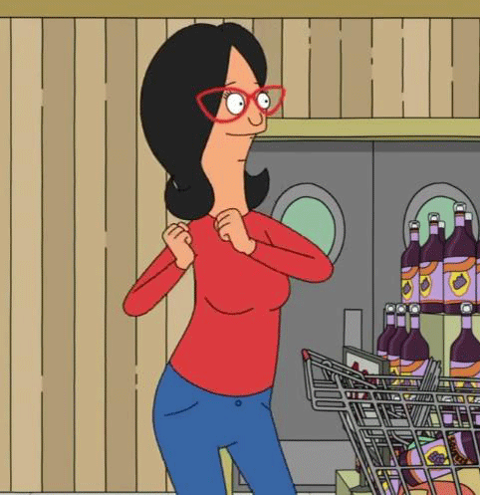
Open in order to…celebrate!
Notes:
So we have a lot to celebrate, for all that we’ve accomplished in the open access movement. But…and I know you can hear that “but” coming.

Slide 8
John Lewis accepting
National Book Award
https://youtu.be/uqmYNOPVyO4
Notes:
I want to show you all this video of John Lewis accepting the National Book Award. It’s not very long, but it’s an exceptional 2 minutes.

Slide 9
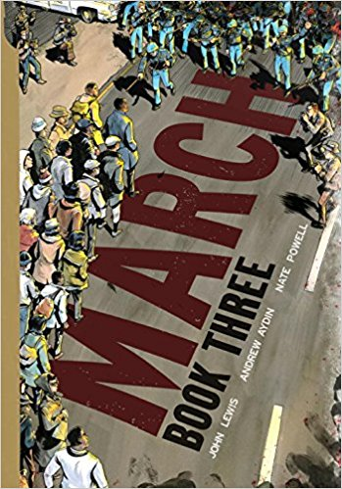
Librarians as Gatekeepers
Notes:
There’s a lot to unpack in this video. First, March is the first comic book to ever win this award. This is because until recently, we thought comic books were a bad influence on kids. As librarians, we participated in what has been called the biggest self-censorship of any industry, by the comic book industry. This was all based on faulty research by Fredric Wertham, and recently disproved by Carol Tilley, a librarian at Urbana-Champaign.

Slide 10
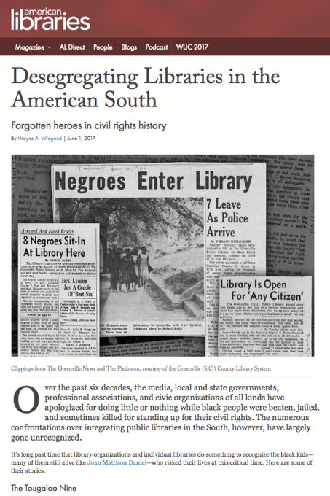
Librarians as Gatekeepers
1896: The U.S. Supreme Court decision Plessy v. Ferguson establishes the “separate but equal” law that legalizes segregated libraries.
1954: Brown v. Board of Education Supreme Court decision declares “separate but equal” facilities based solely on race unconstitutional.
https://americanlibrariesmagazine.org/2017/06/01/desegregating-libraries-american-south/
Notes:
Second, is how librarians didn’t just ban books, but we banned people.

Slide 11
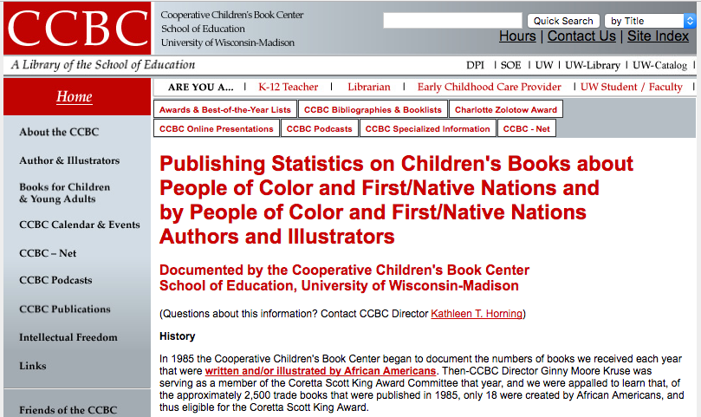
Publishers as Gatekeepers

Slide 12
Race/Ethnicity of Mainstream Publishing Professionals
Low, J. “Where is the Diversity in Publishing? The 2015 Diversity Baseline Survey Results.” (January 2016) http://blog.leeandlow.com/2016/01/26/where-is-the-diversity-in-publishing-the-2015-diversity-baseline-survey-results/
Notes:
And it’s no surprise that you have a lack of diversity, when you look atthe demographics of representation within mainstream publishing professionals.
At this point, you may be asking yourselves, what does this have to do with the open access movement?

Slide 13
Notes:
This amazing infographic is the work of the Cooperative Children’s Book Center with David Huyck, Sarah Park Dahlen, and Molly Beth Griffin. This doesn’t even make a distinction between POC authors – it’s purely representation within the books.

Slide 14
Race/Ethnicity of
Scholarly Publishing Professionals
Greco, A., Wharton, R., Brand, A. “Demographics of scholarly publishing and communication professionals.” (February 2016) Learned Publishing 2016; 29:97-101 http://onlinelibrary.wiley.com/doi/10.1002/leap.1017/full

Slide 15
Race/Ethnicity of Full-time Faculty
Data from National Center for Education Statistics, https://nces.ed.gov/programs/digest/d15/tables/dt15_315.20.asp

Slide 16
Race/Ethnicity of Library Professionals
From the ALA Diversity Counts Study http://www.ala.org/offices/diversity/diversitycounts/divcounts

Slide 17
Who has power?
Journal
You submit an abstract, article, or proposal.
The editor (or editorial board) takes a quick look and decides it’s worth a review.
Your fellow academics
Your work gets sent out to a couple reviewers.
They decide whether it’s good, needs revision, or is no good.
You and the Journal
The journal tells you whether your work is accepted or needs revision and possibly re-review.
It gets published.
Librarians
Select/Purchase
Promote/circulate
Keep/weed
Catalog/discovery
Book publisher
You submit a proposal with a few chapters.
Your fellow academics
Your work gets sent out to a couple reviewers.
They decide whether it’s good, needs revision, or is no good.
Book publisher
You are offered a contract.
Puts together a package with marketing and sales projecting success
It is approved with stakeholders
You and the book publisher
It gets published.
The editor (or editorial board) decides it’s worth a review.
Librarians
Select/Purchase
Catalog/discovery
Promote/circulate
Keep/weed
Notes:
But of course the problem is me, it’s all of us, because we hold the power. So I want us to ask ourselves, as we think of these demographics in academic publishing. Who has the power in this process?
As an aside, this slide is CC-BY please do use it.

Slide 18
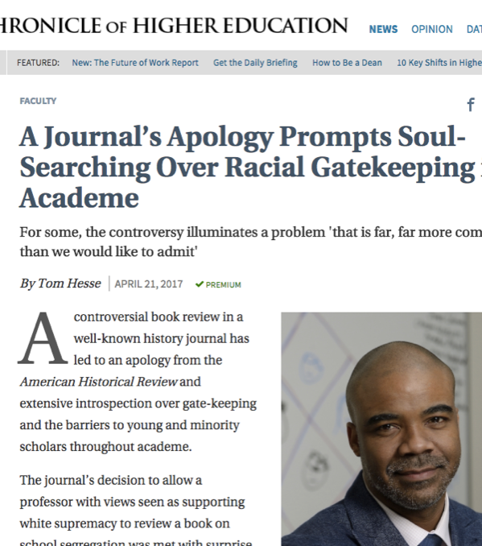
In 2017 thus far…
American Historical Review, a leading history journal, apologized for assigning a review to a white supremacist.
  Jaschik, Scott, “The Wrong Reviewer,” Inside Higher Ed, April 18, 2017. https://www.insidehighered.com/news/2017/04/18/history-journal-apologizes-assigning-review-book-urban-education-and-inequality
Hypatia, a feminist philosophy journal, apologized for and retracted a paper that analogized Rachel Dolezal to transgender people.
  Anderson et al, “Statement by the Board of Hypatia” Hypatia, May 18, 2017, http://hypatiaphilosophy.org/Editorial/index.html#boardstatement
The Journal of Political Philosophy apologized for an issue devoted to the Black Lives Matter movement that included zero black authors.
  Krishnamurthy, Meena, “Open Letter from the Editors of the Journal of Political Philosophy” Philosopher, May 25, 2017. https://politicalphilosopher.net/2017/05/25/open-letter-from-the-editors-of-the-journal-of-political-philosophy/.
Third World Quarterly had 15 members of its editorial board resign because an article espousing colonialism that was rejected by peer reviewers was still published.
Notes:
Who decides who or what gets published as part of the scholarly record? Because this is just this year, and these are incidents that we know about – how many incidents happened unbeknownst to us?

Slide 19
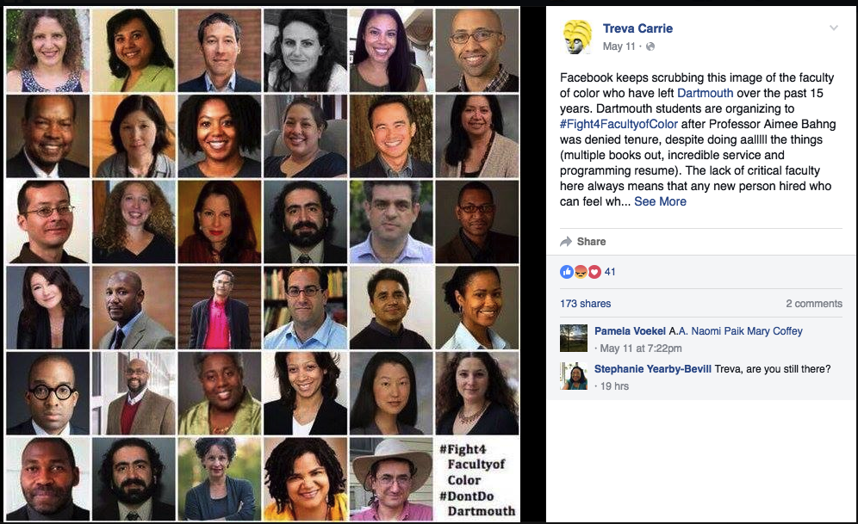
Who decides value?

Slide 20
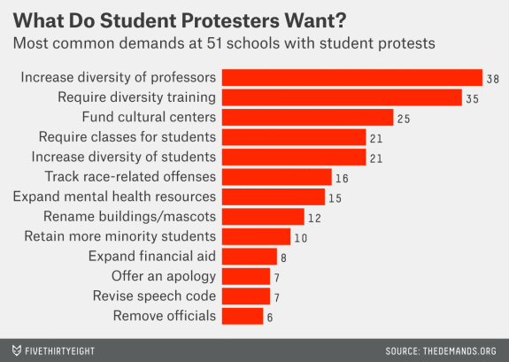
There are now 80 schools on www.thedemands.org
Leah, Libresco. “Here Are the Demands from Students Protesting Racism at 51 Colleges.” (Dec. 3, 2015) FiveThirtyEight.com https://fivethirtyeight.com/features/here-are-the-demands-from-students-protesting-racism-at-51-colleges/

Slide 21
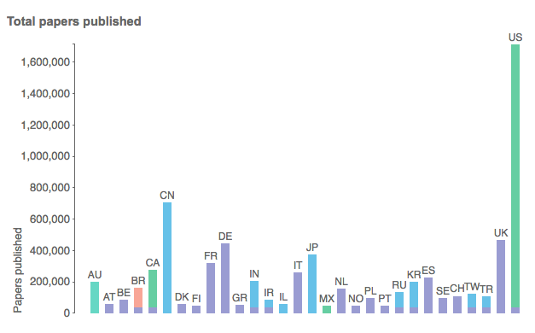
“Scientists in these 30 countries contributed the largest shares of the more than 5 million papers published between 2008 and 2012.”
Larivière, V., Ni, C., Gingras, Y., Cronin, B., & Sugimoto, C. R. (2013). Bibliometrics: Global gender disparities in science. Nature, (7479), 211. doi:10.1038/504211a

Slide 22
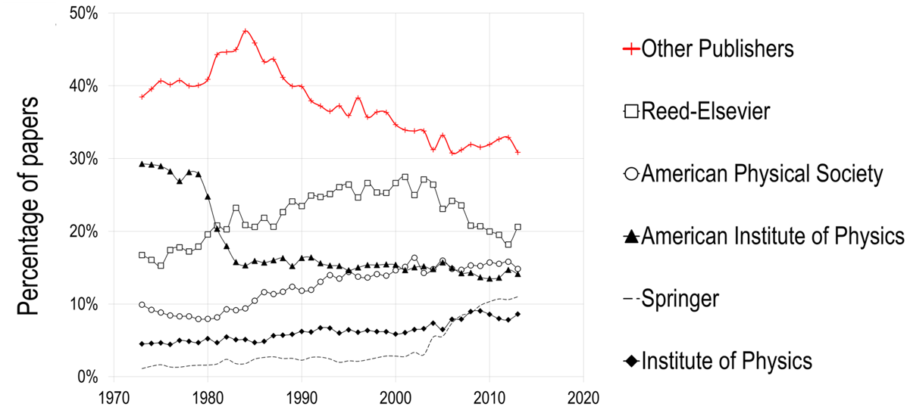
Who owns our output?
Larivière V, Haustein S, Mongeon P (2015) The Oligopoly of Academic Publishers in the Digital Era. PLoS ONE10(6): e0127502. https://doi.org/10.1371/journal.pone.0127502

Slide 23
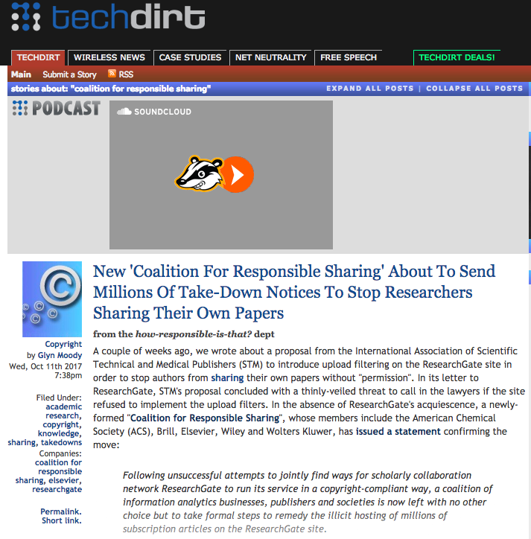
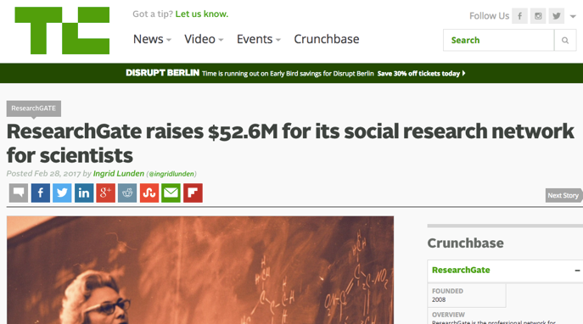
Who owns our networks?
https://techcrunch.com/2017/02/28/researchgate-raises-52-6m-for-its-social-research-network-for-scientists/
https://www.techdirt.com/blog/?company=coalition+for+responsible+sharing
Our intellectual property?

Slide 24
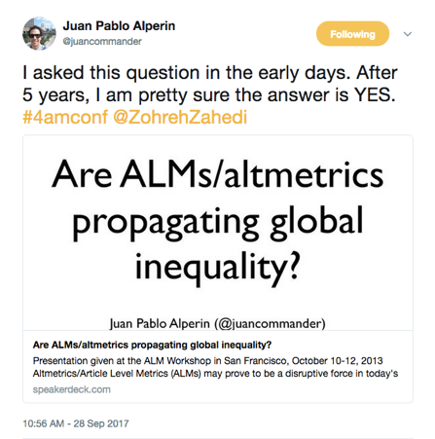
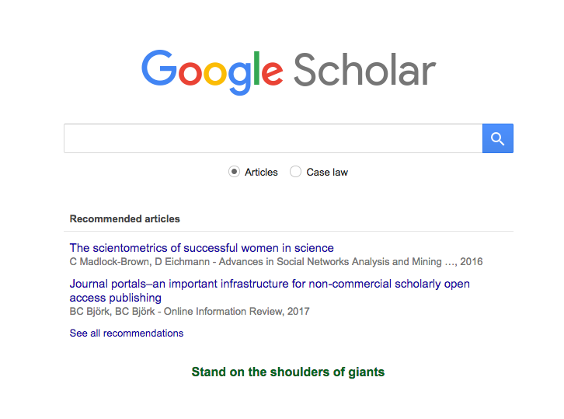
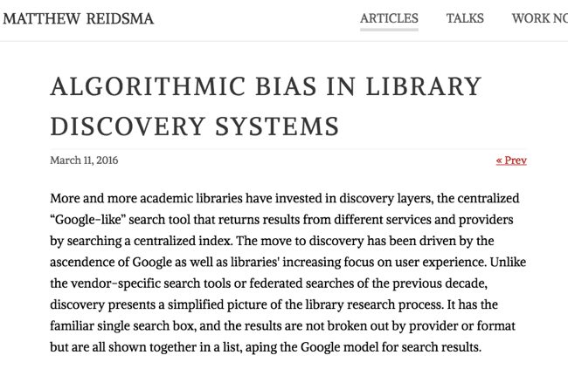
Who owns our algorithms?
https://matthew.reidsrow.com/articles/173

Slide 25
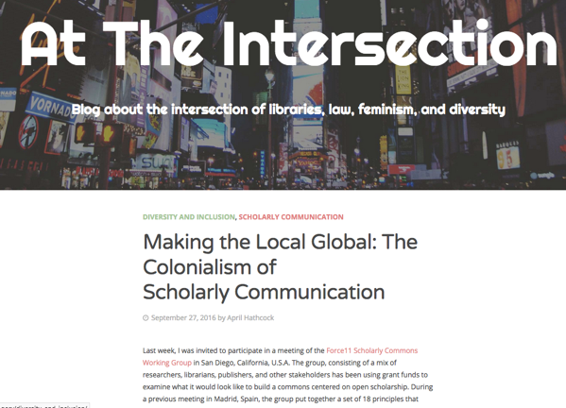
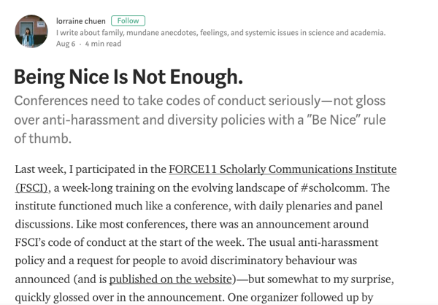
Who owns OA spaces?
https://aprilhathcock.wordpress.com/2016/09/27/making-the-local-global-the-colonialism-of-scholarly-communication/
https://medium.com/@lorraine_chu3n/being-nice-is-not-enough-b9f4f9184707

Slide 26
Who owns open access?
2011: Springer acquires twelve open access journal titles from Hindawi
2011: Wolters Kluwer Health acquires Medknow PVT Ltd., a leading Scientific, Technical & Medical (STM) journal publishing operation headquartered in Mumbai, India and one of the largest open access publishers in the world
2012: De Gruyter acquires Versita and becomes third-biggest international Open Access publisher
2013: Elsevier acquires Mendeley
2016: Elsevier acquires SSRN
2016: SAGE Publishing acquires Libertas Academica
2017: Elsevier acquires BePress

Slide 27
From Walidah’s “Liberated Archives” Keynote, Society of American Archivists (SAA) 2017 Annual Conference, Portland, OR
And that's the other piece, about making sure it's accessible to people. It's not just about saying, "Come, come into archives!" Even if it's open and it's free and you can just walk in, "You don't even need ID! Just come in, just put the gloves on, but you know it's cool you don't need ID!" That's not enough because these institutions for centuries have been telling oppressed peoples "You do not belong here." You can't change that just by sending out an e-mail and saying "Hey it's open!" and then sitting there and saying "Why aren't people of color coming?" It's important to say: how do we make that this information is accessible, how do we take this knowledge that people actually want-- not what we assume they want-- out into the community where folks can use it and engage with it.

Slide 28
Institutions and Vocational Awe
Ettarh, Fobazi. (2017, July) Vocational Awe. Keynote presented at Pushing the Margins: Women of Color and Intersectionality in LIS, Los Angeles, CA
Notes:
In her keynote, at the Pushing the Margins Symposium in Los Angeles this year, Fobazi Ettarh defined vocational awe as ”The idea that libraries, as an institution, as a field, is inherently good. And therefore assumes that some core aspects of the profession cannot be critiqued, is beyond critique.”
She goes on to say that this idea that librarianship is a sacred duty is toxic, that critique is necessary for change, growth, reform].
“At the end of the day, libraries are an institution. These are just some of the other institutions we have, they also have ideals...and yet, many of these can agree that these institutions need reform. So what makes libraries, which are just an institution, any different?
We must awknowledge that we as libraries are institutions located at the center of institutional oppressions and marginalization in order to change.”
And I’ve shown you these statistics on how the content and accessibility around children’s books directly reflects institutional oppressions in order to turn that lens back on scholarly publishing.

Slide 29
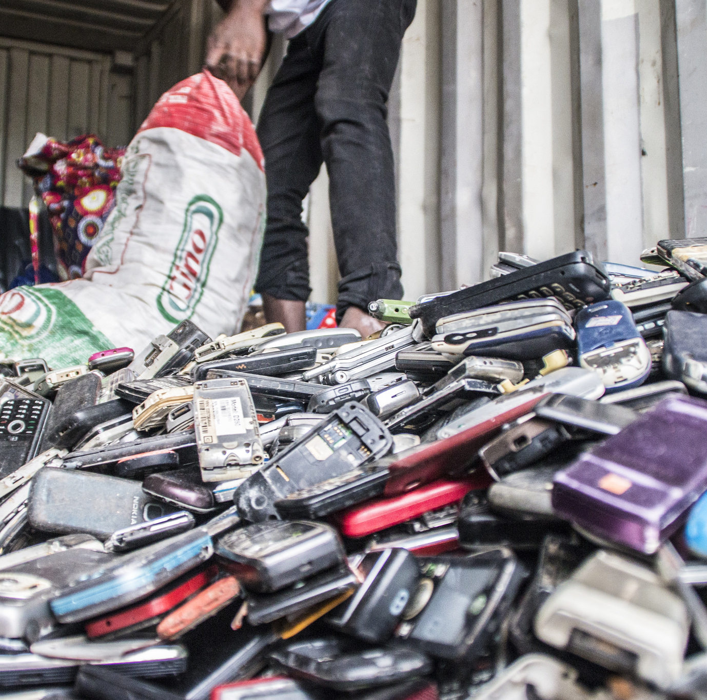
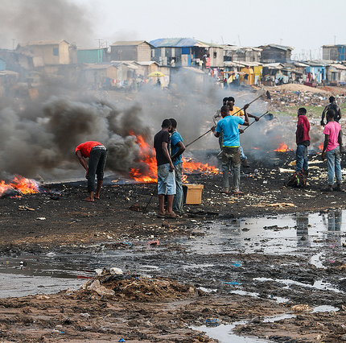
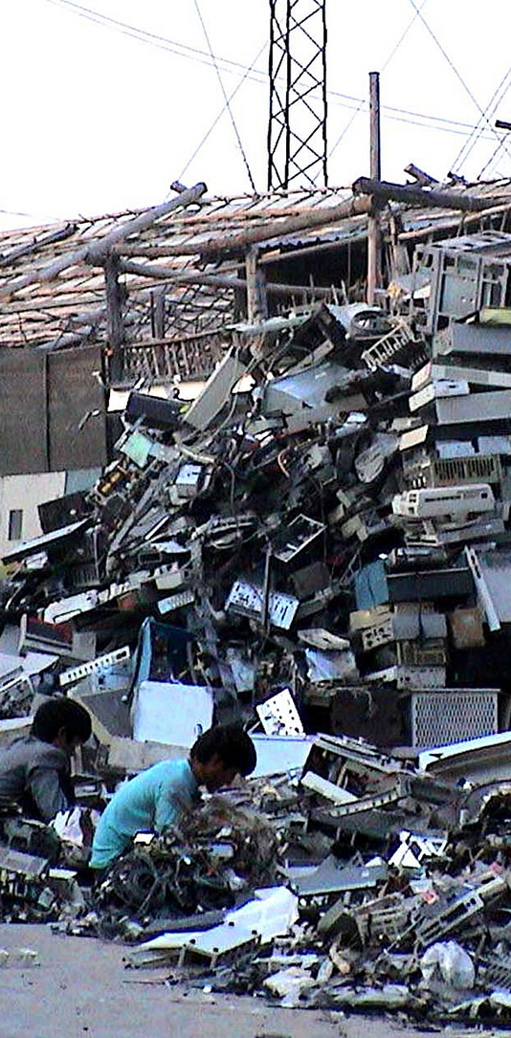
Open access relies on technology, and therefore has the same problems as technology.
From top to bottom
Collecting scrap phones, Greater Accra, Ghana, CC-BY-NC-SA Fairphone/Closing The Loop, Photograph by Joost de Kluijver
Burning site, Agbogbloshie, CC-BY-NC-SA Fairphone
E-scrapping, Lianjiang River, Guiyu, China, CC-BY-ND Basel Action Network

Slide 30
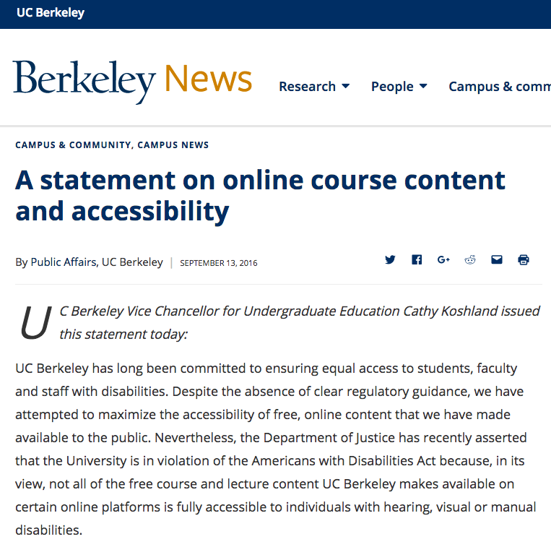
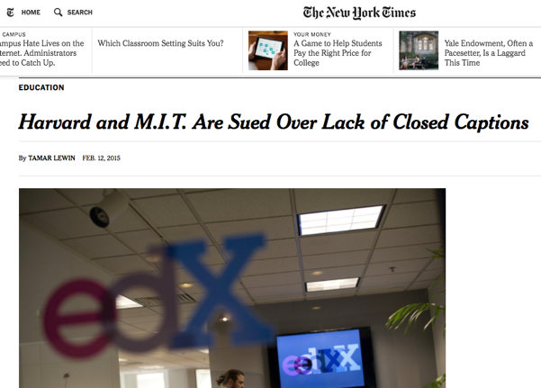
Making education accessible?
https://nyti.ms/2jDmqIQ
http://news.berkeley.edu/2016/09/13/a-statement-on-online-course-content-and-accessibility/
Higher Ed Accessibility Lawsuits, Complaints, and Settlements
University of Minnesota http://www.d.umn.edu/~lcarlson/atteam/lawsuits.html
Notes:
Reflect back on John Lewis video

Slide 31
Examples of Action
Library Publishing Coalition’s Ethical Framework for Library Publishing
Association of American University Presses (AAUP) Diversity Fellowships, funded by Mellon
Martin Paul Eve, co-director of the Open Library of the Humanities
  “[D]iversity of participation is important to our platform … we will actively monitor and release reports on demographics across our platform (particularly with respect to editors), taking measures, where necessary, to remove barriers to participation and to ensure breadth of representation.”
OpenCon Diversity Statement available at https://sparcopen.org/wp-content/uploads/2017/07/Diversity-Equity-and-Inclusion-Report-July-10-V1-Release.pdf
The Knowledge Gap: Geopolitics of Academic Production http://knowledgegap.org/
Combined OER efforts on accessibility across the country

Slide 32
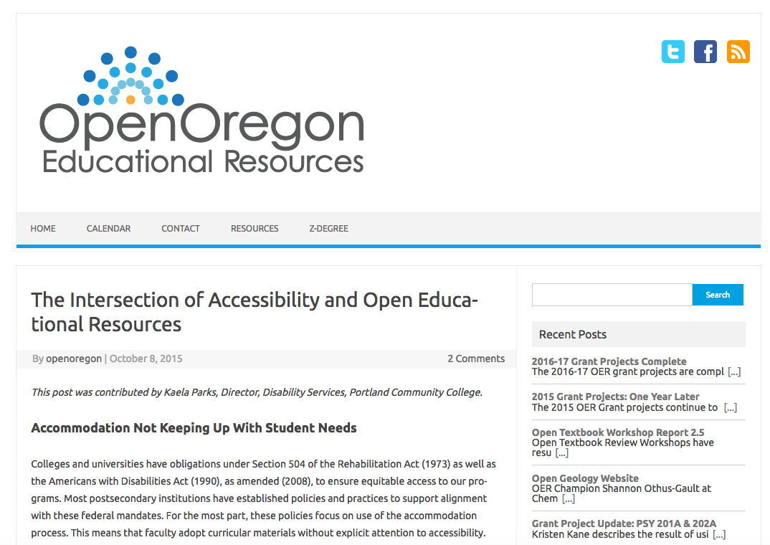
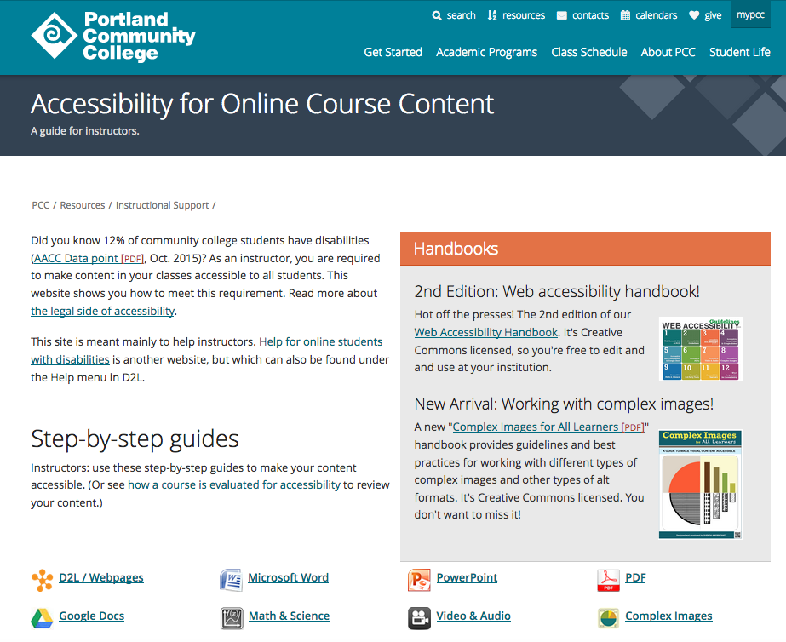

Slide 33
Things You Can Do
Metadata | Purchasing | Teaching | Research | Publication
Include open access and marginalized publications in your catalog | Support open access efforts like Knowledge Unlatched Subscribe to publications that provide a voice for marginalized | Educate faculty and students on structures of power - ACRL Framework for info lit | Read broadly Share what you read, subscribe to those things | Challenge the makeup of editorial boards, reviewers, and authors Partner w/those doing social justice work Ask: What’s your diversity statement/policy? How are you ensuring accessibility?

Slide 34
Questions?
Acknowledgements to the
Haudenosaunee Confederacy
Piscataway Indians
"To make a revolution, people must not only struggle against existing institutions. They must make a philosophical/ spiritual leap and become more 'human' human beings. In order to change/transform the world, they must change/transform themselves.”
— Grace Lee Boggs, Living for Change

Slide 35
“We live in an age of colorblind delusions, so it is possible to think that intent makes something sexist or racist. I’m a sociologist. For me, perpetuating the inequalities resulting from intergenerational cumulative disadvantage doesn’t require intent. In fact, racism and sexism work best of all when intent is not a prerequisite.”
- Tressie McMillan Cottom, Lower Ed: The Troubling Rise of For-Profit Colleges in the New Economy. The New Press, 2017, Page 187

Slide 36
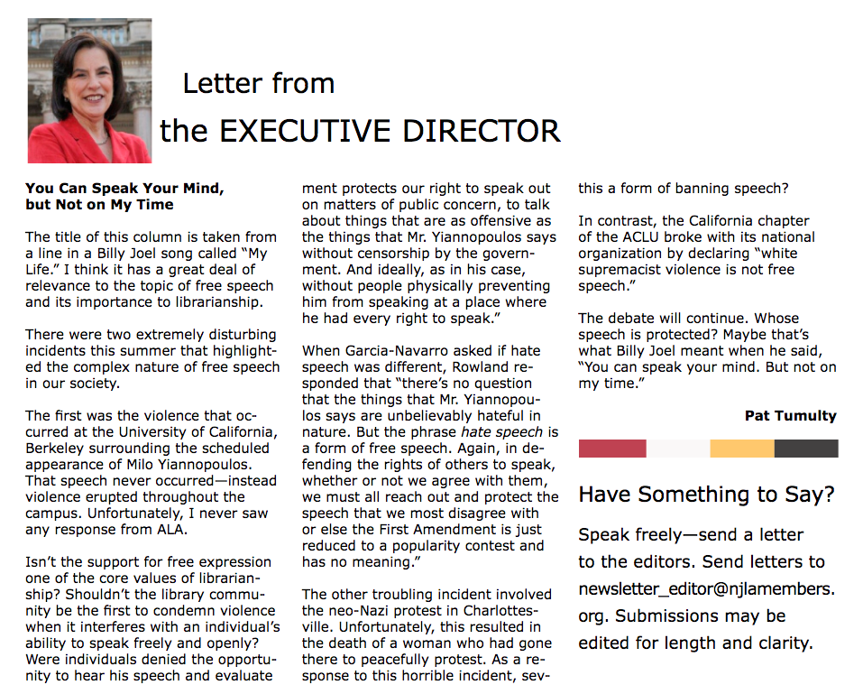

Slide 37
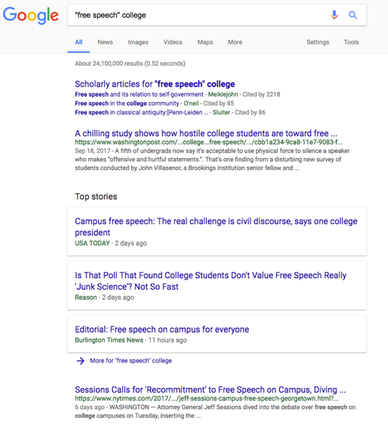
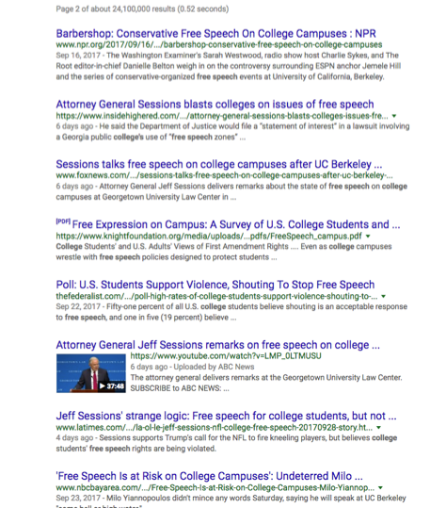
What happens when you Google “free speech” and “college”?
Whitney Philips in her article “Berkeley Doesn't Have to Choose Between Social Justice and Free Speech”
Another reason these discussions tend to crash and burn is that they often sidestep one of the most critical, and vexing, aspects of the issue…many fights over free speech don't just unfold on the internet, already a hotbed of rapid-fire, fetishized amplification. These fights are often run through the filter of the internet, and even more specifically, through the filter of trolling (in the above-linked interview with Bill Maher, Yiannopoulos directly refers to himself as a "virtuous troll" crusading for speech).
https://motherboard.vice.com/en_us/article/vb73zm/berkeley-doesnt-have-to-choose-between-social-justice-and-free-speech
The public narrative is that students are against free speech.

Slide 38
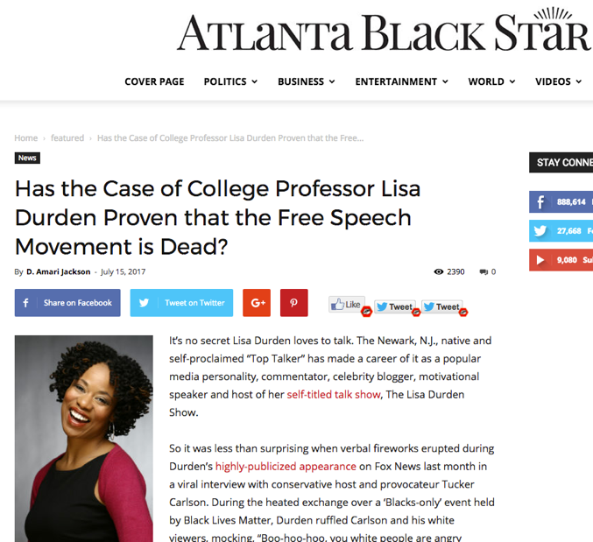
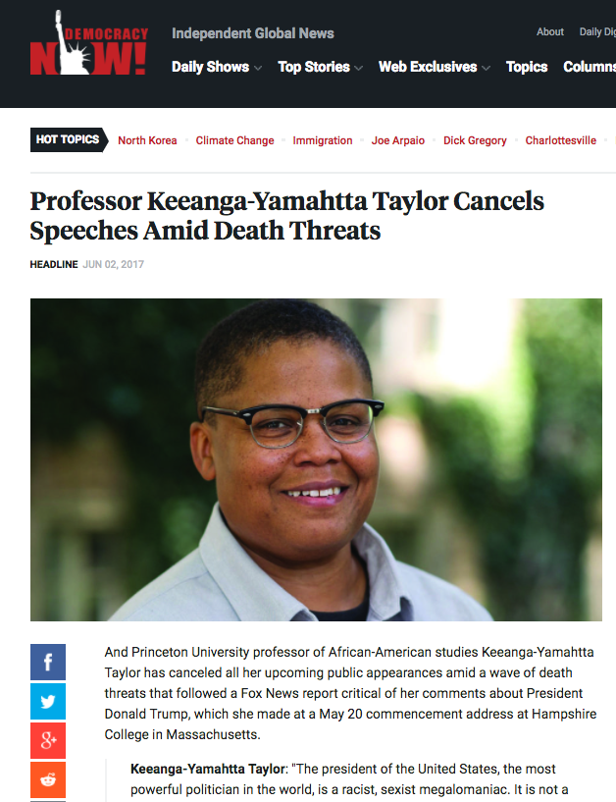
From the article:
‘“Who fired me was Dr. Munroe and Dr. Lee at Essex County College. That’s the problem, because Fox gave me free speech.’
Apparently, by firing Durden, many feel Essex County College revealed itself as an unsafe space for free speech. Since her June release, there’s been a diverse outpouring of support for the professor and ongoing demands for her reinstatement. The college has been heavily criticized for denying the former adjunct professor due process and freedom of expression. “While we may not agree with every point Durden made, we firmly oppose this lack of due process that led to Durden’s termination,” said American Federation of Teachers of New Jersey (AFTNJ) president Donna Chiera in a recent AFTNJ article.”’
http://atlantablackstar.com/2017/07/15/has-the-case-of-college-professor-lisa-durden-proven-that-the-free-speech-movement-is-dead/

