Slide 1
FAIR USE WEEK 2017
USING COPYRIGHTED WORK IN COURSES
Fair Use Week 2017
Zief Law Library and Gleeson Library

Slide 2
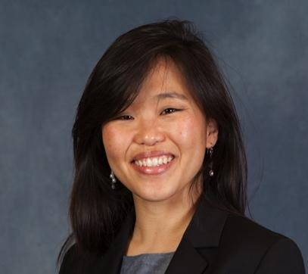
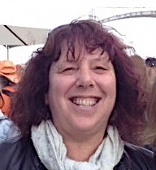
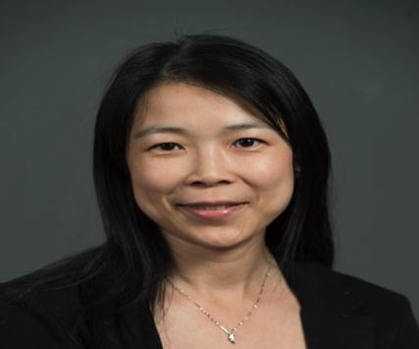
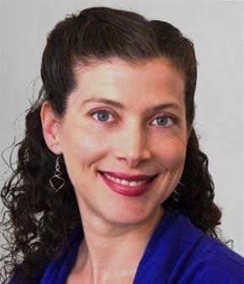

COPYRIGHT ADVISORY TEAM
Charlotte Roh
Scholarly Communications Librarian
Debbie Benrubi
Technical Services Librarian and Media Librarian
Zheng (Jessica) Lu
Digital Program Librarian
Jodi Collova, JD
Research Librarian Fellow
Matt Collins
Reference Librarian

Slide 3
QUESTIONS TO ADDRESS
What is copyright?
What is fair use?
What is (Creative Commons) licensing?
What steps do I need to make sure I’m doing the right thing?

Slide 4
YOUR COPYRIGHT
17 U.S. Code § 102
(a) Copyright protection subsists, in accordance with this title, in original works of authorship fixed in any tangible medium of expression, now known or later developed, from which they can be perceived, reproduced, or otherwise communicated, either directly or with the aid of a machine or device. Works of authorship include the following categories: (1) literary works;
(2) musical works, including any accompanying words;
(3) dramatic works, including any accompanying music;
(4) pantomimes and choreographic works;
(5) pictorial, graphic, and sculptural works;
(6) motion pictures and other audiovisual works;
(7) sound recordings; and
(8) architectural works.
(b) In no case does copyright protection for an original work of authorship extend to any idea, procedure, process, system, method of operation, concept, principle, or discovery, regardless of the form in which it is described, explained, illustrated, or embodied in such work.

Slide 5
FAIR USE: USING COPYRIGHTED WORK
“the fair use of a copyrighted work…for purposes such as criticism, comment, news reporting, teaching (including multiple copies for classroom use), scholarship, or research, is not an infringement of copyright.”
17 U.S. Code § 107 - Limitations on exclusive rights: Fair use
Notwithstanding the provisions of sections 106 and 106A, the fair use of a copyrighted work, including such use by reproduction in copies or phonorecords or by any other means specified by that section, for purposes such as criticism, comment, news reporting, teaching (including multiple copies for classroom use), scholarship, or research, is not an infringement of copyright. In determining whether the use made of a work in any particular case is a fair use the factors to be considered shall include—
(1) the purpose and character of the use, including whether such use is of a commercial nature or is for nonprofit educational purposes;
(2) the nature of the copyrighted work;
(3) the amount and substantiality of the portion used in relation to the copyrighted work as a whole; and
(4) the effect of the use upon the potential market for or value of the copyrighted work.
The fact that a work is unpublished shall not itself bar a finding of fair use if such finding is made upon consideration of all the above factors.

Slide 6
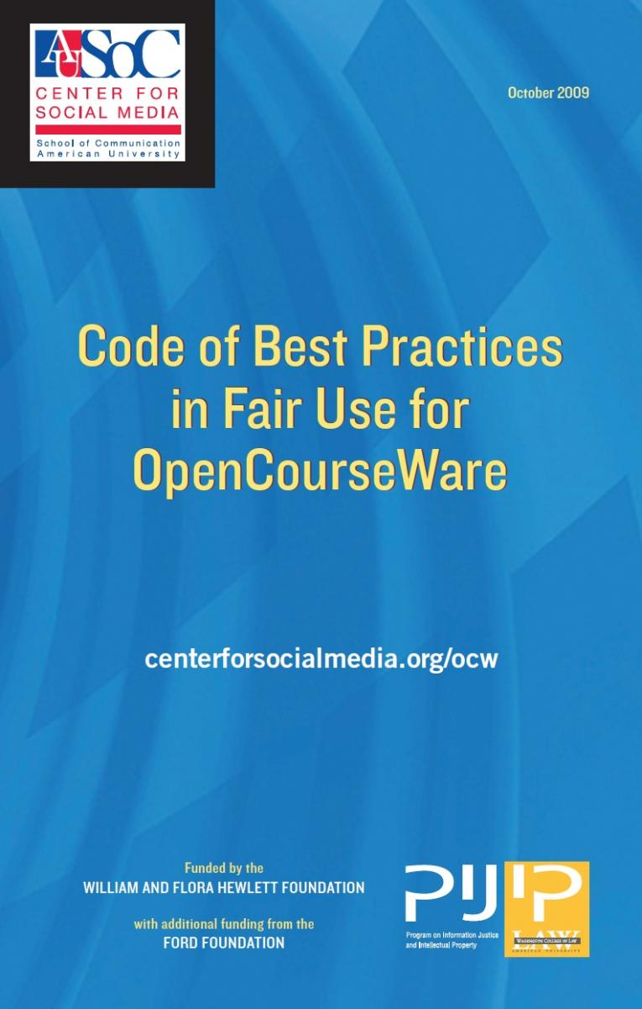
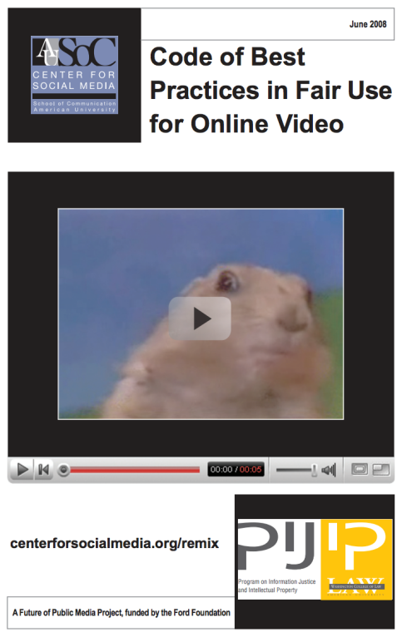
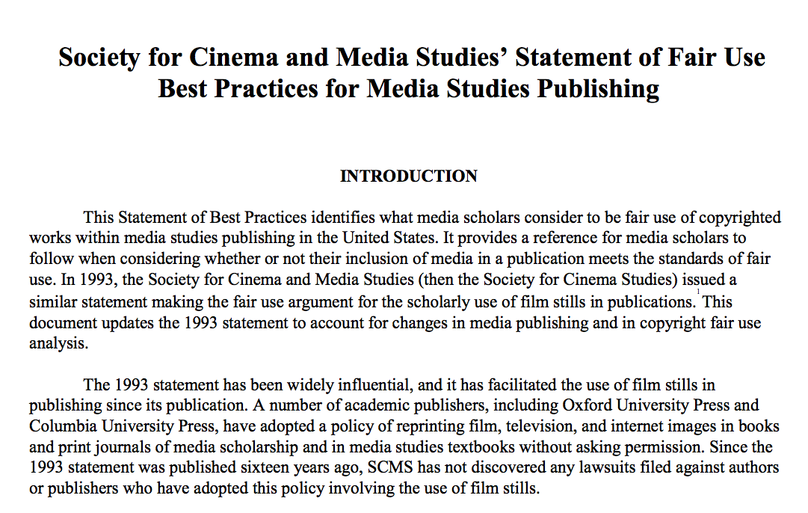
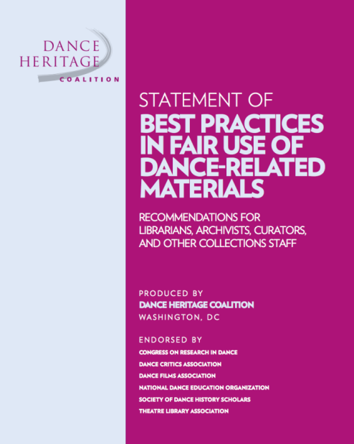
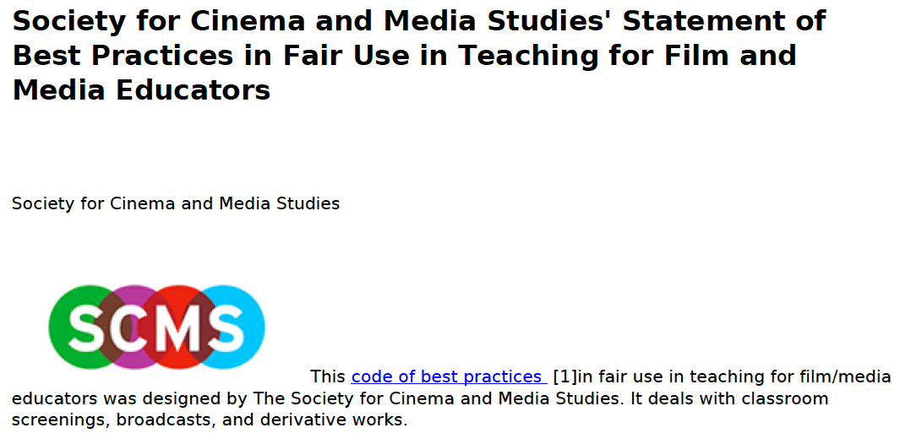
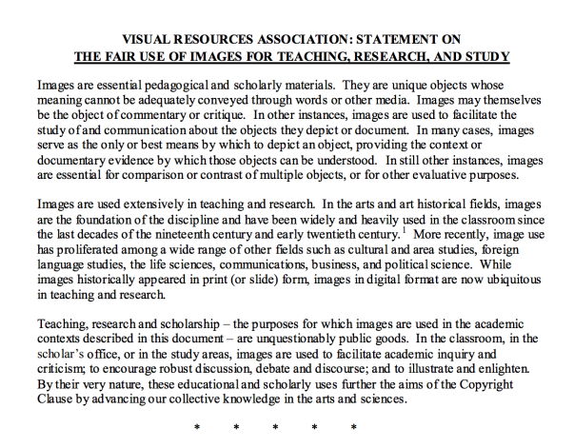
This slide is from the Code of Best Practices
in Fair Use for the Visual Arts
http://www.collegeart.org/fair-use/
…AND MORE!

Slide 7
STEPS TO TAKE
Is it copyrighted or in the public domain? | Check Peter Hirtle’s chart http://copyright.cornell.edu/resources/publicdomain.cfm
How is it licensed? | Check its terms of use, either through the library (by contract), or through Creative Commons, or otherwise stated.
Is it fair use? | Use a fair use checklist to guide you: http://www.ala.org/advocacy/sites/ala.org.advocacy/files/content/copyright/FairUseChecklist.pdf Bonus: http://newmediarights.org/fairuse/
Do you need/have permission? | Linking is legal in the United States! Instructions on how to link to library resources are on the Gleeson Library YouTube channel or at https://youtu.be/Kk5NCg8a9Tw?list=PLqo_V0J36d5kaMNypM6sdbp2-bLQtKF8A

Slide 8
LET’S PRACTICE!

Slide 9

COPYRIGHT INFRINGEMENT?
Can linking to content on YouTube or another website get an instructor or the institution in trouble for copyright infringement?
Does fair use permit use of up to (but no more than) 30 seconds of a video or 10% of a text in an educational context?
Author A plagiarizes a short but distinctive phrase from Author B. Copyright infringement?
Novelist Dana Black has written a best-seller significantly based on a detailed and incredible historical theory that is almost certainly not true. Copyright infringement?
A political science researcher has found evidence of fraud by searching a proprietary, licensed database of business information. The researcher is about to publish a paper with materials quoted, but the publisher is worried that the data is proprietary and licensed. The license says no quoting is permitted, and the content can only be viewed but not quoted. Can the researcher argue fair use given the important public purpose of demonstrating fraud?
A professor wants to teach a film studies MOOC, and include short clips of films to illustrate her points. The MOOC will be open to the world and already has 75,000 people from around the world enrolled, three months in advance. The clips will be posted in an open format, and viewable by all students, as well as members of the public, and will be annotated extensively by the professor with voiceovers and moving graphics super-imposed on the clips. Which of these defenses & limitations might help the professor?
  17 USC 107, “fair use”
  17 USC 110(1), “classroom performance” http://www.copyright.gov/title17/92chap1.html#110
  Subtitle C of Title III of H.R. 2215, the “TEACH Act” for distance education http://www.ala.org/advocacy/copyright/teachact
From Laura Quilters’ Copyright Boot Camp January 2015 http://blogs.umass.edu/lquilter/2015/01/12/copyright-bootcamp-jan-13-and-14-2015/

Slide 10
Questions?

Slide 11




CREATIVE COMMONS LICENSING
CC-BY: Attribution
  Others must credit you as the original creator of the work.
NC: Noncommercial
  Others may not share, adapt, or reuse your work if their use is primarily intended for commercial advantage or monetary compensation.
ND: No Derivatives
  Others can share your work, but they must not change it.
SA: Share Alike
  Those who adapt or remix your work must use the same Creative Commons license on any derivative works.
http://creativecommons.org/

Slide 12
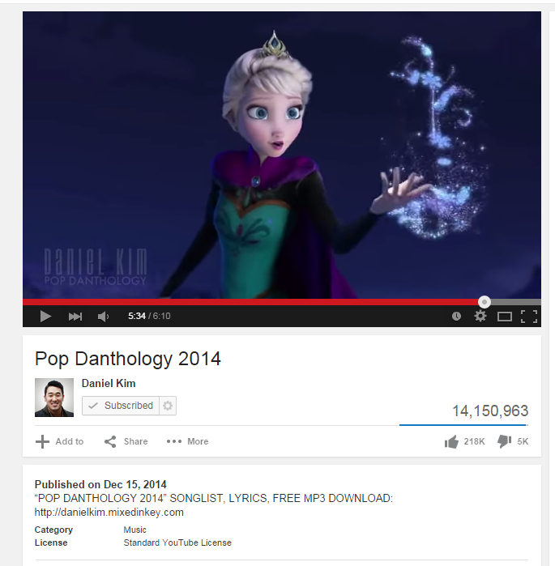
OPEN EDUCATIONAL RESOURCES:
THE 5R FRAMEWORK
Retain
Reuse
Revise
Remix
Redistribute
Notes:
Educational resources that are freely available for any of these things that you do online anyway.

Slide 13
OER INCLUDES
Curriculum
Course materials
Collections
Tools
Syllabi
Textbooks
Journal articles
Software
Assignments
E-books
Calculators
Simulations
Content modules
Art galleries
Learning objects
Analytics
Labs
Video libraries
And more!
Notes:
So where can these be found? You can look online or…

Slide 14
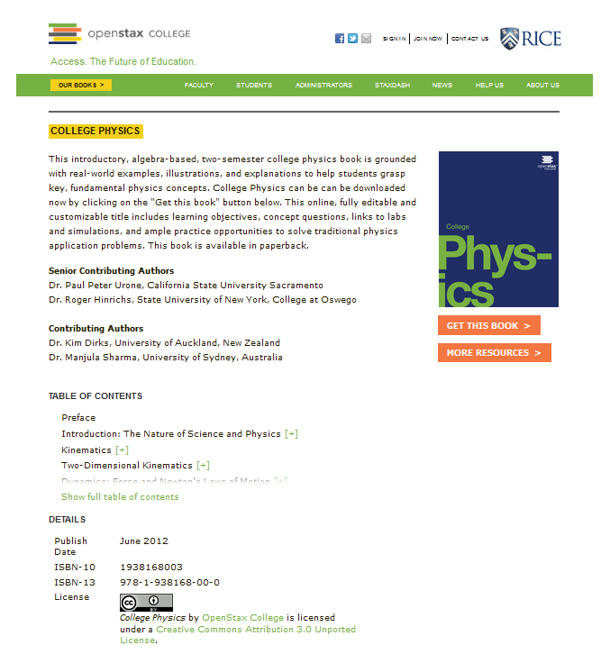
http://openstaxcollege.org/textbooks/college-physics

Slide 15
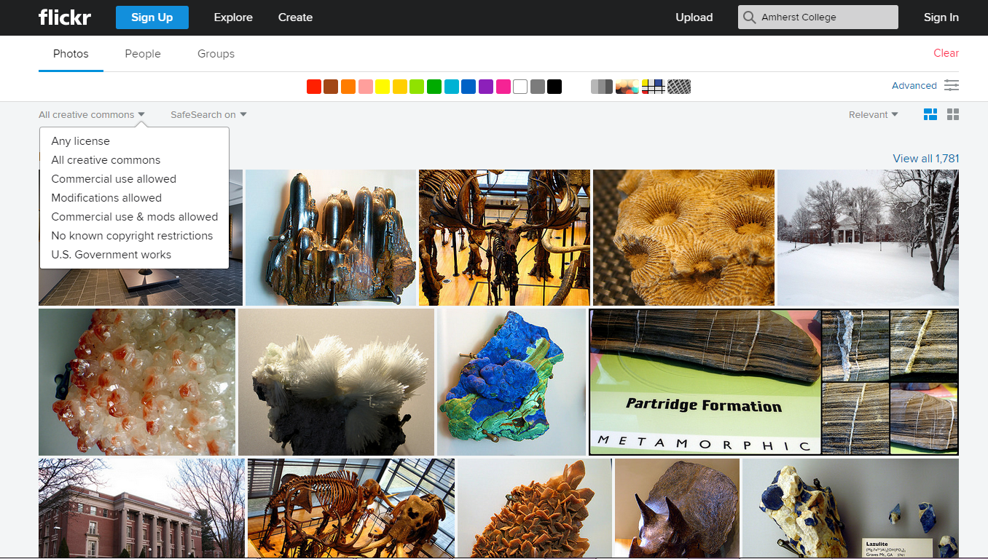

Slide 16
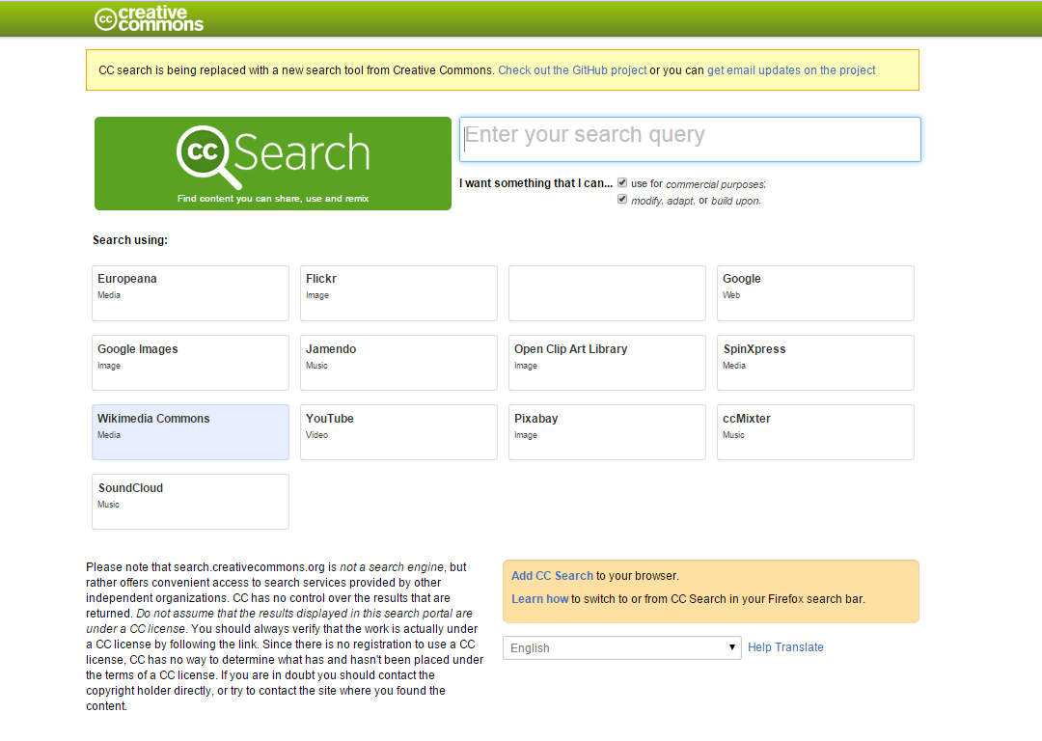

Slide 17
QUESTIONS?
The Wrap Up
Copyright has protection rights for creators and fair use rights for users (who become creators)
Licensing through Creative Commons allows users to give each other more rights for an open and free culture of use and remixing

