Slide 1
Open Education Resources
http://l.facebook.com/l.php?u=http%3A%2F%2Fwww.dorkly.com%2Fpost%2F68577%2Fpokemon-you-didnt-realize-were-based-on-actual-things&h=KAQFypY8N
Charlotte Roh
University of san francisco
July 3, 2016

Slide 2
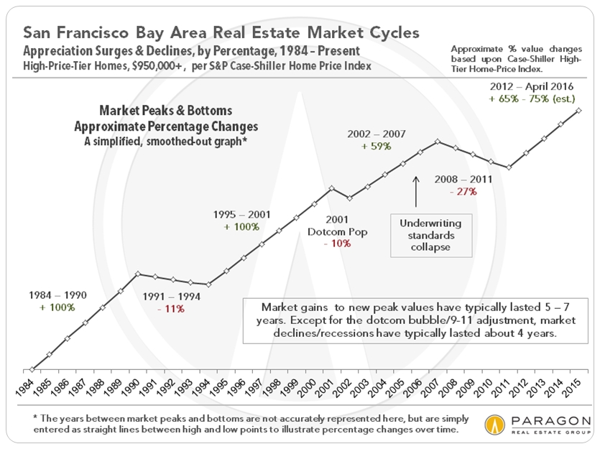
What’s expensive?
(That’s a 380% increase.)

Slide 3
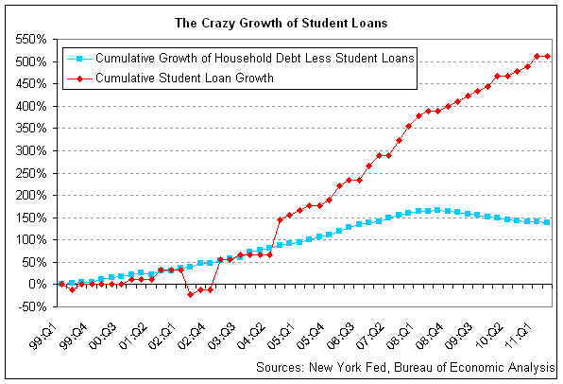
Student Debt?
(That’s a 512% increase.)

Slide 4
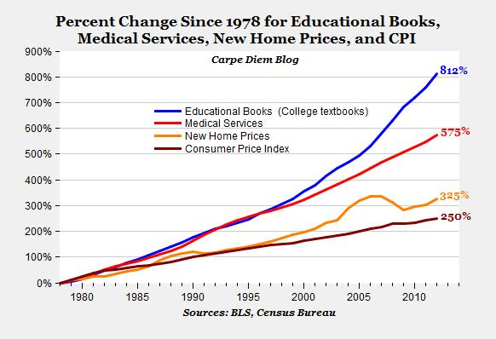
And then there’s this.

Slide 5

70-80% of students have not
Bought a textbook because of cost

Slide 6
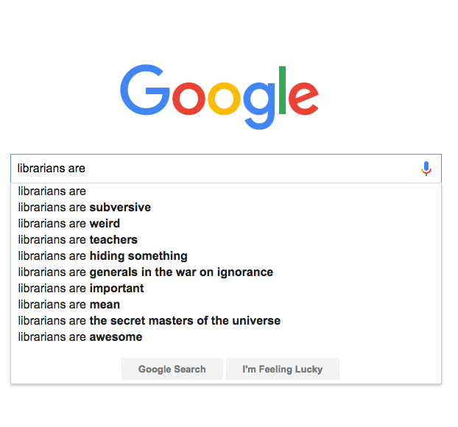
“You cannot change any society unless you take responsibility for it, unless you see yourself as belonging to it and responsible for changing it.”
^{– Grace lee boggs}

Slide 7
Open education Library model
Conceived by Steven Bell at Temple University
Popularized by Marilyn Billings at the University of Massachusetts Amherst
How it works:
Sponsored by the Provost’s Office and the Friends of the Library
$1,000-$2,000 grants for faculty, depending on class size
Competitive grant review by service points who support faculty
The OEI is a faculty incentive program (a small grant) that encourages:
The creation of new teaching materials,
The use of library subscription materials,
Or the use of existing open (free) information resources.

Slide 8
infrastructure
Flipping classrooms for interactive learning w/ne materials
Workshops for OER, copyright, & Creative Commons licensing
Information Technology
Libraries
Liaison consultations to find resources and create new content
Circulation & electronic reserves to find subscription materials
Creating new curriculum materials and scaffolding
Classroom technologies & hosting
Center for Teaching & Faculty Development
Instructional technologies and experimentation

Slide 9
OEI Outcomes
The Numbers
89% student satisfaction with materials at UMass
$960,268 saved in the first semester, $1 million saved over time at UMass
Math students are scoring higher with 67% more A students, Salt Lake Community College
Student participation increases and drop out rate decreases, Tidewater Community College
42% more students passing college algebra, Mercy College
Partnerships with bookstores, Monroe Community College
Students have money to buy groceries and gas, Tacoma Community College
The Impact
Students are better prepared for class and more engaged
An opportunity for new teaching styles and flipped classrooms
Service points on campus are partnering for student success
Library seen as a campus leader and librarians seen as experts
Student pride in the university and participation the open education movement
http://www.sparc.arl.org/resource/list-oer-projects-policies
Notes:
Q: Has the OEI worked?
A: Yes, there have been substantial savings to students and reports of better engagement in classrooms.

Slide 10
Why Open Ed at USF?
Student access to learning materials means greater engagement and success. (COST!)
Faculty can change not just their materials but their style of teaching.
Service points can collaborate more effectively.
New educational materials are available for the world.

Slide 11
OER includes
Curriculum
Content modules
Course materials
Assignments
Simulations
Labs
Collections
Journal articles
Tools
Syllabi
Textbooks
Learning objects
E-books
Software
Calculators
Art galleries
Video libraries
Analytics
And more!
Notes:
So where can these be found? You can look online or…

Slide 12
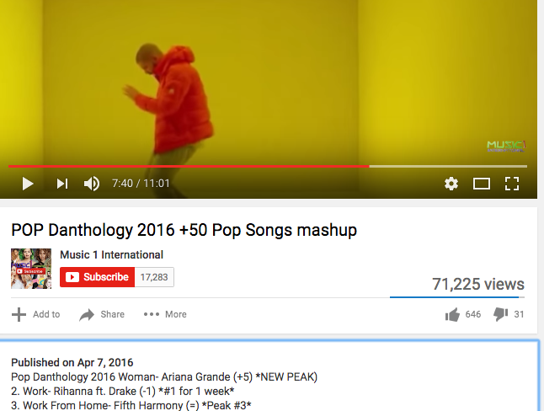
Open Educational Resources
The 5R permissions Framework
Retain
Revise
Remix
Redistribute
Reuse
Notes:
Educational resources that are freely available for any of these things that you do online anyway.

Slide 13
Open education resources
SPARC has a list-serv and a monthly phone call: http://sparcopen.org/our-work/sparc-library-oer-forum/
Open Education Conference: http://openedconference.org/2016/ and https://www.youtube.com/user/openedconference/videos
UMass Amherst OER library guide: http://www.library.umass.edu/services/teaching-and-learning/oer/open-textbooks/
California repository, Merlot: https://www.merlot.org/merlot/index.htm

Slide 14

Let’s explore these resources!

Slide 15
challenges
Open educational resources are still being developed for many subject areas
Resources are scattered and overwhelming
Free materials are negatively perceived
Departmental requirements for curriculum based in traditional textbooks
Academic freedom of faculty should be respected
Faculty investment of time and/or money in retooling their courses
Scope of change is difficult to implement across campus
  Constant changes in people teaching and courses offered

Slide 16
The OER landscape
California schools
  CALPIRG is focused on making textbooks affordable
  Affordable Course Materials Initiative at UCLA: $27,500 to 23 instructors, saved more than $160,000
  Affordable Learning Solutions at CS San Marcos: over 60 faculty, saving $1.6 million in 72 courses
State
  Efforts like California Open Educational Resources Council, Merlot, and Cool4Ed are underway
  Connecticut has passed open education bill, other states are considering similar legislation regarding open education materials
National
  The U.S. Department of Education created its first open education advisor position last year
  Library and educational organizations (like SPARC) are focused on open education

Slide 17
Possible partners/stakeholders
Gleeson Library | Geschke Center
  Liaison librarians as subject experts
  Circulation and reserves making library materials available
  Licensing and collection development checking vendor agreements
  Scholarly communication librarian and copyright team for copyright, fair use, and licensing
Center for Teaching Excellence
  Talking with departments
  Letter of support
Information Technology Services: Center for Instruction and Technology
  Integrating materials in Canvas
  Flipped classroom development
  New material w/technology
Student Life and Organizations
  Julie Orio, Interim Vice Provost of Student Life
  Student Senate
  Graduate Student Senate
  Educators for Social Justice
Bookstore
  National Association of College Stores
CRASE
  Faculty Champions (possible)
  Jonathan Hunt, Rhetoric and Language
  Keally McBride, Politics
  Paul Zeitz, Math

Slide 18
stakeholders
Administration
Education and outreach
Teaching faculty and graduate students
Students
Service points
Tenure and promotion
Changing courses
Active learning and assessment
Partnering in support
Support and promote
Assessment and advocacy
Outreach and advocacy

Slide 19
Administration
Teaching faculty and graduate students
Students
Service points
Tenure and promotion
  Partner with faculty association to include in tenure checklists
  Work with dept chairs to encourage and recognize change
  Changing courses
    Determine large gen ed courses that are easy to flip
    Check with reserves to see which professors care about access for all students
  Active learning and assessment
    Quick click surveys in the classroom
    Engagement in improving OERs
Partnering in support
  Training members of the library and partnering service points to be knowledgeable about OERs and how to support them
  Establish a network of who to call when questions arise
  Outreach and advocacy
    First-hand accounts of hardship in order to convey true impact
    Personal requests to professors
Support and promote
  Include open ed status in course catalogs
  Work with Jesuit universities as part of social justice mission
  Assessment and advocacy
  Work with professors who are already open ed in order to flip their departments
Education and outreach
  Training faculty to use OERs
  Promoting the use of OERs

