Slide 1
Scholarly Communication as a Tool for Social Justice and Diversity
Charlotte Roh, Scholarly Communication Resident, University of Massachusetts Amherst
Emily Drabinski, Coordinator of Library Instruction, Long Island University Brooklyn
Harrison Inefuku, Digital Repository Coordinator, Iowa State University

Slide 2
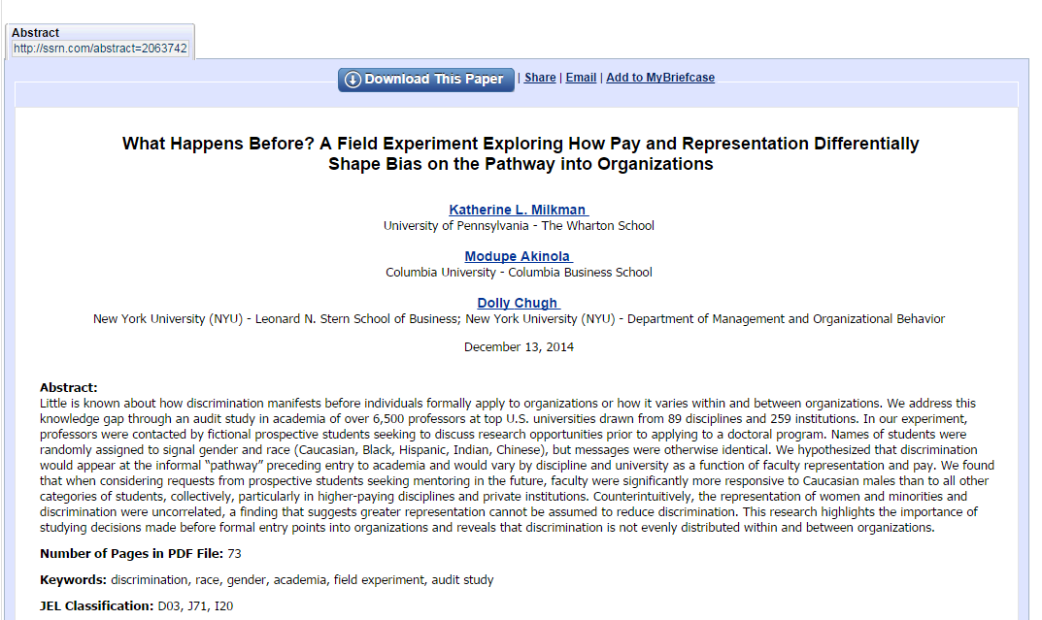
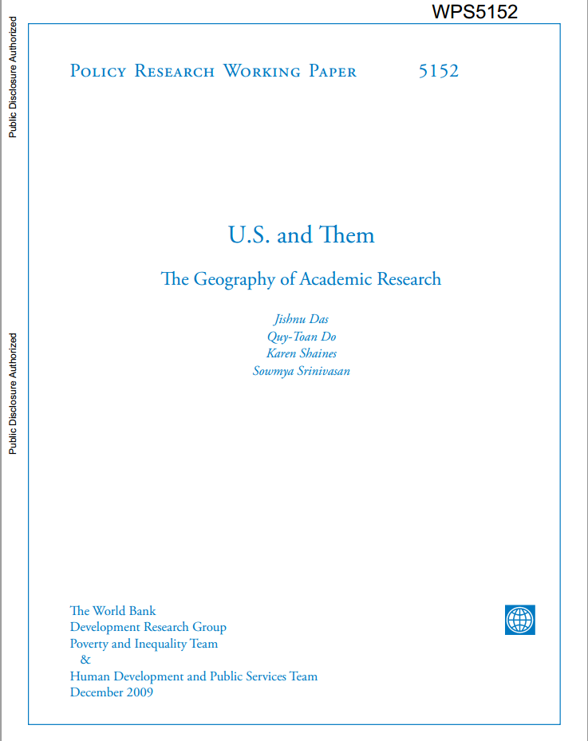
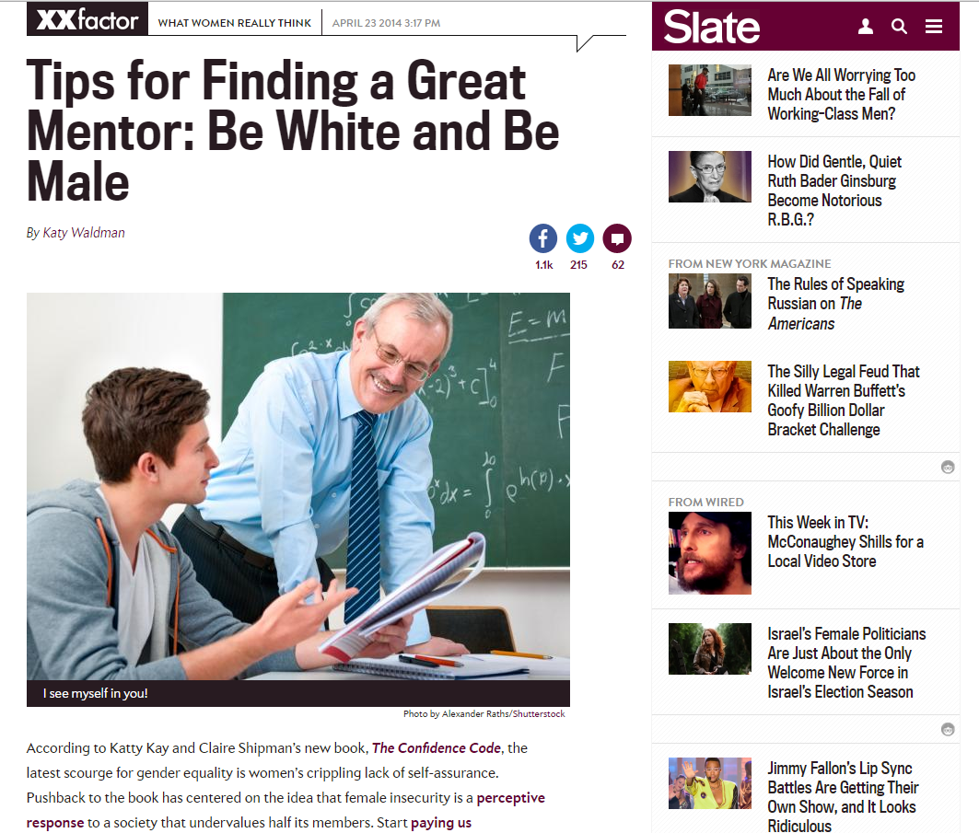

Slide 3
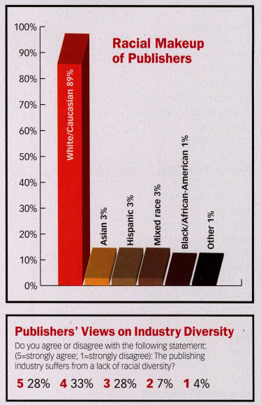
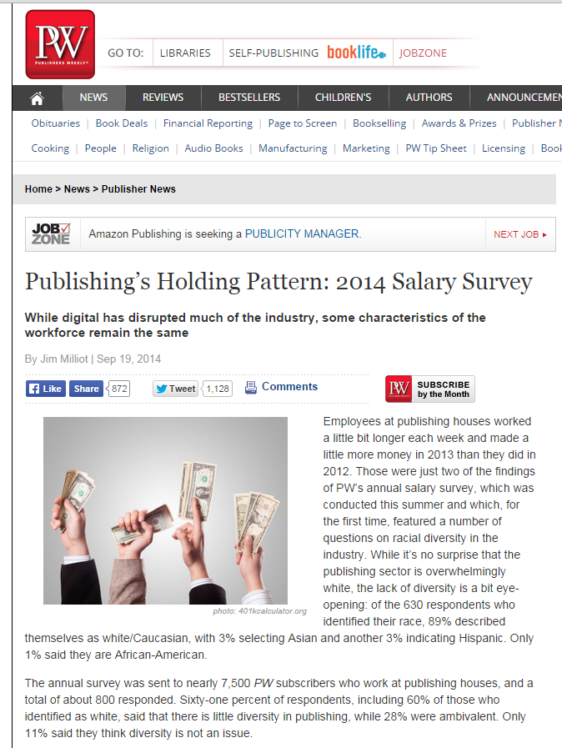

Slide 4
From ALA Demographics Studies
September 2014
2.8% of respondents report having a disability.
http://www.ala.org/research/sites/ala.org.research/files/content/initiatives/membershipsurveys/September2014ALADemographics.pdf

Slide 5
How do we solve the problem?
Scholarly communication is systemically flawed.

Slide 6
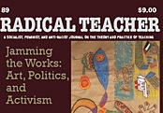
How can our small scholarly journal that we all care about a lot survive?

Slide 7
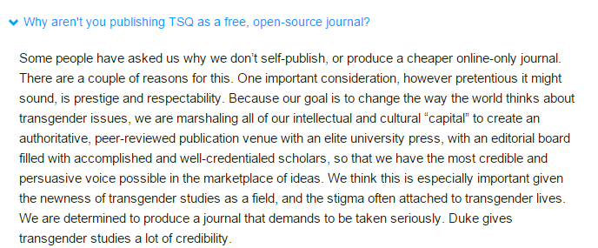
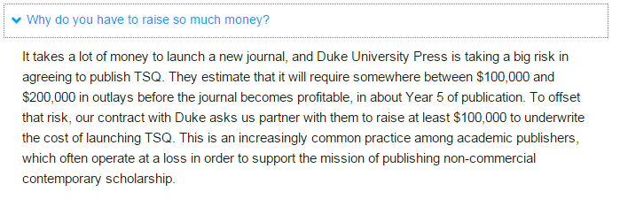
https://www.kickstarter.com/projects/tsq/tsq-transgender-studies-quarterly

Slide 8
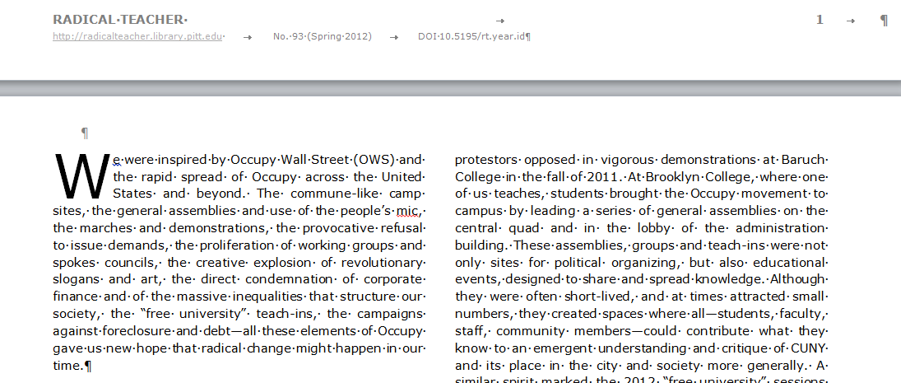
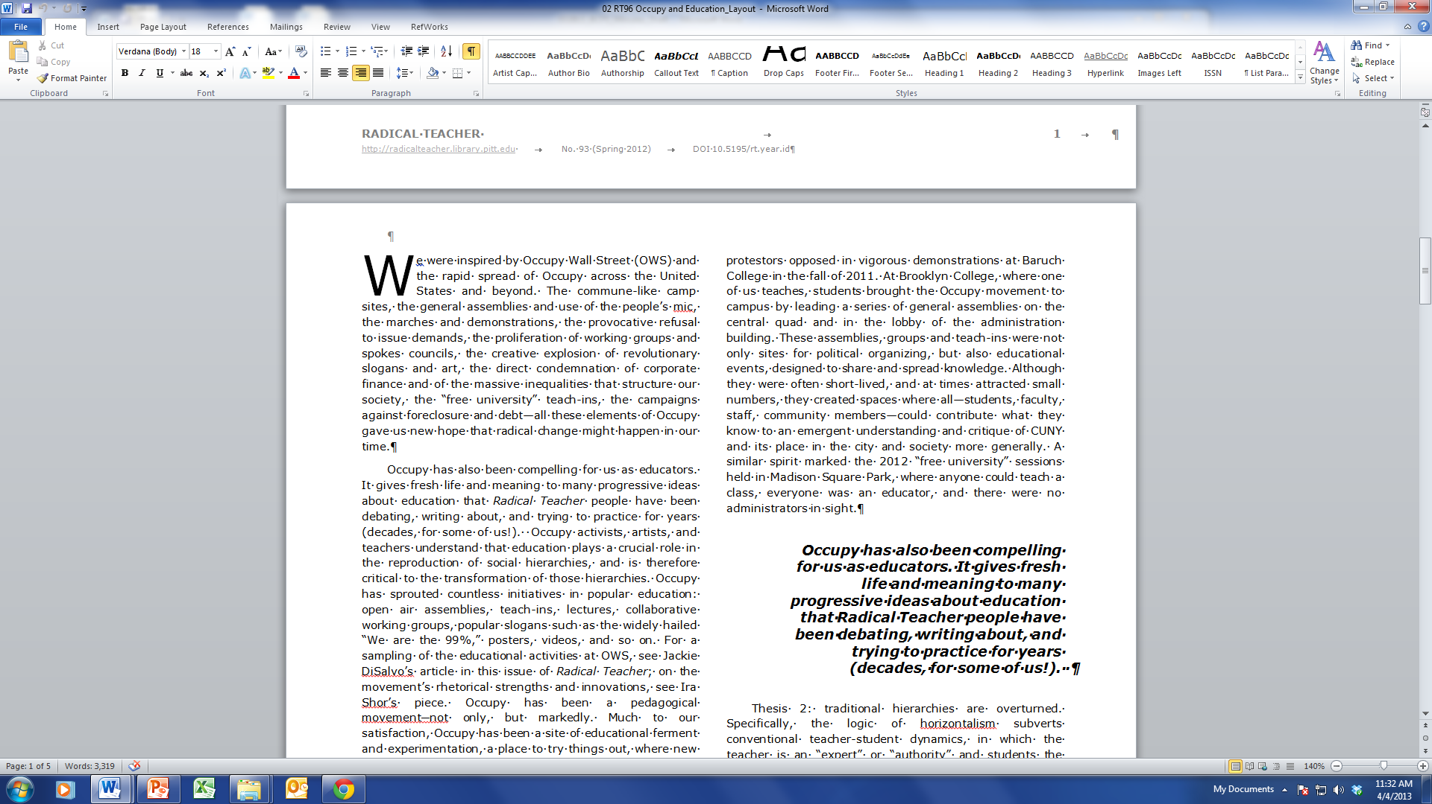

Slide 9
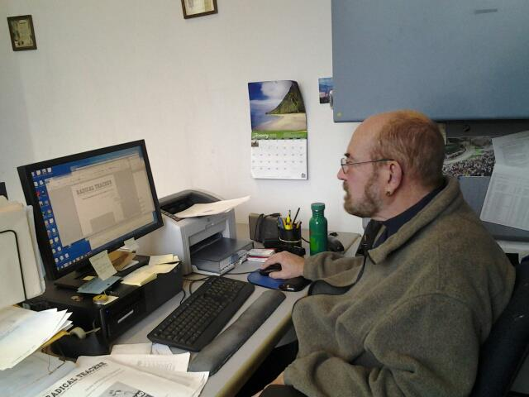
Leonard inserting his first title.

Slide 10
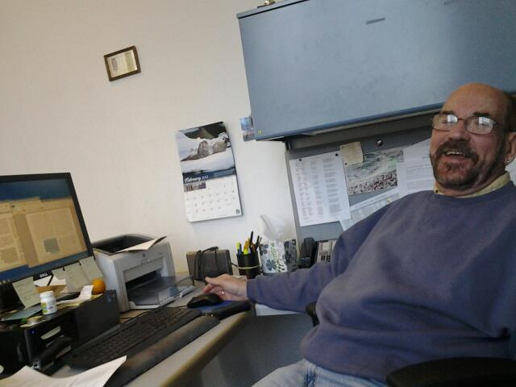
Leonard, after we learned how to format pull quotes.

Slide 11
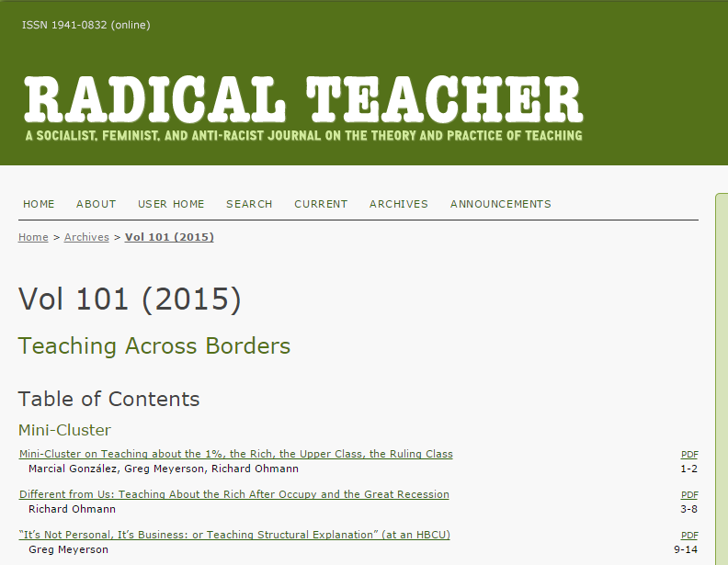

Slide 12
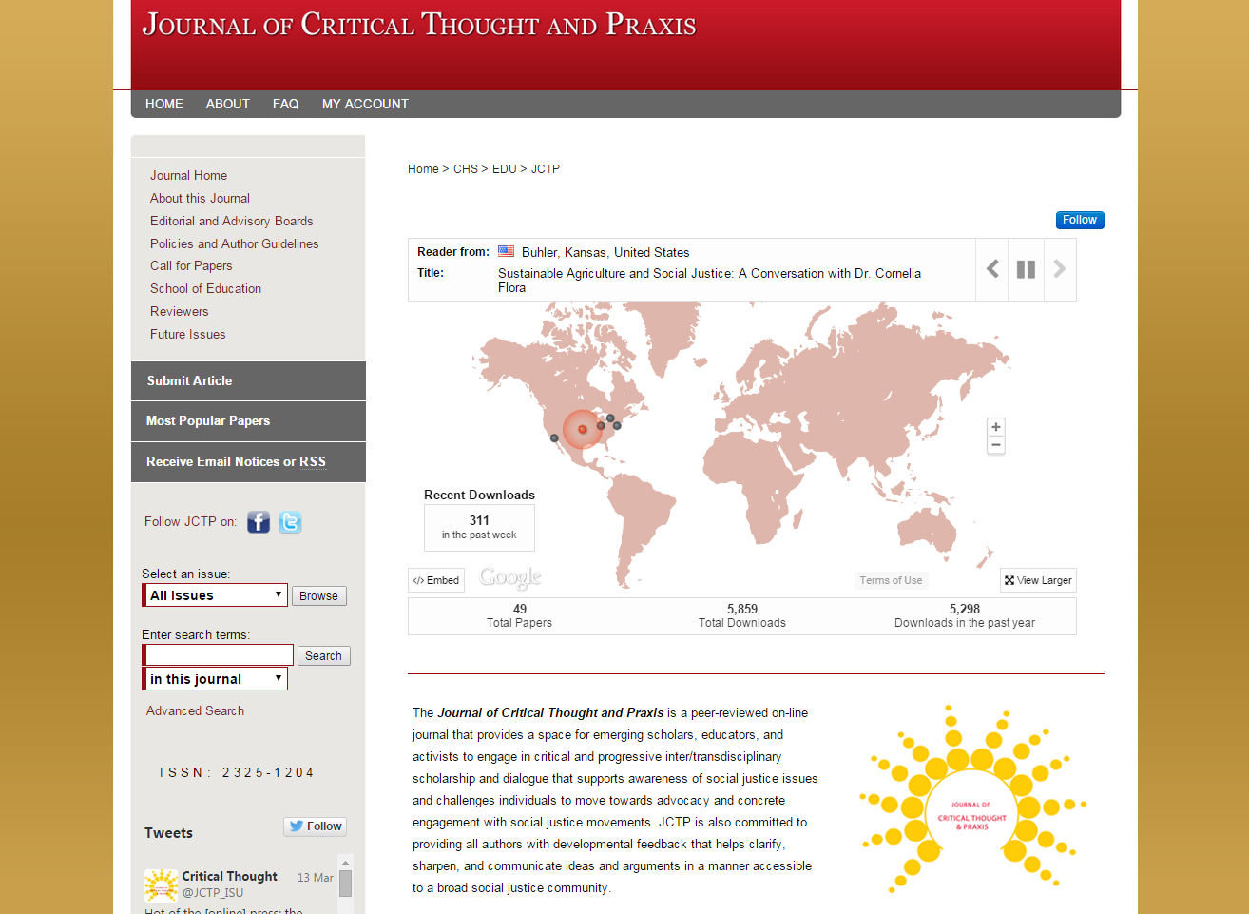

Slide 13
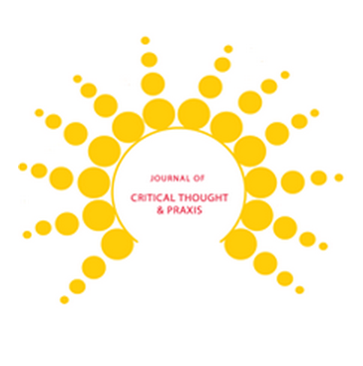
Journal of Critical Thought and Praxis
http://lib.dr.iastate.edu/jctp/
Thank you!
Cameron Beatty, Andres Lopez, Gabrielle Roesch-McNally, Danica Schieber, Cristobal Salinas, Jr.

Slide 14
But first, any Questions?
Now you’ve seen some examples, let’s do some work.

Slide 15
Scholarly Communication Action Plan
Mission
  How does this tie into the organizational mission and/or the mission of stakeholders?
Goals/Objectives
    Specific
    Measurable
    Attainable
    Relevant
    Time-bound
Barriers

Slide 16
Scholarly Communication Action Plan
Goals | Key Stakeholders | Barriers to Success | Overcoming Barriers

Slide 17
Questions?

