Slide 1
The Open Education Initiative at UMass Amherst
Seeking Alternatives to High-Cost Textbooks
Charlotte Roh
UMass Libraries All Staff Meeting 2/19/14
Based on Marilyn Billings’ OER Summit Presentation (October 2013)
Notes:
Who here knows what this is? And has somehow been involved?

Slide 2
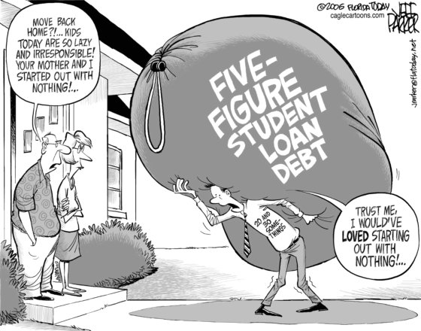
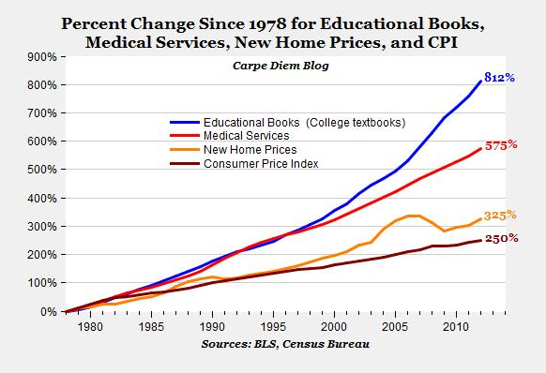
Textbook Trends
“I stopped buying textbooks my second semester here.”
– Marieme Traoreh, Library student assistant
Notes:
The cost of textbooks has gone up and everyone is worried about it. Last year the Dept. of Ed put out announcements regarding the need to shift to digital resources to 1) help alleviate the cost of textbooks and 2) prepare our students to be technology literate. And I can use these 2 images two demonstrate these points because of fair use.

Slide 3
Seeking Solutions
The Provost’s Office and the University Libraries of the University of Massachusetts Amherst launched the Open Education Initiative (OEI) in the Spring of 2011.
The OEI is a faculty incentive program (a small grant) that encourages:
  the creation of new teaching materials,
  the use of library subscription materials,
  or the use of existing open (free) information resources to support our students’ learning.
Notes:
Funded through both the Provost’s Office and the Libraries. Open education resources are resources that are open and free to the public. For the OEI, we tweaked things so that it includes library subscription materials as well.

Slide 4
OEI Grant: Faculty Proposals
Basic course information
  Number of students
  Current textbook(s) and cost
Narrative (500 words)
  Outcomes
  Sustainability
  Challenges
Anticipated OER implementation date
Notes:
The faculty proposal is very straightforward. It addresses quite simply the cost of the textbook per student and what the course is trying to accomplish with these resources. Really, these are things that any professor considers when thinking of course materials.
Capturing in ScholarWorks

Slide 5

Professor Hossein Pishro-Nik
Course
Electrical and Computer Engineering 314: Introduction to Probability and Random Processes
Cost of Regular Textbook : $143
Proposed Cost Savings : $14,630
Created: Introduction to Probability
Semesters Taught: 8
Total Enrollment: 468
Total Savings: $43,329+ as it has been used in other courses as well
Notes:
This is just for the initial cost savings, for just one class. I am currently in the midst of assessment, and one of the big things we are asking is how many classes have been taught using the open education resources using the OEI grant. Each of these faculty members have taught the classes in the proposal more than once, so we can actually double the savings for these four people.
[Click on Hossein’s picture for an example of his work.]

Slide 6
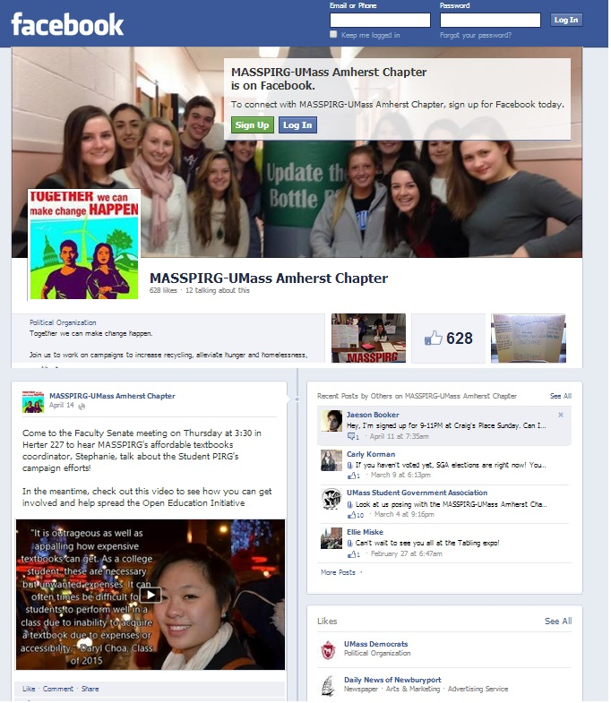
Stephanie Chan
Students spend an average of $1,200 on textbooks and supplies a year.
This is 79.8% of a student’s summer earnings if working full-time at Massachusetts minimum wage
65% of students surveyed have decided not to buy a textbook due to its cost.
http://masspirgstudents.org/campaigns/ma/make-textbooks-affordable

Slide 7
Success Stories
Faculty | School/College | Course | Proposed Savings Per Student | Proposed Course Savings | Actual Savings
Miliann Kang | College of Humanities & Fine Arts | Women's Studies 187: Gender, Sexuality and Culture | $75 | $22,500 | $45,450
Charlie Schweik | College of Natural Sciences | Natural Resource Conservation 592: Introduction to Geographic Information Systems | $50 | $1,500 | 12,400
Pam Trafford | Isenberg School of Management | School of Management 797: Financial Reporting for Decision Making | $200 | $8,000 | $13,200
Patricia Bianconi | College of Natural Sciences | Chemistry 342: Inorganic Chemistry Laboratory | $235 | $10,575 | $34,075
Daiheng Ni | College of Engineering | Civil & Environmental Engineering 520: Traffic Flow Theory | $150 | $3,150 | $6,000
Nicholas Reich | School of Public Health and Health Sciences | Public Health 697: Introduction to Statistical Computing and Data Visualization | $130 | $3,900 | $2,730
Barbara Roche | College of Social and Behavioral Sciences | Journalism 397E: Entrepreneurial Journalism | $100 | $1,500 | $1,900
Patricia Gorman | Honors College | Honors 390W: Irish Writers and Cultural Contexts | $65 | $1,625 | $2,145

Slide 8
Inspiring Other Institutions
University of Maryland
University of Wisconsin
North Carolina State University
Purdue University
Community College of Vermont
Holyoke Community College
University of California, Los Angeles
California State Polytechnic University, Pomona
Wake Forest University
Connecticut Distance Learning Consortium
…and more.
UMass Amherst has a national presence because of the Open Education Initiative.
Notes:
This model is so scaleable and practical, it has really had impact beyond our library and inspired dozens of campuses across the country, and even the world – Jay and Marilyn did an international webinar last week! So we should all be proud.

Slide 9
The Open Education Initiative the Office of the Provost and UMass Amherst Libraries

