Slide 1
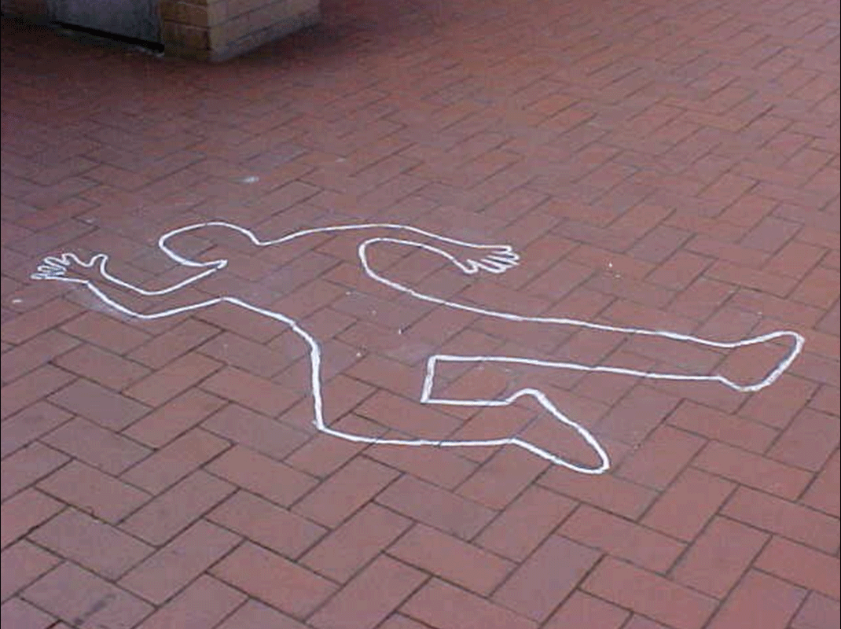
Discriminatory Impact of Public Arrest Records on Communities of Color
Professor Chuck MacLean, Duncan School of Law
Lincoln Memorial University, Knoxville, TN
Presented at Davis-Elkins College, Nov. 12, 2010

Slide 2
What is an Arrest?
Arrest = liberty constrained for a period of time – often a very short period of time
Although citizens have the power to arrest in some circumstances, this study focuses on arrests by law enforcement
Arrest standard = probable cause (articulable basis)
Conviction = guilty plea, finding of guilt, or verdict of guilt, in a court of law – with or without trial
Conviction standard = beyond a reasonable doubt
Intermediate issue = charging (probable cause PLUS substantial probability of success at trial)
Arrest is NOT equal to conviction
And THAT is where the problems lie

Slide 3
What is an Arrest Record?
Arrest Record = document evidencing the arrest of a particular person for a particular offense on a particular occasion
AR’s are not accompanied by conviction
AR’s are not accompanied by reports or evidence proving up the crime of arrest
AR’s are not proof that the arrestee did the crime, just proof there was a minimal amount of evidence of a crime

Slide 4
Ubiquity of Public Arrest Records
Electronic databases
Open door policy w/Court and LE records
Sunshine and FOIA-related statutes
Assumption that the public has a “right to know”
Assumption that public will use these data responsibly & non-discriminatorily
Internet-based free sources for arrest records (242,000 “hits”)
Internet-based fee-based arrest records (2.4 million “hits”)

Slide 5
Uses for Public Arrest Records
Snooping on neighbors, family, friends
Research on daughter’s new boyfriend
Due diligence, generally
Housing – sales and rentals
Business – hiring, firing, discipline
But arrest records are inadmissible in court for essentially ANY purpose – because the

Slide 6
So why aren’t those Uses just fine?
It is a matter of due process
And quantum of evidence for arrest is much less than quantum of evidence for convictions
And “innocent until proven guilty”
So it is really relevance – right?
Is evidence of an arrest sans conviction relevant to these decisions (due diligence, housing, employment)
And what if those arrests are not equivalent?

Slide 7
Is there any “relevance” to arrest information?
Do courts allow evidence of past arrests to come before a jury?
Why not?
Should employment and housing decision makers be using irrelevant information on which to base these critical quality of life decisions?
Are those decision-makers subject to suit if they do not conduct bkgd checks for arrest records and EE or tenant commits a crime?

Slide 8
Is there any “relevance” to arrest information?
Why don’t we just have some federal agency or federal statute forbid employers to use such irrevant information?
Great minds long ago beat us to that punch
See e.g., Civil Rights Act of 1964 and policy statement of the EEOC thereupon
“Conviction records constitute reliable records that the [job] applicant engaged in the criminal behavior . . . On the other hand, arrests alone are not reliable indicators that the person actually committed the crime”
EEOC Policy Statement 9-7-90

Slide 9
Have well-intentioned legislative and policy fixes eliminate the bias?
The Civil Rights Act & policies thereunder are positive steps in the right direction
But of what effect?
How can a claimant discern that his/her arrest record was the cause of the decisionmaker’s rejection of the claimant as a tenant or employee?
Short of confession/admission, that is . . . .
So, if we cannot stop the bias, can we stop the data source – the arrest records – or stop their use?

Slide 10
Public Housing Example
Imagine this scenario:
  Chicago IL – Cook County
  PH waiting list – 10-year wait
  Applicant, who rode out those 10 years, rises to the top of the waiting list & steps up to move in
  Applicant has 34 arrests during the preceding 10 years – all related to his homelessness
  None of those arrests resulted in convictions
  None related to violence or drug trafficking
PHA denies tenancy to the applicant due to the arrests as “history of criminal activity”

Slide 11
Public Housing Example
That scenario came true in:
Landers v. Chicago Housing Auth., ___ N.E.2d ___, No. 1-09-1717, 2010 WL 3718028 (Ill. App. Ct. Sep. 20, 2010).
Landers had been on the PH waiting list since February 1995
Hit the top of the waiting list in November 2008 – 13.5 years on the waiting list
34 arrests in those years – not 1 conviction

Slide 12
Public Housing Example
So what was afoot in Landers?
Check out this confluence – this list of factors all conspiring to lock out Landers
ARREST STATISTICS
  Blacks are 33% of the total Chicago population (2008 Population Estimate)
  Blacks are 75% of all Chicago arrestees (Chicago Police Dept. Annual Report 2008)
  Blacks are well over 80% of Chicago drug arrestees (Id.)
  Black arrestees are far more likely than White arrestees to have their charges dismissed (not charged – just arrested) – this likelihood of Black arrestees having their charges dismissed is much greater when the arrest charge involves substantial officer discretion (Tomic & Hakes, 2008)

Slide 13
Public Housing Example
So what was afoot in Landers? Next in confluence:
PUBLIC HOUSING STATISTICS
  Blacks are 33% of the total Chicago population (2008 Population Estimate)
  Blacks are 60% of the persons/families on the waiting list for Chicago public housing (Chicago Housing Authority, Public Housing Waitlist Demographics, 2009 – date from 2008)
  Blacks are well over 80% of the persons/families on the waiting list for “Section 8” public housing in Chicago (Id.)

Slide 14
Public Housing Example
So what was afoot in Landers? Next in confluence:
QUALITY OF LIFE IMPACTS
  Criminal Codes have exploded in the past 15-20 years
  Many more crimes on the books
  Many relate to nuisance & homelessness (loitering, petty thefts, shoplifting, public urination, drinking in public, drug paraphernalia, etc., etc.
  Those new crimes yield more arrests of the poor
  And the poor are disproportionately Black

Slide 15
Public Housing Example
So what was afoot in Landers? Next in confluence:
POLICING IMPACTS
  May be racial profiling impacts
  May be racist law enforcement decisions
  May be other policing decisions that are race-neutral, but have a racially disparate impact (e.g., decisions to increase patrols in high-crime areas, which are also characterized by highest percent of Black residents [Chicago has been billed as America’s most segregated city])

Slide 16
Public Housing Example
So picture these confluences:
ARREST IMPACTS – Blacks are 33% of population, but 75-80% of arrestees
DISMISSAL IMPACTS – Black arrestees are more likely to have their cases dropped/dismissed after arrest
PUBLIC HOUSING IMPACTS – Blacks are 33% of population but 60-80% of public housing applicants and waiting list denizens
QUALITY OF LIFE IMPACTS – lifestyle “crimes,” e.g., loitering, panhandling, public drinking, etc., often yield arrests but rarely yield convictions (and fully 90% of “municipal ordinance” arrestees in Chicago are Black

Slide 17
So, the confluences graphically:

Slide 18
So What Can or Should be Done?
Option 1: Outlaw use of arrest records (sans convictions) in tenancy decisions in public housing – already done in employment arena (EEOC), but easy to just deny, and leaves private landlords uncontrolled
Option 2: Outlaw use of arrest records in all tenancy decisions, public and private – easy to deny – hard to restrict private use of own property (maybe could if the private landlord took any government benefits)
Option 3: Restrict public access to arrest records – they are irrelevant, meaningless, misleading, prone to yield racially disparate detriments – but public access to government data craze is in full swing & the profusion of government and other data on the Internet has outstripped our wisdom and tools to limit the evils – perhaps just limit access to “proper” purposes
Option 4: Limit landlord liability (NB & LB?)

Slide 19

It’s Really a No-Brainer . . . .

Slide 20
That's all, folks !!!

